Slide 1
Strategy
#Report 2
PRINCIPLES OF MANAGEMENT
PRACTICAL CLASS #8
SPRING 2025

Slide 2
Agenda
PRINCIPLES OF MANAGEMENT
Risk Management
SWOT Analysis
Competitive Advantage
Scale & Scope Economies

Slide 3
Risk Management
The main risks faced by corporations:
PRINCIPLES OF MANAGEMENT

Slide 4
Risk Management
The main risks faced by corporations:
PRINCIPLES OF MANAGEMENT
Strategic risks
Operational risks
Financial risks
Reputational risks
Market risks
Cybersecurity risks
Supply Chain risks
Environmental risks
Etc.

Slide 5
Risk Management
PRINCIPLES OF MANAGEMENT

Slide 6
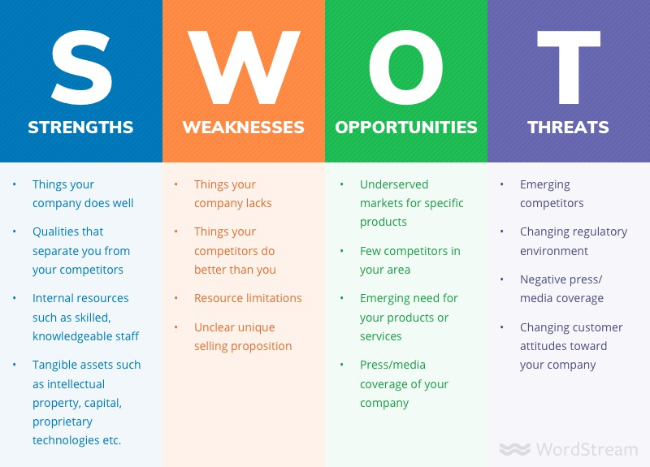
SWOT Analysis
PRINCIPLES OF MANAGEMENT
Internal
External
SWOT analysis is a strategic planning tool used to identify and evaluate the Strengths, Weaknesses, Opportunities, and Threats related to a business, project, or decision

Slide 7
SWOT Analysis
PRINCIPLES OF MANAGEMENT

Slide 8
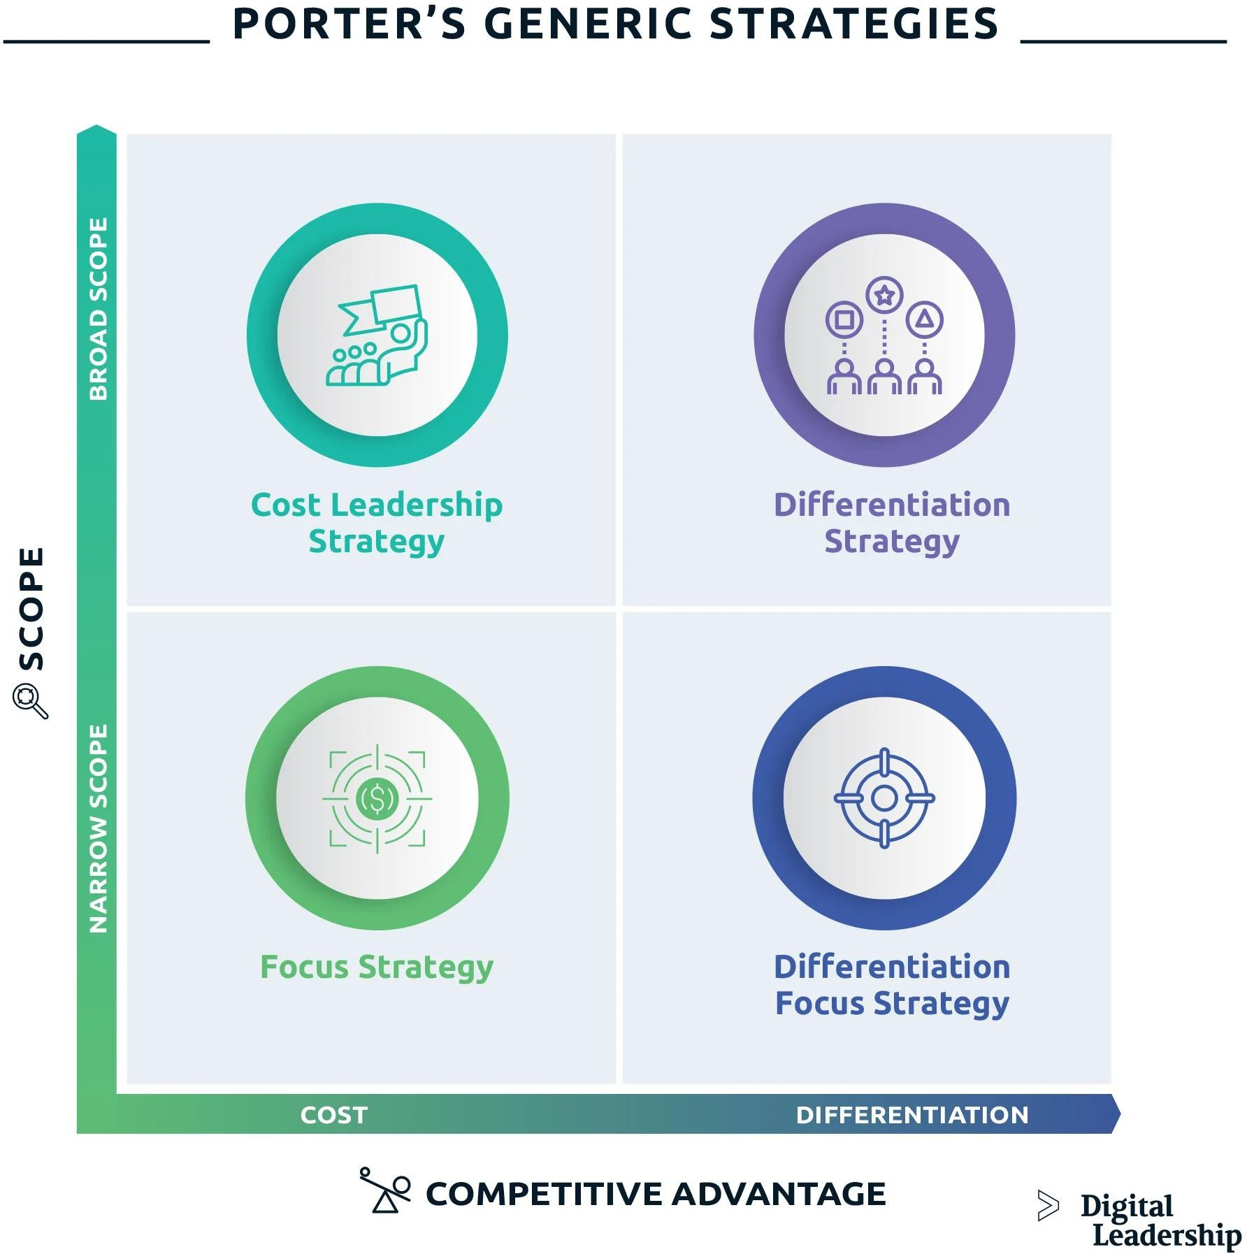
Competitive Advantage
PRINCIPLES OF MANAGEMENT

Slide 9
Competitive Advantage
PRINCIPLES OF MANAGEMENT

Slide 10
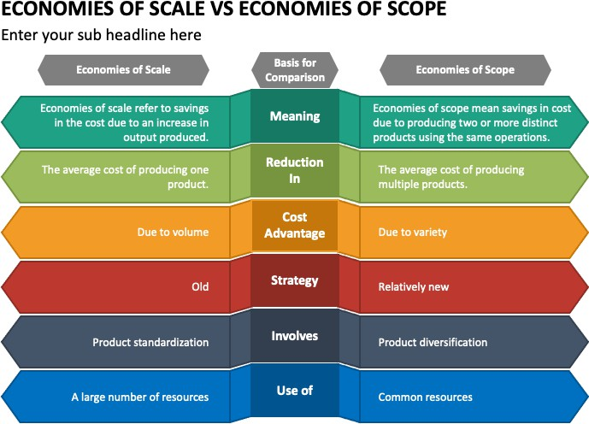
Scale & Scope Economies
PRINCIPLES OF MANAGEMENT

Slide 11
Scale & Scope Economies
PRINCIPLES OF MANAGEMENT

Slide 12
Thank you!

