Slide 1
Midterm Correction
PRINCIPLES OF MANAGEMENT
PRACTICAL CLASS #6
SPRING 2025

Slide 2
Agenda
PRINCIPLES OF MANAGEMENT
1. Go to market strategy
2. Midterm Correction

Slide 3
Market
PRINCIPLES OF MANAGEMENT
A Go-To-Market (GTM) strategy is a step-by-step plan that a company uses to launch a product or service into the market successfully. It defines how a business reaches customers, communicates value, and drives sales efficiently. When creating a go to market strategy there 6 distinct concepts a manager should analyse:
Market → Understanding what problem you are fixing and what is your market
Ideal Customer Profile → You should design your ICP. You should know their behaviour, what they are thinking, who they get advice from…
Value Proposition → It is an easy way of explaining why someone should by your product
Offer → It is the solution you provide
Messaging → How are you going to communicate with your market and make them aware of your product
Positioning → It is perception of your brand

Slide 4
Midterm Correction
PRINCIPLES OF MANAGEMENT

Slide 5
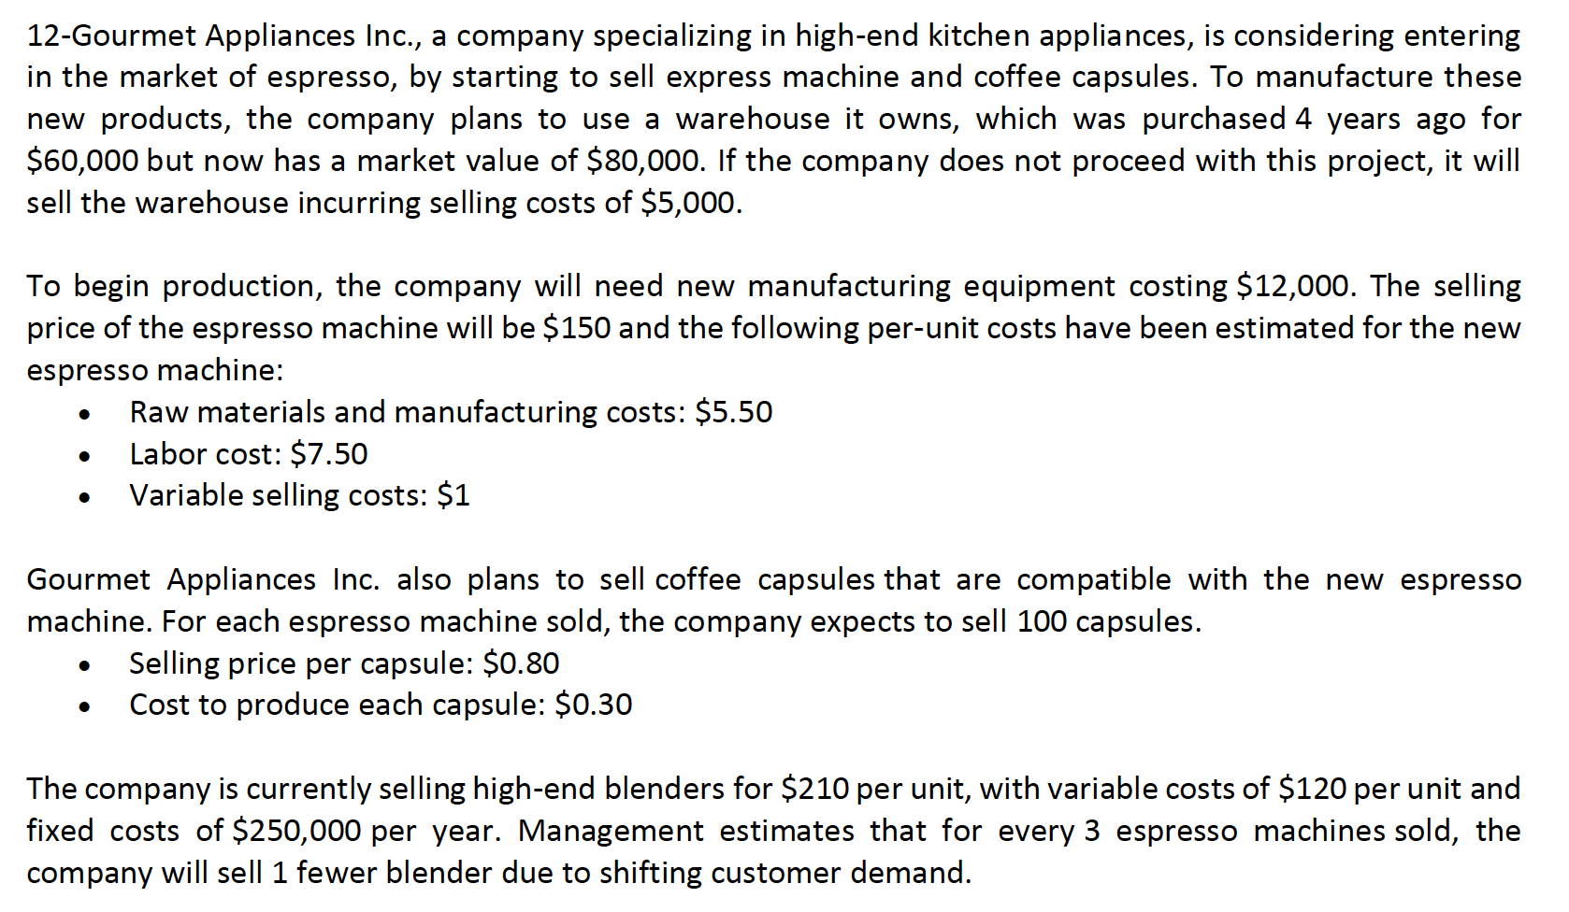
Exercise 12
PRINCIPLES OF MANAGEMENT

Slide 6
Exercise 12
PRINCIPLES OF MANAGEMENT

Slide 7
Exercise 12
PRINCIPLES OF MANAGEMENT

Slide 8
Exercise 12
PRINCIPLES OF MANAGEMENT

Slide 9
Exercise 12
PRINCIPLES OF MANAGEMENT

Slide 10
Exercise 12
PRINCIPLES OF MANAGEMENT

Slide 11
Go to market
PRINCIPLES OF MANAGEMENT
A go to market strategy should detail how a company plans to attract its ideal customer and establish a market presence.
When creating a go to market strategy there 6 distinct concepts a manager should analyse:
Market
Ideal Customer Profile
Value Proposition
Offer
Messaging
Positioning

