Slide 1
Raising Equity Capital
Advanced Financial Management

Slide 2
Advanced Financial Management | Raising Equity Capital
Key takeaways
01
Equity is the basic form of capital in any company and although its main characteristics are common across all companies, each company’s shares might have its own specific rights and characteristics
02
Raising Equity is a key component of Financial Management since its an available capital source at any stage of the company’s maturity
03
There are many options to raise equity, from Venture Capital in the early stages of the company to access to the general financial markets through Initial Public Offerings in later stages

Slide 3
Advanced Financial Management | Raising Equity Capital
Raising Equity
Typical equity financing timeline
Assets
Debt
Maturity
Profit
Equity
Institutional Partners
Expansion
Pers. Savings + FFF
Retained earnings
Time
Venture capital / Business Angels
Public Offerings (e.g. IPO)
+ Cash
+ Equity
Start-up
Seed stage
Retained earnings
Private
Personal savings
Choice depends on several factors, mainly: sector, maturity stage, total amount needed and control
FFF: family, friends and “fools”
Business angels
Venture capital
Institutional partners
(…) other
Public
Initial Public Offering (IPO)
Secondary Offering
Notes:
Institutional investors manage large quantities of money in many different types of assets. Typically they are pension funds, insurance companies, endowments and foundations.
May choose to invest directly in private firms.
Or may invest indirectly by becoming limited partners in venture capital firms.
Corporate investors: established firms may decide to invest in younger private companies.
May invest for corporate strategic objectives in addition to the desire for investment returns
Examples: Daimler invested in 2009 in electric car maker Tesla as part of a strategic collaboration on the development of lithium-ion battery systems. Google invested in DocuSign, which allows the easy electronic signing of documents.

Slide 4
IPOs costs
Advanced Financial Management | Raising Equity Capital
Direct Costs
The underwriting spread:
The underwriting spread is the fee paid by the firm to the underwriters.
Typically this about 7% of the issue price.
Costs due to IPO underpricing
IPOs issue prices tend to be below the closing price on that day.
The difference between closing price and issue price is lost by issuers.
Notes:
Broadly, there are two main types of IPO costs. First main ones are the direct costs incurred during the IPO. These consist substantially of the underwriting spread, which is the fee paid by the firm issuing the stocks to the underwriters, such as the investment bank. This underwriting spread is typically about 7% of the issue price.
The second broad category of costs are the costs due to the IPO underpricing. By and large, the issue prices of IPOs tend to be below the closing price on the day of the IPO, that is, the price generally goes up above the issue price on the day of the IPO. The and the difference between the closing price and the issue price is typically lost by issuers.
The IPO underpricing costs are typically much larger than the direct costs.
In this video, I will present you the evidence showing that the IPO ipo's issue prices are on average below the closing price. I will also show how large the difference is and present the main potencial reasons for the existence of the under-pricing.

Slide 5
Why are IPOs underpriced?
Advanced Financial Management | Raising Equity Capital
Underwriter price supports
Underwriters can support the price of an IPO by buying shares at IPO price or lower
Benefit the underwriter
Favors for the clients of the underwriters
Risk averse owners
Once-in-a-lifetime very positive NPV project
Information asymmetry (Winner's curse)
Form of adverse selection: an auction’s winner (i.e. the highest bidder) may have overestimated the object’s value
You win (get all the shares you requested) when demand for the shares by others is low and the IPO is more likely to perform poorly.
We need all types of investors to buy the shares of an IPO, otherwise there may not be enough demand for the issues.
Notes:
Given that we have established that underpricing occurs and that therefore the issuing firm shareholders are giving up some potential profit, what are the reasons that explain why shareholders are willing to leave some money on the table, as it were, in the IPO.
There are several possible explanations for underpricing that have been put forward. The first one is underwriter price supports. Depending on the specifics of the agreement between the issuer and the underwriter, the underwriter will commit to help sell the shares. Thus, they have an incentive to sell at a lower the price so that they can buy the shares if the issue is not selling very well. An example of an agreement between the issuer and the underwriter is called “firm commitment”. In this case, the underwriters agree to assume all inventory risk and purchase all shares directly from issuers. Thus, underwriter commits to buying at a price even if they may not be able to sell it for that price to the wide public. You can see why the underwriters will prefer to set the issue price lower to make sure they don’t end up selling these shares at a loss.
Another potential reason is that it benefits the under writer in other business dealings. By setting a lower price, the underwriter can offer this deal to some of its other clients and give them a large first day return. This will make its other clients happy, which may lead to more future business with these clients.
Another reason that is typically put forward is risk aversion of the owners. The action of going public takes place once and therefore the issuing firms to make sure that the experience is very positive and generates a very high income.
The final reason is called the winner’s curse. The winner’s curse is a form of adverse election that happens in auctions. The winner’s curse is the general result that the auctions’ winner, which is the highest bidder, very likely overestimated the object’s value it is biddin for, okay? Applying this result to IPOs, it suggests that if you do win in an IPO, meaning if you do get a lot of the shares you bid, it's because the overall demand for these shares is actually low and therefore the IPO is likely to not be a good deal.

Slide 6
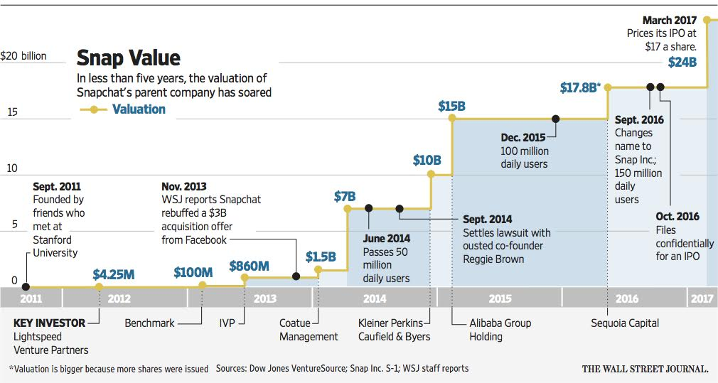
Advanced Financial Management | Raising Equity Capital
Example: Snap funding rounds
Notes:
IPO happened in early March 2017

Slide 7
Advanced Financial Management | Raising Equity Capital
Example: Snap stock price over time
First day return = 44%
Issue price
$17

Slide 8
News discussion
Advanced Financial Management | Raising Equity Capital
FT Article: “Why Deliveroo's IPO might not be the dud it seemed”
Do you think the main reason Deliveroo’s IPO was a flop was the lack of profits?
Does the article suggest there is a risk for IPO overpricing?
“It is supply chain shortages, soaring inflation and spooked central banks that are ending the IPO party.”
Why do you think the quoted factors may affect IPO activity trends?
Notes:
1. 26% drop. Uncertainty about the employment status of riders. The dual class share which gives higher power to CEO. Probably the fact that the IPO market is cooling down – more on this on question 3.
2. Yes, since it now has a reputation for having been a flop. Also, the fact that some firms have decided not to do IPOs “Steak joint Hawksmoor has put plans to list on ice. PureGym looks likely to join it, among others. ”
3. What do you think affects IPO activity trends? The value investors are going to be willing to pay for a share must reflect the present value of growth opportunities investors believe exist for the company. If the factors mentioned affect the number of positive NPV projects available, then they will be willing to pay less for the IPO. Furthermore, it may be the case they believe there are few reasons for raising that much capital at all.

Slide 9
Exercise
Advanced Financial Management | Raising Equity Capital
Three years ago, you founded Outdoor Recreation, Inc., a retailer specializing in the sale of equipment and clothing for recreational activities such as camping, skiing, and hiking. So far, your company has gone through three funding rounds:
It is currently 2011 and you need to raise additional capital to expand your business. You have decided to take your firm public through an IPO. You would like to issue an additional 6.5 million shares through this IPO. Assuming that your firm successfully completes its IPO, you forecast that 2011 net income will be $7.5 million.
Your investment banker advises you that the prices of other recent IPOs have been set such that the P/E ratios based on 2011 forecasted earnings average 20. Assuming that your IPO is set at a price that implies a similar multiple, what will your IPO price per share be?
What percentage of the firm will you own after the IPO?
Round | Date | Investor | Shares Issued | Share Price ($)
Series A | Feb 2007 | You | 500,000 | 1
Series B | Aug 2008 | Angels | 1,000,000 | 2
Series C | Sept 2009 | Venture Capital | 2,000,000 | 3.5

Slide 10
Exercise - solutions
Advanced Financial Management | Raising Equity Capital
Your investment banker advises you that the prices of other recent IPOs have been set such that the P/E ratios based on 2011 forecasted earnings average 20. Assuming that your IPO is set at a price that implies a similar multiple, what will your IPO price per share be?
With a P/E ratio of 20, and forecasted earnings of $7.5 million, the total value of the firm post IPO should be:
$$\frac{P}{EPS}=\frac{E}{Earnings}=20↔\frac{E}{\$7.5M}=20↔E=\$150M$$
There are currently (0.5M + 1M + 2M) = 3.5M shares outstanding (before the IPO). At the IPO, the firm will issue an additional 6.5 million shares, so there will be 10 million shares outstanding immediately after the IPO. With a total market value of $150 million, each share should be worth:
$$\frac{E}{N}=\frac{\$150M}{10M}=\$15$$

Slide 11
Exercise - solutions
Advanced Financial Management | Raising Equity Capital
What percentage of the firm will you own after the IPO?
After the IPO, you will own 500,000 of the 10 million shares outstanding, or 5% of the firm.

Slide 12
Exercise
Advanced Financial Management | Raising Equity Capital
Firm G will become public. After the issuance, the debt-to-value ratio of the firm will be 30%. Currently Firm H, which has similar operations is trading at $5 and has a debt-to-value ratio of 60%. Firm G has 10M shares and firm H has 3M shares. Firm G reported earnings of 10 while Firm H reported earnings of 15. Using market value over earnings as the multiple, what is the IPO price of Firm G?

Slide 13
Exercise
Advanced Financial Management | Raising Equity Capital
Firm G will become public. After the issuance, the debt-to-value ratio of the firm will be 30%. Currently Firm H, which has similar operations is trading at $5 and has a debt-to-value ratio of 60%. Firm G has 10M shares and firm H has 3M shares. Firm G reported earnings of 10 while Firm H reported earnings of 15. Using market value over earnings as the multiple, what is the IPO price of Firm G?
We start computing the market value of Firm H:
$$V=E+D=E+0.6V⇒V=\frac{E}{1−0.6}=\frac{3×5}{0.4}=37.5$$
Therefore, $\frac{V}{EBIT}=2.5.$ It is now easy to find the value of G:
$$V^{G}=2.5×10=25$$
We need the equity value:
$$E^{G}=\left(1−\frac{D^{G}}{V^{G}}\right)V^{G}=0.7×25=17.5$$
Therefore, $p=\frac{17.5}{10}=1.75.$

Slide 14
Exercise
Advanced Financial Management | Raising Equity Capital
Consider you want to bid in an auction IPO. You know that the firm might be worth 1 million dollars or 10 million dollars. Several investors know the actual value, but you do not. Nonetheless, you know they are equally likely. What would be your maximum bid if the risk-free is 0?
10 million dollars
0 million dollars
5.5 million dollars
1 million dollars
Notes:
adela

Slide 15
Exercise
Advanced Financial Management | Raising Equity Capital
Consider you want to bid in an auction IPO. You know that the firm might be worth 1 million dollars or 10 million dollars. Several investors know the actual value, but you do not. Nonetheless, you know they are equally likely. What would be your maximum bid if the risk-free is 0?
10 million dollars
0 million dollars
5.5 million dollars
1 million dollars
If you bid 10 million, you lose money if the firm is bad and break even if it is good. On average, you lose. If you bid between 1 and 10, you only win the auction if the firm is bad. Hence, you lose money everytime.
Notes:
adela

Slide 16
Exercise
Advanced Financial Management | Raising Equity Capital
Mark established his firm using 500,000 from his own capital and creating 1 million shares. Two years later, an angel investor invested 1.5 million in exchange for 2 million of new shares. Nowadays, Mark is considering raising even more capital from venture capital. The venture capital firm offers 2 million in exchange for 1 million shares. If Mark decides to raise the extra capital on these terms, what percentage of the firm will Mark end up owning?
50%
12.5%
9%
25%
Notes:
adela

Slide 17
Exercise
Advanced Financial Management | Raising Equity Capital
Mark established his firm using 500,000 from his own capital and creating 1 million shares. Two years later, an angel investor invested 1.5 million in exchange for 2 million of new shares. Nowadays, Mark is considering raising even more capital from venture capital. The venture capital firm offers 2 million in exchange for 1 million shares. If Mark decides to raise the extra capital on these terms, what percentage of the firm will Mark end up owning?
50%
12.5%
9%
25%
$$\frac{1}{1+2+1}=0.25$$
Notes:
adela

