Slide 1
Limits to the use of Debt
Advanced Financial Management

Slide 2
Advanced Financial Management | Capital Structure – Limits of Debt
Key takeaways
01
Understand what is the Trade-off Theory and be able to distinguish between direct bankruptcy costs and indirect bankruptcy costs.
02
Understand how to incorporate direct and indirect bankruptcy costs in the firm’s valuation.
03
Recognize the different types of conflicts of interest: risk-shifting and debt overhang.

Slide 3
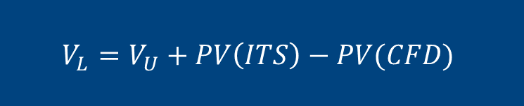
Bankruptcy costs
Advanced Financial Management | Capital Structure – Limits of Debt
Costs of Financial Distress
Trade-off Theory
Costs of Financial Distress (CFD) are costs arising from bankruptcy or distorted business decisions before bankruptcy
Direct - legal and administrative costs of bankruptcy
Indirect - losses from customers/suppliers /employees abandoning firm, or poor investment/operating decisions, decisions prior to bankruptcy or while bankruptcy is being resolved
How to account for CFD in valuation?
$$V_{L}=V_{U}+PV\left(ITS\right)−PV(CFD)$$
Trade-off theory:
Optimal capital structure is based on a trade-off between tax savings and the distress costs of debt
Notes:
What are the bankruptcy costs? These are also known as the costs of financial distress and these are costs that arise from bankruptcy or distorted business decisions right before the firm goes into bankruptcy but when there is a real threat that the firm will go into bankruptcy. Two different types we will discuss:
The first type of costs are the direct costs and these are the legal and administrative costs of bankruptcy.
The second type of costs are the indirect costs of bankruptcy and these consist for all the losses of customers or suppliers or even employees abandoning the firm before bankruptcy occurs because they know the firm is in danger of going bankrupt. Other types of indirect costs may stem from bad investment decisions or operating decisions that lead to destruction of value prior to bankruptcy or while bankruptcy is being resolved.
As I mentioned, we want to take into account both the benefits and the costs of debt. The Trade-off theory does just that. We adjust the value of the firm formula we had before by adding an extra item which is the present value of the financial cost of distress. Since this is a negative effect of debt, it has a negative sign, right? Then the value of the levered firm is equal to the value of the unlevered firm, plus the present value of the ITS minus the present value of the cost of financial distress.
More specifically the trade off theory takes into account exactly the trade off between increase tax savings and distress costs of debts when deciding whether or not to increase debt

Slide 4
Asset substitution/ risk-shifting
Advanced Financial Management | Capital Structure – Limits of Debt
Consider a value destroying project:
Consider a firm that has Assets in cash worth $200 and Debt worth $200 (the actual Face Value is $300). Equity is currently worth 0 (Assume r=0.)
Shareholders are offered a gamble at a price of $200: with 10% they win $1,000 and with 90% win nothing. Will shareholders take the bet?
$NPV=−200+\left[1000×0.1+0×0.9\right]=−100<0$
Shareholders take the gamble:
It destroys 100 in firm value
But it gives them the possibility of getting 700 with some probability
 | t = 0 | t = 1
 | E(V₀) | Good State | Bad State | E(V₁)
Firm | 100 | 1000 | 0 | 0.1(1000)+0.9(0) = 100
Equity | 70 | 1000 – 300 = 700 | 0 | 70
Debt | 30 | 300 | 0 | 30
Notes:
Do the balance sheet of the firm and show what happens to assets (since it uses its own assets to finance the project)

Slide 5

Debt overhang/underinvestment
Advanced Financial Management | Capital Structure – Limits of Debt
Take the firm from the previous example. Consider a government-sponsored project that guarantees $350 in one period if firm invests $300 today. Also assume r=10%. The payoffs for Equity and Debt are shown below:
Since the shareholders have to invest 100 their NPV of this project is:
Thus, stockholders will decide not to take the project even though it has a positive net present value to the firm as a whole!
 | t = 0 | t = 1
 | E(V₀) | Good state | E(V₁)
Firm | 318.18 | 350 | 350
Equity | 45.45 | 50 | 50
Debt | 272.73 | 300 | 300
This is >0 but shareholders have to invest $100 of their own money.
$$NPV=−100+\frac{50}{1.1}=−54.55<0$$
Notes:
Recall NPV=-300+350/1.1 = 18.18>0

Slide 6
CFD summary
Advanced Financial Management | Capital Structure – Limits of Debt
What are the costs of financial distress (CFD)?
  Direct costs (lawyer's fees, court fees) are small
  Indirect costs can be large and can arise before bankruptcy
Indirect costs also vary across firms/industries and the type of company's assets:
  e.g. Much lower if they are, for instance, real estate or tangible assets. Higher if assets are intangible.
  Industries in which firms can more easily increase risk (e.g. growth firms) may face higher indirect costs from risk-shifting behaviour

Slide 7
Exercise 1
Advanced Financial Management | Capital Structure – Limits of Debt
Gladstone Corporation is about to launch a new product. Depending on the success of the new product, Gladstone may have one of four values next year: $150 million, $135 million, $90 million, or $80 million. These outcomes are all equally likely. Suppose the opportunity cost of capital for assets, debt and equity is 5% and that there are no bankruptcy costs. (Ignore all other market imperfections, such as taxes.)
What is the initial value of Gladstone's equity without leverage?
Now suppose Gladstone has zero-coupon debt with a $100 million face value due next year.
What is the initial value of Gladstone's debt?
What is the value of Gladstone's levered equity? What is Gladstone's total value with leverage?
What happens to the value of debt, equity and the value of the levered firm if 25% of the value of Gladstone's assets will be lost to bankruptcy costs.

Slide 8

Exercise 1 - solutions
Advanced Financial Management | Capital Structure – Limits of Debt
What is the initial value of Gladstone's equity without leverage?
$$V_{U}=E=\frac{0.25×150+0.25×135+0.25×90+0.25×80}{1+r_{A}}=108.33$$
What is the initial value of Gladstone's debt?
FV = 100
$D=\frac{0.25(100+100+90+80)}{1+r_{D}}=\frac{92. 5}{1.05}=88.09$
States
1
2
3
4
Firm
150
135
90
80
Debt
100
100
90
80
Equity
50
35
0
0

Slide 9
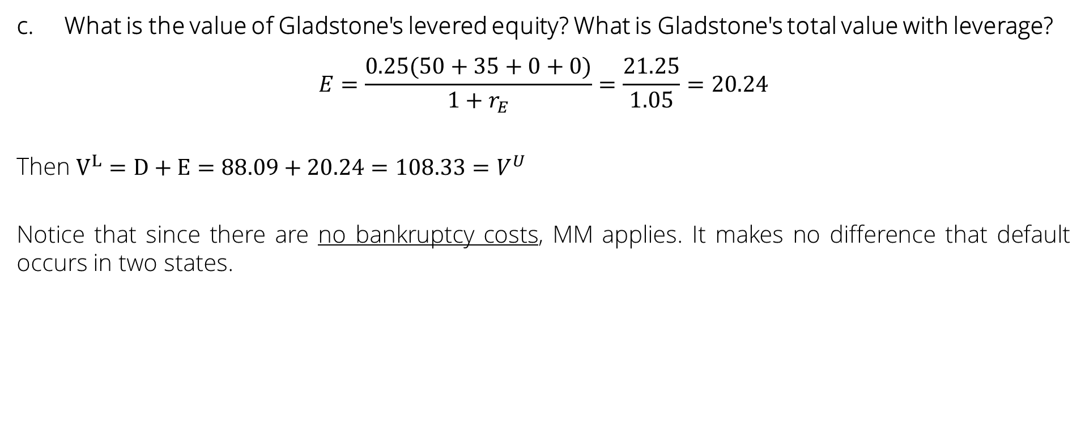
Exercise 1 - solutions
Advanced Financial Management | Capital Structure – Limits of Debt
What is the value of Gladstone's levered equity? What is Gladstone's total value with leverage?
$$E=\frac{0.25(50+35+0+0)}{1+r_{E}}=\frac{21.25}{1.05}=20.24$$
Then $V^{L}=D+E=88.09+20.24=108.33=V^{U}$
Notice that since there are no bankruptcy costs, MM applies. It makes no difference that default occurs in two states.

Slide 10

Exercise 1 - solutions
Advanced Financial Management | Capital Structure – Limits of Debt
What happens to the value of debt, equity and the value of the levered firm if 25% of the value of Gladstone's assets will be lost to bankruptcy costs.
$$D=\frac{0.25(100+100+(1−0.25)90+(1−0.25)80)}{1.05}=77.98$$
$E=20.24$ -> same as in question c since shareholders only receive when there is no default.
$V^{L}=D+E=77.98+20.24=98.21<V^{U}$
The difference between $V^{U}−V^{L}=10.12$ are the bankruptcy costs:
$PV\left(bankruptcy costs\right)=\frac{0.25(0.25×90+0.25×80)}{1+r_{A}}=10.12$
States
1
2
3
4
Firm
150
135
90 x (1-0.25)
80 x (1-0.25)
90
80
Debt
100
100
90 x (1-0.25)
80 x (1-0.25)
Equity
50
35
0
0

Slide 11
Exercise 2
Advanced Financial Management | Capital Structure – Limits of Debt
Consider the case of Henrietta Ketchup, a budding entrepreneur with two possible investment projects that offer the following payoffs (assuming zero discount rate):
Project 1: Investment now: 12. Payoff one year from now: 15 with probability 1.
Project 2: Investment now: 12. Payoff one year from now: 24 with probability 0.4 and 0 with probability 0.6.
Calculate the expected payoffs to the bank and Ms. Ketchup if the bank lends the present value of $10. Which project would Ms. Ketchup undertake? What agency problem leads to the decision?
What is the maximum amount the bank could lend that would induce Ms. Ketchup to take project 1?

Slide 12
Exercise 2 - solutions
Advanced Financial Management | Capital Structure – Limits of Debt
Calculate the expected payoffs to the bank and Ms. Ketchup if the bank lends the present value of $10. Which project would Ms. Ketchup undertake? What agency problem leads to the decision?
Let’s look at the values for the firm, debt and equity:
t = 0
t = 1
States
40%
60%
E(V
)
1
Project 1
Firm
NPV =
-
12+15 =
3
15
15
15
Ms. Ketchup chooses project 2 even though it has a negative NPV, because it has a higher value of equity. This is the risk-shifting problem.
Debt
10
10
10
Equity
5
5
5
Project 2
Firm
NPV =
-
12+9.6 =
-
2.4
24
0
24x0.4=9.6
Debt
10
0
4
Equity
14
0
5.6
Notes:
Bank lends the PV(10)= D=10/(1+r)
Also note that FV=10.

Slide 13
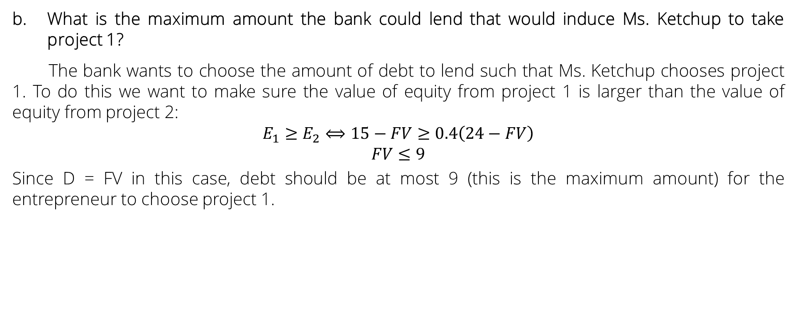
Exercise 2 - solutions
Advanced Financial Management | Capital Structure – Limits of Debt
What is the maximum amount the bank could lend that would induce Ms. Ketchup to take project 1?
The bank wants to choose the amount of debt to lend such that Ms. Ketchup chooses project 1. To do this we want to make sure the value of equity from project 1 is larger than the value of equity from project 2:
$$E_{1}≥E_{2}⟺15−FV≥0.4\left(24−FV\right)$$
$$FV≤9$$
Since D = FV in this case, debt should be at most 9 (this is the maximum amount) for the entrepreneur to choose project 1.

Slide 14
Exercise 3
Advanced Financial Management | Capital Structure – Limits of Debt
Firm U wants to start a project with cash flows, after one year, equal to 400, 105, 20 with equal probability, and an initial investment of 100. The outcome of the project does not depend on the state of the economy and the risk-free rate is 5%. The firm will suffer a financial distress cost of 20 if it cannot honor completely the payment to the lender. Firm U asks for a loan to pay the initial investment.
What is the probability that the firm enters into default (Hint: think that debt must have a PV equal to 100)
What is the interest rate of the loan
What is the value of Firm U if this is the only project of the Firm and faces a corporate tax of 30%
What is the proportion of the initial investment financed through debt that maximizes firm value.

Slide 15

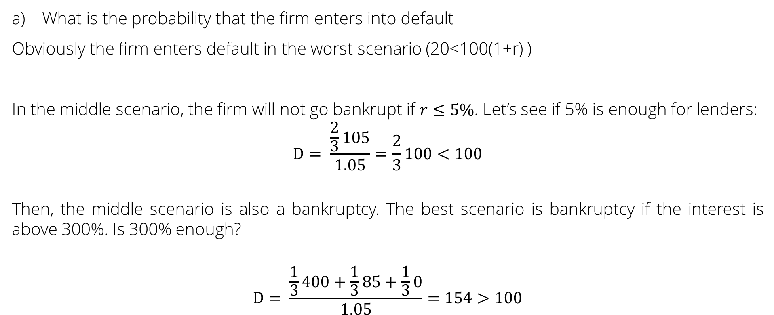
Exercise 3
Advanced Financial Management | Capital Structure – Limits of Debt
$$\frac{2}{3}$$
What is the probability that the firm enters into default
Obviously the firm enters default in the worst scenario (20<100(1+r) )
In the middle scenario, the firm will not go bankrupt if $r≤5\%$. Let’s see if 5% is enough for lenders:
$$D= \frac{\frac{2}{3}105}{1.05}=\frac{2}{3}100<100$$
Then, the middle scenario is also a bankruptcy. The best scenario is bankruptcy if the interest is above 300%. Is 300% enough?
$$D= \frac{\frac{1}{3}400+\frac{1}{3}85+\frac{1}{3}0}{1.05}=154>100$$
5% is not enough
300% is enough

Slide 16
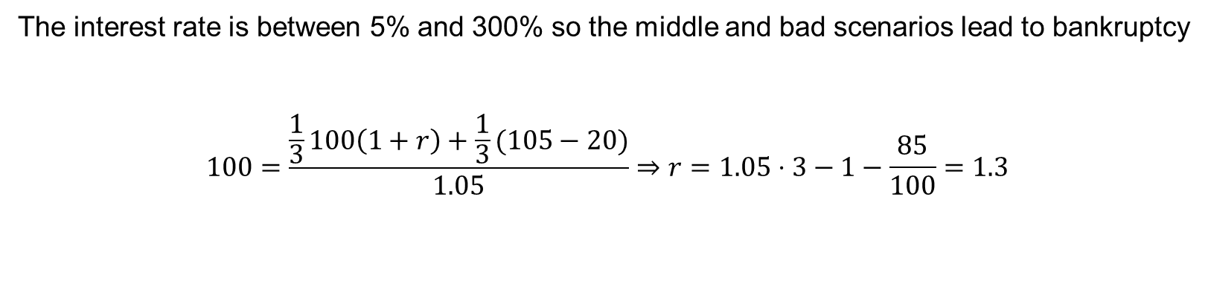
Exercise 3
Advanced Financial Management | Capital Structure – Limits of Debt
What is the interest rate of the loan
The interest rate is between 5% and 300% so the middle and bad scenarios lead to bankruptcy
$$100=\frac{\frac{1}{3}100\left(1+r\right)+\frac{1}{3}(105−20)}{1.05}⇒r=1.05⋅3−1−\frac{85}{100}=1.3$$
The interest rate is:
130%

Slide 17

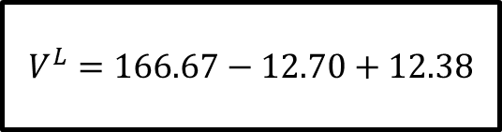
Exercise 3
Advanced Financial Management | Capital Structure – Limits of Debt
What is the value of Firm U if this is the only project of the Firm and faces a corporate tax of 30%
$$V^{U}=\frac{400+105+20}{3(1.05)}=166.67$$
$$PV\left(CFD\right)=\frac{\frac{2}{3}20}{1.05}=12.70$$
$$PV\left(ITS\right)=\frac{\frac{1}{3}130×0.3}{1.05}=12.38$$
$$V^{L}=166.67−12.70+12.38$$

Slide 18
Exercise 3
Advanced Financial Management | Capital Structure – Limits of Debt
What is the optimal proportion of the initial investment financed through debt.
Note that the payment to debtholders for the optimal debt is 400,105, 20 or 0
Consider it is 100
Then 104 will provide a higher ITS and the same CFD
Hence it cannot be 100
We just showed that no debt is better than 100% because the CFD are too high
We need to try repayments equal to 105 and 20

Slide 19


Exercise 3
Advanced Financial Management | Capital Structure – Limits of Debt
$$V^{L}=166.67−6.35+7.3=167.62$$
How much can I ask without getting into distress in the middle scenario?
$$D=\frac{\left(\frac{2}{3}\right)105+(20−20)/3}{1.05}=66.67⇒IntPaym=38.33$$
$$PV\left(ITS\right)=\frac{\frac{2}{3}×38.33×0.3}{1.05}=7.3$$
$$PV\left(CFD\right)=\frac{\frac{1}{3}20}{1.05}=6.35$$

Slide 20
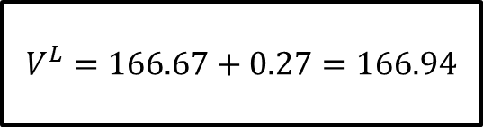

Exercise 3
Advanced Financial Management | Capital Structure – Limits of Debt
How much can I ask without getting into distress in the worst scenario?
$$D=\frac{20}{1.05}=19.05⇒IntPaym=0.95$$
$$PV\left(ITS\right)=\frac{0.95×0.3}{1.05}=0.27$$
$$V^{L}=166.67+0.27=166.94$$
We obtain the highest value with bankruptcy in the worst scenario (66.67% initial investment in debt)

