Slide 1
Mergers and Acquisitions
Advanced Financial Management

Slide 2
Advanced Financial Management | Mergers and Acquisitions
Key takeaways
01
Mergers and Acquisitions represent one key type of investments for companies to generate growth and improve the enterprise value
02
The enterprise value might benefit from M&A due to the creation of synergies that can arise from revenues, costs, assets management or debt capacity
03
Ultimately, the price of the acquisition will depend on the valuation of the target company, the estimated synergies and the negotiation process

Slide 3
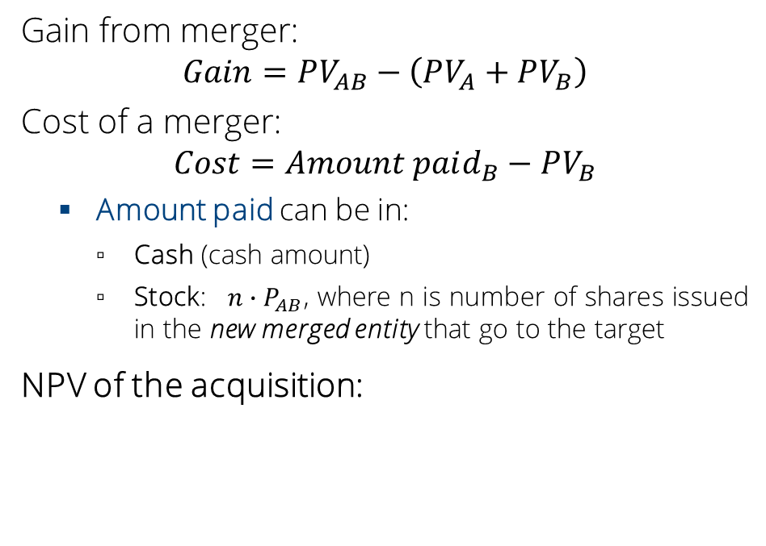
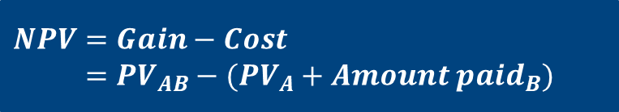
Estimating merger gains
Advanced Financial Management | Mergers and Acquisitions
Notation
NPV of M&As
Gain from merger:
$$Gain=PV_{AB}−\left(PV_{A}+PV_{B}\right)$$
Cost of a merger:
$$Cost=Amount paid_{B}−PV_{B}$$
  Amount paid can be in:
    Cash (cash amount)
    Stock: $n∙P_{AB}$, where n is number of shares issued in the new merged entity that go to the target
NPV of the acquisition:
Acquirer
A
Merged firm
AB
B
Target
$$NPV=Gain−Cost$$
$$=PV_{AB}−(PV_{A}+Amount paid_{B})$$
Notes:
Do vertical graph plotting the value of a, b and value of a,b, amount paid and the NPV
Also do balance sheets of both stand alone firms and the firm together and emphasize the shares of B will disappear either way.

Slide 4
Estimating merger gains
Advanced Financial Management | Mergers and Acquisitions
Start with the targets stand-alone market value PV_{B} and concentrate on the changes in cash flow that would result from the merger
You add value only if you can generate additional economic rents
If the merger is financed by acquirer's stock, then cost depends on the value of the shares in the new company
Due to asymmetric information, optimistic managers prefer to finance mergers with cash.

Slide 5
Who benefits from a takeover?
Advanced Financial Management | Mergers and Acquisitions
Returns to Bidders and Targets in the US - event study results
Announcement returns
Deal characteristics
Acquisition premium
Notes:
Stock versus Cash Offers
The market prefers cash
The decline in the price of acquirers who issue stock instead of pay cash (investors may perceive this as a signal the firm does not have cash to pay for the deal)

Slide 6
Exercise 1
Advanced Financial Management | Mergers and Acquisitions
The market values of buyer and seller are €2 billion and €1.1 billion, respectively. The buyer thinks that the combined companies can cut operating costs by €40 million per year in perpetuity.
The buyer reckons that a successful cash bid will probably cost €1.4 billion. Alternatively, it is considering offering sellers shareholders a 33% stake in the merged firm. Assume cost of capital at 11%.
What is the gain, cost and NPV of two alternatives?

Slide 7

Exercise 1 - solutions
Advanced Financial Management | Mergers and Acquisitions
First we need to compute the PV of the gain from the merger (for both the cash and stock offer):
$$Gain=\frac{€40M}{0.11}=€363.6M$$
The cost of the cash offer is $Cost=€1400M−€1100M=€300M$.
Thus the NPV of the cash offer is:
$$NPV=€363.6M−€300M=€63.6M$$

Slide 8
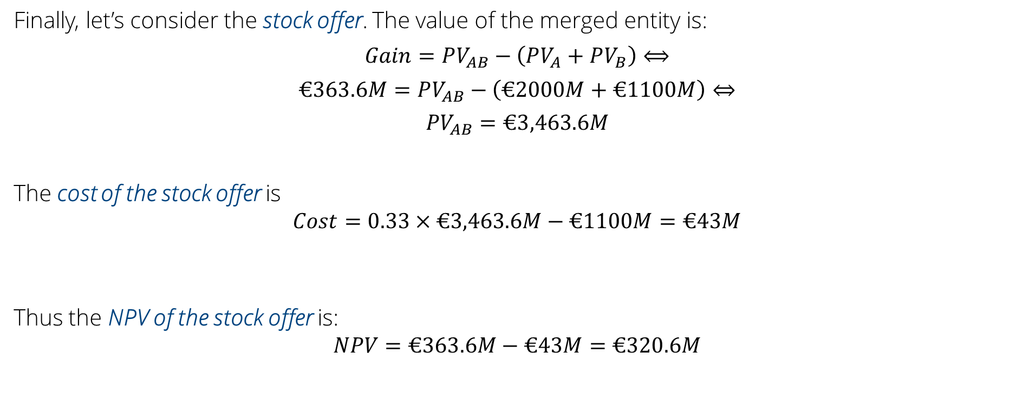
Exercise 1 - solutions
Advanced Financial Management | Mergers and Acquisitions
Finally, let’s consider the stock offer. The value of the merged entity is:
$$Gain=PV_{AB}−\left(PV_{A}+PV_{B}\right)⟺$$
$$€363.6M=PV_{AB}−\left(€2000M+€1100M\right)⇔$$
$$PV_{AB}=€3,463.6M$$
The cost of the stock offer is
$$Cost=0.33×€3,463.6M−€1100M=€43M$$
Thus the NPV of the stock offer is:
$$NPV=€363.6M−€43M=€320.6M$$
Notes:
Write on the board: cost in stock = n x Pab
The value of firm ab is PVab = Nab x Pab
So this share of stock in firm ab given to B stockholders is n/Nab
Cost = n x Pab x Nab / Nab = n/Nab x PVab

Slide 9
Exercise 2
Advanced Financial Management | Mergers and Acquisitions
As treasurer of Company A, you are investigating the possible acquisition of Company B. You have the following basic data:
You estimate that investors currently expect a steady growth of about 6% in B's earnings and dividends. Under new management this growth rate would be increased to 8% per year, without any additional capital investment required. Further, under new management next year’s dividend will stay the same.
What is the gain from the acquisition?
What is the cost of the acquisition if A pays €25 in cash for each share of B?
What is the cost of the acquisition if A offers one share of A for every three shares of B?
How would the cost of cash offer and the share offer change if expected growth rate of B were not changed by the merger?
Company | A | B
Next year’s expected EPS | €5 | €1.5
Next year’s expected Div_{ps} | €3 | €0.8
Number of shares | 1,000,000 | 600,000
Stock price | €90 | €20

Slide 10
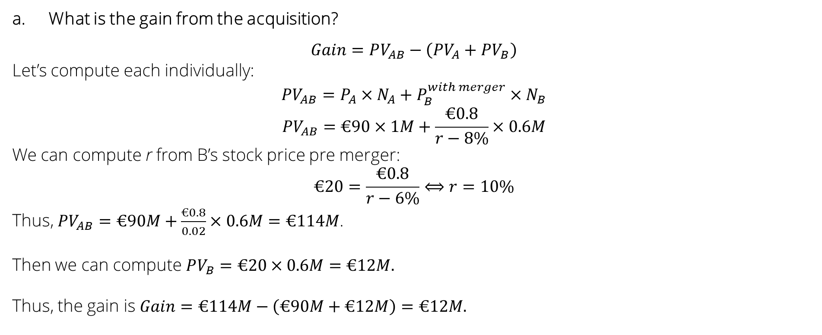
Exercise 2 - solutions
Advanced Financial Management | Mergers and Acquisitions
What is the gain from the acquisition?
$$Gain=PV_{AB}−\left(PV_{A}+PV_{B}\right)$$
Let’s compute each individually:
$$PV_{AB}=P_{A}×N_{A}+P_{B}^{with merger}×N_{B}$$
$$PV_{AB}=€90×1M+\frac{€0.8}{r−8\%}×0.6M$$
We can compute r from B’s stock price pre merger:
$$€20=\frac{€0.8}{r−6\%}⟺r=10\%$$
Thus, $PV_{AB}=€90M+\frac{€0.8}{0.02}×0.6M=€114M$.
Then we can compute $PV_{B}=€20×0.6M=€12M.$
Thus, the gain is $Gain=€114M−\left(€90M+€12M\right)=€12M.$

Slide 11
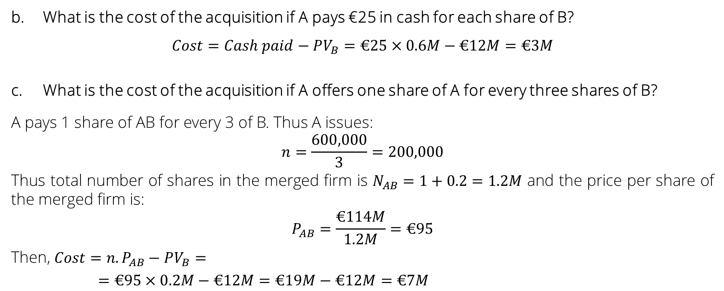
Exercise 2 - solutions
Advanced Financial Management | Mergers and Acquisitions
What is the cost of the acquisition if A pays €25 in cash for each share of B?
$$Cost=Cash paid−PV_{B}=€25×0.6M−€12M=€3M$$
What is the cost of the acquisition if A offers one share of A for every three shares of B?
A pays 1 share of AB for every 3 of B. Thus A issues:
$$n=\frac{600,000}{3}=200,000$$
Thus total number of shares in the merged firm is $N_{AB}=1+0.2=1.2M$ and the price per share of the merged firm is:
$$P_{AB}=\frac{€114M}{1.2M}=€95$$
Then, $Cost=n. P_{AB}−PV_{B}=$
$=€95×0.2M−€12M=€19M−€12M=€7M$

Slide 12
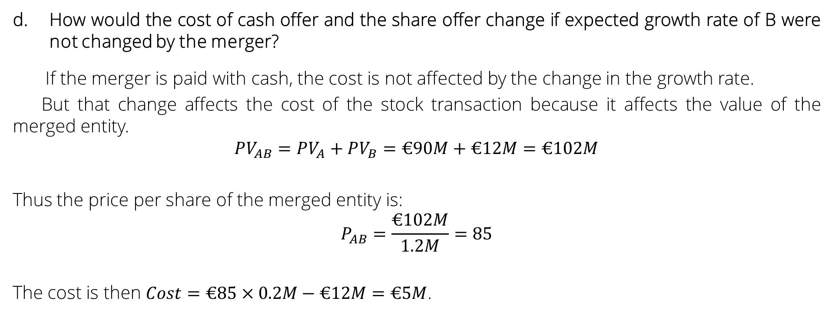
Exercise 2 – solutions
Advanced Financial Management | Mergers and Acquisitions
How would the cost of cash offer and the share offer change if expected growth rate of B were not changed by the merger?
If the merger is paid with cash, the cost is not affected by the change in the growth rate.
But that change affects the cost of the stock transaction because it affects the value of the merged entity.
$$PV_{AB}=PV_{A}+PV_{B}=€90M+€12M=€102M$$
Thus the price per share of the merged entity is:
$$P_{AB}=\frac{€102M}{1.2M}=85$$
The cost is then $Cost=€85×0.2M−€12M=€5M$.

Slide 13
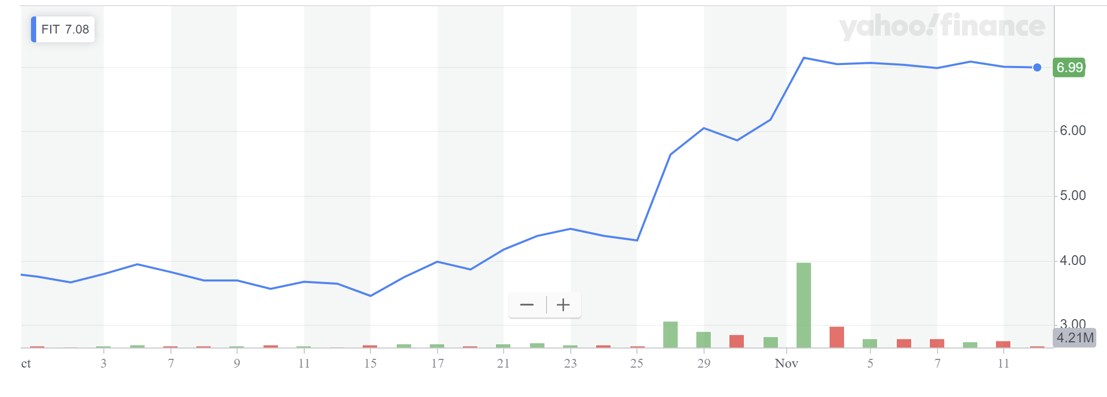
Google takeover of Fitbit
Advanced Financial Management | Mergers and Acquisitions
Google offer
Public announcement
Reuters reported on November 1st 2019 that Google had offered $7.35 per share on October 28th.
Check article – Google concedes on Fitbit data

Slide 14
News discussion
Does it seem to you that the premium paid by Google for Fitbit is too high? Why? What piece of evidence can be used to guide your answer.
2. What are the risks of the merger?
3. What type of synergies may Google be aiming to take advantage of?

Slide 15
Exercise 3
Advanced Financial Management | Mergers and Acquisitions
Firm A produces computers and buys the microchips from Firm B (1 per computer). Firm A pays 100€ per microchip and 10€ in transport costs per microchip. Firm B requires 80€ to produce each microchip, and it does not require any input except a factory. Firm A is contemplating buying Firm B and immediately relocating the factory to eliminate transport costs entirely. If they do so, they need to incur a cost of 10,000 to construct the new factory, but they expect to sell the old factory in 3 years for 9,000. The discount rate is 5% and the firms live forever without growing or shrinking. The value of firm A is 1 million and it only produces computers.
Compute the gain of the acquisition if Firm A sells 100 computers a year
Compute the minimum number of computers such that the gain of the acquisition is positive
Assume the new factory is bigger and allows Firm A to produce 50% more computers than before. What is the gain of the acquisition if Firm A sold 100 computers before the acquisition?

Slide 16

Exercise 3
Advanced Financial Management | Mergers and Acquisitions
Firm A produces computers and buys the microchips from Firm B (1 per computer). Firm A pays 100€ per microchip and 10€ in transport costs per microchip. Firm B requires 80€ to produce each microchip, and it does not require any input except a factory. Firm A is contemplating buying Firm B and immediately relocating the factory to eliminate transport costs entirely. If they do so, they need to incur a cost of 10,000 to construct the new factory, but they expect to sell the old factory in 3 years for 9,000. The discount rate is 5% and the firms live forever without growing or shrinking. The value of firm A is 1 million and it only produces computers.
Compute the gain of the acquisition if Firm A sells 100 computers a year
Note that Firm A will now pay less for the computers but Firm B will gain less so there is no gain
$$\frac{10×100}{0.05}−10000+\frac{9000}{{1.05}^{3}}=17774.54$$

Slide 17
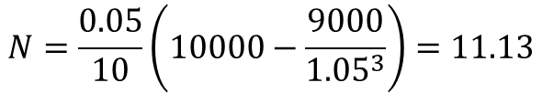

Exercise 3
Advanced Financial Management | Mergers and Acquisitions
Firm A produces computers and buys the microchips from Firm B (1 per computer). Firm A pays 100€ per microchip and 10€ in transport costs per microchip. Firm B requires 80€ to produce each microchip, and it does not require any input except a factory. Firm A is contemplating buying Firm B and immediately relocating the factory to eliminate transport costs entirely. If they do so, they need to incur a cost of 10,000 to construct the new factory, but they expect to sell the old factory in 3 years for 9,000. The discount rate is 5% and the firms live forever without growing or shrinking. The value of firm A is 1 million and it only produces computers.
Compute the minimum number of computers such that the gain of the acquisition is positive
$$\frac{10×N}{0.05}−10000+\frac{9000}{{1.05}^{3}}=0$$
$$N=\frac{0.05}{10}\left(10000−\frac{9000}{{1.05}^{3}}\right)=11.13$$

Slide 18

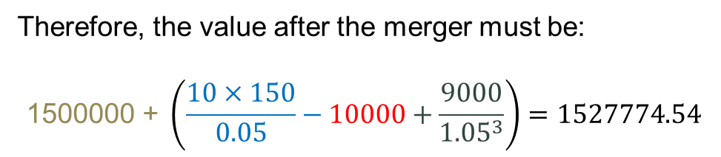
Exercise 3
Advanced Financial Management | Mergers and Acquisitions
Firm A produces computers and buys the microchips from Firm B (1 per computer). Firm A pays 100€ per microchip and 10€ in transport costs per microchip. Firm B requires 80€ to produce each microchip, and it does not require any input except a factory. Firm A is contemplating buying Firm B and immediately relocating the factory to eliminate transport costs entirely. If they do so, they need to incur a cost of 10,000 to construct the new factory, but they expect to sell the old factory in 3 years for 9,000. The discount rate is 5% and the firms live forever without growing or shrinking. The value of firm A is 1 million and it only produces computers.
Assume the new factory is bigger and allows Firm A to produce 50% more computers than before. What is the gain of the acquisition if Firm A sold 100 computers before the acquisition?
If the firm produced 150 computers without merging the value would have been 1.5M
Therefore, the value after the merger must be:
$$\text{150}\text{0000} \text{+} \left(\frac{10×150}{0.05}−10000+\frac{9000}{{1.05}^{3}}\right)=1527774.54$$
$$Gain=527774.54$$

Slide 19
Exercise 4
Advanced Financial Management | Mergers and Acquisitions
Firm C’s market capitalization on 1st January 2022 is 100, and Firm D’s market capitalization price is 25. On 2nd January 2022, Firm C publicly announced that they will buy Firm D on 2nd June 2022. The gain of the acquisition equals 10 (value on the 2nd of January). Both firms have the same number of shares. Consider an annual discount rate (risk-free) of 5%, a ROE of 8% and a 100% payout for both firms (except in d). If needed, assume that firms have no debt. Solve the first two questions under the two different acquisition methods:
Firm C pays 30 to buy Firm D
Firm C exchanges one share for four shares of D
a) Compute the return of Firm D from the 1st of January 2022 to the 3rd of January 2022
b) Compute the return of Firm C from the 1st of January 2022 to the 3rd of January 2022
c) Find the payment to buy Firm D that makes the return for Firm D from the 1st of January 2022 to the 3rd of January 2022 equal to 0
d) Find the exchange ratio to buy Firm D that makes the return for Firm D from the 1st of January 2022 to the 3rd of January 2022 equal to 0

Slide 20


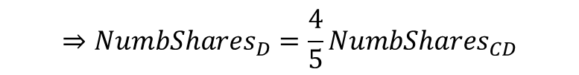

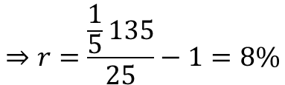
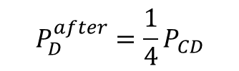

Exercise 4
Advanced Financial Management | Mergers and Acquisitions
a) Compute the return of Firm D from the 1st of January 2022 to the 3rd of January 2022
Cash case (30)
Firm D investors will get 30 as a payment in six months for sure. Then the price of all the stocks (market cap) is:
Stock case (4:1)
4 shares of D give you the rights to collect the payout of one share of the combined firm:
$$MCap_{D}=\frac{30}{{\left(1.05\right)}^{1/2}}=29.28$$
$$⇒r=\frac{29.28}{25}−1=17.12\%$$
$$P_{D}^{after}=\frac{1}{4}P_{CD}$$
$$=\frac{1}{5}MCap_{CD}$$
$$⇒r=\frac{\frac{1}{5}135}{25}−1=8\%$$
$⇒MCap_{D}=\frac{1}{4}P_{CD}×$ $\frac{4}{5}NumbShares_{CD}$
$$NumbShares_{CD}=NumbShares_{D}+newshares=\frac{5}{4}NumbShares_{D}$$
$$⇒NumbShares_{D}=\frac{4}{5}NumbShares_{CD}$$
$$MCap_{CD}=100+25+10$$

Slide 21


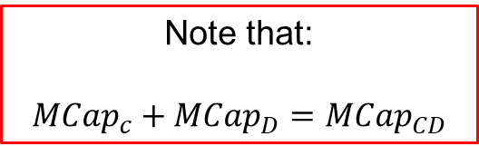
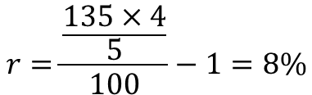
Exercise 4
Advanced Financial Management | Mergers and Acquisitions
b) Compute the return of Firm C from the 1st of January 2022 to the 3rd of January 2022
Cash case (30)
Firm C shareholders get the rights of all dividends of CD but they have to lose 30 (in 6 months):
Stock case (4:1)
Firm C shareholders get the rights of (4/5) of all dividends of CD
$$MCap_{c}=125+10−\frac{30}{{\left(1.05\right)}^{\frac{1}{2}}}≈105.72$$
$$⇒r=\frac{105.72}{100}−1=5.72\%$$
Note that:
$$MCap_{c}+MCap_{D}=MCap_{CD}$$
$$NumbShares_{CD}=\frac{5}{4}NumbShares_{C}⇒NumbShares_{C}=\frac{4}{5}NumbShares_{CD}$$
$$r=\frac{\frac{135×4}{5}}{100}−1=8\%$$

Slide 22


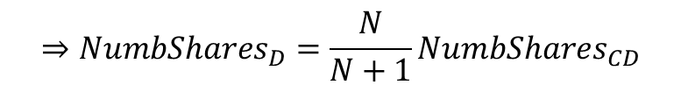

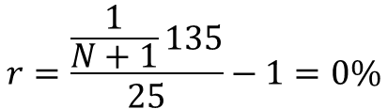


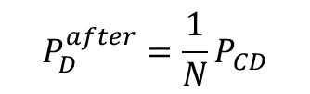

Exercise 4
Advanced Financial Management | Mergers and Acquisitions
c) Find the payment (C) to buy Firm D that makes the return for Firm D from the 1st of January 2022 to the 3rd of January 2022 equal to 0
d) Find the exchange ratio (N:1) to buy Firm D that makes the return for Firm D from the 1st of January 2022 to the 3rd of January 2022 equal to 0
$$⇒r=\frac{MCap_{D}}{25}−1=0\%$$
$$MCap_{D}=\frac{C}{{\left(1.05\right)}^{1/2}}=25⇒C=25.62$$
$$⇒MCap_{D}=25$$
$$P_{D}^{after}=\frac{1}{N}P_{CD}$$
$$⇒MCap_{D}=\frac{1}{N+1}MC{ap}_{D}$$
$$NumbShares_{CD}=NumbShares_{D}+newshares=\left(1+\frac{1}{N}\right)NumbShares_{D}$$
$$⇒NumbShares_{D}=\frac{N}{N+1}NumbShares_{CD}$$
$$r=\frac{\frac{1}{N+1}135}{25}−1=0\%$$
$$⇒\frac{1}{N+1}=\frac{25}{135}$$
$$⇒N=\frac{135}{25}−1=4.4$$

