Slide 1
Mock Midterm
Exam
Advanced Financial Management

Slide 2
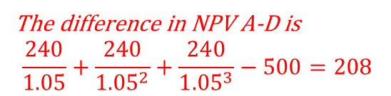
Multiple Choice 1
Which of the following projects would you choose? Assume the discount rate is 5%
a) A project that pays 500 in the next 3 years and requires an investment of 1000 today
b) A project that pays 250 in the next 6 years and requires an investment of 1000 today
c) A project that pays 1500 in 3 years and requires an investment of 1000 today
d) A project that pays 260 in the next 3 years and requires an investment of 500 today
Pays the same as a, but takes more time
Pays the same as a, but all at the end
The difference in NPV A-D is
$$\frac{240}{1.05}+\frac{240}{{1.05}^{2}}+\frac{240}{{1.05}^{3}}−500=208$$

Slide 3


Multiple Choice 2
Which of the following statements is correct? Assume APR is 5%, and we use semi-annual compounding
a) The PV of a project that pays 100 every year from next year is greater than 2000
b) The EAR equals 2.5%
c) The PV of a project that pays 100 every six months, starting in six months, is 4000
d) The future value of cash flow of 200 today in 3 years is 231.52
Annual compounding would be equal (100/0.05)
Then, semi-annual must be lower
EAR>APR with semi-annual comp.
$$\frac{100}{0.025}$$
$$200{\left(1.025\right)}^{6}=231.94$$

Slide 4
Multiple Choice 3
Which of the following statements is correct?
a) The real yield of a bond is always higher than the nominal yield if inflation is positive
b) Diversifiable risk can be eliminated by holding many stocks
c) Trading on margin allows investors to reduce the risk.
d) A portfolio investing in two assets with the same expected return and standard deviation will have the same expected return and standard deviation as the assets.
Real yield is always lower
By definition
Trading on margin increases risk
Due to diversification, the standard deviation will be lower

Slide 5


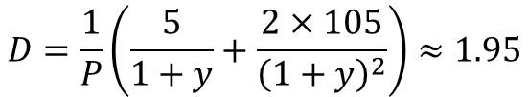
Exercise 1
Firm A issued a five-year 5%-coupon bond with a face value of 100 that currently trades at 95 euros and just paid the third coupon. Firm A also issued a ten-year 10%-coupon callable bond with a face value of 100 that just paid the ninth coupon. A callable bond gives the right to Firm A to buy back the bond at a specified price, in this case, the specified price is 92.
A) What is the yield of the noncallable bond?
$$P=\frac{5}{1+y}+\frac{105}{{\left(1+y\right)}^{2}}=95$$
$$⇒y≈7.8$$
B) What is the duration of the noncallable bond?
$$D=\frac{1}{P}\left(\frac{5}{1+y}+\frac{2×105}{{\left(1+y\right)}^{2}}\right)≈1.95$$

Slide 6
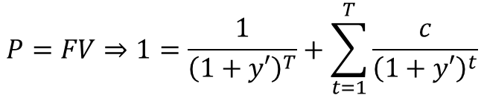

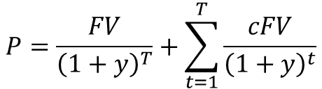




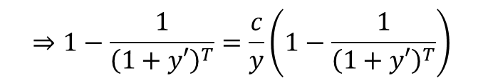


Exercise 1
Firm A issued a five-year 5%-coupon bond with a face value of 100 that currently trades at 95 euros and just paid the third coupon. Firm A also issued a ten-year 10%-coupon callable bond with a face value of 100 that just paid the ninth coupon. A callable bond gives the right to Firm A to buy back the bond at a specified price, in this case, the specified price is 92.
C) Using the duration approximation, find the yield that makes the noncallable bond trade at par (P =100)
$$100−95$$
$$ΔP=−D⋅Δy⇒Δy=−\frac{ΔP}{D}$$
$$⇒Δy=−\frac{5}{1.95}≈−2.56$$
$$y^{′}≈5.24\%$$
D) Find the exact yield that makes the non-callable bond trade at par.
$$P=\frac{5}{1+y}+\frac{105}{{\left(1+y\right)}^{2}}=100⇒y=5\%$$
If a coupon bond trades at par, $c=y$
$$P=\frac{FV}{{\left(1+y\right)}^{T}}+\sum_{t=1}^{T}{\frac{cFV}{{\left(1+y\right)}^{t}}}$$
$$P=FV⇒1=\frac{1}{{\left(1+y′\right)}^{T}}+\sum_{t=1}^{T}{\frac{c}{{\left(1+y′\right)}^{t}}}$$
$$⇒1−\frac{1}{{\left(1+y′\right)}^{T}}=\frac{c}{y}\left(1−\frac{1}{{\left(1+y′\right)}^{T}}\right)$$
$$⇒c=y′$$

Slide 7



Exercise 1
Firm A issued a five-year 5%-coupon bond with a face value of 100 that currently trades at 95 euros and just paid the third coupon. Firm A also issued a ten-year 10%-coupon callable bond with a face value of 100 that just paid the ninth coupon. A callable bond gives the right to Firm A to buy back the bond at a specified price, in this case, the specified price is 92.
E) What is the maximum yield for which Firm A calls the bond?
$$P=\frac{110}{1+y}>92$$
$$y<\frac{110}{92}−1=19.57\%$$
$$⇒$$

Slide 8
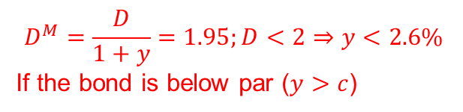

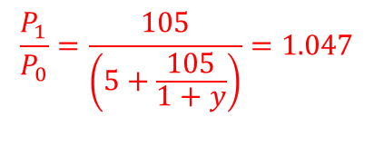
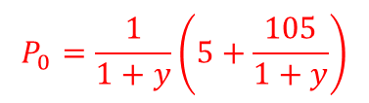

Multiple Choice 4
Consider a two-year coupon bond with a 5% coupon rate, face value equal to 100, and price equal to 91. Which of the following statements is true? Assume coupons are paid annually.
a) The yield of the bond is 10.2%
b) The duration of the bond is 2.08 years
c) If interest rates increase by 1%, the bond price increases by 1.95%
d) The price change of the bond in the first year is 5.5%
$$\frac{5}{1+y}+\frac{105}{{\left(1+y\right)}^{2}}=91⇒y=10.2\%$$
Duration is always lower than maturity for coupon bonds
$$D^{M}=\frac{D}{1+y}=1.95;D<2⇒y<2.6\%$$
If the bond is below par ($y>c$)
$$P_{1}=\frac{105}{1+y}$$
$$P_{0}=\frac{1}{1+y}\left(5+\frac{105}{1+y}\right)$$
$$\frac{P_{1}}{P_{0}}=\frac{105}{\left(5+\frac{105}{1+y}\right)}=1.047$$

Slide 9

Exercise 2
Consider for the first four questions the firms B, C, and D. Firm B has an expected return of 4%, Firm C, 6%, and Firm D, 6.5%. The standard deviation of Firm B,C, D are 20%, 25%, 32%, respectively. The returns of Firm B and C have a correlation of 0.2, the returns of Firm B and D have a correlation of 0.3, and the returns of Firm C and D are independent (uncorrelated). The risk-free asset return is 2%.
A) What is the average return of an equally-weighted portfolio?
$$E\left(r\right)=\frac{1}{3}\left(4+6+6.5\right)=5.5$$
B) What is the standard deviation of an equally-weighted portfolio?
$$V\left(r\right)=\frac{1}{9}\left({0.2}^{2}+{0.25}^{2}+{0.32}^{2}\right)+\frac{2}{9}0.2⋅0.25⋅0.2+\frac{2}{9}0.3⋅0.2⋅0.32=0.02925$$
$$std\left(r\right)=17.10\%$$

Slide 10




Exercise 2
Consider for the first four questions the firms B, C, and D. Firm B has an expected return of 4%, Firm C, 6%, and Firm D, 6.5%. The standard deviation of Firm B,C, D are 20%, 25%, 32%, respectively. The returns of Firm B and C have a correlation of 0.2, the returns of Firm B and D have a correlation of 0.3, and the returns of Firm C and D are independent (uncorrelated). The risk-free asset return is 2%.
C) If you invest 100 euros in B, 200 in C, and 100 in the risk-free asset, what is your expected return?
$$w_{A}=\frac{100}{400}=\frac{1}{4}$$
$$w_{B}=\frac{200}{400}=\frac{1}{2}$$
$$E\left(r\right)=\frac{1}{4}4+\frac{1}{2}6+\frac{1}{4}2=4.5\%$$
D) If you invest in the portfolio above, what is the standard deviation of the return?
$$V\left(r\right)={\left(\frac{1}{4}\right)}^{2}{0.2}^{2}+{\left(\frac{1}{2}\right)}^{2}{0.25}^{2}+2\frac{1}{4}\frac{1}{2}0.2⋅0.25⋅0.2=0.0020625$$
$$std\left(r\right)=14.36\%$$

Slide 11


Exercise 2
Consider for the first four questions the firms B, C, and D. Firm B has an expected return of 4%, Firm C, 6%, and Firm D, 6.5%. The standard deviation of Firm B,C, D are 20%, 25%, 32%, respectively. The returns of Firm B and C have a correlation of 0.2, the returns of Firm B and D have a correlation of 0.3, and the returns of Firm C and D are independent (uncorrelated). The risk-free asset return is 2%.
E) Compute the standard deviation of the returns of a portfolio that invests 50% in Firm E and 50% in Firm F
$$0.5×2.10+0.5×0.57$$
Year | Firm E | Firm F
2016 | 2.10% | 0.57%
2017 | 1.50% | -0.26%
2018 | 8.40% | 7%
2019 | -3.12% | -0.25%
2020 | -0.50% | 5.00%
2021 | 1% | 2%
Portfolio
1.34
0.62
7.70
-1.69
2.25
1.50
Portfolio-m
-0.61
-1.33
5.75
-3.64
0.30
-0.45
$$E\left(r\right)=\frac{1}{6}\left(1.34+0.62+7.70−1.69+2.25+1.50\right)=1.95$$
$$1.34−1.95$$
$$V\left(r\right)=\frac{1}{5}\left({0.61}^{2}+{1.33}^{2}+{5.75}^{2}+{3.64}^{2}+{0.3}^{2}+{0.45}^{2}\right)$$
$$V\left(r\right)=8.1243‰$$
$$std\left(r\right)=\sqrt{8.1243} =3.12\%$$

Slide 12
Multiple Choice 5
Select the correct statement
a) Diversification implies that the beta of a portfolio of two securities with beta 1.2 is lower than 1.2
b) The slope of the security market line is the risk premium
c) The tangency portfolio lies outside the efficient frontier
d) According to the CAPM, an asset with a beta equal to 0 has an expected return equal to 0.
The beta of the portfolio is 1.2
It lies ON the efficient frontier
No, it is the risk-free rate

Slide 13

Exercise 3
Consider the economy has only two stocks: Firm G and Firm H. Firm G has an expected excess return of 3.22%, and Firm H has an expected excess return of 5.71%. Firm G has a beta of 0.644, a market capitalization of 100, and a standard deviation of 40%. Firm H's standard deviation is 56%.
A) What is the market risk premium (=expected excess return of the market)?
$$⇒RP=\frac{322}{644}=5$$
$$Firm G \left(CAPM\right):3.22=0.644⋅RP$$
B) The beta of Firm H is
$$Firm H \left(CAPM\right):5.71=5β_{H}⇒β_{H}=1.14$$

Slide 14
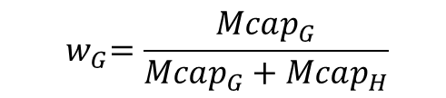


Exercise 3
Consider the economy has only two stocks: Firm G and Firm H. Firm G has an expected excess return of 3.22%, and Firm H has an expected excess return of 5.71%. Firm G has a beta of 0.64, a market capitalization of 100, and a standard deviation of 40%. Firm H's standard deviation is 56%.
C) What is the market capitalization of Firm H?
$${3.22 w}_{G}+5.71\left(1−w_{G}\right)=5$$
$${ w}_{G}=\frac{Mcap_{G}}{Mcap_{G}+Mcap_{H}}$$
$$3.22 Mcap_{G}+5.71Mcap_{H}=5(Mcap_{G}+Mcap_{H})$$
$$Mcap_{H}=\frac{500−322}{0.71}≈250$$

Slide 15


Exercise 3
Consider the economy has only two stocks: Firm G and Firm H. Firm G has an expected excess return of 3.22%, and Firm H has an expected excess return of 5.71%. Firm G has a beta of 0.64, a market capitalization of 100, and a standard deviation of 40%. Firm H's standard deviation is 56%.
D) What would be the expected excess return of Firm G if the excess return of the market doubles?
$$E\left(r_{i}−r_{f}\right)=βE(r_{m}−r_{f})$$
If the excess return of the market doubles the expected return of every stock doubles
$$6.44\%$$

Slide 16
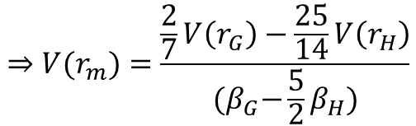

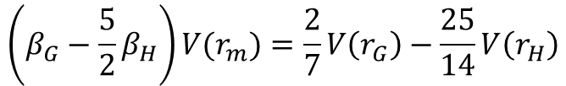
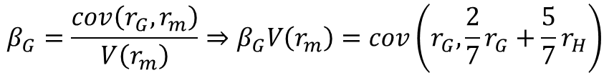

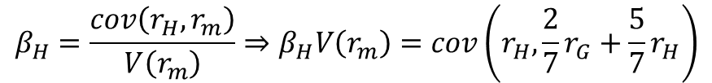


Exercise 3
Consider the economy has only two stocks: Firm G and Firm H. Firm G has an expected excess return of 3.22%, and Firm H has an expected excess return of 5.71%. Firm G has a beta of 0.64, a market capitalization of 100, and a standard deviation of 40%. Firm H's standard deviation is 56%.
$$std\left(r_{m}\right)=\sqrt{0.2331}=48.28\%$$
E) What is the standard deviation of the market?
$$100/350$$
$$β_{G}=\frac{cov\left(r_{G},r_{m}\right)}{V\left(r_{m}\right)}⇒β_{G}V\left(r_{m}\right)=cov\left(r_{G},\frac{2}{7}r_{G}+\frac{5}{7}r_{H}\right)$$
$$=\frac{2}{7}V\left(r_{G}\right)+\frac{5}{7}cov(r_{G},r_{H})$$
$$β_{H}=\frac{cov\left(r_{H},r_{m}\right)}{V\left(r_{m}\right)}⇒β_{H}V\left(r_{m}\right)=cov\left(r_{H},\frac{2}{7}r_{G}+\frac{5}{7}r_{H}\right)$$
$$=\frac{5}{7}V\left(r_{H}\right)+\frac{2}{7}cov(r_{G},r_{H})$$
$$⇒V(r_{m})=\frac{\frac{2}{7}V\left(r_{G}\right)−\frac{25}{14}V\left(r_{H}\right)}{{(β}_{G}−\frac{5}{2}β_{H})}$$
$$\left(β_{G}−\frac{5}{2}β_{H}\right)V(r_{m})=\frac{2}{7}V\left(r_{G}\right)−\frac{25}{14}V\left(r_{H}\right)$$

