Slide 1
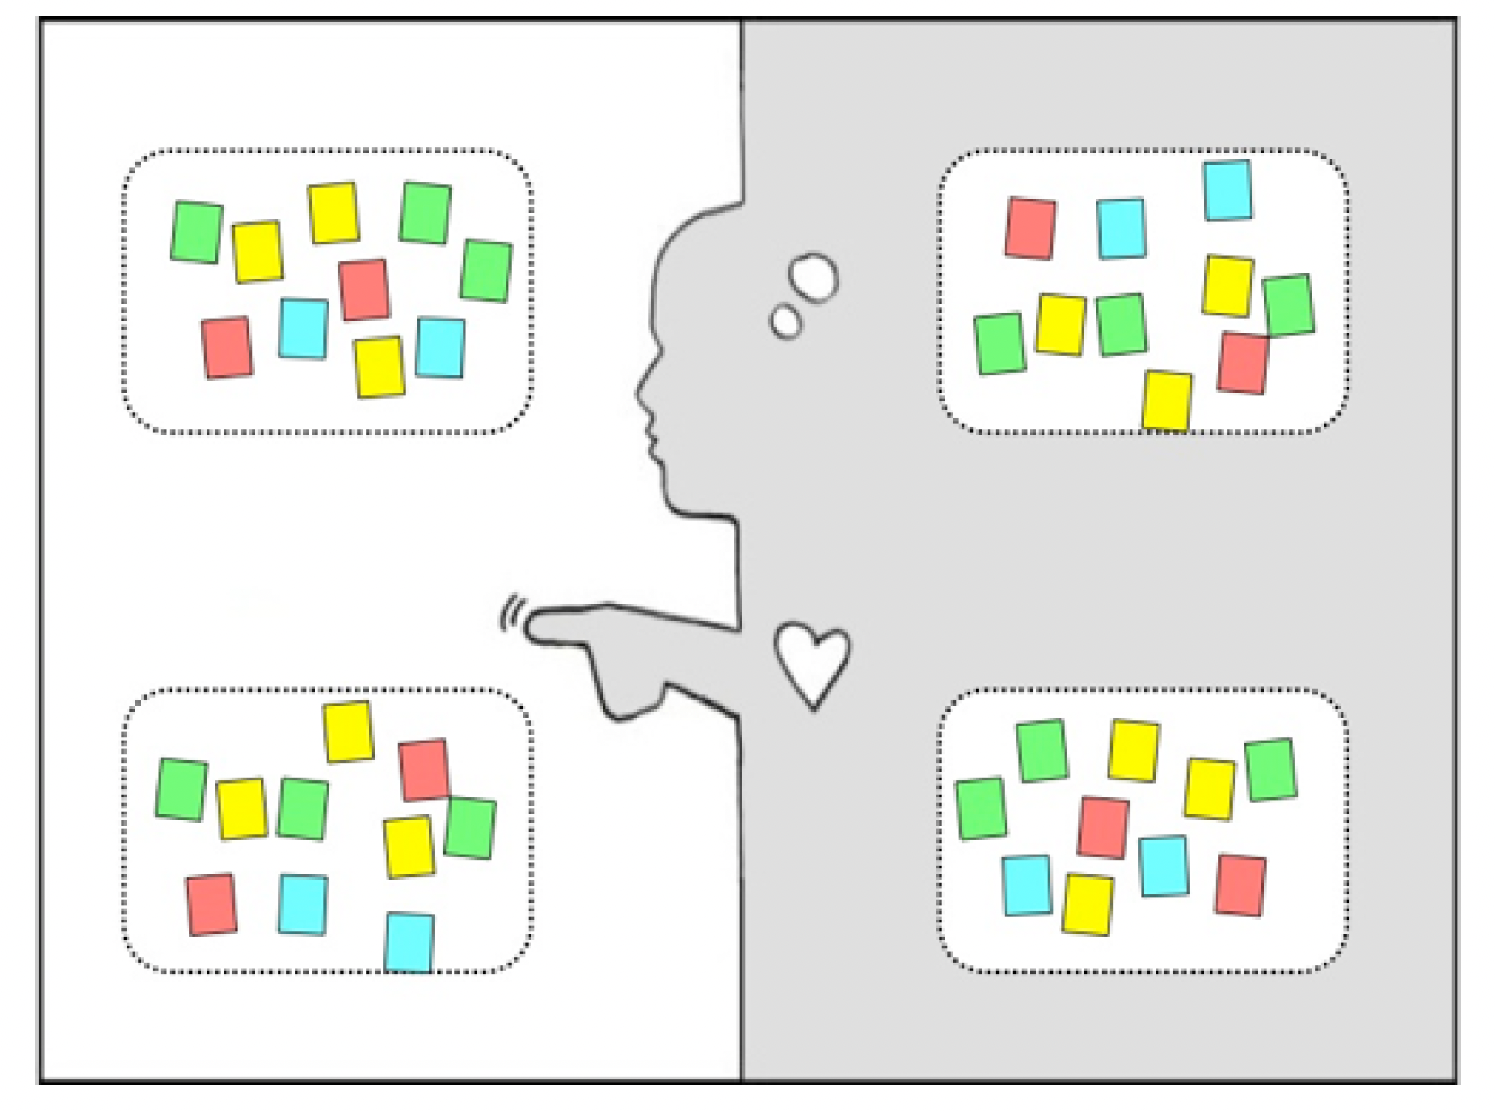
Empathy map
SAY: What are some quotes and defining words the primary stakeholder said?
DO: What actions and behaviors did you notice?
THINK: What might your user be thinking?What does this tell you about
their beliefs?
FEEL: What emotions might the person be feeling?
Notes:
How do we get there?

