Slide 1
Strategic Business Models | Ilya Okhmatovskiy
Evolution and Variation of Business Models
in the Leather Industry
Carlos Marques (58420) | Manuel Castro (58741)
February 27, 2025

Slide 2
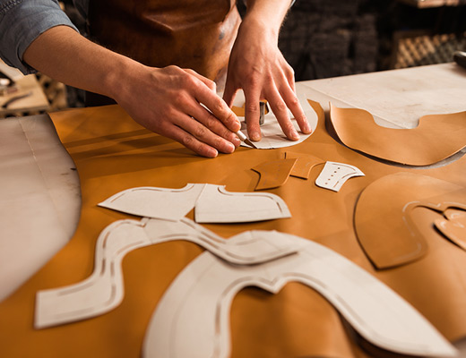
Table of Contents
SBM - 2025
1
Introduction
2
Evolution and Variation of Business Models
3
Differences in Business Models
4
Market Dynamics
5
Q&A

Slide 3
Leather Industry
1 - Introduction
SBM - 2025
1
2
3
Global Scope
Sustainabilty Focus
Core Processes
Global sector that repurposes animal hides into high-quality materials used across various sectors.
By recycling hides that would otherwise be discarded, the industry significantly reduces waste while adding economic value.
There are several technical steps such as tanning, retanning, crust preparation and finishing.

Slide 4
Industry Timeline
2 – Evolution and Variation of Business Models
SBM - 2025
Ancient Beginnings (5000 BCE – 400 BCE)
Transition from ancestral methods to the first innovation - vegetable tanning
Industrial Revolution (19th century)
Introduction of power driven machines that revolutionized the process and enabled mass production.
Modern Era
Advances in technology that allow for a better focus on sustainabiity and industrial efficiency.
Middle Ages
Preservation and gradual improvements in traditional methods, remaining an artisanal craft.
Late 19th Century
Discovery of chrome tanning with chemical salts, which became the most widely used tanning method.

Slide 5
Evolution of BMs
2 – Evolution and Variation of Business Models
SBM - 2025
Industrial Revolution
Mid – 20th Century
End of the 20th Century – Early 21st Century
Shift from small workshops to large factories.
Introduction of mass production and economies of scale.
Greater control over the supply chain through vertical integration.
Formation of major players in the industry who could capture more value.
Emergence of specialized players focusing on specific segments of the value chain.
Leverage economies of scale and/or scope for competitive advantage.

Slide 6
3- Differences in Business Models
SBM - 2025
Integrated Tanneries
Process & Focus
Companies manage the full value chain – from acquisition of raw hides into finished leather.
Control of every industrial process to ensure quality and consistency across the product line.
Economies at Play
Scale – High investment in capital equipment to drive down per-unit costs.
Scope – Diverse output by offering a range of leather grades with different finishings, to cater different market segments.
Risks & Considerations
Their complexity and capital intensity expose them to risks, with any variations in the industrial product or in the quality of raw material.

Slide 7
Wet-Blue Tanneries
3- Differences in Business Models
SBM - 2025
Process & Focus
Companies specialized solely in chrome tanning, producing and intermediate product known as wet-blue
This stage stabilizes the raw hide and prepares it for further processing.
Economies at Play
Large Scale Efficiency – High-volume production facilities enable significant cost reductions through economies of scale..
Standardization – Wet-blue leather is a commodity product, with less room for differentiation.
Risks & Considerations
Their success depends on maintaining a consistent supply of quality raw hides, and a steady downstream demand from retanning or finishing specialists.

Slide 8
Crust Tanneries
3- Differences in Business Models
SBM - 2025
Process & Focus
Specialize in producing crust leather—an intermediate, partially finished product that has undergone chrome tanning and retanning.
This includes steps like fatliquoring, dyeing, drying, and conditioning, but the leather hasn’t received the final finishing touches.
Important role in the Supply Chain, with their output serving as a robust base for final finishing operations, either conducted in-house or by downstream finishing specialists.
Economies at Play
Scale: Capable of operating large facilities to produce standard crust leather in high volumes, which drives down costs.
Scope: They produce various types of crust leather optimized for different applications, such as footwear or upholstery.
Risks & Considerations
Their competitive position relies on both efficient production and coordination with finishing operations to ensure quality and market readiness.

Slide 9
Retanning and Finishing Tanneries
3- Differences in Business Models
SBM - 2025
Process & Focus
These tanneries purchase wet-blue leather and/or crust and transform it into a finished product.
Processes includes retanning, dyeing, fatliquoring, and applying various finishing techniques.
With a high customization, it’s possible to tailor the leather’s properties to meet the specific needs of fashion brands and accessory manufacturers.
Economies at Play
Scope: Offer a variety of finished leather types, capitalizing on product differentiation to serve different segments.
Flexibility: Smaller-scale, agile operations allow rapid adaptation to market trends.
Risks & Considerations
High dependance on the quality and timely delivery of wet-blue from upstream suppliers, and their margins are tied to the value they add during finishing.

Slide 10
Synergies and Competitive Dynamics
4 – Market Dynamics
SBM - 2025
Vertical integration and interdependencie.
Shared technology advancements and standards.
Competition in market segments – Integrated vs Specialized & Scale vs Flexibility.
Supply Chain Coordination – Long term contracts and collaborative partnerships.

Slide 11
Strategic Business Models | Ilya Okhmatovskiy
Questions & Answers
Carlos Marques (58420) | Manuel Castro (58741)
February 27, 2025

