Slide 1
mechanism design
revelation principle one-agent case: optimal mechanism multi-agent case: Groves-Clarke and AGV mechanisms Bilateral trade Auctions

Slide 2
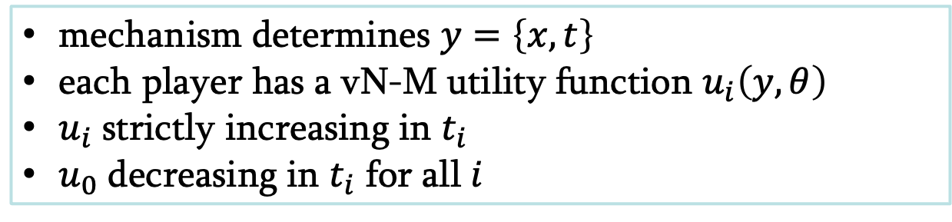
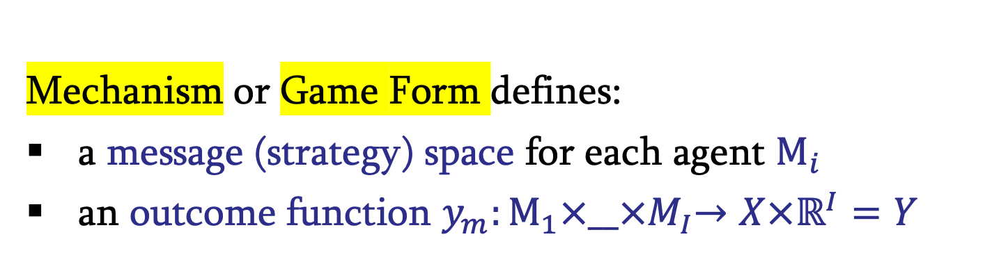
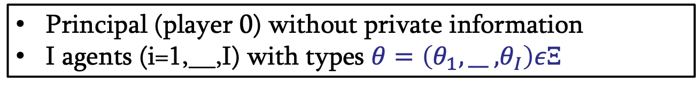
mechanism design
Principal (player 0) without private information
I agents (i=1,__,I) with types $θ=\left(θ_{1},\text{__ ,}θ_{I}\right)εΞ$
Mechanism or Game Form defines:
a message (strategy) space for each agent $Μ_{i}$
an outcome function $y_{m}:Μ_{1}{×\text{__}×M}_{I}→X×ℝ^{I}=Y$
mechanism determines $y=\left\{x,t\right\}$
each player has a vN-M utility function $u_{i}\left(y,θ\right)$
$u_{i}$ strictly increasing in $t_{i}$
$u_{0}$ decreasing in $t_{i}$ for all $i$

Slide 3
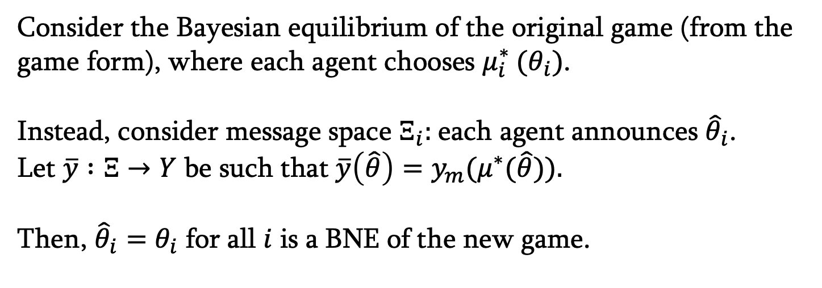
mechanism design
REVELATION PRINCIPLE
Principal can restrict herself to direct revelation mechanisms in which message space is just type space and s.t. agents accept mechanism regardless of type and simultaneously reveal types
Consider the Bayesian equilibrium of the original game (from the game form), where each agent chooses $μ_{i}^{∗} (θ_{i})$.
Instead, consider message space $Ξ_{i}:$each agent announces ${\hat{θ}}_{i}$.
Let $\overline{y} :Ξ→Y$ be such that $\overline{y}\left(\hat{θ}\right)=y_{m}(μ^{∗}(\hat{θ})\text{).}$
Then, ${\hat{θ}}_{i}=$ $θ_{i}$ for all $i$ is a BNE of the new game.

Slide 4
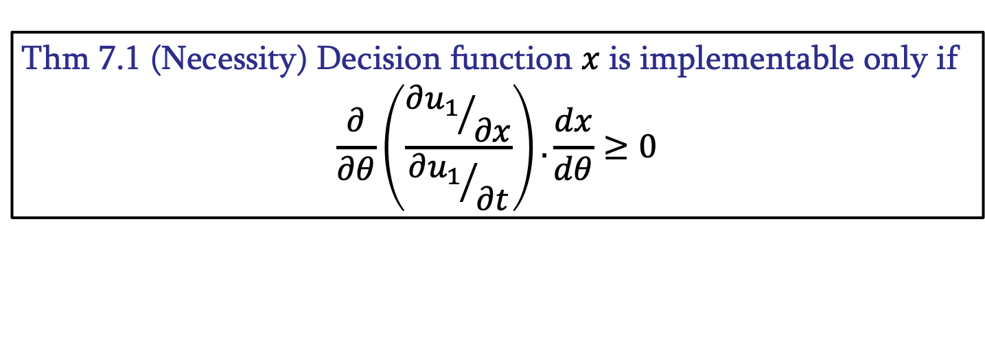
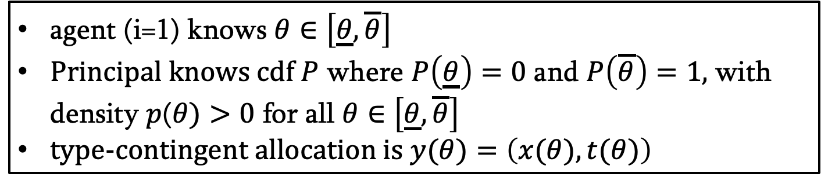
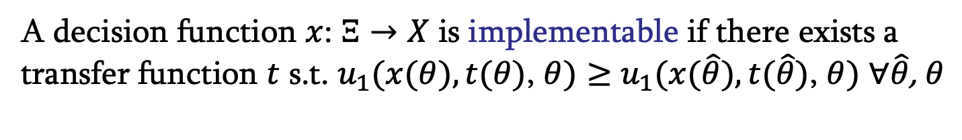
mechanism design
1-agent case
agent (i=1) knows $θ∈\left[\underline{θ},\overline{θ}\right]$
Principal knows cdf $P$ where $P\left(\underline{θ}\right)=0$ and $P\left(\overline{θ}\right)=1,$ with density $p$($θ)>0$ for all $θ∈\left[\underline{θ},\overline{θ}\right]$
type-contingent allocation is $y(θ)=\left(x(θ),t(θ)\right)$
A decision function $x$: $Ξ→X$ is implementable if there exists a transfer function $t$ s.t. $u_{1}(x(θ),t(θ)$, $θ)≥$ $u_{1}(x(\hat{θ}),t(\hat{θ})$, $θ)$ $∀\hat{θ}$, $θ$
Thm 7.1 (Necessity) Decision function $x$ is implementable only if
$$\frac{∂}{∂θ}\left(\frac{{∂u_{1}}/{∂x}}{{∂u_{1}}/{∂t}}\right).\frac{dx}{dθ}≥0$$

Slide 5
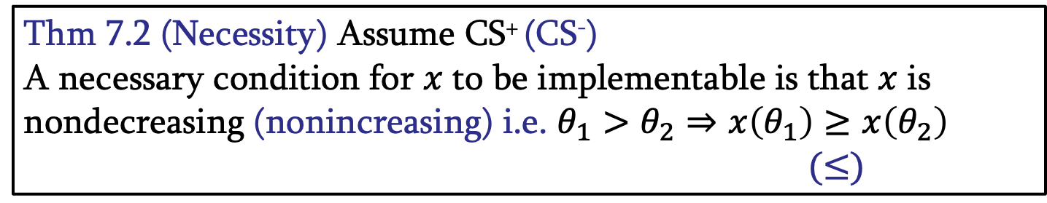
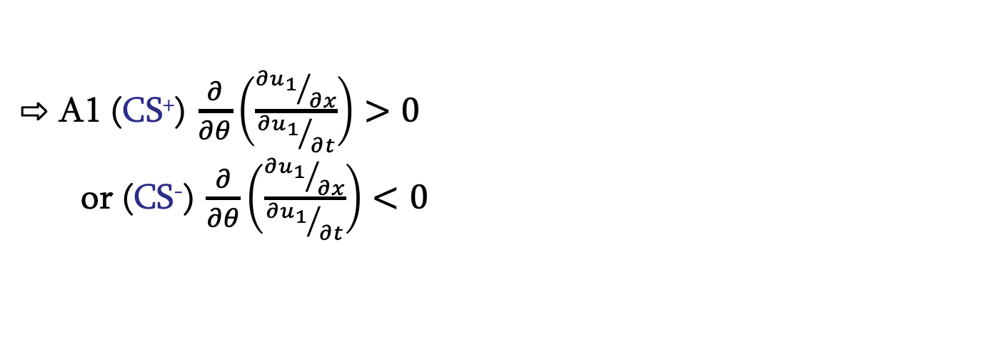
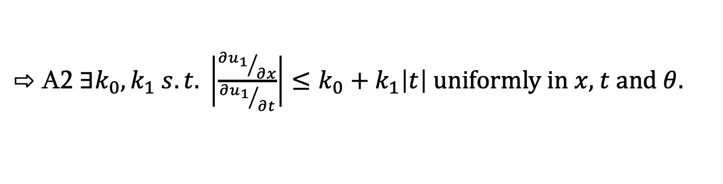
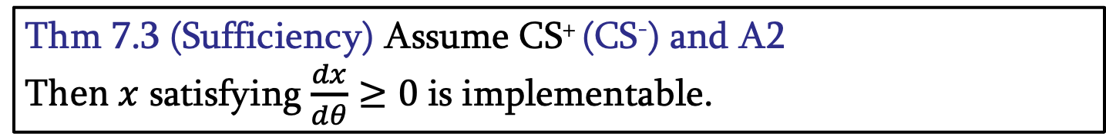
mechanism design
1-agent case
A1 (CS⁺) $\frac{∂}{∂θ}\left(\frac{{∂u_{1}}/{∂x}}{{∂u_{1}}/{∂t}}\right)>0$
or (CS⁻) $\frac{∂}{∂θ}\left(\frac{{∂u_{1}}/{∂x}}{{∂u_{1}}/{∂t}}\right)<0$
Thm 7.2 (Necessity) Assume CS⁺ (CS⁻)
A necessary condition for $x$ to be implementable is that $x$ is nondecreasing (nonincreasing) i.e. $θ_{1}>θ_{2}⇒x\left(θ_{1}\right)≥x\left(θ_{2}\right)$
$(≤)$
A2 $∃k_{0},k_{1} s.t. \left|\frac{{∂u_{1}}/{∂x}}{{∂u_{1}}/{∂t}}\right|≤k_{0}+k_{1}\left|t\right|$ uniformly in $x$, $t$ and $θ$.
Thm 7.3 (Sufficiency) Assume CS⁺ (CS⁻) and A2
T$hen x$ satisfying $\frac{dx}{dθ}≥0$is implementable.

Slide 6
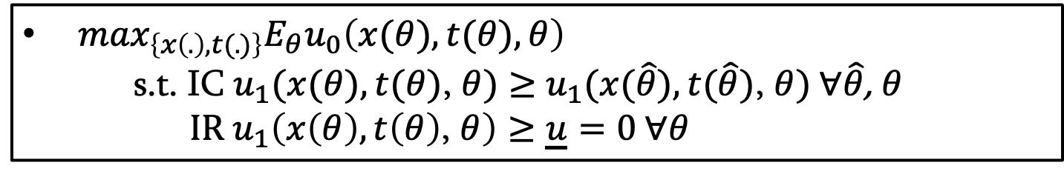
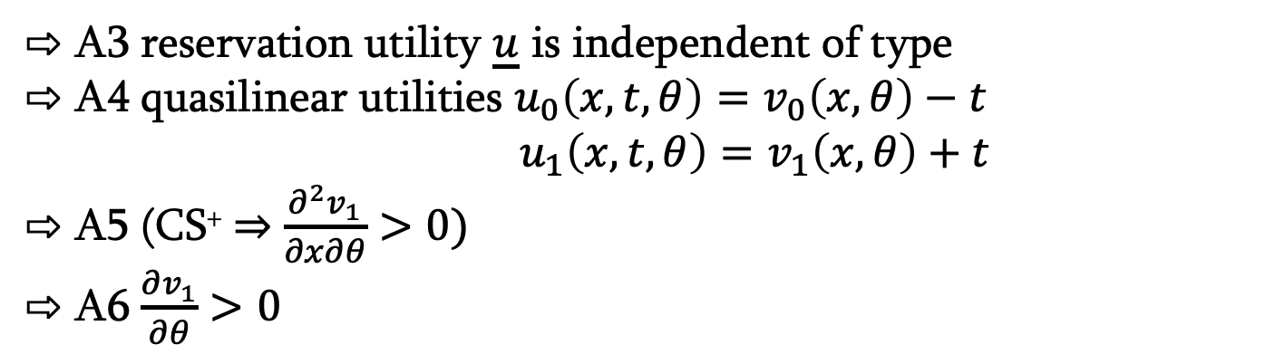
mechanism design
1-agent case
A3 reservation utility $\underline{u}$ is independent of type
A4 quasilinear utilities $u_{0}\left(x,t,θ\right)=v_{0}\left(x, θ\right)−t$
              $${ u}_{1}\left(x,t,θ\right)=v_{1}\left(x, θ\right)+t$$
A5 (CS⁺ $⇒$ $\frac{∂^{2}v_{1}}{∂x∂θ}>0)$
A6 $\frac{∂v_{1}}{∂θ}>0$
$\max_{\left\{x\left(.\right),t(.)\right\}}E_{θ}u_{0}\left(x(θ),t(θ),θ\right)$
s.t. IC $u_{1}(x(θ),t(θ)$, $θ)≥$ $u_{1}(x(\hat{θ}),t(\hat{θ})$, $θ) ∀\hat{θ}$, $θ$
$\text{IR} u_{1}\left(x\left(θ\right),t\left(θ\right)\text{,} θ\right)≥\underline{u}=0 ∀θ$

Slide 7
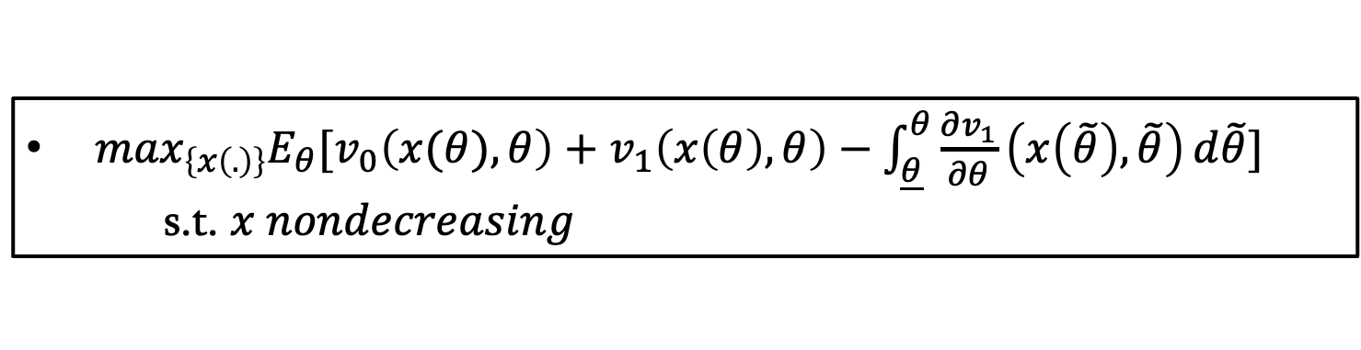
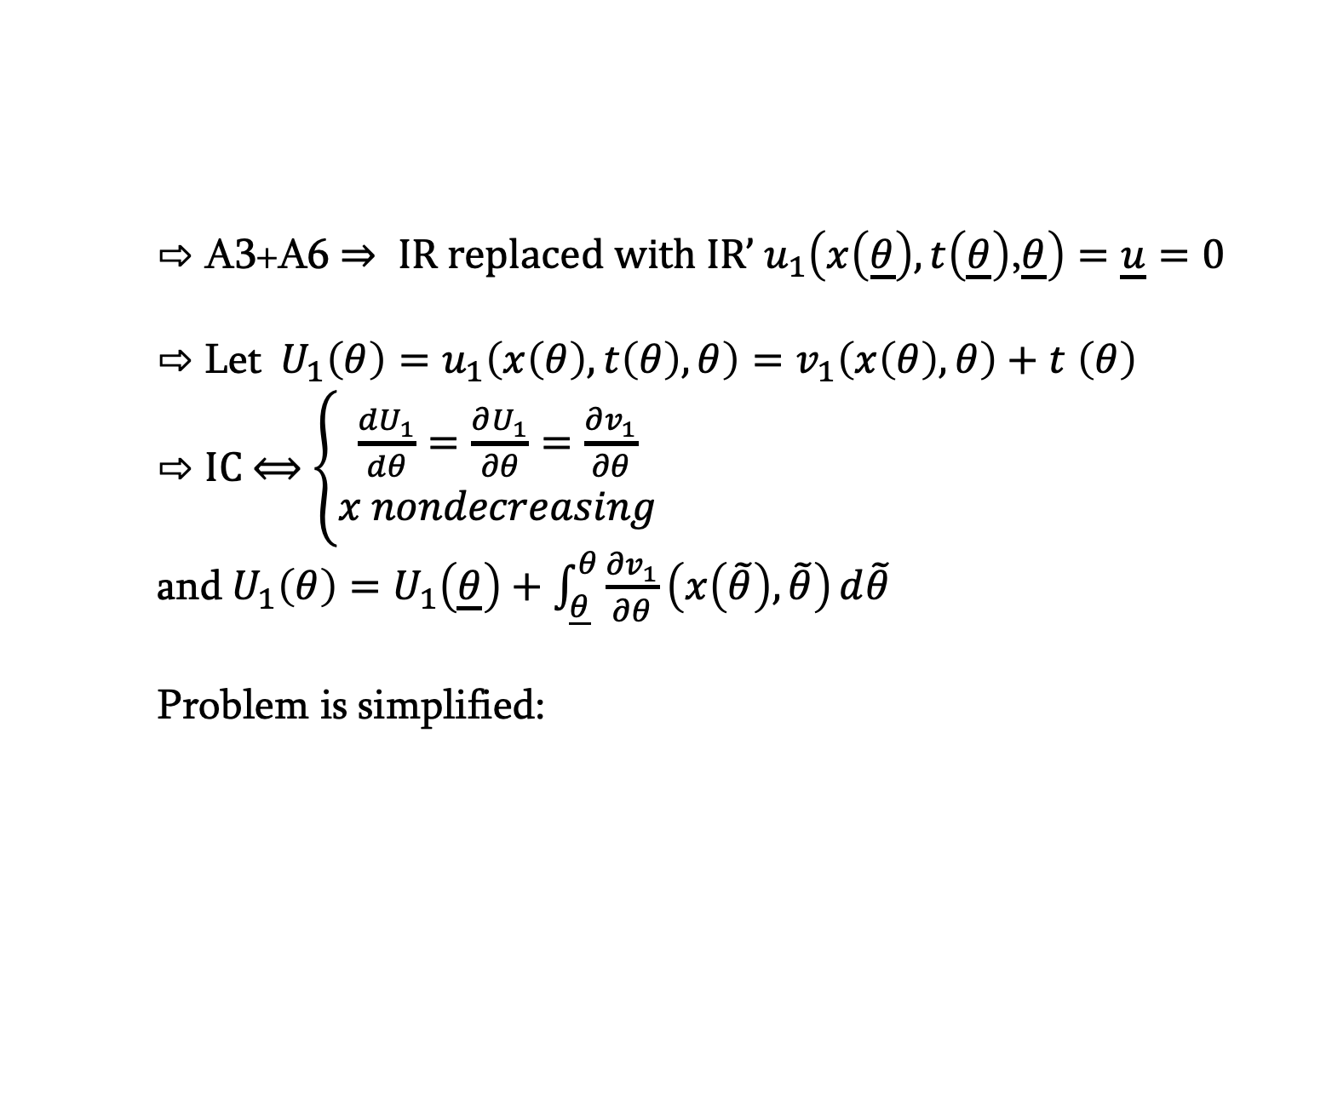
mechanism design
1-agent case
A3+A6 $⇒ \text{IR} \text{replaced} \text{with} \text{IR}’ u_{1}\left(x\left(\underline{θ}\right),t\left(\underline{θ}\right)\text{,}\underline{θ}\right)=\underline{u}=0$
Let${ U}_{1}{\left(θ\right)=u}_{1}\left(x\left(θ\right),t\left(θ\right),θ\right)=v_{1}\left(x\left(θ\right), θ\right)+t$ $\left(θ\right)$
IC ⟺ $\left\{\begin{aligned}\frac{dU_{1}}{dθ}=\frac{∂U_{1}}{∂θ}=\frac{∂v_{1}}{∂θ} \\ x nondecreasing\end{aligned}\right.$
and${ U}_{1}\left(θ\right)=U_{1}\left(\underline{θ}\right)+\int_{\underline{θ}}^{θ}{\frac{∂v_{1}}{∂θ}\left(x\left(\tilde{θ}\right),\tilde{θ}\right)}d\tilde{θ}$
Problem is simplified:
$\max_{\left\{x\left(.\right)\right\}}E_{θ}{[v}_{0}\left(x(θ), θ\right)+$ $v_{1}\left(x\left(θ\right), θ\right)−\int_{\underline{θ}}^{θ}{\frac{∂v_{1}}{∂θ}\left(x\left(\tilde{θ}\right),\tilde{θ}\right)}d\tilde{θ}]$
s.t. $x nondecreasing$

Slide 8
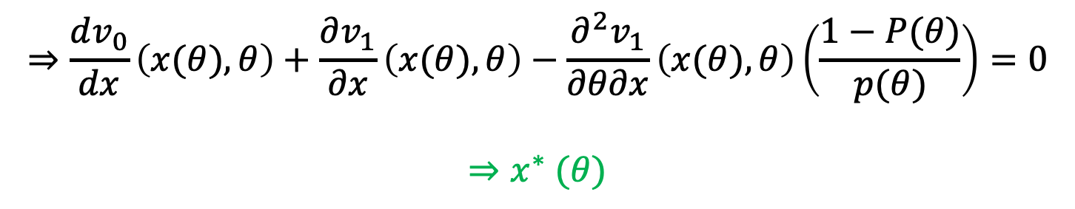
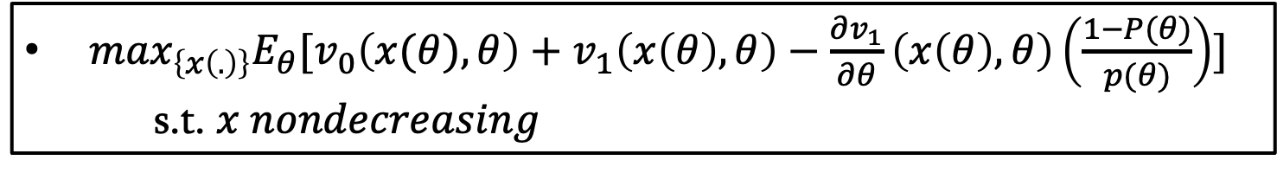
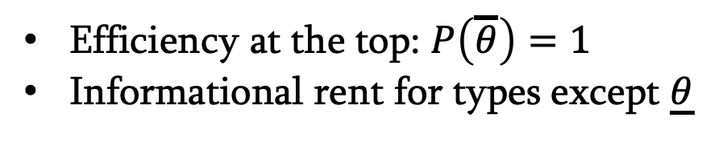
mechanism design
1-agent case
Objective function can be rewritten as:
$\max_{\left\{x\left(.\right)\right\}}E_{θ}{[v}_{0}\left(x(θ), θ\right)+$ $v_{1}\left(x\left(θ\right), θ\right)−\frac{∂v_{1}}{∂θ}\left(x\left(θ\right),θ\right)\left(\frac{1−P(θ)}{p(θ)}\right)]$
s.t. $x nondecreasing$
$$⇒\frac{dv_{0}}{dx}\left(x(θ), θ\right)+\frac{∂v_{1}}{∂x}\left(x(θ), θ\right)−\frac{∂^{2}v_{1}}{∂θ∂x}\left(x(θ), θ\right)\left(\frac{1−P(θ)}{p(θ)}\right)=0$$
$$⇒x^{∗} (θ)$$
Efficiency at the top: $P\left(\overline{θ}\right)=1$
Informational rent for types except $\underline{θ}$

Slide 9
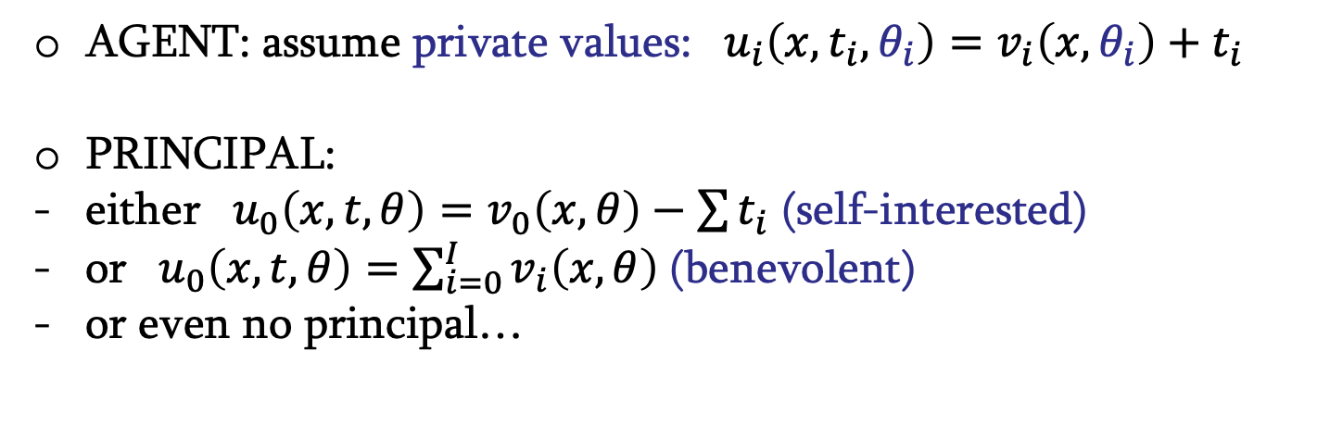
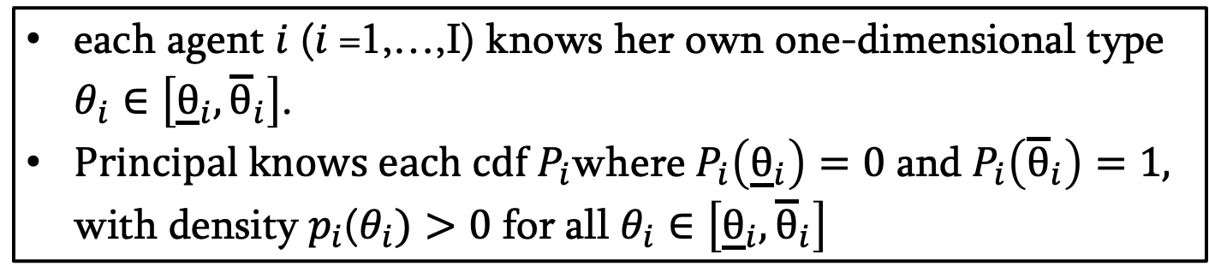
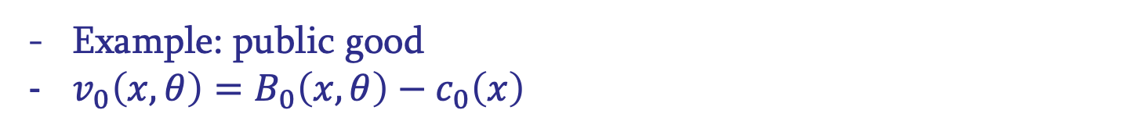
mechanism design
several-agent case
each agent $i$ ($i$=1,…,I) knows her own one-dimensional type $θ_{i}∈\left[{\underline{θ}}_{i},{\overline{θ}}_{i}\right]$.
Principal knows each cdf$P_{i}$where$P_{i}\left({\underline{θ}}_{i}\right)=0$ and$P_{i}\left({\overline{θ}}_{i}\right)=1,$ with density$p_{i}$($θ_{i})>0$ for all $θ_{i}∈\left[{\underline{θ}}_{i},{\overline{θ}}_{i}\right]$
AGENT: assume private values: ${ u}_{i}\left(x,t_{i},θ_{i}\right)=v_{i}\left(x,θ_{i}\right)+t_{i}$
PRINCIPAL:
either ${ u}_{0}\left(x,t,θ\right)=v_{0}\left(x,θ\right)−\sum{t_{i}}$ (self-interested)
or ${ u}_{0}\left(x,t,θ\right)=\sum_{i=0}^{I}{v_{i}\left(x,θ\right)}$(benevolent)
or even no principal…
Example: public good
$v_{0}\left(x, θ\right)=B_{0}\left(x,θ\right)−c_{0}\left(x\right)$

Slide 10

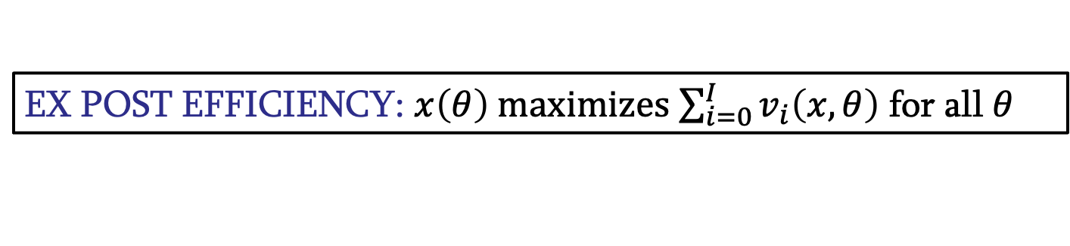
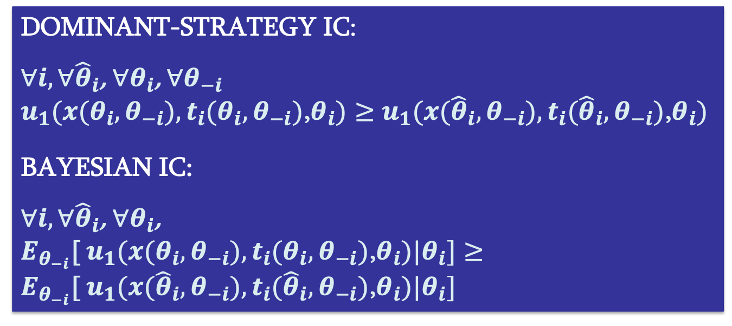
mechanism design
several-agent case
EX POST EFFICIENCY: $x\left(θ\right)$ maximizes$\sum_{i=0}^{I}{v_{i}\left(x,θ\right)}$ for all $θ$
BUDGET BALANCE: $\sum_{i=1}^{I}{t_{i}\left(θ\right)}≤−c_{0}\left(x\left(θ\right)\right)$
DOMINANT-STRATEGY IC:
$∀i, ∀{\hat{θ}}_{i}$, $∀θ_{i}$, $∀θ_{−i}$
$u_{1}(x(θ_{i},θ_{−i}),t_{i}(θ_{i},θ_{−i})$,$θ_{i})≥$ $u_{1}(x({\hat{θ}}_{i},θ_{−i}),t_{i}({\hat{θ}}_{i},θ_{−i})\text{,}θ_{i})$
BAYESIAN IC:
$∀i, ∀{\hat{θ}}_{i}$, $∀θ_{i}$,
$E_{θ_{−i}}$[ $u_{1}(x(θ_{i},θ_{−i}),t_{i}(θ_{i},θ_{−i})$,$θ_{i})|θ_{i}]≥$
$E_{θ_{−i}}$[ $u_{1}(x({\hat{θ}}_{i},θ_{−i}),t_{i}({\hat{θ}}_{i},θ_{−i})$,$θ_{i})|θ_{i}]$

Slide 11
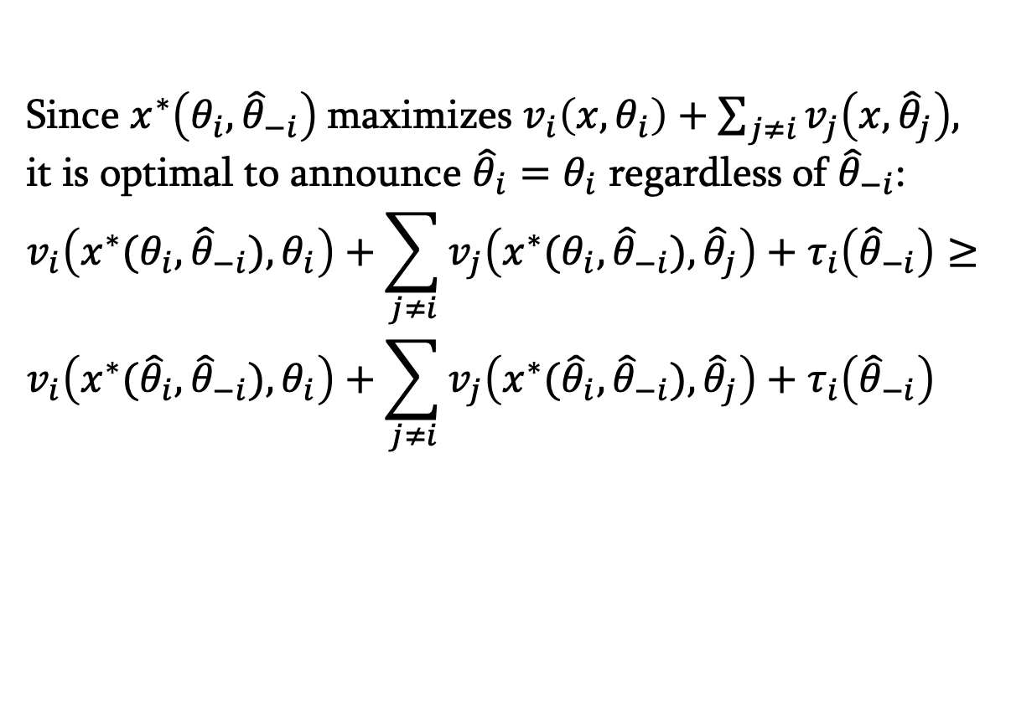
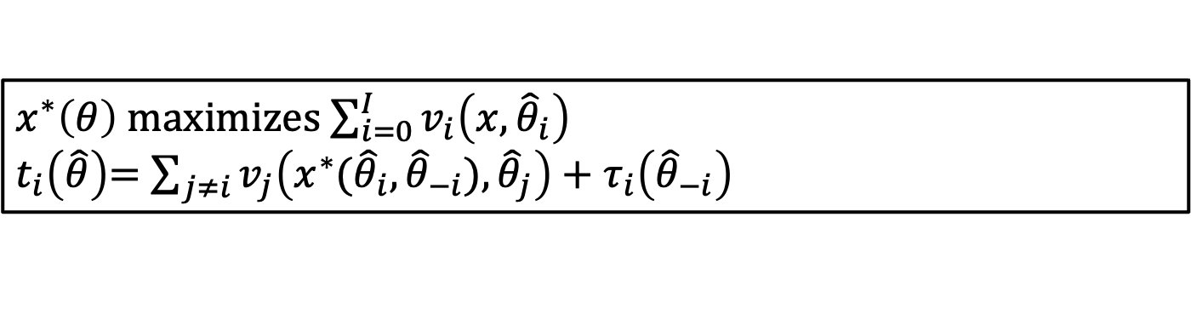
mechanism design
GROVES-CLARKE MECHANISM
Any efficient provision of public good may be implemented in dominant strategies as long as budget balance not necessary.
Idea is to internalize the surplus “externality”
$x^{∗}\left(θ\right)$ maximizes$\sum_{i=0}^{I}{v_{i}\left(x,{\hat{θ}}_{i}\right)}$
$t_{i}\left(\hat{θ}\right)$= $\sum_{j≠i}{v_{j}\left(x^{∗}({\hat{θ}}_{i},{\hat{θ}}_{−i}),{\hat{θ}}_{j}\right)}+τ_{i}\left({\hat{θ}}_{−i}\right)$
Since $x^{∗}\left(θ_{i},{\hat{θ}}_{−i}\right)$maximizes $v_{i}\left(x,θ_{i}\right)+\sum_{j≠i}{v_{j}\left(x,{\hat{θ}}_{j}\right),}$
it is optimal to announce ${\hat{θ}}_{i}=θ_{i}$ regardless of ${\hat{θ}}_{−i}$:
$$v_{i}\left(x^{∗}(θ_{i},{\hat{θ}}_{−i}),θ_{i}\right)+\sum_{j≠i}{v_{j}\left(x^{∗}(θ_{i},{\hat{θ}}_{−i}),{\hat{θ}}_{j}\right)}+τ_{i}\left({\hat{θ}}_{−i}\right)≥$$
$$v_{i}\left(x^{∗}({\hat{θ}}_{i},{\hat{θ}}_{−i}),θ_{i}\right)+\sum_{j≠i}{v_{j}\left(x^{∗}({\hat{θ}}_{i},{\hat{θ}}_{−i}),{\hat{θ}}_{j}\right)}+τ_{i}\left({\hat{θ}}_{−i}\right)$$

Slide 12
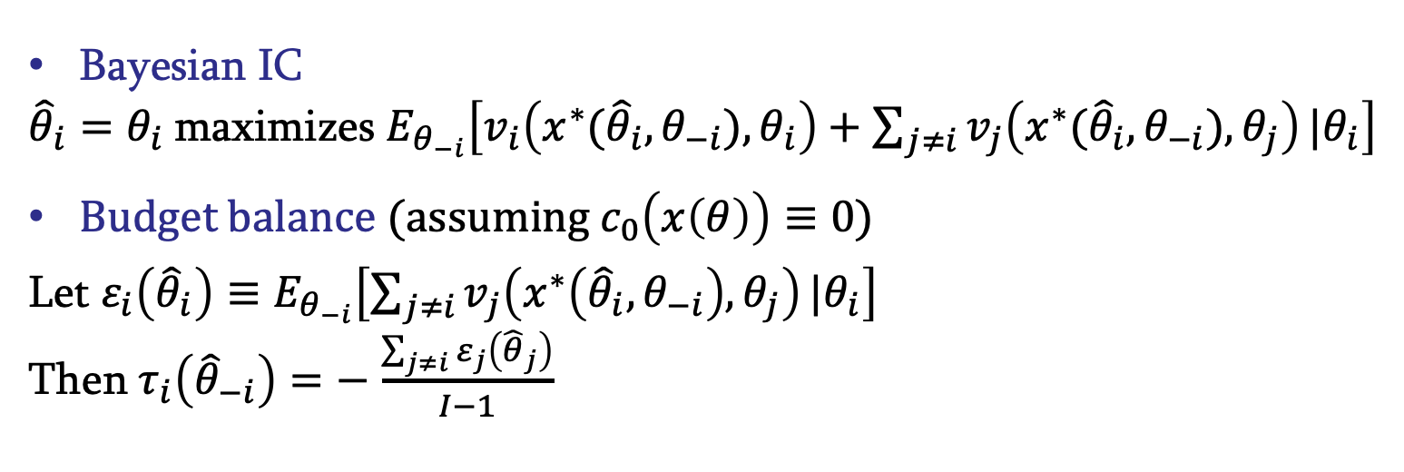
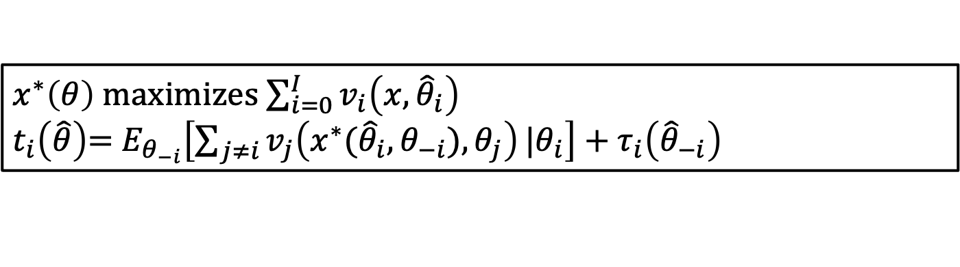
mechanism design
AGV MECHANISM
Budget balance is a problem in Groves-Clarke
Introduce BB and IR, drop dominant strategy IC: d’Aspremont/Gérard-Varet mechanism
$x^{∗}\left(θ\right)$ maximizes$\sum_{i=0}^{I}{v_{i}\left(x,{\hat{θ}}_{i}\right)}$
$t_{i}\left(\hat{θ}\right)$= $E_{θ_{−i}}\left[\sum_{j≠i}{v_{j}\left(x^{∗}({\hat{θ}}_{i},θ_{−i}),θ_{j}\right)}|θ_{i}\right]+τ_{i}\left({\hat{θ}}_{−i}\right)$
Bayesian IC
${\hat{θ}}_{i}=θ_{i}$maximizes $E_{θ_{−i}}\left[v_{i}\left(x^{∗}({\hat{θ}}_{i},θ_{−i}),θ_{i}\right)+\sum_{j≠i}{v_{j}\left(x^{∗}({\hat{θ}}_{i},θ_{−i}),θ_{j}\right)}|θ_{i}\right]$
Budget balance (assuming $c_{0}\left(x\left(θ\right)\right)≡0$)
Let $ε_{i}\left({\hat{θ}}_{i}\right)≡E_{θ_{−i}}\left[\sum_{j≠i}{v_{j}\left(x^{∗}\left({\hat{θ}}_{i},θ_{−i}\right),θ_{j}\right)}|θ_{i}\right]$
Then$τ_{i}\left({\hat{θ}}_{−i}\right)=−$ $\frac{\sum_{j≠i}{ε_{j}\left({\hat{θ}}_{j}\right)}}{I−1}$

Slide 13
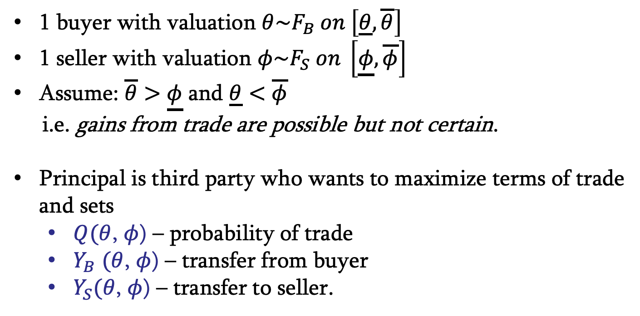
mechanism design
BILATERAL TRADE
1 buyer with valuation $θ\sim F_{B} on \left[\underline{θ},\overline{θ}\right]$
1 seller with valuation $φ\sim F_{S} on \left[\underline{φ},\overline{φ}\right]$
Assume: $\overline{θ}>$ $\underline{φ}$ and $\underline{θ}<$ $\overline{φ}$
i.e. gains from trade are possible but not certain.
Principal is third party who wants to maximize terms of trade and sets
  $Q(θ$, $φ$) – probability of trade
  $Y_{B}$ $(θ$, $φ$) – transfer from buyer
  $Y_{S}(θ$, $φ$) – transfer to seller.

Slide 14
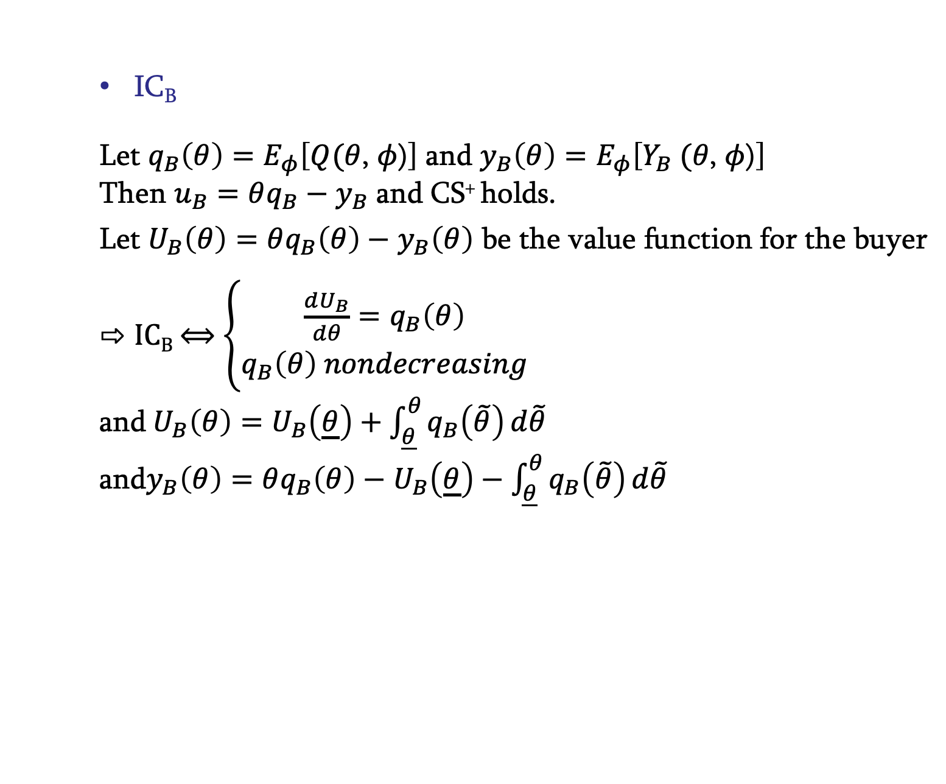
mechanism design
BILATERAL TRADE
IC_{B}
Let ${q_{B}\left(θ\right)=E}_{φ}\left[Q(θ\text{, }φ\text{)}\right]$ and ${y_{B}\left(θ\right)=E}_{φ}\left[Y_{B} (θ\text{, }φ\text{)}\right]$
Then $u_{B}=θq_{B}−$ $y_{B}$ and CS⁺ holds.
Let $U_{B}\left(θ\right)=θq_{B}\left(θ\right)−$ $y_{B}\left(θ\right)$ be the value function for the buyer
IC_{B} ⟺ $\left\{\begin{aligned}\frac{dU_{B}}{dθ}=q_{B}\left(θ\right) \\ q_{B}\left(θ\right) nondecreasing\end{aligned}\right.$
and${ U}_{B}\left(θ\right)=U_{B}\left(\underline{θ}\right)+\int_{\underline{θ}}^{θ}{q_{B}\left(\tilde{θ}\right)}d\tilde{θ}$
and$y_{B}\left(θ\right)=θq_{B}\left(θ\right)−$ $U_{B}\left(\underline{θ}\right)−\int_{\underline{θ}}^{θ}{q_{B}\left(\tilde{θ}\right)}d\tilde{θ}$

Slide 15
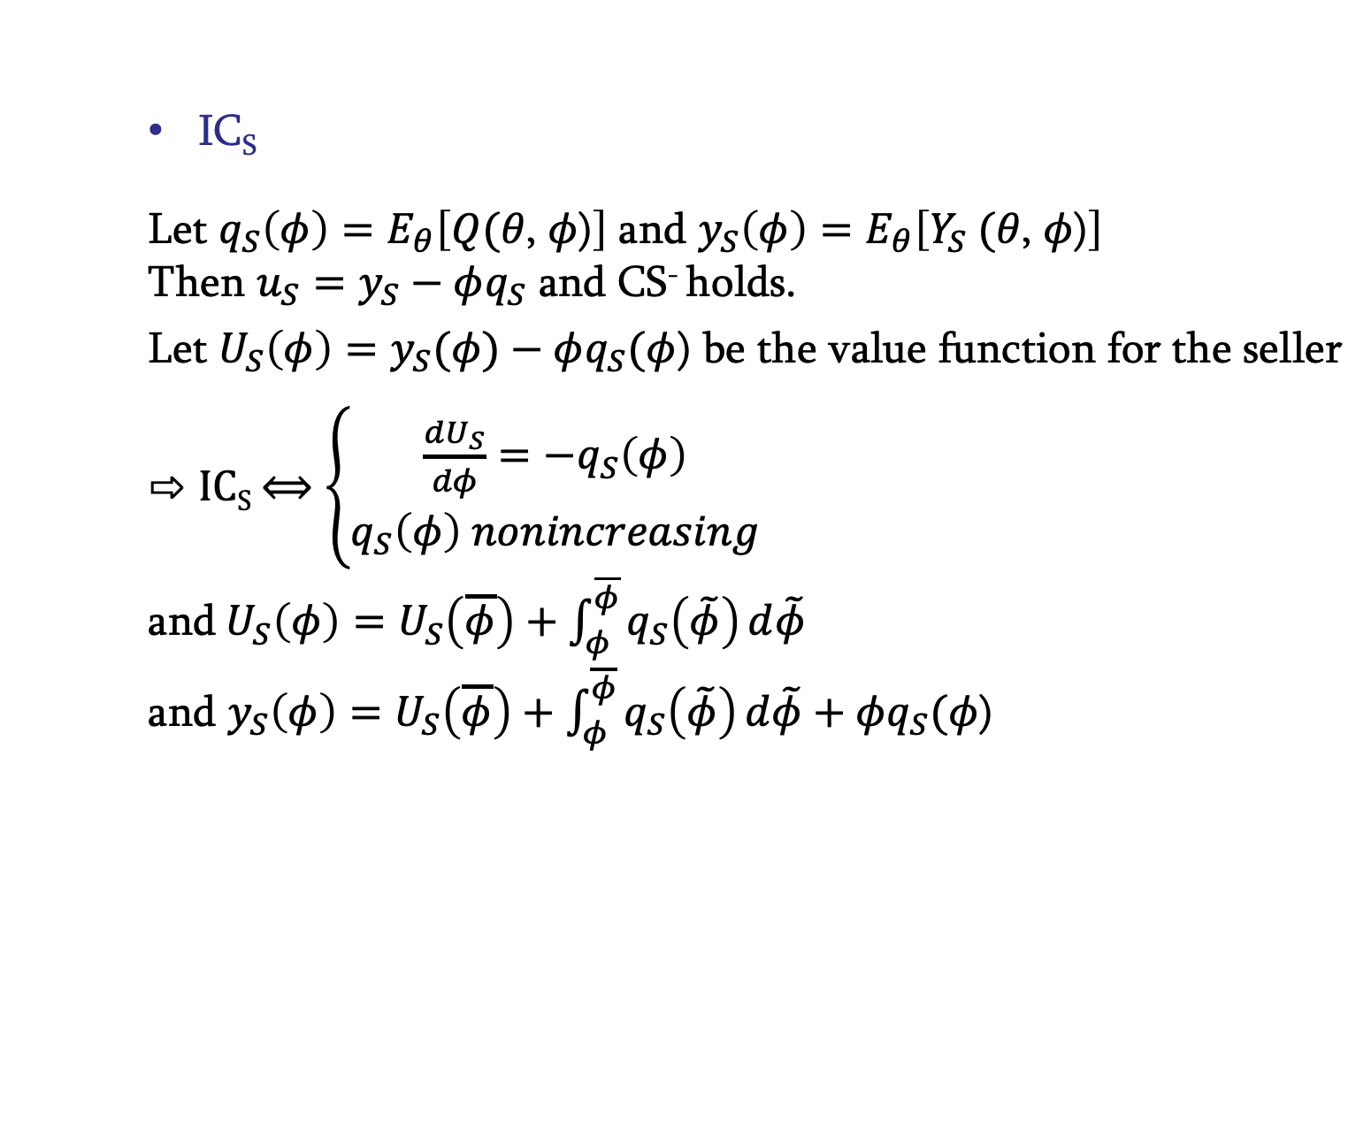
mechanism design
BILATERAL TRADE
IC_{S}
Let ${q_{S}\left(φ\right)=E}_{θ}\left[Q(θ\text{, }φ\text{)}\right]$ and ${y_{S}\left(φ\right)=E}_{θ}\left[Y_{S} (θ\text{, }φ\text{)}\right]$
Then $u_{S}=y_{S}−φq_{S}$ and CS⁻ holds.
Let $U_{S}\left(φ\right)=y_{S}(φ)−φq_{S}(φ$) be the value function for the seller
IC_{S} ⟺ $\left\{\begin{aligned}\frac{dU_{S}}{dφ}={−q}_{S}\left(φ\right) \\ q_{S}\left(φ\right) nonincreasing\end{aligned}\right.$
and${ U}_{S}\left(φ\right)=U_{S}\left(\overline{φ}\right)+\int_{φ}^{\overline{φ}}{q_{S}\left(\tilde{φ}\right)}d\tilde{φ}$
and $y_{S}\left(φ\right)=U_{S}\left(\overline{φ}\right)+\int_{φ}^{\overline{φ}}{q_{S}\left(\tilde{φ}\right)}d\tilde{φ}+φq_{S}(φ\text{)}$

Slide 16

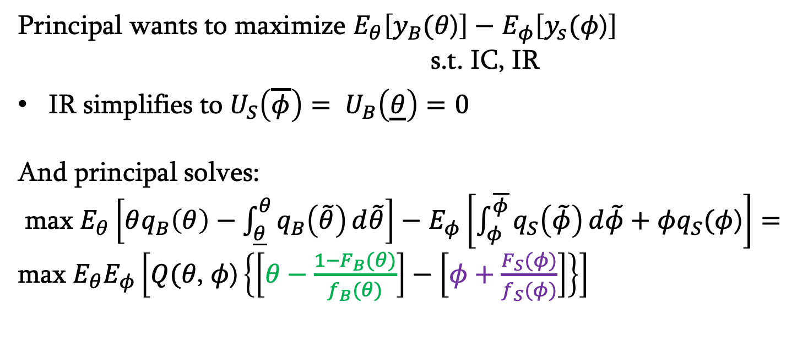
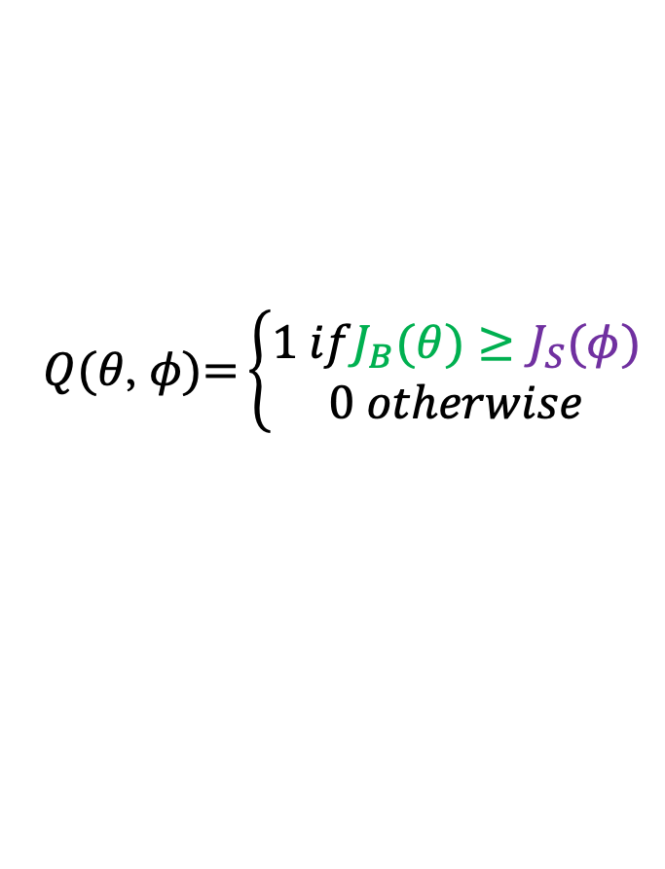

mechanism design
BILATERAL TRADE
Principal wants to maximize $E_{θ}\left[y_{B}(θ\text{)}\right]−$ $E_{φ}\left[y_{s}(φ\text{)}\right]$
s.t. IC, IR
IR simplifies to $U_{S}\left(\overline{φ}\right)= U_{B}\left(\underline{θ}\right)=0$
And principal solves:
max $E_{θ}\left[θq_{B}\left(θ\right)−\int_{\underline{θ}}^{θ}{q_{B}\left(\tilde{θ}\right)}d\tilde{θ}\right]−$ $E_{φ}\left[\int_{φ}^{\overline{φ}}{q_{S}\left(\tilde{φ}\right)}d\tilde{φ}+φq_{S}(φ\text{)}\right]=$
max $E_{θ}E_{φ}\left[Q(θ\text{, }φ\text{)}\left\{\left[θ−\frac{1−F_{B}(θ)}{f_{B}(θ)}\right]−\left[φ+\frac{F_{S}(φ)}{f_{S}(φ)}\right]\right\}\right]$
$$J_{B}(θ)$$
$$J_{S}(φ)$$
$$Q(θ\text{,} φ\text{)=}\left\{\begin{aligned}1 ifJ_{B}(θ)≥J_{S}(φ) \\ 0 otherwise\end{aligned}\right.$$
NOT EFFICIENT!

Slide 17
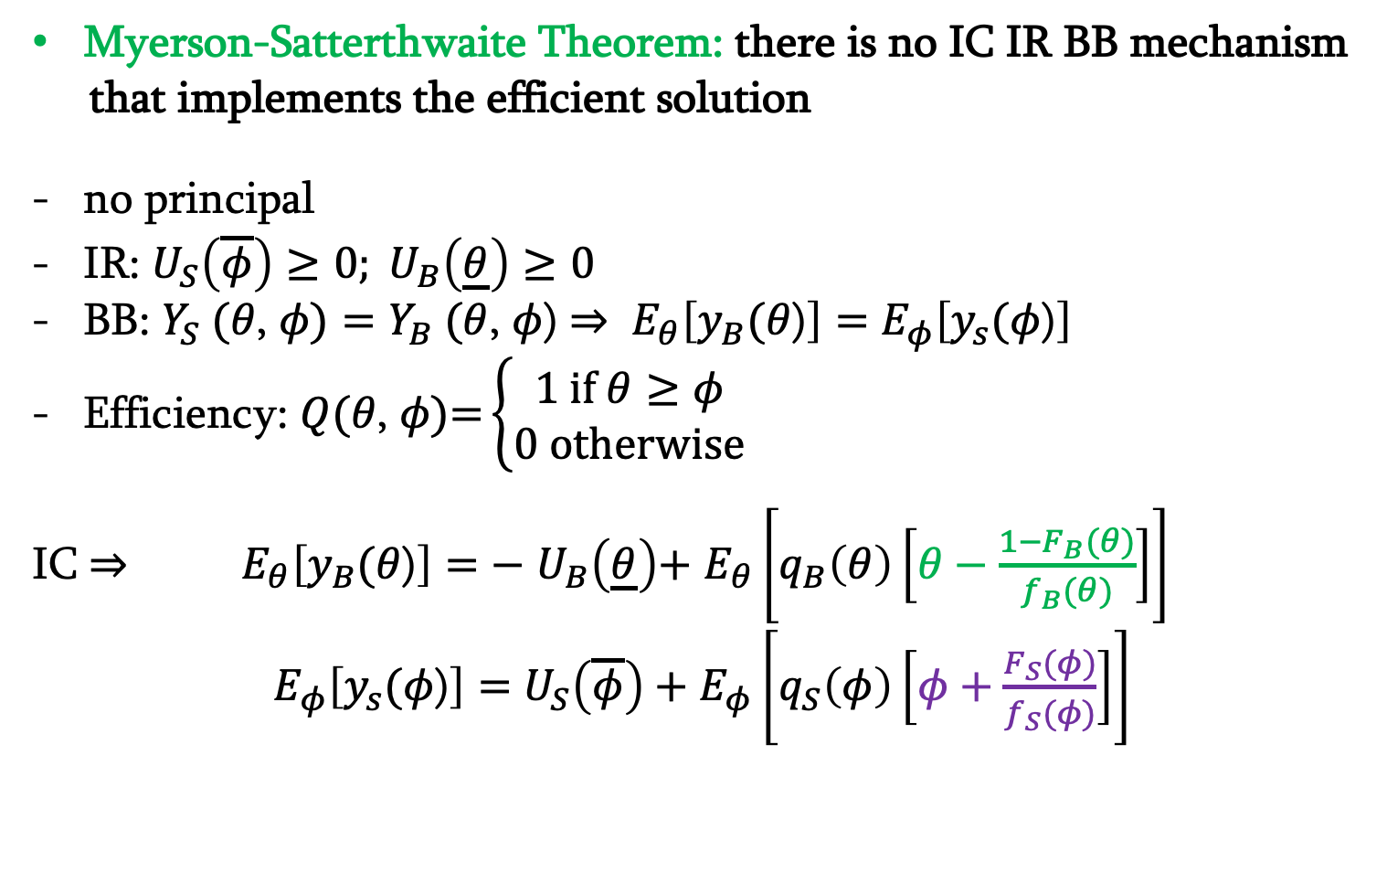
mechanism design
BILATERAL TRADE
Myerson-Satterthwaite Theorem: there is no IC IR BB mechanism
that implements the efficient solution
no principal
IR: $U_{S}\left(\overline{φ}\right)≥0; U_{B}\left(\underline{θ}\right)≥0$
BB: $Y_{S} (θ\text{, }φ\text{)}=Y_{B} (θ\text{, }φ\text{)}$ $⇒ E_{θ}\left[y_{B}(θ\text{)}\right]=$ $E_{φ}\left[y_{s}(φ\text{)}\right]$
Efficiency: $Q(θ\text{,} φ\text{)=}\left\{\begin{aligned}1 if θ≥φ \\ 0 otherwise\end{aligned}\right.$
IC $⇒ E_{θ}\left[y_{B}(θ\text{)}\right]=$ $− U_{B}\left(\underline{θ}\right)$+ $E_{θ}\left[q_{B}\left(θ\right)\left[θ−\frac{1−F_{B}(θ)}{f_{B}(θ)}\right]\right]$
$E_{φ}\left[y_{s}(φ\text{)}\right]=$ $U_{S}\left(\overline{φ}\right)+E_{φ}\left[q_{S}\left(φ\right)\left[φ+\frac{F_{S}(φ)}{f_{S}(φ)}\right]\right]$

Slide 18
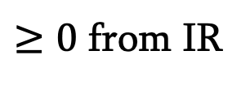
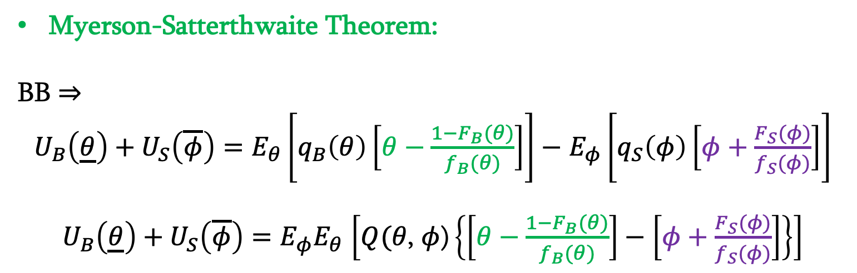
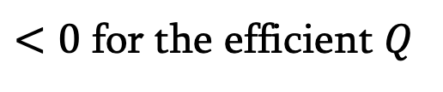
mechanism design
BILATERAL TRADE
Myerson-Satterthwaite Theorem:
BB $⇒$
$U_{B}\left(\underline{θ}\right)+U_{S}\left(\overline{φ}\right)=E_{θ}\left[q_{B}\left(θ\right)\left[θ−\frac{1−F_{B}(θ)}{f_{B}(θ)}\right]\right]−$ $E_{φ}\left[q_{S}\left(φ\right)\left[φ+\frac{F_{S}(φ)}{f_{S}(φ)}\right]\right]$
$U_{B}\left(\underline{θ}\right)+U_{S}\left(\overline{φ}\right)=E_{φ}E_{θ}$ $\left[Q(θ\text{, }φ\text{)}\left\{\left[θ−\frac{1−F_{B}(θ)}{f_{B}(θ)}\right]−\left[φ+\frac{F_{S}(φ)}{f_{S}(φ)}\right]\right\}\right]$
$≥0$ from IR
$<0$ for the efficient $Q$
IMPOSSIBILITY!

Slide 19
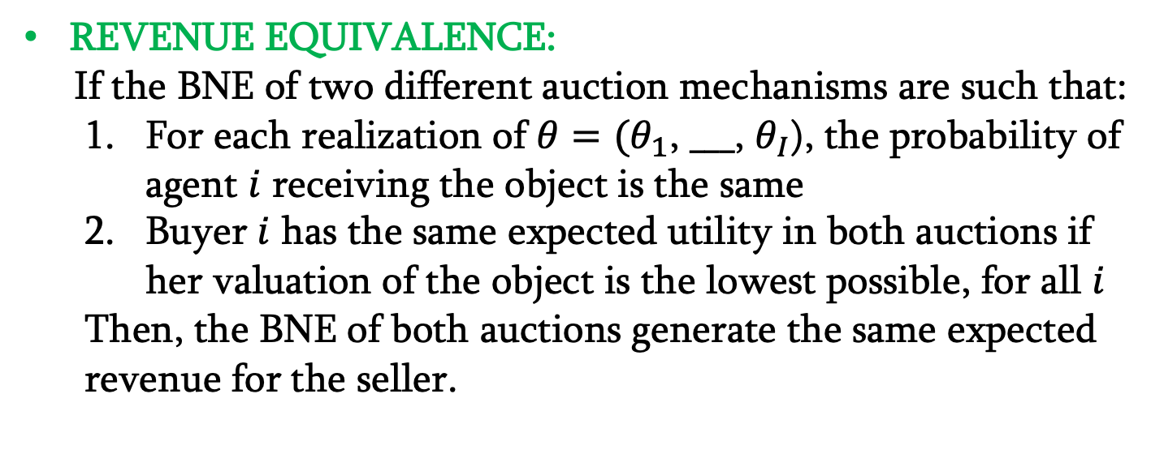
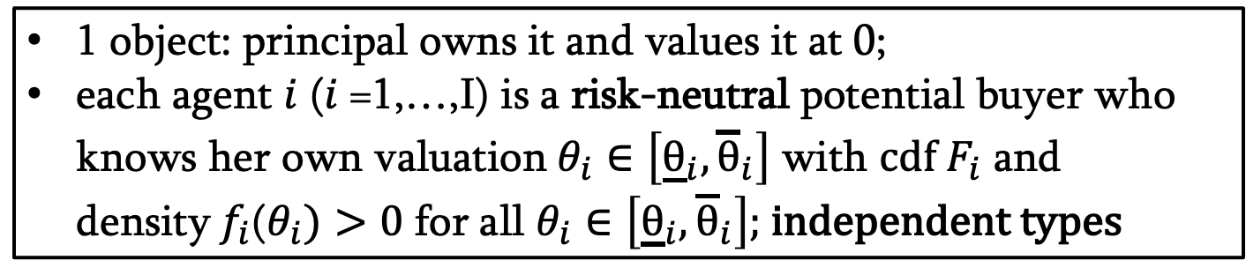
mechanism design
AUCTIONS
1 object: principal owns it and values it at 0;
each agent $i$ ($i$=1,…,I) is a risk-neutral potential buyer who knows her own valuation$θ_{i}∈\left[{\underline{θ}}_{i},{\overline{θ}}_{i}\right]$ with cdf$F_{i}$ and density$f_{i}$($θ_{i})>0$ for all $θ_{i}∈\left[{\underline{θ}}_{i},{\overline{θ}}_{i}\right]$; independent types
REVENUE EQUIVALENCE:
If the BNE of two different auction mechanisms are such that:
  For each realization of $θ=(θ_{1}$, $___$, $θ_{I}$), the probability of agent $i$ receiving the object is the same
  Buyer $i$ has the same expected utility in both auctions if her valuation of the object is the lowest possible, for all $i$
  Then, the BNE of both auctions generate the same expected revenue for the seller.

Slide 20
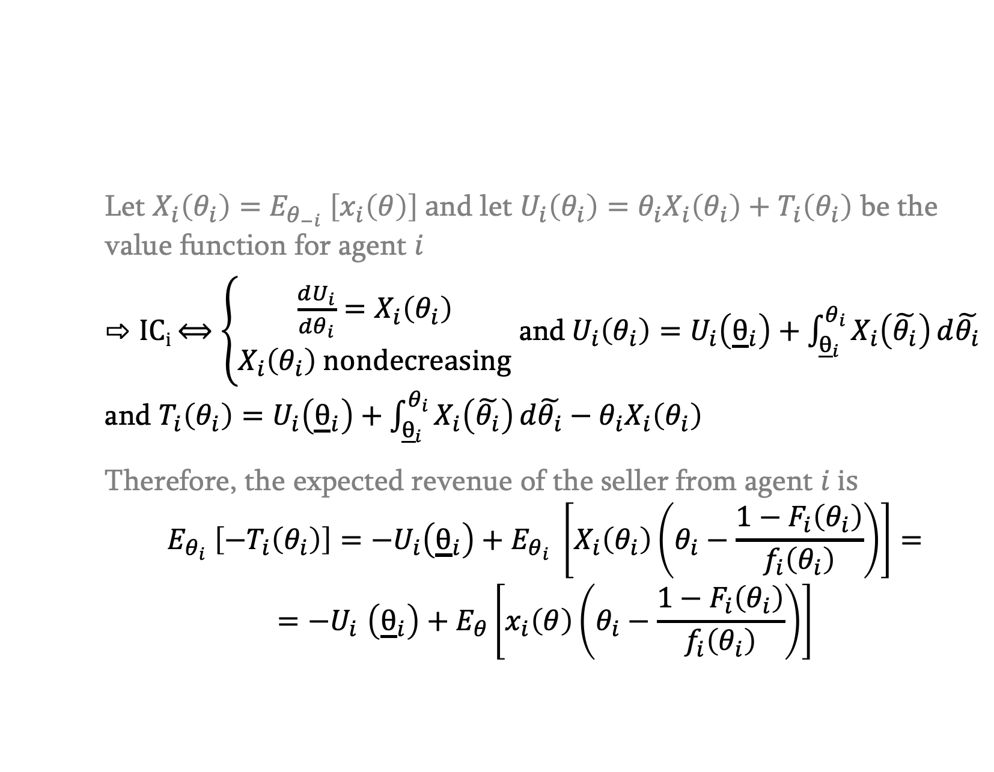
mechanism design
AUCTIONS
REVENUE EQUIVALENCE:
Let $X_{i}\left(θ_{i}\right)=$ $E_{θ_{−i}} \left[x_{i}\left(θ\right)\right] a$nd let $U_{i}\left(θ_{i}\right)=θ_{i}X_{i}\left(θ_{i}\right)+$ $T_{i}\left(θ_{i}\right)$ be the value function for agent $i$
IC_{i} ⟺ $\left\{\begin{aligned}\frac{dU_{i}}{dθ_{i}}=X_{i}\left(θ_{i}\right) \\ X_{i}\left(θ_{i}\right) nondecreasing\end{aligned}\right.$ and${ U}_{i}\left(θ_{i}\right)=U_{i}\left({\underline{θ}}_{i}\right)+\int_{{\underline{θ}}_{i}}^{θ_{i}}{X_{i}\left(\tilde{θ_{i}}\right)}d\tilde{θ_{i}}$
and $T_{i}\left(θ_{i}\right)=U_{i}\left({\underline{θ}}_{i}\right)+\int_{{\underline{θ}}_{i}}^{θ_{i}}{X_{i}\left(\tilde{θ_{i}}\right)}d\tilde{θ_{i}}−θ_{i}X_{i}\left(θ_{i}\right)$
Therefore, the expected revenue of the seller from agent $i is$
$$E_{θ_{i}} \left[−T_{i}\left(θ_{i}\right)\right]={−U}_{i}\left({\underline{θ}}_{i}\right)+E_{θ_{i}} \left[X_{i}\left(θ_{i}\right)\left(θ_{i}−\frac{1−F_{i}\left(θ_{i}\right)}{f_{i}\left(θ_{i}\right)}\right)\right]=$$
$${=−U}_{i}\left({\underline{θ}}_{i}\right)+E_{θ}\left[x_{i}\left(θ\right)\left(θ_{i}−\frac{1−F_{i}\left(θ_{i}\right)}{f_{i}\left(θ_{i}\right)}\right)\right]$$

Slide 21
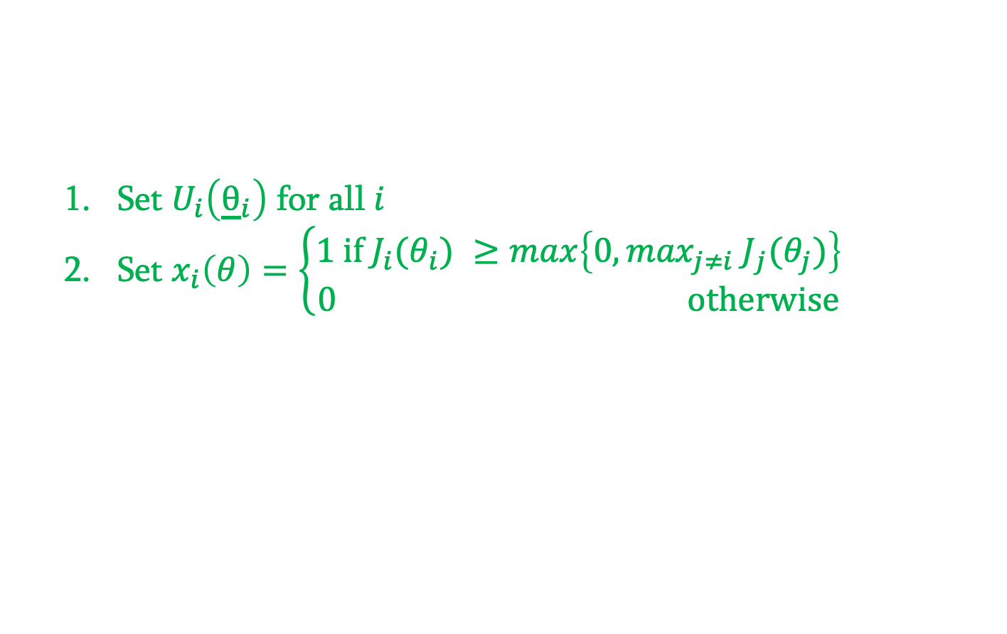
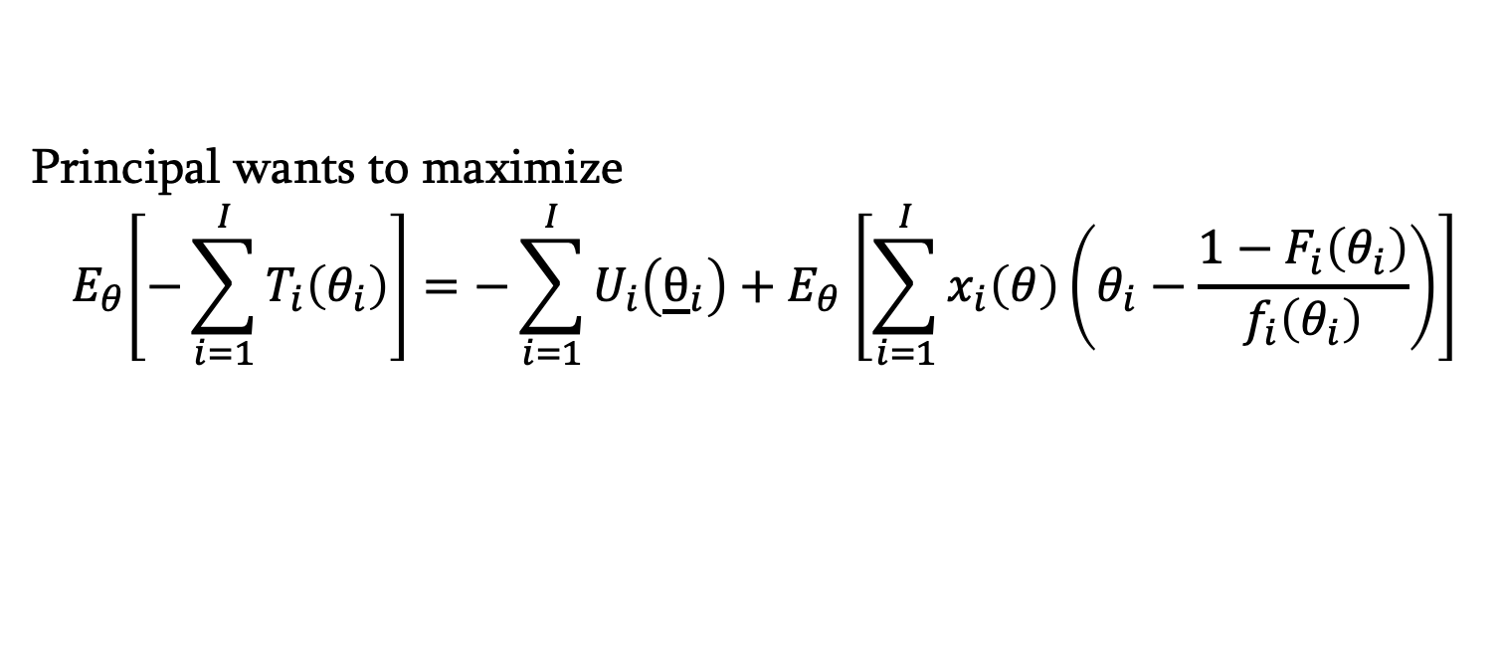

mechanism design
AUCTIONS
OPTIMAL AUCTION:
Principal wants to maximize
$${ E}_{θ}\left[−\sum_{i=1}^{I}{T_{i}\left(θ_{i}\right)}\right]=−\sum_{i=1}^{I}{U_{i}\left({\underline{θ}}_{i}\right)}{+ E}_{θ}\left[\sum_{i=1}^{I}{x_{i}\left(θ\right)\left(θ_{i}−\frac{1−F_{i}\left(θ_{i}\right)}{f_{i}\left(θ_{i}\right)}\right)}\right]$$
$$J_{i}(θ_{i})$$
  Set $U_{i}\left({\underline{θ}}_{i}\right)$ for all $i$
  Set $x_{i}\left(θ\right)=\left\{\begin{aligned}1 if J_{i}(θ_{i}) ≥max\left\{0,\max_{j≠i}{ J}_{j}(θ_{j})\right\} \\ 0 otherwise\end{aligned}\right.$

