Slide 1
asymmetric information
signaling screening moral hazard monopolistic screening

Slide 2
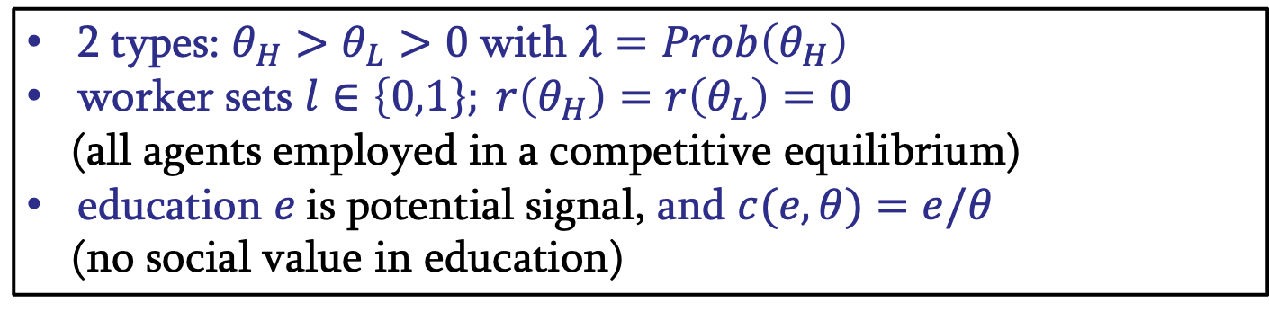
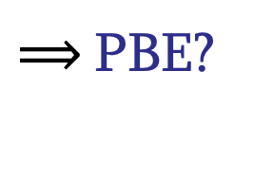
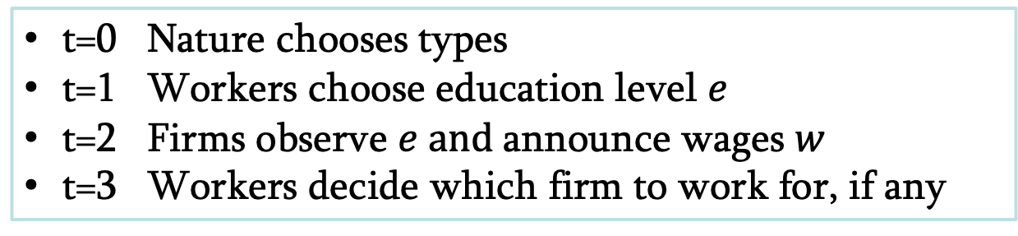
signaling
possibility of overcoming asymmetry of information, but signaling is costly – ambiguous effect on efficiency
2 types: $θ_{H}>θ_{L}>0$with $λ=Prob\left(θ_{H}\right)$
worker sets $l∈\left\{0,1\right\}; r\left(θ_{H}\right)=r\left(θ_{L}\right)=0$
(all agents employed in a competitive equilibrium)
education $e$is potential signal, and $c(e,θ)=e/θ$
(no social value in education)
t=0 Nature chooses types
t=1 Workers choose education level $e$
t=2 Firms observe $e and$announce wages $w$
t=3 Workers decide which firm to work for, if any
$⟹$PBE?

Slide 3
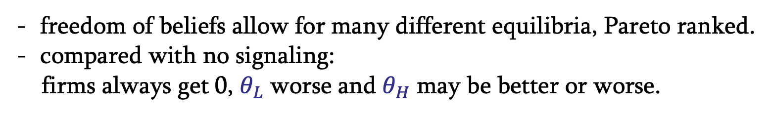
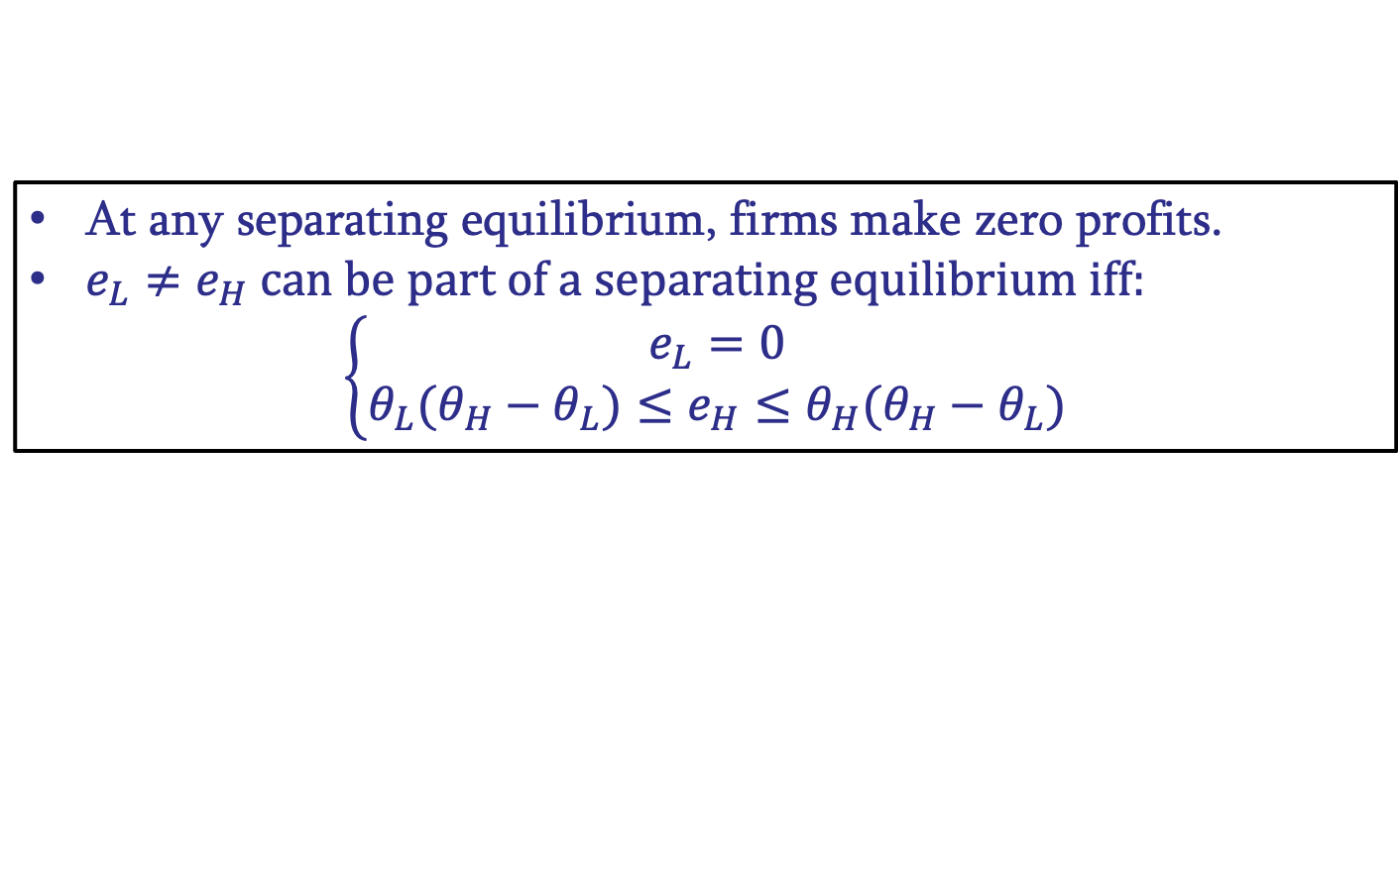
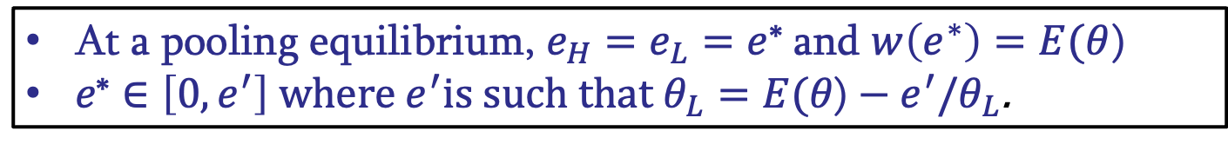
signaling
- Separating equilibria
At any separating equilibrium, firms make zero profits.
$e_{L}≠e_{H} can be part of a separating equilibrium iff:$
$$\left\{\begin{aligned}e_{L}=0 \\ θ_{L}(θ_{H}−θ_{L})≤e_{H}≤θ_{H}(θ_{H}−θ_{L})\end{aligned}\right.$$
freedom of beliefs allow for many different equilibria, Pareto ranked.
compared with no signaling:
firms always get 0, $θ_{L}$ worse and $θ_{H}$ may be better or worse.
- Pooling equilibria
At a pooling equilibrium, $e_{H}=e_{L}=e$* and $w\left(e^{∗}\right)=E(θ$)
$e\text{∗}∈\left[0,e^{′}\right] where e^{′}is such that θ_{L}=E(θ\text{)}−e^{′}/θ_{L}$.
pooling equilibria Pareto ranked, no signal dominates all others.

Slide 4
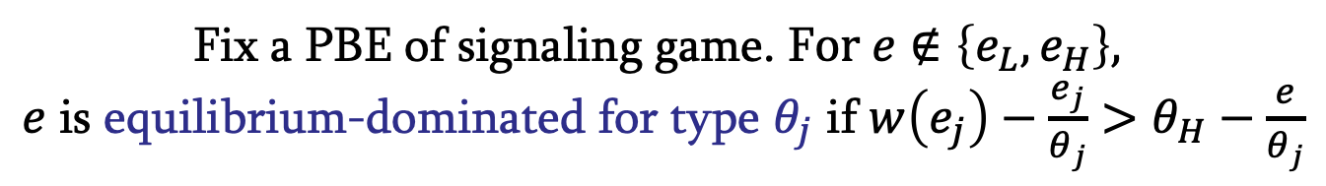
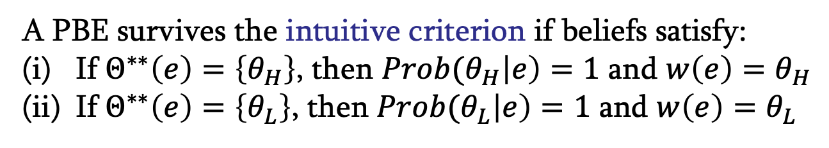
signaling
Intuitive criterion
Fix a PBE of signaling game. F$or e∉\left\{e_{L},e_{H}\right\},$
$e$ is equilibrium-dominated for type $θ_{j}$ if ${w\left(e_{j}\right)−\frac{e_{j}}{θ_{j}}>θ}_{H}−\frac{e}{θ_{j}}$
Let $Θ^{∗∗}\left(e\right)=\left\{θ_{j} :e is not equilibrium−dominated for θ_{j}\right\}$
A PBE survives the intuitive criterion if beliefs satisfy:
If $Θ^{∗∗}\left(e\right)=\left\{θ_{H}\right\}$, then ${Prob(θ}_{H}\left|e\right)=1$ and ${w\left(e\right)=θ}_{H}$
If $Θ^{∗∗}\left(e\right)=\left\{θ_{L}\right\}$, then ${Prob(θ}_{L}\left|e\right)=1$ and ${w\left(e\right)=θ}_{L}$
In signaling game, the unique PBE that survives the intuitive criterion is the best separating equilibrium (with the smallest education level)

Slide 5
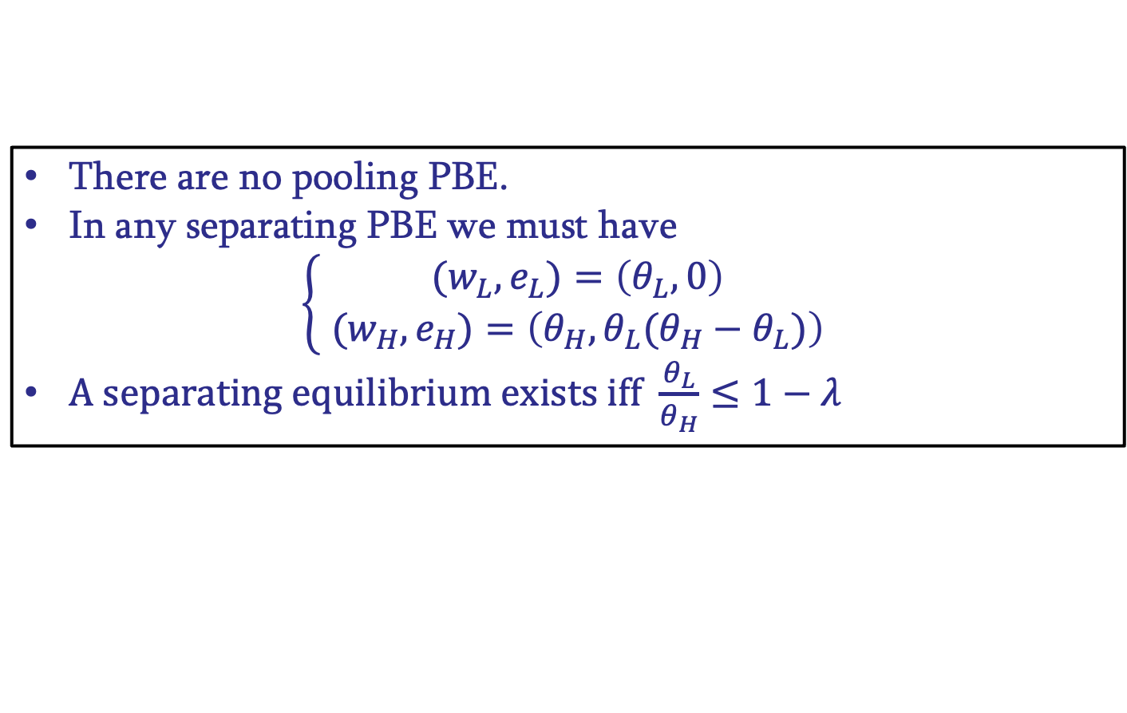
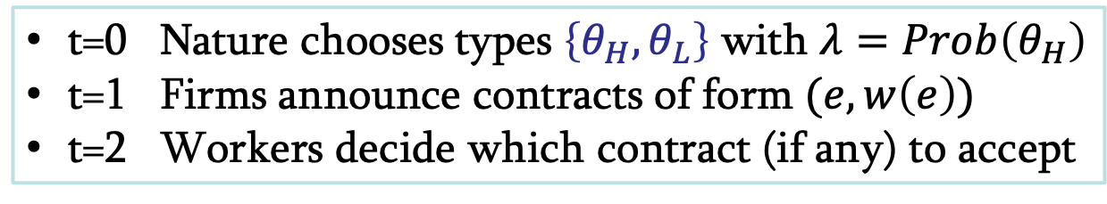
screening
possibility of overcoming asymmetry of information, but uninformed party tries to extract information
t=0 Nature chooses types $\left\{θ_{H},θ_{L}\right\}$ with $λ=Prob\left(θ_{H}\right)$
t=1 Firms announce contracts of form $(e,w\left(e\right))$
t=2 Workers decide which contract (if any) to accept
There are no pooling PBE.
In any separating PBE we must have
$$\left\{\begin{aligned}{(w}_{L},e_{L})=\left(θ_{L},0\right) \\ {(w}_{H},e_{H})=\left(θ_{H},θ_{L}(θ_{H}−θ_{L})\right) \end{aligned}\right.$$
A separating equilibrium exists iff $\frac{θ_{L}}{θ_{H}}≤1−λ$

Slide 6
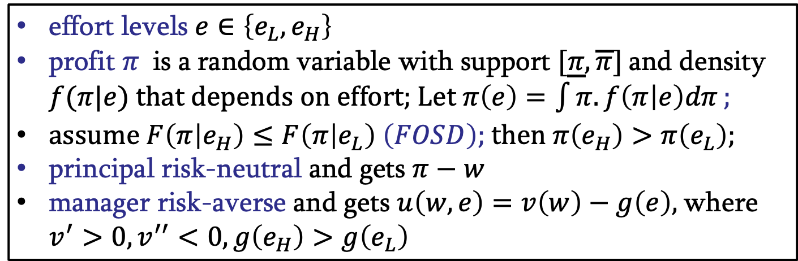
moral hazard
principal-agent: hidden action
example: owner unable to observe manager’s effort
effort levels $e∈\left\{e_{L},e_{H}\right\}$
profit $π$ is a random variable with support $[\underline{π},\overline{π}]$and density $f(π|e)$ that depends on effort; Let $π\left(e\right)=\int{π.f\left(π | e\right)dπ};$
assume $F\left(π | e_{H}\right)≤F\left(π | e_{L}\right) \left(FOSD\right);$then $π\left(e_{H}\right)>π\left(e_{L}\right)$;
principal risk-neutral and gets $π−w$
manager risk-averse and gets $u\left(w,e\right)=v\left(w\right)−g\left(e\right),$where $v^{′}>0, v^{′′}<0,g\left(e_{H}\right)>g\left(e_{L}\right)$

Slide 7
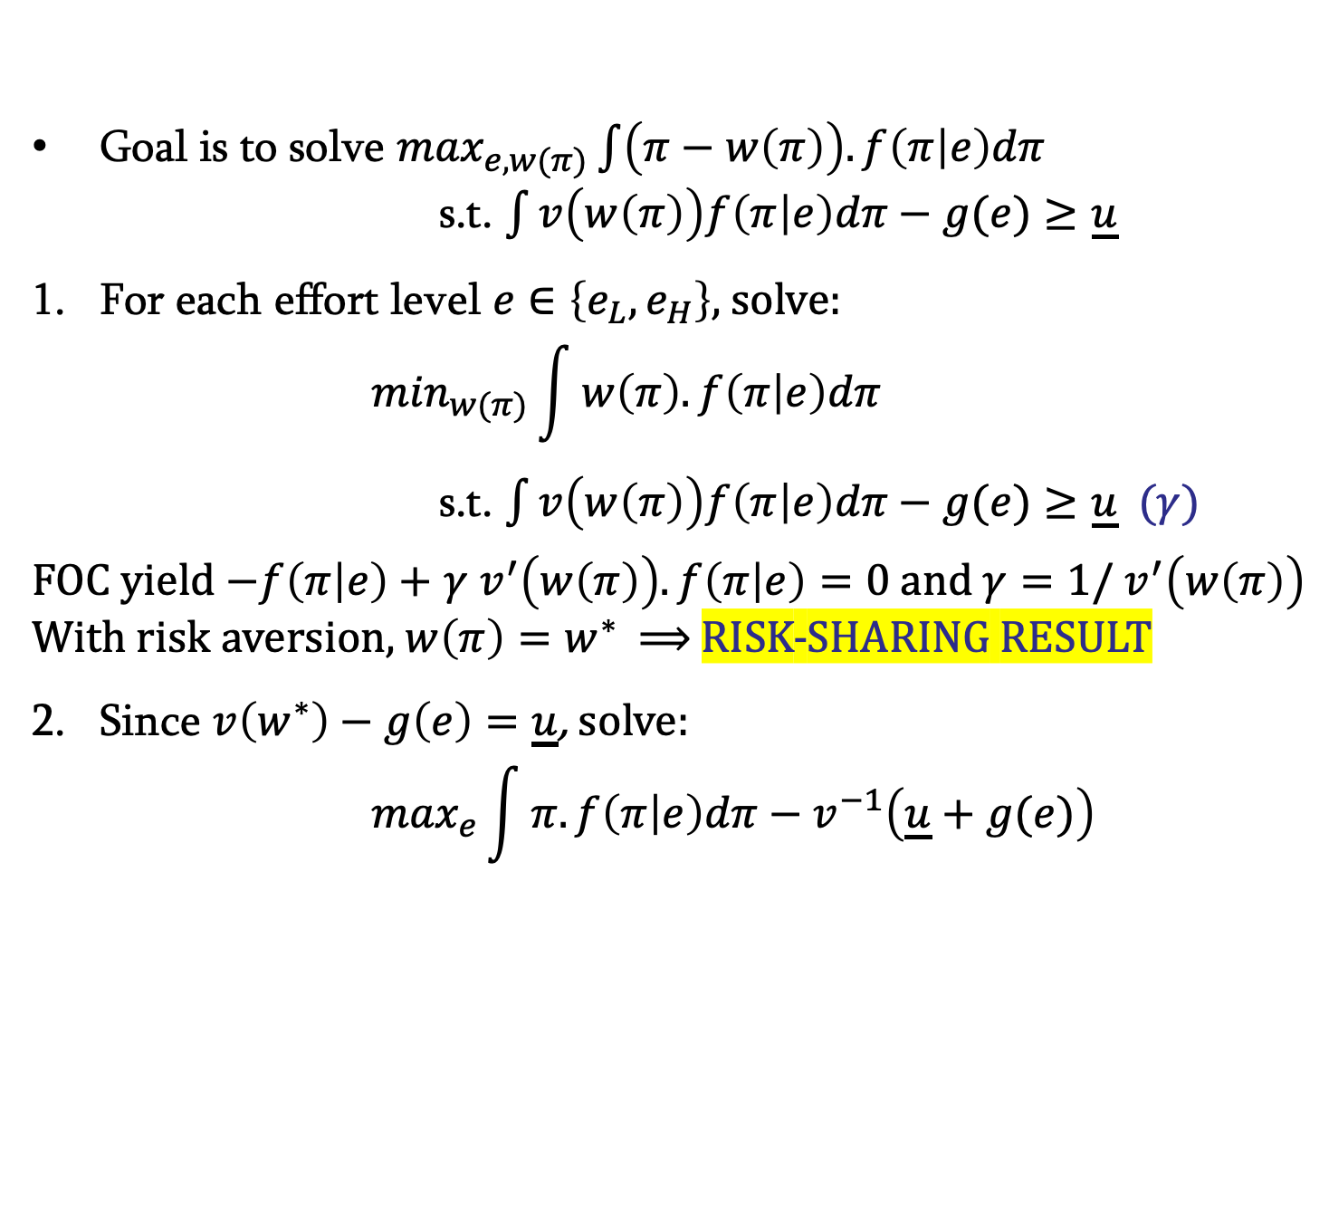
moral hazard
First best (contractible effort)
Goal is to solve $\max_{e,w(π)}\int{\left(π−w\left(π\right)\right).f\left(π | e\right)dπ}$
s.t. $\int{v\left(w\left(π\right)\right)f\left(π | e\right)dπ−g(e)≥\underline{u}}$
For each effort level $e∈\left\{e_{L},e_{H}\right\},$ solve:
          $$\min_{w(π)}\int{w\left(π\right).f\left(π | e\right)dπ}$$
s.t. $\int{v\left(w\left(π\right)\right)f\left(π | e\right)dπ−g(e)≥\underline{u}}$ ($γ)$
FOC yield $−f\left(π | e\right)+$ $γ$ $v^{′}\left(w\left(π\right)\right).f\left(π | e\right)=0$ and $γ=1/$ $v^{′}\left(w\left(π\right)\right)$
With risk aversion, $w\left(π\right)=w^{∗}$ $⟹$RISK-SHARING RESULT
Since $v\left(w^{∗}\right)−g\left(e\right)=\underline{u}$, solve:
          $$\max_{e}\int{π.f\left(π | e\right)dπ−v^{−1}\left(\underline{u}+g(e)\right)}$$

Slide 8
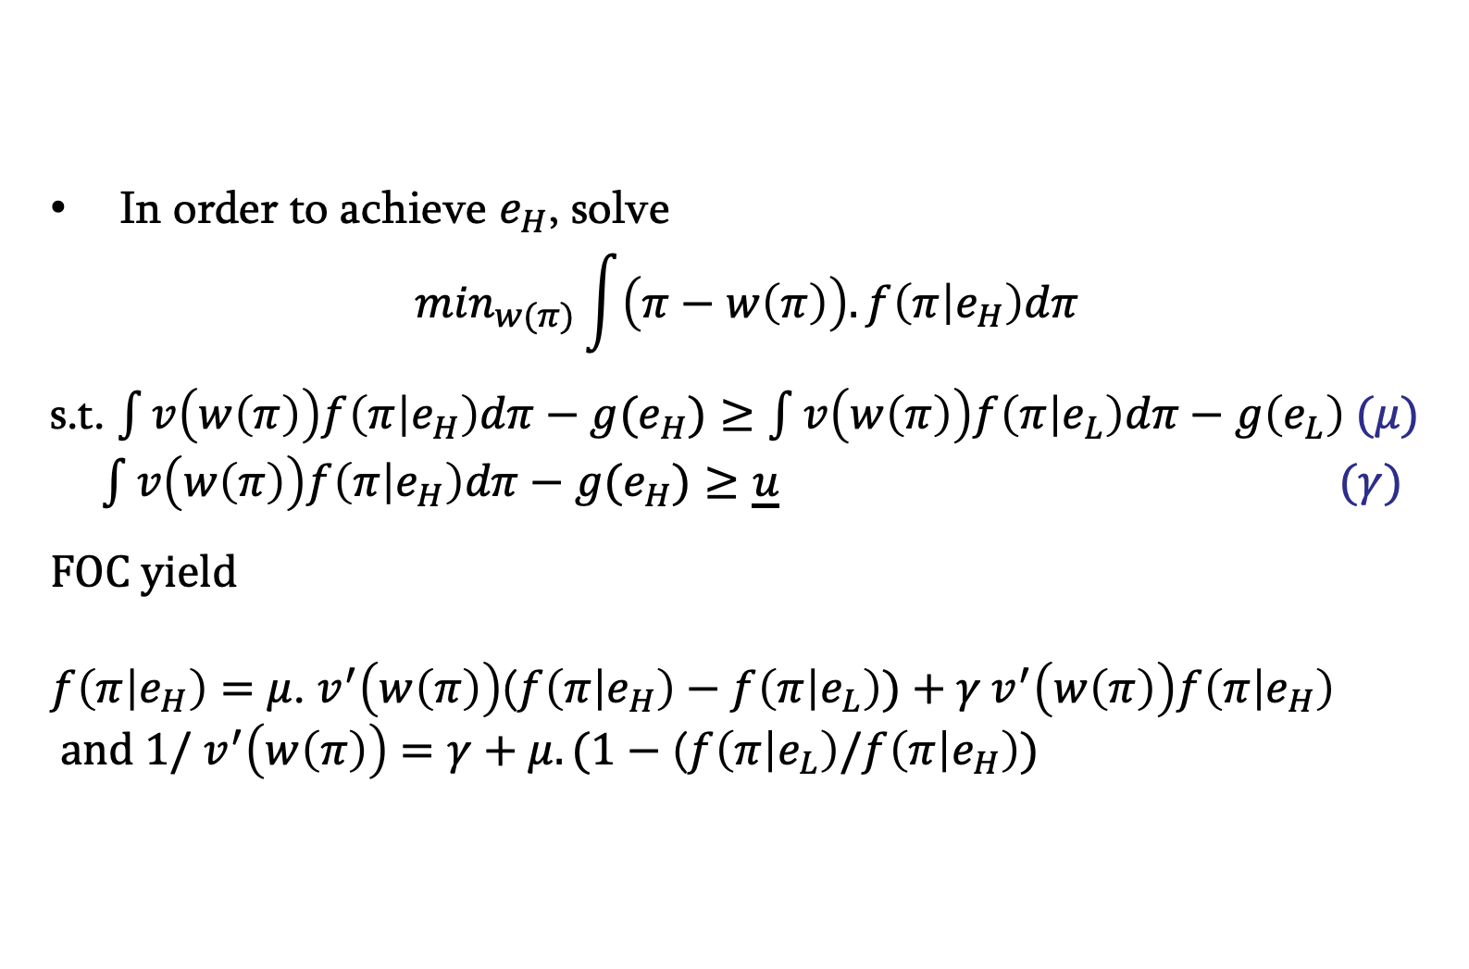
moral hazard
Second best (contractible effort)
In order to achieve $e_{H}$, solve
$$\min_{w(π)}\int{\left(π−w\left(π\right)\right).f\left(π | e_{H}\right)dπ}$$
s.t. $\int{v\left(w\left(π\right)\right)f\left(π | e_{H}\right)dπ−g(e_{H})≥\int{v\left(w\left(π\right)\right)f\left(π | e_{L}\right)dπ−g\left(e_{L}\right) \text{(}μ) }}$
$\int{v\left(w\left(π\right)\right)f\left(π | e_{H}\right)dπ−g(e_{H})≥\underline{u}}$ ($γ)$
FOC yield
$f\left(π | e_{H}\right)=$ $μ$. $v^{′}\left(w\left(π\right)\right)$($f\left(π | e_{H}\right)−f\left(π | e_{L}\right))+γ v^{′}\left(w\left(π\right)\right)f\left(π | e_{H}\right)$
and $1/$ $v^{′}\left(w\left(π\right)\right)$ $=γ+μ.(1−$ ($f\left(π | e_{L}\right)/f\left(π | e_{H}\right))$

Slide 9
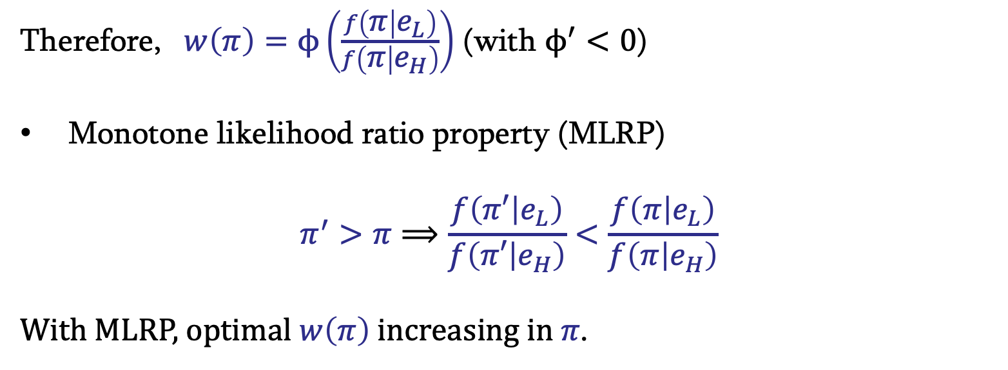
moral hazard
Second best (contractible effort)
Therefore, $w\left(π\right)=ϕ\left(\frac{f\left(π | e_{L}\right)}{f\left(π | e_{H}\right)}\right)$ (with $ϕ^{′}<0$)
Monotone likelihood ratio property (MLRP)
$$π^{′}>π⟹\frac{f\left(π′ | e_{L}\right)}{f\left(π′ | e_{H}\right)}<\frac{f\left(π | e_{L}\right)}{f\left(π | e_{H}\right)}$$
With MLRP, optimal $w\left(π\right)$increasing in $π$.

Slide 10
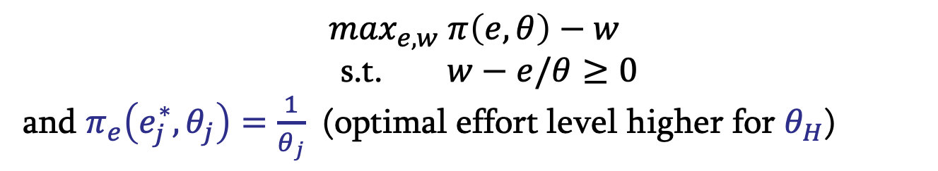
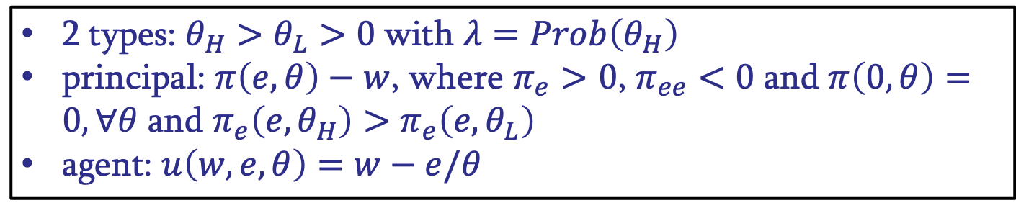
monopolistic screening
principal-agent: hidden information
example: owner unable to observe manager’s productivity
2 types: $θ_{H}>θ_{L}>0$with $λ=Prob\left(θ_{H}\right)$
principal: $π\left(e,θ\right)−w$, where $π_{e}>0$, $π_{ee}<0$ and $π\left(0,θ\right)=0,∀θ$ and $π_{e}\left(e,θ_{H}\right)>π_{e}\left(e,θ_{L}\right)$
agent: $u\left(w,e,θ\right)=w−e/θ$
First best (observable type)
$$\max_{e,w} π\left(e,θ\right)−w$$
s.t. $w−e/θ≥0$
and $π_{e}\left(e_{j}^{∗}, θ_{j}\right)=\frac{1}{θ_{j}}$ (optimal effort level higher for $θ_{H}$)

Slide 11
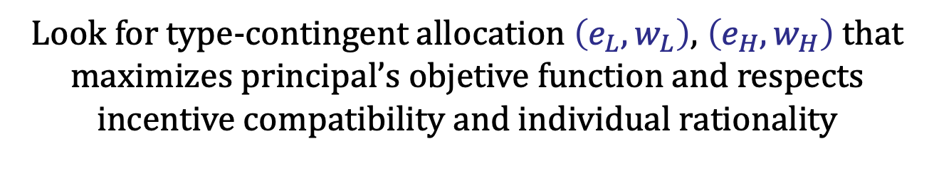
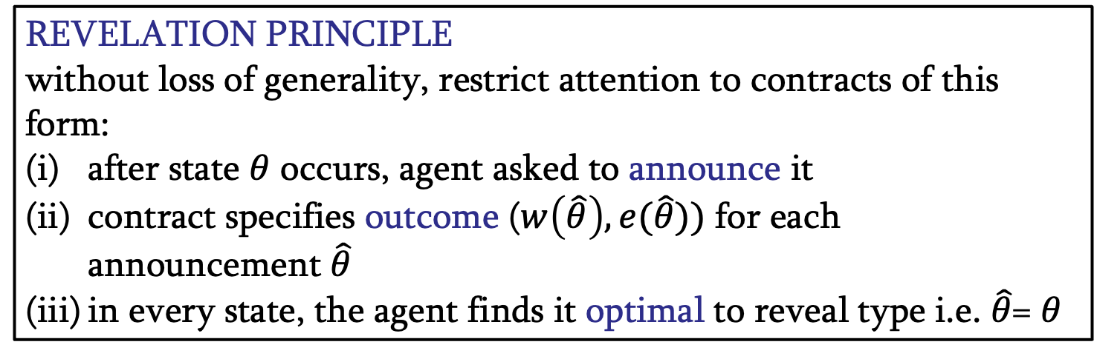

monopolistic screening
Second best (unobservable type)
REVELATION PRINCIPLE
without loss of generality, restrict attention to contracts of this form:
after state $θ$ occurs, agent asked to announce it
contract specifies outcome ($w\left(\hat{θ}\right), e(\hat{θ}))$ for each announcement $\hat{θ}$
in every state, the agent finds it optimal to reveal type i.e. $\hat{θ}$= $θ$
$$⟹$$
Look for type-contingent allocation $\left(e_{L}, w_{L}\right)$, $\left(e_{H},w_{H}\right)$ that maximizes principal’s objetive function and respects incentive compatibility and individual rationality

Slide 12
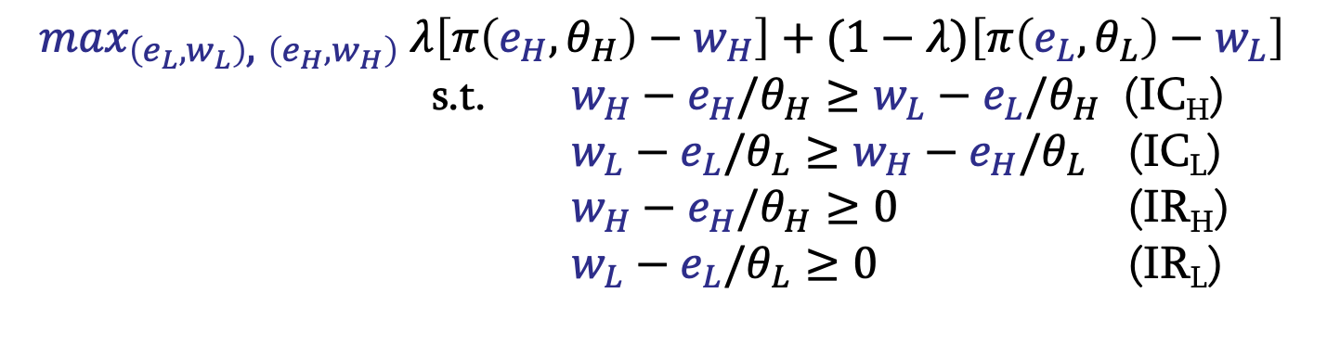
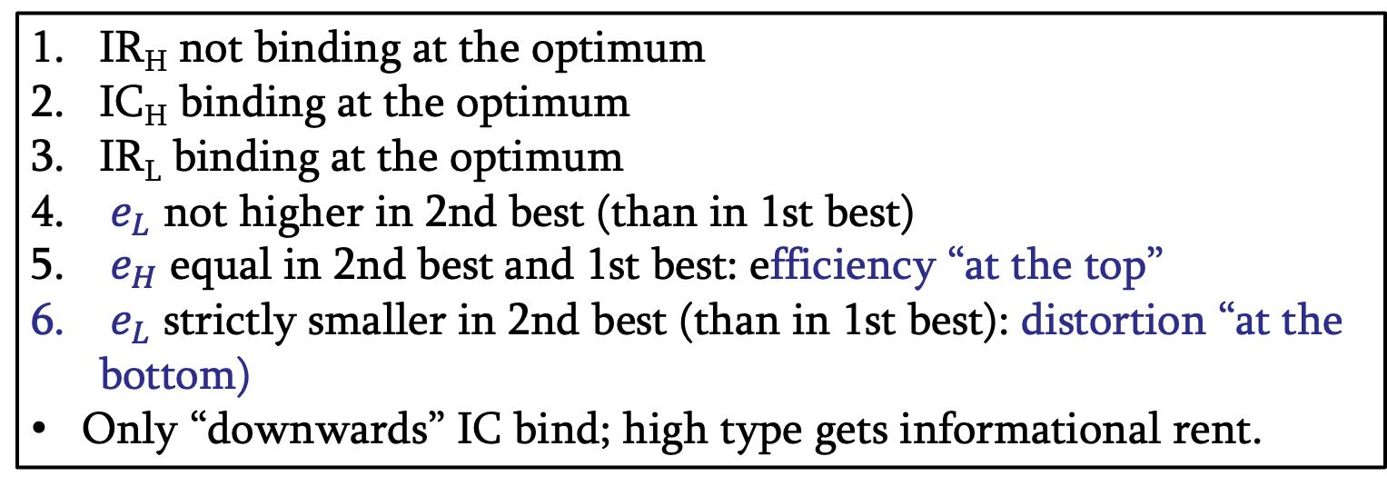
monopolistic screening
Second best (unobservable type)
$$\max_{\left(e_{L}, w_{L}\right)\text{,} \left(e_{H},w_{H}\right)} λ\left[π\left(e_{H},θ_{H}\right)−w_{H}\right]+(1−λ)\left[π\left(e_{L},θ_{L}\right)−w_{L}\right]$$
s.t. $w_{H}−e_{H}/θ_{H}≥w_{L}−e_{L}/θ_{H}$ (IC_{H})
$w_{L}−e_{L}/θ_{L}≥w_{H}−e_{H}/θ_{L}$ (IC_{L})
$w_{H}−e_{H}/θ_{H}≥0$ (IR_{H})
$w_{L}−e_{L}/θ_{L}≥0$ (IR_{L})
IR_{H} not binding at the optimum
IC_{H} binding at the optimum
IR_{L} binding at the optimum
$e_{L}$ not higher in 2nd best (than in 1st best)
$e_{H}$ equal in 2nd best and 1st best: efficiency “at the top”
$e_{L}$ strictly smaller in 2nd best (than in 1st best): distortion “at the bottom)
Only “downwards” IC bind; high type gets informational rent.

