Slide 1
revisiting efficiency
market power externalities public goods adverse selection

Slide 2
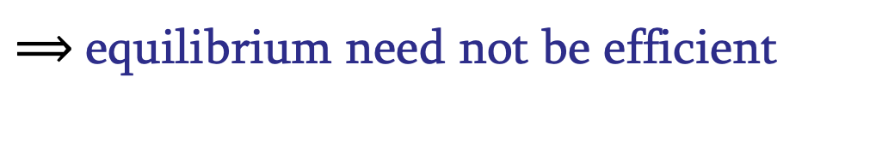
revisiting efficiency
external validity of first welfare theorem hinges on model (and hidden assumptions):
no market power
no externalities
no public goods
no asymmetric information
(more hidden assumptions: rationality, ethics, preferences)
$⟹$equilibrium need not be efficient

Slide 3
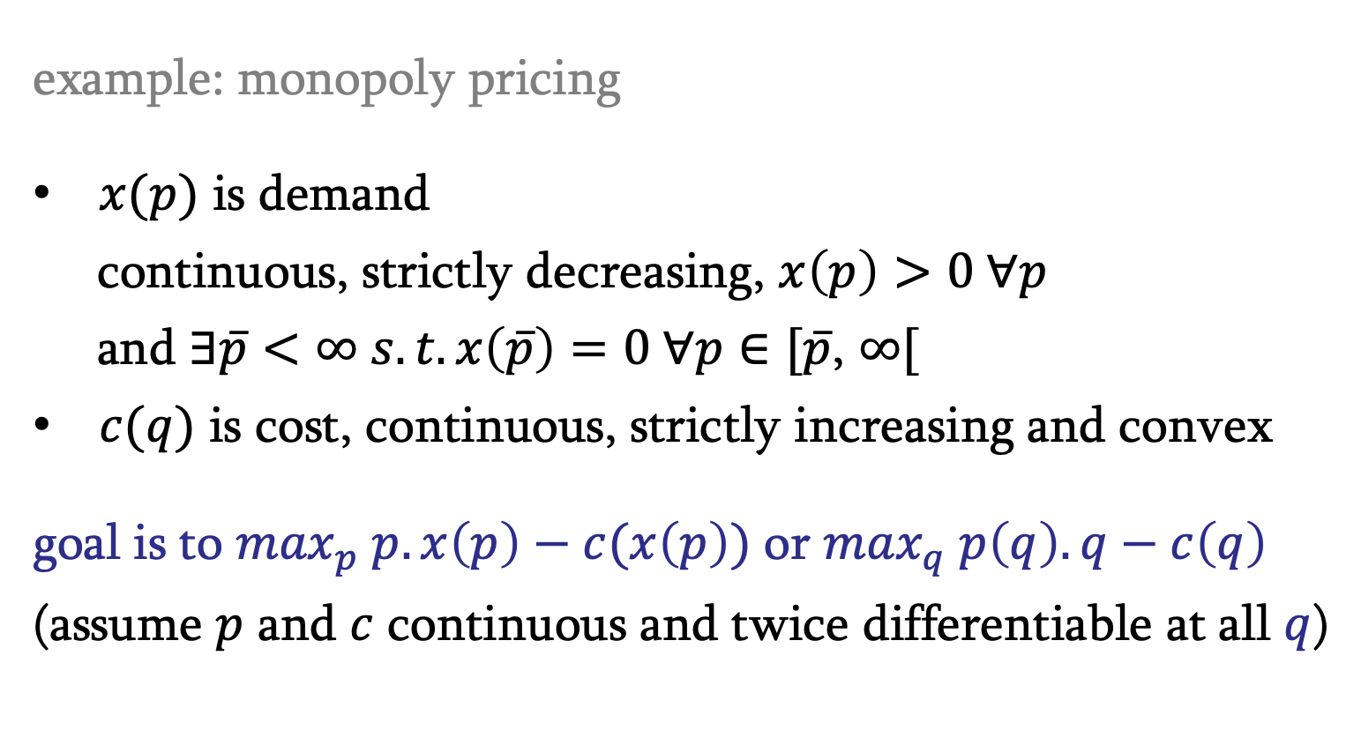
market power
price-taking assumption fails: monopoly, oligopoly
example: monopoly pricing
$x(p)$ is demand
continuous, strictly decreasing, $x\left(p\right)>0 ∀p$
and $∃\overline{p}<∞ s.t. x\left(\overline{p}\right)=0 ∀p∈[\overline{p}$, $∞[$
$c(q)$ is cost, continuous, strictly increasing and convex
goal is to $\max_{p} p.x\left(p\right)−c(x\left(p\right))$ or $\max_{q} p\left(q\right).q−c\left(q\right)$
(assume $p$ and $c$ continuous and twice differentiable at all $q$)

Slide 4
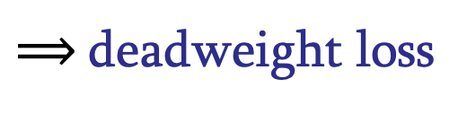
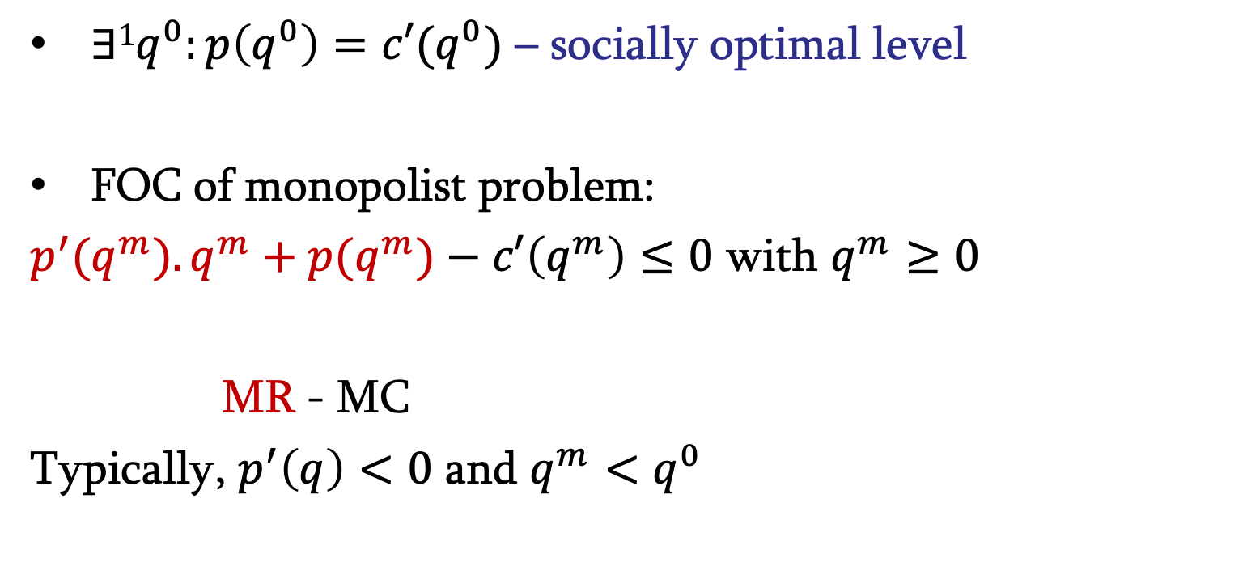
market power
$∃1q^{0}:p\left(q^{0}\right)=c′(q^{0})$ – socially optimal level
FOC of monopolist problem:
$p^{′}(q^{m}).q^{m}+p(q^{m})−c′\left(q^{m}\right)≤0$ with $q^{m}≥0$
MR - MC
Typically, $p^{′}\left(q\right)<0$ and $q^{m}<q^{0}$
$⟹$deadweight loss

Slide 5
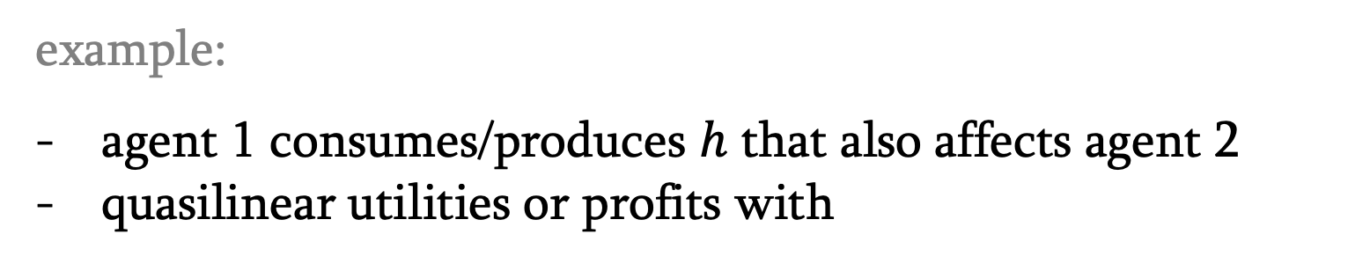
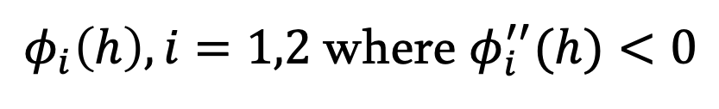
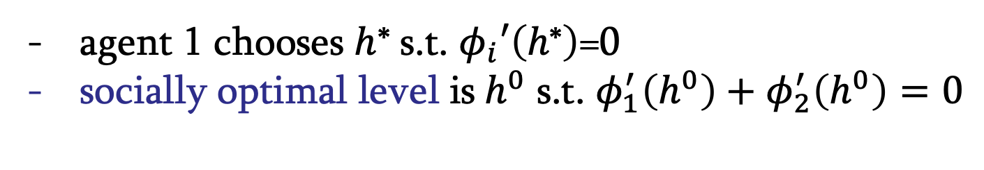
externalities
externality: welfare of one agent or production possibility set for a firm directly affected by actions of another agent in the economy (consumption/production, positive/negative)
example:
agent 1 consumes/produces $h$ that also affects agent 2
quasilinear utilities or profits with
$φ_{i}\left(h\right), i=1,2$where $φ_{i}^{′′}(h)<0$
agent 1 chooses $h$* s.t. $φ_{i}′\left(h\text{∗}\right)$=0
socially optimal level is$h^{0}$ s.t. $φ_{1}^{′}\left(h^{0}\right)+φ_{2}^{′}\left(h^{0}\right)=0$

Slide 6
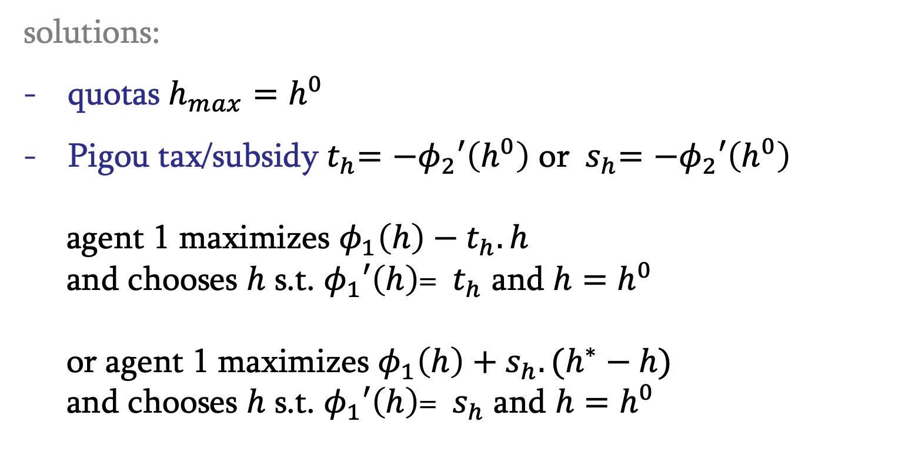
externalities
solutions:
quotas ${h_{max}=h}^{0}$
Pigou tax/subsidy${ t}_{h}=−φ_{2}′\left(h^{0}\right)$ or ${ s}_{h}=−φ_{2}′\left(h^{0}\right)$
agent 1 maximizes $φ_{1}\left(h\right) −{ t}_{h}.h$
and chooses $h$ s.t. $φ_{1}′\left(h\right)$= ${ t}_{h}$ and ${h=h}^{0}$
or agent 1 maximizes $φ_{1}\left(h\right)+s_{h}.(h^{∗}−h)$
and chooses $h$ s.t. $φ_{1}′\left(h\right)$= ${ s}_{h}$ and ${h=h}^{0}$

Slide 7

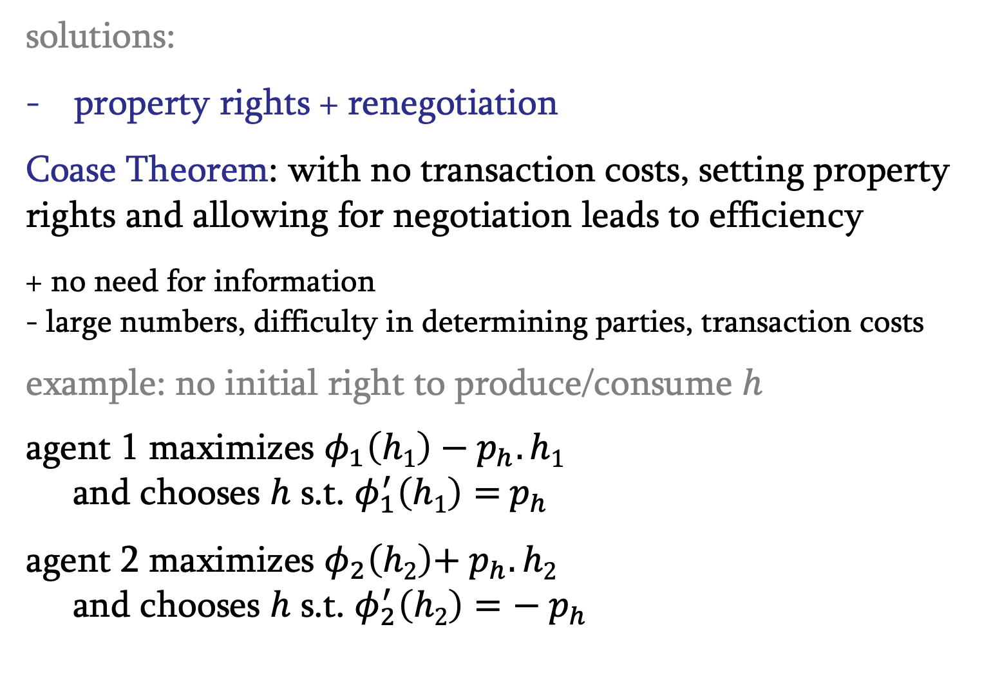
externalities
solutions:
property rights + renegotiation
Coase Theorem: with no transaction costs, setting property rights and allowing for negotiation leads to efficiency
+ no need for information
- large numbers, difficulty in determining parties, transaction costs
example: no initial right to produce/consume $h$
agent 1 maximizes $φ_{1}\left(h1\right) −{ p}_{h}.h1$
and chooses $h$ s.t. $φ_{1}^{′}\left(h1\right)={ p}_{h}$
agent 2 maximizes $φ_{2}\left(h2\right)+{ p}_{h}.h2$
and chooses $h$ s.t. $φ_{2}^{′}\left(h2\right)={− p}_{h}$
in equilibrium,
$h1$ = $h2$ = $h^{0}$and $φ_{1}^{′}\left(h^{0}\right)=−φ_{2}^{′}\left(h^{0}\right)$

Slide 8
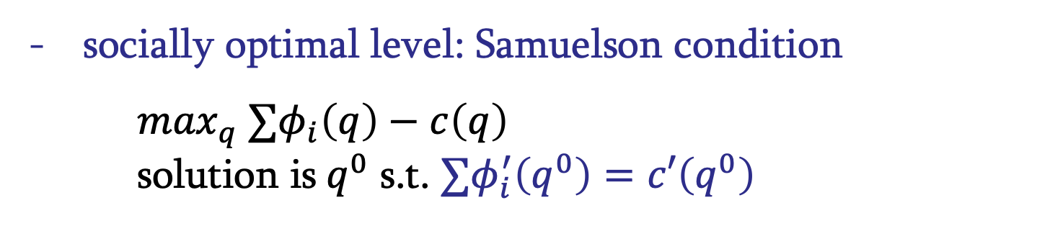
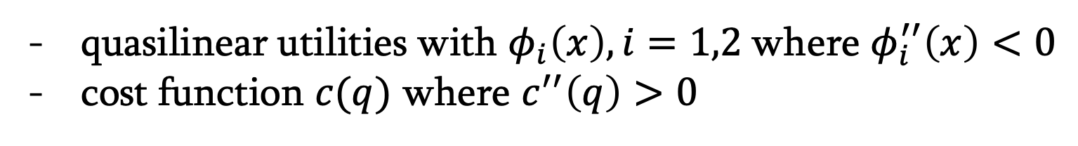
public goods
pure public good: nondepletable (no rivalry in consumption) and impossibility of exclusion
club good: nondepletable (no rivalry in consumption) and possibility of exclusion
quasilinear utilities with $φ_{i}\left(x\right), i=1,2$where $φ_{i}^{′′}\left(x\right)<0$
cost function $c(q)$ where $c^{′′}\left(q\right)>0$
socially optimal level: Samuelson condition
$\max_{q} ∑φ_{i}\left(q\right)−c\left(q\right)$
solution is$q^{0}$ s.t. ${∑φ}_{i}^{′}\left(q^{0}\right)=c′\left(q^{0}\right)$

Slide 9

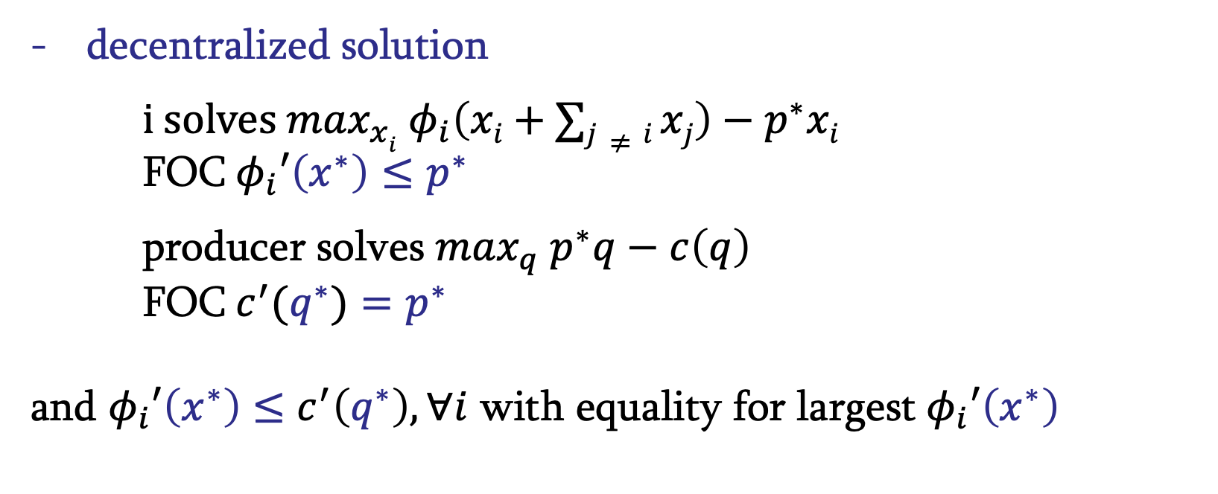
public goods
decentralized solution
$i solves \max_{xi} φ_{i}\left(xi+∑j≠i xj\right)−p^{∗}xi$
FOC$φ_{i}′\left(x^{∗}\right)≤p^{∗}$
producer solves $\max_{q} p^{∗}q−c\left(q\right)$
FOC$c^{′}(q^{∗})=p^{∗}$
and $φ_{i}′\left(x^{∗}\right)$ $≤c^{′}\left(q^{∗}\right),∀i$ with equality for largest $φ_{i}′\left(x^{∗}\right)$
free riding $⟹$underprovision

Slide 10
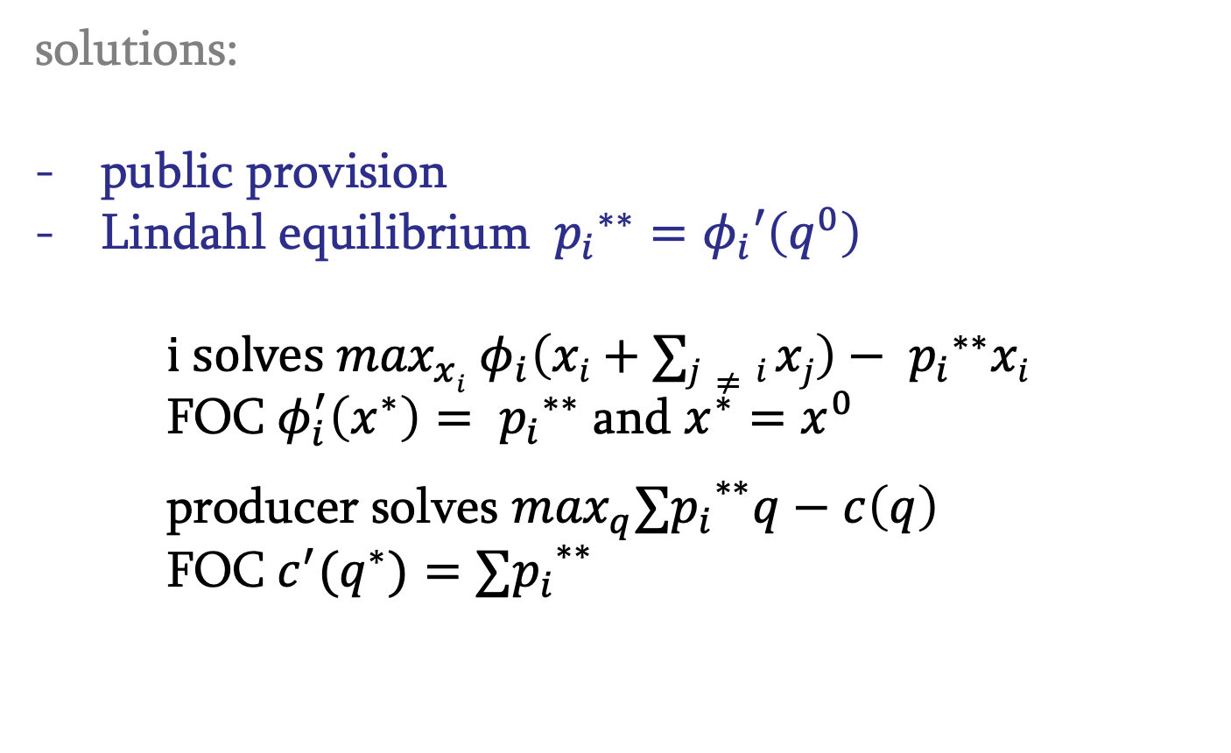
public goods
solutions:
public provision
Lindahl equilibrium ${{{ p}_{i}}^{∗∗}=φ}_{i}′\left(q^{0}\right)$
    $$i solves \max_{xi} φ_{i}\left(xi+∑j≠i xj\right)−{{ p}_{i}}^{∗∗}xi$$
FOC$φ_{i}^{′}\left(x^{∗}\right)={{ p}_{i}}^{∗∗}$ and $x^{∗}=x^{0}$
producer solves $\max_{q}{{∑p}_{i}}^{∗∗}q−c\left(q\right)$
FOC$c^{′}(q^{∗})={{∑p}_{i}}^{∗∗}$

Slide 11
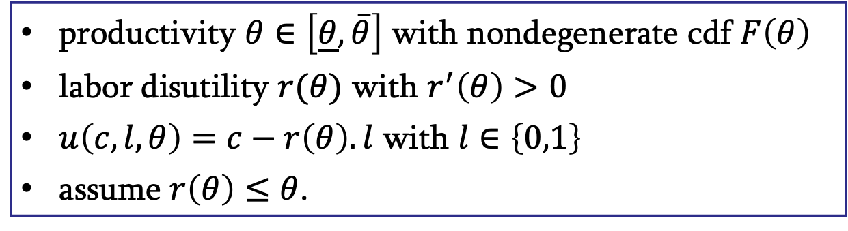
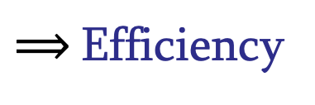
adverse selection
Firms:
CRS
labor input
risk-neutral, goal is to maximize expected profits
price-taker: p=1
productivity $θ∈\left[\underline{θ},\overline{θ}\right]$ with nondegenerate cdf $F\left(θ\right)$
labor disutility $r(θ)$ with $r^{′}\left(θ\right)>0$
$u\left(c,l,θ\right)=c−r\left(θ\right).l$ with $l∈\left\{0,1\right\}$
assume $r\left(θ\right)≤θ$.
Workers
Observable $θ$: $w\left(θ\right)=θ$ (0 profits) and $r\left(θ\right)≤θ$(all employed)
$⟹$Efficiency

Slide 12
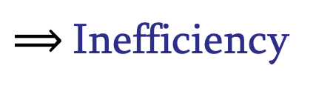
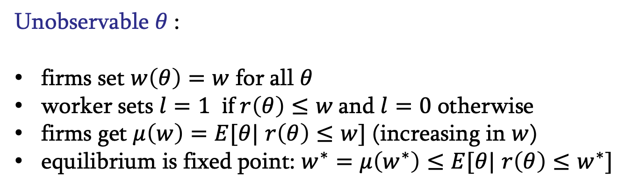
adverse selection
Unobservable $θ$:
firms set $w\left(θ\right)=w$ for all $θ$
worker sets $l=1$ $if r\left(θ\right)≤w$and $l=0$ otherwise
firms get $μ\left(w\right)=E[θ|$ $r\left(θ\right)≤w]$ (increasing in $w$)
equilibrium is fixed point: $w^{∗}=μ\left(w^{∗}\right)≤E[θ|$ $r\left(θ\right)≤w^{∗}]$
Adverse selection:
most productive workers left out of the market
$⟹$Inefficiency

Slide 13
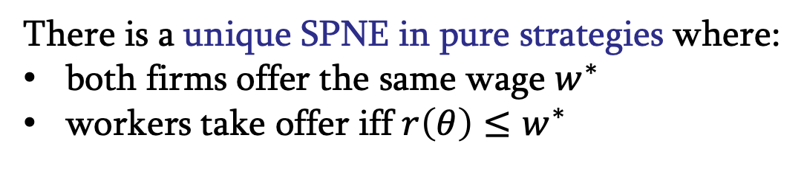
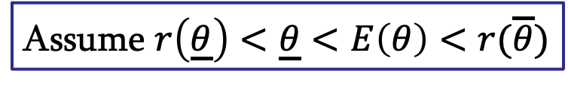
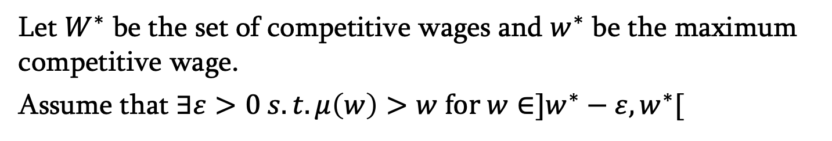
adverse selection
Game-theoretic approach:
t=0 Nature chooses types
t=1 Firms announce wages
t=2 Workers decide on whether to be employed
Assume $r\left(\underline{θ}\right)<\underline{θ}<E\left(θ\right)<r(\overline{θ})$
Let $W^{∗}$ be the set of competitive wages and $w^{∗}$ be the maximum competitive wage.
Assume that $∃ε>0 s.t. μ\left(w\right)>w$ for $w∈]w^{∗}−ε,w^{∗}[$
There is a unique SPNE in pure strategies where:
both firms offer the same wage $w^{∗}$
workers take offer iff $r\left(θ\right)≤w^{∗}$
Still
inefficient

Slide 14

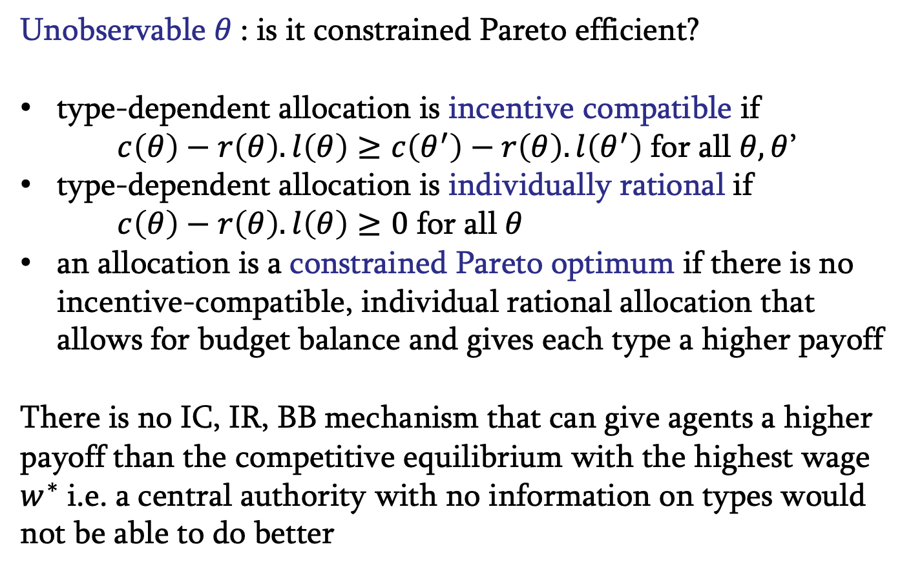
adverse selection
Unobservable $θ$: is it constrained Pareto efficient?
type-dependent allocation is incentive compatible if $c\left(θ\right)−r\left(θ\right).l\left(θ\right)≥c\left(θ^{′}\right)−r\left(θ\right).l\left(θ^{′}\right)$ for all $θ,θ$’
type-dependent allocation is individually rational if $c\left(θ\right)−r\left(θ\right).l\left(θ\right)≥0$ for all $θ$
an allocation is a constrained Pareto optimum if there is no incentive-compatible, individual rational allocation that allows for budget balance and gives each type a higher payoff
There is no IC, IR, BB mechanism that can give agents a higher payoff than the competitive equilibrium with the highest wage $w^{∗}$ i.e. a central authority with no information on types would not be able to do better
$⟹c$onstrained Pareto efficiency

