Slide 1
general equilibrium
introduction cornerstones 2-agent, 2-good economy the Edgeworth box walrasian equilibrium relative prices Walras law welfare properties

Slide 2
walrasian equilibrium: introduction
Economy
=
collection of agents with individual preferences
+
initial stocks (endowments) of commodities
+
technological opportunities

Slide 3
walrasian equilibrium: introduction
Take as given:
Preferences
Endowments
Technological opportunities
Endogeneize:
Commodity prices
Allocations
Production plans

Slide 4
walrasian equilibrium: introduction
4 cornerstones:
Perfect competition: agents are price-takers
Individual optimization: make consumption choices that are optimal given budget set
Rational expectations: agents use the right price in their calculations
Market clearing: on each market, supply = demand.

Slide 5
walrasian equilibrium: introduction
pure exchange economy: no production opportunities
2 goods (l =1,2), 2 consumers (i = 1, 2)
agent i’s consumption vector is x_{i} = (x_{1i}, x_{2i})
agent i’s consumption set is$ℝ_{+}^{2}$
agent i has preferences $≿_{i}$ over consumption vectors
agent i’s initial endowment is ω_{i} = (ω_{1i}, ω_{2i})
Aggregate endowment ω = ω₁ + ω₂ ${∈ℝ}_{++}^{2}$

Slide 6
walrasian equilibrium: introduction
Economy : ${\left(≿_{i}, ω_{i}\right)}_{i=1,2}$
allocation x = (x₁, x₂ ) = ((x₁₁, x₂₁), (x₁₂, x₂₂)) ${∈ℝ}_{+}^{4}$
allocation x is feasible if x_{l1}+ x_{l2} ≤ ω_{l1}+ω_{l2}
allocation x is nonwasteful if x_{l1}+ x_{l2} = ω_{l1}+ω_{l2}
EDGEWORTH BOX

Slide 7
walrasian equilibrium: introduction
- budget set for agent i is $B_{i}\left(p\right)=\left\{x_{i}∈ℝ_{+}^{2}:p∙x_{i}≤p∙ω_{i}\right\}$
price vector $p^{∗}$ and allocation ${x^{∗}=(x_{1}^{∗},x}_{2}^{∗})$
is a walrasian equilibrium
if:
for all i,${ x}_{i}^{∗}∈B_{i}\left(p^{∗}\right)$
for all i, ${ x}_{i}^{∗}≿x_{i},∀x_{i}∈B_{i}\left(p^{∗}\right)$
${x_{1}^{∗}+x}_{2}^{∗}=ω_{1}$+ $ω_{2}$

Slide 8
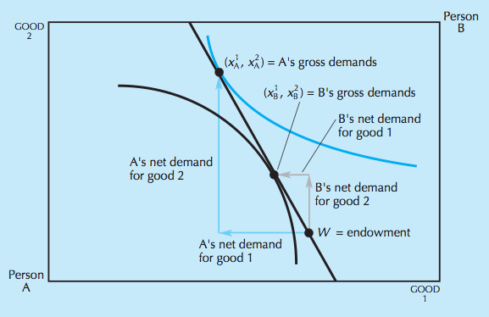
walrasian equilibrium: introduction
example: disequilibrium

Slide 9
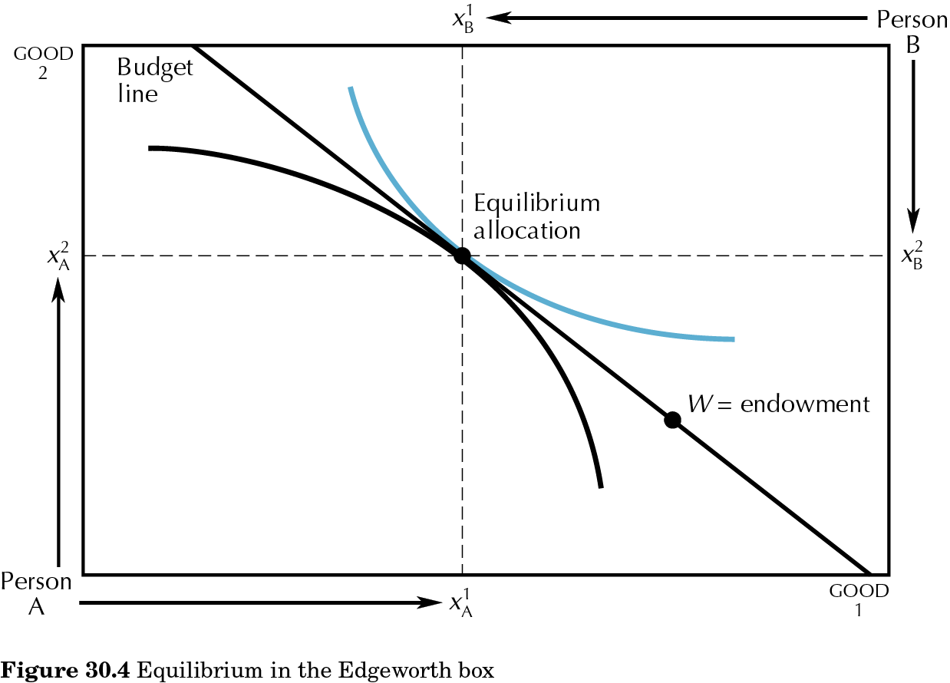
30.04
walrasian equilibrium: introduction
example: equilibrium

Slide 10
walrasian equilibrium: introduction
example
Find the walrasian equilibrium for the economy where:
$u_{i}\left(x_{1i},x_{2i}\right)={x_{1i}}^{α}{x_{2i}}^{1−α}$, i=1,2
𝑢_𝑖 (𝑥_1𝑖,𝑥_2𝑖 )=〖𝑥_1𝑖〗^𝛼 〖𝑥_2𝑖〗^(1−𝛼), i=1,2
$$ω_{1}=\left(1,2\right),ω_{2}=(2,1)$$
𝜔_1=(1,2),𝜔_2=(2,1)

Slide 11
walrasian equilibrium: introduction
Walras Law
If agents have locally non-satiated preferences, the value of aggregate excess demand is 0 for all prices.
Since $p∙x_{1}=p∙ω_{1}$ and $p∙x_{2}=p∙ω_{2}$, then
$$p∙{(x}_{1}+x_{2})=p∙(ω_{1}+ω_{2})$$
and
$$p∙{(x}_{1}−ω_{1})+p∙(x_{2}−ω_{2})=0$$
Therefore, one of the market-clearing equations is redundant.

Slide 12
walrasian equilibrium: introduction
Relative prices
Since individual demands are homogeneous of degree zero, if $p^{∗}$ is an equilibrium price vector, so is $αp^{∗}$ for all $α>0.$
Therefore, only relative prices are determined in equilibrium.

Slide 13
walrasian equilibrium: introduction
Welfare properties
allocation ${\left(x_{i}\right)}_{i=1,2}$ is Pareto optimal if there is no feasible allocation ${\left(y_{i}\right)}_{i=1,2}$ such that ${ y}_{i}≿x_{i} ∀i$ and $∃i$: ${ y}_{i}≻x_{i}$.
Pareto set: set of P.o. allocations
Contract curve: part of Pareto set where all consumers do at least as well as they would with their initial endowments.

Slide 14
walrasian equilibrium: introduction
First Welfare Theorem: If ${[p,\left(x_{i}\right)}_{i=1,2}]$is a walrasian equilibrium, then ${\left(x_{i}\right)}_{i=1,2}$ is Pareto optimal
${\left(x_{i}\right)}_{i=1,2}$is supportable as equilibrium with transfers if there is a price $p^{∗}$ and wealth transfers $T_{1}$ and $T_{2 }$such that $T_{1}+T_{2}=0$ and $∀i$ $x_{i}$ is optimal in
$$B_{i}\left(p^{∗}\right)=\left\{x_{i}∈ℝ_{+}^{2}:p^{∗}∙x_{i}≤p^{∗}∙ω_{i}+T_{i}\right\}$$
Second Welfare Theorem: If preferences are continuous, convex and strongly monotone, then any Pareto optimal allocation is supportable as an equilibrium with transfers.

Slide 15
general equilibrium
formal model of walrasian exchange economy assumptions Walrasian equilibrium properties of excess demand function existence of equilibrium local uniqueness

Slide 16
formal model of walrasian exchange economy
pure exchange economy: no production opportunities
L goods (l = 1, 2, __, L), H consumers (h = 1, 2, __, H)
consumption bundle is x = (x₁, __ , x_{L}) ${∈ℝ}_{+}^{L}$
agent h’s endowment is ω^{h} ${∈ℝ}_{+}^{L}$
aggregate endowment is ω = $\sum_{h=1}^{H}{\text{w}\text{h}}$ ${∈ℝ}_{++}^{L}$ (ω>>0)
agent h’s consumption set is X^{h} ${=ℝ}_{+}^{L}$
agent h has preferences $≿_{h}$ over consumption vectors that can be represented by a utility function u^{h} $:ℝ_{+}^{L}→ℝ$

Slide 17
formal model of walrasian exchange economy
Assumptions
A1 u^{h} $:ℝ_{+}^{L}→ℝ$ is continuous for all h
$$x^{n}→x⟹u^{h}(x^{n})→u^{h}(x)$$
A2 u^{h} is strictly concave for all h
$∀\left(x,y\right){∈ℝ}_{+}^{L}×ℝ_{+}^{L} :x≠y, ∀$ $λ$ $∈(0,1)$
$$u^{h}\left(λx+\left(1−λ\right)y\right)>{λu}^{h}\left(x)+\left(1−λ\right)u^{h}(y\right)$$
A3 u^{h} is strongly monotonic for all h
$$x>y⟹u^{h}\left(x\right)>u^{h}(y)$$
Notes:
Can be relaxed – concave with > or =; or quasiconcave UCS is convex

Slide 18
formal model of walrasian exchange economy
Economy : ${\left(u^{h},ω^{h}\right)}_{h∈H}$
price vector ${p∈ℝ}_{+}^{L}$
budget set $B_{h}\left(p\right)=\left\{x∈ℝ_{+}^{L}:p∙x≤p∙ω^{h}\right\}$
$\left(p,{\left(x^{h}\right)}_{h∈H}\right)$is a walrasian equilibrium if
for all h, $x^{h}∈B_{h}\left(p\right)$
for all h, $u^{h}\left(x^{h}\right)≥u^{h}\left(x\right),∀x∈B_{h}\left(p\right)$
(3)$\sum_{h=1}^{H}{x^{h}=}$ $\sum_{h=1}^{H}{{\text{w}}^{h}}$

Slide 19
formal model of walrasian exchange economy
There is a unique solution to UMP
Max $u^{h}\left(x\right)$
s.t. $p∙x≤p∙ω^{h}$
$x≥0$
let $z^{h}\left(p\right)=$ $x^{h}\left(p,p∙ω^{h}\right)−ω^{h}$ be the excess demand for h
let $z\left(p\right)=\sum_{h=1}^{H}{z^{h}\left(p\right)}$ (note that $z$ $:ℝ_{++}^{L}→ℝ^{L}$)
the equilibrium price vector is $p$s.t. $z\left(p\right)=0$
Marshallian demand
$$x^{h}(p,p∙ω^{h})$$
$$⟹$$
Notes:
Note that if pl=0, then xhl goes to infinity and eq prices must have p>>0; The set of equilibria depends on the properties of agg excess demand z(p)

Slide 20
formal model of walrasian exchange economy
Theorem: Under A1-A3
$z$ is continuous on $ℝ_{++}^{L}$
$z$ is homogeneous of degree zero:
$z\left(p\right)=z\left(λ.p\right)$ for all $p$ and $λ>0.$
Walras Law: $pz\left(p\right)=0$ for all $p$
$z$ is bounded below: $z\left(p\right) ≥−ω$
If sequence ${\left\{p^{n}\right\}}_{n=0}^{∞}$ in $ℝ_{++}^{L}$ converges to $p∈ℝ_{+}^{L}\backslash \left\{0\right\}$ with $p_{l}=0$ for some l, then $Max\left\{z_{1}\left(p^{n}\right),z_{2}\left(p^{n}\right), __,z_{L}\left(p^{n}\right)\right\}→∞$
Notes:
Note that if pl=0, then xhl goes to infinity and eq prices must have p>>0; The set of equilibria depends on the properties of agg excess demand z(p)

Slide 21
formal model of walrasian exchange economy
Homogeneity$⟹$ we can normalize one price and we can focus on simplex
$$Δ_{++}^{L−1}=\left\{p∈ℝ_{++}^{L}:\sum_{l=1}^{L}{p_{l}=1}\right\}$$
Walras Law $⟹$ only L-1 equations of $z\left(p\right)=0$ are linearly independent and we can instead set $\hat{z}\left(p\right)=0$, where $\hat{z}\left(p\right)=[z_{1}\left(p\right),z_{2}\left(p\right),___,z_{L−1}\left(p\right)$]
Notes:
Note that if pl=0, then xhl goes to infinity and eq prices must have p>>0; The set of equilibria depends on the properties of agg excess demand z(p)

Slide 22
formal model of walrasian exchange economy
Existence Theorem:
Let $z\left(p\right)$ be a function defined on all strictly positive price vectors ${p∈ℝ}_{++}^{L}$ and satisfying properties 1.-5.
Then, system $z\left(p\right)=0$ has a solution.
Therefore, a walrasian equilibrium exists in any pure exchange economy where ω>>0 and preferences are continuous, strongly monotonic and strictly convex.
Notes:
Note that if pl=0, then xhl goes to infinity and eq prices must have p>>0; The set of equilibria depends on the properties of agg excess demand z(p)

Slide 23
formal model of walrasian exchange economy
Existence Theorem
Proof: remember Kakutani!
A convex-valued and upper hemicontinuous correspondence
from a nonempty, compact and convex set into itself
has a fixed point.
Notes:
Note that if pl=0, then xhl goes to infinity and eq prices must have p>>0; The set of equilibria depends on the properties of agg excess demand z(p)

Slide 24
formal model of walrasian exchange economy
Local uniqueness
Consider a differentiable aggregate excess demand function: $z_{i}\left(αp_{1},αp_{2},__,αp_{L}\right)$ is independent of $α$ due to homogeneity of degree zero.
Taking the derivative with respect to $α$ yields:
$\sum_{j=1}^{L}{\frac{∂z_{i}}{∂p_{j}}}p_{j}=0$ for all i = 1,__,L i.e. $Dz(p)∙p=0$
The rank of the Jacobian matrix $Dz(p)$is at most L-1.
An equilibrium price vector $p∈ℝ_{++}^{L}$ is regular if the Jacobian matrix $\hat{Dz\left(p^{∗}\right)=}{\left[\frac{∂z_{i}}{∂p_{j}}\left(p^{∗}\right)\right]}_{1≤j≤L−1}$has rank L-1
Notes:
Important for comparative statics

Slide 25
formal model of walrasian exchange economy
Local uniqueness
Any regular equilibrium is locally unique.
Any regular economy has a finite number of equilibria
Theorem (Debreu 1970): for almost all vectors of initial endowments ω ${∈ℝ}_{++}^{LH}$, the exchange economy ${\left(u^{h},ω^{h}\right)}_{h∈H}$ is regular.
The set of regular economies is open, dense and has full measure in $ℝ_{++}^{LH}$.

Slide 26
general equilibrium
formal model of walrasian exchange economy first fundamental theorem of welfare economics second fundamental theorem of welfare economics core properties of equilibrium

Slide 27
formal model of walrasian exchange economy
1st Fundamental Theorem of Welfare Economics
In economy ${\left(u^{h},ω^{h}\right)}_{h∈H}$, ${\left(x^{h}\right)}_{h∈H}$ is feasible if $\sum_{h=1}^{H}{x\text{h}}≤$ $\sum_{h=1}^{H}{\text{w}\text{h}}$.
Feasible allocation ${\left(x^{h}\right)}_{h∈H}$ is Pareto optimal/efficient if there is no feasible allocation ${\left(y^{h}\right)}_{h∈H}$ such that${ u}^{h}\left(y^{h}\right)≥u^{h}\left(x^{h}\right) ∀h$ and $∃h$: ${ u}^{h}\left(y^{h}\right)>u^{h}\left(x^{h}\right)$.
NOTE: if $h$ is made strictly better off and utilities are continuous and monotonic, then we can make all agents strictly better off.
Notes:
Board: Proof

Slide 28
formal model of walrasian exchange economy
$u^{h}$ is locally non-satiated if $∀x{∈ℝ}_{+}^{L}$ and $∀ε>0,$
$∃y{∈ℝ}_{+}^{L}\text{: }{ \left\|y−x\right\|<ε \text{and} u}^{h}\left(y\right)>u^{h}\left(x\right)$
1st Fundamental Theorem of Welfare Economics
If $\left(p,{\left(x^{h}\right)}_{h∈H}\right)$is a walrasian equilibrium
and all consumers are locally non-satiated,
then allocation ${\left(x^{h}\right)}_{h∈H}$ is Pareto optimal.
Notes:
Board: Proof

Slide 29
formal model of walrasian exchange economy
2nd Fundamental Theorem of Welfare Economics
Assume that for all $h$, $u^{h}$ is (i) continuous, (ii) locally non-satiated and nondecreasing, (iii) quasiconcave
Suppose that ${\left({x^{h}}^{∗}\right)}_{h∈H}$ is Pareto optimal and ${x^{h}}^{∗}≫0.$
Then $∃p{∈ℝ}_{+}^{L}$and lump-sum transfers $t^{1},___,t^{H}$ s.t.
$\text{for} \text{all} h, {x^{h}}^{∗}$solves $\max{u^{h}(x^{h})}$
s.t. $p∙x^{h}≤p∙ω^{h}+t^{h}$
(2) $\sum_{h}{t^{h}}=0$
Notes:
Board: Proof

Slide 30
formal model of walrasian exchange economy
2nd Fundamental Theorem of Welfare Economics
Proof: remember Separating Hyperplane Theorem
Let Z be a convex subset of $ℝ^{L}.$
Let $y∉int Z$.
Then $∃p∈ℝ^{L}:p≠0$and $p∙z$ $≥$ $p∙y$ $∀z∈Z$
Notes:
Board: Proof

Slide 31
formal model of walrasian exchange economy
Core properties of walrasian equilibrium
Coalition $S⊆H$improves upon (or blocks) allocation ${\left(x^{h}\right)}_{h∈H}$ ${∈ℝ}_{+}^{LH}$if we can find ${\left(y^{h}\right)}_{h∈H}$ ${∈ℝ}_{+}^{LH}$ s.t.
(i) ${ u}^{h}\left(y^{h}\right)>u^{h}\left(x^{h}\right) ∀h∈S$
(ii)$\sum_{h∈S}{y^{h}}=$ $\sum_{h∈S}{\text{w}\text{h}}$
We say that a feasible allocation ${\left(x^{h}\right)}_{h∈H}$ has the core property if there is no coalition of consumers $S⊆H$ that can improve upon it.
Notes:
Core implies efficiency. Moreover, coincides with contract curve in Edgeworth box

Slide 32
formal model of walrasian exchange economy
Core properties of walrasian equilibrium
Proposition: Any walrasian equilibrium is in the core.
Core Equivalence Theorem (Debreu-Scarf 1963)
Under A1-A3, the walrasian equilibria will coincide with the core when the number of agents is large.
Notes:
Proof of proposition

Slide 33
formal model of walrasian exchange economy
Core properties of walrasian equilibrium
Proof:
The $n$-replica economy $E_{n}$has $n$ agents of each type of agent in economy $E$.
Equal Treatment property: if $x$is in the core, all consumers of the same type receive the same consumption bundle i.e. $x_{hm}=x_{hn}$ for all $m,n,h$
To prove: $\bigcap_{n=1}^{∞}{C(E_{n})}=W(E)$
Notes:
Proof of equal treatment property; proof of theorem

Slide 34
general equilibrium
walrasian private ownership economy general equilibrium under uncertainty

Slide 35
walrasian private ownership economy
Private ownership economy: add production opportunities
L goods (l = 1, 2, __, L), H consumers (h = 1, 2, __, H),
J firms (j = 1, 2, __, J)
technology or production set $Y⊂ℝ^{L}$, nonempty and closed; a production plan is $y∈Y$; if $y_{j}<0$, j is an input; if $y_{j}>0$, j is an output
agent h has an initial endowment of ω^{h} ${∈ℝ}_{+}^{L}$ and a claim to a share $θ_{j}^{h}∈[0,1]$ of profits of firm j, where $\sum_{h=1}^{H}{θ_{j}^{h}=1}$
aggregate endowment is ω = $\sum_{h=1}^{H}{\text{w}\text{h}}$ ${∈ℝ}_{++}^{L}$ (ω>>0)

Slide 36
walrasian private ownership economy
Economy : $\left[{{\left(Y_{j}\right)}_{1≤j≤J},\left(u^{h},ω^{h},θ^{h}\right)}_{h∈H}\right]$
Given a price vector ${p∈ℝ}_{+}^{L}$
budget set $B_{h}\left(p\right)=\left\{x∈ℝ_{+}^{L}:p∙x≤p∙ω^{h}+\sum_{j=1}^{J}{θ_{j}^{h}.p∙y_{j}}\right\}$
$\left(p,{\left(x^{h}\right)}_{h∈H},{\left(y_{j}\right)}_{j∈J}\right)$is a walrasian equilibrium if
for all j, $p∙y_{j}$ $≥p∙y$ for all ${y∈Y}_{j}$
for all h, $u^{h}\left(x^{h}\right)≥u^{h}\left(x\right),∀x∈B_{h}\left(p\right)$
(3)$\sum_{h=1}^{H}{x^{h}=}$ $\sum_{h=1}^{H}{{\text{w}}^{h}+}$ $\sum_{j=1}^{J}{y_{j}}$

Slide 37
walrasian private ownership economy
An aggregate production plan maximizes profits iff every $y_{j}$ maximizes profits in $Y_{j}.$
An aggregate production plan $y(p)$ is independent of the ownership structure but the equilibrium price vector is not.
1st Fundamental Theorem of Welfare Economics
If $\left(p,{\left(x^{h}\right)}_{h∈H},{\left(y_{j}\right)}_{j∈J}\right)$is a walrasian equilibrium
and all consumers are locally non-satiated,
then $\left({\left(x^{h}\right)}_{h∈H},{\left(y_{j}\right)}_{j∈J}\right)$ is Pareto optimal.

Slide 38
general equilibrium under uncertainty
Time and uncertainty
aggregate uncertainty vs. no aggregate uncertainty
common (or objective) vs. subjective probability
complete contingent markets vs. Arrow securities: equivalence between Arrow-Debreu and Radner equilibria
incomplete vs. complete markets
Pure Exchange economy:
2 goods (l = 1, 2), 2 consumers (h = 1, 2), 2 states (s = 1, 2)
$x_{l}^{h}$ (s) is h’s consumption of good l in state s
$⟹$need expected utility for contingent consumption

Slide 39
general equilibrium under uncertainty
Arrow-Debreu economy:
LS markets for contingent commodities at date 0
1 unit of $x_{l}^{h}(s)$ is a claim to 1 unit of good $l$ in state $s$ for $h$
trade and payment occur at date 0;
actual transfer of goods occurs at date 1 (with the implicit assumption of enforceable contracts)
equilibrium concept: Arrow-Debreu equilibrium (extension of walrasian equilibrium)
There may also be consumption at date 0 and include that in the preferences

Slide 40
general equilibrium under uncertainty
Arrow securities (Radner equilibrium) :
market for trade and payment of Arrow securities at t=0
1 unit of $z^{h}(s)$ yields 1 monetary unit in state $s$ for $h$ and costs $q_{s}$
markets reopen at t=1 when $s$ is known and there is a spot market for goods
Rational expectations assumption: when consumers decide on trade of Arrow securities, they anticipate equilibrium prices in spot markets at t=1
Equilibrium: consumers maximize utility subject to budget constraints at t=0 (securities) and t=1 (goods); markets clear – for securities and for goods.

