Slide 1
Investments
Masters in Finance
Spring 2025, Martijn Boons
Book chapter 5

Slide 2
1. Multi-period returns

Slide 3
Multi-period returns: definition and example
P_{t+2}
Return from holding asset from t to t+2, assuming we reinvest capital gain and intermediate income back into the asset:
$$r_{t,t+2}=\frac{C_{t+1}+P_{t+1}}{P_{t}}×\frac{C_{t+2}+P_{t+2}}{P_{t+1}}−1=\left(1+r_{t,t+1}\right)×\left(1+r_{t+1,t+2}\right)−1$$
Example: you earn 10% in year 1 and 20% in year 2;
2-year return = $\left(1+0.1\right)×\left(1+0.2\right)−1=1.32−1=32\%$
≠ sum of returns (30% = return without reinvesting)
This is what most funds do in the real world, but other reinvestment strategies are possible
Not reinvesting intermediate income at all (i.e., consume it)
Reinvest intermediate income at the risk-free rate (i.e., put it on a bank account)
P_{t+1}
P_{t}
C_{t+1}
C_{t+2}

Slide 4
Expected rates of return in multi-period setting
Suppose that risky returns are identically and independently distributed (IID) over time, with
$μ$ the per period expected return = the average return over possible states s: $μ=\sum_{s}{p\left(s\right)r (s)}$
IID is a reasonable assumption given market efficiency.
Total expected returns over n periods:
$$E\left[r_{0,n}\right]=E\left\lfloor \left(1+r_{0,1}\right)\left(1+r_{1,2}\right)…\left(1+r_{n−1,n}\right)\right\rfloor −1= \\ E\left\lfloor \left(1+r_{0,1}\right)\right\rfloor E\left\lfloor \left(1+r_{1,2}\right)\right\rfloor …E\left\lfloor \left(1+r_{n−1,n}\right)\right\rfloor −1= \\ {\left(1+μ\right)}^{n}−1$$
Since E(XY) = E(X)E(Y)+Cov(X,Y), but Cov(X,Y)=0 when X,Y are independent

Slide 5
Volatility and time
Suppose that risky returns are identically and independently distributed (IID) over time, with
$σ^{2}$ the per-period variance = an average over possible states s: $σ^{2}=\sum_{s}{p\left(s\right)}{[r\left(s\right)−μ]}^{2}$
$σ$ the per-period standard deviation, expressed in same percentage units as returns
If returns are relatively small, then over n periods we have
$$r_{0,n}=\left(1+r_{0,1}\right)\left(1+r_{1,2}\right)…\left(1+r_{n−1,n} \right)−1≈ \\ r_{0,1}+r_{1,2}+…+r_{n−1,n}$$
such that
$$Var\left(r_{0,n}\right)≈Var\left(r_{0,1}+r_{1,2}+…+r_{n−1,n}\right)= \\ Var\left(r_{0,1}\right)+Var\left(r_{1,2}\right)+…+Var\left(r_{n−1,n}\right)=n×σ^{2}$$
This means that standard deviation increases with the square root of time:
$$σ_{Annual}=\sqrt{12}σ_{Monthly}$$
Since Var(X+Y)=Var(X)+Var(Y)+2Cov(X,Y) and Cov(X,Y)=0

Slide 6
Estimates of risk and return
True means and variances are unobservable, because the states s are unknown, so we estimate them.
Historical arithmetic average estimated using a sample of N returns:
$$\overline{r}=\frac{1}{N}\sum_{n=1}^{N}{r_{n−1,n}}$$
Arithmetic average $\overline{r}$ is our first estimate of true expected return $μ$
We will later find forward-looking estimates using asset pricing models
Similarly, ${\hat{σ}}^{2}=\frac{1}{N}\sum_{n=1}^{N}{{(r_{n−1,n}−\overline{r})}^{2}}$ estimates the variance
Historical average return is a poor proxy for expected future return
Poorly estimated and sensitive to outliers
→ Disclaimer: past performance is no guarantee for future performance!
Expected returns compensate for risk, which is estimated more precisely based on historical data (and especially using high-frequency data).

Slide 7
Geometric average return
The geometric average tells us, for a sequence of returns, what is the constant per-period return that would have generated the same end-of-period wealth
$$r_{g}={\left(\prod_{n=1}^{N}{\left(1+r_{n−1,n}\right)}\right)}^{1/N}−1={\left(1+r_{0,N}\right)}^{1/N}−1$$
where $r_{0,N}$ is the total return from time 0 to time N.
Geometric mean ≈ Arithmetic mean – ½*Variance

Slide 8
Variance reduction return
There is an important lesson in understanding the difference between arithmetic and geometric returns.
Which two consecutive returns do you prefer?
90%,-50% or
10%,-10%
Lower volatility of B more than makes up for the large difference in (arithmetic) average returns (A. 20% vs. B. 0%).
Lowering return volatility is advantageous for long-term investors.
We will see later that diversification reduces portfolio volatility without affecting arithmetic average returns, thus leading to higher geometric average returns.

Slide 9
Tesla
Calculate average returns and risk for an investment in Tesla stock and compare these numbers to the S&P500
What do these numbers tell you about the average return and risk to expect from investing in Tesla going forward?
Average return:
Most probably little:
Historically, few stocks have repeated such a 15-year track record.
Price may be high due to (i) overpricing, (ii) low discount rates or (iii) high expected growth and all three would imply exceptional returns are unlikely to repeat in the future.
Risk:
Quite a bit: 60% per year isn’t unheard of looking at other individual stocks.
Notes:
Return not commensurate with its risk

Slide 10
2. Historical performance

Slide 11
Historical average returns (1928-2013, US)
Example series in Excel.
If we invest $1 now in each of these asset classes, by how much can we expect it to grow after 30 years if future returns are like the past?
Use geometric averages
E.g., (1+0.096)^30 = 15.6 for investment in stocks
Equity premium = expected excess stock return minus risk-free (T-bills) =
7.9% (typically reported using arithmetic averages)
This is a real return!

Slide 12
Risk
Risk is uncertainty about the future
While equity premium is positive on average, investors know that stocks can strongly underperform in any given year.
By how much?

Slide 13
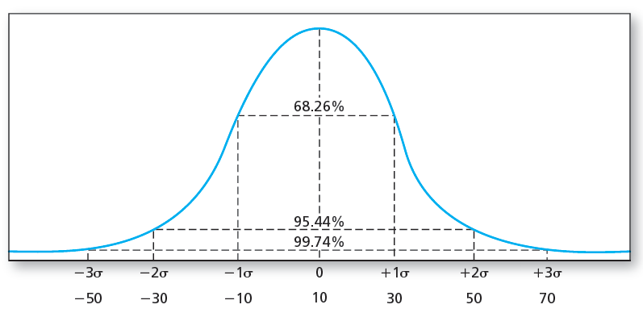
The Normal distribution
Assuming stock returns are normally distributed with mean 10% and standard deviation 20%, we would expect a return below x in y% of the observations:
x | z-score = $\frac{x−mean}{st.dev.}$ | y
10% | 0.0 | 50.00%
0% | -0.5 | 30.85%
-10% | -1.0 | 15.87%
-30% | -2.0 | 2.28%
-50% | -3.0 | 0.13%

Slide 14
Sharpe ratio
Sharpe ratio measures the tradeoff between expected return and risk
How much expected excess return can be obtained per unit of standard deviation
$$SR=\frac{μ−r_{f}}{σ}$$
To estimate the Sharpe ratio, replace with sample moments
$$\hat{SR}=\frac{\overline{r}−r_{f}}{\hat{σ}}$$
In our sample, in annual terms, $\hat{SR}=0.4=\frac{11.5\%−3.6\%}{20\%}$.
Investment managers talk a lot about $SR$ of their portfolio and anything higher than 1 should likely be taken with a grain of salt

Slide 15
The equity premium puzzle (1/3)
The equity premium is one of the most important numbers in financial economics
At what age can you retire? How much will you have? How much should you save as part of your salary?
Podcast: All else equal – How risky should your retirement savings be?
For reasonable levels of risk aversion and given that you are relatively young, popular life-cycle investment models imply you should invest >>50% in equities
The puzzle: this is not at all what we see in reality…
Problem 1: Historical average realized returns are not necessarily a good estimate of expected future returns
Historical averages better for diversified portfolios than individual assets, but even for the market portfolio:
large uncertainty. With 100+ years of data
standard error on mean estimate is 2% (≈20%/$\sqrt{2024−1928}$)
Two-standard error (95%) confidence interval is
[7.9-4%,7.9+4%]=[3.9%,11.9%]
What if there was a structural break? Markets and investors’ portfolios surely more diversified now than in 1930.

Slide 16
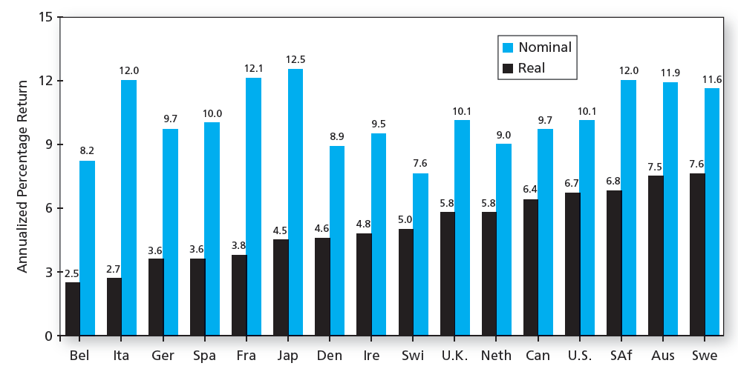
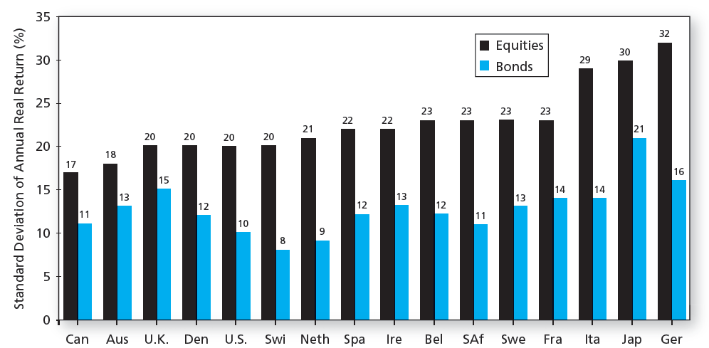
The equity premium puzzle (2/3)
Problem 2: Survivorship bias
US economy was historically very successful, and the US equity market followed suit:

Slide 17
The equity premium puzzle (3/3)
Problem 3: Alternative approaches to measure the equity premium based on fundamental stock valuation yield numbers around 4%
Recall: k = D/P + g → Expected return = dividend yield + expected growth rate of dividends
Claus and Thomas (2001) use analyst forecasts of dividends (and growth rates)
Fama and French (2002) use alternative measures of expected dividend growth icw current D/P
4% is closer to the median across countries
Intuition (see) : Success of US economy has led to
discount rate shocks that were negative on average
crashes that did not happen, but were rationally expected ex ante
Both lead to an upward bias in realized returns.

Slide 18
3. Non-normal returns

Slide 19
Normal returns
Investment management is easier when returns are (jointly) normal
Standard deviation is a sufficient measure of risk when returns are symmetric
The dependence of returns across securities can be summarized using only the pairwise correlation coefficients
Scenario analysis is easy

Slide 20
Non-Normal returns
What if returns are not normally distributed?
Variance (k=2) is no longer a complete measure of risk as higher moments matter, with k-th moment a function of ${E((r−μ)}^{k})$
Post-war US stock market return:
Skewness (k=3): -0.5
Left-tail relatively fatter than right-tail
Kurtosis (k=4): 1.8
Both tails fatter than normal
Measuring (tail) dependence is tricky when dealing with many assets
The normal assumption isn’t too bad and that’s why it’s popular.
Keep higher moments in mind when looking at real-world data though!

Slide 21
Alternatives to standard deviation
Value at Risk (VaR)
Loss corresponding to a very low percentile of the entire return distribution, such as the fifth or first percentile return
Commonly used in banking regulation
Why is VaR redundant for normally distributed returns?
Expected Shortfall (ES)
Also called conditional tail expectation (CTE), focuses on the expected loss in the worst-case scenarios (left tail of the distribution)
More conservative measure of downside risk than VaR

Slide 22
VaR and ES
Example (1): Consider a return that is distributed uniformly in the interval [-20%,+30%]
Uniform distribution: each outcome in the interval is equally likely
Compute the VaR(5%) and the ES(5%) for a portfolio of $10M
VaR(5%) = the outcome for which we estimate that things will only be worse in 5% of cases
ES(5%) = the average outcome in the worst 5% of cases
Example (2):
Calculate the same statistics for monthly US stock market returns since the 1960s and compare to what these statistics would look like if US stock market returns were normally distributed.

Slide 23
4. Time-varying distributions of returns

Slide 24
Stylized facts
Across different asset classes, time periods, geographies, and so on, return distributions seem to be predictably time-varying.
Difficult question: How to distinguish non-normality from time-variation in $μ$ and $σ$?
We will discuss in this course a number of timing strategies. To set the stage, let us consider the equity premium:
Talking to practitioners, you will realize that many of them understand that the equity premium is time-varying.
E.g., many fund managers advocate buying equities after a crash.
Why?
Recall the value of a stock that pays a constant dividend: P = D/k
Rewriting, we see that a proxy for the expected return of a stock k = D/P
So, when prices are low after a crisis, it means that expected returns are high.
This is standard “Present Value” logic: prices and discount rates are negatively correlated

Slide 25
The equity premium
Regressing monthly US equity returns on lagged dividend/price from 1962 to 2014:
$R_{MKT,t+1}=a+\underset{(0.33, t−stat≈2)}{\underbrace{b}}{DP}_{t}+e_{t+1}$ (R²<0.006)
Monthly excess equity market returns are predictable in-sample.
Evidence not strong: practitioners require estimate today of conditionally expected/forward-looking return, which is hard-to-estimate:
Before 2014, nobody knew that 0.33 x DP_{t}, provides a good estimate of next month’s equity premium.
In-sample R² small → out-of-sample R² even smaller.
Out-of-sample R²: Prediction at each point in time uses only historical data available at that point in time!
Coefficient (b) larger in 1st and 2nd sample half, suggesting structural breaks.
Thus, trading on time-varying returns is not easy!
What we do learn from this simple regression: expected stock market returns are time-varying.
To see this even better, consider 10 year returns:
Notes:
Consider
1st half: level of DP very high
2nd half: level of DP very low
If returns in each sample half are perfectly correlated with DP, but the level of returns is the same in each sample than the full sample correlation will be biased downwards

Slide 26
The long-term equity premium and DY
Question: What should investors do with this information?

Slide 27
Volatility is also time-varying
While predicting returns is difficult, predicting volatility is much less so:
No autoregressive component in returns, but clearly in squared returns.
Financial econometrics has had great success in coming up with time-series auto-regressive type models used to filter out conditional variance (${{Var}_{t}(R}_{t+1})=σ_{t}^{2}$)
Key ingredients of models: volatility is persistent & mean-reverting.

Slide 28
5. How financial markets work

Slide 29
The VIX
The volatility index, or VIX, is the volatility implied by option prices.
VIX measures the expected volatility for the underlying up to expiration of the option.
Sophisticated methods to back out market’s expected volatility from current option prices (see FT Alphaville article).
The VIX jumps whenever market turmoil hits and is seen by investors and popular press as an index of fear.

Slide 30
The volatility risk premium
On average, option implied volatility is 4% above actual realized volatility. This represents a 4% volatility risk premium. Why!?
Investors are risk averse and dislike increases in volatility so much that they are willing to “overpay” for options to hedge (relative to risk-neutral investors).
Option prices are increasing in volatility.
This premium is exactly why there are other, less risk averse investors that are willing to sell options (think: hedge funds). They take on this risk and get compensated by a high expected return.
However, when volatility shoots up, these hedge funds incur great losses (see FT article)

Slide 31
What do we learn from this example?
If something is risky, it will carry a price or “risk premium”
Investors dislike volatility and are willing to pay a premium to hedge against increases in volatility.
Throughout the course, we take great care identifying what is risk.
Risk is not only volatility or poor market returns. Risk is any factor that determines bad times for investors: poor economic growth, a real estate crash, inflation, illiquidity, and so on.
Financial markets match investors
Investors that want to hedge volatility and those that are willing to provide this hedge at a certain price.
This matching has become increasingly efficient due faster trading platforms as well as new contracts (e.g., VIX futures).
Financial markets produce information
Market expectations of volatility can be estimated from option prices.

