Slide 1

Investments
Masters in Finance
Spring 2025, Martijn Boons
Chapter 20-21

Slide 2
Introduction

Slide 3
Basic definitions: Options
A call option with strike K and maturity T gives the holder (long position) the right to buy the underlying asset
  At any time up to and including date T if the call is American
  at date T if the call is European
  seller (short position) of the call has the obligation to sell the underlying asset when holder exercises his right
A put option with strike K and maturity T gives the holder (long position) the right to sell the underlying asset
  At any time up to and including date T if the put is American
  at date T if the put is European
  seller (short position) of the put has the obligation to buy the underlying asset when holder exercises his right
Question: Which option is more valuable, an otherwise identical European or American option?

Slide 4
Options on what?
Stock options (American)
Index options (European)
Interest rate caps and floors
Currency options
Options on (commodity) futures
Options on Bitcoin futures
Weather options (http://www.cmegroup.com/trading/weather/ and market efficiency)
And many more...

Slide 5
Non-linear payoffs at maturity
Long Call Payoff:
Max(0,S_{T} - K)
Short Call Payoff
-Max(0,S_{T} - K)
K
S_{T}
K
S_{T}
K = Strike price, S_{T} = Price of asset at maturity
Long Put Payoff:
Max(K-S_{T},0)
Short Put Payoff
-Max(K-S_{T},0)
K
S_{T}
K
S_{T}

Slide 6
Option payoffs: Example
You buy two call options on the firm Imagine with different strike prices 45 (=K_{low}) and 55 (=K_{high}).
  What is your payoff if the stock price at expiration is 40? 50? 60?
  Payoff: Max(0,S_{T}-45) + Max(0,S_{T}-55) →
  40: 0+0, 50: 5+0, and 60: 15+5.
What is your payoff if you bought put options with these strike prices instead?
  Payoff: Max(0,45-S_{T})+ Max(0,55-S_{T})→
  40: 5+15, 50: 0+5, and 60: 0+0.
“Moneyness”
  In-the-money: S_{T} > K for calls; S_{T} < K for puts
  At-the-money: S_{T}=K
  Out-of-the-money: S_{T}<K for calls; S_{T} > K for puts

Slide 7
Option payoffs, profits, and returns
Payoff to long position at expiration ≥ 0.
  The inexistence of arbitrage opportunities in an efficient market implies that the option has a positive price on any date t before maturity T (t<T)
  Options are traded at this price: “the option premium”
The profit from a long option position is the payoff minus the option price
Profit = payoff – price
Return = Profit / price
  Given that option prices are relatively small, option returns are large (in absolute magnitude)!
  Return option seller = -(Return option buyer)
Payoffs | LONG | SHORT
CALL | Max(0,S_{T} - K) | -Max(0,S_{T} - K)=Min(K - S_{T},0)
PUT | Max(K - S_{T},0) | -Max(K - S_{T},0)=Min(S_{T} - K,0)

Slide 8
Example
S&P 500 options
Suppose you bought one June 30, 2025 call option on the S&P500 with strike K = $5850 for a price of $462.10.
  Draw payoff at maturity and profit.
  For which S&P500 value do you break-even (profit = 0)?
  Plot also the % return for the call relative to the S&P500.
BE = 5850+462.10
Options leverage the returns on the underlying → Risk↑↑↑

Slide 9
Option vs. Stock Investments
Could a call option strategy be preferable to a direct stock purchase?
Suppose you think a stock, currently selling for $100, will appreciate.
A 6-month European call with strike price of $100 costs $10 (contract size is 100 shares).
You have $10,000 to invest.
Three alternatives:
Strategy A: Invest entirely in stock. Buy 100 shares, each selling for $100.
Strategy B: Invest entirely in call options. Buy 1,000 calls, each selling for $10. (This would require 10 contracts, each for 100 shares.)
Strategy C: Purchase 100 call options for $1,000. Invest your remaining $9,000 in 6-month T-bills, to earn 3% interest. The bills will be worth $9,270 at expiration.
Calculate the return of these three strategies if the stock price turns out to be 85, 90,…,120 6 months from now and interpret what you find.

Slide 10
Option vs. Stock Investments
 | Payoff as a function of S_T
Strategy | 85 | 90 | 95 | 100 | 105 | 110 | 115 | 120
All stock | 8500 | 9000 | 9500 | 10000 | 10500 | 11000 | 11500 | 12000
All options | 0 | 0 | 0 | 0 | 5000 | 10000 | 15000 | 20000
90% risk-free and 10% options | 9270 | 9270 | 9270 | 9270 | 9770 | 10270 | 10770 | 11270

Slide 11
Option vs. Stock Investments
Option strategy (B) is very risky!
  You are leveraging the payoffs of the stock
Calls + t-bill strategy (C) shows the insurance value of options.
  C‘s T-bill position cannot be worth less than $9270.
  Some return potential is sacrificed to limit downside risk.
Preferring A,B, or C depends on investor’s risk preferences
No arbitrage pricing relations between these strategies form the basis of real-world option pricing models
Options have expanded the investment opportunity set for investors
  Both for speculation and hedging:

Slide 12
Hedging with options
Even though investing in options can be risky, risk management combines options with the underlying in a smart way:
Suppose you have a long position in the S&P500 and are worried about the market crashing over the next few months. What can you do?
Buy a put option: the combination of the underlying + a put is called a protective put.
  You fix a minimum price at which you can sell the asset.
Payoff from position in S&P500 plus a K=5250 (≈5850*(1-10%)) put:

Slide 13
Payoffs for other option (hedging) strategies
Protective collar: finance the purchase of the protective put by selling a call option
  Suppose you want to hedge against a drop in the S&P 500 options of more than 10%, how much upside do you need to give up?
  For any price larger than the strike of the call, you will have to sell your index investment at the strike price of the call.
Covered call: Short the underlying + a long call
  You fix a maximum price at which you can buy the asset
Straddle: Long a put and a call to benefit from market turmoil

Slide 14
General properties of option prices

Slide 15
Notation
c: European call option price; C: American call option price
p: European put option price; P: American put option price
S or S₀, S_{t}, and S_{T}: Asset (usually stock) price today, at some time t, and at expiration date T
K: Strike price
σ: Volatility of asset price
r: Risk-free rate for maturity T
PV(D): Present value of the dividends paid until T
Assumptions:
  There are no transaction costs.
  Borrowing and lending are possible at the risk-free interest rate
  There are no arbitrage opportunities

Slide 16
Option pricing terminology
Intrinsic value at some time t≤T: The value if the exercise decision was taken immediately
  Call: max(S_{t} – K, 0)
  Put: max(K – S_{t}, 0)
Time value: Option price minus intrinsic value
  Call price - max(S_{t} – K, 0)
  Put price - max(K – S_{t}, 0)
Time value 2. is usually positive (we’ll discuss exceptions)
  Even if you could exercise at t<T (i.e., you have an American option), you would not do it!
  Better to sell the option in the market for 1.+2. rather than exercising and getting 1.

Slide 17
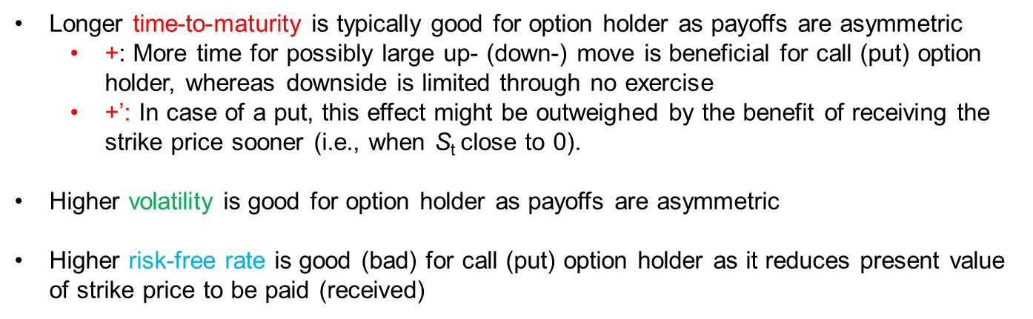
Intuition: Factors affecting option prices
 |  | c | p
Current asset price | S | + | -
Strike price | K | - | +
Maturity | T | + | +’
Volatility | σ | + | +
Risk-free rate | r | + | -
Longer time-to-maturity is typically good for option holder as payoffs are asymmetric
  +: More time for possibly large up- (down-) move is beneficial for call (put) option holder, whereas downside is limited through no exercise
  +’: In case of a put, this effect might be outweighed by the benefit of receiving the strike price sooner (i.e., when S_{t} close to 0).
Higher volatility is good for option holder as payoffs are asymmetric
Higher risk-free rate is good (bad) for call (put) option holder as it reduces present value of strike price to be paid (received)

Slide 18
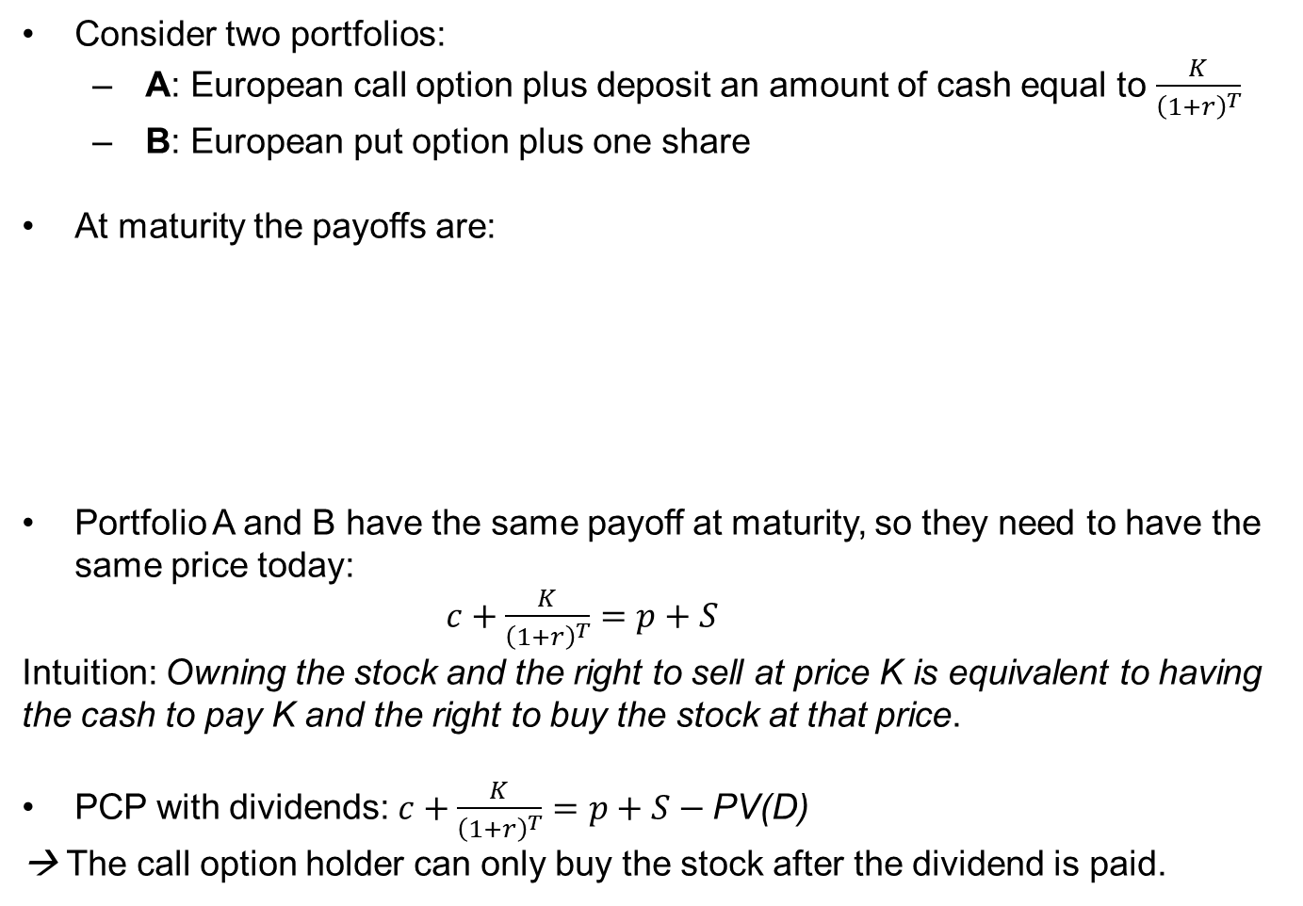
Relative pricing: Put-call parity (i)
Consider two portfolios:
  A: European call option plus deposit an amount of cash equal to $\frac{K}{{\left(1+r\right)}^{T}}$
  B: European put option plus one share
At maturity the payoffs are:
Portfolio A and B have the same payoff at maturity, so they need to have the same price today:
$c+\frac{K}{{\left(1+r\right)}^{T}}=p+S$
Intuition: Owning the stock and the right to sell at price K is equivalent to having the cash to pay K and the right to buy the stock at that price.
PCP with dividends: $c+\frac{K}{{\left(1+r\right)}^{T}}=p+S−\text{PV}\text{(}\text{D}\text{)}$
→ The call option holder can only buy the stock after the dividend is paid.
 | S_{T} ≤ K | S_{T} > K
Portfolio A | 0 + K = K | S_{T} – K + K = S_{T}
Portfolio B | K – S_{T} + S_{T} = K | 0 + S_{T} = S_{T}

Slide 19
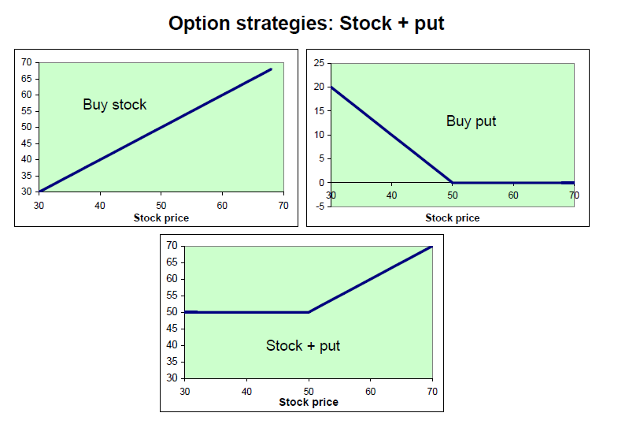
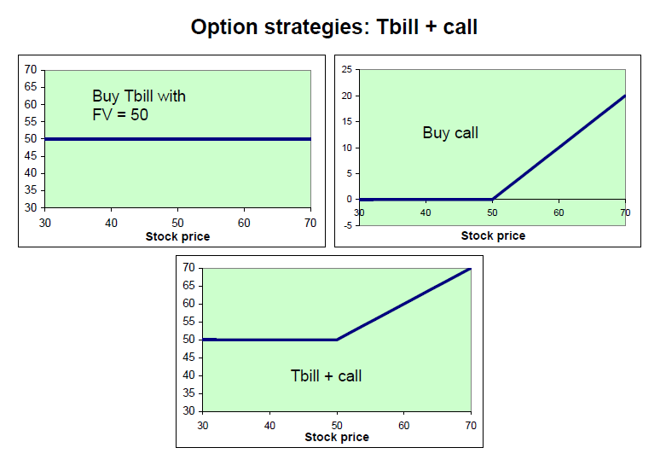
Relative pricing: Put-call parity (ii)
Payoffs of put+stock equal to payoffs of call+bond →
By no arbitrage, price of the strategies must be the same:
p + S = c + PV(K)

Slide 20
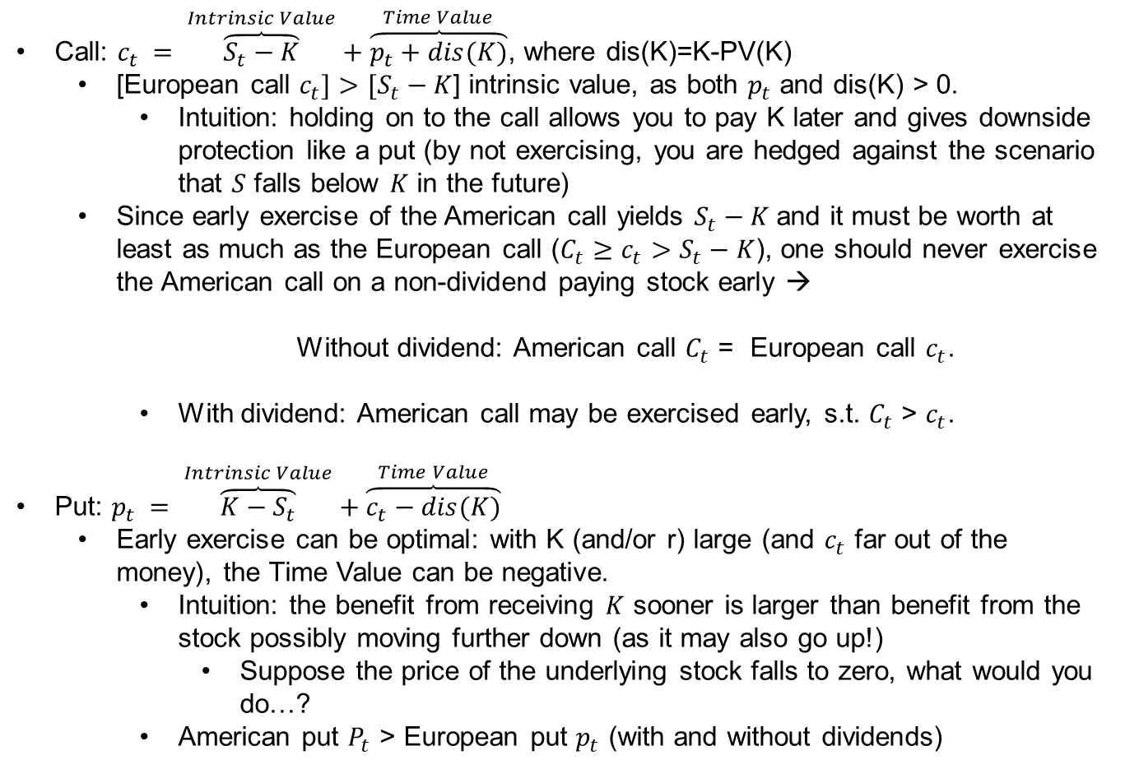
American options: optimal exercise
Call: $c_{t} = \overset{Intrinsic Value}{\overbrace{S_{t}−K}}+\overset{Time Value}{\overbrace{p_{t}+dis(K)}}$, where dis(K)=K-PV(K)
  [European call $c_{t}]>[S_{t}−K$] intrinsic value, as both $p_{t}$ and dis(K) > 0.
    Intuition: holding on to the call allows you to pay K later and gives downside protection like a put (by not exercising, you are hedged against the scenario that $S$ falls below $K$ in the future)
  Since early exercise of the American call yields $S_{t}−K$and it must be worth at least as much as the European call ($C_{t}≥c_{t}>S_{t}−K$), one should never exercise the American call on a non-dividend paying stock early →
    Without dividend: American call $C_{t}$ = European call $c_{t}$.
    With dividend: American call may be exercised early, s.t. $C_{t}$ > $c_{t}$.
Put: $p_{t} = \overset{Intrinsic Value}{\overbrace{K−S_{t}}}+\overset{Time Value}{\overbrace{c_{t}−dis(K)}}$
  Early exercise can be optimal: with K (and/or r) large (and $c_{t}$ far out of the money), the Time Value can be negative.
    Intuition: the benefit from receiving $K$ sooner is larger than benefit from the stock possibly moving further down (as it may also go up!)
      Suppose the price of the underlying stock falls to zero, what would you do…?
    American put $P_{t}$ > European put $p_{t}$ (with and without dividends)

Slide 21
Exercise
Decompose these S&P500 option prices in intrinsic value (IV) and time value (TV). Which options have the largest time value (and why)? To answer this question, consider a spot index value of 5895.34.
Calls |  | Strike | Last trade | Bid | Ask
SPXW241129C05840000 | 11/15/2024 20:48 | 5840 | 77.37 | 91.8 | 92.1
SPXW241129C05850000 | 11/18/2024 15:38 | 5850 | 84 | 83 | 83.4
SPXW241129C05860000 | 11/18/2024 12:16 | 5860 | 70.64 | 77.6 | 78
SPXW241129C05870000 | 11/18/2024 15:33 | 5870 | 68.81 | 70.2 | 70.6
SPXW241129C05880000 | 11/18/2024 15:09 | 5880 | 56.47 | 64.6 | 65
SPXW241129C05890000 | 11/18/2024 15:28 | 5890 | 53.66 | 57.5 | 57.8
SPXW241129C05900000 | 11/18/2024 15:35 | 5900 | 52.1 | 51.7 | 52.1
SPXW241129C05910000 | 11/18/2024 15:29 | 5910 | 42.95 | 46.6 | 46.9
SPXW241129C05920000 | 11/18/2024 15:33 | 5920 | 39.87 | 40.8 | 41.1
SPXW241129C05930000 | 11/18/2024 14:18 | 5930 | 30.95 | 36.3 | 36.6
SPXW241129C05940000 | 11/18/2024 15:40 | 5940 | 31.21 | 31.8 | 32.1
Puts
SPXW241129P05840000 | 11/18/2024 15:32 | 5840 | 29.64 | 28.7 | 29
SPXW241129P05850000 | 11/18/2024 15:42 | 5850 | 31.12 | 31.5 | 31.7
SPXW241129P05860000 | 11/18/2024 15:30 | 5860 | 36 | 34.3 | 34.6
SPXW241129P05870000 | 11/18/2024 15:32 | 5870 | 39 | 38.5 | 38.8
SPXW241129P05880000 | 11/18/2024 15:32 | 5880 | 42.27 | 40.5 | 40.8
SPXW241129P05890000 | 11/18/2024 15:28 | 5890 | 48.44 | 44.9 | 45.3
SPXW241129P05900000 | 11/18/2024 15:35 | 5900 | 49.1 | 48.9 | 49.3
SPXW241129P05910000 | 11/18/2024 14:56 | 5910 | 55.82 | 52.6 | 53
SPXW241129P05920000 | 11/18/2024 14:43 | 5920 | 69.7 | 59.1 | 59.5
SPXW241129P05930000 | 11/18/2024 8:33 | 5930 | 77.4 | 63.4 | 63.7
SPXW241129P05940000 | 11/18/2024 14:44 | 5940 | 81.32 | 69.4 | 69.8
All options have positive TV, but TV is highest for ATM options.
ATM options benefit the most from payoff asymmetry: if price goes in right direction, option payoff increases above 0. If price moves in wrong direction, option payoff stays at zero.

Slide 22
Binomial model

Slide 23
Option pricing in a binomial model
The question we want to answer: what should the price of a European call, put, or any other derivative be at any date before T?
  We used put-call parity to price the call relative to the put
  What about absolute pricing of the call or put?
The binomial option pricing model assumes underlying can move up or down each period
  If we can replicate option’s payoff investing directly in the underlying and a risk-free bond, then we can price the option by no arbitrage.
  The technique is general, and real-world option pricing models extend the basic principles of this simple model.

Slide 24
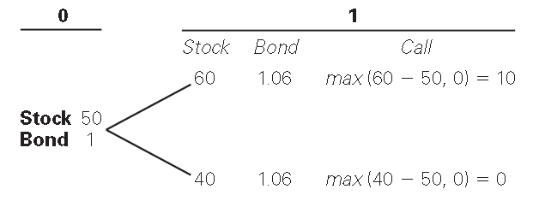
The binomial option pricing model
Let us price a European call option on a stock with exercise price of $50. The stock price today S is equal to $50
(Note, K’s close to S are most actively traded, but many different K’s are available.)
In one period, the stock price will either rise by $10 or fall by $10.
The one-period (simple) risk-free rate is 6%.
Payoffs

Slide 25
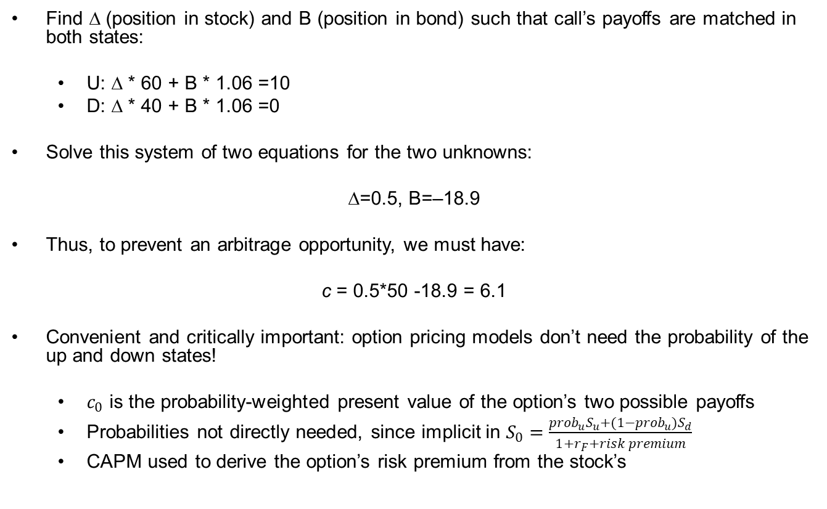
Replicating portfolio (1/2)
Find ∆ (position in stock) and B (position in bond) such that call’s payoffs are matched in both states:
  U: ∆ * 60 + B * 1.06 =10
  D: ∆ * 40 + B * 1.06 =0
Solve this system of two equations for the two unknowns:
∆=0.5, B=–18.9
Thus, to prevent an arbitrage opportunity, we must have:
c = 0.5*50 -18.9 = 6.1
Convenient and critically important: option pricing models don’t need the probability of the up and down states!
  $c_{0}$ is the probability-weighted present value of the option’s two possible payoffs
  Probabilities not directly needed, since implicit in $S_{0}=\frac{{prob}_{u}S_{u}+{(1−prob}_{u})S_{d}}{1+r_{F}+risk premium}$
  CAPM used to derive the option’s risk premium from the stock’s

Slide 26
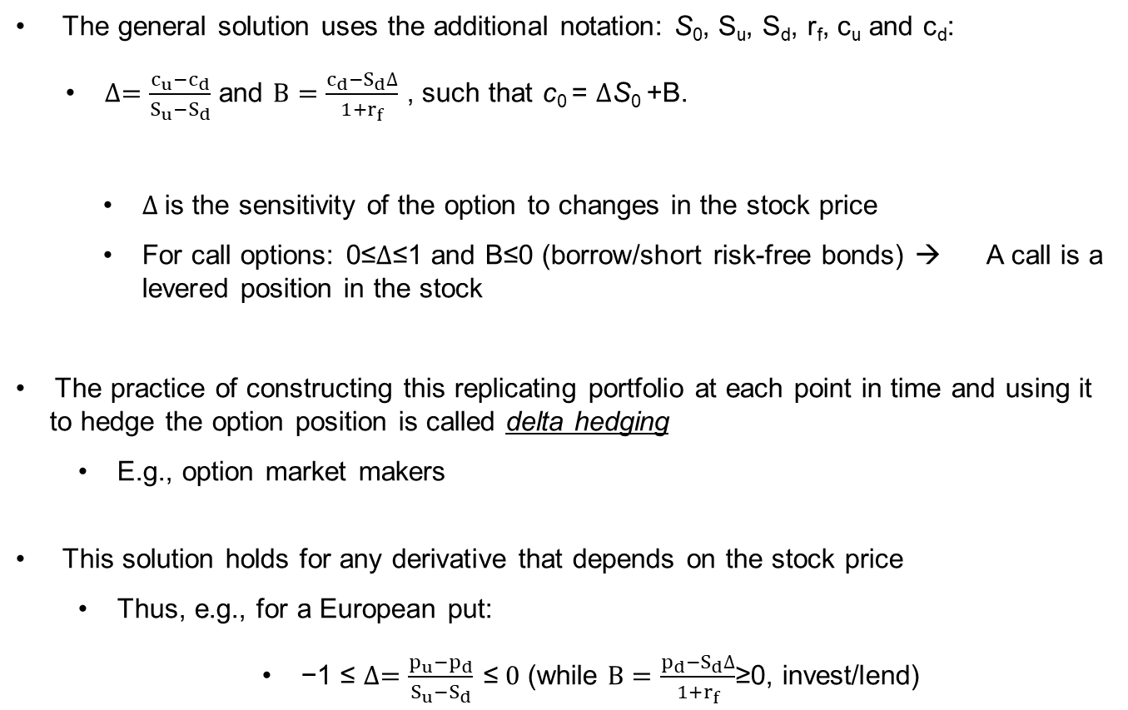
Replicating portfolio (2/2)
The general solution uses the additional notation: S₀, S_{u}, S_{d}, r_{f}, c_{u} and c_{d}:
  $∆=\frac{c_{u}−c_{d}}{S_{u}−S_{d}}$ and $B=\frac{c_{d}−S_{d}∆}{1+r_{f}}$ , such that c₀ = $∆$S₀ +B.
    $∆$is the sensitivity of the option to changes in the stock price
    For call options: 0≤$∆$≤1 and B≤0 (borrow/short risk-free bonds) → A call is a levered position in the stock
The practice of constructing this replicating portfolio at each point in time and using it to hedge the option position is called delta hedging
  E.g., option market makers
This solution holds for any derivative that depends on the stock price
  Thus, e.g., for a European put:
  $\text{−1 }\text{≤} ∆=\frac{p_{u}−p_{d}}{S_{u}−S_{d}} \text{≤} 0$ (while $B=\frac{p_{d}−S_{d}∆}{1+r_{f}}$≥0, invest/lend)

Slide 27
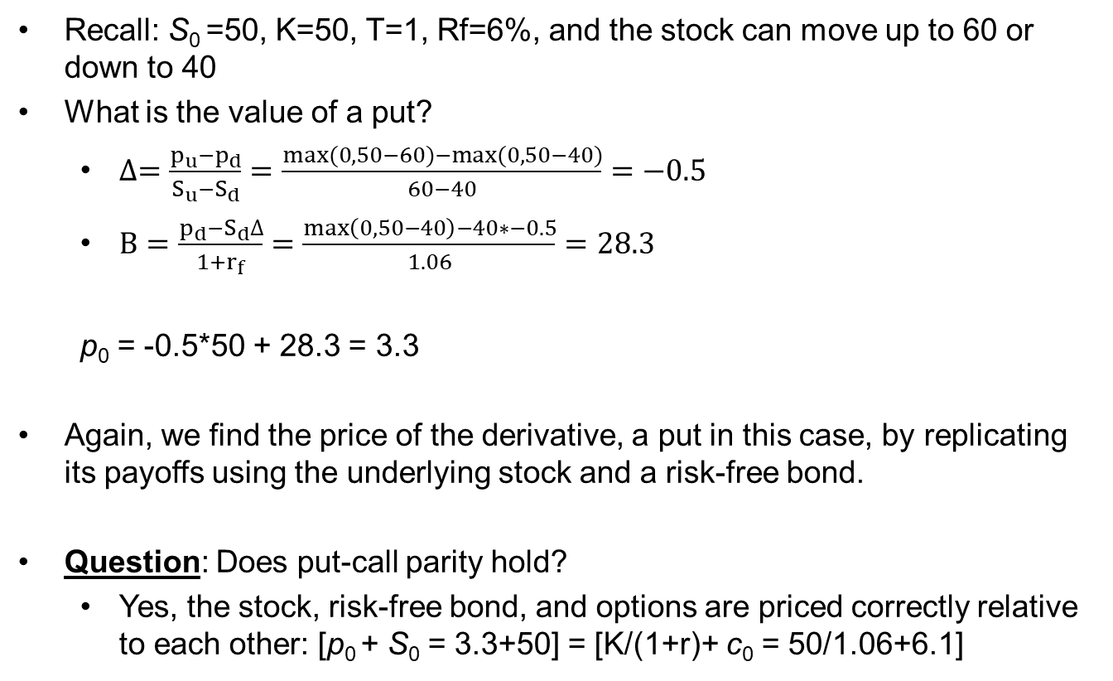
The put option
Recall: S₀ =50, K=50, T=1, Rf=6%, and the stock can move up to 60 or down to 40
What is the value of a put?
  $∆=\frac{p_{u}−p_{d}}{S_{u}−S_{d}}=\frac{max⁡(0,50−60)−max⁡(0,50−40)}{60−40}=−0.5$
  $B=\frac{p_{d}−S_{d}∆}{1+r_{f}}=\frac{\max\left(0,50−40\right)−40∗−0.5}{1.06}=28.3$
  p₀ = -0.5*50 + 28.3 = 3.3
Again, we find the price of the derivative, a put in this case, by replicating its payoffs using the underlying stock and a risk-free bond.
Question: Does put-call parity hold?
  Yes, the stock, risk-free bond, and options are priced correctly relative to each other: [p₀ + S₀ = 3.3+50] = [K/(1+r)+ c₀ = 50/1.06+6.1]

Slide 28
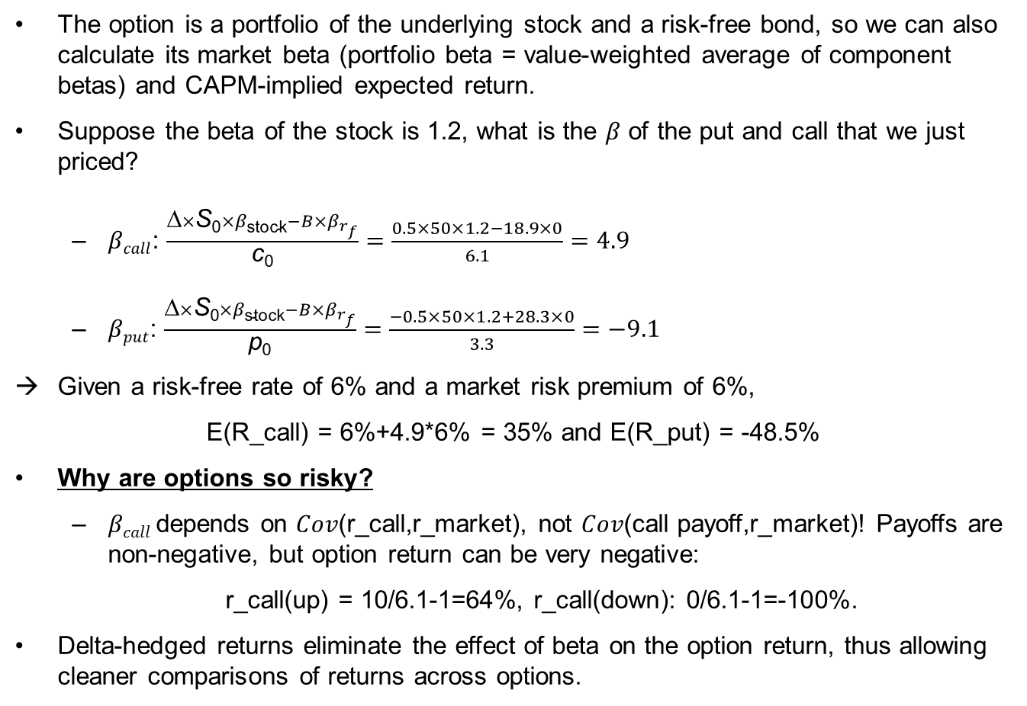
Option beta and expected return
The option is a portfolio of the underlying stock and a risk-free bond, so we can also calculate its market beta (portfolio beta = value-weighted average of component betas) and CAPM-implied expected return.
Suppose the beta of the stock is 1.2, what is the $β$ of the put and call that we just priced?
  $βcall$: $\frac{\text{∆}×\text{S}\text{0}×β\text{stock}−B×β_{r_{f}}}{\text{c}\text{0}}=$ $\frac{0.5×50×1.2−18.9×0}{6.1}=4.9$
  $βput$: $\frac{\text{∆}×\text{S}\text{0}×β\text{stock}−B×β_{r_{f}}}{\text{p}\text{0}}=$ $\frac{−0.5×50×1.2+28.3×0}{3.3}=−9.1$
Given a risk-free rate of 6% and a market risk premium of 6%,
E(R_call) = 6%+4.9*6% = 35% and E(R_put) = -48.5%
Why are options so risky?
  $βcall$depends on 𝐶𝑜𝑣(r_call,r_market), not 𝐶𝑜𝑣(call payoff,r_market)! Payoffs are non-negative, but option return can be very negative:
  r_call(up) = 10/6.1-1=64%, r_call(down): 0/6.1-1=-100%.
Delta-hedged returns eliminate the effect of beta on the option return, thus allowing cleaner comparisons of returns across options.

Slide 29
Multi-period option pricing models

Slide 30
Option pricing
How to make this more realistic?
  Divide time until expiration into smaller periods over which the stock can move up and down by small amounts, such that we end up with a wider range of possible stock prices at expiration of the option
  Broadly two methods:
    Binomial setting with multiple periods
      Dividends and early exercise can be incorporated (as well as other exotic features)
      Can become computationally challenging
    Black-Scholes: Replication in continuous time
      Infinite number of infinitesimally small periods
      Gives us a solution in closed form when interest rate and volatility are constant up to expiration
      Hard to incorporate dividends and early exercise, but more complex extensions of this model exist

Slide 31
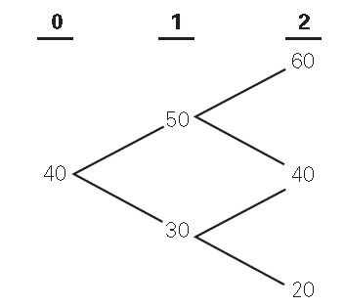
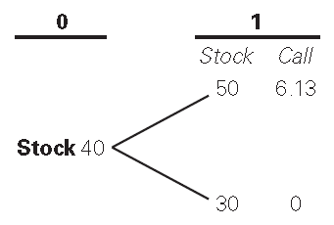
Multi-period binomial model
Extension to multi-period world, each with two states is straightforward: apply the same trick, working backwards
Already calculated c_{1,u}=6.1
c_{1,d}=0
Left with a similar problem as before, which we solve to find c₀=3.6
The replicating strategy is dynamic, as ∆ and B vary across tree nodes!

Slide 32
Black-Scholes option pricing model
  A (more realistic) technique for pricing European options that incorporates that the stock is traded continuously
    Can be derived from the Binomial Option Pricing Model by allowing the length of each period to become very small (holding time until expiration fixed).
    You will see this in Options and Futures elective
  Building blocks
    As before: replication with stock and risk-less bond and no arbitrage
    Continuously compounded stock returns: normally distributed (independent and with constant variance σ²)
    No dividends during the life of the option
    No transaction costs
    Constant until expiration continuously compounded interest rate r

Slide 33
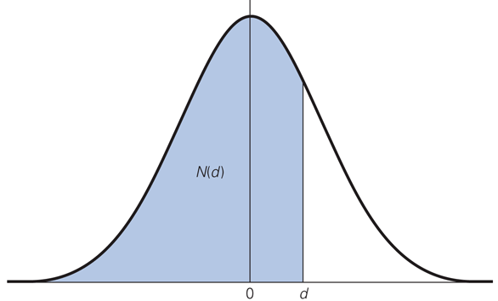
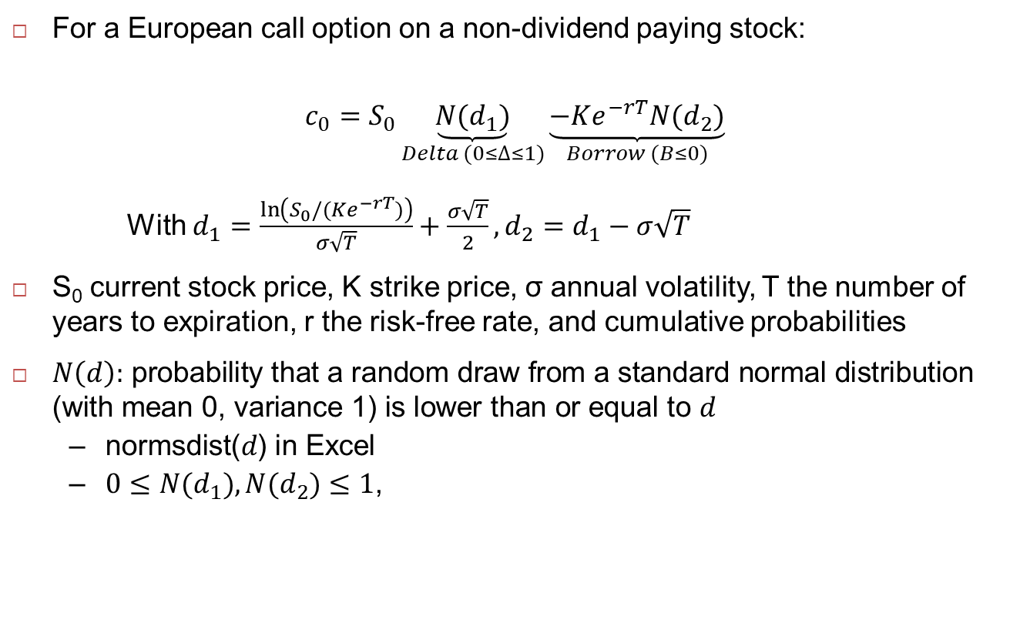
Black-Scholes option pricing model
  For a European call option on a non-dividend paying stock:
  $$c_{0}=S_{0}\underset{Delta (0≤∆≤1)}{\underbrace{N(d_{1})}}\underset{Borrow (B≤0)}{\underbrace{−Ke^{−rT}N(d_{2})}}$$
  With $d_{1}=\frac{\ln\left(S_{0}/(Ke^{−rT})\right)}{σ\sqrt{T}}+\frac{σ\sqrt{T}}{2},d_{2}=d_{1}−σ\sqrt{T}$
  S₀ current stock price, K strike price, σ annual volatility, T the number of years to expiration, r the risk-free rate, and cumulative probabilities
  $N\left(d\right)\text{:} \text{probability} \text{that} \text{a} \text{random} \text{draw} \text{from} \text{a} \text{standard} \text{normal} \text{distribution}\text{ (}\text{with} \text{mean}\text{ 0, }\text{variance}\text{ 1) }\text{is} \text{lower} \text{than} \text{or} \text{equal} \text{to} d$
  $\text{normsdist}\text{(}d\text{) }\text{in} \text{Excel}$
  $0≤N(d_{1}),N(d_{2})≤1$,
Notes:
Note that this solution is very similar to what we had before!

Slide 34
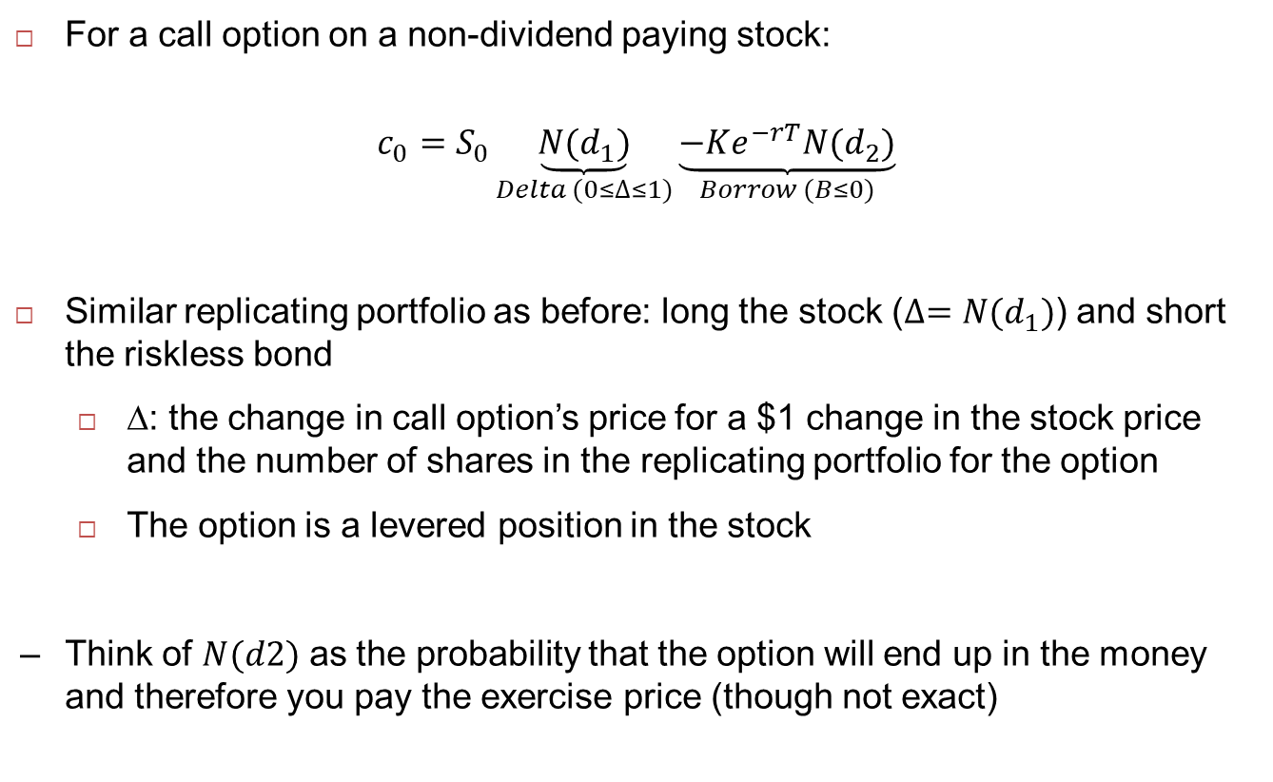
Black-Scholes model: replicating portfolio
  For a call option on a non-dividend paying stock:
  $$c_{0}=S_{0}\underset{Delta (0≤∆≤1)}{\underbrace{N(d_{1})}}\underset{Borrow (B≤0)}{\underbrace{−Ke^{−rT}N(d_{2})}}$$
  Similar replicating portfolio as before: long the stock ($∆=N(d_{1})$) and short the riskless bond
    ∆: the change in call option’s price for a $1 change in the stock price and the number of shares in the replicating portfolio for the option
    The option is a levered position in the stock
  Think of $N(d2)$ as the probability that the option will end up in the money and therefore you pay the exercise price (though not exact)
Notes:
Note that this solution is very similar to what we had before!

Slide 35
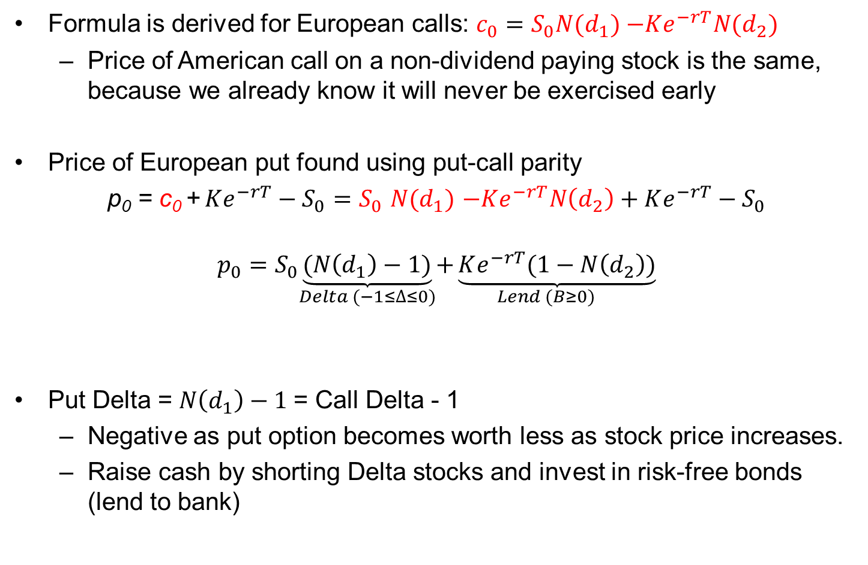
Black-Scholes formula: Applications
Formula is derived for European calls: $c_{0}=S_{0}N(d_{1})$ $−Ke^{−rT}N(d_{2})$
  Price of American call on a non-dividend paying stock is the same, because we already know it will never be exercised early
Price of European put found using put-call parity
p₀ = c₀ + $Ke^{−rT}−S_{0}=S_{0}$ $N(d_{1})$ $−Ke^{−rT}N\left(d_{2}\right)+Ke^{−rT}−S_{0}$
$$p_{0}=S_{0}\underset{Delta (−1≤∆≤0)}{\underbrace{(N\left(d_{1}\right)−1)}}\underset{Lend (B≥0)}{+\underbrace{Ke^{−rT}(1−N\left(d_{2}\right))}}$$
Put Delta = $N\left(d_{1}\right)−1$= Call Delta - 1
  Negative as put option becomes worth less as stock price increases.
  Raise cash by shorting Delta stocks and invest in risk-free bonds (lend to bank)
Notes:
Put delta= Nd1-1 = cd-1

Slide 36
Example (1/2)
What is the value of a call option with 6 months to expiration on Microsoft with an exercise price of $150
The current value of a share of Microsoft is $160
The U.S. 6 month interest rate is 5%, continuously compounded.
The volatility of Microsoft stock is 30% per annum.
Question: Will the value of the call option be below or above the intrinsic value of Max(0,160-150) = 10?
  Above: time value of a call option on a non-dividend paying stock is positive!
  Excel: 20.92=time-value (10.92) + intrinsic value (10)
36
Notes:
European call options have positive time value

Slide 37
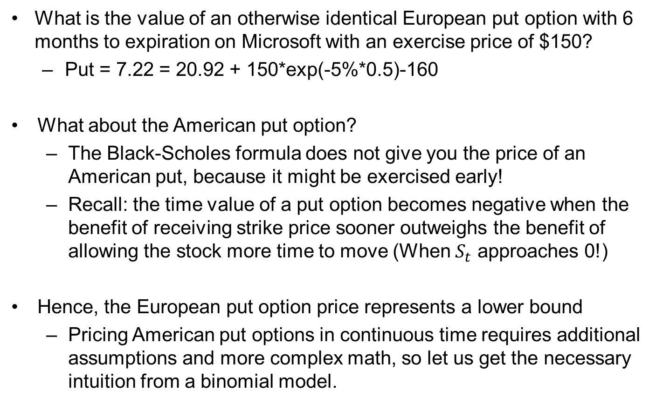
Example (2/2)
What is the value of an otherwise identical European put option with 6 months to expiration on Microsoft with an exercise price of $150?
  Put = 7.22 = 20.92 + 150*exp(-5%*0.5)-160
What about the American put option?
  The Black-Scholes formula does not give you the price of an American put, because it might be exercised early!
  Recall: the time value of a put option becomes negative when the benefit of receiving strike price sooner outweighs the benefit of allowing the stock more time to move (When $S_{t}$ approaches 0!)
Hence, the European put option price represents a lower bound
  Pricing American put options in continuous time requires additional assumptions and more complex math, so let us get the necessary intuition from a binomial model.
37
Notes:
European call options have positive time value

Slide 38
American options
How to deal with American options in a binomial setting?
  In each node of the tree (including t=0!), check how the value of exercising the option immediately compares to the value of not exercising.
  If the former is larger: EXERCISE and replace European option value calculated from future payoffs with intrinsic value that American option holder gets when exercising!
Suppose the value of a stock is $25 today and each year the stock will either be worth 15% more or 15% less. The risk-free rate is a continuously compounded 5%. The strike price is 25. What is the value of the European or American put option that expires in two years?
38

Slide 39
Pricing the European and American put option
Strike | 25 |  |  |  | S_uu | 33.06
r | 5% |  |  |  | p_uu | 0.00
 |  |  | S_u | 28.75
 |  |  | p_u_Euro | 0.18
 |  |  | Delta_u | -0.07
 |  |  | B_u | 2.05
 |  |  | Exercise_u_US | No
 |  |  | P_u_US | 0.18
 | S_0 | 25.00
 | Delta_0_Euro | -0.31 |  |  | S_ud=S_du | 24.44
 | B_0_Euro | 8.75 |  |  | p_ud=p_du | 0.56
 | p_0_Euro | 0.90
 | Delta_0_US | -0.48 | S_d | 21.25
 | B_0_US | 13.20 | p_d_Euro | 2.53
 | P_0_US | 1.29 | Delta_d | -1.00
 | Exercise_0_US | No | B_d | 23.78
 |  |  | Exercise_d_US | Yes | S_dd | 18.06
 |  |  | P_d_US | 3.75 | p_dd | 6.94
[P0_US=1.29]
>
[p0_EU=0.90], because you exercise early in the down state!
The present value of future payoffs is 2.53 (=pd_EU). Exercising early gives 3.75 (=Pd_US), so exercise!
What is the price of the European call option on the same stock and with the same exercise price and date?
What is the price of an American call option with these same features?
[1. 3.28 using PCP; 2. 3.28 as it will never be exercised early!]

Slide 40
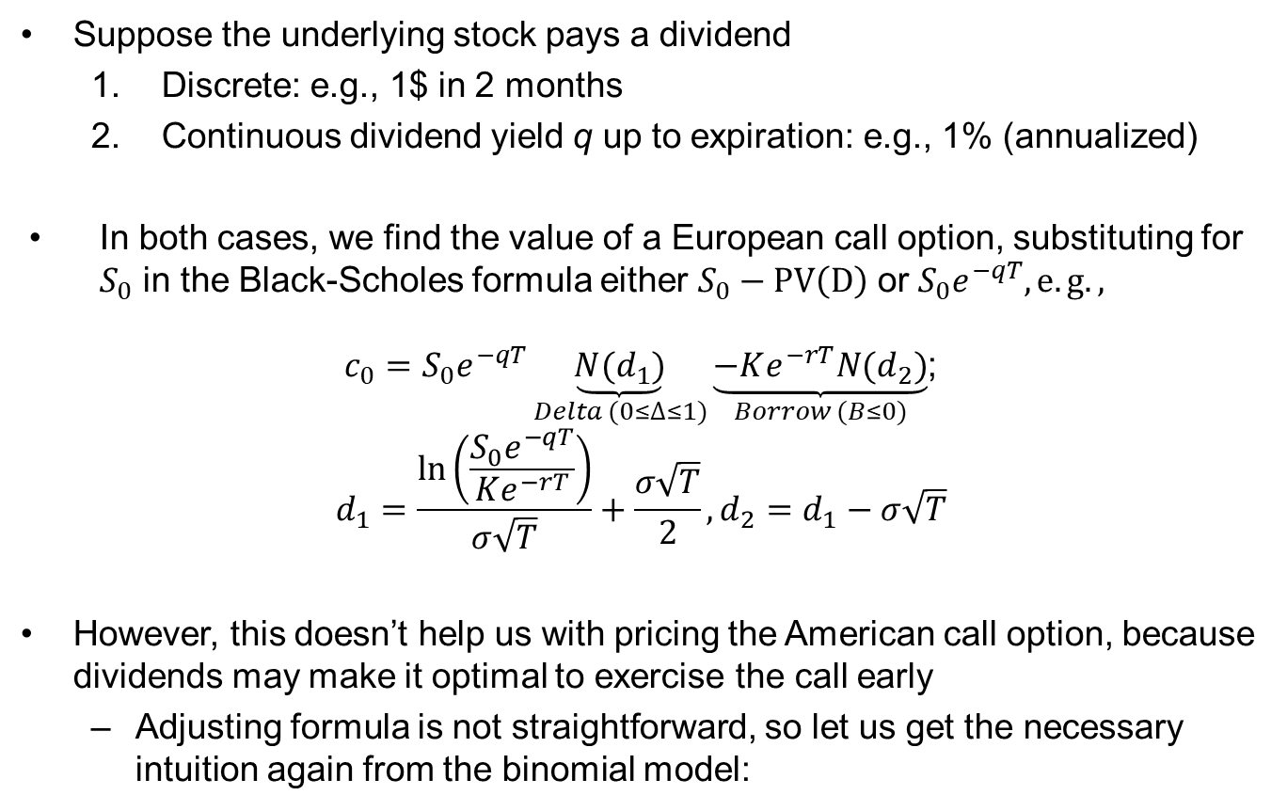
Dividends
Suppose the underlying stock pays a dividend
  Discrete: e.g., 1$ in 2 months
  Continuous dividend yield q up to expiration: e.g., 1% (annualized)
In both cases, we find the value of a European call option, substituting for $S_{0}$ in the Black-Scholes formula either $S_{0}−PV\left(D\right)$ or $S_{0}e^{−qT}, e.g.,$
  $c_{0}=S_{0}e^{−qT}\underset{Delta (0≤∆≤1)}{\underbrace{N(d_{1})}}\underset{Borrow (B≤0)}{\underbrace{−Ke^{−rT}N(d_{2})}}$;
  $$d_{1}=\frac{\ln\left(\frac{S_{0}e^{−qT}}{Ke^{−rT}}\right)}{σ\sqrt{T}}+\frac{σ\sqrt{T}}{2},d_{2}=d_{1}−σ\sqrt{T}$$
However, this doesn’t help us with pricing the American call option, because dividends may make it optimal to exercise the call early
  Adjusting formula is not straightforward, so let us get the necessary intuition again from the binomial model:
40

Slide 41
American call with dividend (1/2)
What is the value of an European and an American call option on the stock, if the stock pays a dividend of 5$ just before t=1, allowing the American option holder to exercise early and receive the dividend if he desires?
Two important changes to approach:
  Stock price path from time 1 to time 2 needs to be adjusted for dividend
    Replication at time 1 uses ex dividend stock price
  American option holder can exercise before dividend!
    And he does…
41

Slide 42
American call with dividend (2/2)
American call exercise
Strike | 25.00 |  |  |  | S_uu | 27.31
r | 0.05 |  |  |  | c_uu | 2.31
D | 5.00 |  | S_u_pre | 28.75
 |  |  | S_u_post | 23.75
 |  |  | Delta_u | 0.32
 |  |  | B_u | -6.23
 |  |  | c_u_Euro | 1.48
 |  |  | Exercise | Yes, before dividend!
 | S_0 | 25.00 | C_u_US | 3.75 | S_ud | 20.19
 | Delta_0_Euro | 0.20 |  |  | c_ud | 0.00
 | B_0_Euro | -3.98
 | c_0 | 0.94
 | Delta_0_US | 0.50 |  |  | S_du | 18.69
 | B_0_US | -10.11 |  |  | c_du | 0.00
 | C_0_US | 2.39 | S_d_pre | 21.25
 |  |  | S_d_post | 16.25
 |  |  | Delta_d | 0.00
 |  |  | B_d | 0.00
 |  |  | c_d_Euro | 0.00
 |  |  | Exercise | No
 |  |  | C_d_US | 0.00
 |  |  |  |  | S_dd | 13.81
 |  |  |  |  | c_dd | 0.00
Replication at time 1 uses ex dividend stock prices!
Replication at time 0 uses cum dividend stock prices, as buying stock gives you the right to the dividend at time 1

Slide 43
Summing up
Black-Scholes is famous for providing a convenient framework to price options
    Option prices quite close to Black-Scholes valuations well before Black and Scholes wrote their paper
    Black-Scholes model provides a good approximation for options that are close to expiration and close to being at-the-money
      Farther from expiration and farther from being-at-the-money, the Black-Scholes approximation can be quite far of
      Stock price movements in the tails are more extreme than the log-normal distribution in Black-Scholes would imply
    Main issue with Black-Scholes: volatility is time-varying
      The framework has been extended to account for time-varying volatility, but these extensions are non-trivial ito math
  Binomial models face a trade-off: computationally more challenging, but much more flexible incorporating non-standard features (discrete dividends, American, multiple exercise dates...)

Slide 44
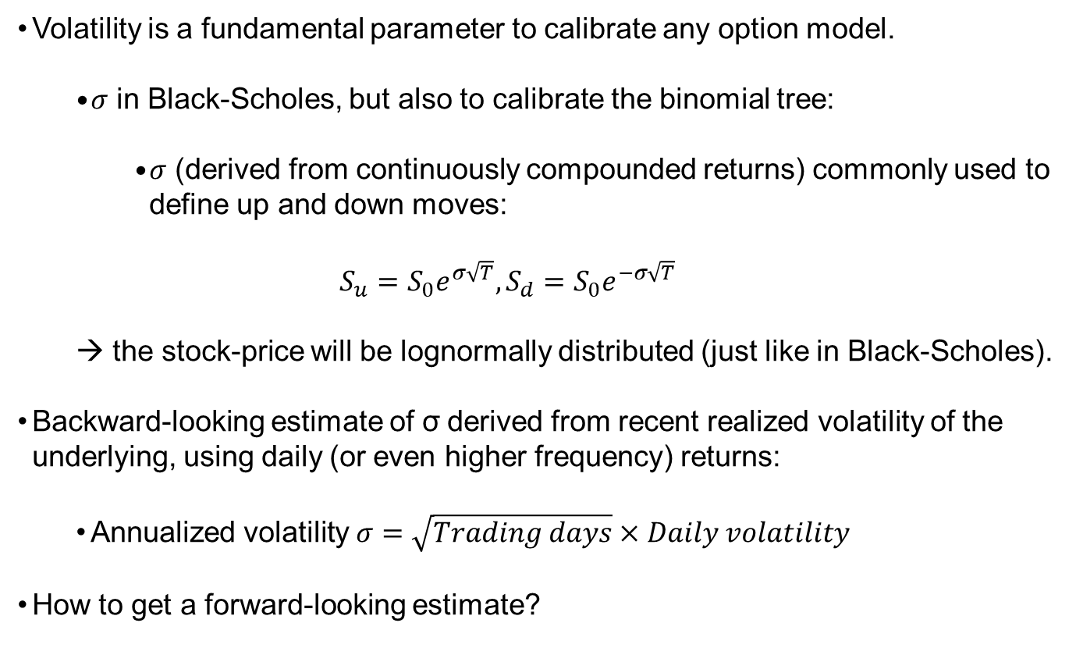
Volatility calibration
Volatility is a fundamental parameter to calibrate any option model.
  $σ$ in Black-Scholes, but also to calibrate the binomial tree:
    $σ$ (derived from continuously compounded returns) commonly used to define up and down moves:
  $$S_{u}=S_{0}e^{σ\sqrt{T}}, S_{d}=S_{0}e^{−σ\sqrt{T}}$$
  → the stock-price will be lognormally distributed (just like in Black-Scholes).
Backward-looking estimate of $\text{σ}$derived from recent realized volatility of the underlying, using daily (or even higher frequency) returns:
  Annualized volatility $σ=\sqrt{Trading days}×Daily volatility$
How to get a forward-looking estimate?

Slide 45
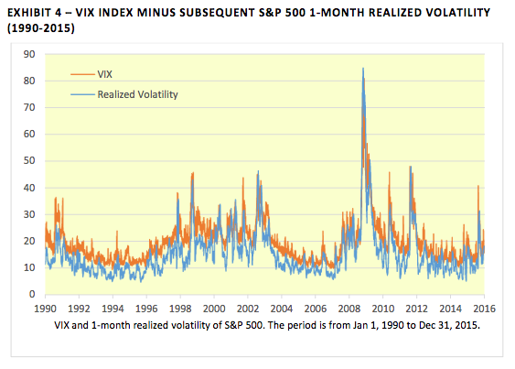
Implied Volatility (IV)
IV is the volatility that sets Black-Scholes price = Market price
  IV is inherently forward-looking, but recall that it also contains information about variance risk premia
  VRP = IV – ex post realized vol → on average, VRP>0 for S&P500 options:
VIX: Index of implied volatility from 30-day options on the S&P500 index
  “Fear factor” for the whole market
  https://www.cboe.com/tradable_products/vix/
  VRP>0 implies that, on average, it pays to sell volatility insurance (e.g., short straddle). Every now and then, such strategies lose big though!
Note: At the end of day t, VIX derived from options expiring in t+30 days and ex post realized volatility defined using returns from day t+1 to t+30.

Slide 46
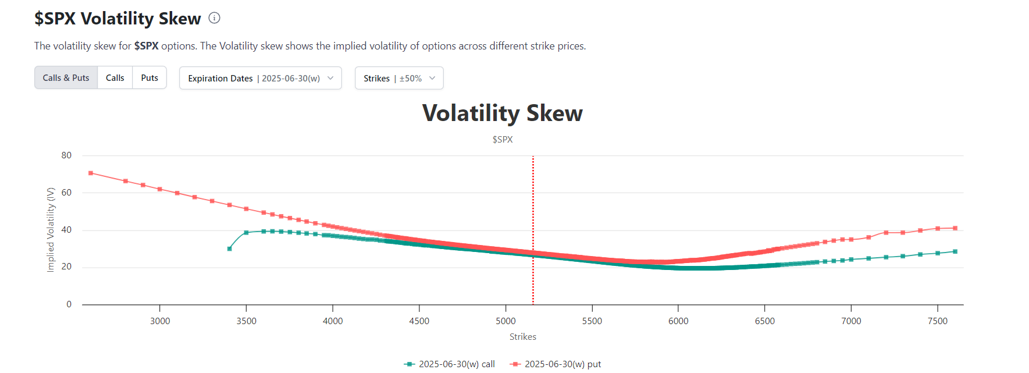
The volatility smile & smirk
Black-Scholes assumes that IV is the same for all strike prices
This is not what we see in the data, though:
Smile: far in/out-of-the-money options have higher IV
Smirk: largest IV for OOM puts
  Among other things, stochastic volatility and leverage effect make extreme negative returns more likely than assumed in BS and thus traded OOM put option prices are higher than what BS predicts
    Leverage effect: negative price shocks lead to higher volatility
    Or maybe OOM puts are just overpriced…

Slide 47
Application: Apple options
On 20-11-2024, Apple stock was trading at a price of 228.28. An American call and put on a stock of Apple with expiration on 29-11-2024 and a strike price of 220 were traded at 9.25 and 0.6, respectively. The historical volatility of daily returns on Apple stock was 17.1% (annualized). The short-term risk-free rate was 4.55% (annualized). Apple had recently paid a dividend.
Estimate the price of the call and put using the Black-Scholes model and the above data.
Compare your estimated prices to the market prices and discuss why they may be different.
Estimate the implied volatility of the call option and compare to the historical volatility.

Slide 48
0DTE options (1/2)
Retail trading volumes in zero-days to expiry options (0DTE) have recently exploded (partly due to easy access through brokerage platforms)
  Roughly 50% of all S&P500 option trading volume is in 0DTEs!
  Directional and volatility bet @ tiny cost, because premiums for ultra-short maturity options are small

Slide 49
0DTE options (2/2)
Interesting questions:
  Who benefits?
    Most evidence (e.g., Beckmeyer et al., 2024) suggests that retail traders are losing, not only due to poor positioning, but also because they simply trade too much (transaction costs)
    Remember roulette…
  Feedback effects on the price of the underlying?
    Suppose retail demand for 0DTE calls ↑ → market maker writes calls and if he cannot find a natural counterparty fast, he hedges (through replication) by buying the underlying → underlying price ↑ → retail demand ↑ because call options in the money → …
    These effects are much less of an issue at lower frequency, for instance, because market maker has more time to find a counterparty that wants to go short.
  What is the point?
    Economically, it would be much more interesting to have liquid long-term options, for instance, to (i) hedge longer-term uncertainty (ii) compensate managers, or (iii) derive maturity-specific discount rates/ expected returns for individual stocks and stock indexes.

Slide 50
Concept checks
[T/F] If the ATM 1-year call and put prices are equal, then the risk-free rate must be zero.
[T/F] Everything else constant, as time goes by, an in-the-money call option gains in value since it gets closer to maturity.
[T/F] The delta of a put goes to -1 as the stock price goes to zero
[T/F] The smile in options contradicts one of the assumptions of the Black-Scholes model
Consider forming the following portfolio:
Short position in one call option on ABC stock with exercise price of $100, which costs $0.375 and;
Long position in one put option on ABC stock with exercise price of $95, which costs $6.25.
You know that both options have one year to maturity. What is your return if the price of one share of ABC stock, at maturity of the options, is $93?
Notes:
If there is no dividend, T, otherwise F
F
T
T
m

Slide 51
Extra: Real options are just options…
You are considering buying a steel mill. The mill can only be operated next year and can produce a maximum of 60 million pounds of steel. Steel prices will be either high or low next year. The current price of steel is $1.30 per pound. In the high state, the steel price will rise to $1.52 per pound and in the low state it will fall to $1.14 per pound. If you buy the mill, you will be able to smelt steel at a variable cost of $1.30 per pound. You can decide how much steel to produce after observing prices in a year. The risk-free rate is 5%.
What is the maximum amount you would be willing to pay for the mill?
What is the value of the option to choose production levels after observing steel prices? (To answer this question, you need to think about how much to produce if you had to choose ex ante.)

