Slide 1

Investments
Masters in Finance
Spring 2025, Martijn Boons
Book Chapter 10

Slide 2
Beta is dead!
The CAPM is rejected in the data:
  Huge body of work shows that the CAPM in its basic form does not explain well variation across assets in average returns:
Corr(average returns, market betas) << 1
Let us consider some of the most powerful evidence to this conclusion from Fama and French (1992)
Sort stocks (at the end of month t) separately on two characteristics that are known to generate a spread in average returns (in month t+1)
  Size (Market Cap): Small firms historically outperformed big firms. Why?
    Perhaps small firms are less diversified?
    But, investors diversify by investing in many stocks…
  BM (book-to-market): High book-to-market firms (Value) historically outperformed low book-to-market firms (Growth). Why?
    When market value is low relative to book value (of firm’s projects), a large discount rate must have been applied.
    Is this larger discount rate appropriate for the firm’s risk or mispricing?

Slide 3

Fama and French (1992) Reject CAPM
Excel: excess returns on 2x10 value-weighted portfolios from 1961 to 2010. (Market portfolio=value-weighted portfolio of all US stocks and $r_{F}$=1 month t-bill return.)
Time series: CAPM alpha almost monotonically decreasing (increasing) in Size (BM), with large alpha of 3.5% (7.1%) for Small-Big (High-Low).
Cross-section: $λ_{M}=5.8\%$, which is close to average excess market return, but R² still only 13% → CAPM beta explains very little variation in average returns across the portfolios.

Slide 4
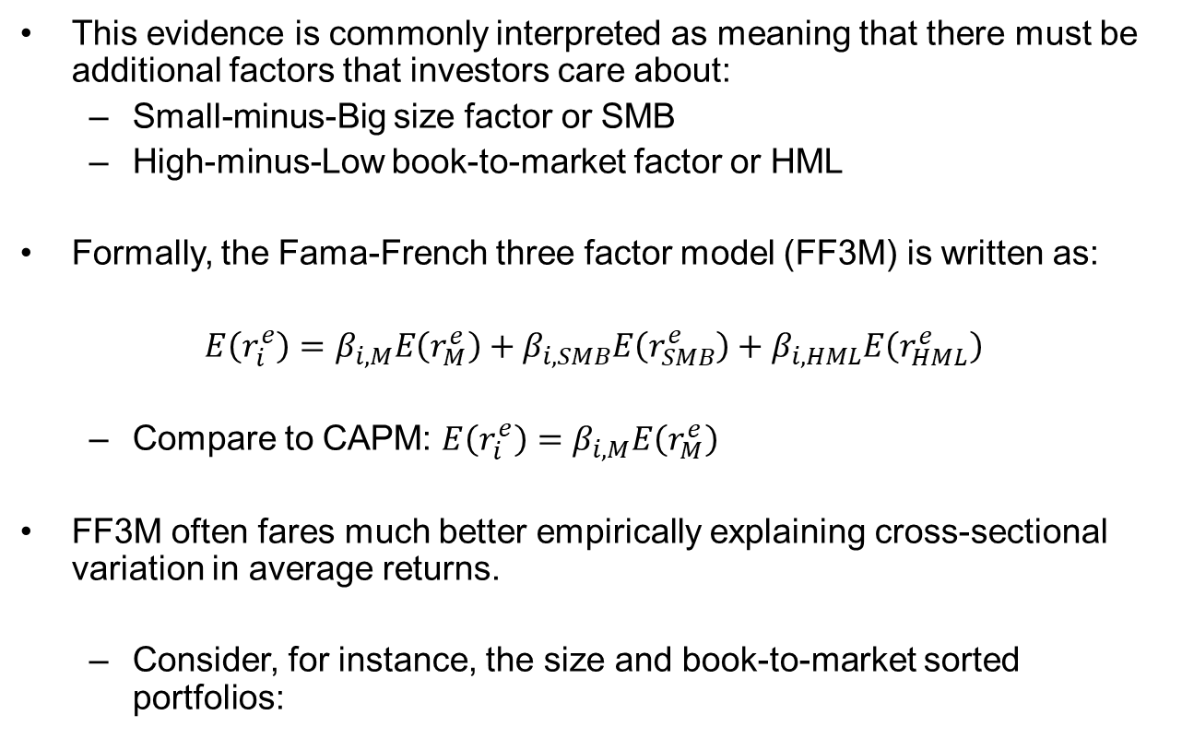
The Fama-French three-factor model
This evidence is commonly interpreted as meaning that there must be additional factors that investors care about:
  Small-minus-Big size factor or SMB
  High-minus-Low book-to-market factor or HML
Formally, the Fama-French three factor model (FF3M) is written as:
$E\left(r_{i}^{e}\right)=β_{i,M}E\left(r_{M}^{e}\right)+β_{i,SMB}E\left(r_{SMB}^{e}\right)+β_{i,HML}E\left(r_{HML}^{e}\right)$
  Compare to CAPM: $E\left(r_{i}^{e}\right)=β_{i,M}E\left(r_{M}^{e}\right)$
FF3M often fares much better empirically explaining cross-sectional variation in average returns.
  Consider, for instance, the size and book-to-market sorted portfolios:

Slide 5

FF3M vs CAPM
Time series: small alphas for portfolios sorted on size, book-to-market
  Same conclusion applies to portfolios sorted on many other characteristics (Fama and French (1996))
Cross-section: $\hat{r_{i,t+1}^{e}}=λ_{0}+λ_{M}\hat{β_{i,M}}$ $+λ_{SMB}\hat{β_{i,SMB}}+λ_{HML}\hat{β_{i,HML}}+a_{i}$
  Exposure to SMB and HML factors improves R² dramatically (95% vs 13% before), i.e., SMB and HML betas explain lots of cross-sectional variation in average returns!

Slide 6
Size and book-to-market factors
We have a better factor model: great!
But, what risks do SMB and HML capture? How do these factors follow from investors’ portfolio choices (like CAPM follows from observation that market=tangency)?
Fama-French allude to interpretation that the new factors provide investors exposure to business cycle risk and therefore capture a risk premium (over and on top of market beta)
  Small and High BM stocks have episodes with large losses that broadly coincide with bad times/recessions
  Business cycles do not perfectly align with poor market returns
→ Thus, these stocks are systematically risky: Low P & High E(R)

Slide 7
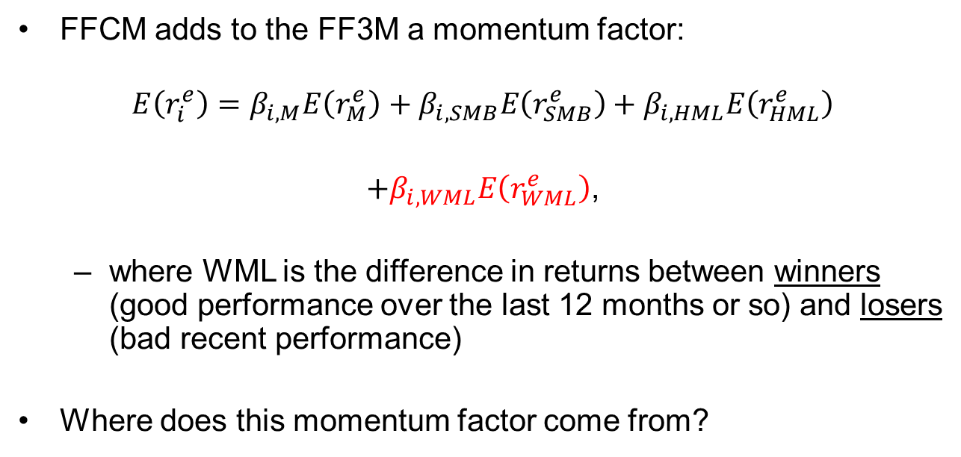
Carhart’s four factor model (FFCM)
FFCM adds to the FF3M a momentum factor:
$$E\left(r_{i}^{e}\right)=β_{i,M}E\left(r_{M}^{e}\right)+β_{i,SMB}E\left(r_{SMB}^{e}\right)+β_{i,HML}E\left(r_{HML}^{e}\right)$$
$+β_{i,WML}E\left(r_{WML}^{e}\right)$,
  where WML is the difference in returns between winners (good performance over the last 12 months or so) and losers (bad recent performance)
Where does this momentum factor come from?

Slide 8
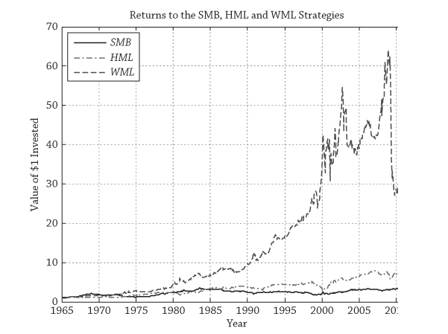
Momentum returns are huge…

Slide 9
Momentum returns are risky
Momentum crashes: Of the eleven largest momentum crashes, seven occurred during the Great Depression in the 1930s, one occurred in 2001, and the other three occurred during the financial crisis
    WML strategy lost > 50% (!) from March to April 2009
Since momentum combines large average returns with business cycle risk, WML is a natural risk factor.
Momentum strategies provide large on average, but risky returns in almost any asset class
  “Value and Momentum Everywhere” (Asness, Moskowitz, Pedersen (2011))

Slide 10
On the origins of multifactor models
Arbitrage Pricing Theory was developed by Steve Ross
APT: If firm-specific risks are uncorrelated, they can be diversified away in large portfolios → Idiosyncratic risk should not be priced
Factor risk cannot be avoided
  Factors capture risks that determine bad times for a sufficiently large set of investors
    Candidates: interest rate shocks, inflation shocks, oil price shocks, illiquidity shocks, monetary policy shocks, and so on.
    Factor affect large set of assets through covariance
  If these shocks do not perfectly align with market returns, factor portfolios must receive a risk premium
    Factor portfolios are long stocks with high exposure to one or more of these risks and short stocks with low exposure
    Long-short factor portfolios capture a non-zero CAPM alpha
      Sign of the alpha depends on whether increase in the risk factor is good or bad news: inflation versus GDP news

Slide 11
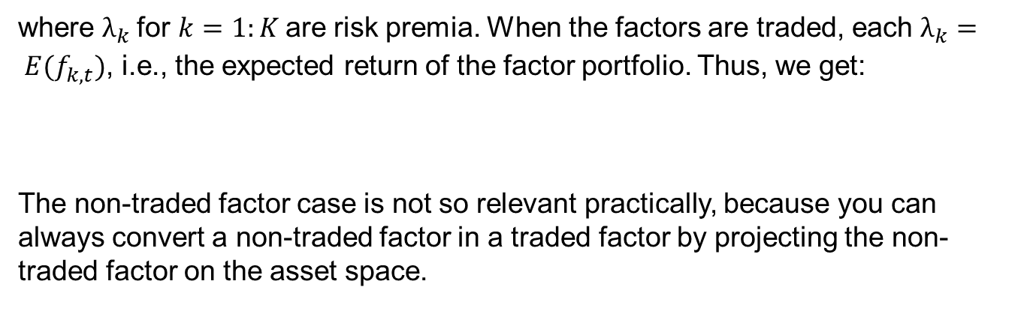

APT return generating process
The APT posits that K factors explain all common or systematic variation in asset returns:
Factor risk: cannot be diversified away
Firm-specific risk
$$r_{i,t}^{e} =β_{i,1}f_{1,t}^{}{+β}_{i,2}f_{2,t}^{}{+…+β}_{i,K}f_{K,t}^{}+{\text{ε}}_{i,t}^{}$$
${E(r}_{i}^{e})=$ $β_{i,1}λ_{1}{+β}_{i,2}λ_{2}{+…+β}_{i,K}λ_{K}$
${E(r}_{i}^{e})=$ $β_{i,1}{E(f}_{1,t}^{}){+β}_{i,2}E(f_{2,t}^{}){+…+β}_{i,k}{E(f}_{k,t}^{}).$
Consequently, exposure to each of the K factors is priced in equilibrium:
where $λ_{k}$for $k=1:K$are risk premia. When the factors are traded, each $λ_{k}= {E(f}_{k,t}^{})$, i.e., the expected return of the factor portfolio. Thus, we get:
The non-traded factor case is not so relevant practically, because you can always convert a non-traded factor in a traded factor by projecting the non-traded factor on the asset space.

Slide 12
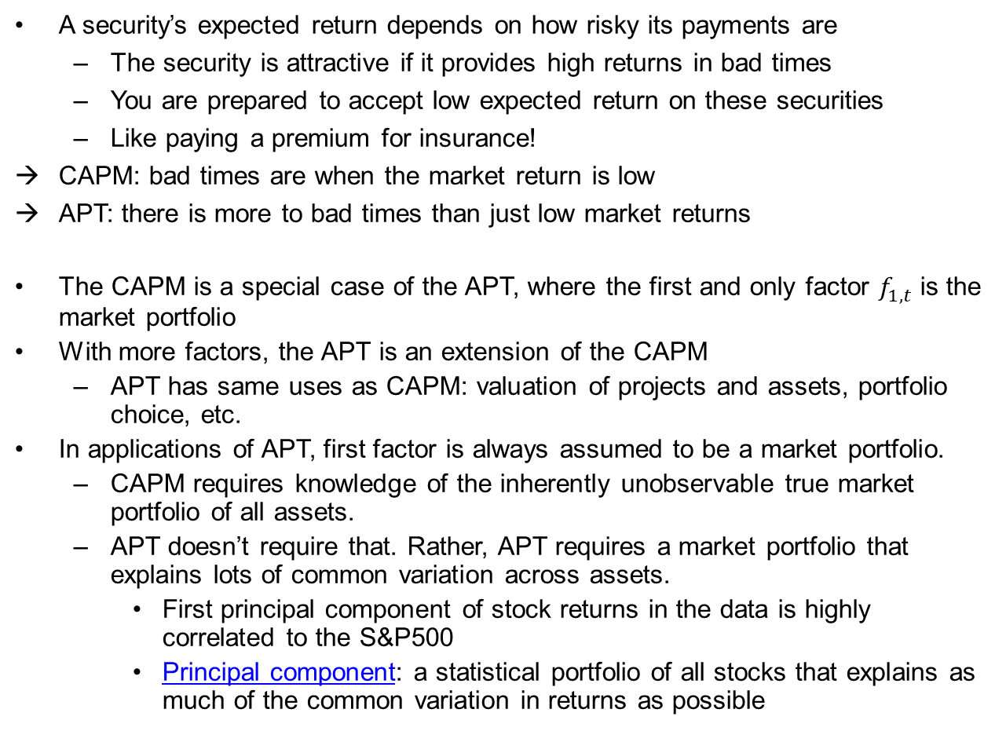
APT vs CAPM
A security’s expected return depends on how risky its payments are
  The security is attractive if it provides high returns in bad times
  You are prepared to accept low expected return on these securities
  Like paying a premium for insurance!
CAPM: bad times are when the market return is low
APT: there is more to bad times than just low market returns
The CAPM is a special case of the APT, where the first and only factor $f_{1,t}^{}$ is the market portfolio
With more factors, the APT is an extension of the CAPM
  APT has same uses as CAPM: valuation of projects and assets, portfolio choice, etc.
In applications of APT, first factor is always assumed to be a market portfolio.
  CAPM requires knowledge of the inherently unobservable true market portfolio of all assets.
  APT doesn’t require that. Rather, APT requires a market portfolio that explains lots of common variation across assets.
    First principal component of stock returns in the data is highly correlated to the S&P500
    Principal component: a statistical portfolio of all stocks that explains as much of the common variation in returns as possible

Slide 13
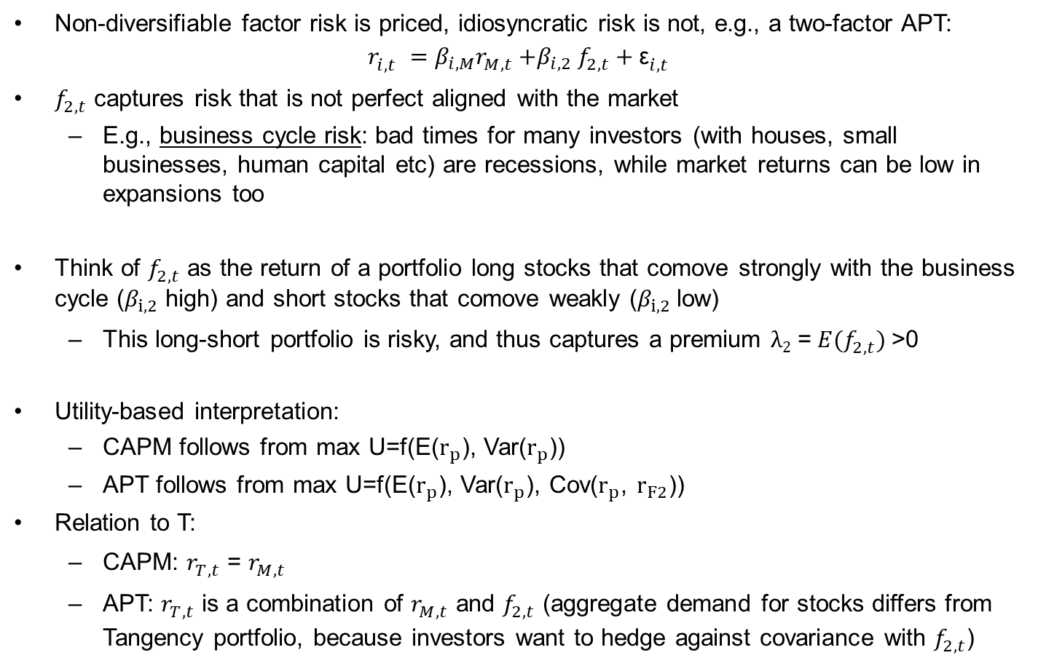
Overview
Non-diversifiable factor risk is priced, idiosyncratic risk is not, e.g., a two-factor APT:
$$r_{i,t}^{} =β_{i,M}r_{M,t}^{}{+β}_{i,2}f_{2,t}^{}+{\text{ε}}_{i,t}^{}$$
$f_{2,t}^{}$ captures risk that is not perfect aligned with the market
  E.g., business cycle risk: bad times for many investors (with houses, small businesses, human capital etc) are recessions, while market returns can be low in expansions too
Think of $f_{2,t}^{}$ as the return of a portfolio long stocks that comove strongly with the business cycle ($β_{i,2}$ high) and short stocks that comove weakly ($β_{i,2}$low)
  This long-short portfolio is risky, and thus captures a premium $λ2$ = $E(f_{2,t}^{})$>0
Utility-based interpretation:
  CAPM follows from max U=f(E($r_{p}$), Var($r_{p}$))
  APT follows from max U=f(E($r_{p}$), Var($r_{p}$), Cov($r_{p}$, $r_{F2}$))
Relation to T:
  CAPM: $r_{T,t}^{}$ = $r_{M,t}^{}$
  APT: $r_{T,t}^{}$ is a combination of $r_{M,t}^{}$ and $f_{2,t}^{}$ (aggregate demand for stocks differs from Tangency portfolio, because investors want to hedge against covariance with $f_{2,t}^{}$)

Slide 14


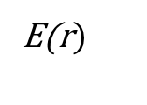



Graphical illustration of a two-factor APT
$$r_{i,t}^{} =β_{i,M}r_{M,t}^{}{+β}_{i,2}f_{2,t}^{}+{\text{ε}}_{i,t}^{}$$
E(r$)$
CAL
MVE portfolios of all risky assets
$$T$$
Combinations of M and f₂
$${E(r}_{T})$$
$$f_{2}^{}$$
$$M$$
$$r_{f}$$
St. Dev.
Market portfolio is not efficient anymore (i.e., M≠T)
Rather, M and f₂ can be combined to get T
  → This means that M and f₂ together price assets

Slide 15
APT implementations
Following Fama and French’s preferred interpretation of the factors in their FF3M, empirical factors are routinely considered APT risk factors
  Empirical factor returns comove with the risks that determine bad times for investors
    SMB and HML correlate strongly with second and third principal component of stock returns in the data, so they do capture considerable comovement.
    WML does not seem to capture as much comovement and Fama and French explicitly do not include it in their model...
      They consider WML an anomaly (next topic)
  Factors are long-short portfolios (excess returns): aggregated over all investors, they must still own the market portfolio
  More recently, Fama and French have been advocating for a 5 factor model: FF3+profitability and investment factors

Slide 16
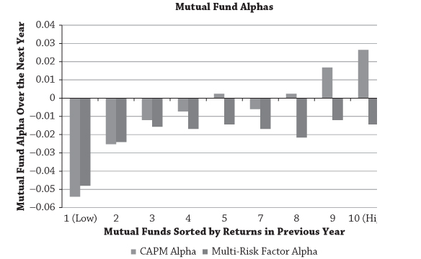
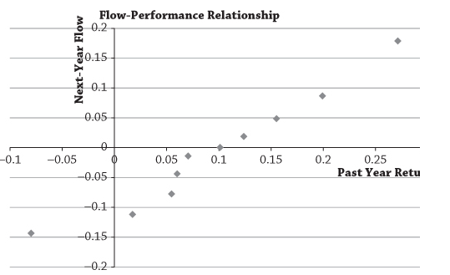
Application 1
Perhaps unsurprisingly, multifactor models typically outperform the CAPM by a large margin in asset pricing tests, i.e., explaining (i) cross-sectional variation in historical average returns of portfolios and (ii) returns of mutual funds and hedge funds
  Did the manager do something special or did he just load on something we knew about already?
From Andrew Ang’s Asset Management book:
Negative average alpha (CAPM and FFCM)
No persistence in high Carhart 4-factor alphas
Yet, investors chase returns:

Slide 17
The reality of active mutual fund performance
Mutual funds advertise high past performance (in general)
  Marketing: average return, Sharpe ratio, CAPM alpha, FF3 alpha,…?
  Survivorship bias: Average return of live (covered by databases) minus dead (not covered) funds is about 4% per year!
The reality: three stylized facts
    The typical active mutual fund delivers a negative alpha after costs, and, at best, a slightly positive alpha before costs
      Large funds perform worst: alpha opportunities are hard to scale, as concentrated in small, illiquid, distressed stocks
    In addition, positive alpha is not persistent (in contrast to negative alpha)
    Yet, investors chase returns!
What can explain these stylized facts?
  Iow: Why are we paying fund managers so much through fees?
  Interview with Jonathan Berk (https://www.youtube.com/watch?v=a41LhZE5Iec )

Slide 18
Intuition (Berk & Green, 2005; Berk & v. Binsbergen, 2015)
A rational equilibrium model that fits these stylized facts:
  Managers have differential talent
  Decreasing returns to scale
Investors chase returns: 1st-best historical return is most likely achieved by the most-skilled manager (with highest E(return))
  This fund receives all new money flows from investors
  Fund becomes bigger, and its E(return) will decrease until its equal to the 2nd-best E(return)
    Now, new money will flow to the 1st- and 2nd-best fund and their E(return) decreases to 3rd-best fund … and so on …
In equilibrium
  E(return) on all funds are equal and investors will be indifferent between active and passive investing
  Highly skilled managers do not obtain a positive alpha after fees, but will manage larger funds and earn higher fees
  Skill is not measured by alpha after fees, but by
    [alpha before fees * size of the fund]!

Slide 19
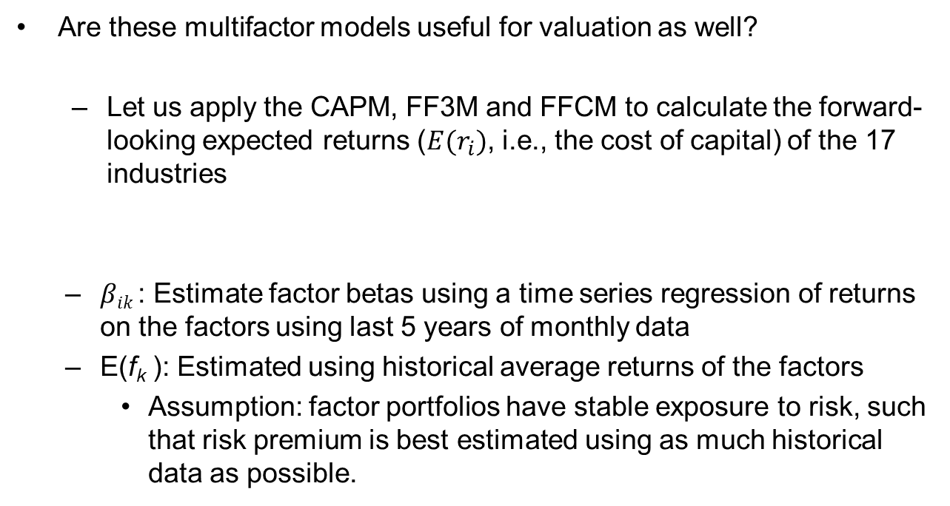
Application 2
Are these multifactor models useful for valuation as well?
  Let us apply the CAPM, FF3M and FFCM to calculate the forward-looking expected returns ($E(r_{i})$, i.e., the cost of capital) of the 17 industries
  $βik$: Estimate factor betas using a time series regression of returns on the factors using last 5 years of monthly data
  E(f_{k} ): Estimated using historical average returns of the factors
    Assumption: factor portfolios have stable exposure to risk, such that risk premium is best estimated using as much historical data as possible.
$$E\left(r_{i}^{e}\right)=β_{i,M}E\left(r_{M}^{e}\right)+β_{i,SMB}E\left(r_{SMB}^{e}\right)+β_{i,HML}E\left(r_{HML}^{e}\right)+β_{i,WML}E\left(r_{WML}^{e}\right)$$

Slide 20
Forward-looking expected returns of 17 industries
Expected returns similar across the three models, suggesting that the CAPM may not be such a bad model to do valuation after all.
Many analysts are working under this assumption!

Slide 21
Conclusions
Our chosen application with well-diversified industry portfolios is quite friendly to the multi-factor models
  Exposures
    When the models are applied to individual stocks, additional noise will be introduced by having to estimate multiple betas over a recent window
  Risk premia
    We have used average excess factor returns over a long history as our estimates of factor risk premia. If you want to improve your forward-looking estimates of the factor risk premia, you will need to estimate them, which introduces additional noise.
  As a result, forward-looking expected returns from multifactor models may be extreme and farther off from reality than a simpler model like CAPM.

Slide 22
Factor models (1/2)
Factor models are extremely useful to estimate the variance-covariance matrix for many assets
  This is a key input in portfolio optimization
  Regardless of whether you believe factors are truly APT risk factors or just capturing mispricing (e.g., due to correlated trading and investor sentiment)
Returns of assets have two components
  Systematic risk
    Small number of factors
    Proxy for economic events (changes in interest rates, inflation, GDP growth)
    Affect large numbers of assets
  Non-systematic risk
    Unique to each asset (new product innovations, changes in management, lawsuits, labor strikes, etc)
    Uncorrelated across assets
Equations that break down an asset’s return into these two components are called factor models

Slide 23
Factor models (2/2)
where
  α: expected excess return when factors are zero
  f: common factors (1…K)
  β: sensitivities of assets to factors
  e: idiosyncratic (firm-specific) risk, uncorrelated with the factors and across firms, with E(e) = 0 → shocks or surprises about the firm

Slide 24
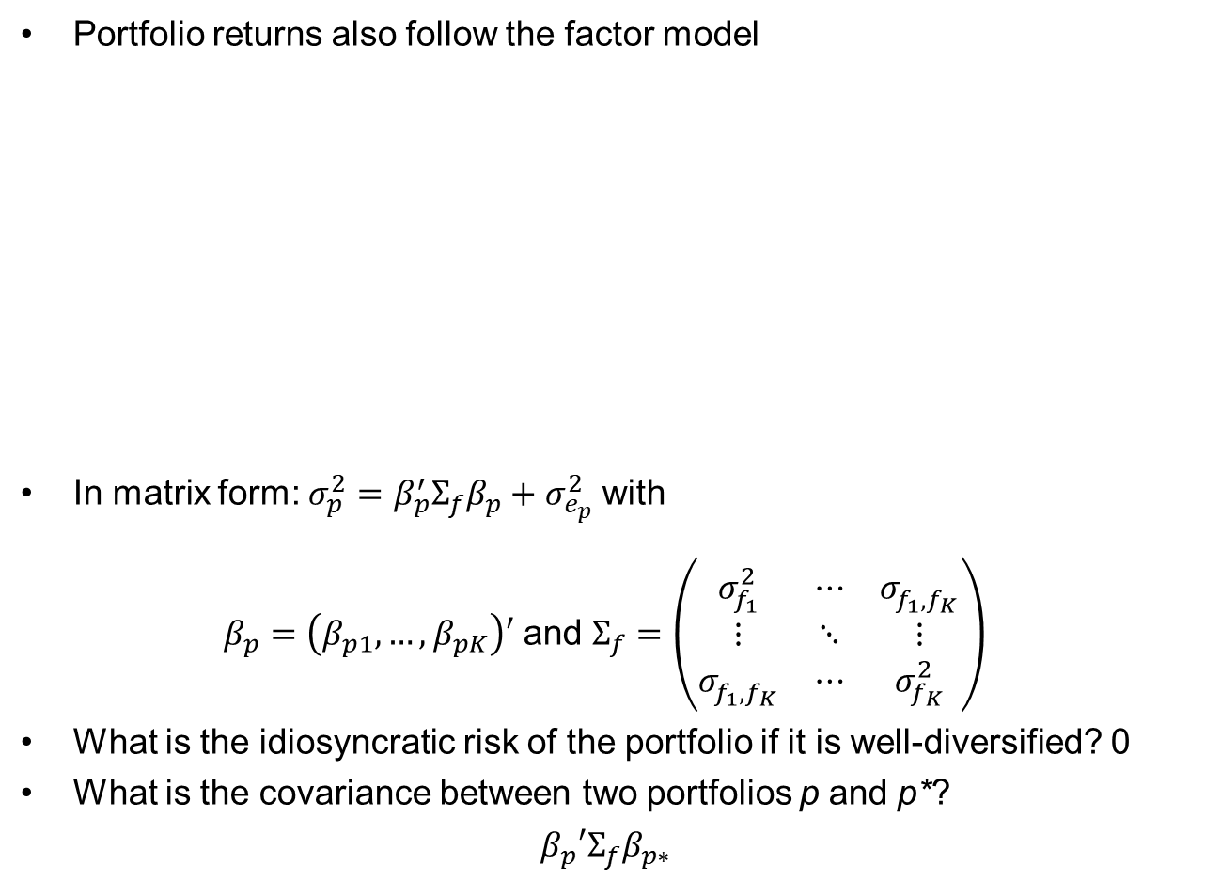
Portfolio risk
Portfolio returns also follow the factor model
In matrix form: ${σ_{p}^{2}=β}_{p}^{′}Σ_{f}β_{p}+$ $σ_{e_{p}}^{2}$ with
$β_{p}=\left(β_{p1},…,β_{pK}\right)′$ and $Σ_{f}=\left(\begin{matrix}σ_{f_{1}}^{2} & ⋯ & σ_{f_{1},f_{K}}^{} \\ ⋮ & ⋱ & ⋮ \\ σ_{f_{1},f_{K}}^{} & ⋯ & σ_{f_{K}}^{2}\end{matrix}\right)$
What is the idiosyncratic risk of the portfolio if it is well-diversified? 0
What is the covariance between two portfolios p and p*?
$β_{p}′Σ_{f}β_{p∗}$

Slide 25
Factor models and MV analysis
Even in the US, there are about 7,000 listed stocks
MV analysis requires 24.5 million numbers
  7,000 variances
  24,496,500 covariances
When N>T, there is a lot of estimation error and the covariance matrix is ill conditioned – it will blow up when inverted for portfolio optimization
With K factors, you need fewer numbers (7,000+K/2)(K+1))
  7,000K betas
  7,000 residual variances
  K(K+1)/2 factor variances and covariances
More robust estimate of covariance matrix
  All real-world risk management tools use a factor approach
  E.g., Bloomberg factor model

Slide 26

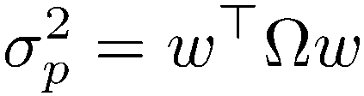
Factor models and MV analysis
Factor models are a good way to estimate the covariance matrix of stocks
B is an N×K matrix with the estimated betas of all stocks
Σ is the covariance matrix of the factors
U is a diagonal matrix with the variances of the epsilons
The variance of a portfolio with a vector of weights w is then
This approach to estimating the covariance matrix of stocks has much less estimation error than the sample covariance matrix
This is the basic building block of any risk management system

Slide 27
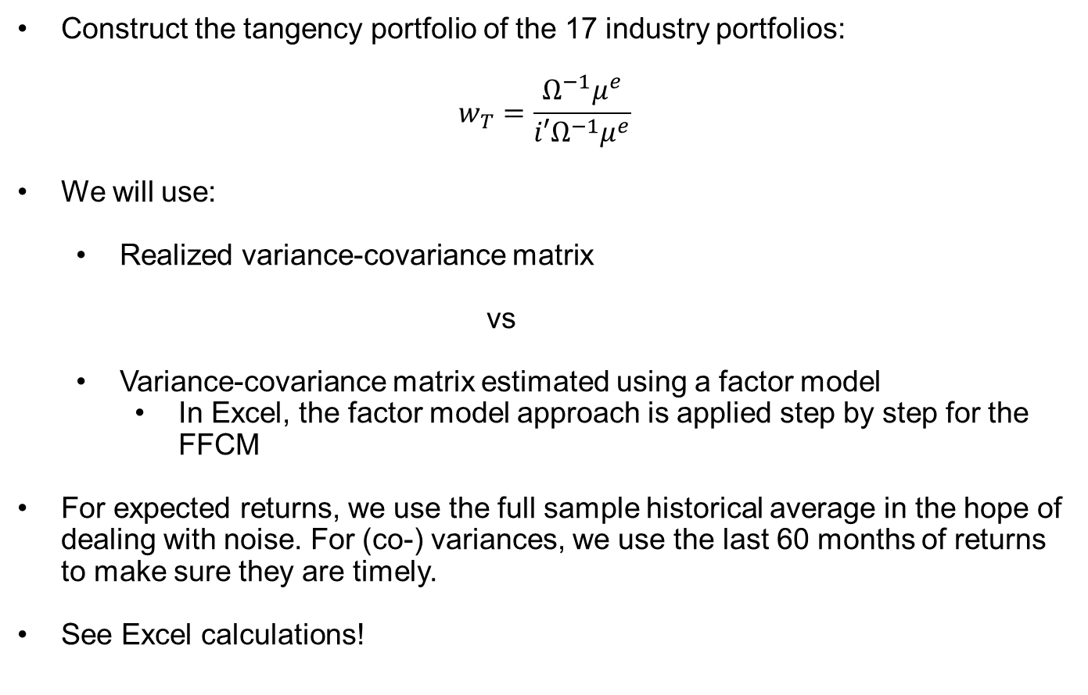
Example: Setup
Construct the tangency portfolio of the 17 industry portfolios:
$$w_{T}=\frac{Ω^{−1}μ^{e}}{i′Ω^{−1}μ^{e}}$$
We will use:
  Realized variance-covariance matrix
  vs
  Variance-covariance matrix estimated using a factor model
    In Excel, the factor model approach is applied step by step for the FFCM
For expected returns, we use the full sample historical average in the hope of dealing with noise. For (co-) variances, we use the last 60 months of returns to make sure they are timely.
See Excel calculations!

Slide 28
Example: Results
Results: Optimal weights are much more extreme for unconstrained approach than for factor-model approach
  Among factor models, smaller models have less extreme weights.
  Less extreme weights are cheaper to invest and tend to perform better in practice when subsequent portfolio performance is considered in an out-of-sample test.
    This is what assignment analyzes with holdout sample!

Slide 29
Summing up
Multifactor models useful to explain returns of (real-world) portfolios and popular for estimating portfolio risk:
  given assets’ betas wrt to the factors and a forward-looking estimate of the factors’ variance-covariance matrix, you can predict portfolio risk.
CAPM more popular for valuation and capital budgeting, because it relies on fewer inputs
  Risk premia: What is the forward-looking expected return of factors like SMB, HML, and WML?
    If risk: past average return is a good indicator.
    If mispricing: the past is not a good indicator, because mispricing will be corrected.
  Exposures: multifactor betas are harder to estimate and much less persistent (or predictable) than market betas
    a firm that has a high-book-to-market ratio now will not likely have a high book-to-market ratio 5 years from now.
    As a result, one should NOT discount all future cash flows at the higher rate applied to high book-to-market firms today.
  The appropriate discount rate for firms’ long-term cash flows is probably close to the market risk premium (see)
    This is the assumption maintained by the vast majority of equity analysts.

Slide 30
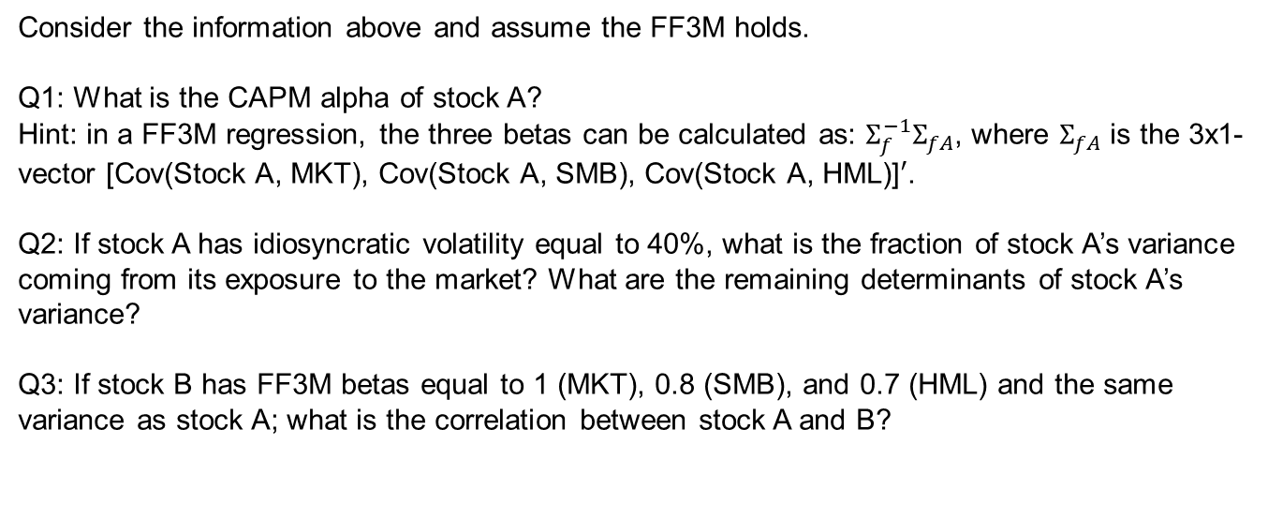
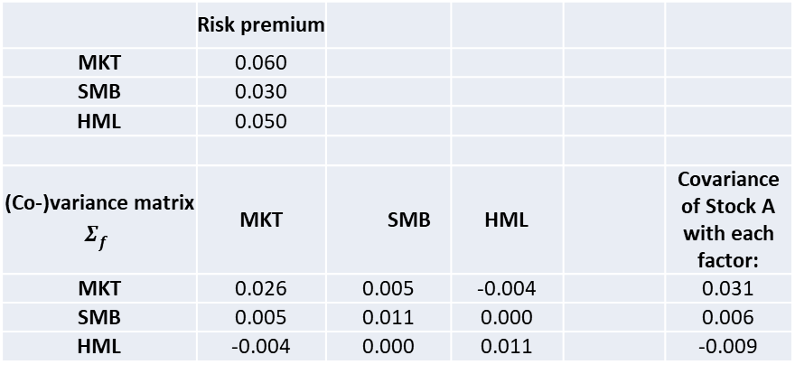
Exercise
 | Risk premium
MKT | 0.060
SMB | 0.030
HML | 0.050
(Co-)variance matrix $Σ_{f}^{}$ | MKT | SMB | HML |  | Covariance of Stock A with each factor:
MKT | 0.026 | 0.005 | -0.004 |  | 0.031
SMB | 0.005 | 0.011 | 0.000 |  | 0.006
HML | -0.004 | 0.000 | 0.011 |  | -0.009
Consider the information above and assume the FF3M holds.
Q1: What is the CAPM alpha of stock A?
Hint: in a FF3M regression, the three betas can be calculated as: $Σ_{f}^{−1}Σ_{fA}$, where $Σ_{fA}$ is the 3x1-vector [Cov(Stock A, MKT), Cov(Stock A, SMB), Cov(Stock A, HML)]$′$.
Q2: If stock A has idiosyncratic volatility equal to 40%, what is the fraction of stock A’s variance coming from its exposure to the market? What are the remaining determinants of stock A’s variance?
Q3: If stock B has FF3M betas equal to 1 (MKT), 0.8 (SMB), and 0.7 (HML) and the same variance as stock A; what is the correlation between stock A and B?

