Slide 1

Investments
Masters in Finance
Spring 2025, Martijn Boons
Chapters 11, 12, 13

Slide 2
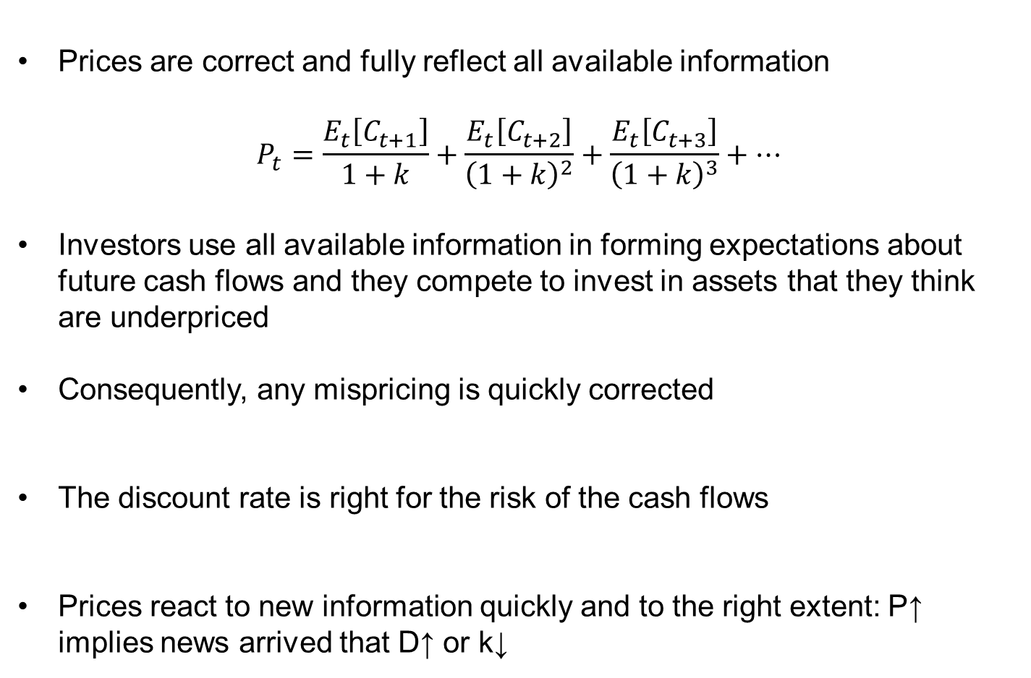
What is market efficiency?
Prices are correct and fully reflect all available information
$$P_{t}=\frac{E_{t}\left[C_{t+1}\right]}{1+k}+\frac{E_{t}\left[C_{t+2}\right]}{{\left(1+k\right)}^{2}}+\frac{E_{t}\left[C_{t+3}\right]}{{\left(1+k\right)}^{3}}+…$$
Investors use all available information in forming expectations about future cash flows and they compete to invest in assets that they think are underpriced
Consequently, any mispricing is quickly corrected
The discount rate is right for the risk of the cash flows
Prices react to new information quickly and to the right extent: P↑ implies news arrived that D↑ or k↓

Slide 3
The Efficient Market Hypothesis
The only way you can get higher returns is by taking on more risk
There is no information out there that can be used to construct strategies that earn returns higher than what is justified by their risk
When we say “prices are correct”, we are implicitly stating what “correct” is: we assume an asset pricing model to go from risk → discount rate
  Joint hypothesis problem: suppose a stock provides an alpha relative to the CAPM
    Is the EMH wrong?
    Is the CAPM wrong?

Slide 4
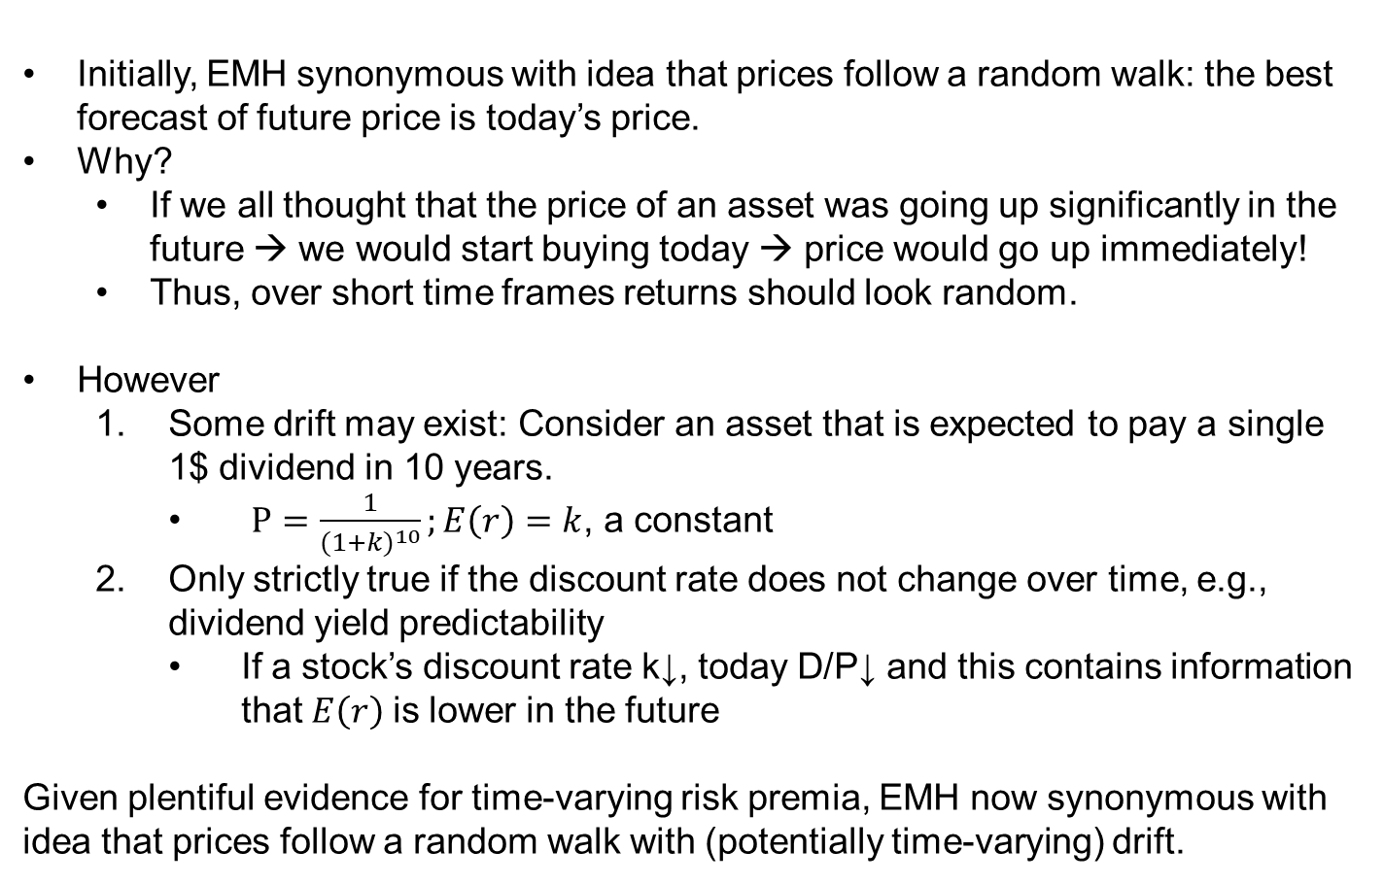
Random Walks
Initially, EMH synonymous with idea that prices follow a random walk: the best forecast of future price is today’s price.
Why?
  If we all thought that the price of an asset was going up significantly in the future → we would start buying today → price would go up immediately!
  Thus, over short time frames returns should look random.
However
  Some drift may exist: Consider an asset that is expected to pay a single 1$ dividend in 10 years.
    $P=\frac{1}{{(1+k)}^{10}};E\left(r\right)=k$, a constant
  Only strictly true if the discount rate does not change over time, e.g., dividend yield predictability
    If a stock’s discount rate k↓, today D/P↓ and this contains information that$E\left(r\right)$ is lower in the future
Given plentiful evidence for time-varying risk premia, EMH now synonymous with idea that prices follow a random walk with (potentially time-varying) drift.

Slide 5
Efficient wrt which information set?
What is the information set implicit in the stock’s market price, i.e., that is used to correctly discount the stock’s dividends given their systematic risk?
Type of information
Form of efficiency
Past Prices
Public
Private
Weak
Semi-strong
Strong

Slide 6
Weak form (past prices) (1/2)
Postulates that current prices fully reflect all information in past prices
  Using past prices, volatility, returns will produce no predictable patterns that can be exploited to yield abnormal returns in the future
  Observed patterns in data merely due to data mining and in-sample predictive power will not repeat out-of-sample
Technical analysis:
  Search for recurring and predictable patterns in prices
  Believe in slow response of prices to fundamentals, such that even weak-form EMH is violated
  Called “chartists” because they study charts of past stock prices and volumes
    Moving averages, patterns (e.g., head and shoulders)

Slide 7
Quiz – MKT or random?
Hint: the sample period is from 2000 to 2014
MKT=Blue, others are random with same mean and variance.
Do you believe that technical traders can get an alpha by identifying heads-and-shoulders in these types of graphs?
  I don’t think so, but maybe a machine can…

Slide 8
Weak form (past prices) (2/2)
Even if there are patterns, they are self-destructing
  Discovery leads to exploitation and ultimately invalidation
Big picture
  Evidence of return predictability based on past prices is rather weak
    Many discoveries do not replicate out-of-sample
    Many believe that the strategies that do work (e.g., momentum) are risky, costly to trade, and have low capacity.
  Just for the lucky few algorithmic traders located close to exchanges? (E.g., Rentec, Flow Traders, Citadel, etc.)
    Interpretation: algorithmic traders keep markets weak form efficient and they are compensated for doing so.
Notes:
Bid (to buy) 50 49 48 ask (to sell) 51 52 53, hit ask, price up, later refill

Slide 9
Semi-strong form (public information)
Postulates that current prices fully reflect all information in past prices AND all publicly available information
Fundamental analysis does not add value
  Sorting through income statements
  Studying industries and the macroeconomy
Some evidence for semi-strong efficiency
  Most stock-picking strategies do not provide an alpha over popular factor models
    Talking to the firm’s manager doesn’t give valuable info over knowing that the company is high book-to-market, profitable, past winner etc. (see Frazzini et al. 2013: Buffet’s Alpha)
  We already saw that professional money managers do not consistently generate alpha

Slide 10
Strong form (private information) (1/2)
Postulates that current prices fully reflect all information, public and private
Strong-form efficiency says that insider trading will not produce profits
  For instance, knowing that a merger will take place before it is publicly announced will not produce profits
Lots of evidence against this form of market efficiency
  Prices move before public announcements, suggesting insider information (see next slide)
  Known insider-information cases generated high payoffs… excluding jail time…
  Even SEC employees were allowed to trade stocks of the firms they were investigating
    Tracking SEC employees’ cell phones to know which firms they are targeting
  What about political insiders?

Slide 11
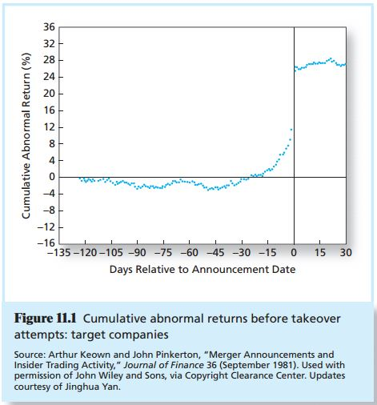
Strong form (private information) (2/2)

Slide 12
Why might markets not be efficient?
Grossman-Stiglitz paradox: if prices reflect all information, why does anyone bother?
  You need arbitrageurs to make prices efficient.
  Arbitrageurs require compensation for their efforts
Behavioral biases and limits to arbitrage
  People make mistakes and correcting them takes time and money: inefficiencies may last a while
    Familiarity bias and home bias: investors hold few stocks, from their own firm or country
    Overconfidence and sensation seeking
    Confirmation bias
I believe the amount of inefficiency is likely not huge, because:
    professional traders are quite unbiased and able
    ``economic survival of the fittest:’’ markets ultimately dominated by traders with fewer biases, as these make better investment decisions

Slide 13
The real effects of stock market (in-) efficiency
If markets were very inefficient, resources would be importantly misallocated.
  Firm with overvalued securities can raise capital too cheaply
  Firm with undervalued securities may have to pass up profitable opportunities because cost of capital is too high
Finance as a discipline is becoming more and more important, because society at large is increasingly aware of these real effects.
Efficient market ≠ perfect foresight market: even rational forecasts incorporating all currently available information may be (very) wrong

Slide 14
Concept check
a. The market risk premium moves countercyclical to the economy, peaking in recessions. A violation of the efficient market hypothesis would imply that investors could take advantage of this predictability and earn excess risk adjusted returns. However, several studies show that successfully timing the changes have eluded professional investors thus far. Moreover a changing risk premium implies changing required rates of return for stocks rather than an inefficiency with the market. So, no.
b. As the market risk premium increases during a recession, stocks prices tend to fall. As the economy recovers, the market risk premium falls, and stock prices tend to rise. These changes could give investors the impression that markets overreact, especially if the underlying changes in the market risk premium are small but cumulative.

Slide 15
Thinking about anomalies
In an efficient market, equilibrium E(r)’s are determined by systematic risk
Anomalies are strategies that provide an abnormal return that is seemingly not justified by the risk the strategy provides to investors
Whenever we talk about anomalies, we need to ask ourselves the following questions:
  The strategy may provide a CAPM alpha, but does it provide an alpha relative to broader measures of risk in multi-factor models, such as the FF3M or FF5M?
  If there is still alpha, is it market inefficiency/mispricing or data-mining?
  If not data-mining, is the strategy profitable taking into account transaction costs and other limits to arbitrage?
  If the strategy is profitable, it should not persist over time.
    If it does persist, why are people not trading? What is the risk?
    → [Back to 1.]

Slide 16
Curious anomalies
There is a whole range of documented anomalies that we are not going to talk about
  E.g., seasonal effects:
    Returns are on average negative on Monday
    Returns are on average positive Wednesday-Friday
    Returns are lower in summers than in winters
  Returns on announcement vs non-announcement days (macro- or firm-specific)
  Returns from opening to close vs from close to opening
Why ignore them?
  Economic: We (still) don’t really know where they come from
  Practice:
    We don’t know if they will persist
      Many seasonal effects disappeared after discovery
      State-of-the-art factor pricing models have increased the bar considerably for something to be called an anomaly
    We don’t know if they are investible

Slide 17
Anomalies into factors
Let us focus the discussion on anomalies in stocks
  Representative of other asset classes
We have already discussed early examples of anomalies:
  Size, book-to-market, and momentum: Small, high book-to-market, and recent winner stocks tend to outperform the CAPM
  Multi-factor models then included SMB, HML, and WML as factors, following APT reasoning
  Are we just going to keep converting anomalies into risk factors?
    Although these factors show some relation to bad ``times’’, it is still very much an open question whether risk is the whole story:
      Can risk fully explain the 20% annual alpha of the WML strategy?
        Or at least the alpha after transaction costs? Momentum is a high turnover, costly strategy (Novy-Marx and Velikov (2016))
      EMH taken too seriously may paradoxically sustain anomalies.
        “High return must be risky, so I am not trading it.”

Slide 18
Small-scale factor models
Recent research shows that out of the hundreds of additional anomalies that have been discovered in the cross section of stocks, few provide an alpha relative to the five-factor model (+momentum)
  Very very few: After further correction for transaction costs and a host of statistical issues (data-mining, multiple hypothesis testing)
  Similarly, new big data and machine learning techniques show that a handful of firm characteristics contain most relevant information about expected stock returns in the cross section (Kelly, Pruitt, Su (2020); DeMiguel et al. (2020); Jensen, Kelly, Malamud, Pedersen (2025))
    Remember: Buffett’s alpha is also mostly determined by selecting stocks on a handful of firm characteristics (rather than selecting stocks within the subset of all firms with those characteristics)

Slide 19
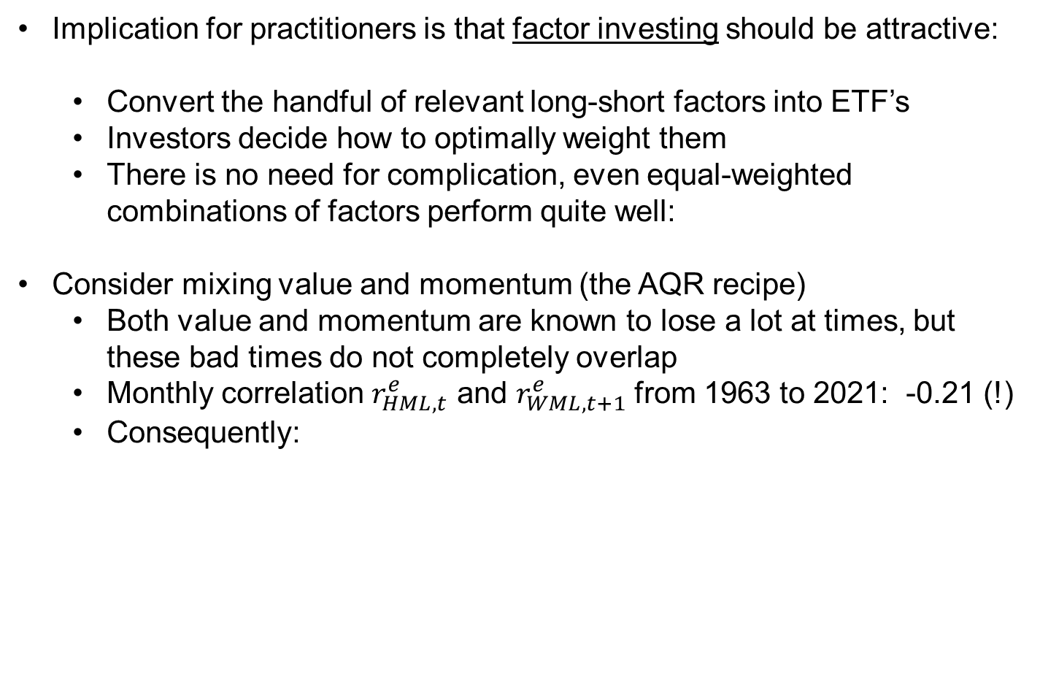
Factor investing
Implication for practitioners is that factor investing should be attractive:
  Convert the handful of relevant long-short factors into ETF’s
  Investors decide how to optimally weight them
  There is no need for complication, even equal-weighted combinations of factors perform quite well:
Consider mixing value and momentum (the AQR recipe)
  Both value and momentum are known to lose a lot at times, but these bad times do not completely overlap
  Monthly correlation $r_{HML,t}^{e}$ and $r_{WML,t+1}^{e}$ from 1963 to 2021: -0.21 (!)
  Consequently:
 | HML | WML | 5050MIX
Avg. Ret. | 3.30% | 7.45% | 5.38%
St. Dev. | 10.00% | 14.63% | 7.94%
Sharpe | 0.33 | 0.51 | 0.68

Slide 20
Factor investing (Simple)
Consider the following information on 5 equally large stocks that are ranked on value and momentum. Suppose an investor allocates +5% (-5%) to the top-2 (bottom-2) value and momentum stocks (relative to their “market value” of 20%). Note, 1=top, 5=bottom. Complete the hidden part of the table, using portfolio weights:
“Tilt”=increase/decrease relative to “market value”
“Characteristics Tilted Portfolio=CTP”=“market value” + “tilt”.
Stock # | 1 | 2 | 3 | 4 | 5
Exp. Exc. Ret. | 2.5% | 10.0% | 0.0% | 10.0% | 2.5%
Market Beta | 0.80 | 1.20 | 0.80 | 0.80 | 1.40
Market value | 20.0% | 20.0% | 20.0% | 20.0% | 20.0%
Value rank | 3 | 2 | 4 | 1 | 5
Momentum rank | 4 | 1 | 5 | 2 | 3
 |  |  |  |  |  | Exp. Exc. Ret. | Beta | CAPM Alpha
Market | 0.20 | 0.20 | 0.20 | 0.20 | 0.20 | 5.0% | 1.00 | 0.00
Tilt | -0.05 | 0.10 | -0.1 | 0.10 | -0.05 | 1.8% | 0.01 | 1.70%
CTP | 0.15 | 0.30 | 0.10 | 0.30 | 0.15 | 6.8% | 1.01 | 1.70%

Slide 21
Factor investing (Advanced)
Consider the following information on five equally large stocks that are ranked on value and momentum. Suppose an investor wants to create a zero-cost and zero-beta portfolio of these five stocks that maximizes CAPM alpha. The portfolio volatility cannot be larger than 10%, while the volatility of the equal-weighted market portfolio of the five stocks equals 20%.
What are the investor’s optimal weights in the five stocks? How do they compare to the “Tilt” from the previous slide?
Answer easily found using Excel Solver; weights are in same direction as before, but a lot more aggressive!
Stock # | 1 | 2 | 3 | 4 | 5
Exp. Exc. Ret. | 2.5% | 10.0% | 0.0% | 10.0% | 2.5%
Market Beta | 0.80 | 1.20 | 0.80 | 0.80 | 1.40
Market value | 20.0% | 20.0% | 20.0% | 20.0% | 20.0%
Value rank | 3 | 2 | 4 | 1 | 5
Momentum rank | 4 | 1 | 5 | 2 | 3
Idiosyncratic volatility | 10% | 10% | 10% | 10% | 10%

Slide 22
Other asset classes
Growing literature (Asness, Moskowitz, Pedersen (2011, 2013), Koijen et al (2017), Boons and Prado (2019), Baba-Yara, Boons, Tamoni (2021)) shows similar patterns in returns in other asset classes
  E.g.: Value and momentum everywhere
    Individual stocks across the globe
    Country indexes
    Commodity futures
    Currencies
    Government bonds
    Corporate bonds
Consequently, we have seen the same trends in all asset classes:
  Factor investing: construct long-short factor strategies to capture few relevant return patterns
  Factor models: predict returns and evaluate performance using APT-type models that include a market portfolio and a few long-short factors

Slide 23
Interpreting the evidence on anomalies
Some anomalies have disappeared on their own
Some anomalies have persisted
  A few of them have been “chosen” to be converted into factors
  While it is a stretch to claim that the full premium captured by these factors is risk, the factors do perform really well in asset pricing tests and capture many patterns that were previously deemed anomalies
    Most money managers do not outperform these factors
  With current improved trading technology, investors should be able to profitably trade on some of these factors (Novy-Marx and Velikov (2016))
    Practitioner concern: what is the risk in factor crowding?
Some anomalies have not been discovered yet
  There are many (!) hedge funds out there and they are probably not all trading the same small set of factors
Conclusion: The market is not fully efficient, but certainly quite efficient

