Slide 1
Investments meets Corporate Finance Stocks and bonds as options Martijn Boons Spring 2025

Slide 2
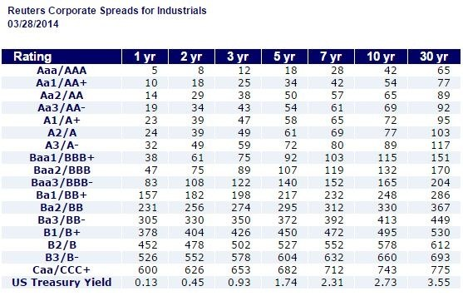
Yield spread
Yield spread = yield to maturity risky bond – yield to maturity risk-free government bond
1 year CAA yield = 600 bps + 13 bps= 6.13% vs 0.18% for AAA

Slide 3
Today
Interpret stocks and bonds of a firm in the context of options to value risky debt, i.e., debt of a firm that might go bankrupt.
Stockholders’ payoff is a European call option on firm value, as they only get paid at maturity if firm value > promised payment to debtholders (=strike price)
Use put-call-parity to interpret bondholders as having given an option to default to stockholders
Theory + Examples
Main ideas are underlying recent research into credit risk and the pricing of debt instruments (see, e.g., http://faculty.chicagobooth.edu/pietro.veronesi/research/Credit_Risk_Lab/ )
Suppose you are pricing the debt of a firm that trades in oil: use prices of oil derivatives to figure out how risky is the firm, what should be the yield on their bonds, etc

Slide 4
The value of a firm and options
Consider a one period world, where a firm has zero-coupon debt with a par value B=1000
What are the payoffs to debt- and equityholders?
FV_{T,} B_{T,} S_{T}
FV_{T}
Bankrupt at T
B_{T} = 1000
B_{T}=FV_{T}
S_{T}= FV_{T} - B_{T}
S_{T}=0
B=1000
FV_{T}

Slide 5
Equity expressed as a call option
The shareholders of the company have a European call option on the firm (S_{T} = Max(0,FV_{T}-1000)) with an exercise price of 1000 (=B=promised payment to debtholders)
If firm value > 1000, stockholders “exercise” and obtain the residual firm value (S_{T} = FV_{T}-1000)
If firm value < 1000, stockholders don’t exercise and obtain a payoff S_{T} = 0
Before: call option with the stock (S₀) as underlying
Now: relating value of stocks to the value of a call option with the firm’s assets (FV₀) as underlying.

Slide 6
Debt expressed using options
Since FV=Equity+Debt and Equity = c, we can view the bondholders as owners of the firm that have written the call option:
B_{T} = FV_{T} – Max(0,FV_{T}-1000)
Or, rewriting put-call parity to this new setting:
c+PV(K)=p+S → c+1000/(1+r)=p+FV
we have that bondholders own a risk-free bond and have written a put option:
$$\underset{Value of debt}{\underbrace{\frac{100}{1+r}−p}}=\underset{Value of the firm −value of equity}{\underbrace{FV−c}}$$
The put option represents the default risk of the corporate bond. The yield of the bond will not be the risk-free rate!
If the firm issues a coupon bond, we can treat these coupons like dividends and adjust put-call parity
Assumption: the coupons are risk-free, as they will not cause the firm to go bankrupt.

Slide 7
Using options to value risky debt!
The put option in this capital structure setting is valuable, because debt is risky, i.e., the firm may go bankrupt!
Let’s assume a firm is issuing debt with principal 100 with 1 year to maturity and coupon rate of 6%, which is also the risk-free rate of interest (i.e., B=106). The firm’s value today is FV₀=100, and in one year it could have the value FV_{T,U}=150 or FV_{T,D}=50
Hence, the firm defaults in bad state:
Value the risky debt and equity of this firm today using replication
Equity is a call option, and valued using
S$\text{0}$= $∆\text{F}\text{V}\text{0}$+$B∗$, where $∆=\frac{\text{S}\text{T}\text{,}\text{U}−\text{S}\text{T}\text{,}\text{D} }{\text{F}\text{V}\text{T}\text{,}\text{U}−\text{FV}\text{T}\text{,}\text{D}}$ and $B∗=\frac{\text{S}\text{T}\text{,}\text{D}−\text{FV}\text{T}\text{,}\text{D}∆}{1+r_{f}}$
Debt is valued as a risk-free bond minus a put option (= $\text{F}\text{V}\text{0}$- S$\text{0}$)

Slide 8
Risky debt and equity
Firm Value
Bond’s Payoffs
Equity payoffs
150
106
Max(0,150-106)= 44
100
50
50
Max(0, 50-106)= 0
The owner of the bond gets (only) the promised cashflow (106, the strike price of the put / call on firm value) if the firm value increases; and gets the total value of the firm if the firm’s value decreases to FV_{T,D} < B (in which case the firm defaults on its debt).
The yield to maturity of debt (y_{B}) will not be the risk-free rate of interest r_{F}=6%!

Slide 9
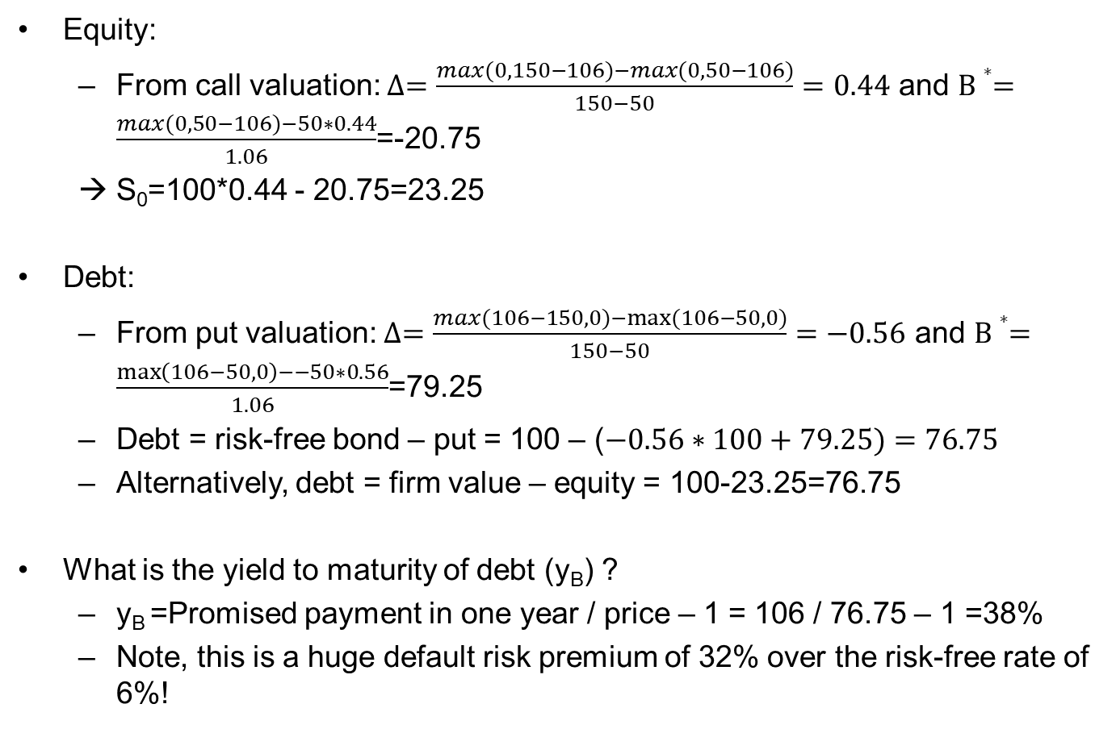
The value of equity and risky debt
Equity:
From call valuation: $∆=\frac{max(0,150−106)−max(0,50−106)}{150−50}=0.44$ and $B∗=\frac{max(0,50−106)−50∗0.44}{1.06}$=-20.75
→ S$\text{0}$=100*0.44 - 20.75=23.25
Debt:
From put valuation: $∆=\frac{max(106−150,0)−max(106−50,0)}{150−50}=−0.56$ and $B∗=\frac{\max\left(106−50,0\right)−−50∗0.56}{1.06}$=79.25
Debt = risk-free bond – put = 100 – ($−0.56∗100+79.25)=76.75$
Alternatively, debt = firm value – equity = 100-23.25=76.75
What is the yield to maturity of debt (y_{B}) ?
y_{B} =Promised payment in one year / price – 1 = 106 / 76.75 – 1 =38%
Note, this is a huge default risk premium of 32% over the risk-free rate of 6%!

Slide 10
Risky debt
Understanding the valuation of risky debt
Risk-free bond with payment at maturity B = 106
Short put option on firm with exercise price B=106
Only if the value of the firm falls below B, shareholders will exercise their put option and effectively sell the firm to the bondholders at a price FV_{T,D} <B. In other words, the firm defaults on the debt.
The bondholders own a default-free bond and sell shareholders an option to default

Slide 11
Cost of debt versus yield to maturity
In our example, the coupon rate differs from the yield to maturity to make clear the effect of default risk.
Yield to maturity: discount rate that sets the price of the debt equal to the present value of the coupons+principal
Value of debt = B/(1+y_{B}) → 76.75 = 106/(1+y_{B}) and y_{B}=38%.
In practice, firms take care to issue bonds at (close to) par and offer an interest/coupon rate that is equal to the yield to maturity of the bonds to be sold.
Thus, if the firm were to issue new bonds, they would issue them with a coupon rate of 38%.
This is why the yield to maturity can be used as the cost of debt in WACC calculations.
The yield to maturity is not the expected return on the bonds, however.
Suppose the beta of the firm is 1, then the beta of the equity will be: (0.44*100*1)/23.25 = 1.89;
The beta of the debt will be: $\frac{100∗0+0.56∗100∗1−79.25∗0}{76.75}=0.73$ (check: beta_firm = 1 = (76.75*0.73+23.25*1.89) / 100)
So, the expected return on the debt will be 6%+0.73*MRP << 38%!

Slide 12
A more realistic example
Suppose a new firm is going to be set up to buy oil for a period of three years. The total investment (debt+equity) in the firm is 100 million. The debt is raised by selling 10% annual coupon bonds with a maturity of three years and face value of 50 million. The risk-free rate is 5%.
Coupons won’t push firm into bankruptcy: coupons are like risk-free dividends.
Covenants block shareholders from paying themselves a liquidating dividend before final coupon payment: Option is European.
The implied volatility of oil “OVX” (the oil-equivalent of the VIX) is currently at 55%.
(If, alternatively, the firm would also sell the oil at an expected profit margin of 10%, the volatility of the firm value would be 0.10*55%.)
Approximate the market value of the firm’s equity and debt. What is the yield to maturity on the debt and the firm’s rating?

Slide 13
Solution
Equity is a three-year European call option on the (coupon-adjusted) assets of the firm, with strike price = 50*(1+10%).
Adjust Black-Scholes to discrete dividends:
$c_{0}={[F}_{0}−PV(coupon 1\&2)]N(d_{1})$ $−Ke^{−rT}N(d_{2})$;
$$d_{1}=\frac{\ln\left(\frac{{[F}_{0}−PV(coupon 1\&2)]}{Ke^{−rT}}\right)}{σ\sqrt{T}}+\frac{σ\sqrt{T}}{2},d_{2}=d_{1}−σ\sqrt{T}$$
Equity=$c_{0}$=52 million; so Debt must be worth 100-52=48 million.
Yield to maturity on the Debt solves:
48 = 5 * exp(-ytm) + 5 * exp(-ytm*2) + 55 * exp(-ytm*3) → ytm = 11%
Default spread over the risk-free rate for the firm is 11% - 5% = 6%, which puts the firm between the B- and C rating category!

