Slide 1

Investments
Masters in Finance
Spring 2025, Martijn Boons
Book chapters 1-4

Slide 2
Learning goals
Economics: to understand the economic role of financial assets and markets, and the key trade-offs faced by investors
Institutions: to learn about the mechanics of real-world financial markets and contracts
Application: being able to value assets and construct “optimal” portfolios
Some knowledge of calculus, probability & statistics, and economics is expected! Excel is required, other programming languages may come in handy.

Slide 3
Overview of financial markets

Slide 4
Motivation: A simple economic framework
End users of capital (producers/firms)
Assets
Liabilities/claims
Financial liabilities from perspective of users
Financial assets from perspective of investors
Define how income is split across investors
Land
Buildings
Brands
Org. capital
Growth options
Op. liabilities
Bonds (debt)
Stocks (equity)
Etc.
Households (investors)
Relationship most of the time is intermediated (banks, mutual funds, etc.); WHY?
  Matching, diversification, monitoring etc.
Savings
Notes:
Why: small investor cannot advertise he has money available; cannot analuze and moitor all availale investments; wouldn’t be diversified.
Operating liabilities: buy on credit

Slide 5
Main categories of financial assets
Equity
  Limited liability
  “Owners” of the firm (most of the time…), in the sense that shareholders control managerial decisions (to some extent…)
  Residual claimants: entitled to receive income generated by firm after all other claimants have received their share
  Therefore, risky.
Debt
  Promised payments (interest)
  Varying maturities and default risk
  Less sensitive to financial condition of issuer (especially if senior and/or collateralized)
Derivatives
  Payoffs depend on performance of other securities
  Examples: call options on stocks, commodity futures
  Usually very risky

Slide 6
Key economic roles of financial assets and markets
Information production
  Example: market deems firm’s prospects in new geographic market to be good → higher share price → facilitates raising money (SEO vs IPO) for financing project
Consumption timing
  Financial assets allow investors to substitute current consumption for future consumption
Risk sharing and allocation
  Investors can easily hold diversified portfolios
  More (less) risk-averse investors can hold less (more) risk through their portfolio choice
Separation of ownership and management
  Firms have become too big to be owned by one agent and risk-averse agents want to diversify
  Compensation packages include stocks and options to align manager’s incentives with owners (=shareholders)
Notes:
Problems: Mechanisms to mitigate agency problems:
Tie managers' income to the success of the firm (stock options)
Monitoring from the board of directors
Proxy voting by large shareholders to solve monitoring problem
Secutiry analysts serve important function in monitoring as well

Slide 7
Financial markets are competitive (i)
Many intelligent and well-funded economic agents constantly looking to make a profit by choosing their optimal portfolio
  Portfolio: Active or passive collection of investment assets
    Asset allocation: Choice among broad asset classes
    Security selection: Choice of securities within each asset class
Key implications:
Risk-return trade-off
  To increase expected returns, investors must take on more risk.
  Ceteris paribus, a more risky asset has a lower price.
  Which promise is more valuable to you: A bond promising to pay 1000$ in 10 years issued by the United States government or by Nvidia?

Slide 8
Financial markets are competitive (ii)
Market efficiency
  In fully efficient markets when prices quickly adjust to all relevant information, no asset will be under- or overpriced.
    What about Tesla?
  Grossman-Stiglitz Paradox (1980): Markets cannot be perfectly efficient – we can only get near-efficiency:
    Investors will not rationally incur the expenses of gathering information unless they expect to be rewarded by higher gross returns compared with the free alternative of accepting the market price.
  Important implications: active portfolio management through asset allocation (``market timing’’) and security selection (``stock picking’’) only pays off when you have an informational advantage over other market participants
    This simple idea spurred recent growth in passive management.
  Podcast: All else equal - Why good stocks are not good buys?

Slide 9
Key trends in financial markets
Globalization: more and more assets are easily investible for more and more investors
Securitization and financial engineering: new assets tailored to demand of investors wanting to hedge a particular exposure or speculate in a particular direction. [Partly due to:]
Technological advances: transaction costs have fallen considerably over time due to move from specialist to computerized market-making.
  More recent trends include:
    Algorithmic trading: computer program fully authorized to trade
    High-frequency trading: sometimes at very high speed
    Dark pools (place bid/ask for everyone to see or “dark”)
    PFOF (e.g., Citadel pays RobinHood a small fee to execute your orders on their app, which are uninformed)
Open question: Are all these trends improving social welfare?

Slide 10
Focus on US stock markets
US markets are the core of the worldwide financial system
NYSE and NASDAQ combined are much larger than other exchanges
  12 (6) times the size of the German (London) stock exchange
However, considerable co-movement across markets.
  Cumulative return since 1988 in local currency:

Slide 11
Indexes and portfolio weights
Indexes like the S&P500 are value-weighted
  Larger weight given to economically more important firms
  Requires no rebalancing (except when the index is reconstituted or firms issue/repurchase shares), making them easy and cheap to track for funds and ETFs
Suppose you have 125 to invest in the following two firms:
What is your annual return if you had bought a price-weighted portfolio (one of each share)?
  (30+85)-(25+100)=-10 or a return of 1/5*(30/25)+4/5*(85/100) -1= -8%.
  You own 1/200 of A and 1/100 of B, so not value-weighted.
What is your annual return if you had bought a value-weighted portfolio?
  Relative weights equal (25*200)/[(25*200+100*100)]=1/3 in A and 2/3 in B
  You would own 125/(25*200+100*100)]=0.83% of the shares of A and B, so 1.67 shares of A and 0.83 shares of B
  Over the year, the change in value of your investment would be
  (1.67*30 + 0.83*85) -125 = -4.16 or return equal to 1/3*(30/25) + 2/3*(85/100) -1 = -3.3%
 | A | B
# of shares outstanding | 200 | 100
Price today | 25 | 100
Price in 1 year | 30 | 85

Slide 12
Example (Continued)
Price-weighted
Weights today | 0.20 | 0.80
Return | -0.08
Weights in 1 year | 0.26 | 0.74
Value-weighted
Weights today | 0.33 | 0.67
Return | -0.03
Weights in 1 year | 0.41 | 0.59
Equal-weighted
Weights today | 0.50 | 0.50
Return | 0.02
Weights in 1 year | 0.59 | 0.41
  At the end of the year, you still own 0.83% of each company, so the portfolio is still value-weighted:
    1.67*30/120.83 = 30*200/(30*200 + 100*85) = 0.41 in A and 0.59 in B
    → There is no need to trade to keep the portfolio value-weighted!
What is your annual return if you had bought an equal-weighted portfolio?
  62.5 invested in both A and B (62.5/25 shares of A and 62.5/100 shares of B)
  Change in value would be:
  (62.5/25*30 + 62.5/100*85) - 125 = 3.125 or a return of 0.5*(30/25) + 0.5*(85/100) -1 = 2.5%
  At the end of the year, the portfolio is not equal-weighted anymore:
    62.5/25*30 / (62.5/25*30+ 62.5/100*85) = 30*200/(30*200 + 100*85) = 0.59 in A and 0.41 in B
    You will need to trade back to 50/50!
    Rebalancing will be contrarian, which may be attractive.

Slide 13
2. Prices are present values

Slide 14
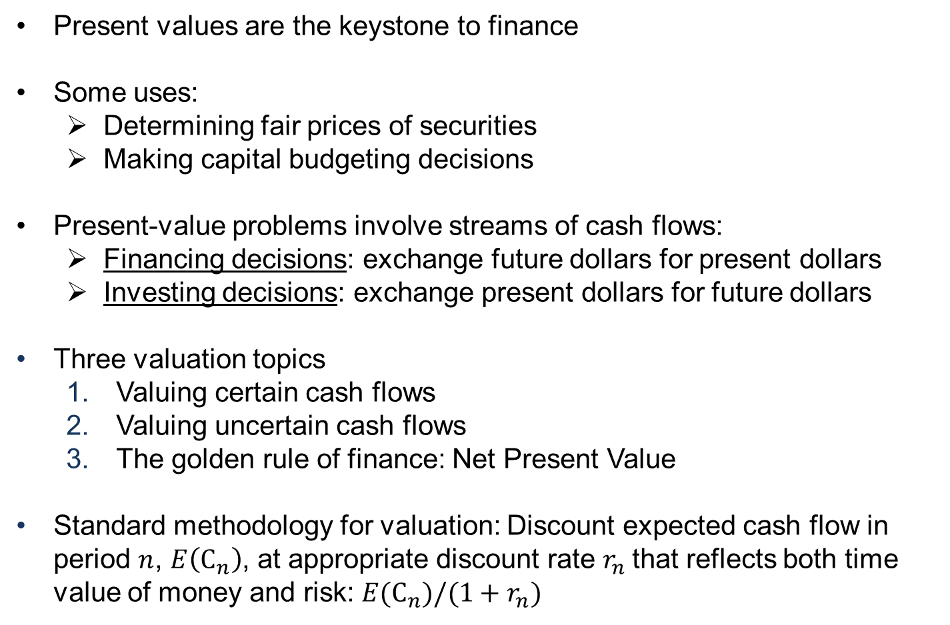
Outline
Present values are the keystone to finance
Some uses:
  Determining fair prices of securities
  Making capital budgeting decisions
Present-value problems involve streams of cash flows:
  Financing decisions: exchange future dollars for present dollars
  Investing decisions: exchange present dollars for future dollars
Three valuation topics
  Valuing certain cash flows
  Valuing uncertain cash flows
  The golden rule of finance: Net Present Value
Standard methodology for valuation: Discount expected cash flow in period $n$, $E\left(C_{n}\right)$, at appropriate discount rate $r_{n}$that reflects both time value of money and risk: $E(C_{n})/(1+r_{n})$

Slide 15
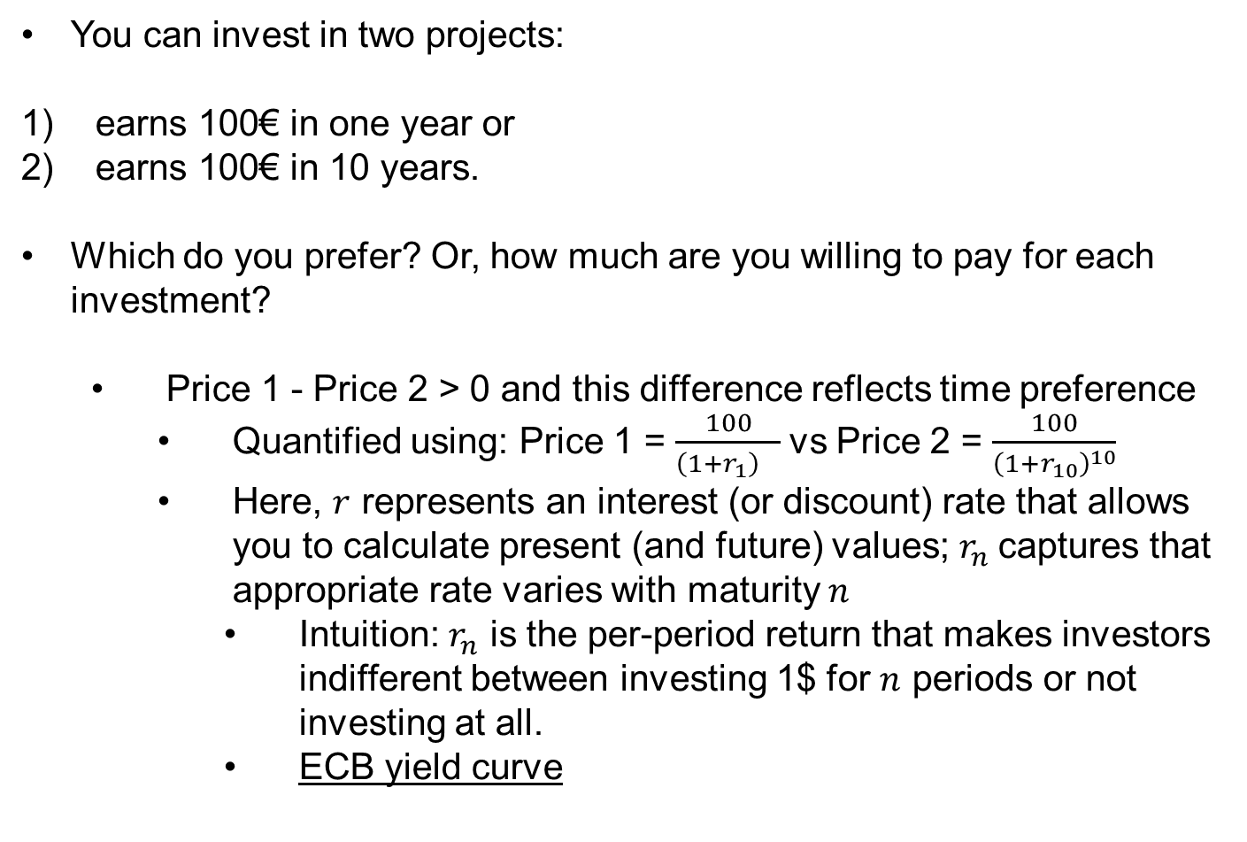
Time value of money
You can invest in two projects:
earns 100€ in one year or
earns 100€ in 10 years.
Which do you prefer? Or, how much are you willing to pay for each investment?
  Price 1 - Price 2 > 0 and this difference reflects time preference
    Quantified using: Price 1 = $\frac{100}{{\left(1+r_{1}\right)}^{}}$vs Price 2 = $\frac{100}{{\left(1+r_{10}\right)}^{10}}$
    Here, $r$ represents an interest (or discount) rate that allows you to calculate present (and future) values; $r_{n}$captures that appropriate rate varies with maturity $n$
      Intuition: $r_{n}$ is the per-period return that makes investors indifferent between investing 1$ for $n$ periods or not investing at all.
      ECB yield curve

Slide 16
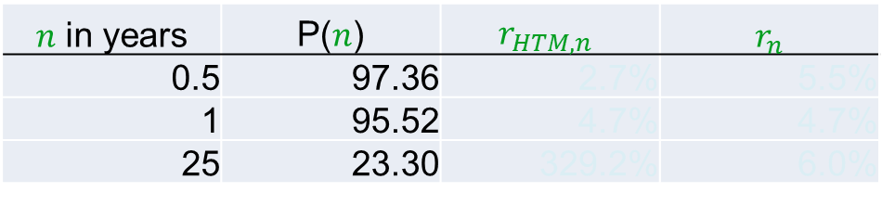
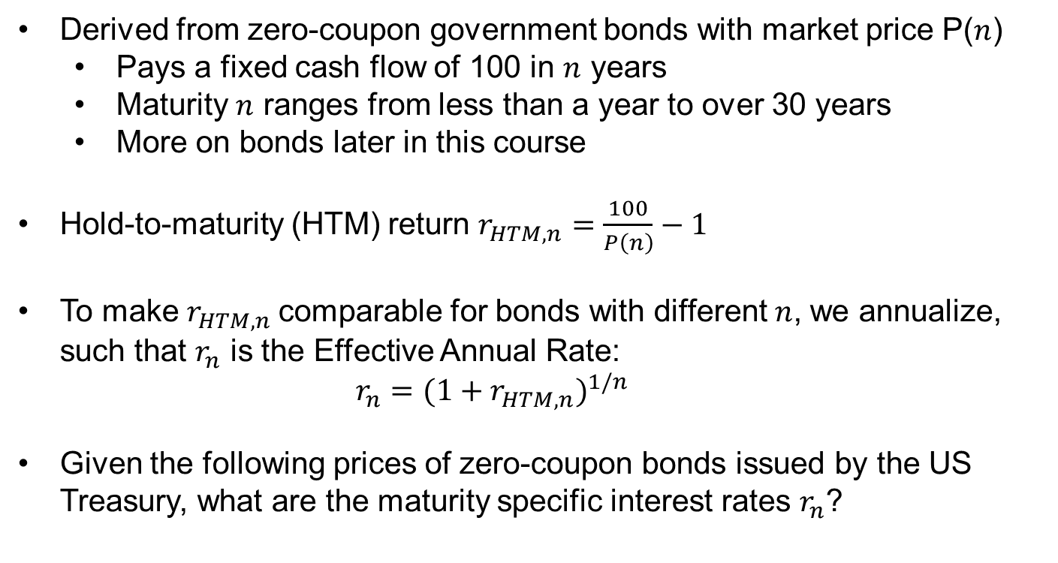
Maturity-specific interest rates
Derived from zero-coupon government bonds with market price P($n$)
  Pays a fixed cash flow of 100 in $n$ years
  Maturity $n$ ranges from less than a year to over 30 years
  More on bonds later in this course
Hold-to-maturity (HTM) return $r_{HTM,n}=\frac{100}{P\left(n\right)}−1$
To make $r_{HTM,n}$comparable for bonds with different $n$, we annualize, such that $r_{n}$ is the Effective Annual Rate:
$r_{n}={(1+r_{HTM,n})}^{1/n}$
Given the following prices of zero-coupon bonds issued by the US Treasury, what are the maturity specific interest rates $r_{n}$?
$n$ in years | P($n$) | $$r_{HTM,n}$$ | $r_{n}$
0.5 | 97.36 | 2.7% | 5.5%
1 | 95.52 | 4.7% | 4.7%
25 | 23.30 | 329.2% | 6.0%

Slide 17
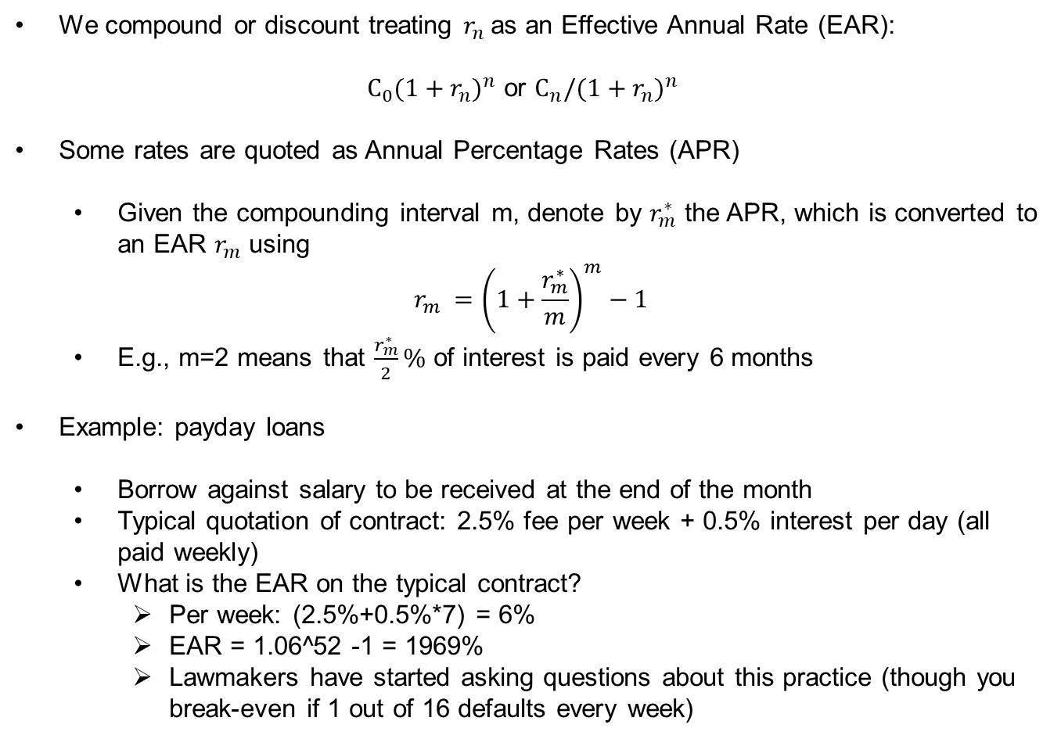
Annual Percentage Rates
We compound or discount treating $r_{n}$as an Effective Annual Rate (EAR):
  $C_{0}{(1+r_{n})}^{n}$ or $C_{n}/{(1+r_{n})}^{n}$
Some rates are quoted as Annual Percentage Rates (APR)
  Given the compounding interval m, denote by $r_{m}^{∗}$ the APR, which is converted to an EAR $r_{m}$ using
$$r_{m} ={\left(1+\frac{r_{m}^{∗}}{m}\right)}^{m}−1$$
  E.g., m=2 means that $\frac{r_{m}^{∗}}{2}\%$ of interest is paid every 6 months
Example: payday loans
  Borrow against salary to be received at the end of the month
  Typical quotation of contract: 2.5% fee per week + 0.5% interest per day (all paid weekly)
  What is the EAR on the typical contract?
    Per week: (2.5%+0.5%*7) = 6%
    EAR = 1.06^52 -1 = 1969%
    Lawmakers have started asking questions about this practice (though you break-even if 1 out of 16 defaults every week)

Slide 18
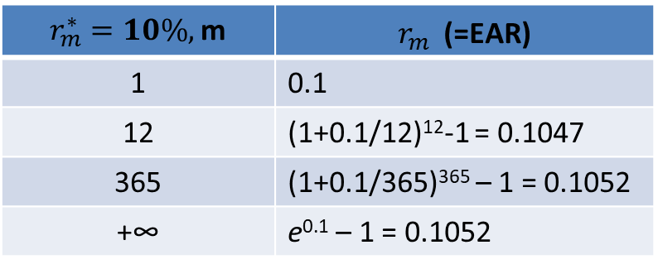
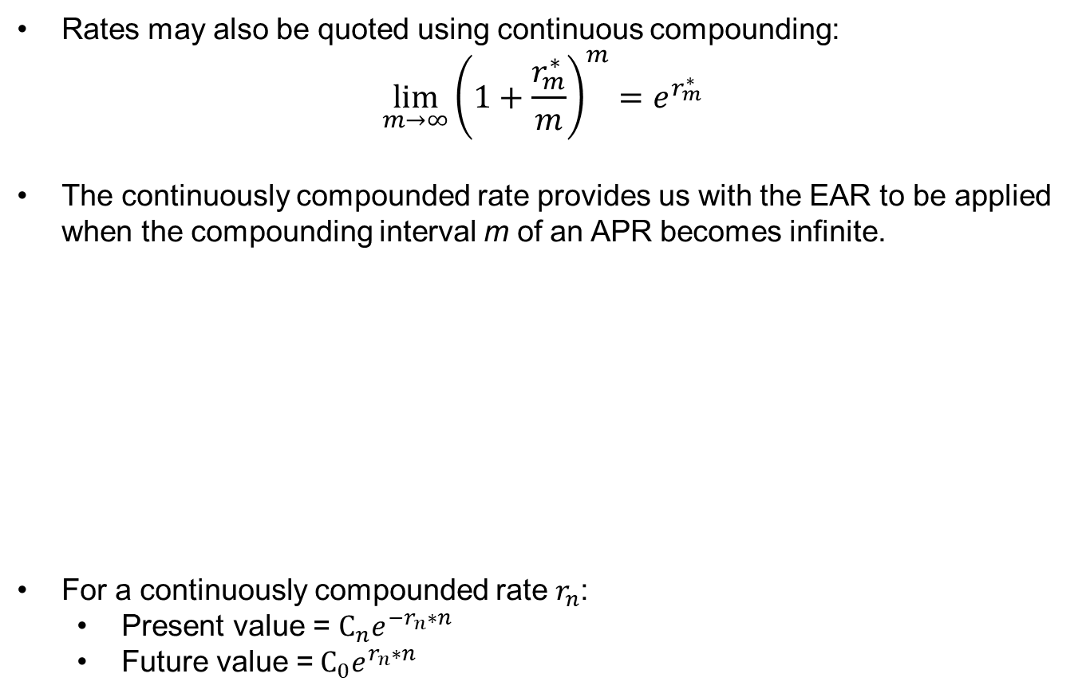
Continuously compounded rates
Rates may also be quoted using continuous compounding:
$$\lim_{m→∞}{{\left(1+\frac{r_{m}^{∗}}{m}\right)}^{m}=e^{r_{m}^{∗}}}$$
The continuously compounded rate provides us with the EAR to be applied when the compounding interval m of an APR becomes infinite.
For a continuously compounded rate $r_{n}$:
  Present value = $C_{n}e^{−r_{n}∗n}$
  Future value =$C_{0}e^{r_{n}∗n}$
$r_{m}^{∗}=10\%,$m | $r_{m}^{}$ (=EAR)
1 | 0.1
12 | (1+0.1/12)¹²-1 = 0.1047
365 | (1+0.1/365)³⁶⁵ – 1 = 0.1052
+∞ | e^{0.1} – 1 = 0.1052

Slide 19
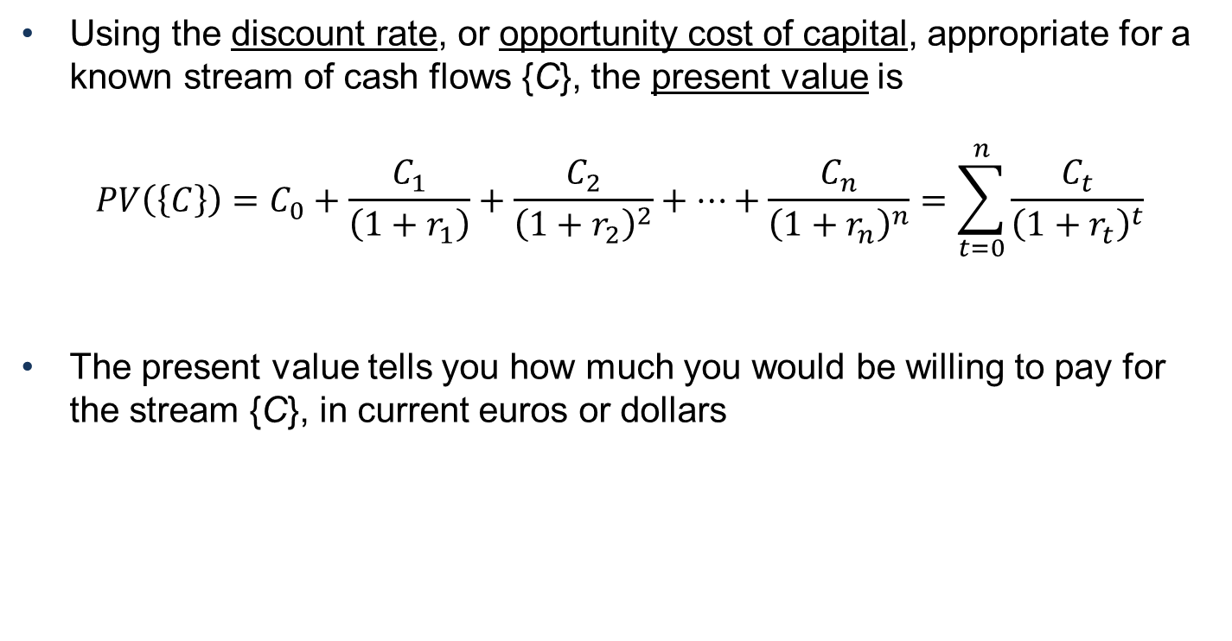
Present value of multiple cash flows
Using the discount rate, or opportunity cost of capital, appropriate for a known stream of cash flows {C}, the present value is
$$PV\left(\left\{C\right\}\right)=C_{0}+\frac{C_{1}}{\left(1+r_{1}\right)}+\frac{C_{2}}{{\left(1+r_{2}\right)}^{2}}+…+\frac{C_{n}}{{\left(1+r_{n}\right)}^{n}}=\sum_{t=0}^{n}{\frac{C_{t}}{{\left(1+r_{t}\right)}^{t}}}$$
The present value tells you how much you would be willing to pay for the stream {C}, in current euros or dollars

Slide 20
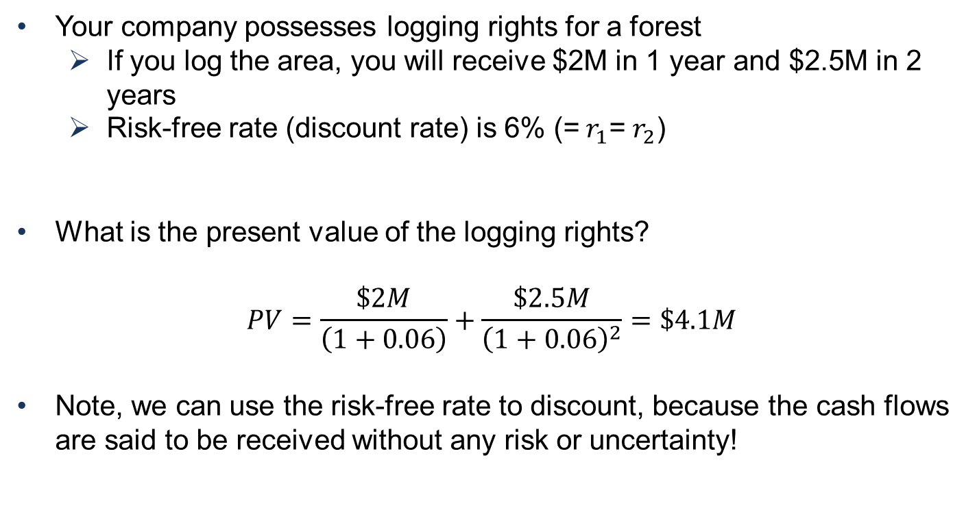
Example
Your company possesses logging rights for a forest
  If you log the area, you will receive $2M in 1 year and $2.5M in 2 years
  Risk-free rate (discount rate) is 6% (= $r_{1}$= $r_{2}$)
What is the present value of the logging rights?
$$PV=\frac{\$2M}{\left(1+0.06\right)}+\frac{\$2.5M}{{\left(1+0.06\right)}^{2}}=\$4.1M$$
Note, we can use the risk-free rate to discount, because the cash flows are said to be received without any risk or uncertainty!

Slide 21
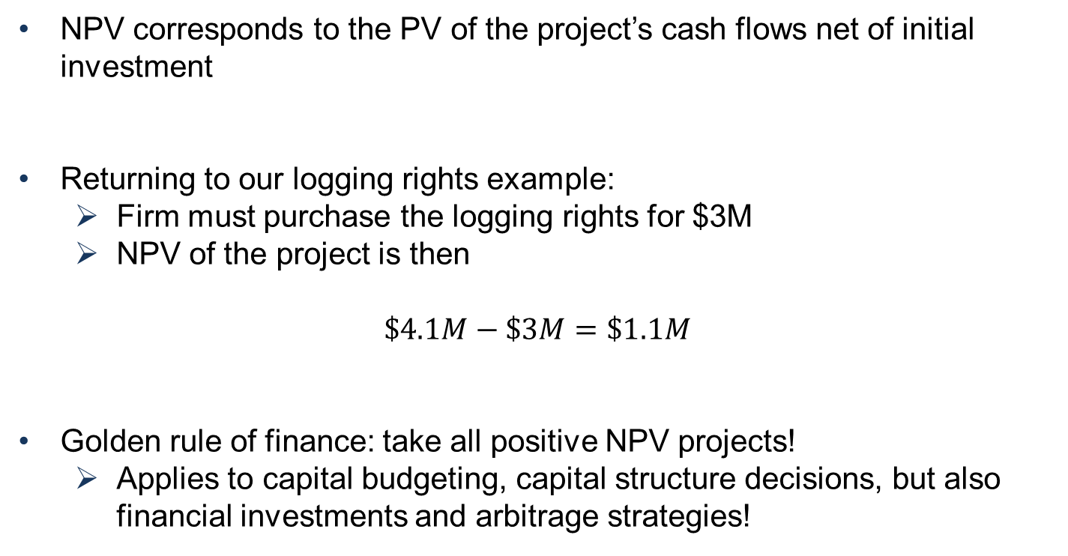
Net present value (NPV)
NPV corresponds to the PV of the project’s cash flows net of initial investment
Returning to our logging rights example:
  Firm must purchase the logging rights for $3M
  NPV of the project is then
$$\$4.1M−\$3M=\$1.1M$$
Golden rule of finance: take all positive NPV projects!
  Applies to capital budgeting, capital structure decisions, but also financial investments and arbitrage strategies!

Slide 22
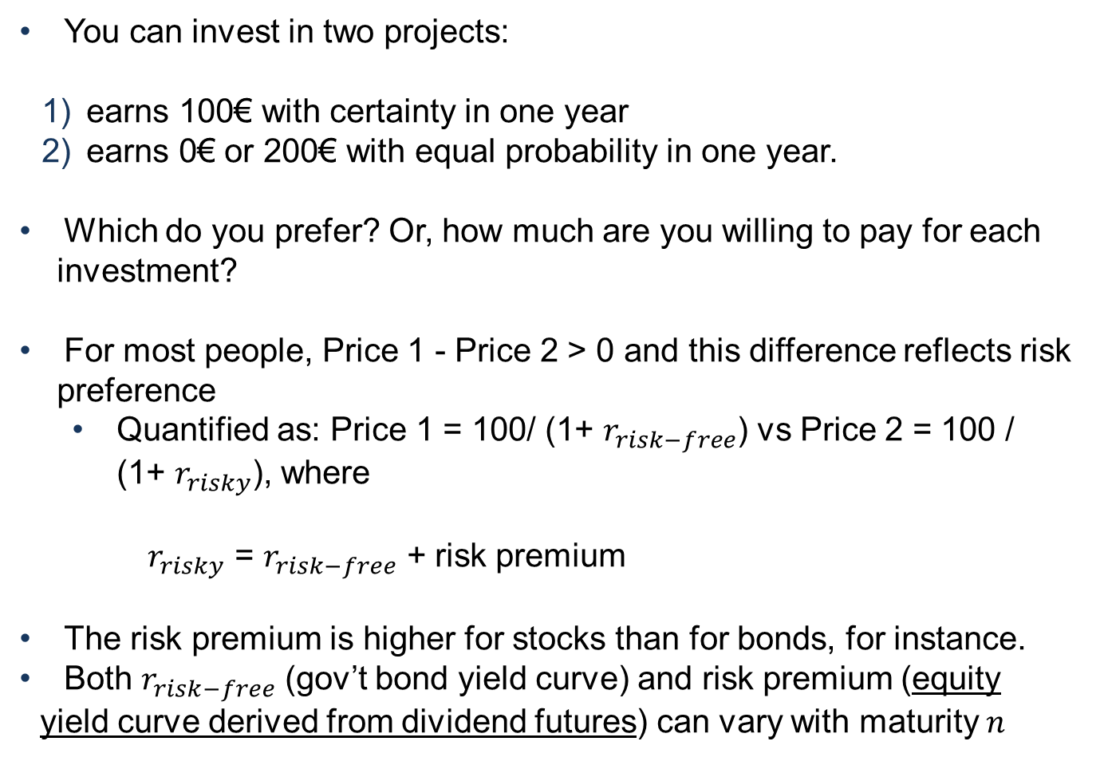
Risk (i)
You can invest in two projects:
earns 100€ with certainty in one year
earns 0€ or 200€ with equal probability in one year.
Which do you prefer? Or, how much are you willing to pay for each investment?
For most people, Price 1 - Price 2 > 0 and this difference reflects risk preference
  Quantified as: Price 1 = 100/ (1+ $r_{risk−free}$) vs Price 2 = 100 / (1+ $r_{risky}$), where
  $r_{risky}$ = $r_{risk−free}$ + risk premium
The risk premium is higher for stocks than for bonds, for instance.
Both $r_{risk−free}$ (gov’t bond yield curve) and risk premium (equity yield curve derived from dividend futures) can vary with maturity $n$

Slide 23
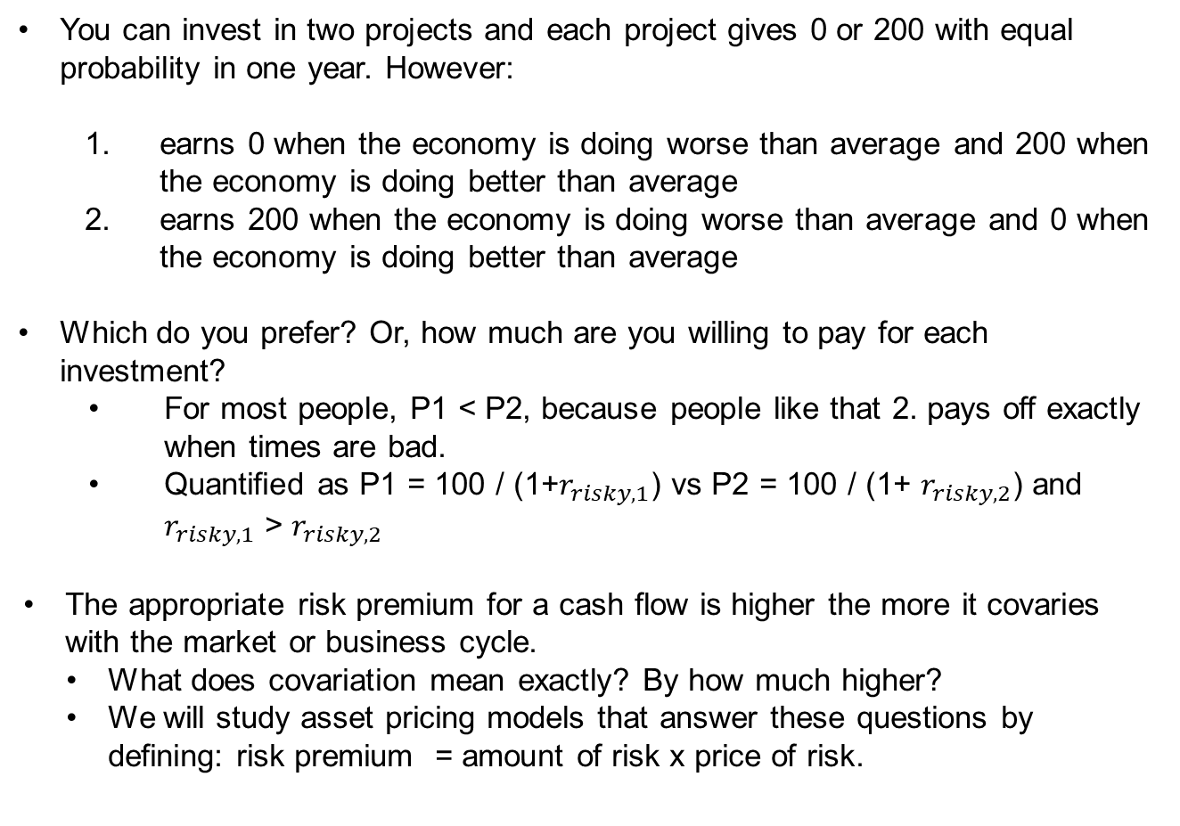
Risk (ii)
You can invest in two projects and each project gives 0 or 200 with equal probability in one year. However:
  earns 0 when the economy is doing worse than average and 200 when the economy is doing better than average
  earns 200 when the economy is doing worse than average and 0 when the economy is doing better than average
Which do you prefer? Or, how much are you willing to pay for each investment?
  For most people, P1 < P2, because people like that 2. pays off exactly when times are bad.
  Quantified as P1 = 100 / (1+$r_{risky,1}$) vs P2 = 100 / (1+ $r_{risky,2}$) and $r_{risky,1}$ > $r_{risky,2}$
The appropriate risk premium for a cash flow is higher the more it covaries with the market or business cycle.
  What does covariation mean exactly? By how much higher?
  We will study asset pricing models that answer these questions by defining: risk premium = amount of risk x price of risk.

Slide 24
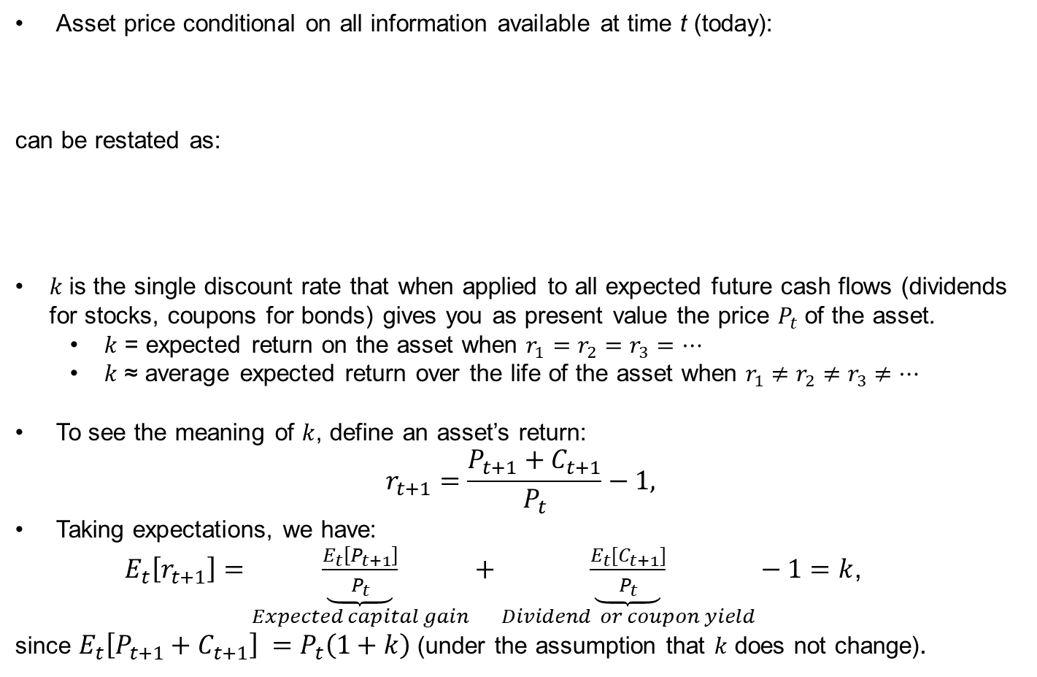
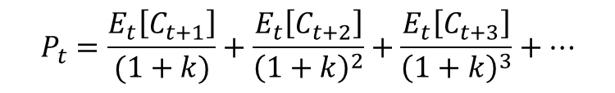
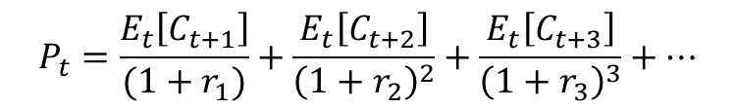
Prices, discount rates, and (expected) returns
Asset price conditional on all information available at time t (today):
can be restated as:
$k$is the single discount rate that when applied to all expected future cash flows (dividends for stocks, coupons for bonds) gives you as present value the price $P_{t}$of the asset.
  $k$ = expected return on the asset when $r_{1}$ $=r_{2}=r_{3}=…$
  $k$ ≈ average expected return over the life of the asset when $r_{1}$ $≠$ $r_{2}≠r_{3}$ $≠…$
To see the meaning of $k$, define an asset’s return:
$$r_{t+1}=\frac{P_{t+1}+C_{t+1}}{P_{t}}−1,$$
Taking expectations, we have:
$E_{t}\left[r_{t+1}\right]=\underset{Expected capital gain}{\underbrace{\frac{E_{t}\left[P_{t+1}\right]}{P_{t}}}}+\underset{Dividend or coupon yield}{\underbrace{\frac{{E_{t}[C}_{t+1}]}{P_{t}}}}−1=k$,
since $E_{t}\left[P_{t+1}+C_{t+1}\right] =P_{t}\left(1+k\right)$ (under the assumption that $k$ does not change).
$$P_{t}=\frac{E_{t}\left[C_{t+1}\right]}{(1+r_{1})}+\frac{E_{t}\left[C_{t+2}\right]}{{\left(1+r_{2}\right)}^{2}}+\frac{E_{t}\left[C_{t+3}\right]}{{\left(1+r_{3}\right)}^{3}}+…$$
$$P_{t}=\frac{E_{t}\left[C_{t+1}\right]}{(1+k)}+\frac{E_{t}\left[C_{t+2}\right]}{{\left(1+k\right)}^{2}}+\frac{E_{t}\left[C_{t+3}\right]}{{\left(1+k\right)}^{3}}+…$$

Slide 25
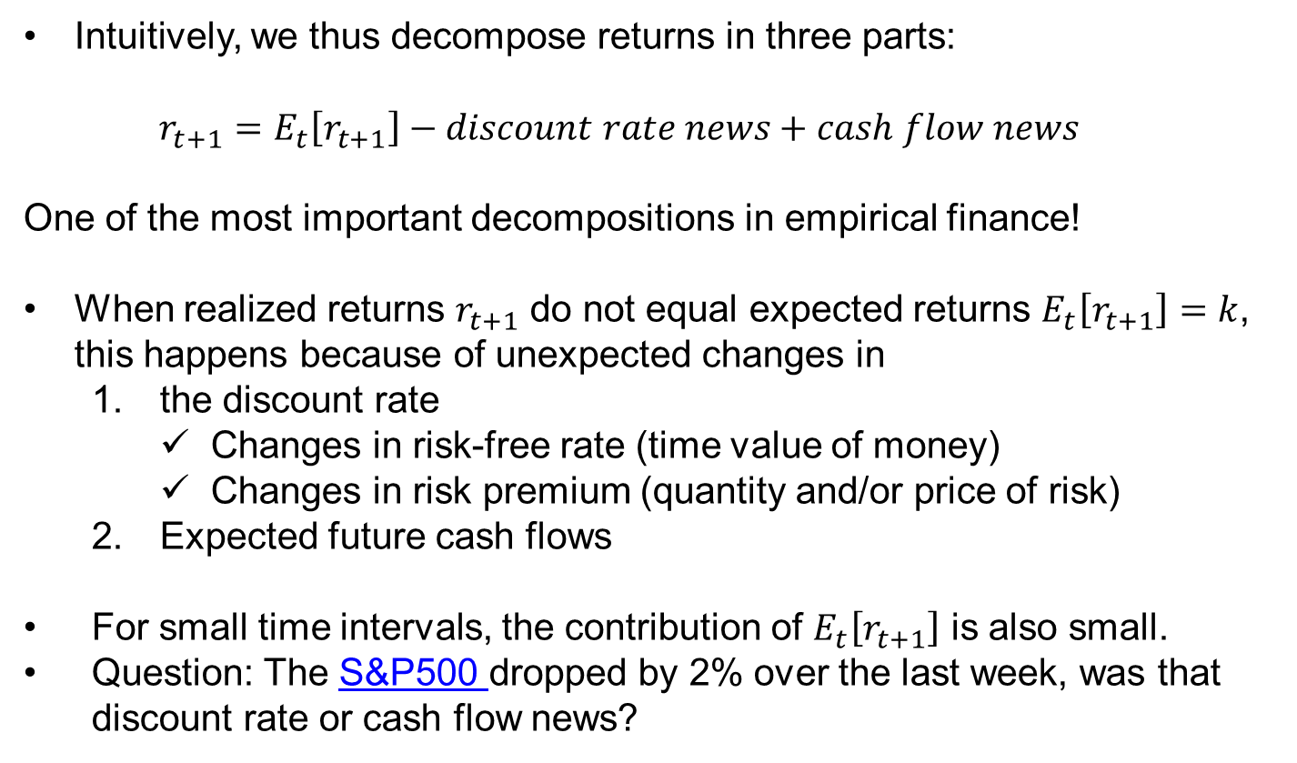
Returns and expected returns
Intuitively, we thus decompose returns in three parts:
  $$r_{t+1}=E_{t}\left[r_{t+1}\right]−discount rate news+cash flow news$$
One of the most important decompositions in empirical finance!
When realized returns $r_{t+1}$ do not equal expected returns $E_{t}\left[r_{t+1}\right]=k$, this happens because of unexpected changes in
  the discount rate
    Changes in risk-free rate (time value of money)
    Changes in risk premium (quantity and/or price of risk)
  Expected future cash flows
For small time intervals, the contribution of $E_{t}\left[r_{t+1}\right]$ is also small.
Question: The S&P500 dropped by 2% over the last week, was that discount rate or cash flow news?

Slide 26
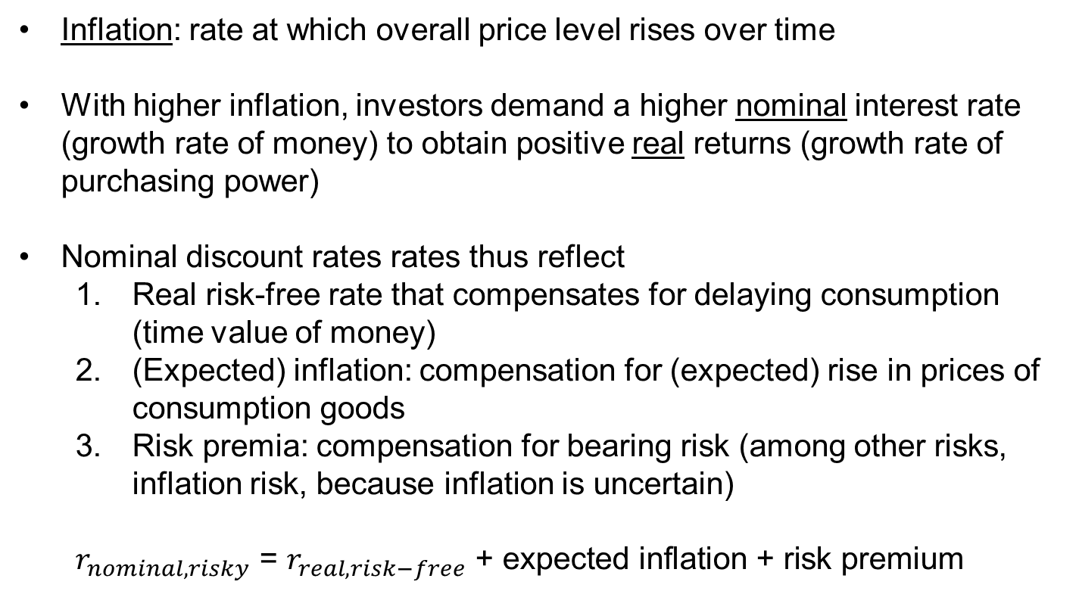
Returns and inflation (1/2)
Inflation: rate at which overall price level rises over time
With higher inflation, investors demand a higher nominal interest rate (growth rate of money) to obtain positive real returns (growth rate of purchasing power)
Nominal discount rates rates thus reflect
  Real risk-free rate that compensates for delaying consumption (time value of money)
  (Expected) inflation: compensation for (expected) rise in prices of consumption goods
  Risk premia: compensation for bearing risk (among other risks, inflation risk, because inflation is uncertain)
  $$r_{nominal,risky}\text{ = }r_{real,risk−free}\text{ +} \text{expected} \text{inflation}\text{ +} \text{risk} \text{premium}$$

Slide 27
Returns and inflation (2/2)
Inflation risk: an example
  Consider $1,000 nominal bond maturing in one year with a $100 default-free interest payment (10% nominal return)
  Real cash flow – i.e. how much you will be able to consume? – is however risky, since (realized) inflation is random:
  (1+real return) = (1+nominal return) / (1+inflation)
This means that long-term Treasury bonds are actually risky too
  Long-term treasury bonds possibly even riskier than some stocks, because long-term inflation is highly uncertain.
  Fortunately, nowadays, inflation-linked bonds are available.

Slide 28
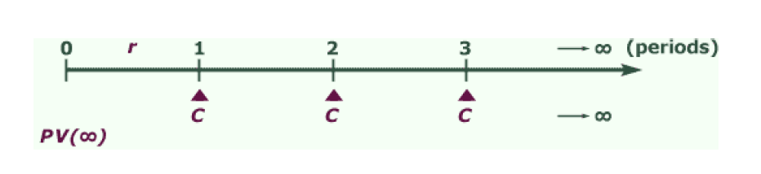
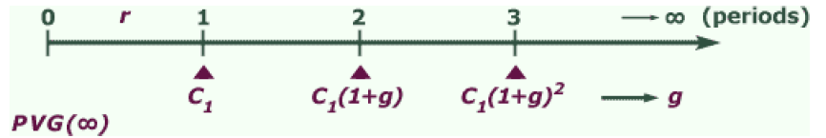
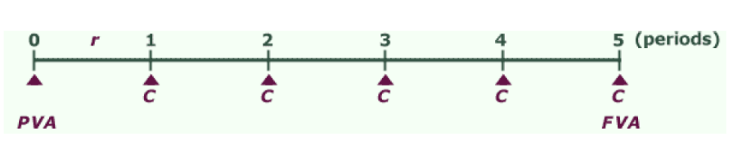
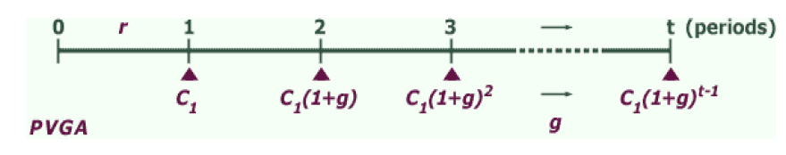
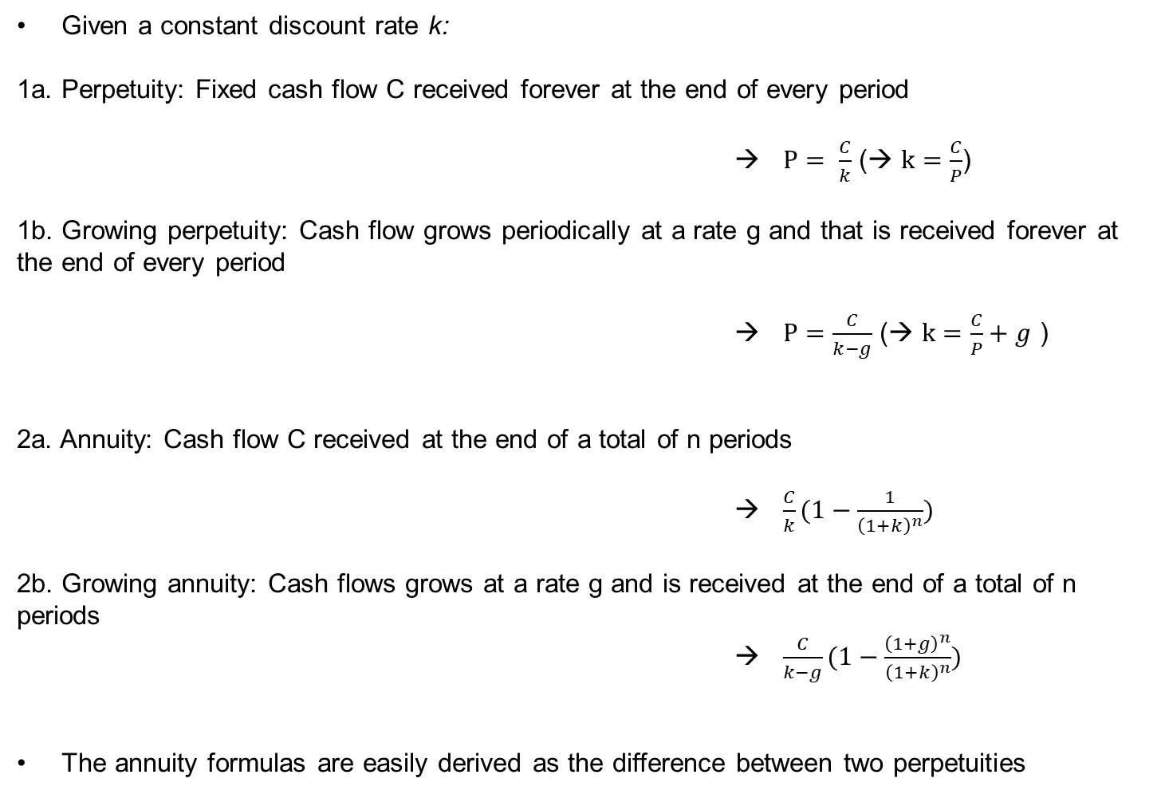
Shortcuts to calculate present values
Given a constant discount rate k:
1a. Perpetuity: Fixed cash flow C received forever at the end of every period
                → $P= \frac{C}{k}$ (→ $k=\frac{C}{P}$)
1b. Growing perpetuity: Cash flow grows periodically at a rate g and that is received forever at the end of every period
→ $P=\frac{C}{k−g}$ (→ $k=\frac{C}{P}+g$ )
2a. Annuity: Cash flow C received at the end of a total of n periods
→ $\frac{C}{k}(1−\frac{1}{{\left(1+k\right)}^{n}})$
2b. Growing annuity: Cash flows grows at a rate g and is received at the end of a total of n periods
→ $\frac{C}{k−g}(1−\frac{{\left(1+g\right)}^{n}}{{\left(1+k\right)}^{n}})$
The annuity formulas are easily derived as the difference between two perpetuities
Notes:
a) PV(Perpetuity)=D/(1+r)+D/(1+r)^2…
PVP*(1+r)=D+D/(1+r)+D/(1+r)^2…. <-> r*PVP = D <-> PVP = D/r
Growing:
PV(GrowingPerpetuity)=D/(1+r)+D*(1+g)/(1+r)^2…
PVGP-PVGP*(1+g)/(1+r)=D/(1+r) <-> PVGP*(1+r)-PVGP(1+g) = D <-> PVGP = D/(r-g)
b) PV(Annuity) = D/(1+r)+D/(1+r)^2…+D/(1+r)^n
PV(Annuity)=PVP(today)-PVP(n+1) = D/r – D/r*(1/(1+r)^n) = D/r*(1-1/(1+r)^n
Growing:
PV(GrowingAnnuity) = D/(1+r)+D*(1+g)/(1+r)^2…+D*(1+g)^n-1/(1+r)^n
PVGA=PVGP(today)-PVGP(n+1) = D/(r-g) – D/(r-g)*(1+g)^n/(1+r)^n) = D/(r-g)*(1-(1+g)^n/(1+r)^n)

Slide 29
Example
Take company Alfa
  Expected to generate per-share dividends of $1 over the next year
  Dividends expected to grow at 2% per year “forever”
  Appropriate discount rate is 8%
Q1: What is Alfa’s current stock price?
  Growing perpetuity: 1/(8%-2%)=16.67
Q2: What is the fraction of the price coming from dividends after year 10?
  Dividend in year 11: 1*(1+2%)^10=1.22
  Present value: [1.22/(8%-2%)]*(1/(1+8%)^10) = 9.41
  Fraction: 9.41/16.67 = 0.56
General result: for the average stock (and the stock market as a whole), most of the value is due to long-term dividends
Then, why do managers seem to care mostly about short-term earnings targets?
  “Positive” interpretation: Changes (growth) in current earnings are a signal of future earnings
  “Negative” interpretation: short-termism (bonuses tied to current earnings and will manager stay at the company for over 10 years?)
    Institutional investors are concerned about this issue: https://www.blackrock.com/corporate/investor-relations/2018-larry-fink-ceo-letter
    Solution: managerial compensation plans consist of stock (and option) elements that incentivize long-term growth

Slide 30
Some corporate finance
In the real world, firms face a trade-off when deciding what to do with the earnings they generate: (i) pay out earnings as dividends now or (ii) reinvest earnings to potentially create more growth in earnings and thus dividends in the future.
What will maximize the share price?
  Cutting dividends to invest increases the share price if and only if the new investments have a return larger than the discount rate.
  Intuitive, but let’s see this more formally.

Slide 31
Trading off dividends and reinvestment
Consider the following situation in a firm
  Current earnings per share: EPS
  Discount rate (cost of capital): k
  Return on investment: z
  Payout rate: p (reinvestment rate: (1-p))
Implied growth rate of dividends: g=(1-p)*z
Stock price at t=0: EPS*p / (k-g)
Time | 0 | 1 | 2 | 3 | 4 | …
Earnings |  | EPS | EPS+(1-p)EPS*z = (1+g) * EPS | (1+g)*EPS+(1-p)*(1+g)*EPS*z = EPS*(1+g)^2 | EPS*(1+g)^3
Dividends |  | p*EPS | p*EPS*(1+g) | p*EPS*(1+g)^2 | p*EPS*(1+g)^3
Reinvestment |  | (1-p)*EPS | (1-p) *EPS*(1+g) | (1-p)*EPS*(1+g)^2 | (1-p)*EPS*(1+g)^3

Slide 32
Example continued
What is the price of Alfa stock if EPS=1.25, k=8%, z=10%, and p=80%?
  P = (EPS*p)/(k-(1-p)*z)=(1.25*80%) / (8%-2%) = 16.7
What happens to the share price of Alfa as payout ratio and return on investment change?
With z>k: price of the stock decreases as payout increases, i.e., the firm should reinvest as much as possible
  As time passes, return on investment will go down (competition), and the company must at some point start paying out dividends
Conversely, with z<k: price of the stock increases in payout, as reinvesting destroys value
With z=k: payout strategy doesn’t matter
  In an efficient market, this is the relevant case and dividend policy is irrelevant!
 |  | Return on investment (z)
 | Price | 6% | 8% | 10%
Payout ratio (p) | 70% | 14.11 | 15.63 | 17.50
 | 80% | 14.71 | 15.63 | 16.67
 | 90% | 15.20 | 15.63 | 16.07

Slide 33
3. Practicalities of trading in financial markets

Slide 34
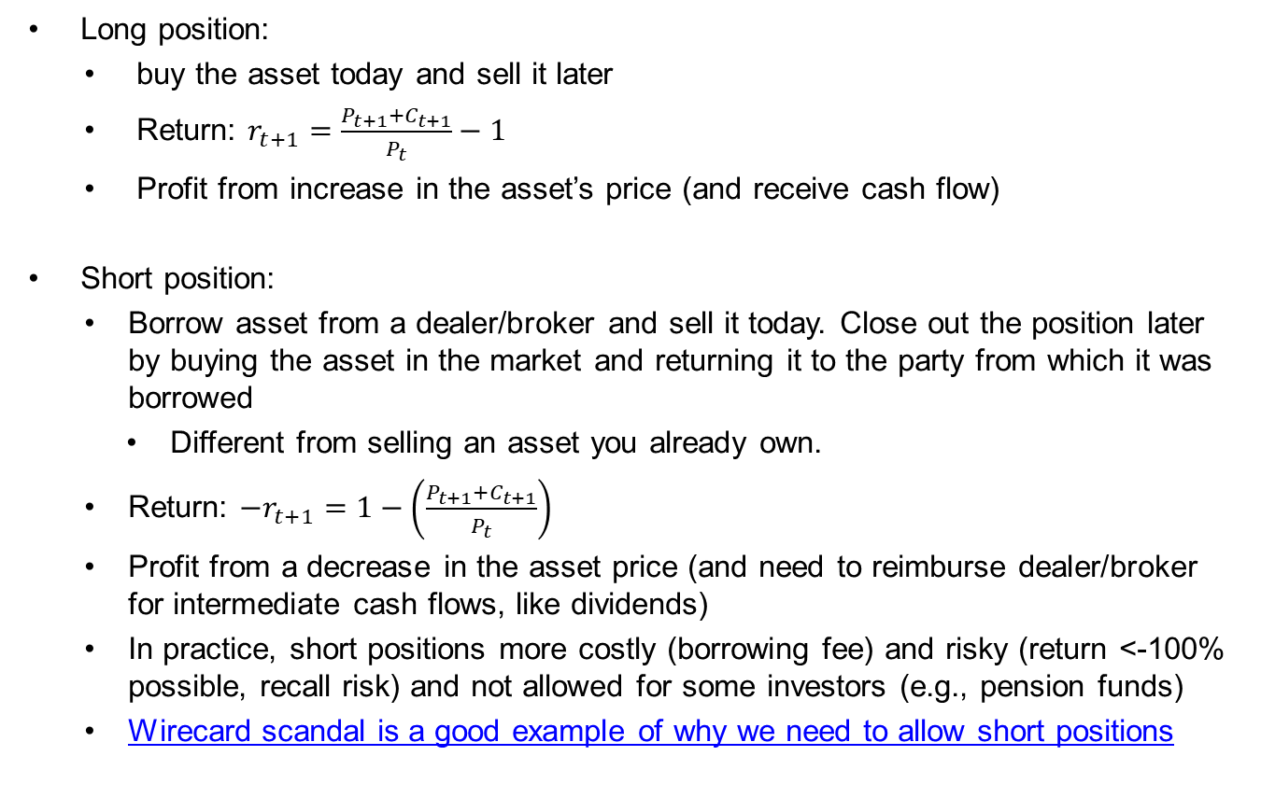
Buy or sell? Long or short?
Long position:
  buy the asset today and sell it later
  Return: $r_{t+1}=\frac{P_{t+1}+C_{t+1}}{P_{t}}−1$
  Profit from increase in the asset’s price (and receive cash flow)
Short position:
  Borrow asset from a dealer/broker and sell it today. Close out the position later by buying the asset in the market and returning it to the party from which it was borrowed
    Different from selling an asset you already own.
  Return: $−r_{t+1}=1−\left(\frac{P_{t+1}+C_{t+1}}{P_{t}}\right)$
  Profit from a decrease in the asset price (and need to reimburse dealer/broker for intermediate cash flows, like dividends)
  In practice, short positions more costly (borrowing fee) and risky (return <-100% possible, recall risk) and not allowed for some investors (e.g., pension funds)
  Wirecard scandal is a good example of why we need to allow short positions

Slide 35
Types of orders on an exchange
Market Order:
  Traders specify “buy” or “sell” (and quantity)
  Priority is time – it is executed immediately
  Trader receives current market price
Limit Order:
  Traders specify buying or selling price (and quantity)
  Priority is price – it is executed if and when condition is met
  A collection of limit orders waiting for execution is a limit order book.
Bid-ask spread:
  Difference between the bid and ask prices
  Implicit cost of trading
    You compensate the counterparty for providing liquidity (and market-making more generally) as well as information asymmetry.
If you are uninformed, you typically want to make market orders in the most liquid period of the day.

Slide 36
Example: FedEx
If I want to buy a share of FedEx and I post a market order, at which price will that be executed?
If I want to buy 500 shares of FedEx and I post a market order, at which price(s) will that be executed?
If I post a limit order to buy 500 shares at a price of 90, where will I enter the order book? (Limit buy order)

Slide 37
Buying on Margin
Definition:
  Investor borrows part of the purchase price of a stock from a broker
  Investor contributes the remaining portion
“Margin” refers to the percentage or amount contributed by the investor
  Initial margin is set by the regulator and depends on the asset
  Maintenance margin
    Minimum equity that must be kept in the margin account
    Margin call if value of securities falls too much
Goal: Leverage the investment

Slide 38
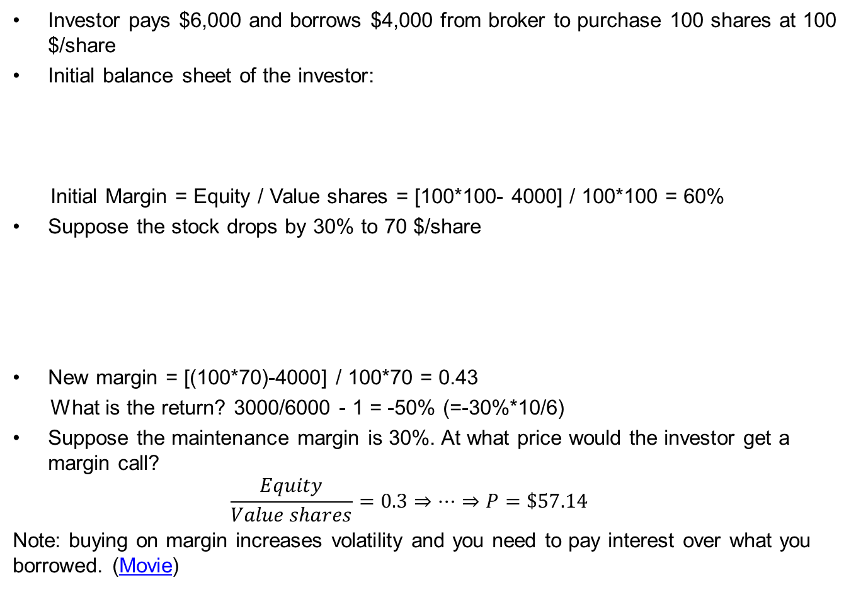
Maintenance margin details
Investor pays $6,000 and borrows $4,000 from broker to purchase 100 shares at 100 $/share
Initial balance sheet of the investor:
  Initial Margin = Equity / Value shares = [100*100- 4000] / 100*100 = 60%
Suppose the stock drops by 30% to 70 $/share
New margin = [(100*70)-4000] / 100*70 = 0.43
  What is the return? 3000/6000 - 1 = -50% (=-30%*10/6)
Suppose the maintenance margin is 30%. At what price would the investor get a margin call?
  $$\frac{Equity}{Value shares}=0.3⇒…⇒P=\$57.14$$
Note: buying on margin increases volatility and you need to pay interest over what you borrowed. (Movie)
Assets |  |  | Liabilities and Owner’s Equity
100 shares | $10,000 |  | Loan from broker | $4,000
 |  |  | Equity | $6,000
Assets |  |  | Liabilities and Owner’s Equity
100 shares | $7,000 |  | Loan from broker | $4,000
 |  |  | Equity | $3,000
Notes:
(100* P)-4000 / 100*P = 0.3
1-40/P =0.3
40/0.7=P

Slide 39
Exercise
You expect a stock to pay a dividend of 5$ over the next year and that dividend is expected to grow at a rate of 6% in the 9 years after. After that, the growth is expected to slow down and hit 1% per year. Given a discount rate of 10%, what must be the price of the stock?
Suppose the stock is traded at a price of 70$ in the market, should you go long or short? What is the NPV of this investment? Is this a risk-free profit?
What is your return over the next year if, at the end of the 1st year and just before the first dividend is paid, the market price agrees completely with your expectations?
What is your return if you had used 50% margin (i.e., you invest 35$ of your own money and 35$ you borrow from the broker)? How much equity will you have in your margin account?

