Slide 1
Investments
Masters in Finance
Spring 2025, Martijn Boons
Book chapters 6 and 7

Slide 2
Agenda
Key question: How to optimally combine (a large number of) assets in a portfolio?
Mean-variance analysis
Developed by Harry Markowitz in the early 1960’s
Foundation for portfolio choice models in practice
Main insight: Diversification is a “free lunch,” the opportunity to reduce risk without sacrificing expected return
Recall: arithmetic avg return = & risk - imply geometric avg return +
How to get there:
Capital Allocation: choosing between riskless and risky asset
Optimal portfolio of risky assets

Slide 3
Portfolios with one risky asset

Slide 4
Capital allocation: motivation
Pre-Markowitz investment advice:
When you are young, put your money into a couple of risky stocks that have a chance to do well
Closer to retirement, put all your money into bonds and safe stocks
Traditional advice is wrong
Investors should control risk of their portfolio through the split between riskless and risky assets: capital allocation
Today: how capital allocation between one risky and one riskless asset works.
Next week: Why everyone should hold the same portfolio of risky assets.
Riskless asset: usually is a nominally risk-free short-term sovereign debt instrument (T-bill)
Risky asset: a passive, well-diversified portfolio of stocks
Capital allocation important dimension of portfolio choice
Drives more than 90% of variation in institutional investor returns

Slide 5
Passive vs. active strategies
Passive investment strategy: investing in a portfolio comprising a broad group of firms (e.g., MSCI world or S&P500)
Contrast with active investiment strategies, where investor is looking to go long or overweight underpriced assets & go short or underweight overpriced assets.
How relevant is it to study passive investment strategies?
Active strategies are much more expensive: need to find mispricing, which is costly, and this skill is in short supply.
Passive strategies instead “buy and hold.”
Low performance of active fund managers
Consistent with decades of academic research, we have recently seen big outflows of active into passive strategies
However, what is the equilibrium? Can everyone be passive?

Slide 6
Utility approach to risk (1/2)
Mean-variance utility function:
$$U=E\left[r\right]−\frac{A}{2}×σ^{2},$$
where
A is the investor’s risk-aversion index: estimated using questionnaires.
How much are you willing to pay to avoid a risk of a certain magnitude (standard deviation)?
A falls between 2 and 10 for most investors.
U can be thought of as a certainty-equivalent rate
Meaning $E\left[r\right]=10\%$, A=4, $σ^{2}={20\%}^{2}$ equivalent to 2% risk-free
Consider investing in one of two assets: X or Y
The more risk averse you are, the larger must be the difference $E\left[r_{X}\right]−E\left[r_{Y}\right]$ to compensate for a given $σ_{X}>σ_{Y}$ for you to still be willing to invest in X rather than Y.

Slide 7
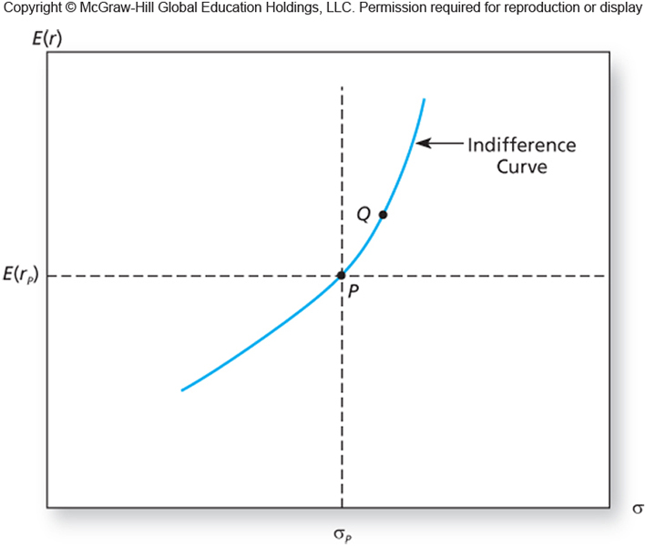
Utility approach to risk (2/2)
Indifference curves give us different combinations of expected returns and standard deviation with the same utility score
Certainty equivalent

Slide 8
The Capital Allocation Line (1/3)
Denote by y the fraction of the portfolio invested in the risky asset (a portfolio of various individual securities)
y<1: lending, y>1: borrowing (high leverage), y<0: short-selling
If I have 1$ to invest, y=0.5 means 50 cent in the risky asset and 50 cent on a bank account earning the risk-free rate
Note, for most investors and in most realistic settings, 0<y<1 will be satisfied at the optimum.
The (expected) return and risk of your complete portfolio, denoted by $r_{c}$, is then given by
$r_{c}=y{r_{p}+\left(1−y\right)r_{f}=r}_{f}+y(r_{p}−r_{f})$ with
$E\left[r_{c}\right]=r_{f}+yE\left[r_{p}−r_{f}\right]$ and $σ_{c}=yσ_{p}$
where $r_{p}$ is the return on the risky asset
It follows that all optimal portfolios lie on a straight line (in “mean-standard deviation space”) with slope equal to the Sharpe ratio of the risky asset:
$$⇒E\left[r_{c}\right]=r_{f}+\frac{\left(E\left[r_{p}\right]−r_{f}\right)}{σ_{p}}σ_{c}$$

Slide 9
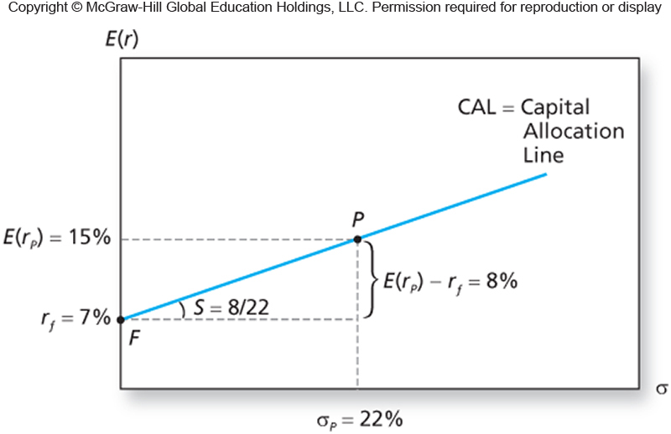
The Capital Allocation Line (2/3)
Graphically:

Slide 10
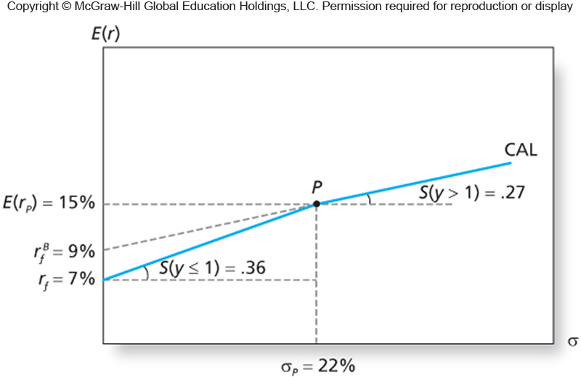
The Capital Allocation Line (3/3)
If you borrow at a higher rate than the rate at which you lend, due to default risk (you are less creditworthy than the bank from which you borrow):

Slide 11
Optimal capital allocation (1/2)
To pick a point on the CAL, solve the utility maximization problem:
$$\max_{y}{U}=E\left[r_{c}\right]−\frac{A}{2}σ_{c}^{2}=r_{f}+y\left[E\left[r_{p}\right]−r_{f}\right]−\frac{A}{2}y^{2}σ_{p}^{2}$$
First-order conditions yield
$$y^{∗}=\frac{E\left[r_{p}\right]−r_{f}}{Aσ_{p}^{2}}$$
The higher is the expected excess return (risk) of the risky asset, the more (less) you will optimally choose to invest in it.
The higher is your risk aversion, the more you penalize risk.
Optimal weight in risky asset: $y^{∗}$=(15%-7%)/(22%^2*4)=41%
Close to common, but boring, investment advice of 50/50

Slide 12
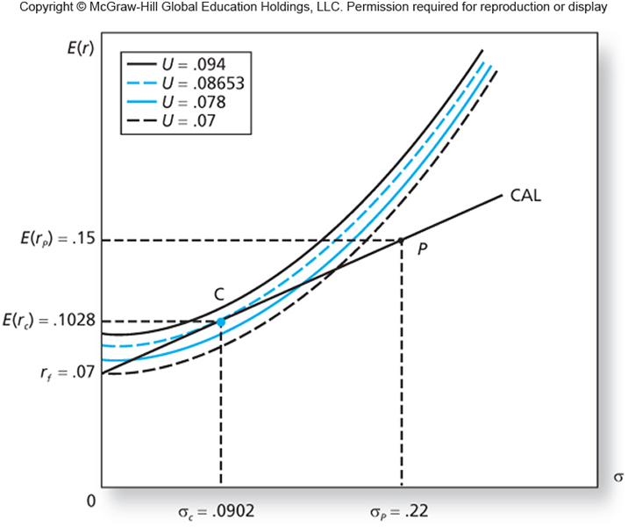
Optimal capital allocation (2/2)
Graphically:
$y^{∗}$=(15%-7%)/22%^2*4=41% → $E\left[r_{c}\right]$=7%+41% * (15% -7%) = 10.3%
Notes:
Maximize utility means moving northwest until indifference curve hits from above the CAL

Slide 13
Capital Allocation Line: Overview and Exercise
Mean-variance investors allocate a fraction $y$ of wealth to a risky asset $p$ and remainder to a risk-free asset
All portfolios $c$ of the two assets lie on a straight line: the CAL, with
$$E\left[r_{c}\right]=r_{f}+\frac{\left(E\left[r_{p}\right]−r_{f}\right)}{σ_{p}}σ_{c}$$
Investors choose a portfolio on CAL by maximizing
$\max_{y}{U}=E\left[r_{c}\right]−\frac{A}{2}σ_{c}^{2}=r_{f}+y\left[E\left[r_{p}\right]−r_{f}\right]−\frac{A}{2}y^{2}σ_{p}^{2}$→$y=\frac{E\left[r_{p}\right]−r_{f}}{Aσ_{p}^{2}}$
Exercise:
Q1: What is the standard deviation of the optimal portfolio with an expected return of 12%?
Q2: What is the expected return of the optimal portfolio with a standard deviation of 12%?
Q3: For which risk aversion level is 100% in $p$ optimal?
[1: 13.75%; 2: 11.36%; 3: 1.65]
Notes:
Maximize utility means moving northwest until indifference curve hits from above the CAL

Slide 14
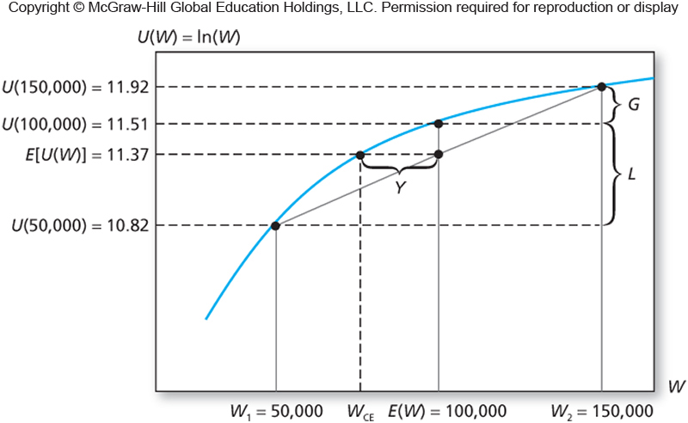
Log utility and the Kelly criterion (1/3)
Alternative models of utility have similar implications as mean-variance utility over single-period returns.
Consider log utility over end-period wealth $W_{T}$
investors choose a portfolio to maximize $E\left[\ln{(W_{T})}\right]$
Graphically,
Note, E(U(W))<U(E(W)), because 100 for sure is better than either 50 or 150, as going from 100 to 50 hurts you more than going from 100 to 150 benefits you

Slide 15
Log utility and the Kelly criterion (2/3)
Under certain assumptions, it is simple to determine the optimal capital allocation of a log-utility investor (Kelly criterion)
Suppose you face an investment where instantaneous returns are normally distributed, with
$μ$the instantaneous mean rate of return (in annual terms)
$σ$the instantaneous standard deviation (in annual terms)
It is then possible to show that wealth at time T follows a lognormal distribution:$\ln{(W_{T})}$is normal with
$\ln{{(W}_{0})+}\left(μ−σ^{2}/2\right)T$ the mean (Why does $σ$ show up? Higher volatility, lower wealth due to compounding.)
$σ\sqrt{T}$ the standard deviation

Slide 16
Log utility and the Kelly criterion (3/3)
Letting the mean and standard deviation of the portfolio depend on capital allocation as before, a log-utility investor maximizes
$${\left(r_{f}+y\left[E\left[r_{p}\right]−r_{f}\right]−y^{2}σ_{p}^{2}/2\right)T}_{}$$
Using first-order conditions we obtain
$$y=\frac{E\left[r_{p}\right]−r_{f}}{σ_{p}^{2}}$$
Notice that the solution is independent of initial wealth or time horizon
Question: is the average investor more or less risk-averse than a log-utility maximizer?

Slide 17
Portfolios with multiple risky assets

Slide 18
The goal
So far we thought about capital allocation: how to split your wealth between a riskless and a risky asset
Suppose now that we want to come up with the “best” possible porfolio of all available assets, i.e., a riskless asset and many risky assets
We will see that covariances are crucially important, as they determine the potential benefits of diversification.
To start, we consider the case of two risky assets:
 | Debt | Equity
Exp. Ret. | 8% | 13%
St. Dev. | 12% | 20%
Correlation | 0.3
Covariance | 0.0072

Slide 19
Covariance and correlation
IID assumption means returns are independent over time, not across assets!
Covariance measures co-movement: $σ_{DE}=Cov\left(r_{s,D},r_{s,E}\right)$ =
$=\sum_{s}{p\left(s\right)}(r_{s,D}−μ_{D})(r_{s,E}−μ_{E}$), for states of nature s
$=\frac{1}{N}\sum_{n=1}^{N}{(r_{n,D}−\overline{r_{D}}})(r_{n,E}−\overline{r_{E}})$, for a sample of N observations
Correlation: ${ ρ}_{DE}=\frac{σ_{DE}}{σ_{D}σ_{E}}$, using standard deviations $σ_{D}{,σ}_{E}$
How to interpret correlation, ${ −1≤ρ}_{DE}≤$1?
Imprecise:
Precise: with $σ_{D}$=12%, $σ_{E}$=20% what does $ρ_{DE}$=0.3 mean?
On average, when $r_{E}$ increases by one standard deviation (+20%), $r_{D}$increases by 0.3 standard deviations (0.3*12%=3.6%)

Slide 20
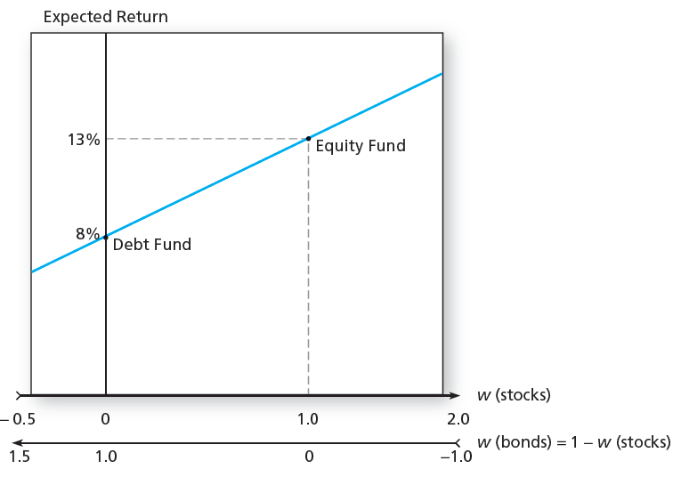
Expected return of two asset portfolio
Expected return of a portfolio is the weighted average of the expected returns on the individual securities.
With w_{D}, w_{E} the proportion of the portfolio invested in each asset, expected portfolio return,
E(r_{p}) = w_{D}E(r_{D})+w_{E}E(r_{E}) or
E(r_{p}) = w_{D}E(r_{D})+(1-w_{D})E(r_{E}), when all wealth is invested and weights sum to 1

Slide 21
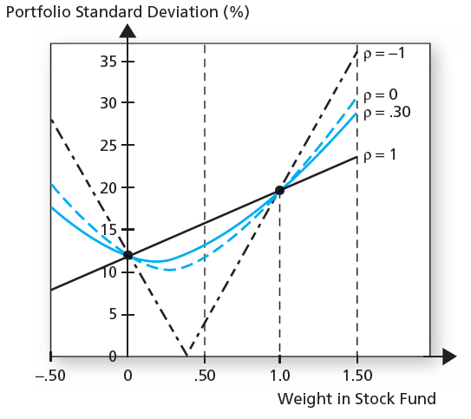
Standard deviation of two asset portfolio
Is the standard deviation of the portfolio ($σ_{p}$) also a weighted average?
No, only in the exceptional case that the two assets are perfectly positive correlated (with ${ ρ}_{DE }=1:$σ_{p}= w_{D} σ_{D} + w_{E} σ_{E})
Otherwise, σ_{p}²=Var(r_{p})=Var(w_{D}r_{D}+w_{E}r_{E})=$w_{D}^{2}\text{σ}\text{D}\text{2}{+w}_{E}^{2}\text{σ}\text{E}\text{2}$+2 w_{D} w_{E} σ_{D} σ_{E}${ ρ}_{DE }$
What do these portfolio standard deviations look like graphically?
Portfolio standard deviation falls below individual standard deviations (and the more so the lower is correlation)

Slide 22
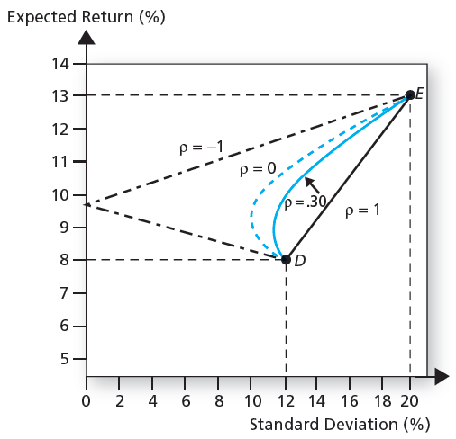
Correlations and the risk-return trade-off
Diversification benefits for
-1 ≤ ρ ≤ 1:
For ρ=1: no diversification benefits
Diversification benefits ↑ as ρ↓
For ρ=-1: perfect diversification: positive average return with zero risk

Slide 23
Minimizing risk
Using calculus, it is straightforward to obtain the weight in Debt that minimizes portfolio variance given a certain correlation:
$\min_{w_{D}}{w_{D}^{2}\text{σ}\text{D}\text{2}{+(1−w}_{D})\text{2}\text{σ}\text{E}\text{2}\text{+2} \text{w}\text{D}{(1−w}_{D})\text{σ}\text{D}\text{E} }$
→ $w_{D}^{MV}=\frac{\text{σ}\text{E}\text{2}−{\text{σ}}_{DE}}{\text{σ}\text{D}\text{2}+\text{σ}\text{E}\text{2}−2{\text{σ}}_{DE}}$
For ${ ρ}_{DE }=0.30$, we find
$w_{D}^{MV}=\frac{{0.20}^{2}−0.0072}{{0.12}^{2}+{0.20}^{2}−2×0.0072}=0.82$ (see Excel)
If ${ ρ}_{DE }$=-1, $w_{D}^{MV}=0.62;$but what is the variance of this portfolio?
Zero!

Slide 24
The efficient frontier
We plot the portfolios of D and E (including short positions) in expected return-standard deviation space.
Would you ever invest in portfolios on the red line?
No! Possible to find a portfolio with same risk, but higher expected return. Thus, inefficient.
Green line is the efficient frontier.

Slide 25
Which portfolio of two assets is optimal?
Which portfolio on the efficient frontier to pick?
Maximize mean-variance utility (or some other utility function): the more risk-averse, the lower both E(r_{p}) and σ_{p}².
Suppose now that there is also a risk-free asset you can invest in.
Reduce σ_{c}² (and E(r_{c})) by investing part of wealth in the risk-free asset, i.e., T bills.
Increase σ_{c}² (and E(r_{c})) by borrowing and investing even more in D and E.
Let us consider capital allocation between the risk-free asset and portfolios of D and E.
Complete portfolio return
$$r_{c}=\text{w}\text{D}\text{E}\text{(}r_{D}\text{)+}\text{w}\text{E}\text{E}\text{(}r_{E}\text{)}{+\text{(1}−\text{w}\text{D}{−\text{w}\text{E})r}_{f}}_{}=yr_{p}+(1−y)r_{f}$$
where $r_{p}$ is some portfolio of D and E and $\text{w}\text{D}$+ $\text{w}\text{E}$= $y$

Slide 26
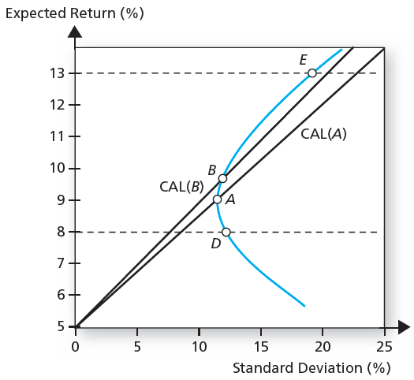
The Capital Allocation Line
Consider two portfolios of the risky assets, denoted A and B. The CAL between the risk-free asset and A and B, respectively, look as follows:
Why? Both expected return and standard deviation are linear in the fraction y invested in the risky asset portfolio:
E($r_{c})=r_{f}+y{(E(r}_{p})−r_{f}$)
$$σ_{c}=yσ_{p}$$

Slide 27
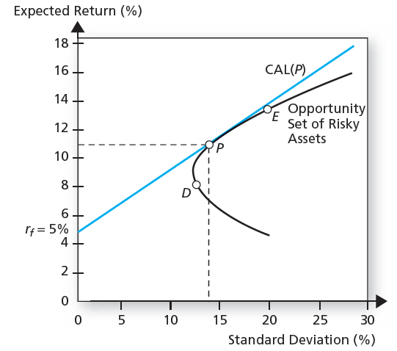
Maximizing Sharpe ratio
For any change in y, E($r_{c})$ increases by Δy*(E($r_{p})$- $r_{f}$) and $σ_{c}$ increases by Δy* $σ_{p}$
Thus, the slope of the CAL is constant and equals the Sharpe ratio of $p$
$$\frac{Portfolio excess return}{Portfolio standard deviation}=\frac{E\left(r_{p}\right)−r_{f}}{σ_{p}}$$
So, the best possible portfolio P of the risky assets D and E maximizes this slope and thus the compensation per unit of standard deviation:
P (or T) is called the Tangency portfolio
All optimal portfolios on the CAL have the same relative weight in D and E as P.

Slide 28
The tangency portfolio
Portfolios on the CAL dominate all other portfolios, irrespective of risk aversion.
The tangency portfolio is the portfolio with 100% invested in the risky assets that maximizes Sharpe ratio. It can be shown (very tedious…) that the solution to this problem is
$$w_{D}^{T}=\frac{μ_{D}^{e}\text{σ}\text{E}\text{2}−{μ_{E}^{e}σ}_{DE}}{μ_{D}^{e}\text{σ}\text{E}\text{2}+μ_{E}^{e}\text{σ}\text{D}\text{2}{−(μ_{D}^{e}+μ_{E}^{e})σ}_{DE}},$$
where $μ_{i}^{e}$ is the excess return of asset i
Alternatively, use Excel Solver
In our case, $w_{Debt}^{T}$=40%; $w_{Equity}^{T}$=60%,
with expected return and standard deviation $μ_{}^{T}=11\%$, $σ_{}^{T}$=14.2%
Notes:
https://www.youtube.com/watch?app=desktop&v=IhYhVW6IO7I

Slide 29
Two fund separation
This analysis essentially separates the portfolio choice problem into two independent tasks.
All investors regardless of individual risk preferences will choose the same risky asset portfolio, that is, the optimal combination of risky assets: the Tangency portfolio
Highest return for every unit of risk!
Same idea applies when we go from two to any larger number of risky assets (see assignment).
Depending on individual risk preferences, each investor combines the Tangency portfolio (“fund #1”) with an investment in the risk-free asset (“fund #2”) to achieve his desired expected return with minimum risk
This is why the traditional portfolio advice is wrong: everyone should invest in the same optimally diversified combination of the risky assets

Slide 30
Example
Investor with mean-variance preferences and risk-aversion coefficient A=4.
What is the optimal complete portfolio for this investor?
Plug tangency portfolio as risky asset into optimal capital allocation between risky and riskfree asset:
Recall: $y=\frac{E\left[r_{T}\right]−r_{f}}{Aσ_{T}^{2}}=\frac{11\%−5\%}{4∗{0.142}^{2}}=0.744$, so that means:
Tangency | 0.74
 | Debt | 0.30
 | Equity | 0.45
Risk-free | 0.26

Slide 31
More realistic portfolios: N assets
Two assets: σ_{P}²=Var(r_{P})=Var(w_{D}r_{D}+w_{E}r_{E})=
$w_{D}^{2}\text{σ}\text{D}\text{2}{+w}_{E}^{2}\text{σ}\text{E}\text{2}$+2 w_{D} w_{E} σ_{DE}
Three assets:
σ_{P}²$=\text{Var}\text{(}\text{w}\text{D}\text{r}\text{D}\text{+}\text{w}\text{E}\text{r}\text{E}\text{+}\text{w}\text{C}\text{r}\text{C}\text{)=}w_{D}^{2}\text{σ}\text{D}\text{2}{+w}_{E}^{2}\text{σ}\text{E}\text{2}{+w}_{C}^{2}\text{σ}\text{C}\text{2}$+
2 w_{D} w_{E} σ_{DE} +2 w_{D} w_{C} σ_{DC} +2 w_{E} w_{C} σ_{EC}
Generalizing to the N asset case, we can write:
σ_{P}²=$Var\left(\sum_{i=1}^{N}{w_{i}}r_{i}\right)$ =$\sum_{i=1}^{N}{w_{i}^{2}}$ $\text{σ}\text{i}\text{2}$+ $\sum_{i=1}^{N}{\sum_{j≠i}{w_{i}w_{j}}}$σ_{ij}
{=[N variance terms] + [N*(N-1) covariance terms]}
There is an important economic insight we can get from this equation.

Slide 32
Diversifying firm-specific risk
Let us consider an equal-weighted portfolio of N risky assets or stocks:
σ_{P}²$=\sum_{i=1}^{N}{\frac{1}{N^{2}}Var\left(r_{i}\right)}+\sum_{i=1}^{N}{\sum_{j≠i}{\frac{1}{N^{2}}Cov\left(r_{i},r_{j}\right)}=}$
$$\frac{1}{N^{}}\left(\frac{1}{N^{}}\sum_{i=1}^{N}{Var\left(r_{i}\right)}\right)+\frac{N(N−1)}{N^{2}}\left(\frac{1}{N(N−1)}\sum_{i=1}^{N}{\sum_{j≠i}{Cov\left(r_{i},r_{j}\right)}}\right)=$$
$$\frac{1}{N}Avg. Var+(1−\frac{1}{N})Avg. Cov$$
As the number of stocks in the portfolio grows large (N↑), firm-specific risk is diversified away and the only risk that is left is comes from covariances between the stocks in the portfolio

Slide 33
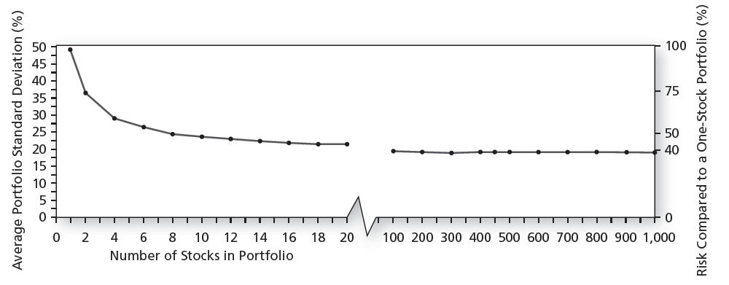
Diversification at work
The variance of an equal weighted portfolio of N assets can be written as:
$\frac{1}{N}Avg. Var+(1−\frac{1}{N})Avg. Cov$
Graphically:
Rule of thumb: with about 50 stocks, firm-specific risk is diversified away
Puzzle: Many investors do not own more than a handful of stocks, even though diversified portfolios are easily available: Exchange Traded Funds (ETF)!
Firm-specific or idiosyncratic risk
Non-diversifiable or systematic risk

Slide 34
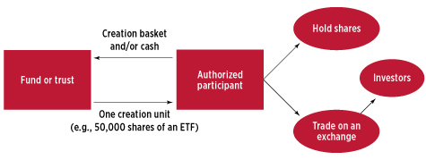
Intermezzo: What is an ETF?
ETF’s allow you to invest in large portfolios of stocks at low cost. ETF’s track broad, diversified indexes, such as the S&P500 and MSCI World.
Fee for Vanguard S&P500 ETF is 0.07% per year, which is relative to 1.5% for the average US equity mutual fund!
Fund owns basket of shares (e.g., all or subset of S&P500 stocks) and shares on ETF are traded in secondary market.
These ETF shares are what you and I invest in!
Synthetic ETF’s track using swaps and derivatives
Authorized Participant exists to ensure pricing of ETF shares is consistent with pricing of basket of shares ETF owns. Typically a broker/dealer, think Goldman, Morgan Stanley etc.
Two roles:
ETF creation (source ICI)

Slide 35
Intermezzo: ETF pricing mechanism
Continuous arbitrage through creation and redemption of ETF shares
What happens if share of the ETF is at Premium relative to basket of shares fund owns?
AP buys basket of shares in secondary market and deposits them to fund in return for shares of ETF, which it then sells in secondary market at higher price.
Conversely, Discount: AP buys shares of ETF at lower price in secondary market, delivers them to fund and receives basket of shares in return, which it then sells in secondary market at higher price.
ETF’s holdings are reported very frequently, thus facilitating also arbitrage by other investors
Question for the future: What happens to ETF when AP runs into trouble?

Slide 36
Some matrix algebra… (1/2)
Formally, how should we model diversification across a large set of N assets?
Use matrix algebra
Let us denote by $μ$the (Nx1) vector of expected returns and by w the (Nx1) vector of portfolio weights (and $i$ an (Nx1) vector of ones):
$μ=\left[\begin{matrix}μ_{1} \\ \begin{aligned}μ_{2} \\ ⋮\end{aligned} \\ μ_{N}\end{matrix}\right],μ^{e}=μ−r_{f},w=\left[\begin{matrix}w_{1} \\ \begin{aligned}w_{2} \\ ⋮\end{aligned} \\ w_{N}\end{matrix}\right]$, $i=\left[\begin{matrix}1 \\ \begin{aligned}1 \\ ⋮\end{aligned} \\ 1\end{matrix}\right]$
Let us denote by $Ω$the (N x N) var-cov matrix (with N variance terms and N*(N-1) covariance terms):
$$Ω=\left[\begin{matrix}\text{σ}\text{1}\text{2} \\ σ_{21} \\ \begin{aligned}⋮ \\ σ_{N1}\end{aligned}\end{matrix} \begin{matrix}σ_{12} \\ \text{σ}\text{2}\text{2} \\ \begin{aligned}⋮ \\ σ_{N2}\end{aligned}\end{matrix} \begin{matrix}… \\ … \\ \begin{aligned}⋱ \\ …\end{aligned}\end{matrix} \begin{matrix}σ_{1N} \\ σ_{2N} \\ \begin{aligned}⋮ \\ \text{σ}\text{N}\text{2}\end{aligned}\end{matrix}\right]$$

Slide 37
Some matrix algebra… (2/2)
Using matrix algebra, expected portfolio return and variance:
$μ_{p}=w^{′}μ=\sum_{i}{w_{i}μ_{i}}$ and $σ_{p}^{2}=w^{′}Ωw=\sum_{i}{\sum_{j}{w_{i}w_{j}σ_{ij}}}$
Now, find portfolio weights $w_{p}$ that minimize risk for a desired level of expected return ${\text{μ}}_{p}$:
$\min_{w_{p}}{w_{p}′}$ $Ω$ $w_{p}$, subject to ${w_{p}}^{′}μ=μ_{p}^{desired}$and ${w_{p}}^{′}i=1$
Solution easily found in Excel (Part I) or using
$${ w}_{p}=g+hμ_{p}^{desired},$$
where $g=\frac{1}{D}(B(Ω^{−1}i)$-A$(Ω^{−1}μ))$ and $h=\frac{1}{D}(C(Ω^{−1}μ)$-A$(Ω^{−1}i))$ using
$A=i′$ $Ω^{−1}μ$, $B=μ′$ $Ω^{−1}μ$, $C=i′$ $Ω^{−1}i$, and $D=BC−A^{2}$

Slide 38
Excel example: The efficient frontier of three assets
Let us calculate the mean-variance frontier of three assets: D, E and C.
Assume: $μ_{C}=10\%, \text{σ}\text{C}\text{=15\%}$, and ${ ρ}_{DC }=−0.1; ρ_{EC }=0.30$
Main insights:
Curve moves northwest;
The more assets you have, the more unlikely that any individual asset ends up on the frontier

Slide 39
Excel example: The CAL
Using the same insight as before, i.e., combinations of the risk-free asset and any arbitrary portfolio of risky assets lie on a straight line, we can find the tangency portfolio that maximizes Sharpe ratio.
Excel (Part II): Max Sharpe ratio D,E,C = 0.495 > D,E = 0.423

Slide 40
The Tangency portfolio
Formally, we can solve for optimal portfolios of N assets and a risk-free asset using
$$\min_{w_{p}}{w_{p}′}Ωw_{p}\text{, }\text{subject} \text{to} {w_{p}}^{′}μ^{e}=μ_{p}^{e,desired}$$
Note, we are using expected excess returns, $μ^{e}$=$μ−r_{F}$, and the weights don’t need to sum to 1 anymore: any residual wealth not invested in the risky assets is invested in the risk-free asset
The solution has the following form:
${ w}_{p}=c_{p}\overline{w}, where c_{p}=\frac{μ_{p}^{e,desired}}{μ^{e′}Ω^{−1}μ^{e}}$ and $\overline{w}=Ω^{−1}μ^{e}$.
Thus, optimal portfolios have same relative weights in risky assets defined by the vector $\overline{w}$ (and $1−i′{ w}_{p}$ in the risk-free asset), such that the Tangency portfolio with 100% weight in risky assets
$w_{T}=\frac{Ω^{−1}μ^{e}}{i′Ω^{−1}μ^{e}}$, see Excel (Part III)

Slide 41
Extra: Solution method
Solving Lagrangian:
$$\min_{w_{p}}{w_{p}′}Ωw_{p}\text{ − 2}\text{L}{{(w}_{p}}^{′}μ^{e}−μ_{p}^{e,desired})$$
From derivative wrt $w_{p}$, we find:
$2Ωw_{p}$-2L$μ^{e}=0⟷w_{p}=LΩ^{−1}μ^{e}$
From derivative wrt L, Lagrangian multiplier, we find:
${w_{p}}^{′}μ^{e}=μ_{p}^{e,desired}$ $⟷L=\frac{μ_{p}^{e,desired}}{μ^{e^{′}}Ω^{−1}μ^{e}}$
Combining, we have:
$$w_{p}=\frac{μ_{p}^{e,desired}}{μ^{e^{′}}Ω^{−1}μ^{e}}Ω^{−1}μ^{e}$$
Similarly, weights of the global minimum variance portfolio of the risky assets are found as: $w_{GMV}=\frac{Ω^{−1}i}{i′Ω^{−1}i}$ (see Part III)

Slide 42
Constructing optimal portfolios in practice
Given current estimates of expected returns $μ_{t}^{e}$ and the var-cov matrix $Ω_{t}$, optimal portfolio of multiple risky assets has weights: $\frac{{Ω_{t}}^{−1}μ_{t}^{e}}{i′{Ω_{t}}^{−1}μ_{t}^{e}}$
$μ_{t}^{e}$may incorporate portfolio manager’s views and information from specific forecasting or asset pricing models (CAPM!)
Relying on historical averages and (co-) variances as estimates of these conditional moments is extremely dangerous and yields extreme long- and short-positions that are practically meaningless
Mean-variance analysis is quite sensitive to inputs, like most optimization tools
Let’s look at an example as you will likely encounter the same problem in the assignment.

Slide 43
Example of the issue with MV analysis
Optimal portfolio of 10 stock market indexes using ±30 years of data:
 | US | Aus | NZea | Can | Den | Ger | Jap | Swe | Swi | UK | Exp. Ret. | St. Dev. | Sharpe
Tangency portfolio | 0.3 | 1.3 | -0.4 | 0.3 | 0.6 | -1.1 | -1.1 | 0.5 | 1.7 | -1.1 | 33.5% | 32.1% | 0.93
Equal weighted | 0.1 | 0.1 | 0.1 | 0.1 | 0.1 | 0.1 | 0.1 | 0.1 | 0.1 | 0.1 | 10.8% | 16.1% | 0.45

Slide 44
Practical Solutions
1. Forward-looking, not historical, estimates
Expected returns that condition on today’s circumstances
Standard deviations and covariances
Volatility relatively easy to predict with recent (high-frequency) data.
Correlations a bit harder, but still easier than returns.
2. Incorporate portfolio constraints
No short-selling, no leverage
Economic constraints and shrinkage
Black-Littermann approach shrinks towards a market-value weighted portfolio of the assets depending on how noisy are estimates of returns and risk.
That said, as so often, the simple things may work best.
DeMiguel et al. (2009): Equal-weighted or 1/N strategies perform relatively well in many settings, even compared to complex methods specifically designed to deal with estimation error
Question: Do you think 1/N strategies are popular in the industry?

