Slide 1

Investments
Masters in Finance
Spring 2025, Martijn Boons
Chapter 14-15-16

Slide 2
Bonds defined
Bonds promise to pay coupons at pre-specified dates and a fixed principal amount (face value) at the maturity date
  Fixed coupons (most common): % of face value (typically 100$ or 1000$)
    0% coupon = zero coupon bond
    Variable coupon (rare)
  Maturity ranges from overnight to > 30 years
  Nominal vs real
  Default risk-free vs default risk
    US vs Greek government
    Government vs corporations
Bonds are traded at discount (P<face value; e.g., zero coupon bonds), par (P=face value) or premium (P>face value)
Large variety of bonds issued by single issuer
  E.g., US Treasury
    T-Bills: 4,13, 26, and 52 weeks (no coupons)
    T-Notes: 2,3,5,7 and 10 years (semi-annual coupons)
    T-Bonds: 30 years (semi-annual coupons)
  Big companies like BoA and GE have ≈ 50 different bond issues outstanding
    Different maturities & coupon rates

Slide 3
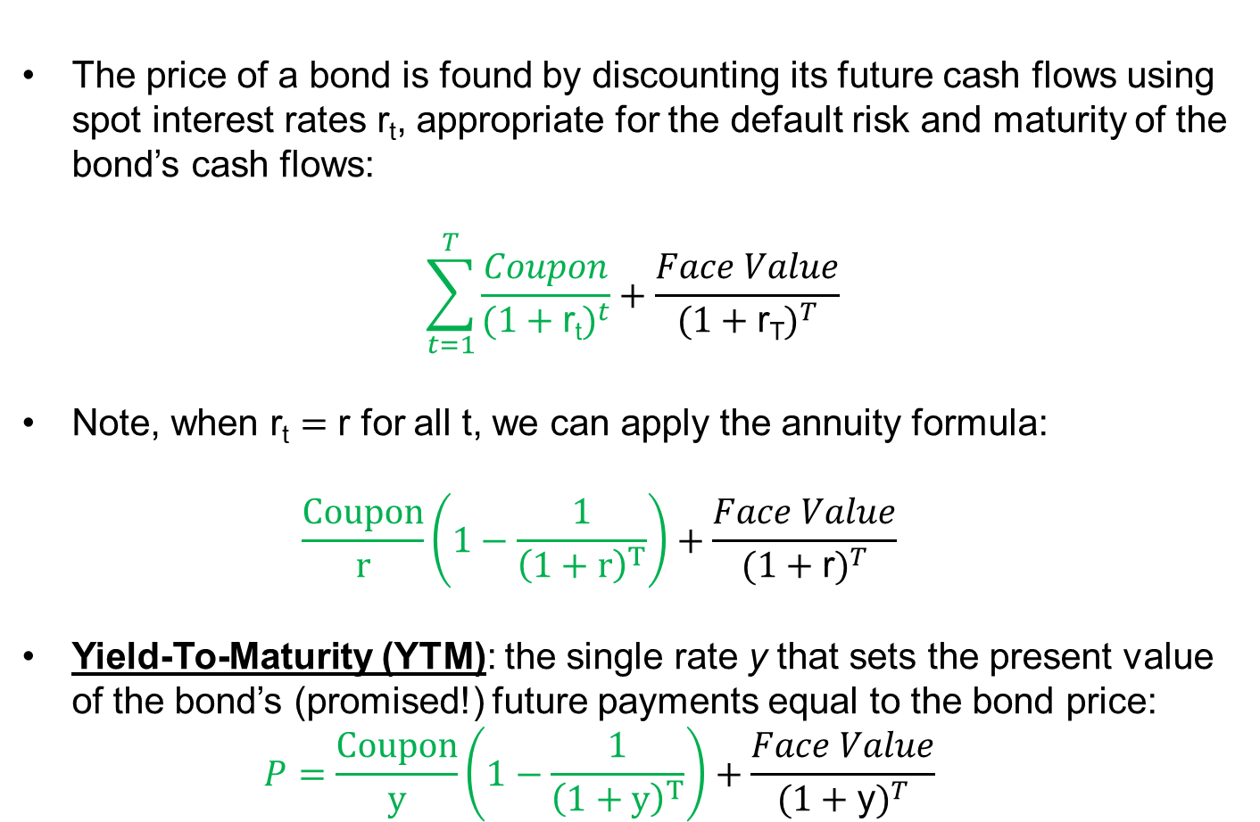
Bonds defined
The price of a bond is found by discounting its future cash flows using spot interest rates r_{t}, appropriate for the default risk and maturity of the bond’s cash flows:
$$\sum_{t=1}^{T}{\frac{Coupon}{{(1+\text{r}\text{t})}^{t}}}+\frac{Face Value}{{(1+\text{r}\text{T})}^{T}}$$
Note, when $\text{r}\text{t}=\text{r}$ for all t, we can apply the annuity formula:
  $$\frac{Coupon}{r}\left(1−\frac{1}{{\left(1+r\right)}^{T}}\right)+\frac{Face Value}{{(1+\text{r})}^{T}}$$
Yield-To-Maturity (YTM): the single rate y that sets the present value of the bond’s (promised!) future payments equal to the bond price:
  $$P=\frac{Coupon}{y}\left(1−\frac{1}{{\left(1+y\right)}^{T}}\right)+\frac{Face Value}{{(1+\text{y})}^{T}}$$

Slide 4
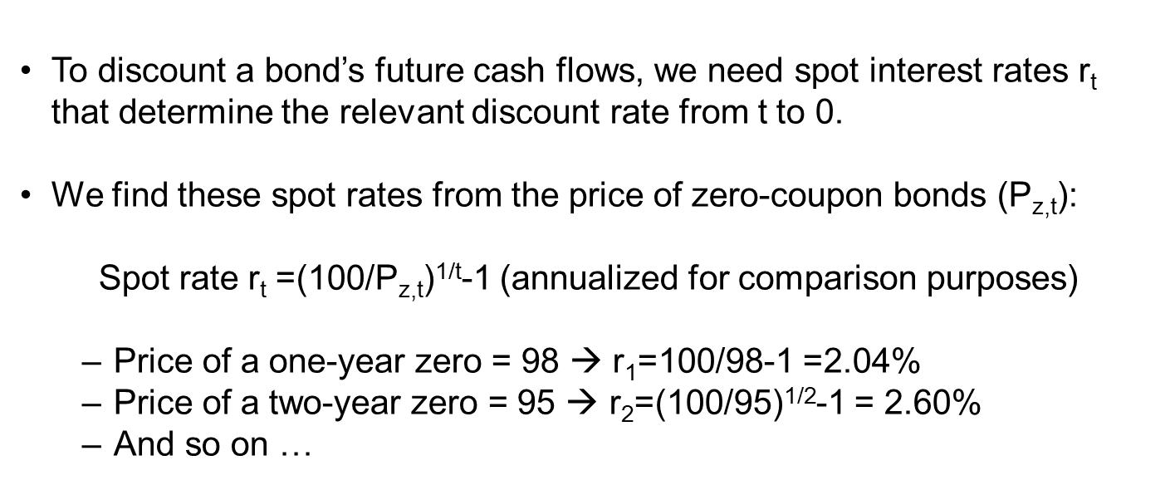
Spot rates
0
1
2
3
4
5
r₁
(1+r₂)²
(1+r₄)⁴
To discount a bond’s future cash flows, we need spot interest rates $\text{r}\text{t}$ that determine the relevant discount rate from t to 0.
We find these spot rates from the price of zero-coupon bonds (P_{z,t}):
Spot rate r_{t} =(100/P_{z,t})^{1/t}-1 (annualized for comparison purposes)
  Price of a one-year zero = 98 → r₁=100/98-1 =2.04%
  Price of a two-year zero = 95 → r₂=(100/95)^{1/2}-1 = 2.60%
  And so on …

Slide 5
STRIPS
More precisely, spot rates are found using STRIPS
  acronym for Separate Trading of Registered Interest and Principal of Securities
  Started trading in January 1985
A Treasury note with 10 years remaining to maturity consists of
  A single principal payment at maturity
  20 coupon payments (semi-annually for 10 years)
When this note is STRIP’d, the 20 coupons and the principal become separate securities, i.e., zero coupon bonds.
  Spot rates are the yields of these nominally risk-free zero coupon bonds.
  Yield curve

Slide 6
STRIP prices and the yield curve
Source: Wall Street Journal
How did we get from the 3 and 10 year STRIP price to their yields?
r₃ = (100/97.5)^(1/3)-1 =0.85%
r₁₀= (100/85.5)^(1/10)-1 =1.6%

Slide 7
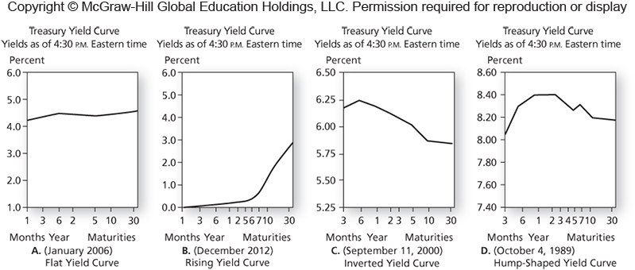
Yield curve over time
Usually upward sloping, because uncertainty about interest rates and inflation increase with maturity.
But, there is considerable time-variation:
  Important insight: interest rates vary over time and with maturity!
Inversions tend to occur when bad times are approaching: investors fear short-term economic uncertainty and avoid reinvestment risk from buying short-term bonds, such that these prices (yields) are relatively low (high).

Slide 8
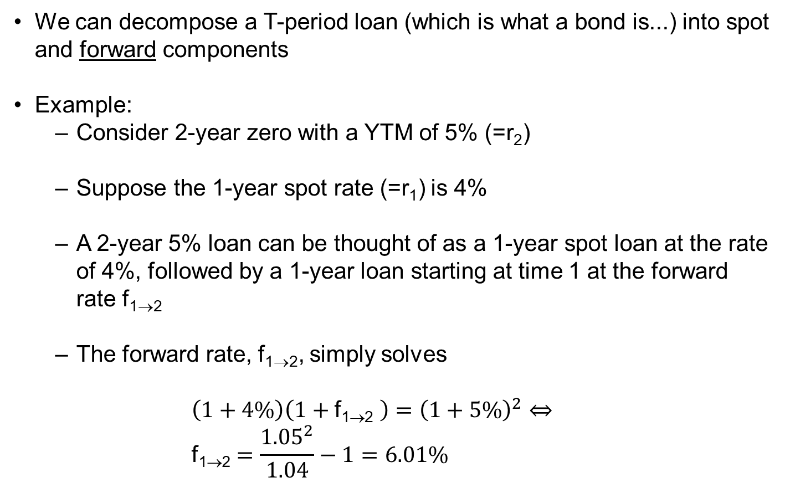
Forward rates (1/3)
We can decompose a T-period loan (which is what a bond is...) into spot and forward components
Example:
  Consider 2-year zero with a YTM of 5% (=r₂)
  Suppose the 1-year spot rate (=r₁) is 4%
  A 2-year 5% loan can be thought of as a 1-year spot loan at the rate of 4%, followed by a 1-year loan starting at time 1 at the forward rate f_{1→2}
  The forward rate, f_{1→2}, simply solves
  $$\left(1+4\%\right)\left(1+\text{f}\text{1}\text{→2} \right)={\left(1+5\%\right)}^{2}⇔ \\ \text{f}\text{1}\text{→2}=\frac{{1.05}^{2}}{1.04}−1=6.01\%$$

Slide 9
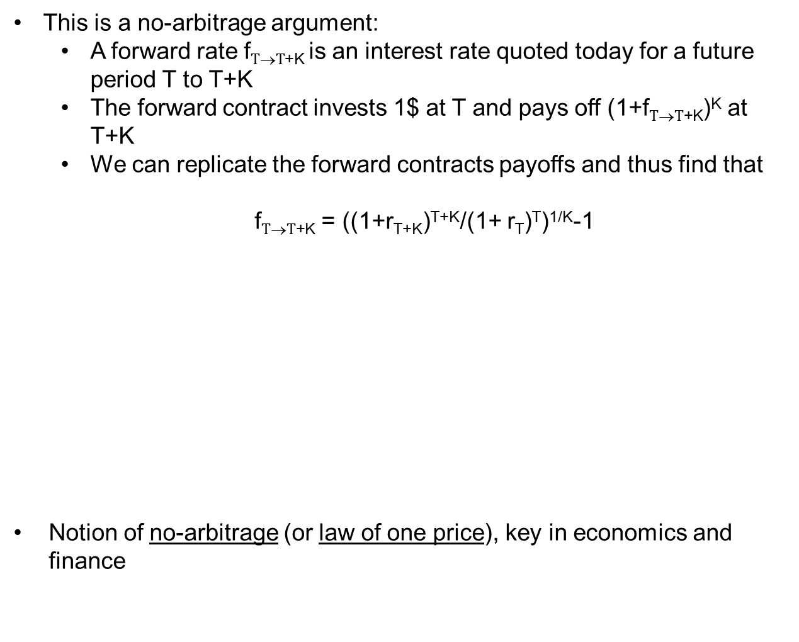
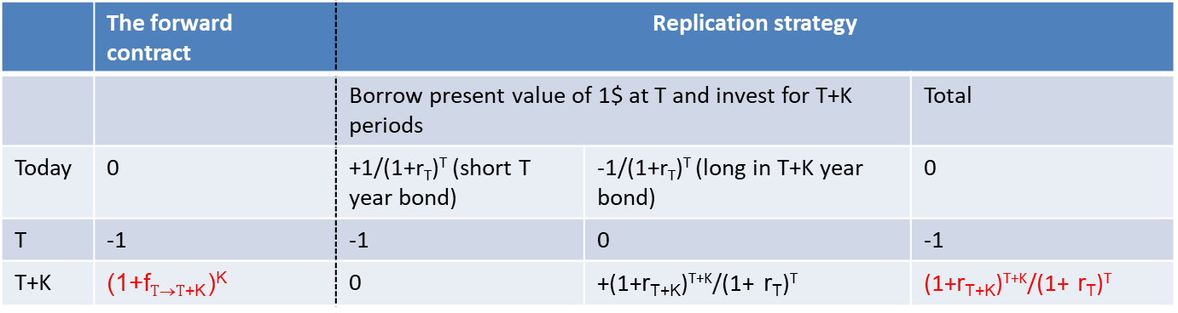
Forward rates (2/3)
This is a no-arbitrage argument:
  A forward rate $\text{f}T\text{→}T\text{+}\text{K}$is an interest rate quoted today for a future period T to T+K
  The forward contract invests 1$ at T and pays off (1+$\text{f}T\text{→}T\text{+}\text{K}$)^{K} at T+K
  We can replicate the forward contracts payoffs and thus find that
  $\text{f}T\text{→}T\text{+}\text{K}$ = ((1+r_{T+K})^{T+K}/(1+ r_{T})^{T})^{1/K}-1
Notion of no-arbitrage (or law of one price), key in economics and finance
 | The forward contract | Replication strategy
 |  | Borrow present value of 1$ at T and invest for T+K periods |  | Total
Today | 0 | +1/(1+r_{T})^{T} (short T year bond) | -1/(1+r_{T})^{T} (long in T+K year bond) | 0
T | -1 | -1 | 0 | -1
T+K | (1+$\text{f}T\text{→}T\text{+}\text{K}$)^{K} | 0 | +(1+r_{T+K})^{T+K}/(1+ r_{T})^{T} | (1+r_{T+K})^{T+K}/(1+ r_{T})^{T}

Slide 10
Forward rates (3/3)
Forward rates reflect two things
  Expectations about future spot rates
    If yield curve is upward (downward) sloping, then forward rates are higher (lower) than spot rates
  Risk premium, since future spot rates are uncertain
    By agreeing today on a forward rate, you are taking risk that interest rates move against you.
    You want to be compensated for this risk.
The ``expectations hypothesis of the term structure’’ states that risk premia are zero (or, at least, constant), such that any variation in forward rates reflects variation in expected future spot rates
  Confidently rejected in the data (Fama and Bliss, 1987; many others)

Slide 11
Yield to maturity (1/2)
The yield-to-maturity (YTM) of a bond provides a measure for the return of investing in the bond
  The YTM corresponds to the single rate at which discounting future cash flows generates the bond’s current price
    It is like an internal rate of return: the discount rate that sets an NPV = 0
  Annualized holding period return if you hold the bond until maturity (and there is no default)
  However, YTM does not correspond to the realized return in each future period
    The reason is that interest vary over time and with maturity
    Thus, coupons are reinvested at uncertain rates

Slide 12

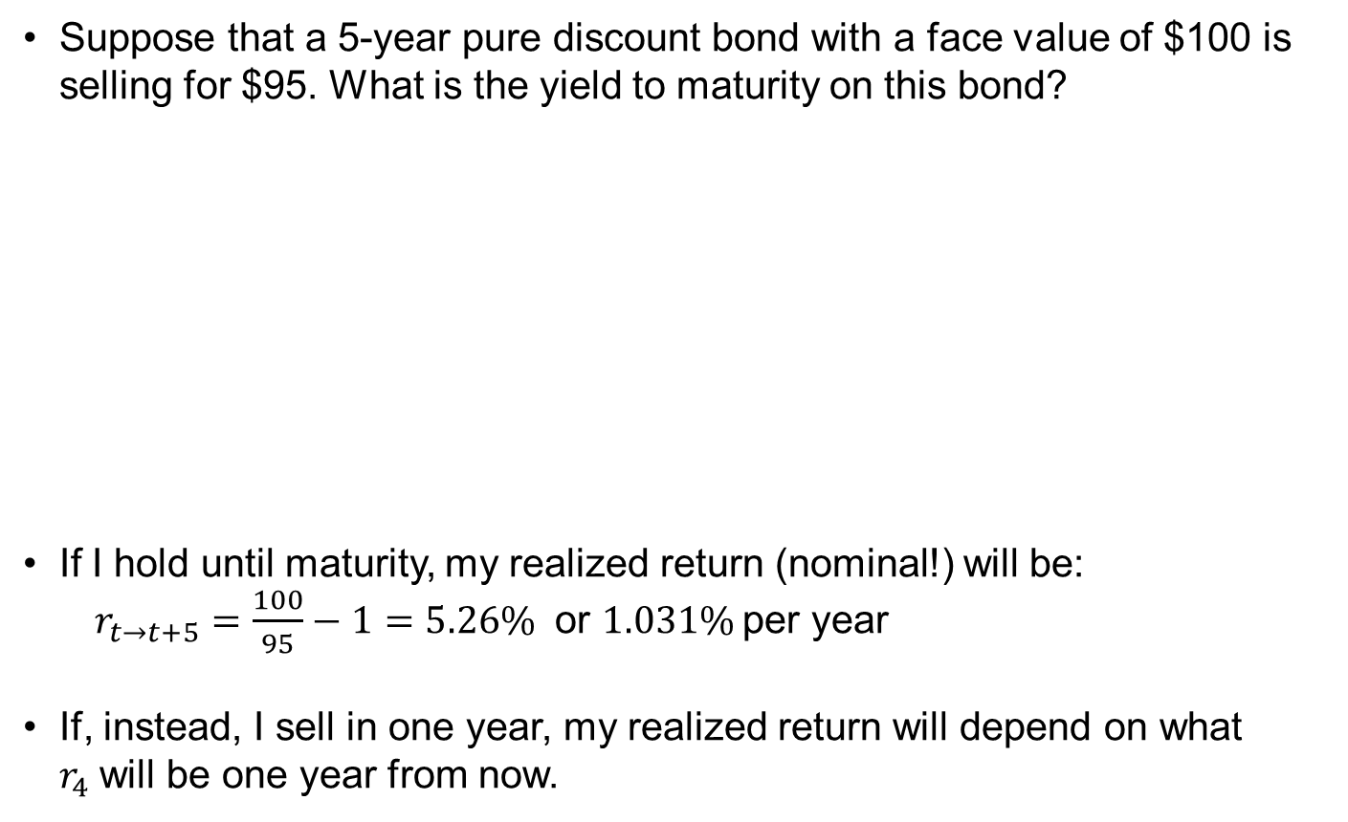
Yield to maturity (2/2)
Suppose that a 5-year pure discount bond with a face value of $100 is selling for $95. What is the yield to maturity on this bond?
If I hold until maturity, my realized return (nominal!) will be:
  $r_{t→t+5}=\frac{100}{95}−1=5.26\%$ or $1.031\%$per year
If, instead, I sell in one year, my realized return will depend on what $r_{4}$will be one year from now.
$$95=\frac{100}{{\left(1+r_{5}\right)}^{5}} \\ {\left(1+r_{5}\right)}^{5}=\frac{100}{95} \\ r_{5}={\left(\frac{100}{95}\right)}^{1/5}−1=1.031\%$$

Slide 13
Coupon bonds (1/4) – example
You can purchase a 5-year coupon bond with an annual coupon rate of 7% and a face value of $1,000
You know the following information for zero coupon bonds from the market for Treasury Strips (recall: prices are quoted per $100 of face value)
What would you pay for the coupon bond?
 | 1 | 2 | 3 | 4 | 5
Strip Price | 98 | 95 | 92 | 89 | 85
Spot rate | 2.04% | 2.60% | 2.82% | 2.96% | 3.30%

Slide 14
Coupon bonds (2/4) – example
We have essentially constructed a replicating portfolio of zeros
  70$ worth of 1,2,3,4-year zero coupon bonds
  1070$ worth of 5-year zero coupon bond
This is the no-arbitrage price of the coupon bond.
  What if the market price is 1,150?
    Arbitrage opportunity! Buy bond, short replicating portfolio.
      Payoff today = 21 = 1171-1150
      Payoff at all dates 1,…,5 in the future = 0

Slide 15
Coupon bonds (3/4) – YTMs
Consider the previous 5-year coupon bond with annual coupon rate of 7%, face value of $1,000, and price of $1,171. What is the yield to maturity on this bond?
It turns out that
In Excel: Solver or IRR

Slide 16
Coupon bonds (4/4) – YTMs
Yield to maturity on the coupon bond is 3.24%
  In practice, firms usually aim to issue bonds at (close to) par: they offer a coupon rate that is approximately equal to the yield to maturity of the bonds to be sold.
  As time passes, bond’s risk may change and thus yield may differ from coupon rate: bond will trade at discount or premium
The YTM is a weighted-average of the yield of zero-coupon bonds with equal and shorter maturities
  The YTM (3.24%) is closest to the 5-year zero-yield (3.30%), because this yield is used to discount the bond’s largest cash flow!
As the coupon rate increases, weight of YTM in earlier strip yields increases
  When the yield curve is upward sloping: higher coupons → lower YTM.

Slide 17
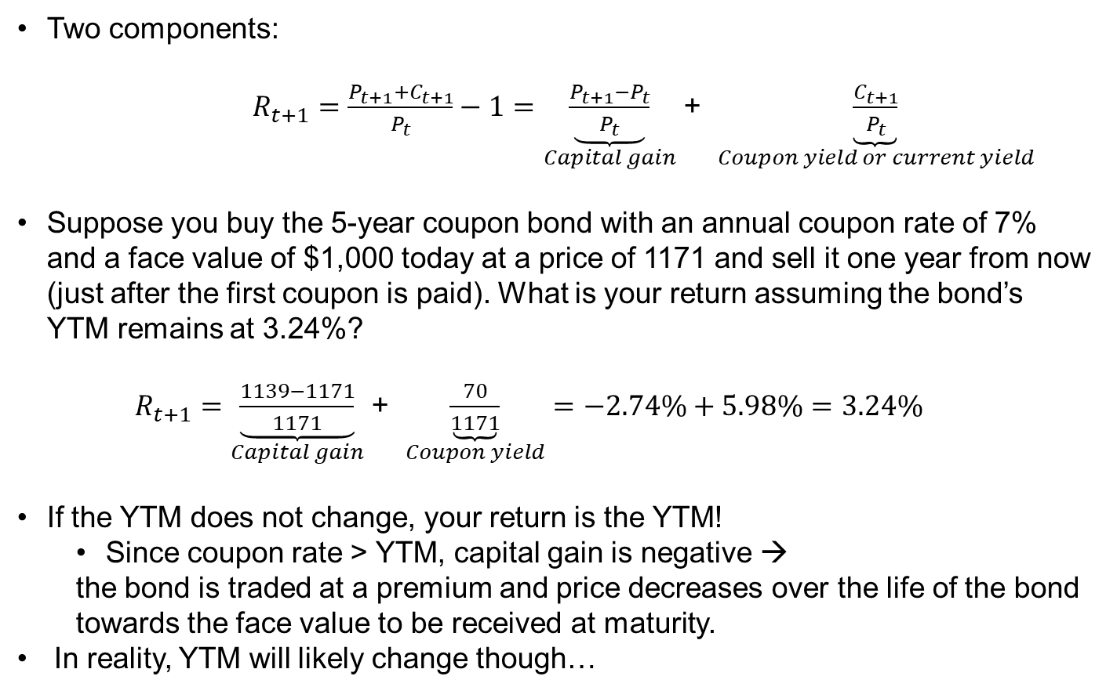
Decomposing bond returns
Two components:
$R_{t+1}=\frac{P_{t+1}+C_{t+1}}{P_{t}}−1=\underset{Capital gain}{\underbrace{\frac{P_{t+1}−P_{t}}{P_{t}}}}$ + $\underset{Coupon yield or current yield}{\underbrace{\frac{C_{t+1}}{P_{t}}}}$
Suppose you buy the 5-year coupon bond with an annual coupon rate of 7% and a face value of $1,000 today at a price of 1171 and sell it one year from now (just after the first coupon is paid). What is your return assuming the bond’s YTM remains at 3.24%?
  $R_{t+1}=\underset{Capital gain}{\underbrace{\frac{1139−1171}{1171}}}$ + $\underset{Coupon yield}{\underbrace{\frac{70}{1171}}}=−2.74\%+5.98\%=3.24\%$
If the YTM does not change, your return is the YTM!
  Since coupon rate > YTM, capital gain is negative →
  the bond is traded at a premium and price decreases over the life of the bond towards the face value to be received at maturity.
In reality, YTM will likely change though…

Slide 18
Yields and returns
Yield-to-maturity ≠ expected return in each year over the life of a bond
  Exception: holding a default-free zero-coupon bond until maturity.
  Expected return depends on yield of bonds with shorter maturities, which for coupon bonds means the rate at which coupons can be reinvested.
Example: what is the expected return if I buy the 5 year coupon bond for 1171 and sell it after 1 year? Assume the “expectations hypothesis of the term structure” is correct.
  Forward rate = expected future spot rate (+ risk premium=0).
 | 1 | 2 | 3 | 4 | 5
Strip Price | 98 | 95 | 92 | 89 | 85
Spot Rate | 2.04% | 2.60% | 2.82% | 2.96% | 3.30%
Coupon Bond Price = Present Value of all future CF's at t=0
Coupon Bond | 70 | 70 | 70 | 70 | 1070
Present Value at t=0 | 68.6 | 66.5 | 64.4 | 62.3 | 909.5
Bond Price at t=0 | 1171.3
Expected Spot rates at t=1 equal Forward Rates at t=0
Forward Rates |  | f(1-->2) | f(1-->3) | f(1-->4) | f(1-->5)
E.g., (1+2.6%)^2 / (1+2.04%) -1= 3.16% |  | 3.16% | 3.21% | 3.26% | 3.62%
Expected return from t=0 to t=1
Expected Present Value at t=1 | 70.0 | 67.9 | 65.7 | 63.6 | 928.1
Expected Bond Price at t=1 | 1195.2
Expected Return | 2.04%
This is what we expect the 1yr spot rate to be at t=1!
≠YTM, which was 3.24%!

Slide 19
Interest-rate risk

Slide 20
Interest rate risk (1/2)
Even if coupon and principal are guaranteed: Bond returns are risky!
  There is an inverse relation between interest rates/yields and prices
  Level, slope, and curvature of yield curve vary over time

Slide 21
Interest rate risk (2/2)
Consider a 15-year bond with annual coupon of 8 and principal of 100
Suppose that the yield curve is flat at 5%
  The bond then sells at 131.14 (why?)
When interest rates move, bond prices change
  Suppose, immediately after you buy the bond, the yield curve falls by 100 basis points to 4%
    Bond price goes from 131.14 to 144.47
    Return = 10.2%
  Instead, suppose the yield curve goes up by 100 basis points to 6%
    Bond price goes to 119.42
    Return = -8.9%
  Convexity: price decrease for yield increase is smaller than price increase for equal decrease in yield (-8.9% vs 10.2%)

Slide 22
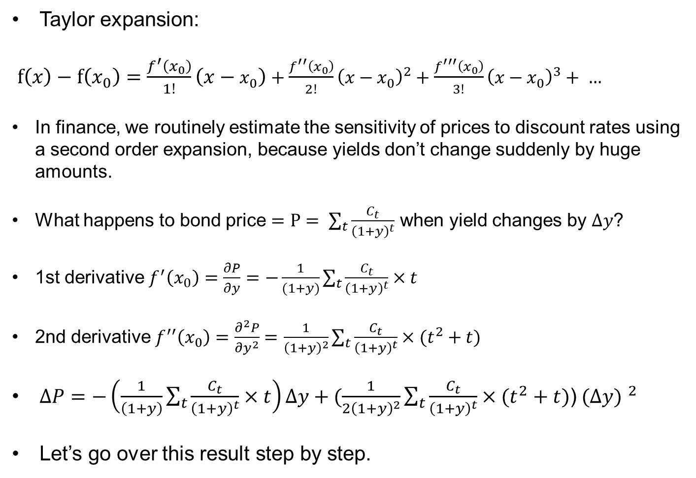
Some math
Taylor expansion:
$f\left(x\right)−f\left(x_{0}\right)=\frac{f^{′}\left(x_{0}\right)}{1!}\left(x−x_{0}\right)+\frac{f^{′′}\left(x_{0}\right)}{2!}{\left(x−x_{0}\right)}^{2}+\frac{f^{′′′}\left(x_{0}\right)}{3!}{\left(x−x_{0}\right)}^{3}+ …$
In finance, we routinely estimate the sensitivity of prices to discount rates using a second order expansion, because yields don’t change suddenly by huge amounts.
What happens to bond price $=P= \sum_{t}{\frac{C_{t}}{{\left(1+y\right)}^{t}}}$ when yield changes by $∆y$?
1st derivative $f^{′}\left(x_{0}\right)$ $=\frac{∂P}{∂y}=−\frac{1}{(1+y)}\sum_{t}{\frac{C_{t}}{{\left(1+y\right)}^{t}}}×t$
2nd derivative $f^{′′}\left(x_{0}\right)=\frac{∂^{2}P}{∂y^{2}}=$ $\frac{1}{{\left(1+y\right)}^{2}}\sum_{t}{\frac{C_{t}}{{\left(1+y\right)}^{t}}}×(t^{2}+t)$
$∆P=−\left(\frac{1}{\left(1+y\right)}\sum_{t}{\frac{C_{t}}{{\left(1+y\right)}^{t}}}×t\right)∆y+(\frac{1}{2{\left(1+y\right)}^{2}}\sum_{t}{\frac{C_{t}}{{\left(1+y\right)}^{t}}}×(t^{2}+t)$) ${(∆y) }^{2}$
Let’s go over this result step by step.

Slide 23
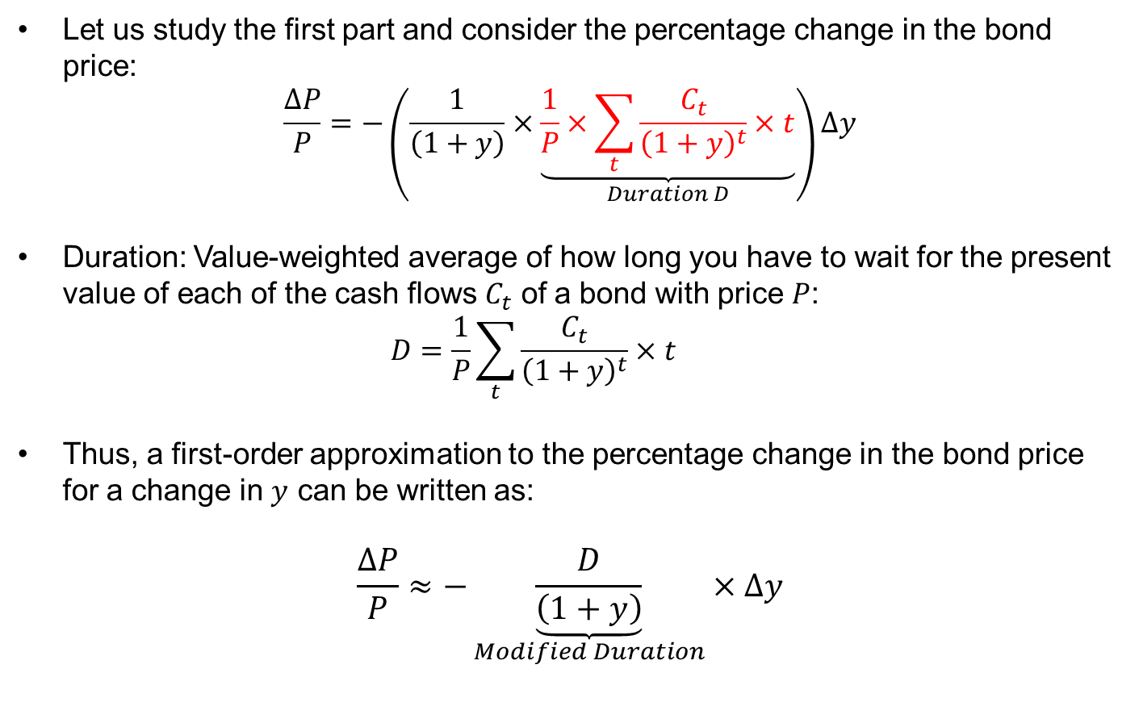
What determines bond price changes?
Let us study the first part and consider the percentage change in the bond price:
$$\frac{∆P}{P}=−\left(\frac{1}{\left(1+y\right)}×\underset{Duration D}{\underbrace{\frac{1}{P}×\sum_{t}{\frac{C_{t}}{{\left(1+y\right)}^{t}}}×t}}\right)∆y$$
Duration: Value-weighted average of how long you have to wait for the present value of each of the cash flows $C_{t}$ of a bond with price $P$:
  $$D=\frac{1}{P}\sum_{t}{\frac{C_{t}}{{\left(1+y\right)}^{t}}×t}$$
Thus, a first-order approximation to the percentage change in the bond price for a change in $y$ can be written as:
$$\frac{∆P}{P}≈−\underset{Modified Duration}{\underbrace{\frac{D}{\left(1+y\right)}}}×∆y$$

Slide 24
Duration: examples
For zero coupon bonds: duration = maturity
Duration of a growing perpetuity: (1+y)/(y-g)
  Often used to approximate the duration of the stock market: (1+10%)/(10-3%) ≈ 15 years.
Approximate the change in price of the 15 year bond using duration and compare to the actual change.
  Duration = 9.996 years
 | Approximated % change | Approximated new price | Actual new price
to 4% | -9.996/(1+5%)*-1%=0.095 | 143.623 | 144.474
to 6% | -0.095 | 118.655 | 119.424

Slide 25
Price risk (1/2)
Long term bonds are more sensitive to interest rate changes than short-term bonds. Why?

Slide 26
Price risk (2/2)
High-coupon bonds are less sensitive than low-coupon bonds. Why?

Slide 27
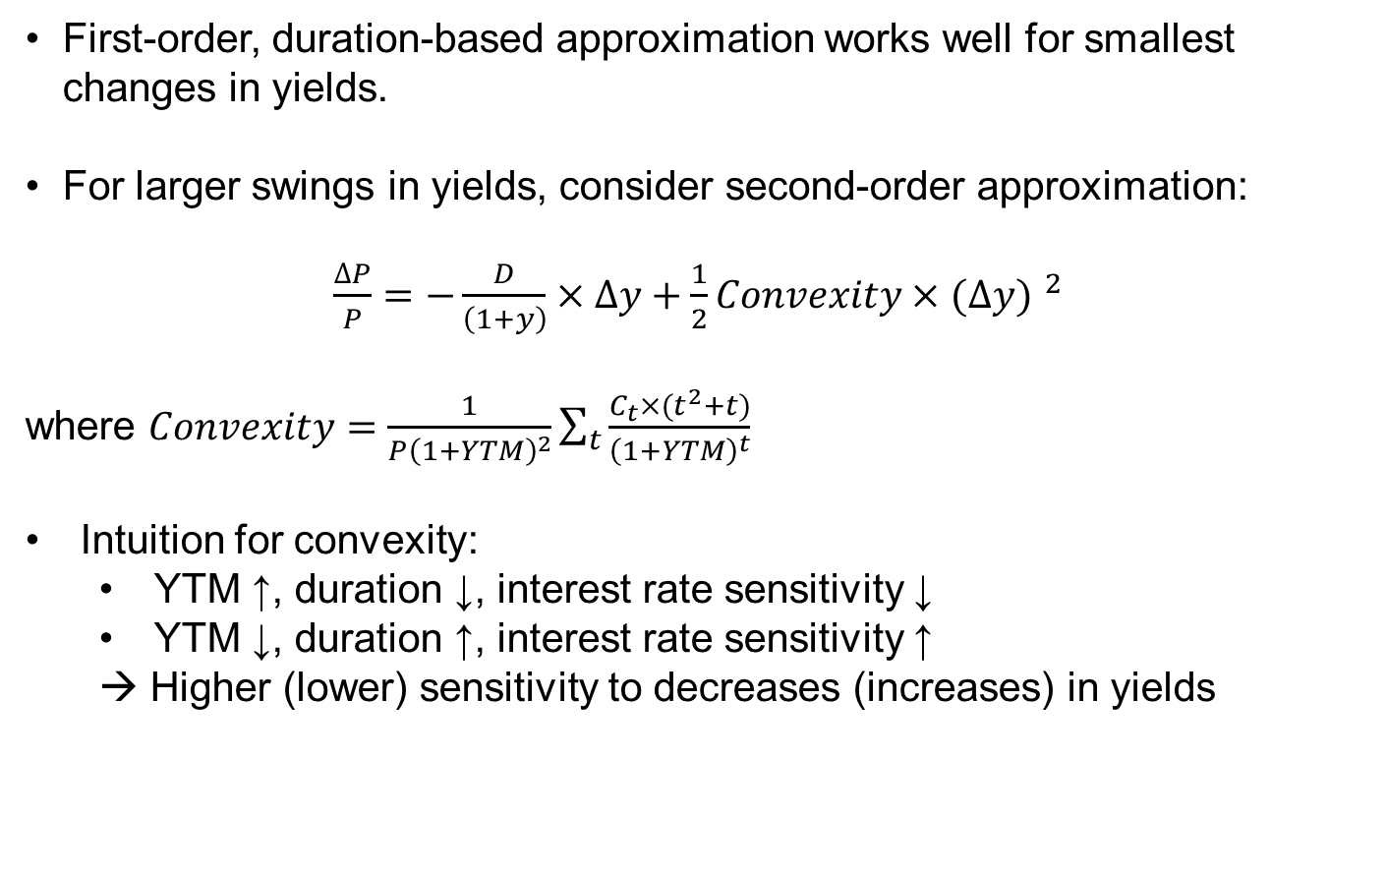
Convexity (1/2)
First-order, duration-based approximation works well for smallest changes in yields.
For larger swings in yields, consider second-order approximation:
$\frac{∆P}{P}=−\frac{D}{\left(1+y\right)}×∆y+\frac{1}{2}Convexity$ $×$ ${(∆y) }^{2}$
where $Convexity=\frac{1}{P{\left(1+YTM\right)}^{2}}\sum_{t}{\frac{C_{t}×(t^{2}+t)}{{\left(1+YTM\right)}^{t}}}$
Intuition for convexity:
  YTM ↑, duration ↓, interest rate sensitivity ↓
  YTM ↓, duration ↑, interest rate sensitivity ↑
  → Higher (lower) sensitivity to decreases (increases) in yields

Slide 28
Back to our example
Approximate the change in price of the 15 year bond using duration and convexity
  Duration = 9.996 years
  Convexity = 123.29
  We are getting closer due to non-linearity in 2nd vs 1st order approximation!
  Still, even larger changes in yields require even higher order approximations:
 | Approximated % change | Approximated new price | Actual new price | Abs(Diff)
First order
to 4% | 0.095 | 143.623 | 144.474 | 0.85
to 6% | -0.095 | 118.655 | 119.424 | 0.77
Second order
to 4% | 0.101 | 144.432 | 144.474 | 0.04
to 6% | -0.089 | 119.463 | 119.424 | 0.04

Slide 29
Convexity
    (Approximated) Returns for changes in the yield from 5% to 1%, 2%, …, 9%

Slide 30
Interest rate risk management
In interest rate risk management (for bond funds, pension funds, insurance companies etc) duration-matching is of first-order importance, while convexity-matching is of second-order importance.
Example: Pension fund asset-liability management (ALM)
  Liabilities: long-term pension promises with duration ~20 years
  Assets are chosen to match this duration
Duration matching: D*_{Assets} x Assets = D*_{Liabilities} x Liabilities
  (using D* is modified duration)
  Unsurprisingly, pension funds invest large fraction of portfolio in long-term bonds and long-term assets, such as real estate.
  Similarly, we can match convexity: C_{Assets} x Assets = C_{Liabilities} x Liabilities

Slide 31
Interest rate risk management
Suppose you have invested 1 million $ in the 15 year bond with
  YTM = 5%, Price = 131.14$
  Duration = 9.996 years
  Convexity = 123.29
You are worried about interest rate risk over the next few months and desire to hedge against it. Suppose there are two very liquid zero-coupon Treasury bonds that you decide to hedge with:
  5-year maturity with a 3% yield
  10 year maturity with a 4% yield
1. How much do you need to short and/or long of each bond to hedge interest rate risk (to a second-order approximation)?
2. Analyze how good your hedge is if all yields suddenly increase by 1%.

Slide 32
Solution
1. We have two equations, which we need to solve for two unknowns:
Use D* = modified duration = D/(1+y)
(a) D*bond = w5 x D*5 + w10 x D*10
(b) Cbond = w5 x C5 + w10 x C10
(a) - D*5/C5 x (b) = D*bond - D*5/C5 x Cbond =
w5 x (D*5 - D*5/C5 x C5) + w10 x (D*10 - D*5/C5 x C10)
w10 = D*bond - D*5/C5 x Cbond / (D*10 - D*5/C5 x C10)
w5 = (D*bond - w10 x D*10) / D*5
w10 1.485 → you need to short 1.485*1 million worth of 10 year zeros
w5 -0.980 → you need to long 0.980*1 million worth of 5 year zeros
2. By approximation, you have hedged perfectly: the hedged return = 0.
In reality, you are 0.4 basis points off, but this is less than 1/1000 of the bond’s return!
Returns
 | Approximated
 | First order | Second order | Actual
ZC5 | -0.0485 | -0.0471 | -0.0472
ZC10 | -0.0962 | -0.0911 | -0.0913
Payoffs:
Hedge portfolio | 0.0952 | 0.0890 | 0.0893
Bond | -0.0952 | -0.0890 | -0.0893
Hedged | 0.00000 | 0.00000 | -0.00004

Slide 33
Issues with duration (+convexity) matching
Requires active rebalancing
  Duration and convexity change with yields and as time passes
All our calculations are made using the YTM of bonds, which is a weighted average of yields of different maturities
  For instance, two bonds with the same YTM may be differentially impacted when the slope and curvature of the term structure change, while the level of yields remains the same.
  Take derivatives with respect to r_{1,} r_{2,} r₃ ... (partial or key duration and convexity) or with respect to the level, slope and curvature factors that drive 99.X% of the variation in these yields.

Slide 34
Some practical issues

Slide 35
Bond pricing conventions
In practice, bond prices are expressed as % of face value (100, basically)
  Number after the hyphen denotes 32nds (also called “ticks”)
  A “+” sign means half a tick
Examples
  Price of 101-12 means 101.375% of face value
  Price of 108-31+ means (108 + 31.5/32)% of face value
Why?
  Traditionally, trades and quotes were communicated by hand
  In exercises, we will work with decimals.
    Does this tick size and reporting method make sense given today’s technology?
    There are more oddities in bond pricing that abstract from what is important:

Slide 36
Accrued interest (1/3)
When purchasing a bond between coupon dates, the buyer must pay accrued interest to the seller in excess of the quoted price
  The holder of the bond at coupon payment date receives the full amount of interest, whereas the seller actually held the bond over part of the current coupon period
  Price that is paid including accrued interest: dirty price or full price
    This is the present value of future cash flows (and thus the theoretically correct price that we have considered so far!)
  Quoted price before accrued interest: clean price or flat price
    = Dirty price – accrued interest

Slide 37
Accrued interest (2/3)
Example: what is the accrued interest for a 4% T-Note that matures on 31-12-2018, if the bond is transacted on 31-3-2018?
  Bond pays semi-annual coupons of 4/2 each December- and June-end until maturity;
  Number of days between December 31 2017 (last coupon date) and March 31 2018 (transaction date): 90;
  Number of days between coupon dates (December 31 2017 and June 30 2018): 181;
  Accrued interest=4/2 x 90/181=0.99% of face value.
    Buyer of the bond will pay dirty price to seller, which equals:
    quoted price (excl. June 30 2018 coupon) + accrued interest (claim to June 30 2018 coupon)

Slide 38
Accrued interest (3/3)
The distinction between dirty and clean prices is important for quickly interpreting charts (e.g., in financial press)
  Clean prices get rid of zig-zag pattern: closing in on next coupon P↑, but as coupon is paid P↓
  Helps pinning down source of a change in bond price when interest rates vary over time and with maturity...
Dirty = PV(of all future cash flows), Clean = Dirty - Accrued
Accrued = 3.5 on (or just before) coupon date, 0.5*3.5 in between coupon dates

Slide 39
Wrapping up
Exact calculation of bond transaction price depends on market conventions and fineprint
  Coupons are usually paid semi-annually, i.e., 4% coupon means 4%/2 = 2% every 6 months.
  In US yields are often quoted as APR’s with semi-annual compounding, whereas in Europe yields are often quoted as EAR’s.
  Day count conventions: actual/360, actual/actual, …?
  I don’t find this super-interesting: as long as everyone agrees on the exact formula with which the price (or payoff, more generally) is calculated...

Slide 40
Corporate bonds

Slide 41
Overview of fixed-income markets
Source: SIFMA, statistics, Q2 2015

Slide 42
Default risk and expected returns
When the issuer is not the Treasury, there is default risk
  Under default, lender does not receive the bond’s promised payments, but only some recovery value which depends on
    The bond’s provisions such as seniority and collateral
    The result of a complex bargaining process in the bankruptcy courts
    The liquidation value of the firm’s assets
For a bond without default risk, YTM is a good estimate of expected return
  YTM is a weighted average of the return you expect to make in each year over the life of the bond
For a bond with default risk, YTM overstates the expected return
  Recall: the yield is the single discount rate that sets the PV of the bond’s promised (≠expected) payments equal to its current price
  Risk-return trade-off: ceteris paribus, bonds with higher default risk have higher yields, but this higher yield translates less than 1-for-1 to higher expected return.

Slide 43
The expected return of risky debt
Broadly two methods to adjust yield for default risk:
  Discount (i) probability of x (ii) loss in case of default
  Use the CAPM
Each method relies on information from ratings
43

Slide 44
Transition matrix (Moody’s)
Historically, year t AAA bonds never defaulted in year t+1!
Notes:
WR means without rating

Slide 45
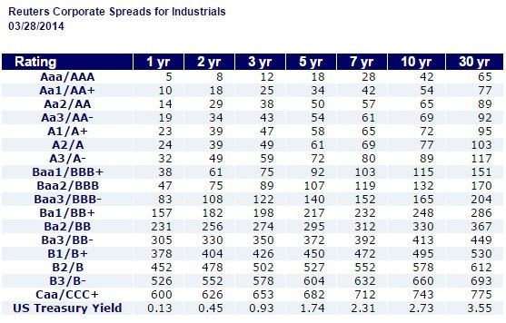
Yield spread
Yield spread = yield to maturity risky bond – yield to maturity risk-free government bond
1 year CAA yield = 600 bps + 13 bps= 6.13% vs 0.18% for AAA

Slide 46
Method 1: Adjusting the yield to maturity
Consider a one-year bond with YTM of y. For each $1 invested in the bond today, the issuer promises to pay $(1 + y) in one year. Suppose the bond will default with probability p, and L is the expected loss per $1 of debt in the event of default.
$1
T=0
T=1 year
No default
$(1 + y)
In case of default
$(1 + y − L)
So the expected return of the bond
  r_{d} = (1 − p)(1+y) + p(1+y − L) – 1
  = y − pL
  = Yield to Maturity − Prob(default) × Expected Loss

Slide 47
The probability of and loss in case of default
This adjustment of the yield can be large!
  The average loss rate for corporate bonds in case of default is about 60%
  Default probabilities are easily obtained per rating category:
  Combining, expected return of a B rated bond =
    Normal times: Yield – [5.5%*60% = 3.3%]
    Recession: Yield – [16%*60% = 9.6%]
47
Rating: | AAA | AA | A | BBB | BB | B | CCC | CC−C
Default Rate: Average | 0.0% | 0.1% | 0.2% | 0.5% | 2.2% | 5.5% | 12.2% | 14.1%
In Recessions | 0.0% | 1.0% | 3.0% | 3.0% | 8.0% | 16.0% | 48.0% | 79.0%
Independent of year t being a normal or recession year, AAA bonds never defaulted in year t+1!

Slide 48
Method 2: CAPM expected return on debt
Calculating the CAPM beta for an individual corporate bond is more difficult than for a stock
  Bonds are traded infrequently and returns not covered in standard databases.
Fortunately, we can use ratings again:
Note that the rating category ignores industry, so beta should probably be scaled up (down) in procyclical (countercyclical) industries
48
By Rating | A and above | BBB | BB | B | CCC
Avg. Beta | <0.05 | 0.10 | 0.17 | 0.26 | 0.31
By Maturity | (BBB and above) | 1-5 year | 5-10 year | 10-15 year | >15 year
Avg. Beta | Blank | 0.01 | 0.06 | 0.07 | 0.14

Slide 49
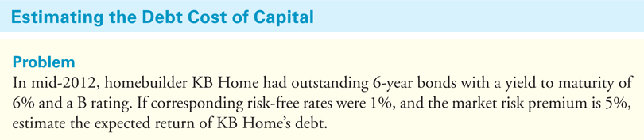
Example
49
Given the low rating of debt, we know the yield to maturity of KB Home’s debt is likely to significantly overstate its expected return. Using the information from the previous slides, we can use either of the two methods to estimate the expected return:
Method 1: E(Rd) = yield – p*L = 6% - 5.5%*60% = 2.7%
Method 2: E(Rd) = 1% + 0.26*5% = 2.3%
While both estimates are rough approximations, they confirm that the expected return of KB Home’s debt is well below its promised yield of 6%!
We’ll come back to bond prices when there is default risk later, because we can price risky bonds w. option-pricing techniques.

