Slide 2
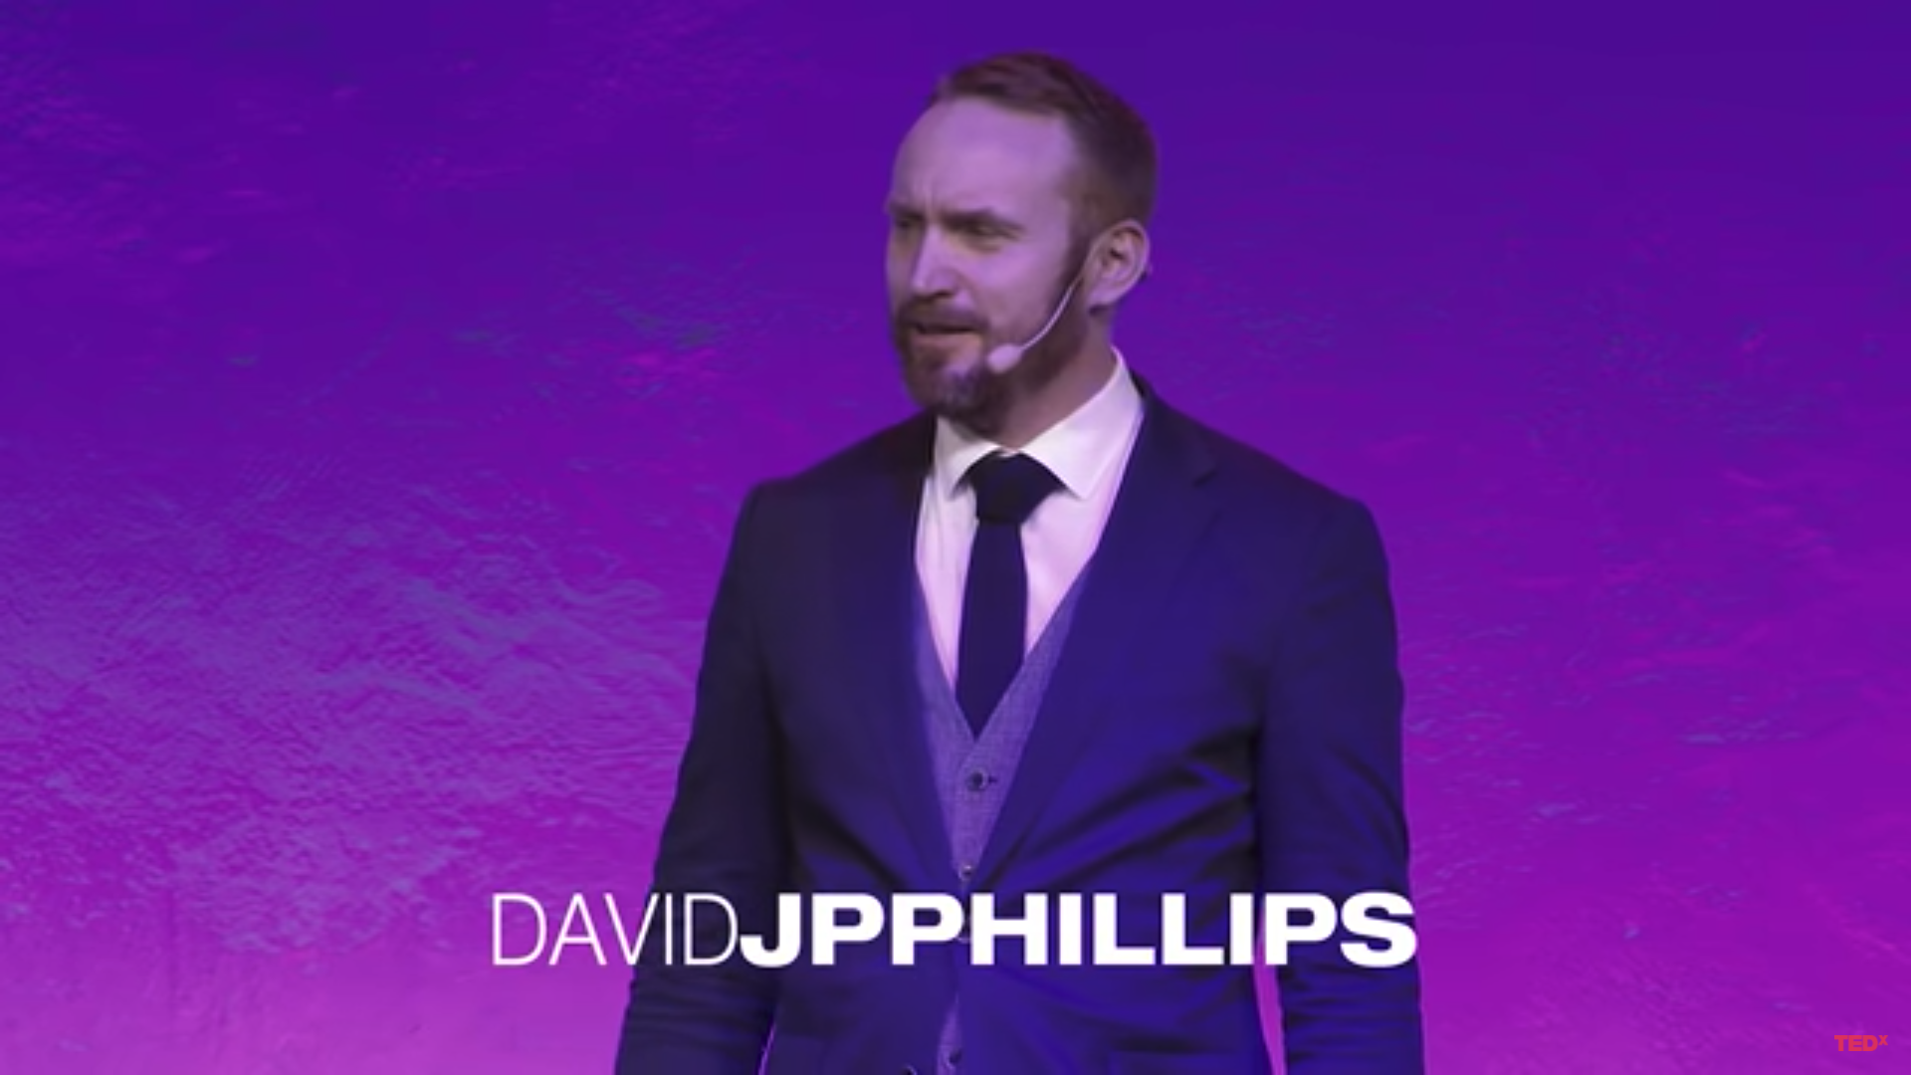
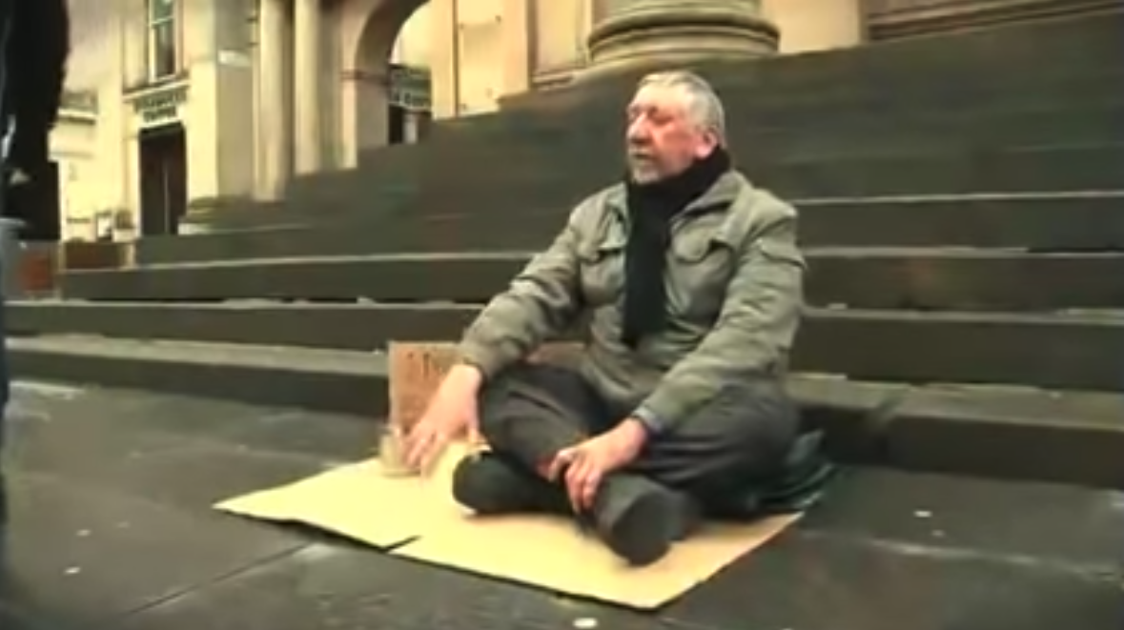

Slide 4
https://sefirot.it/cicero-deck/landing

Slide 5
https://sefirot.it/cicero-deck/landing

Slide 7
* https://solarsystem.nasa.gov/missions/mars-climate-orbiter/in-depth/

Slide 8
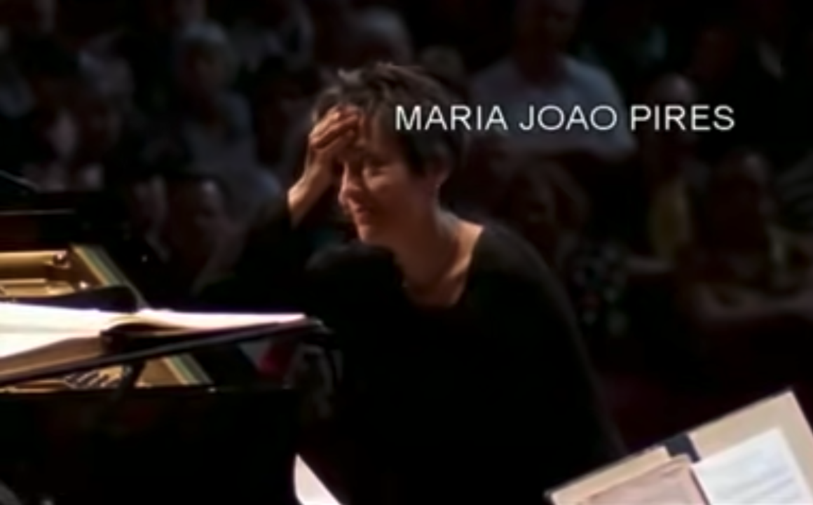

Slide 10
All rights reserved by Center for Creative Leadership - https://www.ccl.org/

Slide 11
All rights reserved by Center for Creative Leadership - https://www.ccl.org/

Slide 22
Post-its for you to use ☺
Copy paste, crop, increase or decrease size…
Do what serves you best, in any part of this eJournal!

