Slide 1
1227 International Management
Corporate Social Responsibility
Across Countries
© Ilya Okhmatovskiy
© Andrew Spicer

Slide 2
Agenda
CSR and related concepts
Doing good after generating profits vs. doing good while generating profits
MNCs taking advantage of cross-national differences in minimum wages and tax rates
Reconciling profit motivation and sustainability motivation (shared value)
When profitability and sustainability goals are in conflict

Slide 3
CSR and related concepts
Non-market Strategy
Stakeholder Management
Political Risk
Corporate Social Responsibility
Codes of Conduct
Corporate Sustainability
Compliance Programs
Business Ethics
Triple Bottom Line
Shared Values
Values-Based Management

Slide 4
CSR defined
“Corporate social responsibility (CSR) can be defined as the actions of a firm to benefit society beyond the requirements of the law and the direct interests of the firm.” (Luthans & Doh, 2018: 85)
“We define CSR as actions that appear to further some social good, beyond the interests of the firm and that which is required by law” (McWilliams & Siegel, 2001: 117)

Slide 5
What CSR should be about: Views from Ghana
A global perspective that respects local culture
Building local capacity leaving a positive legacy
Empowerment and ownership
Teaching skills to employees and enabling communities to be self-sufficient
Filling-in when the government falls short
Giving access to information
CSR requires creation of partnerships
Source: Holme & Watts (2000) Making good business sense

Slide 6
What CSR should be about: Views from Thailand
The bigger the company, the greater the obligation
Environmental damage mitigation and prevention
Transparency
Consumer protection
Changing people’s attitudes towards the environment
Youth and gender issues
Source: Holme & Watts (2000) Making good business sense

Slide 7
“Explicit” CSR in the U.S. versus “implicit” CSR in Europe
About 15-20 years ago, many large U.S. companies were already talking about various CSR initiatives but relatively few European companies back then described their social programs as CSR
Matten & Moon (2008) argued that European companies are not less socially responsible, it’s just that their social programs are not framed as CSR
Large companies in Europe traditionally accepted their obligation to collaborate with the government in efforts to increase social welfare and protect the environment but only recently began to describe this as CSR

Slide 8
Stakeholder management: Stakeholders give support . . .
Media
Community
Favorable press
coverage
Legitimacy
Regulators
Activists
Discretion
Advocacy
Firm
Lower cost
of capital
Loyalty
Investors
Commitment
Customers
Collaboration
Employees
Partners
Adapted from C. Fombrun, N. Gardberg & M. Barnett (2000). Business & Society Review, 105(1): 85-106.

Slide 9
. . . but stakeholders can also take away their support
Media
Community
Unfavorable press
coverage
NIMBY
Regulators
Activists
Increased
oversight
Boycotts
Firm
Capital
crunch
Withdrawal
Investors
Turnover
Difficult
to attract
Customers
Employees
Partners
Adapted from C. Fombrun, N. Gardberg & M. Barnett (2000). Business & Society Review, 105(1): 85-106.

Slide 10
Non-market strategy
Non-market strategy recognizes that businesses are social, political and ethical entities, not just economic agents
A basic premise of this orientation is that non-market forces and actors affect the strategic direction and market objectives of businesses
Non-market strategy considers how managers anticipate, preempt and respond to actors, influences, issues and actions emanating from cultural, social, political and regulatory arenas
=> Strategy for building relationships with non-market stakeholders
Source: Adapted from Lawton, Doh and Rajwani (2014)

Slide 11
Non-market environment of business
Top Leadership
Natural Resources
NGOs (Non-Governmental Organizations)
Competitors
Climate
Change
Social
Issues
Market Intermediaries
Customers
Public Relations
Employees
Communities
Investors
Supply Chain
Associates
Political
Systems
Managers
Operations
Firm
Cultures and Values
Market Environment
Government
Officials
The “Non-Market” Environment

Slide 12
CSR in local and global markets
 | Local | Global
Strategic | How do I understand and manage societal expectations and contracts? How do I manage multiple stakeholders and non-market demands in my business model? | How do I operate across communities that place conflicting social and political demands on business organizations?
Moral | To what extent do values matter for corporate and managerial decision-making? How do I communicate and manage corporate and individual values? | How do I operate across communities that possess different social values and ethics? When should I adapt my values to local customs? When should I not?

Slide 13
Purpose of the firm
Should we treat firms as instruments for generating profits or more than that?
What is the purpose of the firm?
Is the only purpose of the firm to earn profits?
Do firms have a moral responsibility or just legal responsibility?
To what extent should managers act upon their own values? Can managers be confident that they know which choices would be optimal for the society?

Slide 14
Bill Gates has been using wealth generated by Microsoft for philanthropy

Slide 15
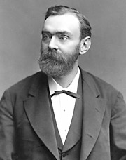
Alfred Bernhard Nobel
A newspaper mistakenly wrote Alfred Nobel’s obituary after his brother died
The obituary described Alfred Nobel as a merchant of death:
“Dr. Alfred Nobel, who became rich by finding ways to kill more people faster than ever before, died yesterday.”
The false obituary motivated Nobel to leave the bulk of his fortune for the creation of the Nobel prize.
Sources: Nobelprize.org; Nobel Prize Foundation; Bankston (2003)

Slide 16
What is the purpose of a firm?
1950s - 1970s
“Hewlett-Packard does not exist to make a profit, it exists to make a contribution ” (David Packard, co-founder of HP)
“For over 50 years, one of HP’s fundamental corporate objectives has been to provide long-term employment for its people” (David W. Packard, co-founder’s son and large shareholder, in 2001)

Slide 17
Redefining corporate missions: From primacy of shareholders to putting customers first
1980s - 1990s
“We exist to create value for our share owners on a long-term basis by building a business that enhances The Coca-Cola Company's trademarks.”
“Sara Lee Corporation's mission is to build leadership brands in consumer packaged goods markets around the world. Our primary purpose is to create long-term stockholder value.”
Since 2000
“The Coca-Cola Company exists to benefit and refresh everyone who is touched by our business.”
“Sara Lee Corporation's mission as a company is to feed, clothe and care for consumers and their families the world over.”

Slide 18
What is the main social contribution of business?
A. Serving customers
B. Paying taxes
C. Various CSR initiatives
D. Generating wealth for business owners

Slide 19
Embracing CSR while taking advantage of cross-national differences in legal requirements?

Slide 20
Taking advantage of lower minimum wages
Source: Wikipedia (minimum wages as of 2014) https://en.wikipedia.org/wiki/List_of_countries_by_minimum_wage

Slide 21
Taking advantage of lower corporate tax rates

Slide 22
Apple registered its EU subsidiary in Ireland
Ireland attracts MNCs like Apple by low taxes and tax advantages for hi-tech companies. Registering a European subsidiary in Ireland allows Apple to pay minimum taxes.
In August 2016, the EU ordered Apple to pay back 13 billion euros ($14.3 billion) in taxes to Ireland, saying the company had received “illegal” tax benefits over the course of two decades (https://www.cnbc.com/2019/09/17/apple-eu-in-court-over-14-billion-dollar-tax-charge.html)
“The majority view expressed by Americans appears to be that it is unfair of the European Union to retrospectively demand more tax from a corporation. The majority view in Europe appears to be that it was unfair of Apple to pay as little as 0.005% tax on billions of dollars of European sales.” Ben Lovejoy, 9to5mac, September 1st, 2016

Slide 23
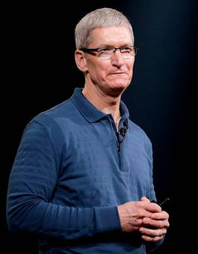
Apple’s tax battle with EU
“This is like playing a basketball game where you score a couple of three-pointers and later someone tells you they were actually just two-pointers… It’s patently unfair and not what you expect from a developed country that has a history of rule and law… It’s wrong… It’s total political crap” Tim Cook, CEO of Apple Irish Independent, September 1st, 2016
In 2020, Apple wins an appeal in the EU's General Court that annulled the 2016 EU decision that Apple has to pay Ireland €13bn in back taxes, but in 2024 European Court of Justice confirms the 2016 EU decision that Apple owes €13bn to Ireland
Source: Financial Times, 2024 (https://www.ft.com/content/d6b7d0fd-a41b-45a9-a830-9cacb10c5151)

Slide 24
Cash tax paid as percentage of profits (2010-2019)
Amazon 12.7%
Facebook 10.2%
Google 15.8%
Netflix 15.8%
Apple 17.1%
Microsoft 16.8%
Source: https://fairtaxmark.net/tax-gap-of-silicon-six-over-100-billion-so-far-this-decade/

Slide 25
Management gurus on CSR and sustainability
Porter & Kramer (HBR, 2006; HBR, 2011)
Companies should engage in CSR because it’s good for business
Nidumolu, Prahalad, & Rangaswami (HBR, 2009)
Sustainability as the key driver of innovations that improve firms’ financial performance
Rangan, Chase, & Karim (HBR, 2015)
CSR initiatives create “shared value” for society and the firm

Slide 26
Reconciling profit motivation and sustainability motivation
Most companies would like to minimize their environmental impact but they are under pressure to increase profitability
Few companies are ready to sacrifice profits and thus sustainable practices will be widely adopted only if they can generate profits
How to make a green business profitable?

Slide 27
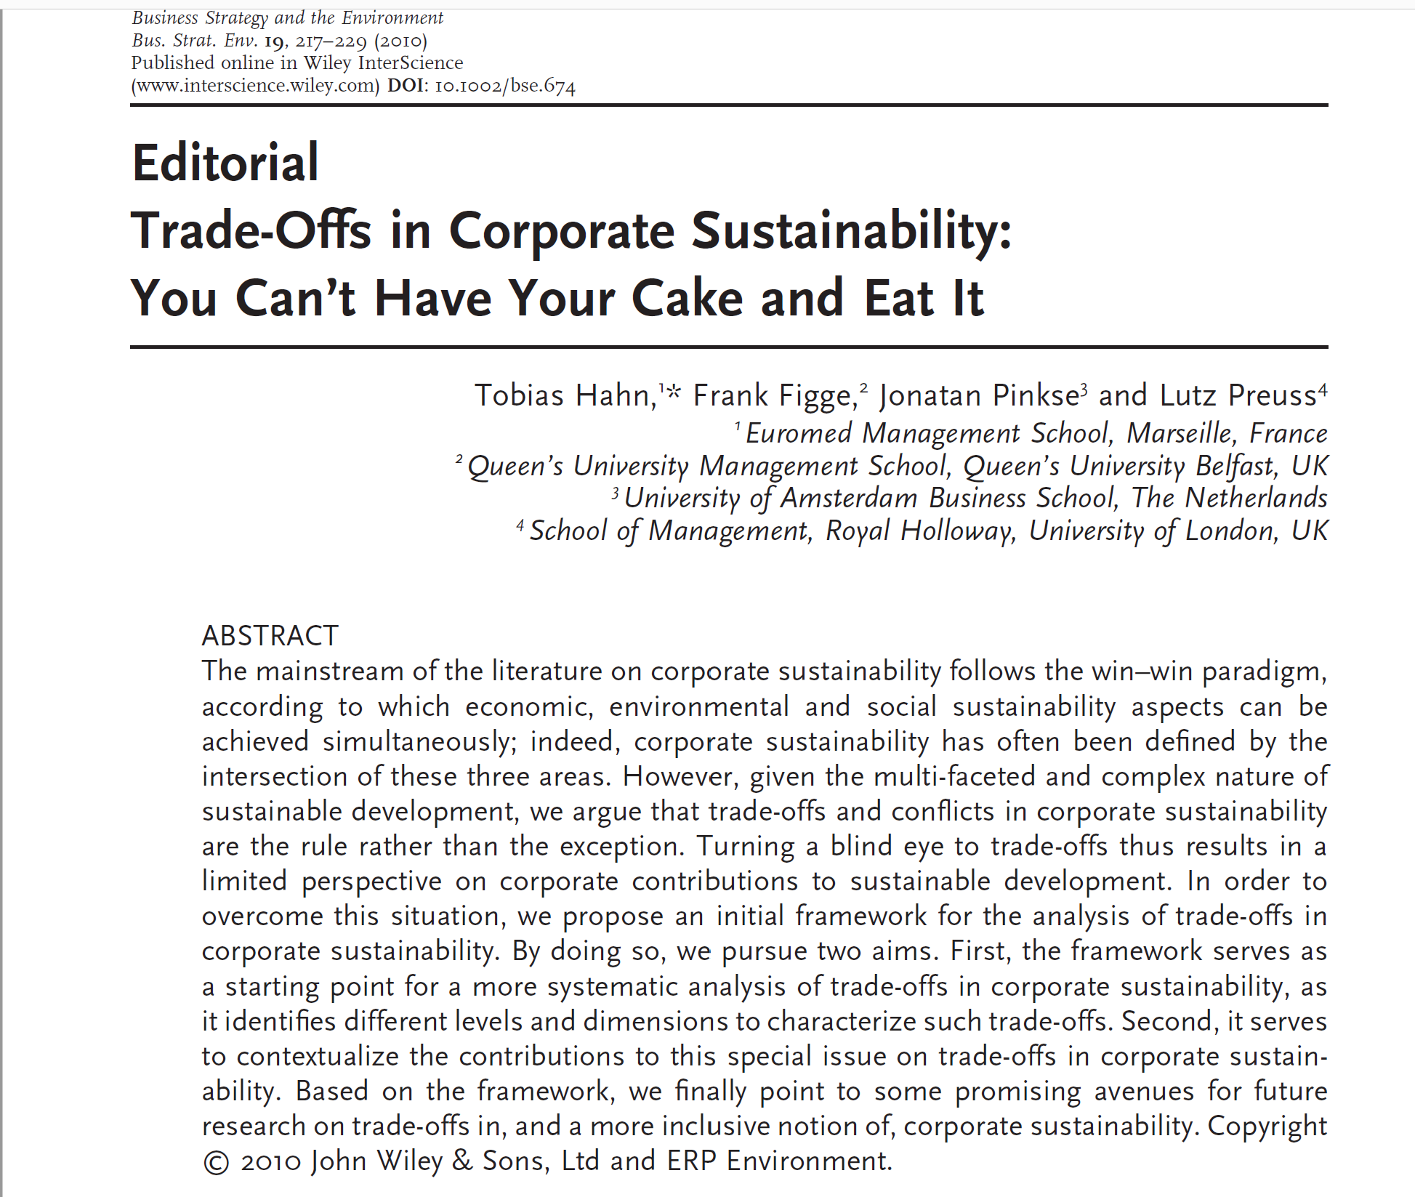

Slide 28
The Shared Value debate
Can you always do good (create social value) and at the same time do well (create business value)?

Slide 29
Profitability-enhancing potential of green business
How making a business green can…
boost revenues?
reduce costs?
facilitate access to resources (financial, human, etc.)?
Which companies with green business models have achieved financial success?

Slide 30
Charging premium prices for green products
Companies expect customers to pay premium prices for green products
Companies pursue sustainability hoping that their customers will notice this and reward these companies by purchasing their products at premium prices
How much premium are customers willing to pay for consuming green products?
Do customers know which companies use more sustainable practices?

Slide 31
Consumer willingness to pay for green products
Source: McKinsey (2012)

Slide 32
Which company used more sustainable practices in 2024?
Banco do Brasil vs. Commerzbank (Germany)
UniCredit (Italy) vs. Bank of China
Cisco (USA) vs. Ericsson (Sweden)
Singapore Telecom vs. Telefônica Brasil
SunPower (USA) vs. Samsung SDI (Korea)
Henkel (Germany) vs. Unilever (UK)
Sun Life (CAN) vs. Assicurazioni Generali (IT)
AstraZeneca (UK) vs. Sanofi (France)
Xerox (USA) vs. Apple (USA)

Slide 33
Reducing costs by consuming less resources
Some green technologies reduce costs
Streamlined operations consume less energy, water, and other inputs – consuming less resources implies lower costs of operation
Examples from Walmart:
Centralized control over lighting and heating of stores reduces electricity consumption
Optimization in using tracks to deliver goods to stores reduces gasoline consumption

Slide 34
Facilitating access to resources by making businesses green
Facilitating access to financial resources by appealing to investors
Some investment funds (e.g., university endowment funds) avoid investing in “dirty” businesses (tobacco, fossil fuel, military equipment, etc.)
Facilitating access to human resources by appealing to current and potential employees
Green businesses are more attractive as employers
Facilitating access to gov-t controlled resources
Governments often support green businesses through subsidies / favorable regulation (e.g., IRA 2022 in US)

Slide 35
Companies’ paths to sustainability
Some companies were “born green” and continue to put emphasis on being green
e.g., Patagonia, Whole Foods
Some companies started with a strong emphasis on being green but gradually switched focus to more conventional business goals
e.g., Body Shop
Some companies were initially driven exclusively by conventional business goals but gradually have embraced the importance of sustainability
e.g., Walmart, Coca-Cola

Slide 36
Partial Overlap: "Where's the Line?"
Source: Adapted from Sharp Paine (2003)

Slide 37
Proactive vs. regulation-imposed sustainability practices
What are the benefits of proactive company-driven sustainability initiatives?
What to do if using more sustainable practices is actually associated with higher costs?
Tragedy of the commons
Government regulation can raise the costs of using unsustainable business practices
making “dirty” businesses less profitable will force companies to change business practices (or to relocate to countries with less strict environmental policies)

Slide 38
When profitability and sustainability goals are in conflict
Some companies known for their sustainability initiatives have not been able to achieve satisfactory financial performance
e.g., Better Place went bankrupt in 2013
Sacrificing profits to remain sustainable
Being green can make you less profitable, but you still can make enough to continue your business
B Corporations (for-profits with a special legal status) – making money is not the only goal
Social enterprises (for-profits and non-profits) – use business as means for achieving social goals

Slide 39
Summary
CSR and related concepts
Doing good after generating profits vs. doing good while generating profits
MNCs taking advantage of cross-national differences in minimum wages and tax rates
Reconciling profit motivation and sustainability motivation (shared value)
When profitability and sustainability goals are in conflict

Slide 40
Reminders
For Friday, May 16th (last “theoretical” class)
read “Global Sourcing at Nike” case
Students responsible for this case submit individual assignments by 9:30 on May 16th
The exam is on May 26th from 8:30 to 10:30
paper-based exam – to be written on the exam paper that will be distributed (you would not use a computer)
closed-book exam – you cannot use course materials or your notes during the exam
this exam will consist of questions that require brief answers (2-3 sentences) and multiple-choice questions
see sample questions with answers on Moodle

