Slide 1
1227 International Management
Innovation and entrepreneurship
across countries
© Ilya Okhmatovskiy

Slide 2
Agenda
Business ecosystems for entrepreneurship and innovation
Pillars supporting entrepreneurial ecosystems
Entrepreneurial ecosystems around the world
Spanning boundaries of local ecosystems
“Born global” firms
Targeting BoP markets
Sharing and protecting knowledge in business ecosystems

Slide 3
Business ecosystems for entrepreneurship and innovation

Slide 4
Ecosystems in nature

Slide 5
Ecosystems in business (Schmiedgen, 2013)

Slide 6
“Business ecosystem” perspective
James Moore: “I suggest that a company be viewed not as a member of a single industry but as part of a business ecosystem that crosses a variety of industries. In a business ecosystem, companies coevolve capabilities around a new innovation: they work cooperatively and competitively to support new products, satisfy customer needs, and eventually incorporate the next round of innovations.” (HBR, 1993)

Slide 7
Business ecosystem defined
Teece (Strategic Management Journal, 2007):
“A community of organizations, institutions, and individuals that impact the enterprise and the enterprise’s customers and suppliers.”
Adner (Journal of Management, 2017):
“The alignment structure of the multilateral set of partners that need to interact in order for a focal value proposition to materialize.”
Jacobides et al. (Strategic Management Journal, 2018):
“A set of actors with varying degrees of multilateral, nongeneric complementarities that are not fully hierarchically controlled.”

Slide 8
“Market-based ecosystem”
C.K. Prahalad: “A market-based ecosystem is a framework that allows private sector and social actors, often with different traditions and motivations, and of different sizes and areas of influence, to act together and create wealth in a symbiotic relationship”
Source: “The Fortune at the Bottom of the Pyramid” (CK Prahalad, 2014)

Slide 9
CK Prahalad: Components of the market-based ecosystem
Large local firms
MNCs
Small and medium enterprises
Micro-enterprises
Cooperatives
Non-government organizations (NGOs)
Source: “The Fortune at the Bottom of the Pyramid” (CK Prahalad, 2014)

Slide 10
Entrepreneurial ecosystem
Successes and failures of entrepreneurial ventures to large extent are determined by their ability to access necessary resources
Institutions and organizations surrounding entrepreneurs can facilitate or inhibit access to resources crucial for new venture development
“Entrepreneurial ecosystem … impact the speed and ability with which entrepreneurs can create and scale new ventures in a sustainable way” (World Economic Forum, 2014)

Slide 11
Pillars that support an entrepreneurial ecosystem
Source: “Entrepreneurial Ecosystems around the Globe” (World Economic Forum, 2014)

Slide 12
Accessible markets
Access to markets comes first - without access to customers all the rest becomes irrelevant
Which types of customers can be targeted?
Large companies
Small / medium companies
Governments / non-profits
Individual consumers
Focusing on domestic customers and / or targeting foreign customers
Based on “Entrepreneurial Ecosystems around the Globe” (World Economic Forum, 2014)

Slide 13
Funding and finance
Venture capital
Angel investors
Grants and government funds
Bank loans
Credit cards
Friends and relatives
Personal savings

Slide 14
Regulatory framework and infrastructure
Ease of starting a business
Tax incentives
Business-friendly legislation
Access to basic infrastructure
electricity, water, etc.
Access to means of transportation and communication
roads, airports, internet, cell phones, etc.
Based on “Entrepreneurial Ecosystems around the Globe” (World Economic Forum, 2014)

Slide 15
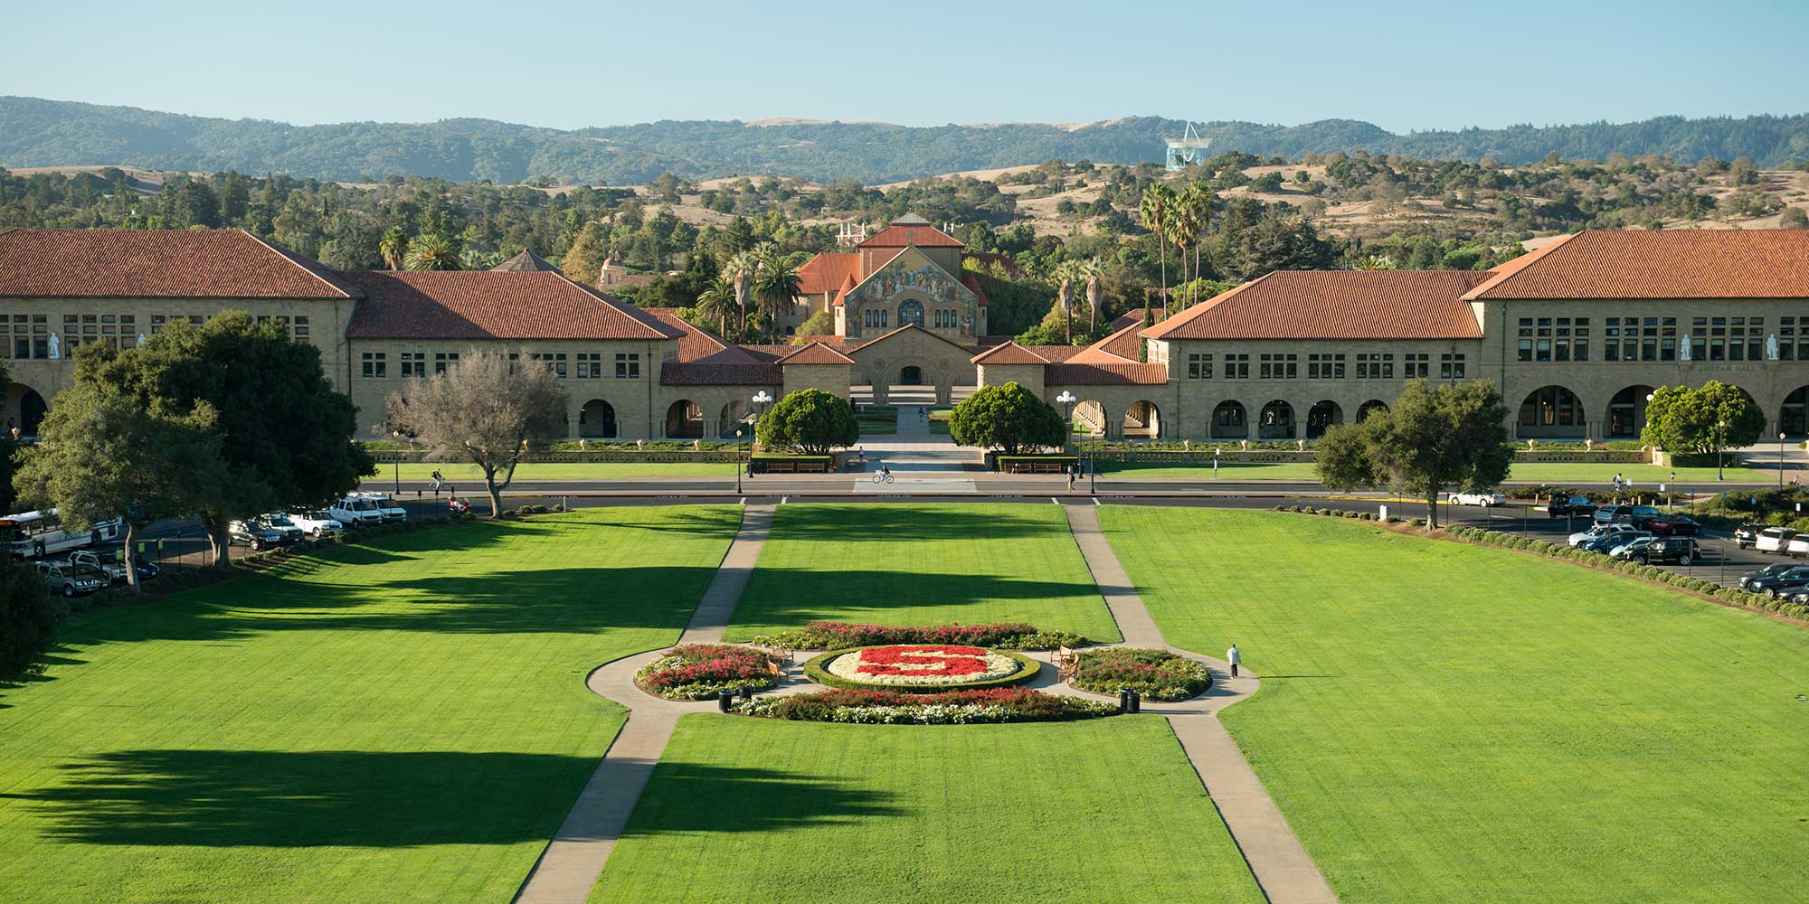
Major universities as catalysts
Universities playing a key role in idea-formation for new companies
Universities playing a key role in providing graduates for new companies
Based on “Entrepreneurial Ecosystems around the Globe” (World Economic Forum, 2014)

Slide 16
Human capital / workforce
Management talent
Technical talent
Entrepreneurial company experience
Outsourcing availability
Access to immigrant workforce
Based on “Entrepreneurial Ecosystems around the Globe” (World Economic Forum, 2014)

Slide 17
Support systems
Network of entrepreneurial peers
Mentors / advisors
Professional services
Incubators / accelerators
Based on “Entrepreneurial Ecosystems around the Globe” (World Economic Forum, 2014)

Slide 18
Education & training
Educational programs for prospective / current employees
Entrepreneurship-focused training
Based on “Entrepreneurial Ecosystems around the Globe” (World Economic Forum, 2014)

Slide 19
Cultural support
Tolerance of risk and failure
Preference for self-employment
Success stories & role models
Positive image of entrepreneurship
Celebration of innovation
Based on “Entrepreneurial Ecosystems around the Globe” (World Economic Forum, 2014)

Slide 20
Evaluating entrepreneurial ecosystems (by region)
Source: “Entrepreneurial Ecosystems around the Globe” (World Economic Forum, 2014)

Slide 21
Evaluating entrepreneurial ecosystems (by country)
Source: “Entrepreneurial Ecosystems around the Globe” (World Economic Forum, 2014)

Slide 22
Growth of Buenos Aires entrepreneurial ecosystem (I)
Source: “Entrepreneurial Ecosystems around the Globe” (World Economic Forum, 2014)

Slide 23
Growth of Buenos Aires entrepreneurial ecosystem (II)
Source: “Entrepreneurial Ecosystems around the Globe” (World Economic Forum, 2014)

Slide 24
Growth of Buenos Aires entrepreneurial ecosystem (III)
Source: “Entrepreneurial Ecosystems around the Globe” (World Economic Forum, 2014)

Slide 25
“High impact” entrepreneurs in Buenos Aires ecosystem
Source: “Entrepreneurial Ecosystems around the Globe” (World Economic Forum, 2014)

Slide 26
Spanning boundaries of local business ecosystems

Slide 27
Between Portugal & Silicon Valley

Slide 28
“Born global” companies
How globalization affects business models of newly founded companies
“Born global” companies
In which industries do we find “born global” companies?
What are the advantages of being “born global”?
Why “born global” companies often originate from emerging economies?

Slide 29
“Born global” company from India

Slide 30
Infosys
Provides IT services, software engineering, and business consulting
Founded in 1981, headquartered in Bangalore
Currently 6th largest traded company in India
Focused on global operations since its founding
Global Delivery Model:
“Sourcing capital from where it is cheapest, producing where it is most cost-effective, and selling where it is most profitable, all without being constrained by national boundaries”

Slide 31
Infosys
Global customers
North America – 61% of revenues
Europe – 25% of revenues
India – 3% of revenues
Global sourcing of resources and capabilities
First Indian company listed on NASDAQ
Attracting talents from different countries
Global operations
Development centers in India, U.S., Europe, Australia, Canada, China, Japan, and Mexico

Slide 32
Entering markets with weak business ecosystems
“Born global” firms often originate in emerging economies and target markets in developed economies
What about established firms from developed economies that target markets in emerging economies?
“Bottom of Pyramid” markets and innovations that facilitate access to these markets

Slide 33
The economic pyramid
Source: “The Fortune at the Bottom of the Pyramid” (CK Prahalad, 2014)

Slide 34
How to serve BOP markets
Design of products should account for limitations associated with low skills and poor infrastructure
Educate customers how to use products
Products should maintain functionality in extreme conditions (noise, dust, heat, etc.)
Convenience of user interface
Develop methods of accessing potential customers in hard-to-reach locations
Focus on designing platforms that allow incorporation of new product features
Source: “The Fortune at the Bottom of the Pyramid” (CK Prahalad, 2014)

Slide 35
Less-Is-More Innovations (LIMI)
Defining Less-Is-More innovations (Afuah, 2014)
Some of the attributes of an older product are stripped off or de-emphasized
The new product is simpler than previous ones
The new product has lower production costs than its predecessors in the market
The new product may have new unexpected features
Less-Is-More versus More-Is-Better innovations
Opportunities for differentiation
Possibility of imitation

Slide 36
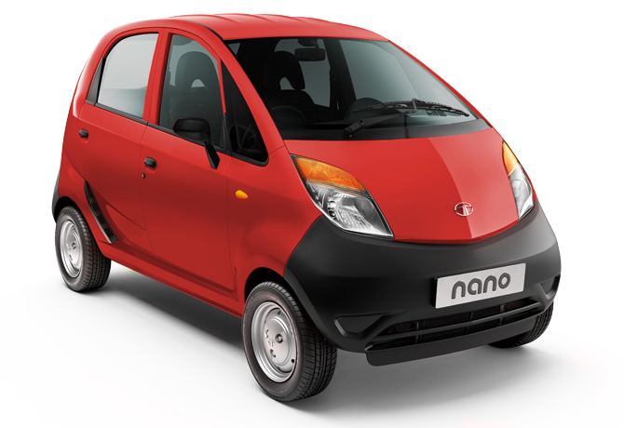
Frugal innovation: What makes the Tata Nano so cheap?
Rear-mounted engine by Bosch: 624cc, 38 PS, 2 cylinder. V-max: 105km/h. 0-100km/h in 21 sec
Manual steering. No airbags.
Fuel tank 15 ltr.
Instruments limited to speedometre, odometre, fuel gauge.
Windows wind-down by hand & no AC & no heater on base model.
Front luggage compart-ment holds battery, wind-shield washer bottle. Room for single suitcase
Rear wheel drive with synchromesh transmission. Lighter than manual or automatic.
Weight saving through extensive use of plastic
Wheel bearings strong enough for 70km/h. Would quickly wear out on higher speeds.
Photo: http://www.tatanano.com/variants.htm (accessed: 15 May 2013). Wolfgang Messner Copyright

Slide 37
Sharing and protecting knowledge in business ecosystems

Slide 38
Henry Chesbrough: Embracing the open innovation model
Closed Innovation Model
Open Innovation Model

Slide 39
IPR protection in the US and in China
Intellectual property rights (IPR) violations in China are common and many US companies blame the Chinese government for weak enforcement of IPR
This situation is very similar to what happened in the 19th century when Europeans complained about widespread IPR violations in the U.S. (Peng et al., 2017)
Charles Dickens on his trip to the U.S. in 1842 was shocked by widespread pirating of his work
American publishers at the time argued that Dickens should be grateful for their free popularization of his work
IPR protection in the U.S. was extended to foreign works for the first time only in 1891
Source: Peng et al. (2017) “An institution-based view of global IPR history”

Slide 40
Source: https://foreignpolicy.com/2019/10/16/china-intellectual-property-theft-progress/#

Slide 41
Summary
Business ecosystems for entrepreneurship and innovation
Pillars supporting entrepreneurial ecosystems
Entrepreneurial ecosystems around the world
Spanning boundaries of local ecosystems
“Born global” firms
Targeting BoP markets
Sharing and protecting knowledge in business ecosystems

Slide 42
Reminders
This Friday, May 9th
To prepare for this case discussion, please review “Fostering Productive Entrepreneurship Communities” report available on Moodle
There are no individual assignments due on May 9th
We have a make-up class on Monday, May 12th
According to Friday schedule (for TXB - in B008 starting at 9:30, for TXA - in B003 starting at 11:00)
Lecture “CSR across countries”
PA presentation by a group responsible for this topic

