Slide 1
1227 International Management
Corporate governance around the world
© Ilya Okhmatovskiy

Slide 2
Agenda
Different types of owners and their prominence in various countries around the world
The agency problem – when interests of owners and managers do not coincide
How corporate governance mechanisms solve the agency problem and how these mechanisms are used around the world
  Executive compensation
  Board of directors
  Market for corporate control

Slide 3
What is corporate governance?
Corporate governance (CG) is about
  the structure of rights and responsibilities among the parties with a stake in the firm (Aoki, 2001: 11)
  relationships of various stakeholders or “constituents” with executives / managers (Larcker & Tayan, 2007)
Most studies consider the relationships between managers and shareholders
Employees
Managers
Shareholders

Slide 4
Types of ownership and cross-national differences in CG
Types of ownership
  Institutional investors, families, the state, other corporations, banks, employees, VC investors, etc.
Different types of owners
  can be found within any country but their relative importance varies across countries
  rely on different CG mechanisms to exercise control
Different CG practices would be common in countries with different dominant types of owners

Slide 5
Ownership by (multiple) institutional investors
Institutional investors tend to have diversified investment portfolios
  Invest in many companies but usually hold a relatively small stake in each company
  Many institutional investors have short-term investment focus – buy and sell shares frequently
Most institutional investors are “passive” and do not try to influence the governance process
  However, some institutional investors (e.g., CalPERS) may actively push for certain governance decisions
Examples of countries where this type of ownership plays an important role: USA, UK

Slide 6
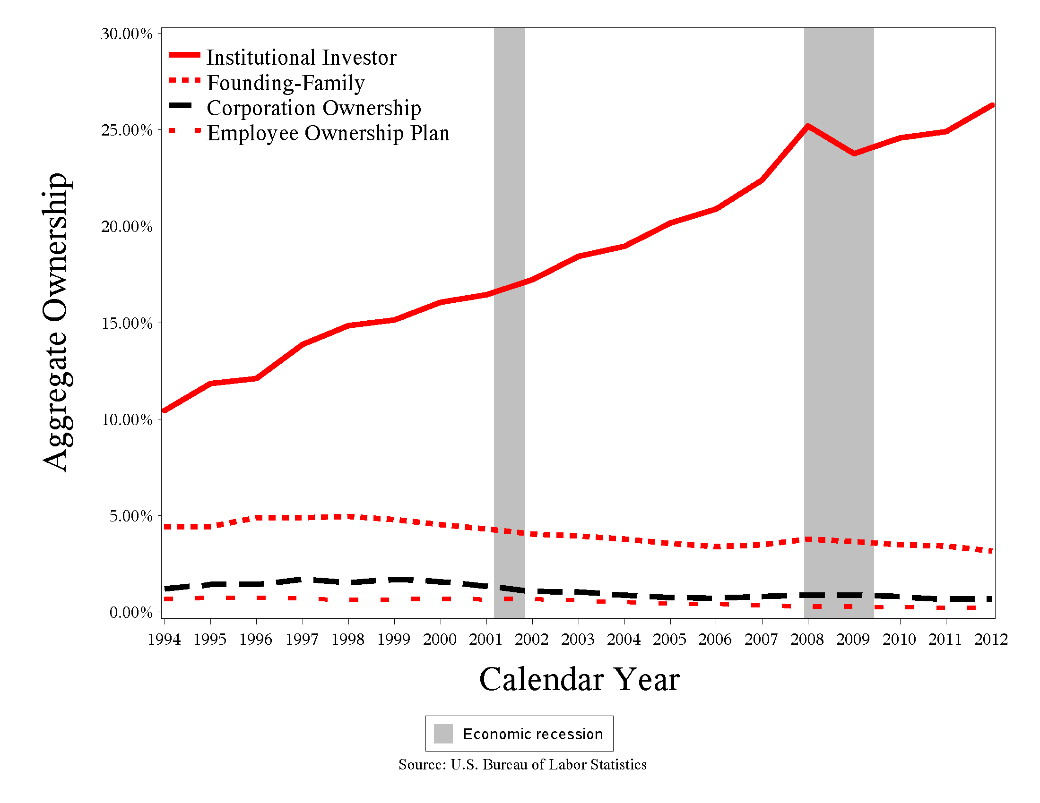
Growth of institutional ownership in the U.S.
Source: G. Zhu (2015)

Slide 7
Family ownership
Long-term orientation
Interests of managers and shareholders coincide when top managers are family members
Independent directors may be present but have limited influence
Examples of countries where family ownership plays an important role: most EU countries

Slide 8
Family ownership and control in
200 largest firms from each country
Source: Sinha (2019) The global variations in family business structures. www.hindustantimes.com

Slide 9
State ownership
Often have goals other than profitability / shareholder value maximization
Government officials often exercise direct control by circumventing formal governance mechanisms
If state-controlled companies are interested in attracting private investors, they may adopt quite rigorous corporate governance standards
Examples of countries where this type of ownership plays an important role: China, Russia

Slide 10
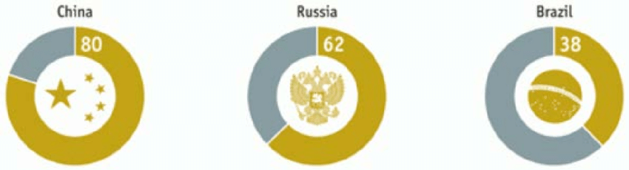
State control of publicly traded companies in emerging economies
The percentage of national stock market capitalization accounted for by state-controlled companies in China, Russia and Brazil (based on MSCI national stock market index)
Source: https://www.economist.com/special-report/2012/01/21/the-world-in-their-hands

Slide 11
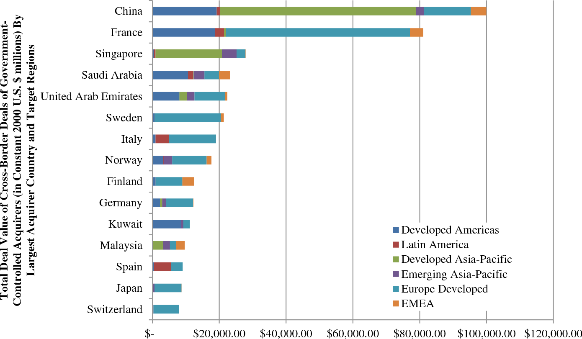
Cross-border acquisitions by state-controlled companies
Source: Karolyi & Liao (2017) State capitalism's global reach

Slide 12
Ownership by other corporations
Focus on maximizing profits across companies connected by ownership network, profitability of some companies is sacrificed to achieve this goal
Directors often represent other companies from the same ownership network
Main risks for independent shareholders are associated not with the agency problem, but with tunneling of resources to affiliated companies
Examples of countries where this type of ownership plays an important role: Japan, Korea

Slide 13
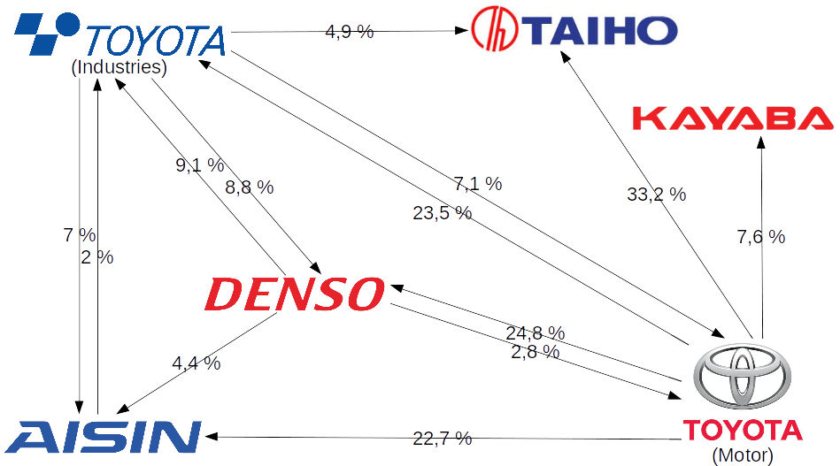
Example of corporate cross-ownership in Japan
Source: Wikipedia

Slide 14
Do managers have the same interests as shareholders?
Why do we need corporate governance?
  To make sure that managers act in the best interests of shareholders
  Particularly relevant for publicly traded companies
Examples of situations when interests of managers and shareholders do not coincide
  Growth
  Profitability
  Risk

Slide 15
Solving the agency problem
Agency relationships:
  The principal hires the agent to perform some task
  The principal wants to make sure that the agent performs this task in a way that maximizes the principal’s benefits
How can we make sure that managers act in the best interests of shareholders?
  Alignment of interests
  Close monitoring

Slide 16
Executive compensation
Aligning interests of managers and owners
  Owners need to compensate managers in such a way that managers act in the best interests of owners
  By linking bonuses to meeting profitability targets, we can motivate managers to increase profits
  Stock options stimulate managers to increase value of the firm’s stock
The solution seems to be straightforward, but some questions remain…
  Do we use the right measures of performance?
  How much do we need to pay to motivate managers?

Slide 17
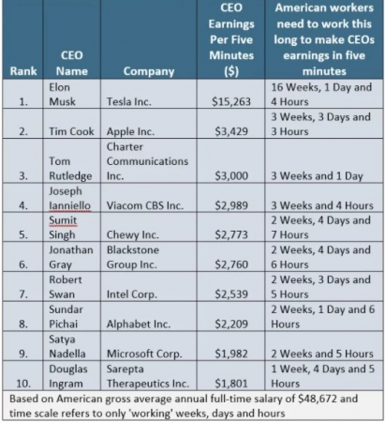
Executive compensation in the U.S.
(based on 2019 data)
Source: https://www.humanresourcesonline.net/the-world-s-top-10-highest-paid-ceos

Slide 18
Rewarding poor performance?
Sometimes huge compensations are paid to CEOs who did not perform well
  e.g., Robert Nardelli at The Home Depot
In 2008, the year of the financial crisis, the Wall Street paid out 18.4 billion in bonuses
  in Spring of 2009, 165 mln in bonuses have been paid to AIG executives while AIG received 170 bln in federal assistance – the U.S. Congress considered special legislation to tax 90% of this income

Slide 19
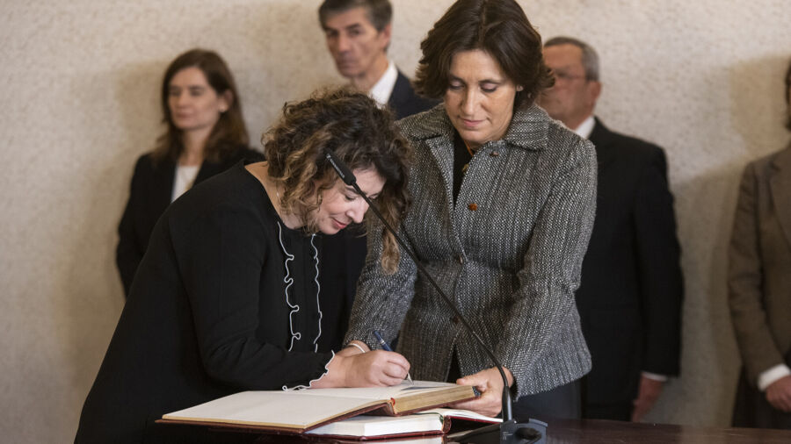
“Golden handshake” scandal in TAP
In 2022 TAP had to cut salaries of employees due to financial difficulties experienced by the company, but paid € 500,000 indemnity to Alexandra Reis who had to leave early her executive position at TAP
Source: https://www.portugalresident.com/tap-golden-handshake-row-secretary-of-state-resigns/

Slide 20
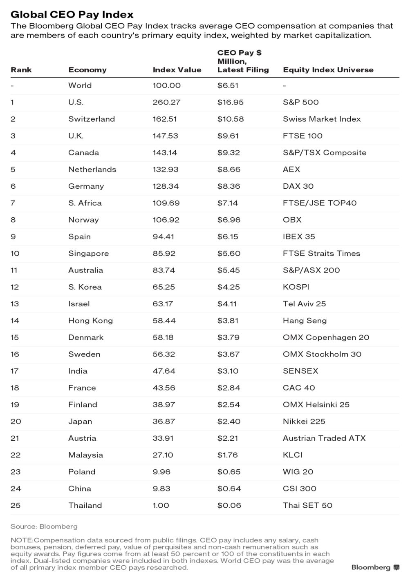
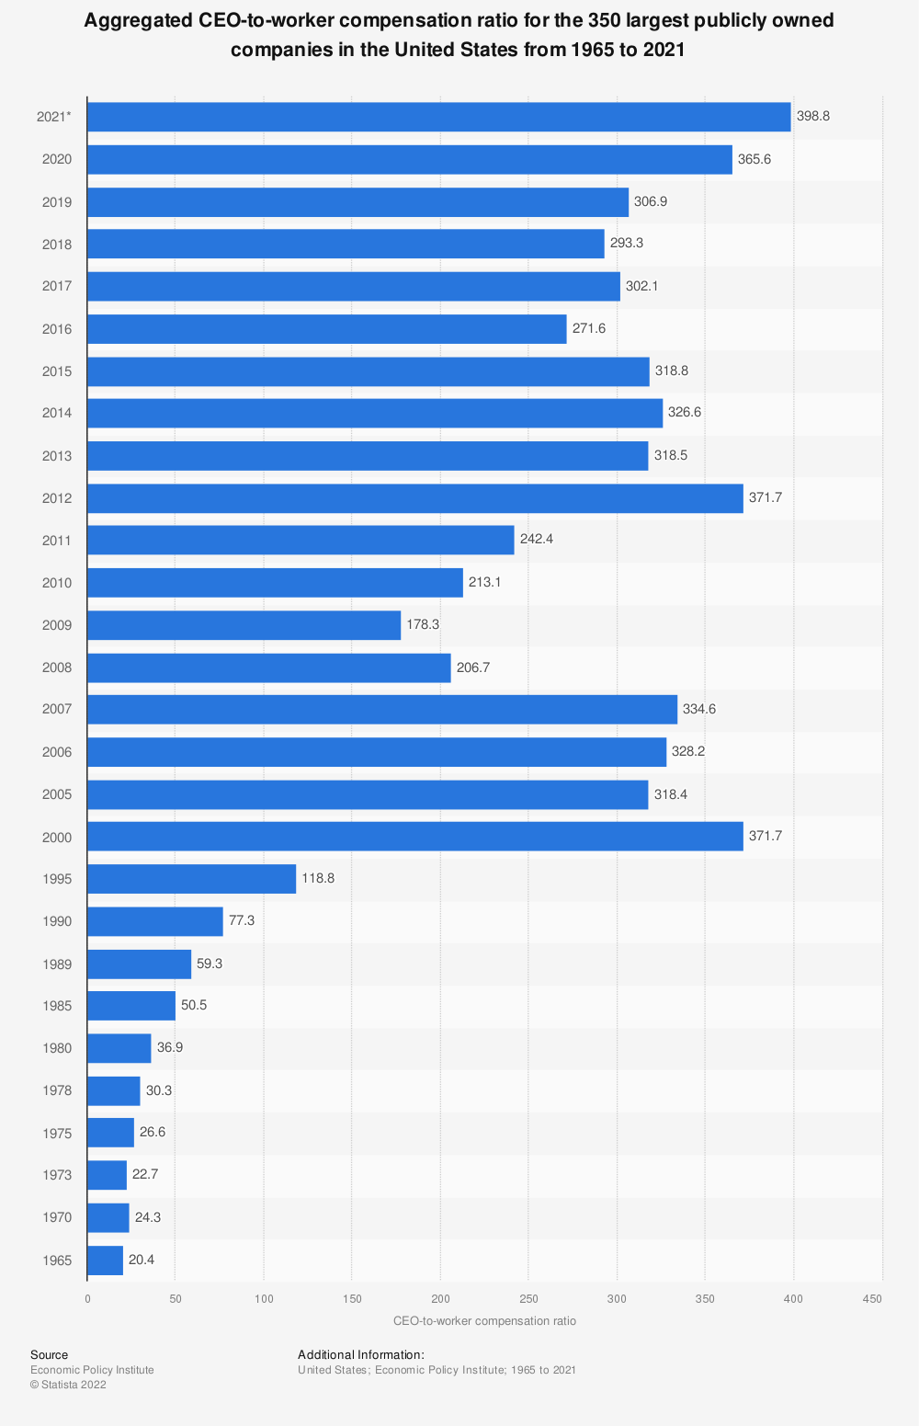

Slide 21
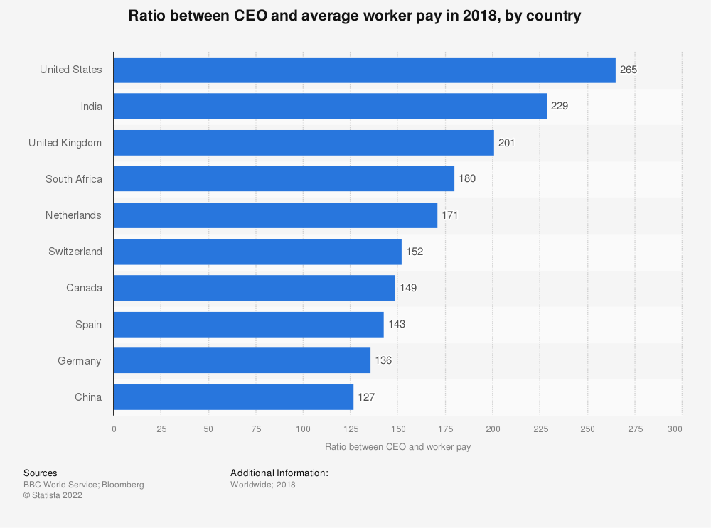
CEO vs. average worker pay around the world

Slide 22
Cross-national differences in executive compensation
Average executive compensation in the US is substantially higher than in Europe and Asia
In Asian countries that favor group rewards (e.g., Japan), executives would be embarrassed by media reports about their high individual compensation
For executives of Chinese SOEs, promotions (decided by the Party Committees) and a potential political career are more important than high compensation
In the U.S., UK, Canada, and Australia executive compensation is often linked to price of shares – less so in other countries

Slide 23
Boards of directors
“The board of directors is a group of elected individuals whose primary responsibility is to act in the owners’ interests by formally monitoring and controlling the corporation’s top-level managers” (Hitt et al., 2013: 302)
Who gets elected to the boards?
What kind of decisions are made by directors?

Slide 24
Effective monitoring
Conditions that may prevent effective monitoring
  Conflicts of interests
  Social ties / Affiliation with the same business community
  Lack of expertise
  Weak incentives to perform the monitoring function properly
Improving quality of monitoring
  Independent directors
  Board committees
  Legal responsibility for negligence

Slide 25
Do boards of directors operate differently in different countries?
Unitary (one-tier) boards in the Anglo-American CG model versus two-tier boards (supervisory board and management board) in German CG model
Employee representatives on supervisory boards in Germany and Austria, but not in the US or UK
In Japanese companies, boards are much larger than in American and European companies
In companies with diffused ownership (e.g., in the US and UK) boards are powerful, in companies with concentrated ownership (Europe, emerging economies) key decisions are de facto made by owners and formalized by boards

Slide 26
Ownership concentration
Concentrated vs. diffused ownership
If an owner is dissatisfied with management, what happens if this owner
  holds a large block of shares?
  holds a small block of shares?
Voice and exit strategies

Slide 27
Market for corporate control
What happens when shareholders sell their shares?
  Strong signal for the board to fire CEO
  The firm becomes an attractive acquisition target
Takeovers as a mechanism for corporate control
  Firms with poor management will be acquired and restructured to make better use of their assets
  The wave of takeovers followed by restructuring in the US in the 1980s (later countered by takeover defenses)
  Potential negative implications for other stakeholders

Slide 28
Cross-national differences in the markets for corporate control
Market for corporate control through takeovers is more active in countries with diffused ownership
In Germany, takeover attempts have been blocked by employee representatives
In Japan, cross-holding of shares by friendly companies protects against hostile takeovers
In the U.S., takeovers are prevented using staggered boards and “poison pills” (takeover attempts trigger sales of assets, issue of shares, etc.)

Slide 29
Summary
Different types of owners and their prominence in various countries around the world
The agency problem – when interests of owners and managers do not coincide
How corporate governance mechanisms solve the agency problem and how these mechanisms are used around the world
  Executive compensation
  Board of directors
  Market for corporate control

Slide 30
Reminders
This Friday, May 2nd we will discuss
  Implications of state ownership of companies
  Acquisitions made by China’s SOEs in EU (based on “Chinese FDI in Europe” report available on Moodle)
Next Tuesday, May 6th
  Lecture about innovation management and entrepreneurship across countries
  PA presentation by a group responsible for this topic

