Slide 1
1227 International Management
Work Motivation and HRM across Countries
© Ilya Okhmatovskiy 2020-2025
This presentation includes materials from
Luthans & Doh “International Management: Culture, Strategy, and Behavior” McGraw-Hill Education © 2018

Slide 2
Agenda
Work centrality around the world
Content theories of motivation
  Maslow’s hierarchy-of-needs, Herzberg’s two factors, and McClelland’s achievement motivation
Process theories of motivation
  Equity theory, goal-setting theory, expectancy theory
Cross-country differences in the motivating effect of various HRM practices
  Job design & reward systems

Slide 3
Work Centrality
Work centrality refers to the importance of work in an individual’s life relative to other areas of interest
Countries differ in the perceived importance of work (as compared with other things in life)
  Japan has the highest level of work centrality
  Israel has the moderately high level
  U.S. and Belgium have average levels
  Germany and the Netherlands have moderately low levels
  Britain has a low level

Slide 4
Value of Work
Work is an important part of people’s lives in the U.S. and Japan
  Americans and Japanese work long hours
  Most Japanese managers expect salaried employees to stay late at work (without extra pay); overtime has become a requirement of the job
  Recent evidence exists that Japanese workers may do far less work in a business day than outsiders would expect

Slide 5
Overwork problem in Japan
Overwork may have serious negative impact on employees
Many employees in Japan complain about chronic exhaustion, emotional stress, and abusive conditions at the workplace
  In Japan, one-third of the working-age population suffers from chronic fatigue
  Some employees complain about the pressure to consume alcohol with colleagues after work
Karoshi, which means “overwork” or “job burnout” is now recognized as a serious social problem in Japan (https://www.youtube.com/watch?v=9Y-YJEtxHeo)

Slide 6
The Nature of Motivation
“Motivation is a psychological process through which unsatisfied wants or needs lead to drives that are aimed at goals or incentives” Luthans & Doh (2008: 434)
The determinants of motivation can be
  Intrinsic - an individual experiences fulfillment through carrying out an activity itself and helping others.
  Extrinsic – incentives in the external environment (competition, compensation, etc.) are of great importance.

Slide 7

The Basic Motivation Process
The motivation process is universal; all people are motivated to pursue goals they value
However, specific needs and goals can be different across cultures and countries

Slide 8
Exploring Content and Process of Motivation
Content Theories of Motivation
  Explain work motivation in terms of what arouses, energizes, or initiates employee behavior
  The subject of most research in the field
Process Theories of Motivation
  Explain work motivation by how employee behavior is initiated, redirected, and halted
  More sophisticated and focused on individual behavior in specific settings

Slide 9
Content theories of motivation
1. Maslow’s hierarchy-of-needs
2. Herzberg’s motivators and hygiene factors
3. McClelland’s achievement motivation

Slide 10
Maslow’s “Hierarchy-of-Needs” Theory
Five basic needs constitute a need hierarchy (counting from the bottom to the top)
    Physiological: basic needs for water, food, clothing, shelter, etc.
    Safety: desires for security, stability, and absence of pain
    Social: needs to interact and affiliate with others and the need to feel wanted by others
    Esteem: needs for power and status
    Self-actualization: desire to reach one’s full potential

Slide 11
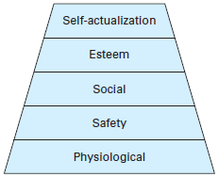
Maslow’s Need Hierarchy

Slide 12
According to Maslow’s Theory
Lower-level needs must be satisfied before higher-level needs become motivators.
A need that is satisfied no longer motivates.
There are more ways to satisfy higher-level needs than there are ways to satisfy lower-level needs.

Slide 13
Haire’s cross-national study about the hierarchy of needs
International managers (not rank and file employees) indicated that upper-level needs were of particular importance to them.
Findings for several country clusters (Latin Europe, U.S./UK, Nordic Europe) indicated autonomy and self-actualization were the most important and least satisfied managers’ needs.
Firms have to be concerned with the satisfaction of these needs for their managers / executives.

Slide 14
Western bias of Maslow’s hierarchy?
In Asian cultures, individuals are inseparable from social groups and their needs are defined by these social groups
Researchers suggested a modification of Maslow’s Western-oriented hierarchy by re-ranking and re-defining needs.
For example, in the Chinese society, belonging to a social group may represent the most basic need while self-actualization will be defined through service to society

Slide 15
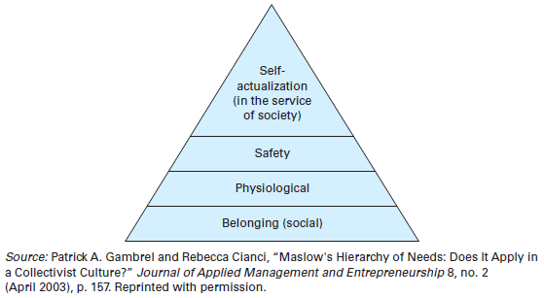
Collectivist Need Hierarchy

Slide 16
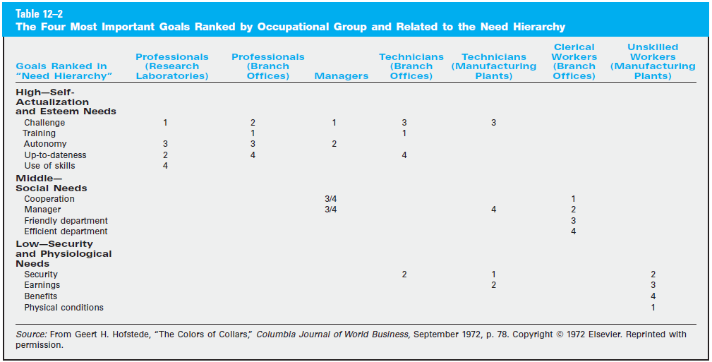
Needs across occupational groups:
Hofstede’s cross-national study

Slide 17
Herzberg’s Two-Factor Theory of Motivation
Herzberg makes a distinction between two types of factors that influence job satisfaction
  Motivators: Job-content factors such as achievement, recognition, responsibility, advancement, and the work itself. Only when motivators are present will there be satisfaction.
  Hygiene Factors: Job-context factors such as salary, interpersonal relations, technical supervision, working conditions, and company policies and administration. If hygiene factors are not taken care of there will be dissatisfaction.

Slide 18
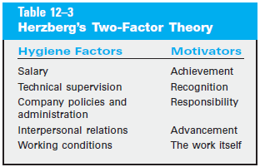
Examples of Hygiene Factors and Motivators
Source: Luthans & Doh (2018)

Slide 19
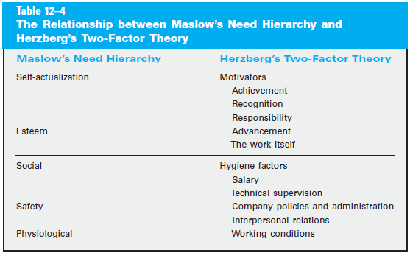
Maslow’s Need Hierarchy vs. Herzberg’s Two Factor Theory
Source: Luthans & Doh (2018)

Slide 20
Testing Herzberg’s Theory in the International Context
A study in an Israeli kibbutz:
  “Satisfactions arise from the nature of the work itself, while dissatisfactions have to do with the conditions surrounding the work.”
A study conducted among 178 Greek managers:
  Overall support of Herzberg’s theory
A survey of 218 middle managers and 196 salaried employees in New Zealand
  Support of Herzberg’s theory across occupational levels

Slide 21
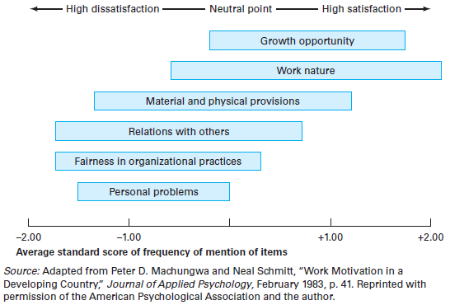
Testing Herzberg’s Theory in a Developing Country (Zambia)

Slide 22
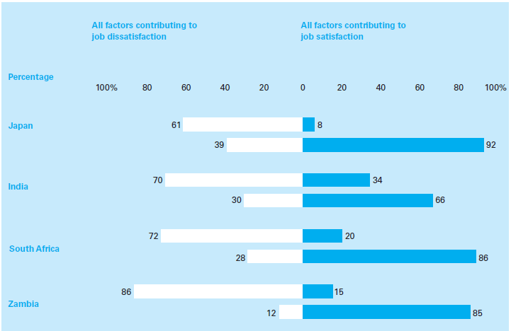
Herzberg, 1987: Impact of Hygiene Factors and Motivators
continues

Slide 23
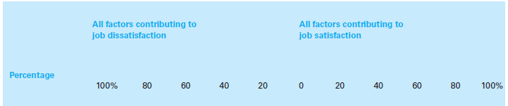
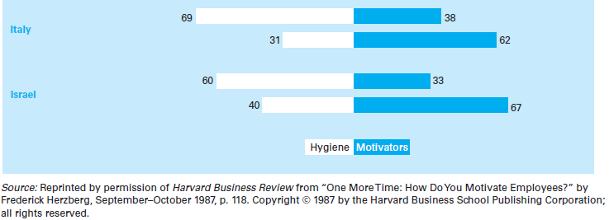
Hygiene factors - higher bar
Motivators - lower bar

Slide 24
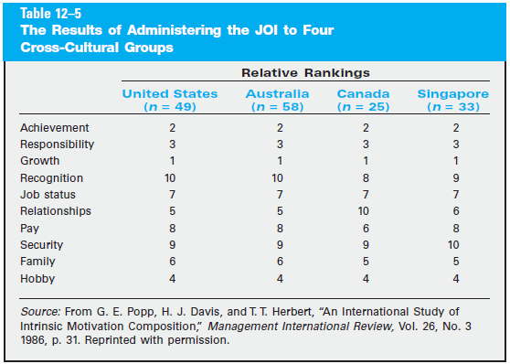
What is important for MBA students from different countries?

Slide 25
McClelland’s Achievement Motivation Theory
Some individuals have a strong motivation to get ahead, to attain success, and to reach objectives.
High achievers
  like situations in which they take personal responsibility for finding solutions to problems.
  tend to be moderate risk-takers rather than high or low risk takers.
  want concrete feedback on performance.
  often tend to be loners rather than team players.

Slide 26
Achievement Motivation: Evidence from Different Countries
Average achievement scores for managers from different countries
  U.S. - 6.74
  Poland - 6.58
  Czech Republic - 3.32
Achievement motivation theory is less relevant in cultures where less value is attributed to individual achievements
  Culture of many countries doesn’t support high achievement
  Cultures rewarding entrepreneurial efforts (e.g., Anglo cultures) do support achievement motivation and their human resources should be managed accordingly

Slide 27
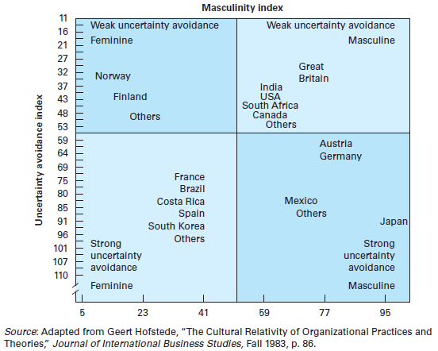
Which cultures encourage high achievement motivation?

Slide 28
Process theories of motivation
1. Equity theory
2. Goal-setting theory
3. Expectancy theory

Slide 29
Equity Theory
Equity theory focuses on how motivation is affected by people’s perception of whether they are treated fairly
  When people perceive that they are treated equitably, this will have a positive effect on their job satisfaction
  If people believe they aren’t being treated fairly (especially, relative to relevant others), they will be dissatisfied, leading to negative effects on job performance; they will attempt to restore equity.
While there is a considerable support for this theory in the Western world, studies from other countries do not always support the equity theory predictions

Slide 30
Cross-national differences in perceived equity
Employees in Asia and Middle East often readily accept inequitable treatment in order to preserve group harmony
In many Asian and Latin American countries, men and women often receive different pay for doing the same work, but due to years of cultural conditioning women may not feel that they are treated inequitably

Slide 31
Goal-Setting Theory
Goal-setting theory focuses on how individuals set goals and respond to them and the overall impact of this process on motivation
Specific areas given attention in this theory
  Level of participation in goal setting
  Goal difficulty
  Goal specificity
  Importance of achieving the goal
  Timely feedback regarding progress toward goals

Slide 32
Goal-Setting Theory
Employees perform well when
  they are assigned challenging goals
  they are assigned specific goals
  they participate in the process of setting the goals
Most studies have been conducted in US; just a few have been carried out in other countries

Slide 33
Participation in goal-setting: Norway versus the U.S.
Norwegian employees shunned participation and preferred to have union representatives work with management to determine work goals
Individual participation in goal setting was inconsistent with the prevailing Norwegian philosophy of participation through unions
Participation in goal setting is motivational for employees in the U.S., but not valued by employees in Norway where it’s a task for union representatives

Slide 34
Expectancy Theory
Expectancy theory postulates that motivation is influenced by a person’s belief that
  Effort will lead to performance
  Performance will lead to specific outcomes
  Outcomes will be of value to the individual

Slide 35
Testing the expectancy theory in the cross-national context
Some researchers found support for the expectancy theory beyond Western countries (e.g., in Israel and Japan)
The expectancy theory is applicable when employees have considerable control over their work and its outcomes
In countries where people believe that what happens is beyond their control (external locus of control), the expectancy theory is less applicable

Slide 36
Cross-country differences in the motivating effect of HRM practices
Job design & Reward systems

Slide 37
Job Design
Job design consists of a job’s content, the methods that are used on the job, and the way the job relates to other jobs in the organization
Job design usually reflect the cultural values of the country
  Assembly-line workers in Japan work at a rapid pace for hours and have little control over their work activities
  Assembly-line workers in Sweden work at more relaxed pace and have a great deal of control over the work activities
  U.S. assembly-line workers typically work somewhere in between―at a pace less demanding than Japan’s but more structured than Sweden’s

Slide 38
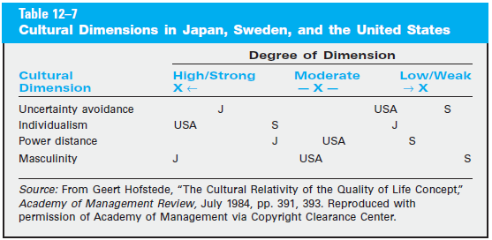
Cultural dimensions may have implications for job design

Slide 39
Sociotechnical Job Designs
Sociotechnical job designs blend personnel and technology
The objective of the sociotechnical job designs is to integrate new technology into the workplace so that workers accept and use it to increase overall productivity
  New technology often requires that people learn new methods and sometimes requires to work faster
  Teamwork with new technologies may enhance job satisfaction (e.g., multifunctional teams used by Volvo in Sweden and by General Foods in the U.S.)

Slide 40
Reward Systems
Managers everywhere use rewards to motivate personnel
  However, significant differences exist between reward systems that work best in one country and those that are most effective in another
    E.g., employees in many Asian countries prefer group rewards to individual rewards
  In some countries (e.g., U.S.) financial rewards (salary raises, bonuses, and stock options) are most important
  In other countries, employees may put less value on monetary rewards and more value on non-financial rewards (social status and recognition in Asia, more pleasant work environment in France, time-off in Sweden, etc.)

Slide 41
Cross-national differences in perceived value of rewards
Sirota and Greenwood surveyed employees of a large electric equipment manufacturer with operations in 40 countries:
  Employees in France and Italy highly valued job security, while Americans and British did not
  Scandinavian employees put high value on personal freedom and autonomy, but not on “getting ahead”
  German employees put high value on job security, fringe benefits, and “getting ahead”
  Japanese highly valued good working conditions and a congenial work environment

Slide 42
Summary
Work centrality around the world
Content theories of motivation
  Maslow’s hierarchy-of-needs, Herzberg’s two factors, and McClelland’s achievement motivation
Process theories of motivation
  Equity theory, goal-setting theory, expectancy theory
Cross-country differences in the motivating effect of various HRM practices
  Job design & reward systems

Slide 43
Reminders
No class this Friday, April 18th
  Happy Easter / Boa Páscoa!
Next Tuesday, April 22nd
  Discuss “LG Display Wroclaw” case
  Students responsible for “LG Display Wroclaw” case submit individual assignments by 9:30 on Apr 22nd
No class on Friday, April 25th (Dia da Liberdade)
On Tuesday, Apr 29th will discuss corporate governance across countries

