Slide 1
1227 International Management
Executing International Strategies
© Ilya Okhmatovskiy
© Andrew Spicer

Slide 2
Agenda
MNCs dealing with the tension between global and local orientations
Global standardization, multidomestic localization, and transnational strategies
Organizational structures adopted by MNCs
Philips vs. Matsushita (Panasonic)
Balancing between global and local orientation

Slide 3
How can MNCs deal with the tension between global and local orientations?

Slide 4
Thinking Globally
The Product Division Manager: “Global business or product-division managers have one overriding responsibility: to further the company’s global-scale efficiency and competitiveness. This task requires not only the perspective to recognize opportunities and risks across national and functional boundaries but also the skill to coordinate activities and link capabilities across these barriers. The global business manager’s overall goal is to capture the full benefit of integrated world-wide operations.”
-- Bartlett and Ghoshal, Harvard Business Review, September-October 1992

Slide 5
Thinking Locally
The Area Manager: “The national subsidiary manager’s [main task] is to be sensitive and responsive to the local market. Country managers play the pivotal role not only in meeting local customer needs but also in satisfying the host government’s requirements and defending their company’s market positions against local and external competitors.”
Bartlett and Ghoshal, Harvard Business Review, September-October 1992

Slide 6
Tension between global and local mindsets
International managers need to analyze the world as a global market (global mindset)
… and to understand national differences (local mindset)
It is the tensions between global and local forces that is at the heart of multinational management
When is it critical to adapt to local conditions and when not?

Slide 7
Integration/Adaptation Framework
Global Standardization
Transnational
High
Degree of Production Integration
Home Replication
Multidomestic Localization
Low
Low
High
Domestic
Company
Degree of Product Adaptation

Slide 8
Home Replication Strategy
R&D | Design | Manufacturing (1) (2) (3) |  |  | Sales | Distr. & Service
Country 2
Country 1
Final Product (Global)
Home Country

Slide 9
International Division Structure
CEO
Domestic
Division A
Domestic
Division B
Domestic
Division C
International
Europe
Africa
Asia
Latin
America

Slide 10
Example: Walmart’s International Division
In the 1990s, Walmart managed operations outside of the US through International Division (ID)
three main foreign regions: Europe, Asia, and Americas
The head of each region reported to the head of ID
The head of ID reported to Walmart’s CEO
Where do you think procurement should be located – within global headquarters or local subsidiaries?
Where to make strategic decisions about store operations in UK or Mexico?

Slide 11
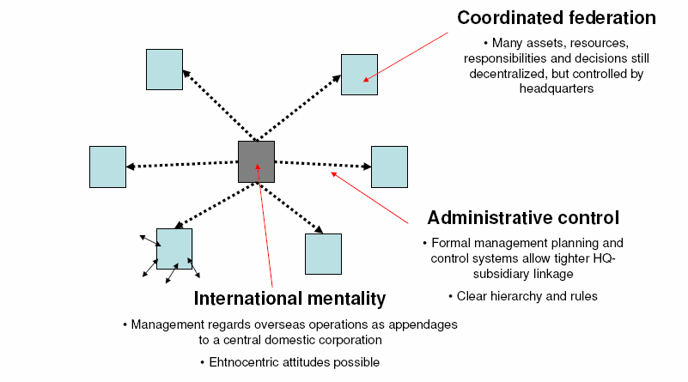
International Division Mentality
Source: Bartlett and Ghoshal (1989)

Slide 12
Multidomestic Localization
R&D | Design | Manufacturing (1) (2) (3) |  |  | Sales | Distri. & Service
 |  |  |  |  |  |  | Final Product 2 (Country 2)
 |  |  |  |  |  |  | Final Product 1 (Country 1)
 |  |  |  |  |  |  | Final Product (Home Country)
Country 2
Country 1
Home Country

Slide 13
Worldwide Area Division Structure
Headquarters
North American
area
European
area
Far East
area
Latin American
area
Middle East /
Africa area

Slide 14
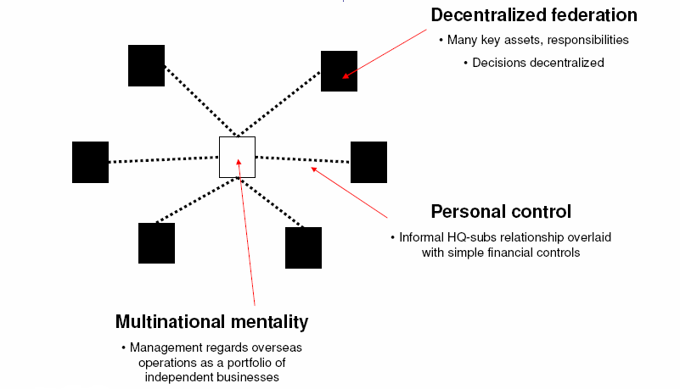
Local (Multidomestic) Mindset
Source: Bartlett and Ghoshal (1989)

Slide 15
Global Standardization
.
R&D | Design | Manufacturing (1) (2) (3) |  |  | Sales | Distr. & Service
Country 2
Country 1
Final Product (Global)
Home Country

Slide 16
Experience curve

Slide 17
A Worldwide Product Division Structure
Headquarters
Worldwide
product group
or division A
Worldwide
product group
or division B
Worldwide
product group
or division C
Area 1
(domestic)
Area 2
(international)
Functional units
Functional units

Slide 18
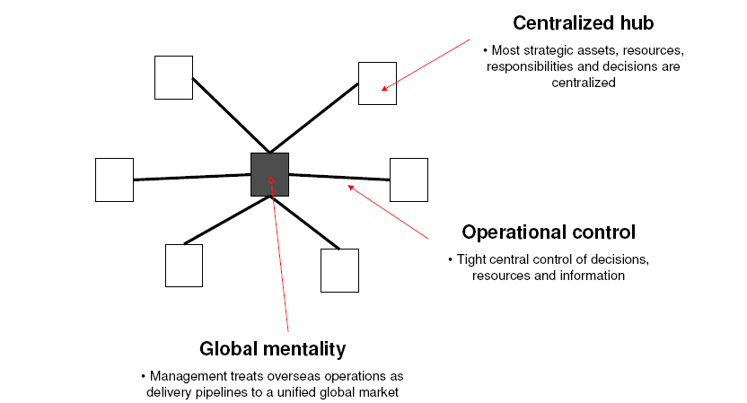
Global Organization Mentality
Source: Bartlett and Ghoshal (1989)

Slide 19
Transnational Strategy
R&D | Design | Manufacturing (1) (2) (3) |  |  | Sales | Distrib. & Service
 |  |  |  |  |  |  | Final Product 2 (Country 2)
 |  |  |  |  |  |  | Final Product 1 (Country 1)
 |  |  |  |  |  |  | Final Product (Home Country)
Country 2
Country 1
Home Country

Slide 20
A Global Matrix Structure
Headquarters
Area 1
Area 2
Area 3
Product
division A
Product
division B
Manager here
belongs to division B
and area 2
Product
division C

Slide 21
Hybrid Structure for Transnational Strategy

Slide 22
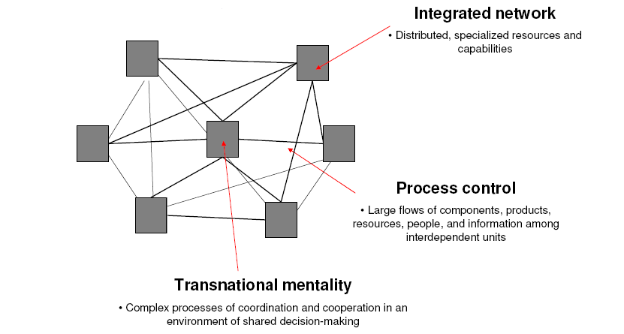
Transnational Mentality
Source: Bartlett and Ghoshal (1989)

Slide 23
Multinational Strategy and Industry Conditions
Source: Grant (2015)

Slide 24
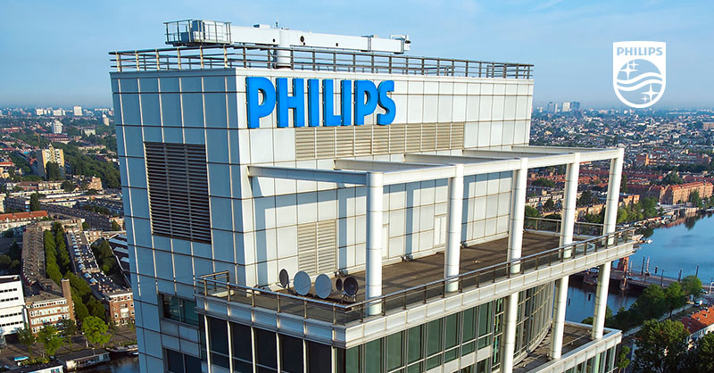
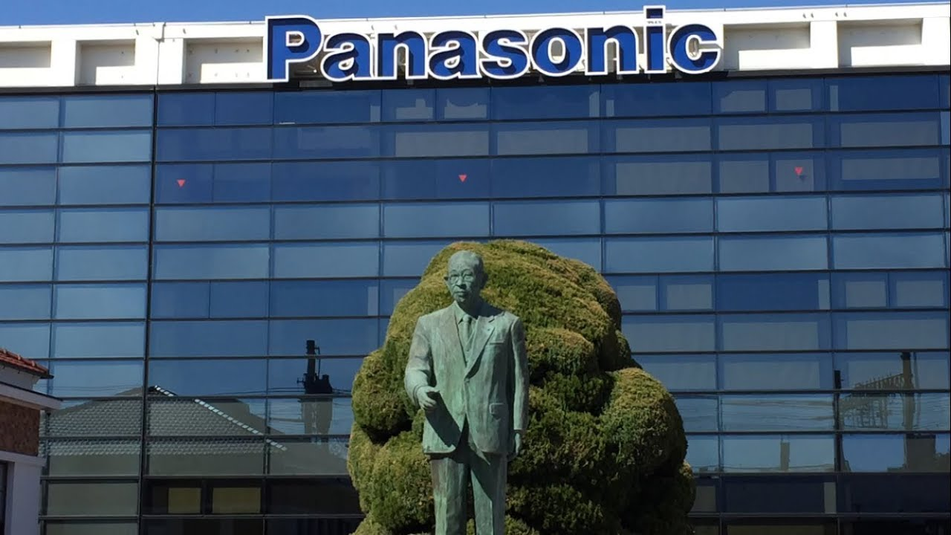
Philips versus Matsushita (Panasonic)
How do they manage multinational operations?

Slide 25
Philips’ roots
Founded in 1892 (Eindhoven, Holland)
Combined technological expertise of Gerard Philips and commercial expertise of Anton Philips
Product diversification
from light bulbs to radios, TVs, audio- and videotapes
International expansion
Before WW II created marketing companies in many European countries, Australia, Brazil, & China
During WW II North American division of Philips assumed the role of the coordinating center

Slide 26
Philips’ traditional strengths
A commitment to technological innovation that allowed the organization to retain its leading edge of product and production innovation.
Strong, independent R&D laboratories.
Created strong entrepreneurial culture through its localization strategy and organizational design
Responsiveness to the needs of national markets
Knowledge of the markets, strong marketing skills
Customized product offerings to satisfy local preferences of consumers

Slide 27
Org. structure & management
National organizations (NOs) in Philips are responsible for administrative, financial, and legal matters
Local control over key assets, resources
Knowledge of local markets, consumer markets
Profit responsibility
Career advancement opportunities
Most board members are NO managers
Best people became NO managers

Slide 28
Matsushita (Panasonic) roots
Founded in 1918 by Konosuke Matsushita
Rapid growth after WWII
1950s – began high volume export operations
1960s – opened plants in Asia and Latin America
1970s – opened plants in Europe and North America
Built massive centralized manufacturing capability
Assets and resources controlled by strong product divisions located in Osaka

Slide 29
Matsushita’s traditional strengths
Created a strategy of developing relatively standardized products and producing them at massive scale
Core competence in low-cost manufacturing
Fast-to-market innovations
Bring new technologies to market faster than competitors required the ability to coordinate R&D, manufacturing, and marketing within product divisions
“Manishita” (copycat)
Own 25,000 retail outlets in Japan
Strong brands
Panasonic, National

Slide 30
Org. structure & management
Administrative control at Matsushita was achieved through the total dependence of the overseas subsidiaries on the parent company for finance
Strong centralized control over operations
Expatriates are often appointed to work at subsidiaries as general managers, accountants, technical managers
Cost advantages through global economies of scale
Close ties between Osaka and foreign subsidiaries
Managers of subsidiaries regularly visit HQ while representatives of HQ often visit subsidiaries

Slide 31
Problems at Philips
Product divisions lack power needed to integrate development, manufacturing, and marketing of products across different national markets
Fragmented value chain – from R&D to sales
Design of new products with little considerations of market needs or production constraints
High costs of operations
Inability to bring innovations to market fast

Slide 32
Why is it difficult to change?
National organizations in Philips have a lot of power
Control over key assets
Traditional career path – most executives came from national organizations
Generate profits - sources of funds for the rest of Philips
Re-organization damages traditional strengths associated with autonomy of R&D labs and national organizations
Ability to generate revolutionary innovations
Responsiveness to conditions of local markets

Slide 33
Problems at Matsushita
Very close control by headquarters stamps out entrepreneurial initiatives
Shortage of innovations
Lack of flexibility and responsiveness to national market differences
Negative effect of centralized production in Japan
Growing labor costs
Strong yen
Protectionist governments favor companies that build plants over those that export

Slide 34
Why is it difficult to change?
Matsushita’s reluctance to relax control over national subsidiaries
Hard to make employees innovative and entrepreneurial overnight
If new subsidiaries are created through acquisitions, many creative employees tend to leave (e.g. Motorola’s TV business in U.S.)

Slide 35
Does each company want to become like the other?
Matsushita’s executive: “I would like to see Matsushita develop a kind of innovation and entrepreneurship which has long characterized the success of Philips. They are very good at adapting central products and strategies to meet local needs. Moreover, they have been able to use the technical and other resources available in the host country to create new products and new businesses.”
Philips’ executive: “The Japanese have taught us the value of pursuing a global strategy with standard products. They had tremendous cost advantages in being able to supply the world market from factories at home. We were trying to compete on a country-by-country basis with all the additional costs associated with fragmented operations.”

Slide 36
Moving toward transnational strategy?
Trying to develop transnational strategies
Building global scale efficiency without losing local responsiveness (Philips)
Developing local responsiveness while retaining global efficiencies (Matsushita)

Slide 37
Combining global integration with local responsiveness
High
Global
Strategy
Trans-
national
Need for Global Integration
Multi-
Domestic
Low
Low
High
Need for Local Market Responsiveness
Notes:
53

Slide 38
Philips vs. Matsushita: Summary
The classic example of the close relationship between a company’s capabilities and its organizational structure
Philip’s localized strategy and Matsushita’s global strategy become embedded in very distinct organizational structures.
Over the long run, the organizational designs become quite difficult to change, demonstrating the power of history and “administrative heritage” in explaining why firms have difficulties in adapting quickly to new circumstances

Slide 39
Philips vs. Matsushita: Summary
Firms usually organize their multinational activities to match their underlying strategy
Philips – National Organization (NO) to match their entrepreneurial, multi-domestic strategy
Matshushita – Centralized organization to match their global standardization strategy
Matching strategy and structure often locks company into strategic positions that are difficult to change over time

Slide 40
Organizing for global-local balance
There is no perfect organization scheme for abolishing the globalization-localization tradeoff
Optimism about new approaches to problems of complex organizations should be tempered with the realization that all-purpose formal organization structure is unlikely
Informal organizational initiatives – culture, cross-country teams and projects, frequent traveling and interactions – are important in coping with inherent problems of creating a global-local balance.
Source: Ghemawat (Redefining Global Strategy, 2007)

Slide 41
Using both global and local logics
Formal rules and charts cannot answer the question of when to think globally and when to think locally
Firms must rely on culture and socialization to create common values and beliefs within the organization
Similarly, successful international management requires an understanding of both local and global logics to make appropriate decisions that respond to the needs of specific situations

Slide 42
“The test of a first-rate intelligence is the ability to hold two conflicting ideas in mind at the same time, and still retain the ability to function.”
F. Scott Fitzgerald

Slide 43
“Local Memoirs of a Global Manager” by Gurcharan Das
“The most important lesson was this: to learn to tap into the roots of diversity in a world where global standardization plays an increasingly useful role. … The fact is that truths in this world are unique, individual and highly parochial. They say all politics is local. So is all business. But this doesn’t keep either from being global. … Globalization does not mean imposing homogeneous solutions in a pluralistic world. It means having a global vision and strategy, but it also means cultivating roots and individual identities. It means nourishing local insights, but it also means reemploying communicable ideas in new geographies around the world.”

Slide 44
Conclusion
Executing strategies at MNCs is to large extent about balancing needs for global integration and local responsiveness
The MNC is defined by the tradeoff between fragmenting pressures to respond to differences in local environments while pursuing the gains from integration across borders
Managing this tension between global integration and local responsiveness is the main challenge in sustaining competitive advantage in a multinational context

Slide 45
Summary
MNCs dealing with the tension between global and local orientations
Global standardization, multidomestic localization, and transnational strategies
Organizational structures adopted by MNCs
Philips vs. Matsushita (Panasonic)
Balancing between global and local orientation

Slide 46
Reminders
This Friday, April 11th
Will discuss “Emirates Airline” case
Students responsible for “Emirates Airline” case submit individual assignments by 9:30 on Apr 11th
Next Tuesday, April 15th
Lecture topic: “Work motivation and HRM across countries”
PA presentation by a group responsible for this topic

