Slide 1
1227 International Management
Entering foreign markets
© Ilya Okhmatovskiy
© Youtha Cuypers

Slide 2
Agenda
Which foreign markets should the company enter first?
How to enter foreign markets (entry modes)
Exporting
Licensing & franchising
Wholly-owned subsidiaries
Mergers and acquisitions
Strategic alliances and joint ventures

Slide 3
Which foreign markets should the company enter first?

Slide 4
Choosing foreign markets
“Rational optimization” approach
Going after the market with the most appealing characteristics
“Learning-by-doing” approach
Uppsala model

Slide 5
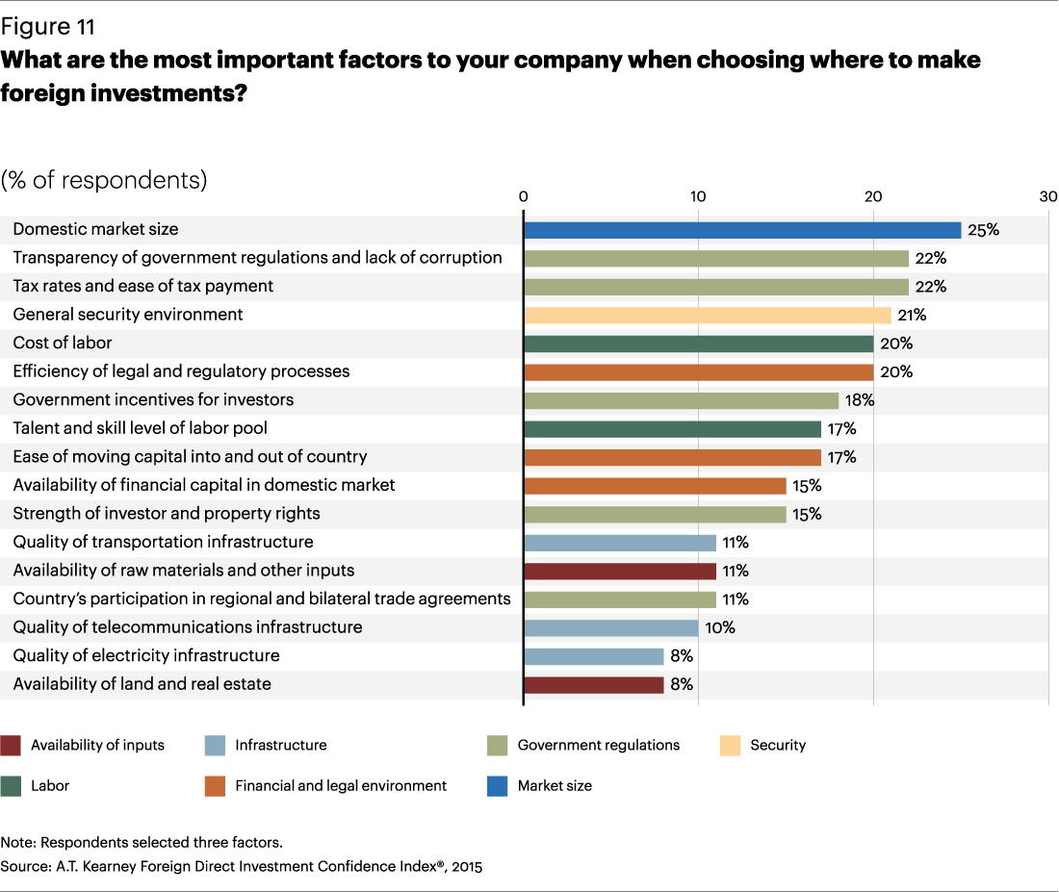

Slide 6
Uppsala model: Psychic distance
Introduced by Jan Johanson (Uppsala University, Sweden) and his colleagues
Johanson and Vahlne (1977); Vahlne and Johanson (2017)
Foreign target markets are selected primarily according to their proximity in terms of “psychic distance”
Psychic distance reflects differences in language, culture, political systems, level of education, or level of industrial development, etc.
Psychic distance makes it difficult to understand foreign environment

Slide 7
Firms begin internationalization by entering proximate foreign markets
According to the Uppsala model, companies start investing in one or few neighboring countries rather than in a variety of countries simultaneously
Investment in a foreign country is carried out cautiously, gradually, and according to managers’ learning progress
Subsequently, the company is expected to follow a sequence from low to high commitment and to enter new markets with successively greater psychic distance

Slide 8
Internationalization process (Johanson & Vahlne, 1977)

Slide 10
Do all firms internationalize as predicted by the Uppsala model?
Psychic distance affects all firms but its effect can be alleviated if firms build “bridges”
For example, an Indian company may begin international expansion by entering the US market
The high psychic distance between India and the US can be “bridged” if the Indian company targets mostly Indian consumers who live in the US
“Born global” firms

Slide 11
How to enter foreign markets?
Exporting
Licensing & franchising
Wholly-owned subsidiaries (greenfield investments)
Mergers and acquisitions
Strategic alliances and joint ventures

Slide 12
Determinants of entry mode choice
Goals and objectives of the firm, such as desired profitability, market share, or competitive positioning
Degree of control desired regarding decisions, operations, and assets involved in a venture
The firm’s financial, organizational, and technological resources and capabilities (strengths and weaknesses)
The types of risk inherent in each proposed foreign venture

Slide 13
Determinants of entry mode choice
Conditions in the target country, such as legal, cultural, and economic circumstances, as well as distribution and transportation systems
Nature and extent of competition from existing rivals and from firms that may enter the market later
Availability and capabilities of partners in the market

Slide 14
Determinants of entry mode choice
The value-adding activities the firm is willing to perform itself in the market and the activities it will delegate to local partners
Long-term strategic importance of the market
Characteristics of the product or service

Slide 15
Entry mode choice is affected by prior entry experiences
Learning from experience:
Prior expansions may lead to learning and change how subsequent entry modes are chosen
Firm experience, experience of other firms, and experience of top management can all be a source of learning
However, due to path dependence, firms tend to rely on the entry modes used before, even if they are not optimal given the conditions of the expansion and the firm’s resources

Slide 16
Exporting
Producing products or services in one country and selling / distributing them to customers in other countries.
Home-based international operations
Usually the firm’s first foreign entry strategy
Low risk, low cost, and flexible
Export channels:
Independent distributor / agent
Firm’s own distributor abroad

Slide 17
Exporting
Advantages
No need to establish foreign operations
Do not transfer competencies to foreign firms
Easy to control operations
Disadvantages
Costs (transportation, tariff)
Limited learning opportunities
Less responsive to local demands
Examples
Microsoft software, Disney’s movies

Slide 18
Boeing’s factory complex in Everett, WA

Slide 19
Licensing / Franchising
Governed by a contract that provides the focal firm a moderate level of control over the foreign partner. Control reflects the ability of the firm to influence the decisions, operations, and strategic resources of a foreign venture.
Typically involve exchange of intangibles (trademarks, intellectual property, know-how, etc.) and services (e.g., technical assistance).

Slide 20
Licensing / Franchising
Advantages
Low-risk & low-cost global expansion strategy
Fast expansion
When a target market is not of strategic interest
Disadvantages
Limited control over licensee’s operations
Lower profit
Transfer of competencies (e.g., technology)
Create potential competitors in other markets
Examples
Lego - licensing; McDonalds, Marriott - franchising

Slide 21
Foreign direct investment
In contrast to home-based international operations (exporting & licensing), foreign direct investment (FDI) involves establishing a presence in the foreign market by investing capital in property located abroad
FDI entails substantial risk and resource commitment
Investors have to deal directly with specific social and cultural conditions in the host market
FDI can be done through
Wholly-owned subsidiary (greenfield investments)
Acquisitions
Equity-based collaborative ventures with foreign partners

Slide 22
Wholly owned subsidiary
Also known as “greenfield investments”
A firm sets up presence abroad - alone and from scratch
Local knowledge and understanding of the market will have to come from within the firm or by hiring locals
Takes time and substantial resources

Slide 23
Wholly owned subsidiary
Advantages
High level of control over the subsidiary
High profit potential
Internal transfer of competencies and proprietary knowledge
Disadvantages
High risk and capital investments
Market access may be difficult (e.g., need to establish distribution channels)
Lack of local knowledge
Host government may not allow
Example
Toyota North America, Philips USA

Slide 24
Mergers & Acquisitions (M&As)
Mergers: assets of two previously separate firms are combined to establish a new legal entity ⇨ “merger of equals”
Acquisitions: assets of the acquired company are absorbed by the acquirer and the target company disappears as a legal entity
Real “mergers” are rare! Usually there is a clearly dominant party

Slide 25
M&As in the beer industry (2000-2013)

Slide 27
Then AB Inbev acquired SABMiller…
AB Inbev acquired SAB Miller in 2015
Combined company produces approx. 1/3 of beer in the world

Slide 28
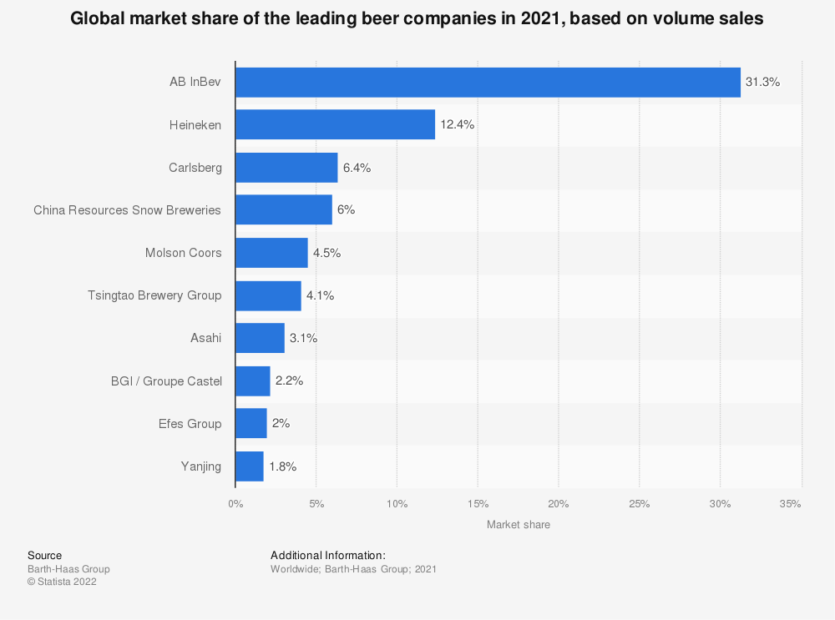

Slide 29
Foreign market entry through acquisition
Advantages
Allows rapid global expansion opportunity
Start foreign operations with a substantial market share
Does not intensify competition by adding production capacity
Disadvantages
Could be expensive
Complex regulation
Difficult to obtain information
Cultural differences
Example
Walmart & Woolco

Slide 30
Strategic alliances and joint ventures

Slide 31
Non-equity strategic alliances
Cooperation between firms is managed directly through contracts, without equity holdings or a new firm being created
Supply / distribution agreements
Joint R&D, marketing, etc. agreements
Detailed contracts are necessary, but even detailed contracts leave some room for uncertainty

Slide 32
Equity strategic alliances
Cooperative contracts are supplemented by equity investments by one partner in the other partner (sometimes these are reciprocal investments)
Why do firms invest in their alliance partners?

Slide 33
Joint Ventures
Cooperating firms invest in a new firm and share its profits
Choosing partners
Do they indeed have valuable skills and resources that they claim?
Working with partners
Do they contribute valuable skills and resources they promised to contribute?
Who is more dependent on success of the joint project?
Terminating joint projects
Who will learn faster?

Slide 34
Strategic Alliances
Advantages
Share risks and resource requirements
Opportunity to learn from partner(s)
Partner’s complementary assets and skills (e.g., technology know-how and marketing skills)
Often favored by host governments
Disadvantages
Transfer of competencies to a potential competitor
Difficult coordination (e.g., different culture, conflicting goals between partners)
Examples: Renault - Nissan, Cisco - Wipro

Slide 35
Renault-Nissan Alliance

Slide 36
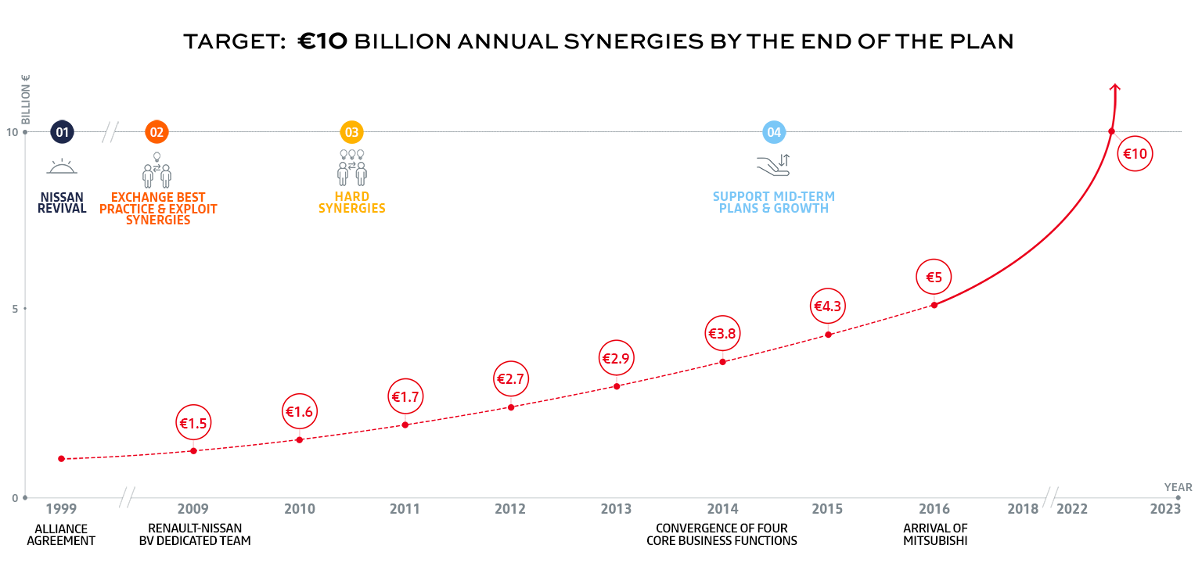
Renault-Nissan Alliance

Slide 37
Automotive industry

Slide 38
Renault-Nissan Alliance

Slide 39
Will Renault-Nissan alliance survive?

Slide 40
Ghosn broke the bail and fled Japan
“With help from an American private-security contractor, Ghosn fled from Japan to Lebanon on 30 December 2019, breaking his bail conditions. On 2 January 2020, Interpol issued a red notice to Lebanon seeking Ghosn's arrest.”
Following the arrest of Carlos Ghosn, press analysts have questioned the alliance's long-term existence. However, because the companies' recent business strategies are interdependent, attempts to restructure the alliance could be counter-productive…
Source: Wikipedia

Slide 41
Why do many alliances fail?
Incompatibility
Incongruent goals
Opportunistic behavior (e.g. after making alliance-specific investments, becoming too dependent on the partner).
Inability to adapt to changing conditions
Culture clash
Partner not making promised resources available
Inadequate management of the alliance, unclear division of responsibilities, etc.

Slide 42
Failed alliance: Suzuki and VW
Formed partnership in 2009 (VW bought a 19.9% stake in Suzuki) to work together on fuel efficient cars, and for VW to gain access to the Indian market for small cars (where Suzuki had a leading position)
In 2011 Suzuki accused VW of not making promised technology available and VW had issues with Suzuki buying diesel engines from Fiat
VW insisted that they needed to increase their stake in Suzuki to 33% to facilitate effective technology transfer
Suzuki perceived this as an attempt to diminish its autonomy and eventually take over the firms
Suzuki wanted to buy back VW’s share
Dispute finally settled in 2015
Source: https://www.reuters.com/article/us-suzuki-volkswagen-idUSTRE76H0BW20110718

Slide 43
Examples of successful alliances

Slide 44
Portfolio of alliances: General Motors
AVTOVAZ
SAAB
FIAT
50% owned
20% owned (2000-5); collaboration on technology and components
SUZUKI
Russian JV to produce cars
10% owned; co-production
20% owned; joint production
GM
FUJI
49% owned; co-production
60% owned
ISUZU
JV to produce cars in China
IBC Vehicles Ltd (UK)
40% investment
50% owned
50.9% owned; technical
and production collaboration
SAIC
(Makes vans in UK)
New United Motor Manufacturing Inc. (NUMMI)
TOYOTA
50% owned
(Makes cars in US)
DAEWOO
Source: Grant (2008)

Slide 45
Summary
Which foreign markets should the company enter first?
How to enter foreign markets (entry modes)
Exporting
Licensing & franchising
Wholly-owned subsidiaries
Mergers and acquisitions
Strategic alliances and joint ventures

Slide 46
Reminders
This Friday, April 4th
Will discuss “Walmart” case
Students responsible for “Walmart” case submit individual assignments by 9:30 on April 4th
Next Tuesday, April 8th
Lecture on “Executing global strategies”
PA presentation by groups responsible for this topic

