Slide 1
1227 International Management
Global distribution of value chain activities
© Ilya Okhmatovskiy
© Andrew Spicer

Slide 2
Agenda
Global value chains
  Rise of global value chains
  Disruptions and resilience of global value chains
Designing value chains to exploit sources of competitive advantages
Where to perform value chain activities?
  Criteria for choosing countries most suitable for performing various value chain activities

Slide 3
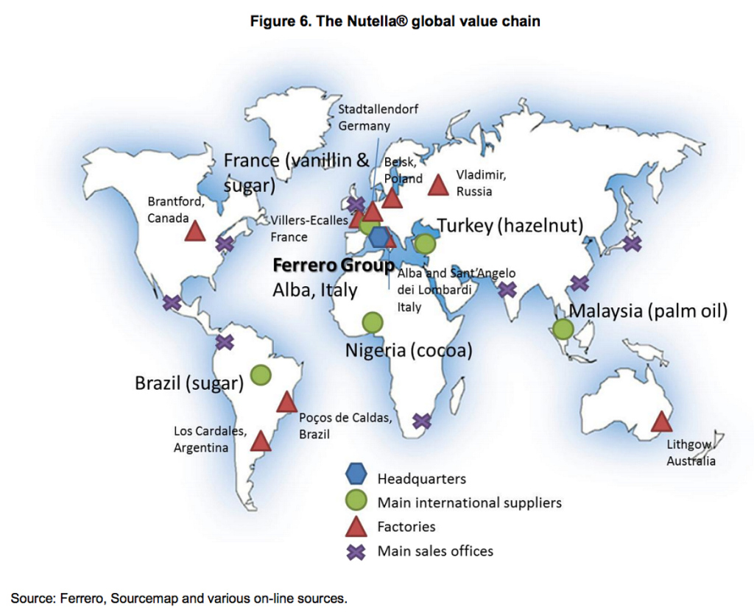

Where and how do you produce and sell products?

Slide 4
Toyota’s operations around the world
Global Inc. (2003)

Slide 5
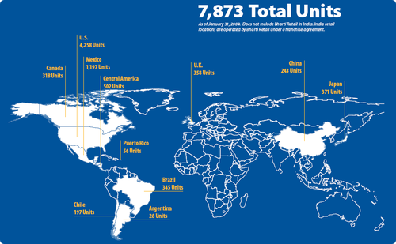
Walmart Stores Abroad
Source: Global Strategies (2016)

Slide 6
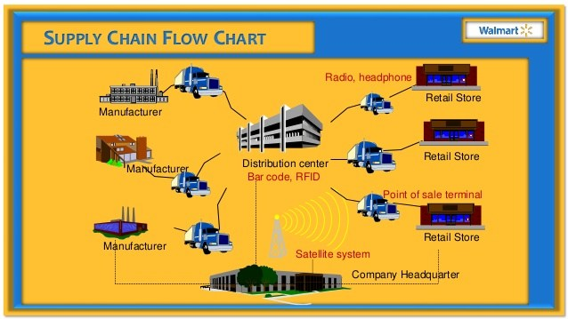
Walmart’s Global Supply Chain

Slide 7
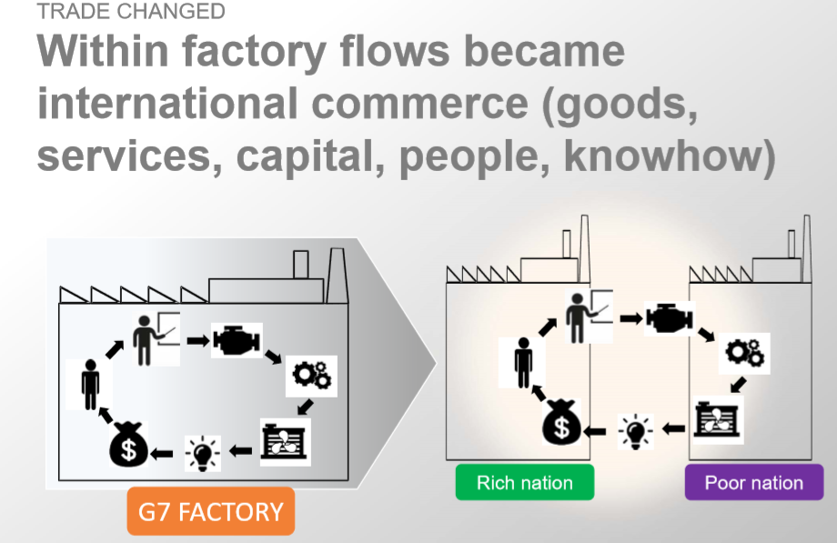
Rise of Global Supply Chains
Source: Baldwin (2016)

Slide 8
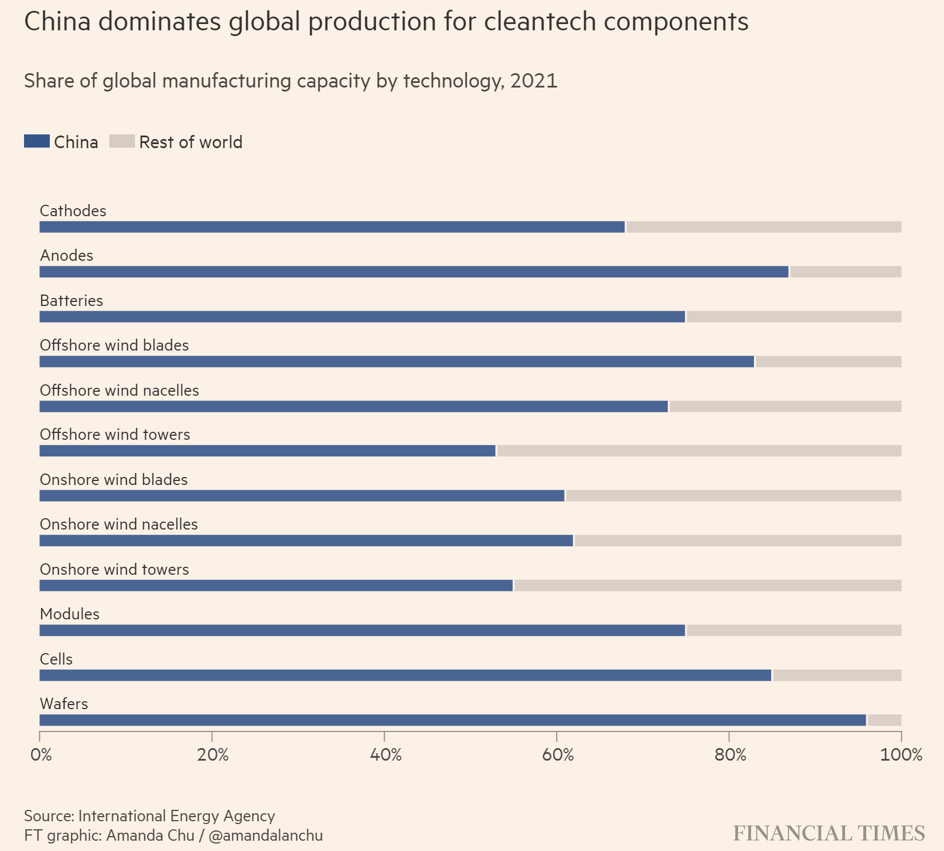

Slide 9
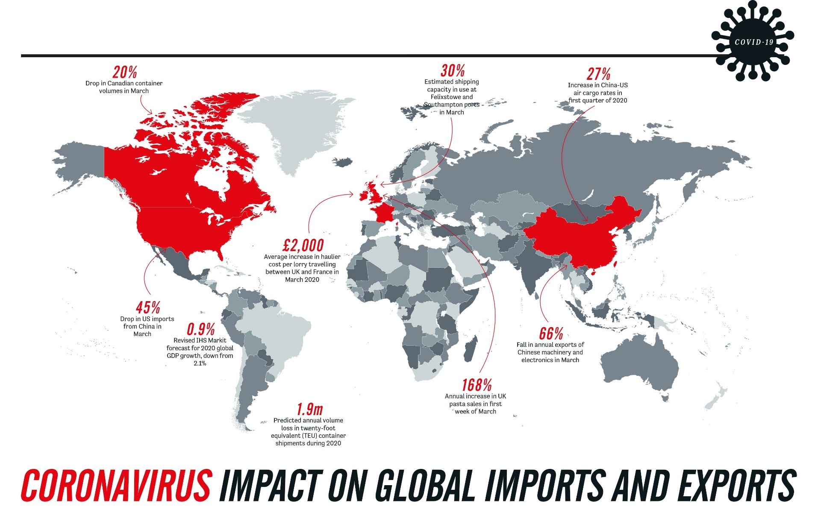
Impact of COVID-19 on global supply chains
Source: https://www.cips.org/supply-management/analysis/2020/april/the-end-of-the-global-supply-chain/

Slide 10
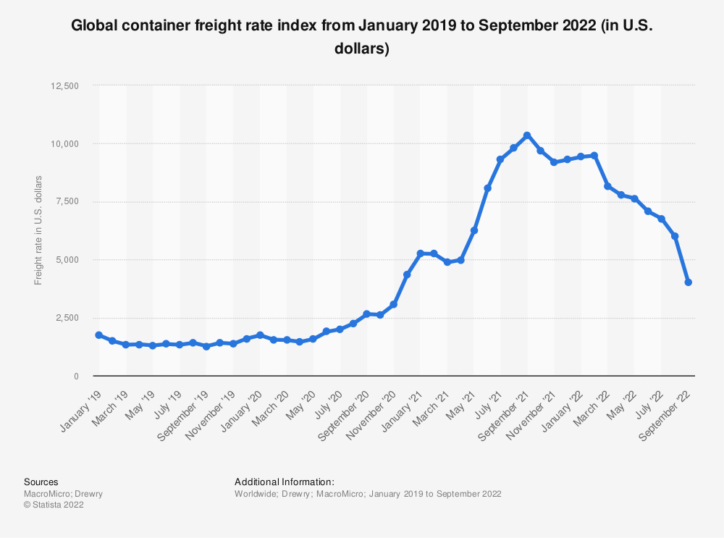
Impact of COVID-19 on delivery costs

Slide 11
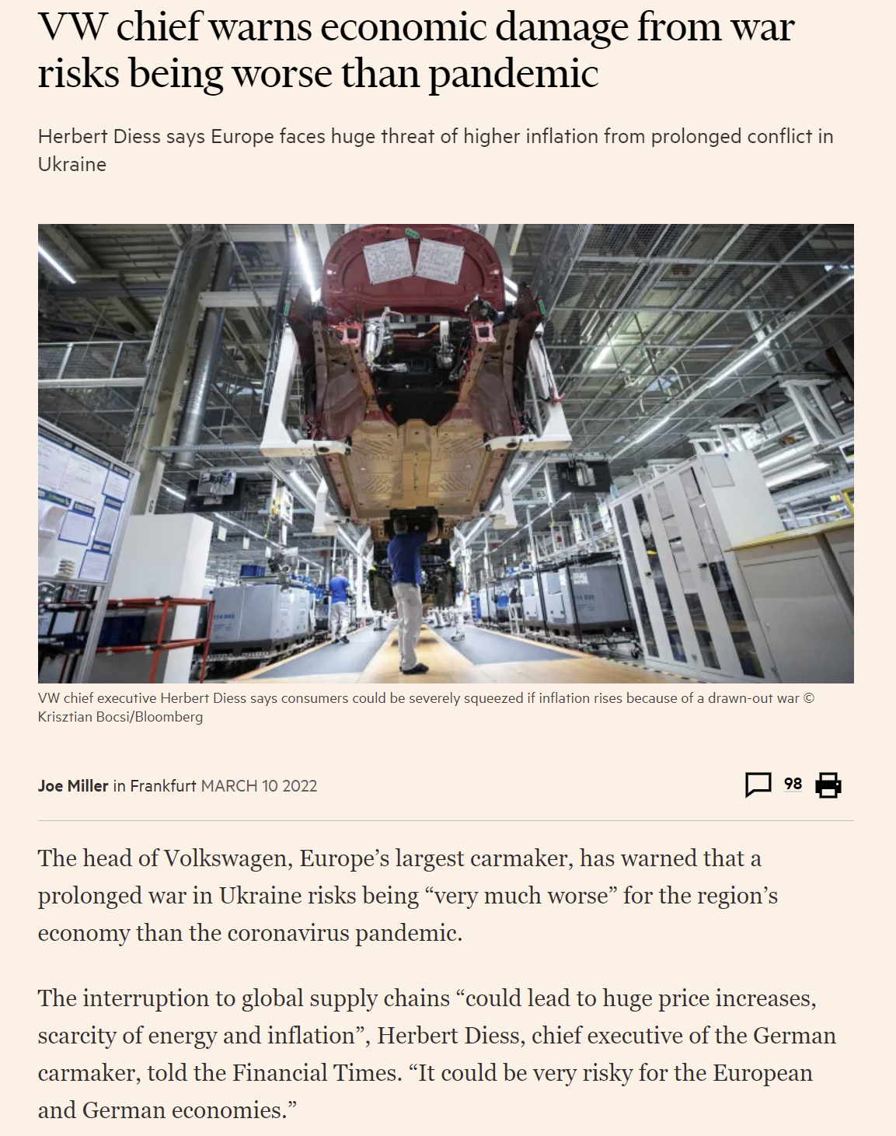
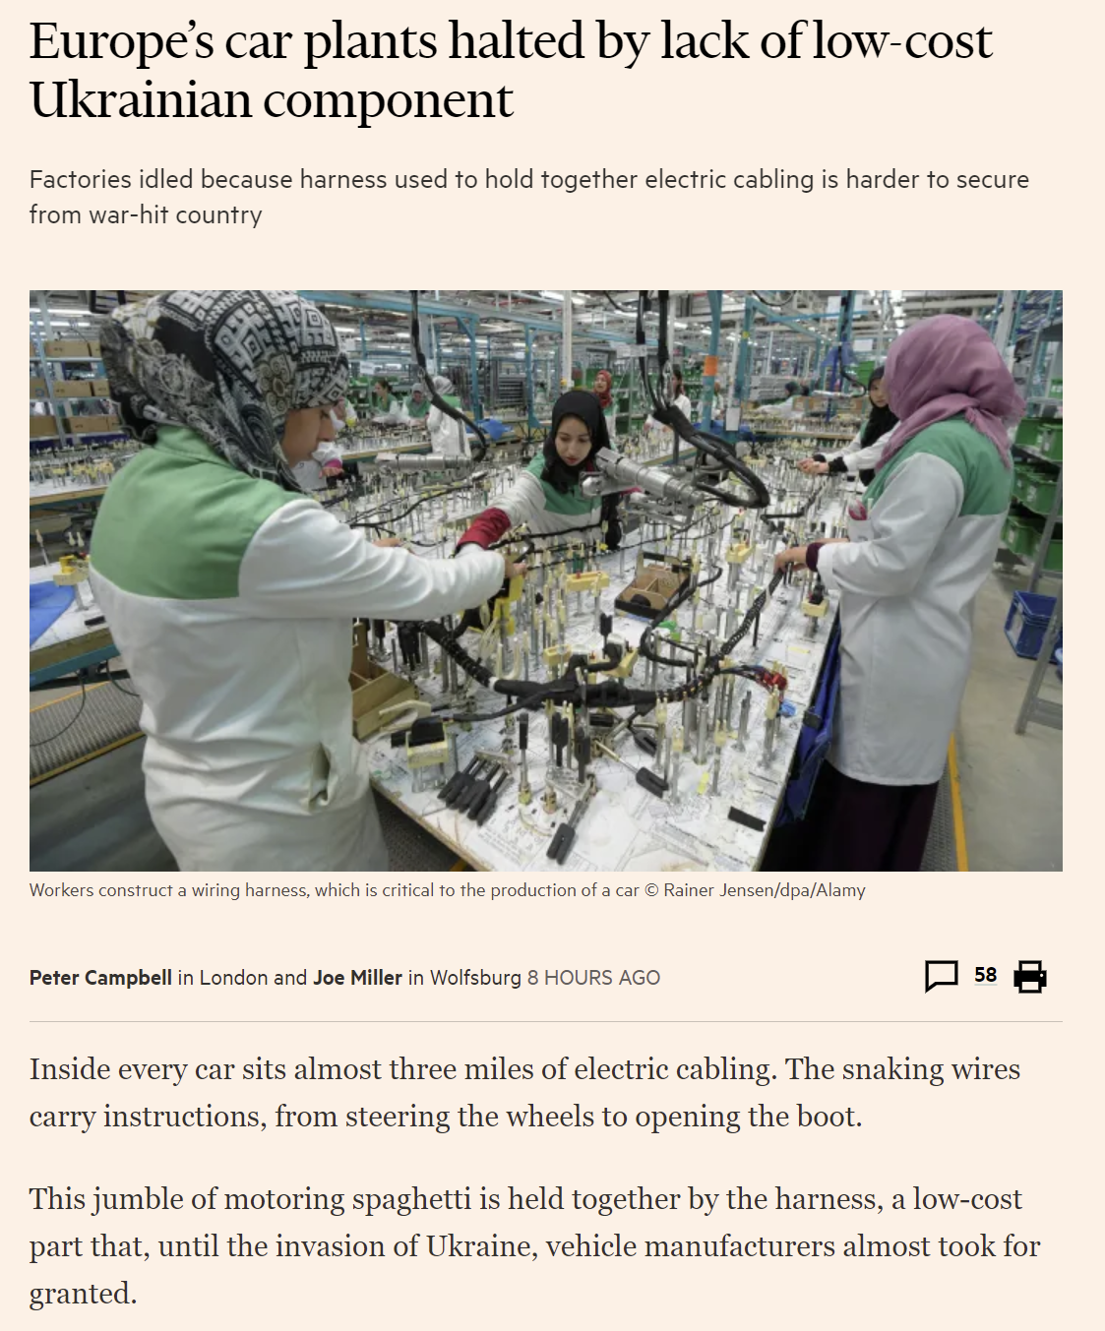
Supply chains disrupted by the military conflict between Russia and Ukraine
Source: Financial Times (2022)

Slide 12
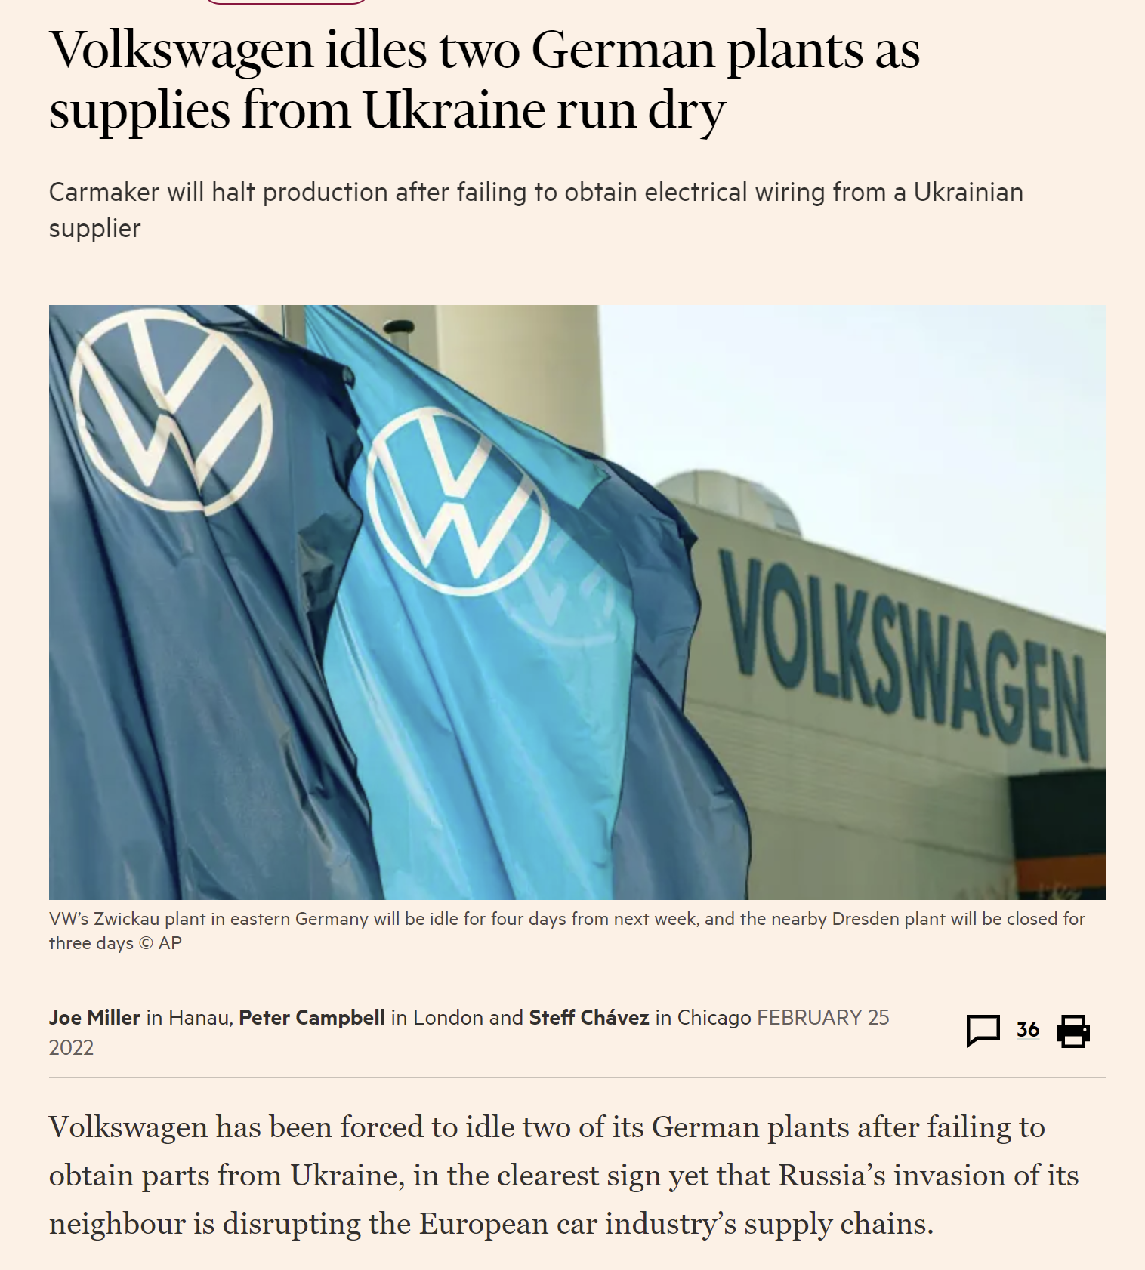
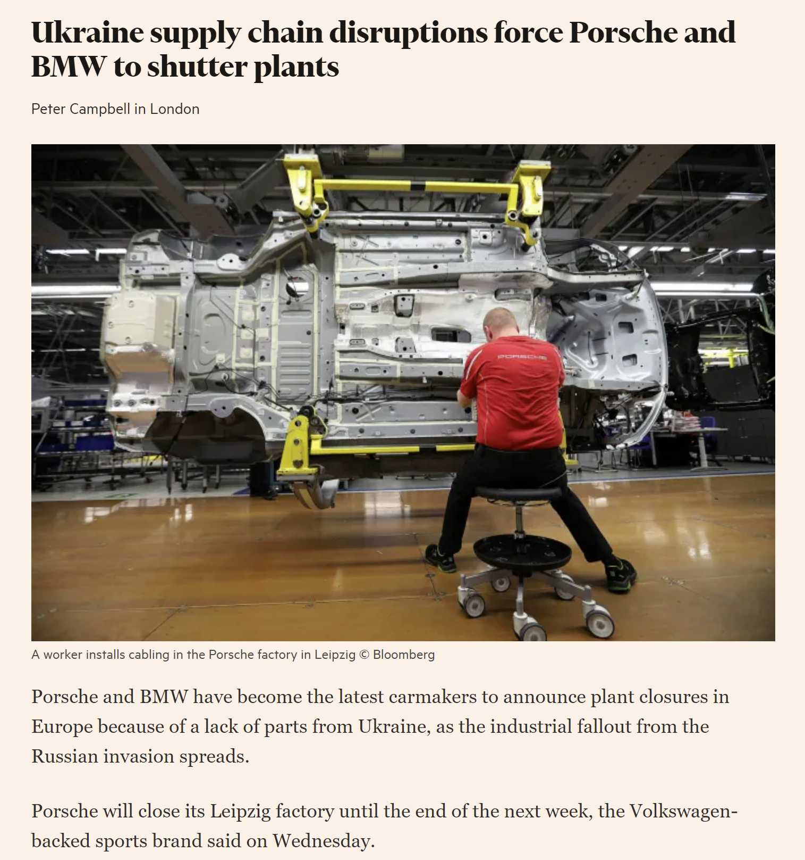
Assembly plants suspend operations as supply of components is interrupted
Source: Financial Times (2022)

Slide 13
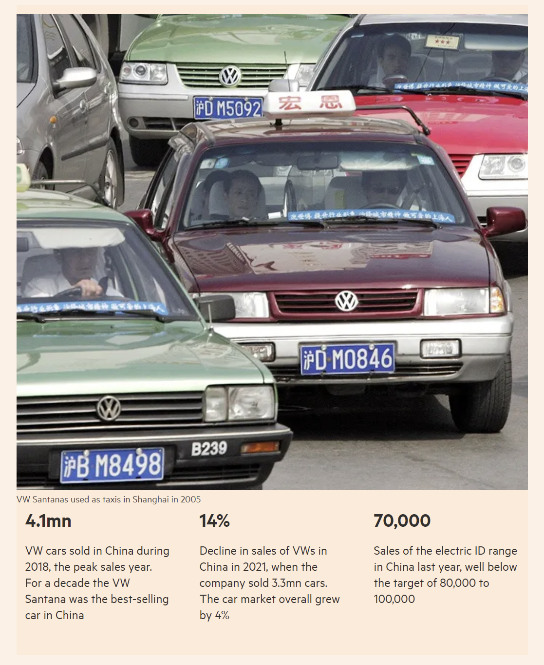
Exposure to political risks in other regions of the world: VW in China
The risks of relying on authoritarian states
“After Lithuania angered Beijing by recognising a de facto Taiwanese consulate, German auto suppliers Continental and Hella suddenly found products made at their Lithuanian sites were being held up at Chinese ports.” (FT, 16 March 2022)
Source: Financial Times (2022)

Slide 14
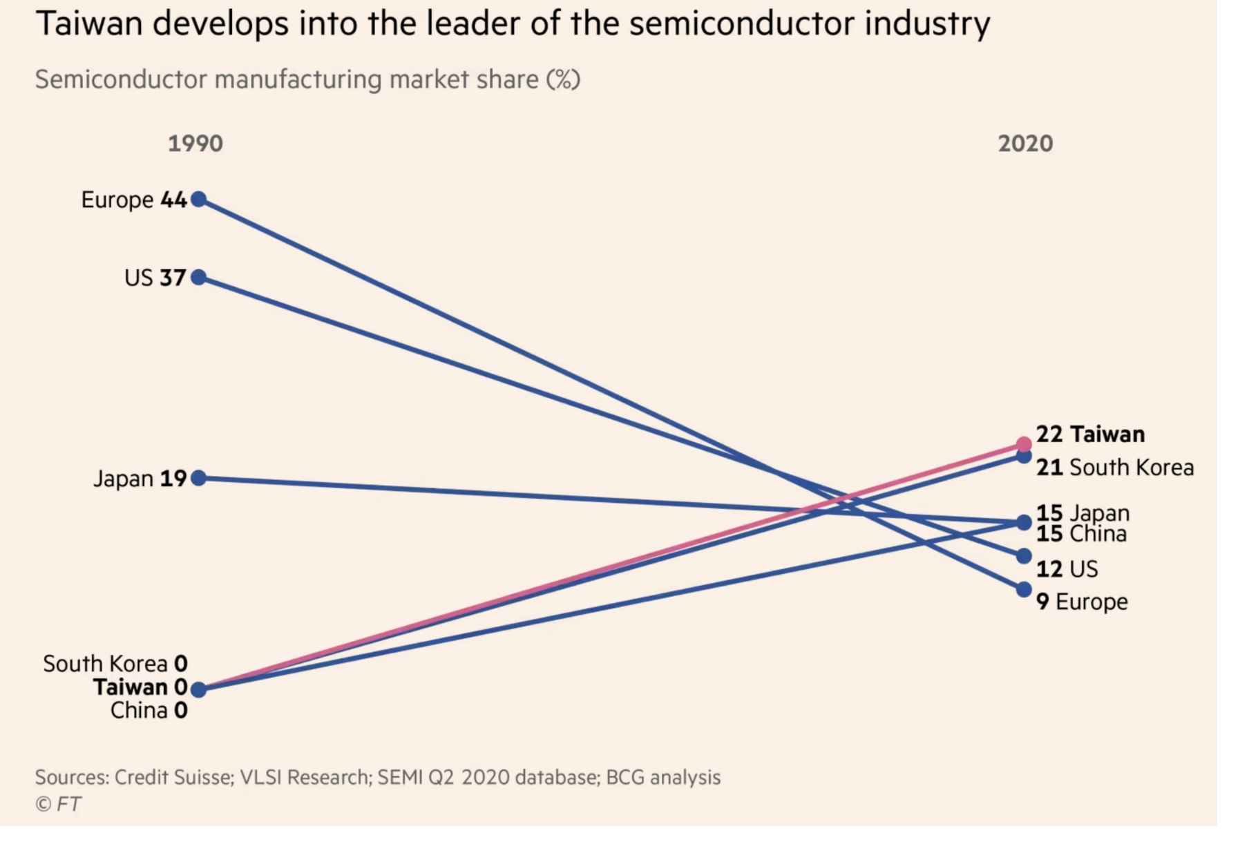
Where semiconductors are manufactured

Slide 15
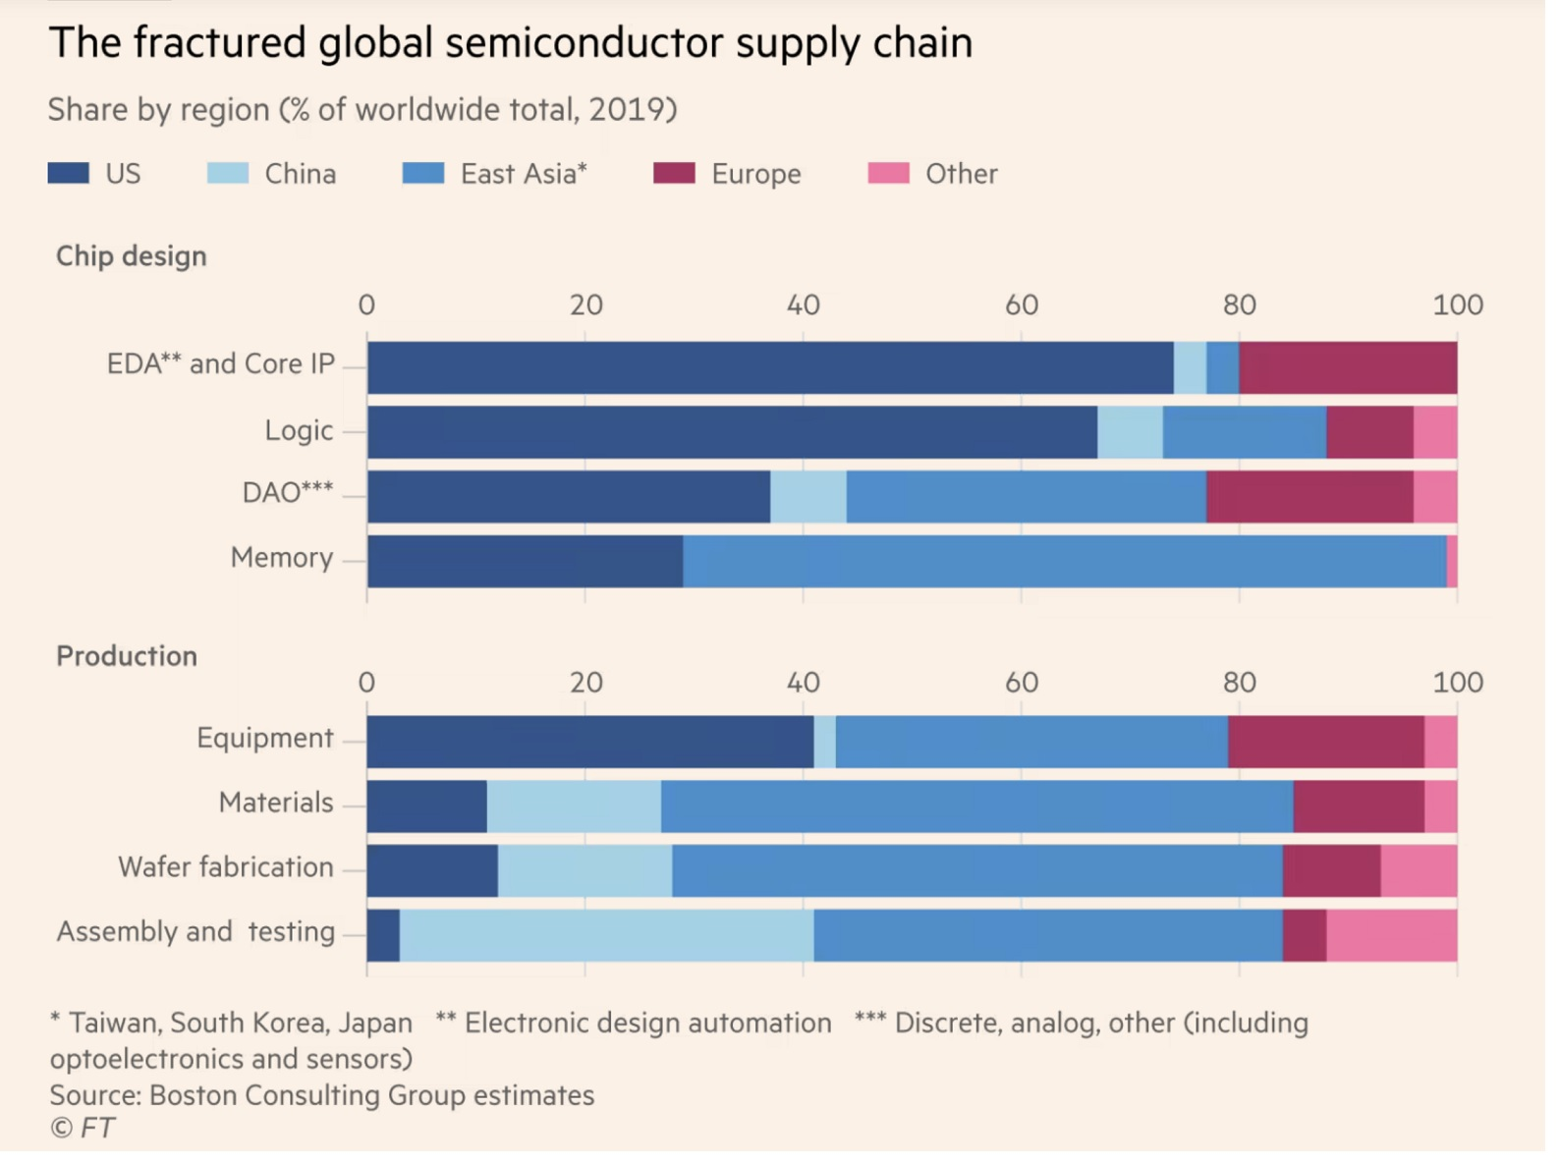
Supply chain – what is needed for producing semiconductors

Slide 16
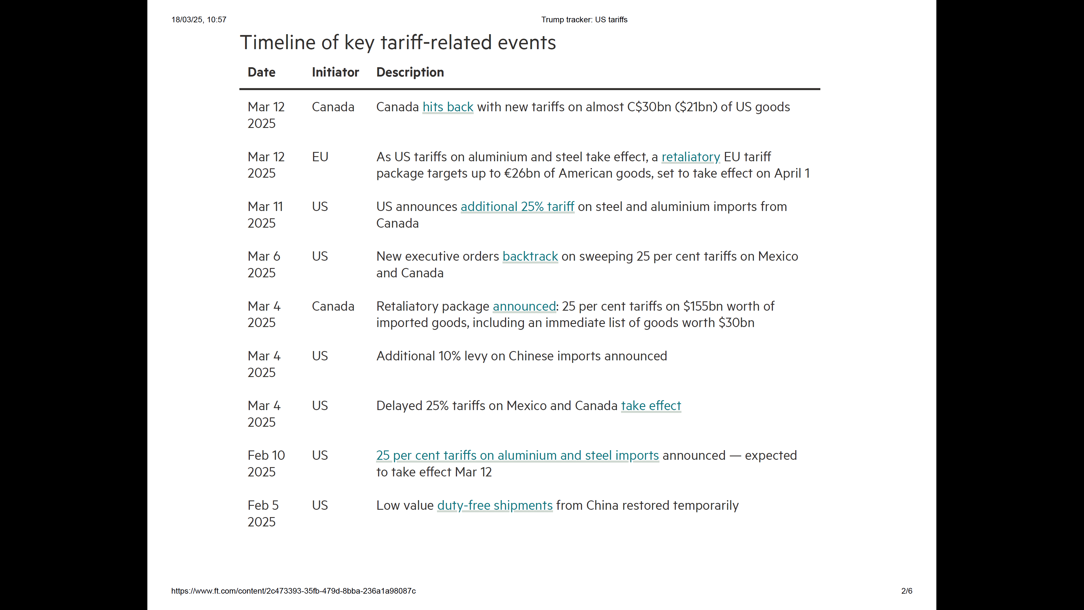
Tariff wars disrupting global value chains

Slide 17
Designing value chains to exploit sources of competitive advantages

Slide 18
Competitive Advantage
Prolonged benefit gained from developing and implementing unique value-adding strategy that is not simultaneously (or shortly thereafter) imitated by current or potential rivals
A firm possesses a sustainable competitive advantage when it consistently earns higher profits than other firms in its industry.
Key questions:
  How can firms consistently earn above-normal profits?
  Why don’t other firms simply imitate successful firms to push down profit levels?
  How do you develop strategies to create and sustain competitive advantage?

Slide 19
Sources of Competitive Advantage
Option A: Spending less money than competitors to develop, produce, and sell your product or service
Option B: Developing and offering products or services with unique characteristics valued by your customers
Need to find sources of competitive advantage that would be difficult for competitors to imitate
Value chain helps identify activities that can provide the firm with competitive advantages

Slide 20
Value Chain Analysis to Identify Sources of Competitive Advantage
MIS that supports fast response capabilities
Training to support customer service excellence
Unique product features. Fast new product development
FIRM INFRASTRUCTURE
HUMAN RESOURCE MANAGEMENT
TECHNOLOGY DEVELOPMENT
INBOUND OPERATIONS OUTBOUND MARKETING SERVICE
LOGISTICS LOGISTICS & SALES
Customer technical support. Consumer credit. Availability of spares
Quality of components & materials
Defect free products. Wide variety
Fast delivery. Efficient order processing
Building brand reputation

Slide 21
How Should a Company Configure its Production System?
TECHNOLOGY
PRODUCT DESIGN
MANUFACTURING
MARKETING
DISTRIBUTION
SERVICE
1. What advantages do I have by distributing my production processes around multiple countries? Can I achieve cost benefits through economies of scale by concentrating all my production in a single country?
2. Can I achieve cost benefits by producing my product in countries
with lower wages? Can I increase value added by producing in countries with unique resources and capabilities?

Slide 22
Where the activities should be performed?

Slide 23
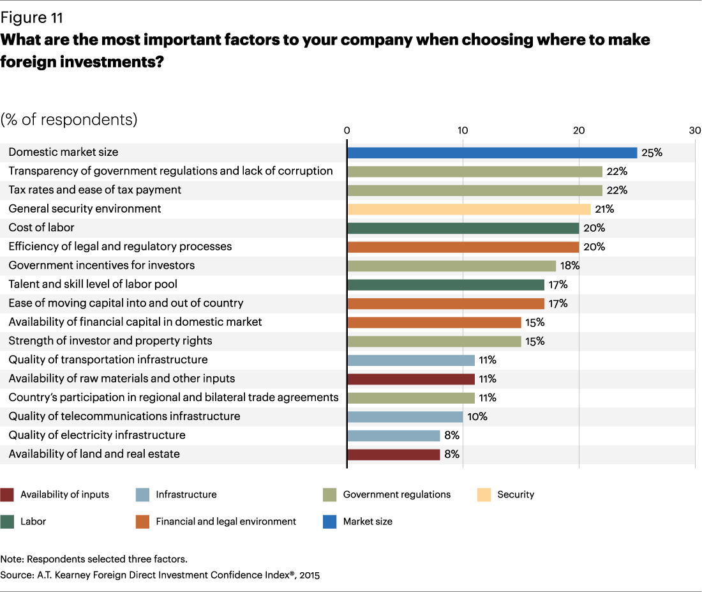

Slide 24
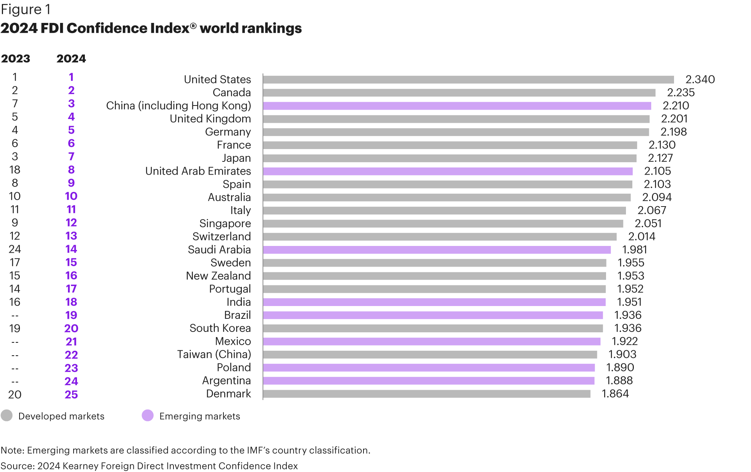

Slide 25
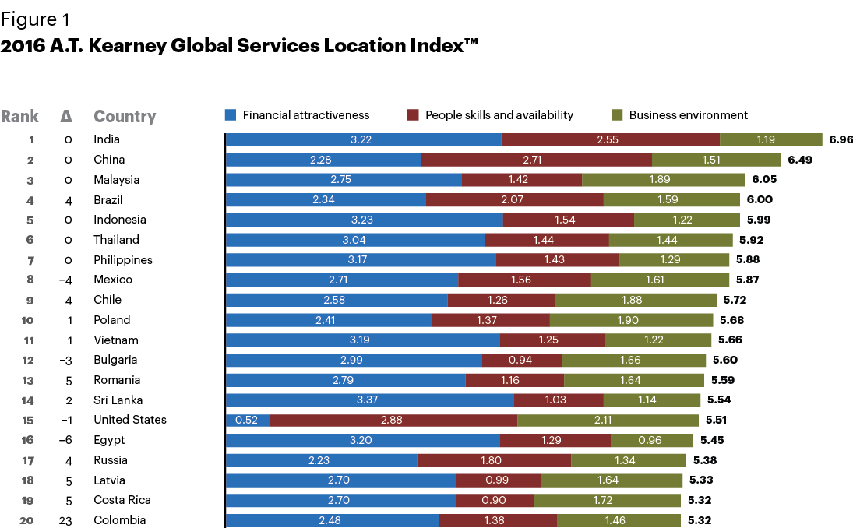

Slide 26
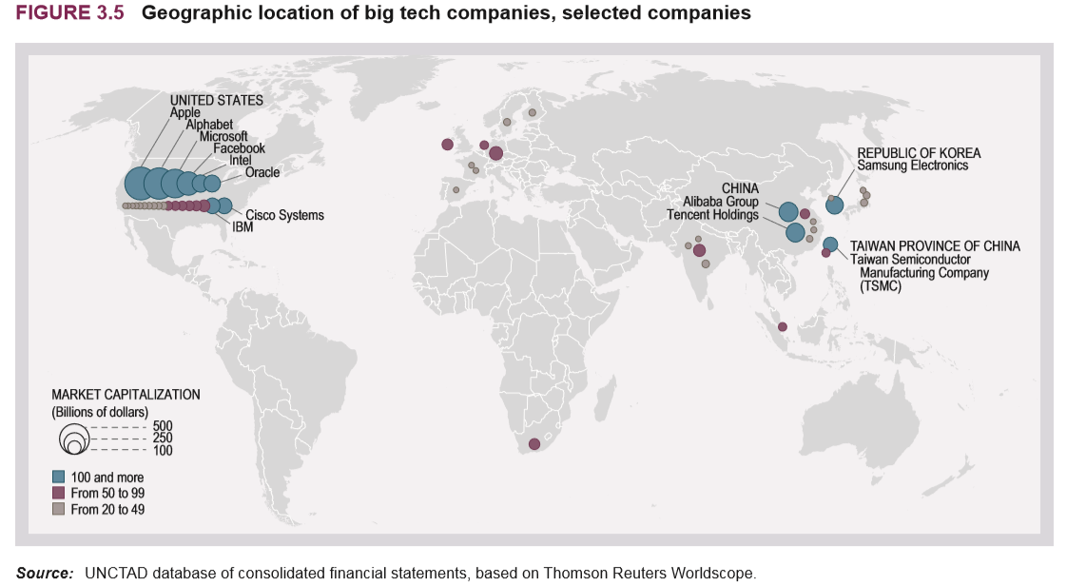
Big Tech Competition

Slide 27
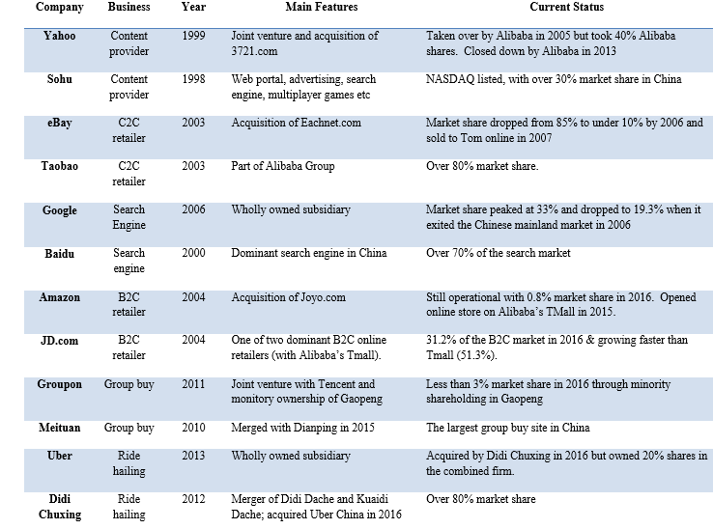
Failure of Western Digital Platform Companies in China
Source: Li. 2019. Why Have All Western Internet Firms (WIFs) Failed in China?

Slide 28
Home Country Advantages
  Home country: environment in which companies are born and learn how to compete
  Michael Porter “The Competitive Advantage of Nations” (1990):
    Each nation established a playing field for its industries
    This (partially) determines the resources firms can rely on or develop and the ensuing firm advantages.
    Can explain the dominance in certain industries by firms from specific countries.

Slide 29
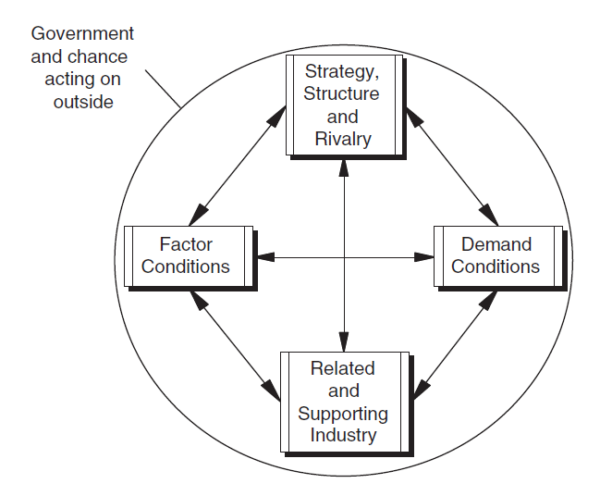
Porter’s Diamond Model

Slide 30
Determinants of the competitive advantage of nations
Factor conditions:
  Natural resources and created factor conditions (skilled labour, scientific knowledge and infrastructure)
Demand conditions:
  size and sophistication of domestic demand
Related and supporting industries:
  High quality, internationally competitive suppliers and supporting industries
Firm strategy, industry structure, and rivalry:
  highly competitive domestic industry is preparing firms for facing foreign competitors

Slide 31
Summary
Global value chains
  Rise of global value chains
  Disruptions and resilience of global value chains
Designing value chains to exploit sources of competitive advantages
Where to perform value chain activities?
  Criteria for choosing countries most suitable for performing various value chain activities

Slide 32
Reminders
No classes until April 1
  Exam period for T3 courses / Spring break
  IM classes will resume on Tuesday, April 1st
Good luck with T3 exams / Enjoy the Spring break!

