Slide 1
1227 International Management
Why Firms Go Abroad
© Ilya Okhmatovskiy
© Andrew Spicer

Slide 2
Agenda
What is a multinational corporation?
Liabilities of foreignness and added value
Seeking new markets vs. seeking sources of competitive advantage (capabilities)
Aggregation, arbitrage, and adaptation
Looking for the right balance between localization and globalization

Slide 3
Multinational Corporation (MNC)
MNCs have operating facilities with dedicated employees (e.g., a factory or a branch office) in more than one country
  A company without operating facilities abroad can sell its product to foreign consumers (=> this company is not MNC)
  Some authors suggest that a firm can be considered as MNC only if operates in more than two countries
Other terms used to describe a firm that operates in several countries
  Multinational Enterprise (MNE)
  Transnational Corporation (TNC)
Sources: Shenkar & Luo (2003), and Jones (2005)

Slide 4

Multinational Corporations

Slide 5
The Rise of MNCs
Source: Global Inc. (2003)

Slide 6
Liabilities of Foreignness: CAGE Perspective
Source: Ghemawat (2007)

Slide 7
Compensating for Liabilities of Foreignness
Hymer (1976): “How can a foreign company compete successfully in an unfamiliar market, where it must be at a disadvantage compared to local firms?”
“For firms to own and control foreign value-adding activities they must possess some kind of innovatory, cost, financial or marketing advantages - specific to their ownership - which is sufficient to outweigh the disadvantages they face in competing with indigenous firms in the country of production.”
Source: Hymer (1976)
Notes:
7

Slide 8
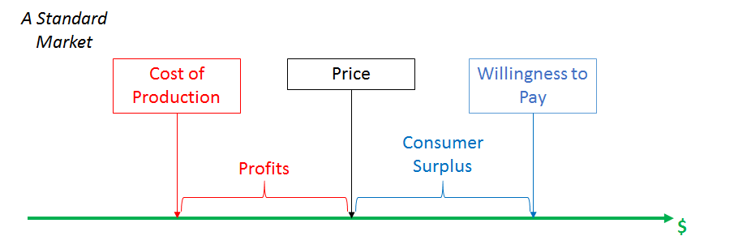
Value creation and appropriation
Source: modl.jhu.edu

Slide 9
Added Value
Added value can arise from introducing / leveraging something from a firm’s home country in a new market
  This can be seen as an extension of a firm’s domestic competitive advantage: selling an original domestic product in a new country or replicating the domestic strategy in a new country
Added value can also arise from accessing in the new market something that would be valuable in the domestic market of this firm
  This can be seen as the development of “worldwide” competitive advantage that arises from the firm’s operations around the world.

Slide 10
Value-Adding Foreign Activity
Multinational firms exist because combining and coordinating activities across multiple geographies enable the units to create and claim more value than they could as independent stand-alone operations.
  Does the firm have a competitive advantage developed in a home country that can be extended to other countries?
  Can a firm develop a worldwide competitive advantage through its own multinationality?

Slide 11
Multinational Competitive Advantage
Seeking new markets to leverage existing competitive advantages
  Does the company have a competitive advantage that can work abroad?
  Need to analyze whether key sources of competitive advantage can be transferred to a particular country
  Example: Walmart opening stores in China
Seeking new sources of competitive advantage
  Can the company go abroad to develop a worldwide competitive advantage?
  Need to analyze the degree to which the value chain can be integrated around the world to develop global sources of competitive advantage
  Example: Walmart’s purchasing operations in China to stock its stores around the world

Slide 12
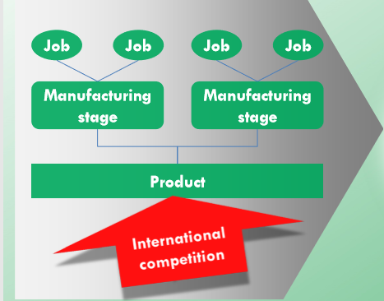
Seeking new markets: Global sales
Source: Baldwin (2016)

Slide 13
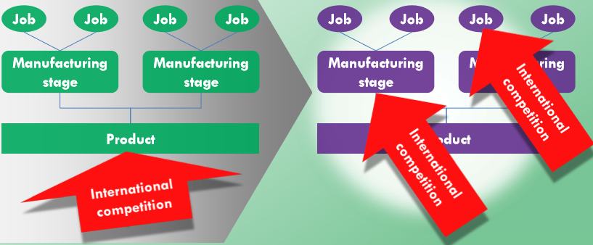
Seeking sources of competitive advantage: Global production
Source: Baldwin (2016)

Slide 14
The Globally Integrated Enterprise
“[N]ew perceptions of the permissible and the possible have deepened the process of corporate globalization by shifting its focus from products to production - from what things companies choose to make to how they choose to make them, from what services they offer to how they choose to deliver them. Simply put, the emerging globally integrated enterprise is a company that fashions its strategy, its management, and its operations in pursuit of a new goal: the integration of production and value delivery worldwide. State borders define less and less the boundaries of corporate thinking or practice.”
  Palmisano (2006), CEO, IBM

Slide 15
From Comparative Advantage to Competitive Advantage
A country is relatively efficient in the production of certain products and activities. E.g.,
  Philippines is relatively more efficient in the production of footwear, apparel, and assembled electronic products than in the production of chemicals and automobiles.
  U.S. is relatively more efficient in the production of semiconductors and pharmaceuticals than shoes or shirts.
Global firms try to locate value chain activities in those countries that have a comparative advantage in these activities.
  Firms seek competitive advantages by exploiting differences in country-level comparative advantages
Notes:
7

Slide 16
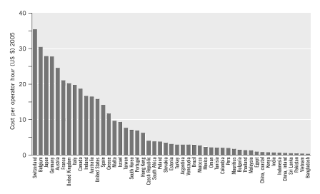
Hourly Labor Costs in the Textile and Clothing Industries
Notes:
7

Slide 17
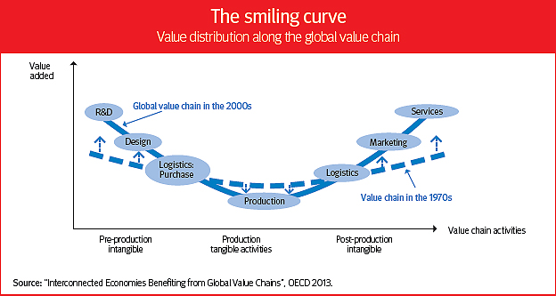
What Does the Firm Need to Own?

Slide 18
Notes:
18

Slide 19
Ghemawat (2007): Managing Differences
Some firms wish to integrate activities around the world to develop global economies of scale and scope (aggregation)
Some firms wish to integrate activities to take advantage of national differences in knowledge or cost (arbitrage)
At the same time, firms need to adapt to local rules, markets and customers (adaptation)

Slide 20
Advantages of Global Integration (Worldwide Competitive Advantage)
Strategic Objective | National Differences in Comparative Advantage (Arbitrage) | Scale and Scope Economies (Aggregation)
Achieving efficiency in current operations | Benefiting from differences in labor and capital costs | Expanding and exploiting potential scale economies Global bargaining power
Innovation and Learning | Benefiting from differences in knowledge and technology | Moving along the experience curve – learning and innovations help decrease costs

Slide 21
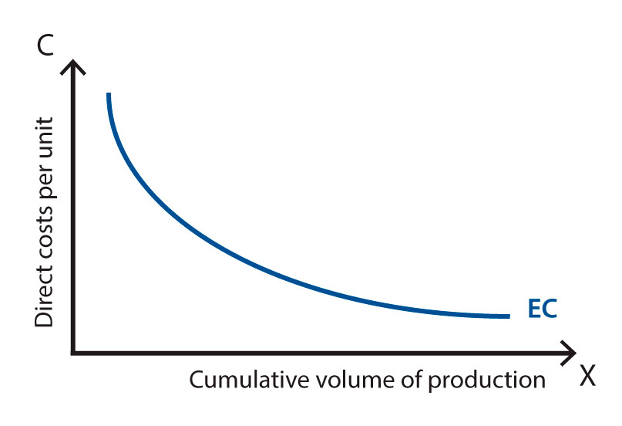
Experience curve
Source: Marketing-dictionary.org

Slide 22
Adding Value through Aggregation
Globalized economies of scale or scope creating efficiencies based on exploiting similarities among geographies or markets rather than adapting to differences
  This typically involves standardizing a significant portion of the value proposition and grouping together development and production
Xerox centralized its purchasing, first regionally, later globally, to create a substantial cost advantage.
Dutch electronics giant Philips created a global competitive advantage for its Norelco shaver product line by centralizing global production in a few strategically located plants.

Slide 23
Global Economies of Scale: GE’s Medical System
“We use 90 warehouses across five continents to ship two million parts annually. There are half a million different types of parts … Seventy-five percent of our demand is met in 4 hours, and 95% is met within 75 hours. Stated differently, it takes no more than 24 hours to ship intra-region, and no more than 48 hours to ship from outside the region.”
-- p. 9, GE Medical Systems case

Slide 24
Adding Value through Arbitrage
Arbitrage exploits economic or other differences between national or regional markets, usually by locating separate parts of the supply chain in different places.
  Nike took advantages of the differences in the required working conditions and expected wages to produce cheaper sneakers in Indonesia.
  Walmart saved billions of dollars a year by buying goods from China
Arbitraging differences across countries can be more than achieving cost efficiencies: firms may seek knowledge and innovation by locating near worldwide centers of excellence
  e.g., Silicon Valley in software development

Slide 25
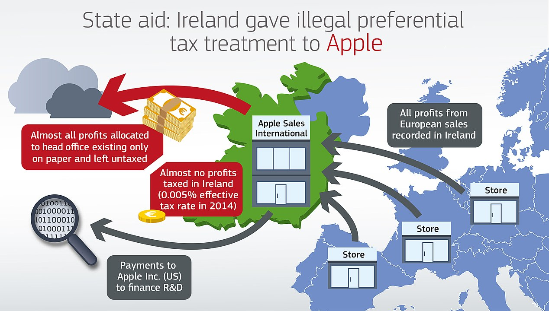

Tax arbitrage – exploiting tax loopholes
Source: https://ec.europa.eu/commission/presscorner/detail/en/ip_16_2923
From 2004 to 2014 Apple used the loopholes (or opportunities?) in the Irish tax system to shield €110.8 billion of non–US profits from tax.

Slide 26
Looking for the right balance between localization and globalization

Slide 27
Adapted from Ghemawat (2007)
Notes:
27

Slide 28
Semi-Globalization and Multinational Strategy
Where’s the right balance?
Global Scale,
Scope and
Knowledge
Local Agility,
Reputation and
Knowledge
Global
Local

Slide 29
Globalization vs. Localization
Value Chain: Should we globally connect our value chain or should we separate it by region / nation?
Product: Should we develop and sell a standardized product or should we develop and sell a product adapted to local conditions?
Organizational Structure: Should we centralize control in global headquarters or decentralize it to local subsidiaries?
Market Entry Decision: How should we exploit global opportunities (either by gaining global competitive advantages or gaining new market share) given large national differences in culture and institutions?
Integrated Non-Market Strategy: Should we follow and adopt global standards of appropriate behavior, or should we allow for local variation in what is considered acceptable behavior?

Slide 30

McDonalds around the World

Slide 31
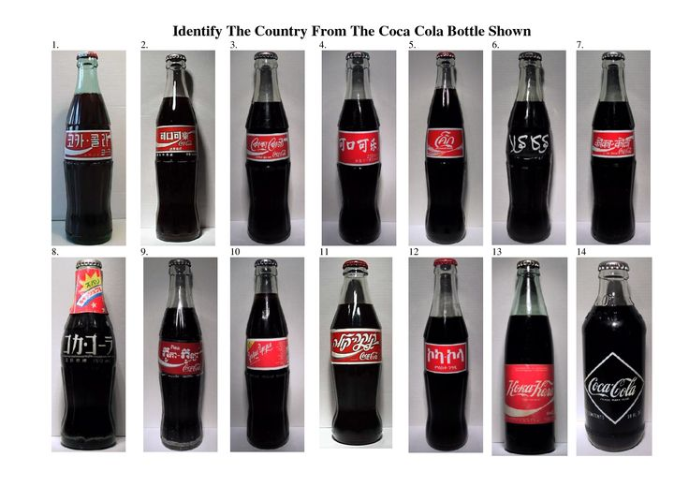
Coca Cola around the World

Slide 32
The Multinational Corporation: Managing a Semi-Globalized World
The MNC is defined strategically by the tradeoff between fragmenting pressures to respond to differences in local environments – places – and the gains from integration across borders.
Challenge is to look at the advantages of multinationality in comparison to the liabilities of foreignness (which represent disadvantages of multinationality)
Managing the tension between globalization and localization is the recurring management challenge for sustaining competitive advantage in the multinational context

Slide 33
Summary
What is a multinational corporation?
Liabilities of foreignness and added value
Seeking new markets vs. seeking sources of competitive advantage (capabilities)
Aggregation, arbitrage, and adaptation
Looking for the right balance between localization and globalization

Slide 34
Reminders
This Friday, March 14th
  Will discuss “Time Out” case
  Students responsible for “Time Out” case should upload to Moodle their individual assignments before 9:30am on Friday, March 14th
Next Tuesday, March 18th
  Lecture about “Global distribution of firms’ activities”
  A group responsible for the PA presentation about this topic will have 10 min to present during our class

