Slide 1
1227 International Management
How institutions affect business
across countries
© Ilya Okhmatovskiy
© Andrew Spicer

Slide 2
Agenda
What is needed for the markets to function?
Transaction costs, institutions, and trust
Comparing the institutional environment of business across countries
Taken-for-granted institutions and “institutional voids”
Facilitating transactions in capital markets: microfinance
Facilitating transactions in product markets: grocery retail

Slide 3
What is needed for the markets to function?

Slide 4
Making the market work
To make the market work, sellers need to prove their trustworthiness to buyers
To solve information asymmetry problem, a product is evaluated by an independent expert
If both parties trust the evaluator, the market clears at prices that reflect the true value

Slide 5
An institutional perspective
Market institutions are rules and procedures that reduce uncertainty and induce cooperation / exchange by establishing structure and incentives for interactions among market participants
Can be formal (laws, regulations) or informal (patterns of behavior, conventions, moral codes)
Market institutions define how the game of business is played, while firms are players in this game

Slide 6
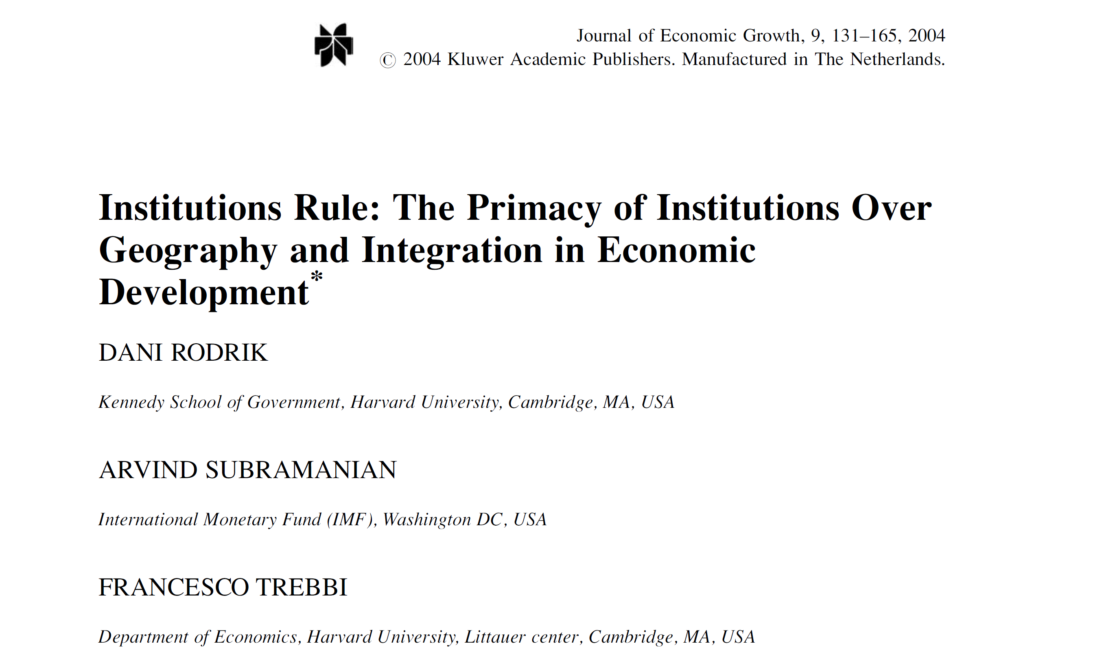
Institutions facilitate economic development
Daron Acemoglu, Dani Rodrik, and other development economists: Institutional development strongly affects a society’s level of economic prosperity

Slide 7
…but may also create obstacles for economic development
Institutions may create obstacles for economic development if they “favor activities that promote redistributive rather than productive activities, that create monopolies rather than competitive conditions, and that restrict opportunities rather than expand them” (North, D. “Institutions, Institutional Change, and Economic Performance” Cambridge Univ Press, 1990: 9)

Slide 8
What do institutions do?
Institutions facilitate market transactions through…
Reducing information asymmetries
Aligning incentives
Reducing transaction costs
Generating trust

Slide 9
Comparative institutional analysis
Comparing the institutional infrastructure of markets across societies
Variation in market rules and procedures
Variation in market intermediaries

Slide 10
Institutions facilitate market transactions by generating trust
Source: Dhanaraj and Khanna (2011)

Slide 11
Without rules, the competition gets ugly

Slide 12
To play the game, we need rules

Slide 13
The rule of law around the world
Source: World Governance Indicators (2014)

Slide 14
Institutional environment of business is not just about the rule of law…
Voice and Accountability
Ability of citizens to participate in selecting their government
Political Stability
Perceptions of the likelihood that the government will be destabilized or overthrown by unconstitutional or violent means
Government Effectiveness
Quality of public and civil services
Regulatory Quality
Ability of the government to formulate and implement sound policies and regulations
Rule of Law
The extent to which agents have confidence in and abide by the rules of society
Control of Corruption
The extent to which public power is exercised for private gain
Source: https://www.worldbank.org/en/publication/worldwide-governance-indicators

Slide 15
Control of corruption around the world

Slide 16
Institutional development across world regions

Slide 17
Institutional infrastructure of product markets
1. Can companies easily obtain reliable data on customer tastes and purchase behaviors? Are there cultural barriers to market research? Do world-class market research firms operate in the country?
2. Can consumers easily obtain unbiased information on the quality of the goods and services they want to buy? Are there independent consumer organizations and publications that provide such information?
3. Can companies access raw materials and components of good quality? Is there a deep network of suppliers? Are there firms that assess suppliers' quality and reliability? Can companies enforce contracts with suppliers?
4. How strong are the logistics and transportation infrastructures? Have global logistics companies set up local operations?
5. Do large retail chains exist in the country? If so, do they cover the entire country or only the major cities? Do they reach all consumers or only wealthy ones?

Slide 18
Institutional infrastructure of capital markets
1. How effective are the country's banks, insurance companies, and mutual funds at collecting savings and channeling them into investments?
2. Are financial institutions managed well? Is their decision making transparent? Do noneconomic considerations, such as family ties, influence their investment decisions?
3. Can companies raise large amounts of equity capital in the stock market? Is there a market for corporate debt?
4 . Does a venture capital industry exist? If so, does it allow individuals with good ideas to raise funds?
5. How reliable are sources of information on company performance? Do the accounting standards and disclosure regulations permit investors and creditors to monitor company management?
6. Do independent financial analysts, rating agencies, and the media offer unbiased information on companies?

Slide 19
Doing Business / Business Ready reports from the World Bank
Analysis of multiple economic indicators
Starting a business
Taxation
Enforcing a contract
Dealing with licenses
Employing workers
Registering property
Getting credit
Protecting investors
Trading across borders
Closing a business

Slide 20
Taken-for-granted institutions are assumed to be present
Assumptions of property rights, contract enforcement, and availability of credible information are common for models of market competition
Another common assumption - the legitimate and capable state (government) that has the will and capacity to define and enforce legal rules
Many models assume that the state (rule-making bodies) remains separate and independent from the market (private sector transactional arenas) - the state as an impartial referee

Slide 21
Institutional voids
Institutional voids literature builds on the central observation that most western economic models make basic assumptions about the institutional environment, such as the presence of property rights, third-party contract enforcement and credible information
Institutional voids may include the absence of specialized intermediaries, regulatory systems, and contract-enforcing mechanisms
Liberalization and deregulation do not automatically lead to the building of a well-functioning market economy

Slide 22
Institutional arrangements that facilitate market transactions
This model builds on an institutional conception of markets: markets are socially created rather than naturally given.
An institutional void is a comparative institutional concept: institutions found in developed markets are often missing or absent in developing country settings
The concept of “void” usually implies the absence of Western institutions, but developing countries may possess alternative market-enhancing institutions instead of those used in developed countries
“Institutional architecture” may be a more value-neutral concept when exploring the institutional context of business across countries

Slide 23
Institutional arrangements in capital markets
How can producers get access to capital?

Slide 24
Getting funds to develop business: options available in developed economies
Paying with a credit card
Obtaining loans from banks
Convincing venture capitalists to invest in your business
Raising funds through public offering of shares at stock exchanges
Issuing bonds and selling them to investors
Crowdfunding through online platforms

Slide 25
Getting funds to develop business: alternative options
Borrowing from the family and friends
Credit unions / savings-and-loans associations
Trade credit from business partners
Obtaining funds from the government
Microfinance (loans to groups of small-scale entrepreneurs with shared liability)
Etc.

Slide 26
How the microfinance model works
Example: Grameen Bank created by Muhammad Yunus in Bangladesh
Serving groups of poor women
No credit history, no loan collateral
Collective responsibility and group pressure
Bank representatives travelling from village to village and meeting groups of borrowers
Maintaining close relationships with borrowers and monitoring the progress of their businesses

Slide 27
Institutional arrangements in product markets
Let’s consider the grocery retail as an example…

Slide 28
The Indian onion market
The Vashi market on the outskirts of Mumbai handles 100-150 truckloads of onions a day - enough to satisfy India’s commercial capital.
The market is a teeming maze of 300-odd selling agents, who mainly act on behalf of middlemen, and several thousand buyers - either retailers or sub-distributors.
Source: The Economist, Dec. 2013

Slide 29
From the wholesale market to retail stores
Cars and trucks pick up small batches of onions from the Vashi market to take them to sub-distributors in Mumbai.
A typical sub-distributor…
handles 200 sacks a day to be sold to retailers and restaurants
buys daily from Vashi market and has space to store only about 12 hours’ worth of stock
marks up prices by 20% but some purchased onions are thrown away as they are either damaged or of inferior quality
The next stop for the onions is a small shop down the road where they are sold for another mark-up of 10% or so…

Slide 30
Grocery markets around the world

Slide 31
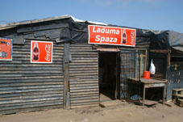
Market intermediation in low-income markets
In emerging markets, P&G estimates that 80% of people shop in mom-and-pop stores no bigger than a closet.
P&G estimates there to be about 20 million high-frequency stores world-wide, so far just 2.5 million carry their products.
“That was a paradigm shift for us,” says P&G Chief Operating Officer Robert McDonald. “We’ll be in those big-box stores, but we’ve got to be in the small ones.”
Source: Wall Street Journal, July 16, 2007

Slide 32
Amazon in India
“India is liberally peppered with small shops — more than 14 million of them, the overwhelming majority smaller than 600 square feet. These so-called mom-and-pop stores typically feature high prices and limited inventories, but in many rural communities they are the only game in town. The government’s FDI restrictions are designed in part to protect these convenience-store owners. When Amazon.in debuted, many Indians feared the online behemoth would put them out of business.
Instead, Amazon has enlisted mom-and-pop store owners as partners in its delivery platform. In small villages and remote areas where few people have internet access, residents can go to their local store and use the owner’s internet connection to browse and select goods from Amazon.in. Store owners record their orders, alert customers when their products are delivered to the store, collect the cash payment, and pass along the money — minus a handling fee — to Amazon. The arrangement neatly circumvents the problem of conducting e-commerce in a cash economy. And store owners report increased sales of their own while customers are on-site.

Slide 33
Summary
What is needed for the markets to function?
Transaction costs, institutions, and trust
Comparing the institutional environment of business across countries
Taken-for-granted institutions and “institutional voids”
Facilitating transactions in capital markets: microfinance
Facilitating transactions in product markets: grocery retail

Slide 34
Reminders
This Friday, February 28th
Will discuss the Harley-Davidson case
Students responsible for the Harley-Davidson case should upload (on Moodle) their written answers to the preparation questions by 9:30 on February 28th
Next Tuesday, March 4th
CARNIVAL – No classes at Nova SBE (see the Course Program on Moodle)

