Slide 1
1227 International Management
National cultures and management
© Ilya Okhmatovskiy, Andrew Spicer, Youtha Cuypers

Slide 2
Agenda
Culture and perception of the world
Culture and stereotypes
Hofstede’s dimensions of culture
Trompenaars’ dimensions of culture
How culture affects management

Slide 3

Cultural frames and biases
“We don’t see things as they are. We see them as we are.”
  – Anais Nin (1961)

Slide 4
Making sense of the world
Culture is the way through which we make sense of the world and, consequently, it shapes:
Our perceptions
The rules and norms that we know or decide to follow
How we make sense of events and social interactions
What we do
Our needs
What we consume
Our beliefs
Our perceived friends and enemies
Our likes and dislikes
Our values

Slide 5
Subconscious cultural blinders
Because most interpretation goes on at a subconscious level, we lack awareness of the assumptions we make and their cultural basis.
Our home culture reality never forces us to examine our assumptions or the extent to which they are culturally based, because we share our cultural assumptions with most other citizens of our country.
All we know is that things do not work as smoothly or logically when we work outside our own culture as when we work with people more similar to ourselves.
Adapted from Adler, N.J. 1991. International Dimensions of Organizational Behavior (2nd ed.).

Slide 6
Erin Meyer: Context in communication
Source: Meyer, E. 2014. The culture map: Breaking through invisible boundaries of global business.

Slide 7

Cultural frames determine what we see
Masuda & Nisbett (2001) presented 20-second animated vignettes of underwater scenes to Japanese and American participants.
After seeing each video twice, participants were asked to report what they had seen.

Slide 8
Paying attention to context
American participants started their statements by mentioning salient objects (defined as being larger, faster moving, and more brightly colored than the other objects) far more frequently than Japanese participants did.
In contrast, Japanese participants began by mentioning information about the field (e.g., water color, floor of the scene, inert objects) almost twice as often as Americans did.
Overall, Japanese actually made 65% more observations about the field than did Americans.
Japanese participants mentioned almost twice as many relations between objects and the field as did American participants.
Source: Masuda & Nisbett (2001).

Slide 9

Separating an object from its surroundings
After participants had seen 10 vignettes, they were presented with still photos of 45 objects that they had seen before and 45 that they had not seen. The 45 previously seen objects were shown either against the original background, no background, or a novel background.
Source: Masuda & Nisbett (2001).

Slide 10
Separating an object from its surroundings
American performance was literally unaffected by the background manipulation.
The Japanese made substantially more errors when the object was seen against a novel background than when it was seen against the original background.
Japanese performance was significantly better for the no-background condition than for the novel background condition but was not significantly worse for the no-background condition than for the original background condition.
Source: Masuda & Nisbett (2001).

Slide 11
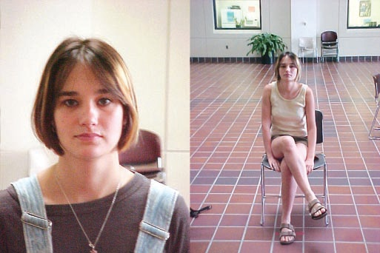
Japanese and American students were asked to take a photo of a person
Photo taken by an American student
Photo taken by a Japanese student
Source: Nisbett & Masuda (2003).

Slide 12
Understanding frames and perceptions
Perception is framed. At any one time there are too many stimuli in the environment for us to observe.
  We screen out most of what we see, hear, taste, and feel.
  We screen out the overload and allow only selected information through our perceptual screen to our conscious mind.
Our frames are usually culturally determined.
  We learn to see the world in a certain way based on our cultural background.
Frames tend to remain constant.
  Once we see something in a particular way, we continue to see it that way.
We therefore see things that do not exist, and do not see things that do exist.
  Our assumptions act as filters and lead us to distort, block, and even create what we choose to see and hear.
Adapted from Adler, N.J. 1991. International Dimensions of Organizational Behavior (2nd ed.).

Slide 13
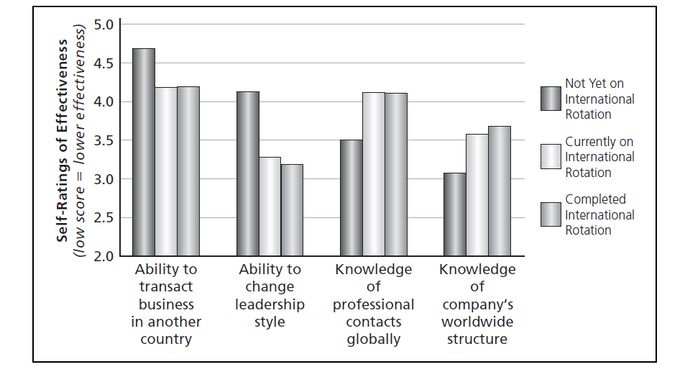
The need for humility
Source: Caligiuri (2012)

Slide 14
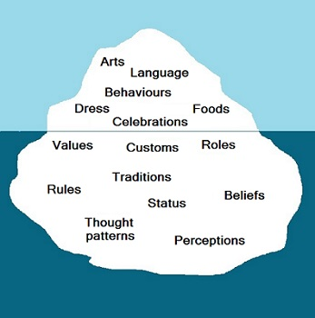
Culture as an iceberg

Slide 15
Edgar Schein’s model of culture

Slide 16
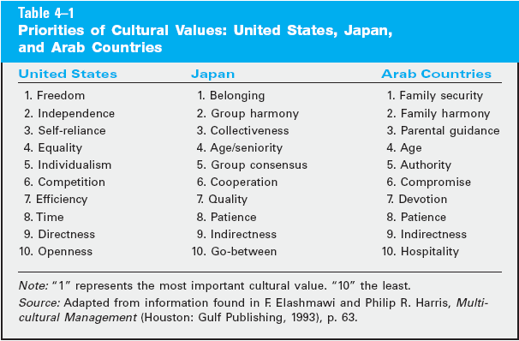

Slide 17
Erin Meyer: How negative feedback is provided
Source: Meyer, E. 2014. The culture map: Breaking through invisible boundaries of global business.

Slide 19
Culture and stereotypes
Stereotypes are widely held but oversimplified categorizations of a particular thing, person, or group.
Specific individuals may or may not fit well into general categories:
  We generalize about the cultural characteristics of the nationalities we study.
  We are discussing the behaviour and values of groups of people, not individuals, i.e. we focus on the collective level
  Individuals may vary and deviate from the expectations based on a collective analysis of a culture - it is essential to recognize this and to take this into account!

Slide 20
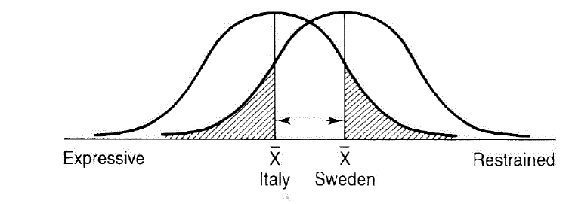
Distribution of individual behavior around averages
Source: Wodehouse et al. (2011) “Culture and concept design”

Slide 21
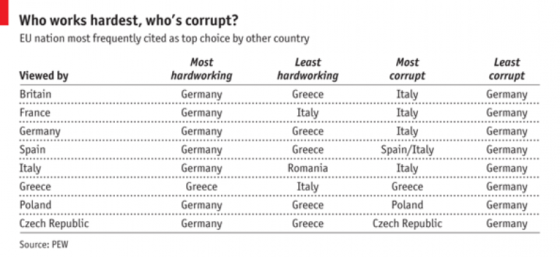
Perceptions and stereotypes in Europe

Slide 22
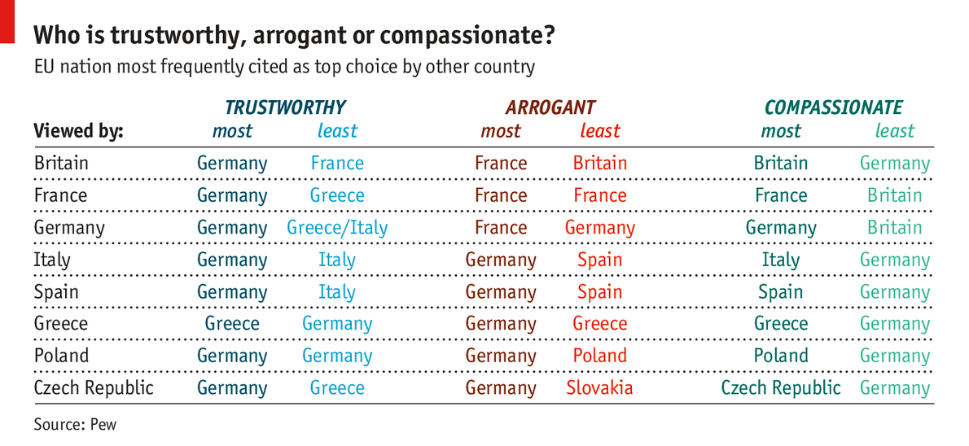
Perceptions and stereotypes in Europe

Slide 23
Hofstede’s study of national cultures
Definition of culture:
  “The collective programming of the mind which distinguishes the members of one group or category of people from another."
4 dimensions of culture identified in 1980, 2 added later (in 1988 and 2010)
Derived from surveys of over 116,000 respondents from over 70 countries around the world
All respondents worked in local subsidiaries of IBM
  Criticized for focus on employees of just one company and generalizing based on that

Slide 24
Individualism vs. collectivism
Individualism versus collectivism refers to whether a person primarily functions as an individual or as a member of a group.
In individualistic societies, each person emphasizes his or her own self-interest; competition for resources is the norm; individuals who compete best are rewarded.
  Examples: Australia, Britain, Canada, and the U.S.
In collectivist societies, ties among individuals are important; business is conducted in a group context; life is a fundamentally cooperative experience; conformity and compromise help maintain harmony.
  Examples: China, Panama, Japan, South Korea.

Slide 25
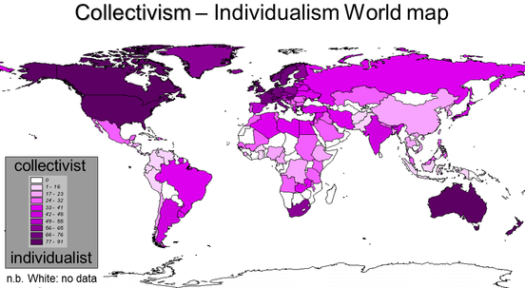
Hofstede’s dimensions of culture

Slide 26
Power distance
Power distance describes how a society deals with inequalities in power that exist among people.
High power distance societies exhibit big gaps between the most and the least powerful; in firms, top management tends to be autocratic, giving little autonomy to lower-level employees.
  Examples: Guatemala, Malaysia, Philippines, and several Middle Eastern countries.
Low power distance societies have small gaps between the most and the least powerful. Firms tend toward flat organizational structures, with relatively equal relations between managers and workers.
  Examples: U.S., Scandinavian countries.

Slide 27
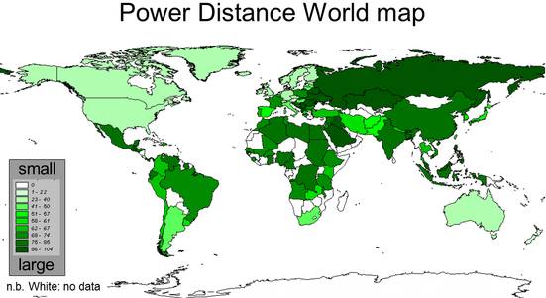
Hofstede’s dimensions of culture

Slide 28
Uncertainty avoidance
Uncertainty avoidance refers to the extent to which people can tolerate risk and uncertainty in their lives.
High uncertainty avoidance societies create institutions to minimize risk and ensure security. Firms emphasize stable careers and regulate worker actions. Decisions are made slowly.
  Examples: Belgium, France, Japan
In low uncertainty avoidance societies, managers are relatively entrepreneurial and comfortable with risk. Firms make decisions quickly. People are comfortable changing jobs.
  Examples: Ireland, Jamaica, U.S.

Slide 29
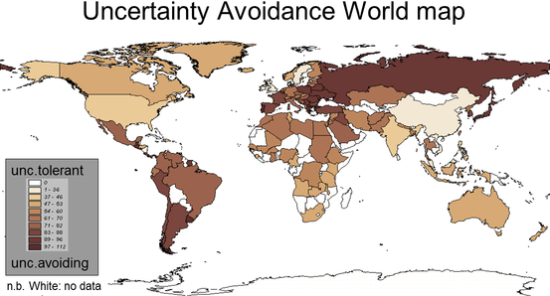
Hofstede’s dimensions of culture

Slide 30
Masculinity vs. femininity
Masculinity versus femininity refers to a society’s orientation based on traditional male and female values.
Masculine cultures value competitiveness, ambition, assertiveness, and the accumulation of wealth. Both men and women are assertive, focused on career and earning money.
  Examples: Australia, Japan.
Feminine cultures emphasize nurturing roles, interdependence among people, and caring for less fortunate people
  Examples: Scandinavian countries where welfare systems are highly developed, and education is subsidized.

Slide 31
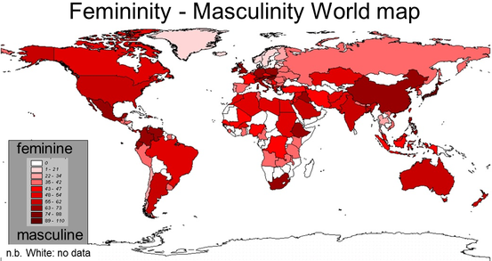
Hofstede’s dimensions of culture

Slide 32
Long-term vs. short-term orientation
Long-term vs. short-term orientation describes the degree to which people and organizations defer gratification to achieve long-term success.
Long-term orientation emphasizes the long view in planning and living, focusing on years and decades.
  Examples: traditional Asian cultures, such as China, Japan, and Singapore, which base these values on the teachings of the Chinese philosopher Confucius (500 B.C.), who espoused long-term orientation, discipline, hard work, education, and emotional maturity.
Short-term orientation is typical in the United States and most other Western countries.

Slide 33
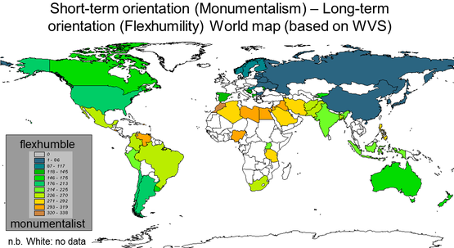
Hofstede’s dimensions of culture

Slide 34
Indulgence vs. Restraint
Indulgence vs Restraint: captures the freedom to satisfy one’s natural needs and desires within a society.
  Indulgent societies encourage instant gratification, it is good to be free and do what your impulses tell you to do.
  Restraint cultures regulate and control behavior based on social norms, life is perceived to be hard and duty not freedom is the normal state of being.
  Countries with high indulgence tend to be located in North and Latin America: freedom of speech is vital, individuals tend to live in the moment
  Countries with low indulgence index tend to be located in Asia and Eastern Europe: individuals express less happiness, believe their own destiny is not in their own hands, maintaining order is seen as vital, people tend to value work ethic over friendship and tend to follow a stricter moral discipline

Slide 35
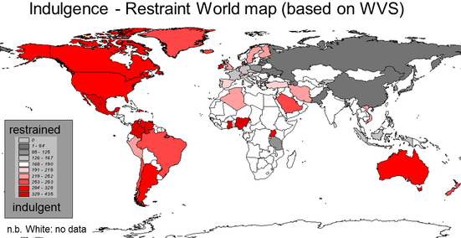
Hofstede’s dimensions of culture

Slide 36
Trompenaars’ dimensions of culture
Universalism vs. Particularism
Individualism vs. Communitarianism
Neutral vs. Emotional
Specific vs. Diffuse
Achievement vs. Ascription
Sequential vs. Synchronous
Inner-directed vs. outer-directed

Slide 37
Trompenaars’ study
Questionnaires administered to over 15,000 mangers from 28 countries
Sample question:
  You are riding in a car one evening, driven by a friend. You notice the car is traveling at 30 miles an hour in a 15-mph speed zone … and then the car strikes a pedestrian. The weeks that follow are a nightmare. Your friend is arrested. As the only witness, you are called to testify. Your friend’s lawyer asks you to say the car was not speeding. You know your testimony could help your friend go to jail — or stay out of it.
  My friend has a definite right as a friend to expect me to testify to the lower speed
  My friend has some right as a friend to expect me to testify to the lower speed
  My friend has no right as a friend to expect me to testify to the lower speed

Slide 38
Survey responses - primacy of rules over relationships
Universalism (no right) | %
Canada | 96
US | 95
Germany | 90
UK | 90
Netherlands | 88
France | 68
Japan | 67
Singapore | 67
Thailand | 63
Hong Kong | 56
Universalism (no right) | %
China | 48
South Korea | 26

Slide 39
How culture affects management
Safety vs. Risk
  In some societies, organizational decision makers are risk averse and have great difficulty with conditions of uncertainty
  In others, risk taking is encouraged, and decision making under uncertainty is common
Centralized vs. Decentralized Decision Making
  In some societies, top managers make all important organizational decisions
  In others, these decisions are diffused throughout the enterprise, and middle- and lower-level managers actively participate in, and make, key decisions

Slide 40
How culture affects management
Informal Procedures vs. Formal Procedures
  In some societies, much is accomplished through informal means
  In others, formal procedures are set forth and followed rigidly
Individual vs. Group Rewards
  In some countries, personnel who do outstanding work are given individual rewards in the form of bonuses and commissions
  In others, cultural norms require group rewards, and individual rewards are frowned upon

Slide 41
How culture affects management
High Organizational Loyalty vs. Low Organizational Loyalty
  In some societies, people identify very strongly with their organization or employer
  In others, people identify with their occupational group, such as engineer or mechanic
Cooperation vs. Competition
  Some societies encourage cooperation between their people
  Others encourage competition between their people

Slide 42
How culture affects management
Short-term vs. Long-term Horizons
  Some culture focus most heavily on short-term horizons, such as short-range goals of profit and efficiency
  Others are more interested in long-range goals, such as market share and technological developments
Stability vs. Innovation
  The culture of some countries encourages stability and resistance to change
  The culture of others puts high value on innovation and change

Slide 43
Example: Hints for doing business in Japan
Collectivist society:
  Strength is in the group: "A single arrow is easily broken, but not ten in a bundle.“
  Do not single out individuals for praise (or criticism)!
Silence is valued over an overabundance of talking. Silence speaks loudly about wisdom and emotional self-control.
  "The duck that quacks is the first to get shot."
Age is important in hierarchy
Decision making style by consensus
Do no try to speed up negotiations, seen as disrespectful
Privacy is valued: careful with small talk
Gift giving is common in business settings
Showing respect is important

Slide 44
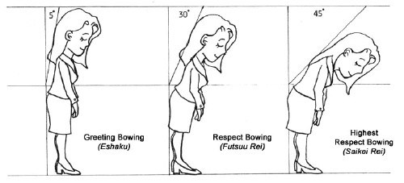
How to bow

Slide 45
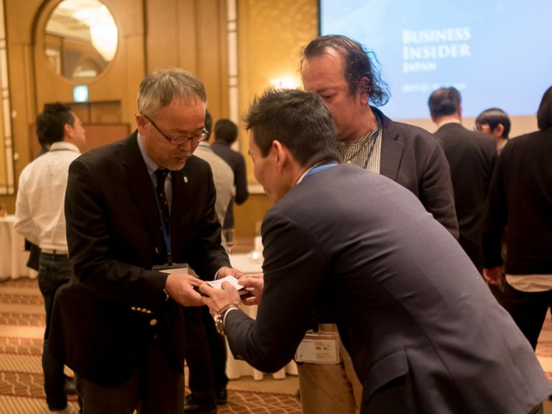
Showing respect

Slide 46
How business meetings start in different countries
Germany | Formal intro. Sit down. Begin.
Finland | Formal intro. Cup of coffee. Sit down. Begin.
USA
UK
France
Japan
Spain/ Italy
Informal intro. Cup of coffee. Jokes. Begin.
Formal intro. Cup of tea.
10 min small talk. Casual beginning.
Formal intro. 15 min small
talk. Begin.
Formal intro. Protocol seating. Tea. 15/20 min small
talk. Signal from senior member. Begin.
20/30 min small talk while others arrive. Begin when all are there.
Number
of minutes
5
10
15
20
25
Adapted from Richard D. Lewis

Slide 47
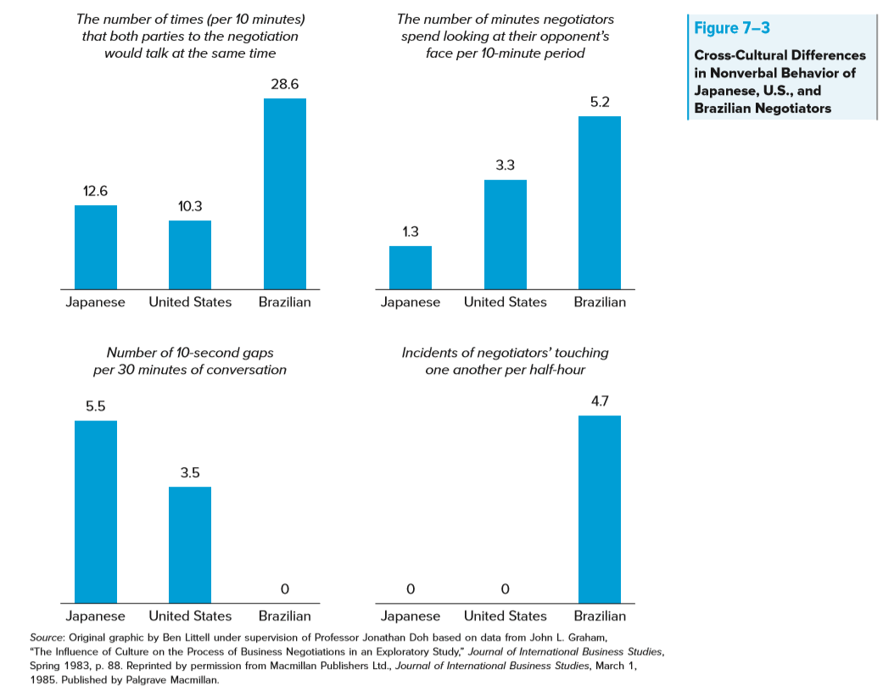

Slide 48
Summary
Culture and perception of the world
Culture and stereotypes
Hofstede’s dimensions of culture
Trompenaars’ dimensions of culture
How culture affects management

Slide 49
Reminders
Case discussion on Friday, Feb 21st
  For everyone: Read “Big Hit Entertainment & BTS: K-Pop” case
  For students responsible for “Big Hit Entertainment & BTS” case: Answer the preparation questions in writing and upload your answers on Moodle before 9:30 on Fri, Feb 21st
Next Tuesday, Feb 25th
  Will discuss how institutions (i.e., rules, policies, regulations) affect business across countries
  A group responsible for PA presentation on Feb 25th will illustrate this topic with examples from their project

