Slide 1
1227 International Management
Global Product Markets
© Ilya Okhmatovskiy
© Andrew Spicer

Slide 2
Agenda
The rise of global product markets
  Pioneers of global trade
  Early voices in favor and against global trade
Economic argument for free trade
  Trade can make both trading parties better off
  Theories of absolute and comparative advantage
Going beyond the economic benefits of trade
  Values dilemma
  Distributional dilemma
  Sovereignty dilemma

Slide 3
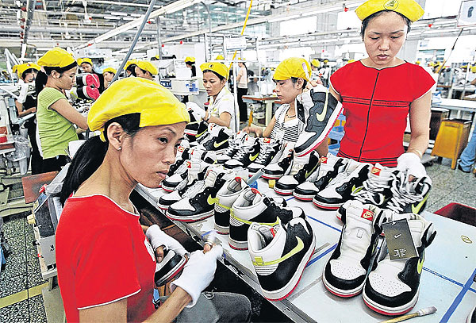
Global Products in Our Lives
Running out the door in a pair of sneakers, you are treading with a foreign made good - designed in Oregon but manufactured in Indonesia or Vietnam.

Slide 4

Global Products in Our Lives
One the way to your car, you make a call – probably, from a smartphone designed in South Korea with software from California and computer chips from Texas and Malaysia and assembled in China.

Slide 5
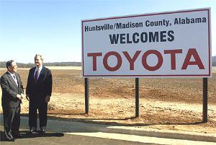
Global Products in Our Lives
The car itself has the name of a foreign-owned company on it and may be assembled in the United States using parts from Asia and Europe

Slide 6
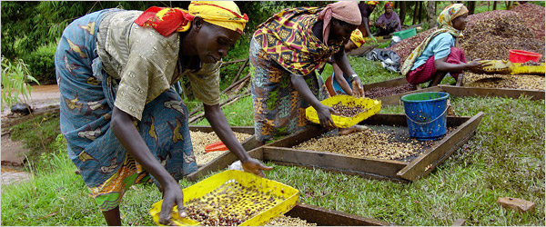
Global Products in Our Lives
Then you go to get a coffee ….
Source: Hovey and Rebmke (2008)

Slide 7
Can a Country Withdraw? Going It Alone
Kelly Cobb, a textile designer in Philadelphia, set out to make a man’s suit out of materials produced within 100 miles of her home.
Two dozen artisans took more than 500 hours to make a very basic suit, but 8 percent of the materials nonetheless had to be sourced from farther away.
Source: Ghemawat, 2011

Slide 8
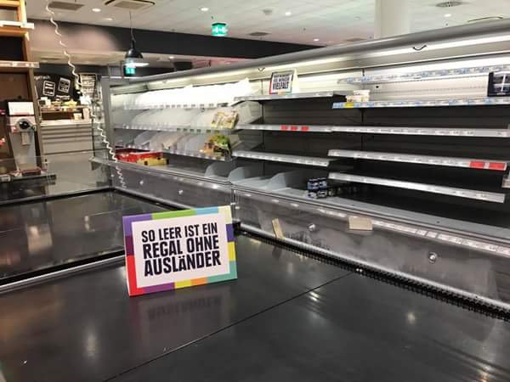
German Retailers Empty Shelves of Foreign Goods to Demonstrate Diversity
Source: http://www.thedrum.com/news/2017/08/25/german-retailer-strips-foreign-goods-shelves-champion-diversity-new-ad

Slide 9
Argument for Open Borders:
The Pie Increases for Everyone

Slide 10
Arguments for Maintaining Borders:
A Zero-Sum Game Perspective

Slide 11
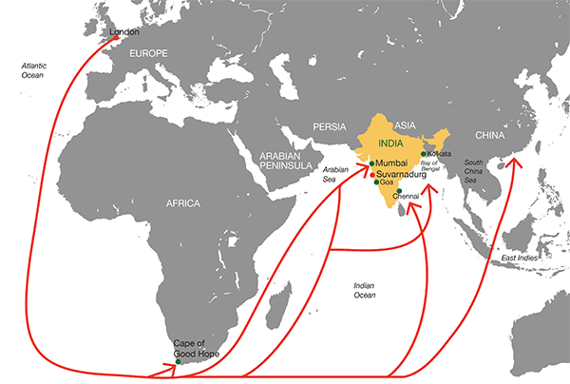
An Enduring Debate:
The British East India Company
An early joint-stock company, which was granted an English Royal Charter by Elisabeth I on December 31, 1600.
In 1610-1611 first factories and trading posts established in India
In 1711, the Company established a trading post in Canton (Guangzhou), China, to trade tea for silver

Slide 12
The Tariff Debate (1667)
In 1667, the East India Company’s domestic headquarters in London “was attacked by rioting weavers, who were enraged that Asian textiles were threatening their livelihood by driving down the price of domestic cloth and reducing their wages.”
This is a challenge that governments have faced again and again: whether to embrace free market trade or to enforce a tax on foreign goods, called a tariff, to help protect domestic manufacturing.
Source: The East India Company: A History (1993)

Slide 13
"Considerations on the East-India Trade” by Henry Martyn (1701)
Henry Martyn in 1701 argues that imports of goods from India represent a benefit to the English nation
Martyn’s argument relies on an analogy between international trade and technological progress:
“Take the sawmill. The sawmill allows two people to do the work that in its absence would have required thirty people. Or consider a barge on the navigable river. Five men on the barge can transport as much freight as one hundred men and as many horses on land.”
Footnote: Some English textile workers in the 19th century actually destroyed textile machinery (https://en.wikipedia.org/wiki/Luddite).
Source: Rodrik (2011) The Globalization Paradox

Slide 14
Trade as Similar to
Technological Progress
If we reject the use of the sawmill or the barge, wouldn’t this be a waste of a nation’s resources?
Wouldn’t it be a similar waste to employ workers in England if the textiles that they produce can be obtained from India by putting fewer people to work?
We can produce textiles at home, or we can obtain the same quantity of textiles from India by producing another commodity which we sell in exchange.
If the latter takes less labor than the former, then who can be against technological progress?
Source: Rodrik (2011) The Globalization Paradox

Slide 15
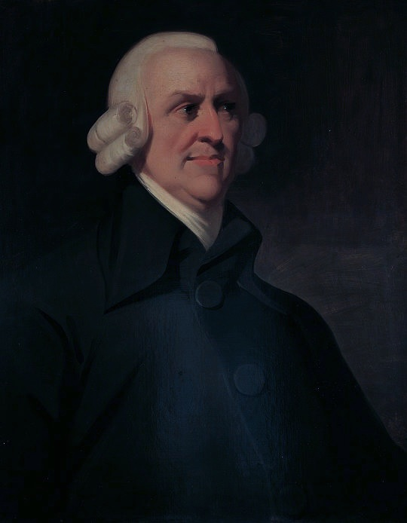
Mutual Benefits of Open Borders:
Adam Smith’s Wealth of Nations (1776)
Adam Smith argues that national wealth and power, corporate success and individual well-being benefit from free trade

Slide 16
Theory of Absolute Advantage
"It is the maxim of every prudent master of a family never to attempt to make at home what it will cost him more to make than to buy. If a foreign country can supply us with a commodity cheaper than we ourselves can make it, better buy it of them with some part of the produce of our own industry employed in a way in which we have some advantage. The general industry of the country, being always in proportion to the capital which employs it, will not thereby be diminished."
  Adam Smith (1776), The Wealth of Nations

Slide 17
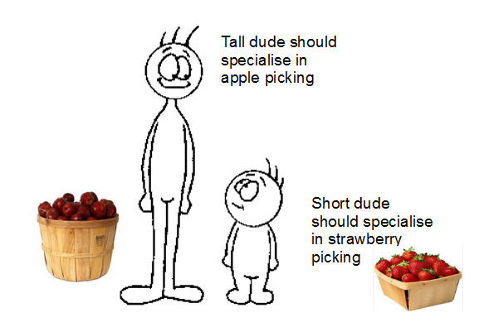
Benefits to Specialization and Trade

Slide 18
Theory of Absolute Advantage
Capability of one country to produce more of a product with the same amount of input than another country
Produce only goods where you are most efficient, trade for those where you are not efficient
Assumes there is an absolute advantage balance among nations – all countries are best at something…
“If someone can do it more cheaply than you, and you can do something more cheaply than them – then you should both make your respective goods and trade.”
© McGraw Hill Companies, Inc.,2005
Source: Hill (2005)

Slide 19
From Absolute to
Comparative Advantage
What happens if one country has an absolute advantage in both products?
  According to a theory of absolute advantage, no trade should occur
  But a theory of comparative advantage suggests that countries should specialize in the goods for which they have a relative advantage, and thus a lower opportunity cost, and then trade

Slide 20
Theory of Comparative Advantage (Ricardo, 1817)
David Ricardo: Principles of Political Economy (1817).
  Introduces the concept of “opportunity cost” instead of direct cost in free-trade arguments
  “Opportunity cost” is the amount of another good you must forgo in order to produce something
A theory of comparative advantage suggests that countries should:
  Produce and export those goods and services for which it is relatively more productive than other countries
  Import those goods and services for which other countries are relatively more productive

Slide 21
The Benefits to Specialization: Comparative Advantage
A famous and wealthy impresario of stage and screen in the 1940s, Billy Rose was also a world-class typist and stenographer. He would thus have encountered enormous difficulty in hiring a secretary who could work nearly as well as he himself could. Still, he hired secretaries because even though he was the world’s best at the job, he could still earn much more in an hour spent manipulating his stage and screen empire than he could in typing.
Source: http://www.mhhe.com/economics/frankb/student/olc/chap03s_els_econat.mhtml

Slide 22
Economic Costs to Discrimination Based on National Identity
“Economists’ policy prescriptions … propose that national policy should be neutral regarding trade or foreign investment, … governments should treat domestic and foreign firms alike and should not discriminate against the foreign firms.”
  -- Gilpin. 2000. The Challenge of Global Capitalism: The World Economy in the 21st Century. p: 191.

Slide 23
Long-Term Productivity Gains and Competitiveness
Trade improves economic performance not only by allocating a country’s resources to their most efficient use, but also by making those resources more productive in what they are doing.
Trade and investment increase competition in a way that stimulates industries to become more efficient and improve their productivity, often by forcing less productive firms out of business and allowing more productive firms to expand.
It also serves as a conduit for the transfer of foreign technologies that enhance productivity

Slide 24
Arguments against opening national borders for trade
The Values Dilemma
  What is fair?
The Distributional Dilemma
  Who wins and who loses?
The Sovereignty Dilemma
  Should we allow others to make and enforce rules over us?
Adapted from Moon. 2000. Dilemmas of International Trade. 2nd Edition.

Slide 25
The Values Dilemma in International Trade and Investment
The values dilemma arises because trade generates many outcomes that citizens evaluate on the basis of ethical principles and social values.
Free trade advocates believe that open borders maximize economic efficiency, competitiveness and standards of living.
Opponents point out that allowing markets to operate freely may result in economic considerations prevailing over ethical considerations such as human rights and labor standards.

Slide 26
The Challenge of Multiple Standards
How should we deal with the following issues?
Chinese exports of toys to the United States are found to contain unsafe levels of lead.
Some of the goods exported from Indonesia to the United States and Europe are manufactured using child labor.
Some of the goods exported from Bangladesh are made in unsafe buildings at risk of fire.
Some manufacturers receive large government subsidies and support while others receive little, leading to calls of “unfair” competition.

Slide 27
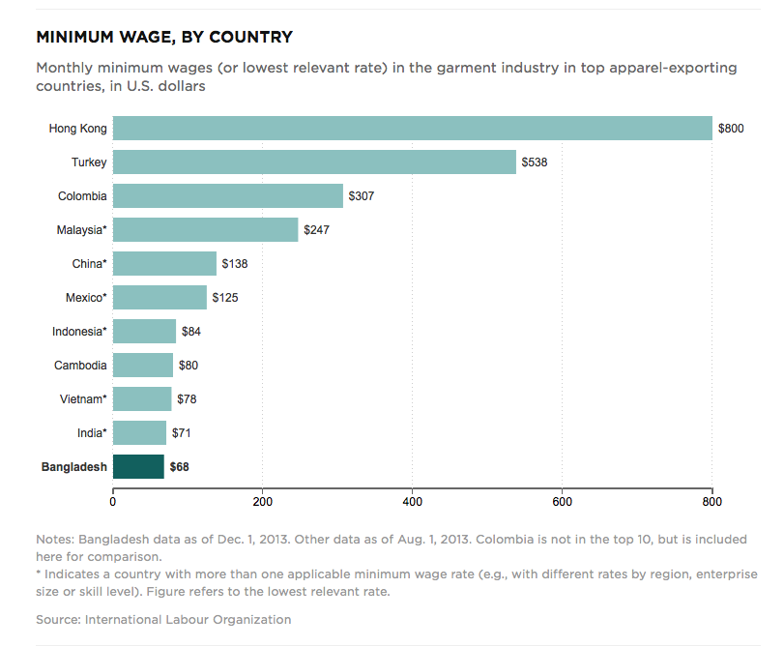
Global Manufacturing in Bangladesh
Unlike other processes in textile industry, sewing remains difficult to automate
  Very low-skilled work, but must be done by a human
Wages are the driving factor in location for textile factories
Source: Planet Money (2014)

Slide 28
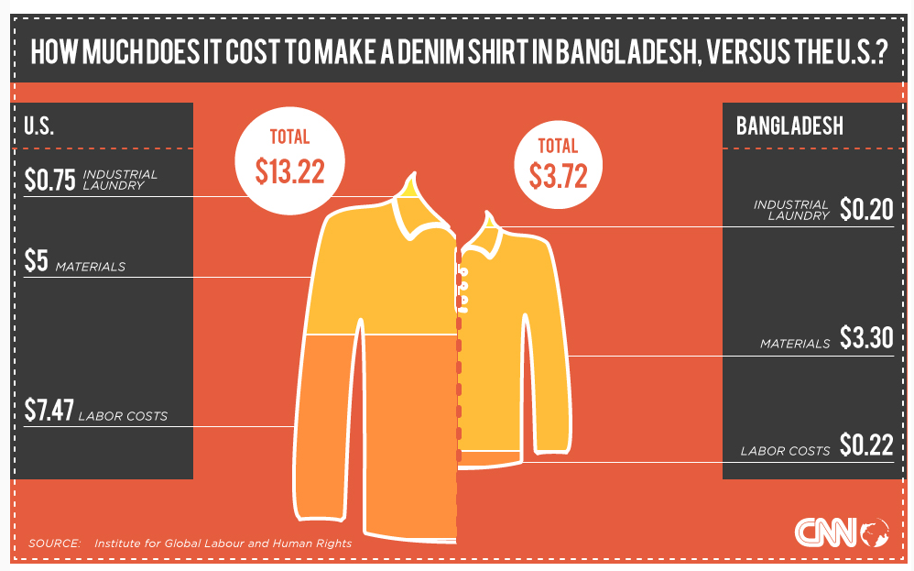

Slide 29
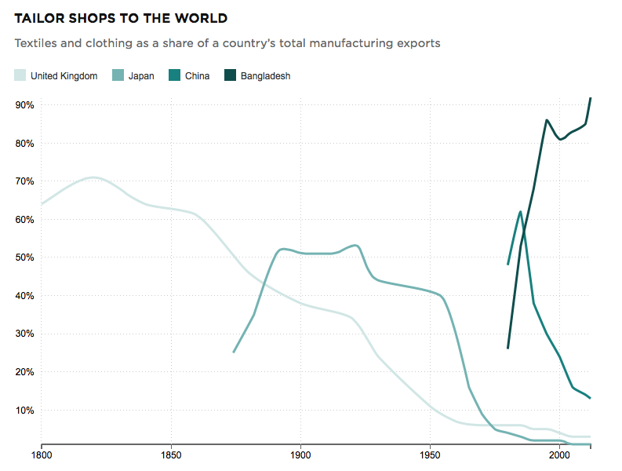
Source: Planet Money (2014)

Slide 30
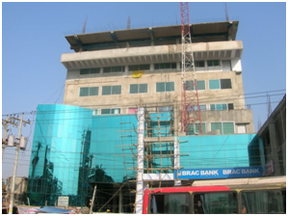
Rana Plaza
Built on a sand-filled pond
Designed for 5 stories
  Had 9 stories
Designed for shops and apartments
  Garment factories throughout
Required reinforced steel
  Used concrete and cheap rebar

Slide 31
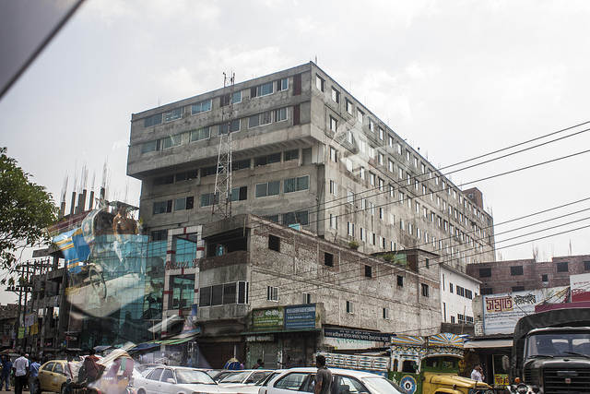
Occupants
Bank
Shopping Mall
Offices
Apartments
Garment Factories

Slide 32
Collapse
April 23, 2013: structural cracks appear
A building engineer recommends evacuation
A building official visits the building and clears it for continued use
Bank and shops evacuated
Garment workers ordered to report to work

Slide 33
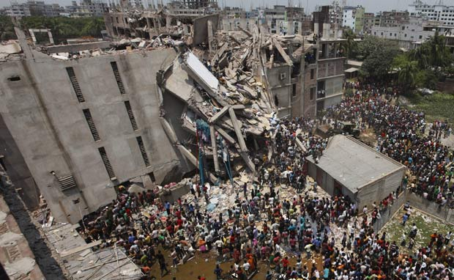
April 24, 2013: 3,122 workers inside

Slide 34
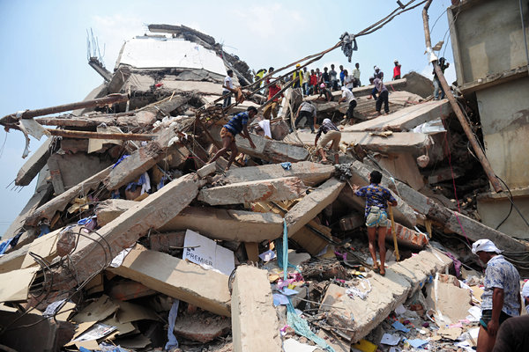
Death Toll Exceeds 1100

Slide 35
Repeated Disasters
Nov 24, 2012: Tazreen Factory Fire
Feb 17, 2013: Smart Export Garments Fire
April 24, 2013: Rana Plaza Collapse
May 8, 2013: Dhaka Factory Fire

Slide 36
Do Multinational Organizations Hold Any Responsibility?
“Even in a situation of grave threat, when they saw cracks in the walls, factory managers thought it was too risky not to work because of the pressure on them from U.S. and European retailers to deliver their goods on time…the prices Western companies pay are so low that they are at the root of why these factories are cutting corners on fire safety and building safety.”
  Dara O’Rourke, an expert on workplace monitoring at the University of California, Berkeley.

Slide 37
Should consumers care?
“We as consumers like to be able to buy ever-greater quantities of ever-cheaper goods, every year…Somebody is bearing the cost of it, and we don’t want to know about it. The people bearing the cost were in this fire.”
  Richard M. Locke, deputy dean of the M.I.T. Sloan School of Management
“It bothers me, but a lot of retailers are getting their clothes from these places and I can’t see how I can change anything. They definitely need to improve, but I’ll still shop here. It’s so cheap.”
  21-year-old university student Elizabeth McNail, clutching a brown paper bag from clothier Primark the day after a building collapse in Savar, Bangladesh killed at least 381 people.
Source: New York Times (12/5/12); Bloomberg News (4/29/13)

Slide 38
The Distributional Dilemma
The distributional dilemma emerges from the propensity of trade to alter the distribution of income and wealth within a country.
  Some individuals and groups may gain from trade while others lose, at least in the short run
Because these distributional consequences have such political implications, the state is more attentive to them than economic theorists are.
Source: Moon. 2000. Dilemmas of International Trade.
Second Edition.

Slide 39
Distributional Dilemma: Sectoral Trade-Offs
The most visible distributional effects are usually sectoral, because trade policy often protects or promotes one industry or sector of the economy at the expense of others.
For example, tariffs on imported steel protect the domestic steel industry by making foreign-produced steel more expensive, but they also harm domestic automakers who must pay higher prices for the steel that they use.
Consumers of cars also face higher prices.
Source: Moon. 2000. Dilemmas of International Trade.
Second Edition. P. 21

Slide 40
Removing Trade Barriers often Benefits Corporations but Hurts Labor
“An especially persistent theme in US trade policy debates has been the fear that trade will benefit the owners of large corporations but erode the employment prospects and wage rates of unskilled workers.
For example, the elimination of trade barriers under NAFTA[USMCA] forces some US manufacturing workers into direct competition with Mexican workers who earn a markedly lower wage.
Unless US wage rates decline, production may shift to Mexico and US jobs will be lost.”
Source: Moon. 2000. Dilemmas of International Trade. Second Edition. P. 21

Slide 41
How Globalization Affects Different Industries and Professions
“However, if that competition drives down wage rates in the United States, the profits earned by the owners of US business might be maintained at the expense of the standard of living of workers in those industries.
The losses from such wage competition will be greatest for workers in high wage countries employed in industries that can move either their products or their production facilities most easily across national borders.
Others, particularly more affluent professionals such as doctors, lawyers and university professors, who face less direct competition from abroad, stand to gain from trade because it lowers prices on the goods they consume.”
Source: Moon. 2000. Dilemmas of International Trade. Second Edition. P. 21

Slide 42
Which Jobs in the U.S. Are at Risk of Being “Traded”
At risk
  14.3 million jobs in manufacturing
  3.2 million jobs in information services
  16.7 million jobs in professional and business services
  Some of the 10.6 million jobs in financial services, wholesale trade, transportation and utilities
Not at risk
  7.6 million jobs in construction and mining
  22 million jobs in local, state, and federal government
  Majority of 15.6 million jobs in retail trade
  Majority of 17.3 million jobs in education and health (except some jobs such as lab testing)
  12.3 million jobs in leisure and hospitality
Source: Blinder, Foreign Affairs (March/April 2006)
Notes:
42

Slide 43
The Globalization of Supply Chains
 | Tradable Tasks (task outputs or processes that can easily transfer across borders) | Non-Tradable Tasks (need for physical presence, personal interactions and/or situational adaptability)
Routine Tasks | Examples: manufacturing jobs, call centers, routine back-office work | Examples: leisure, hospitality and service jobs
Non-Routine Tasks | Examples: Non-routine professional and managerial jobs that require expert judgment and training | Examples: skilled construction, health care and education

Slide 44
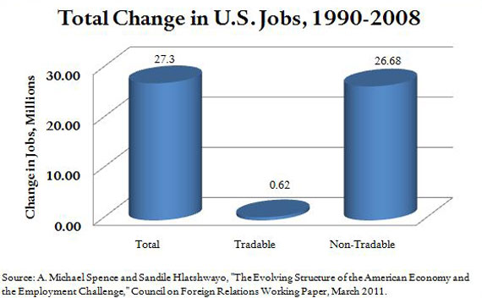
Tradable vs. Non-tradable Jobs

Slide 45
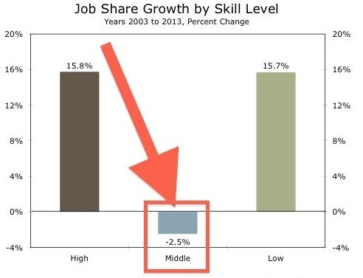
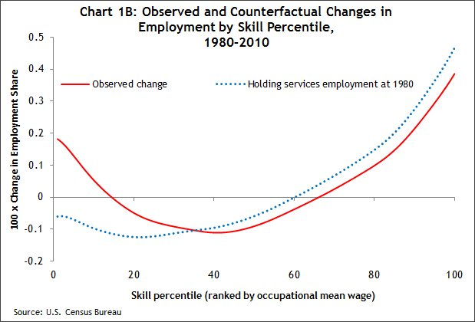
Globalization, Education and Jobs
Source: Wells Fargo (2013); McIntosh (2013)

Slide 46
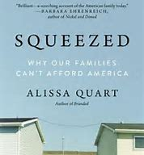
New Concerns of the Middle Class
“Much that middle-class professionals took for granted in previous generations, including homeownership, decent health care, a comfortable retirement, is now out of reach.
Over the past 20 years, the cost of housing has risen dramatically. The price of health care and college has almost doubled in the U.S.
Many people find themselves carrying school and credit-card debt, and working low-paid, temporary or part-time jobs.
Others supplement jobs that once upon a time would have been considered full time, such as teaching, with temporary gigs such as driving an Uber.”
Adapted from: https://www.nytimes.com/2018/07/09/books/review/alissa-quart-squeezed.html

Slide 47
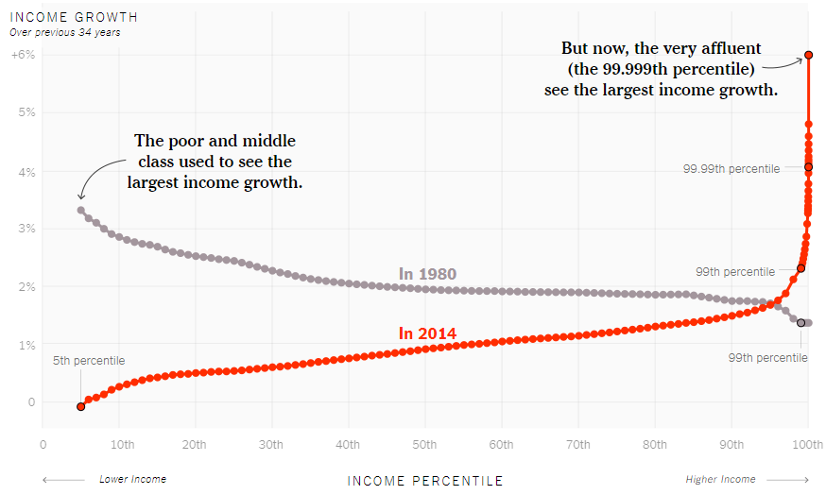
US Wealth Distribution: Income Growth over Previous 34 Years
Source: https://www.nytimes.com/interactive/2017/08/07/opinion/leonhardt-income-inequality.html?mcubz=0

Slide 48
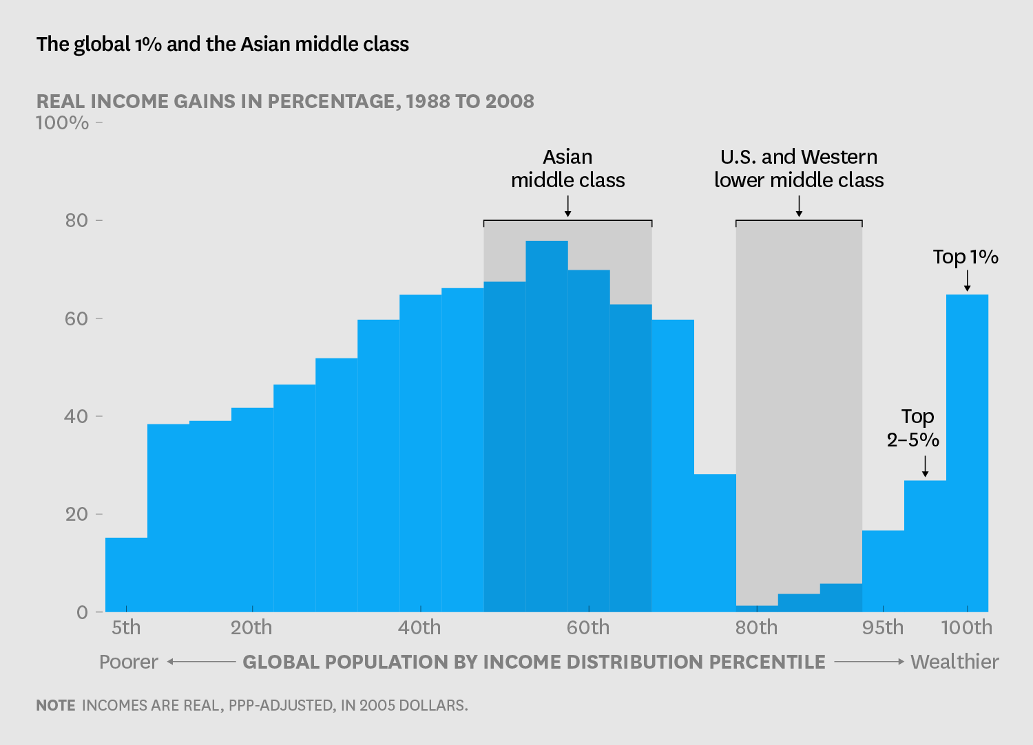
New Concerns about the Win-Win Nature of Open Borders
Source: Harvard Business Review (May 13, 2016)

Slide 49
International Competition for Jobs
“The globalists gutted the American working class and created a middle class in Asia.”
-- Steve Bannon (2016)
Source: Rachman (2017)

Slide 50
The Sovereignty Dilemma
States, and the people who live there, prefer to preserve their sovereignty to make their own decisions
  States are wary that the interdependence implicit in cooperating with foreign actors may constrain independent action and threatens autonomy.
  Do countries have to give up sovereignty to participate in multilateral organizations and agreements?
  Do European citizens have to accept genetically engineered crops or hormone-injected beef in their marketplace to participate in the World Trade Organization?
  Can the US ban shrimp (or other goods) from countries without adequate environmental practices?

Slide 51






The Sovereignty Dilemma and Multilateral Cooperation
Multilateral organizations: organizations formed between three or more nations to work on issues that relate to all of the countries in the organization
Multilateral organizations therefore require joint decision-making rules and enforcement

Slide 52
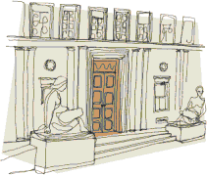
World Trade Organization
154 Rue de Lausanne, Geneva
Responsible for setting international trade standards and settling trade disputes.
Center of debates over trade dilemmas
What is a “fair” standard and what is a “trade barrier” to protect the companies of an individual country?
  Disputed cases: beef hormones; genetically engineered crops; meat inspection; eco-labeling; fuel economy standards; drug inspection; protection of wildlife (tuna and turtle protection; leg-hold traps).

Slide 53
Reaction Against the WTO
“Under the new system, many decisions that affect billions of people are no longer made by local or national governments but instead, if challenged by any WTO member nation, would be deferred to a group of unelected bureaucrats sitting behind closed doors in Geneva.”
-- Ralph Nader

Slide 54
Are there middle ground positions that balance multiple objectives?
The Values Dilemma
  Multinationals could create internal codes of conduct (e.g., Nike), create industry associations (e.g., Apparel Industry Partnership) or create market-based credentialing programs (e.g., certified Fair-Trade coffee)
The Distributional Dilemma
  States could protect or support those most hurt from global trade while still allowing some jobs to compete in the open market
The Sovereignty Dilemma
  States could give up sovereignty on some issues to create global rules while maintaining sovereignty on others
Source: Adapted from Moon. 2000. Dilemmas of International Trade. Second Edition.

Slide 55
Summary
The rise of global product markets
  Pioneers of global trade
  Early voices in favor and against global trade
Economic argument for free trade
  Trade can make both trading parties better off
  Theories of absolute and comparative advantage
Going beyond the economic benefits of trade
  Values dilemma
  Distributional dilemma
  Sovereignty dilemma

Slide 56
Reminders
For Friday’s class
  Read “Streaming the Future: Netflix’s Global Expansion” case (download using a click-through link available on Moodle)
Other tasks
  If you have not uploaded your Background Information Sheet yet, please do (using Dropbox on Moodle)
  Create groups (6 students per group, each group should have members from at least 2 countries)
  Individual assignments (which case you are responsible for) will appear on Moodle by Friday

