Slide 1
social insurance
why insurance?
expected utility and attitude towards risk
why social insurance?
adverse selection
insurance and moral hazard
optimal social insurance

Slide 2
social insurance
Social Insurance
Government spending now focuses on social insurance programs.
Social insurance programs: Government interventions in the provision of insurance against adverse events.
For most programs, eligibility is not means-tested.
Means-tested: Programs in which eligibility depends on the level of one’s current income or assets.

Slide 3
social insurance
What Is Insurance?
Insurance is a promise to make some payment in case of a particular event, in exchange for a payment, called a premium.
Insurance premiums: Money that is paid to an insurer so that an individual will be insured against adverse events.
Insurance products include: health insurance, auto insurance, life insurance, and casualty and property insurance.

Slide 4
social insurance
Why Do Individuals Value Insurance?
Insurance is valuable because it helps individuals smooth consumption across states of the world.
Consumption smoothing: The translation of consumption from periods when consumption is high, and thus has low marginal utility, to periods when consumption is low, and thus has high marginal utility.
States of the world: The set of outcomes that are possible in an uncertain future.

Slide 5
social insurance
Why Do Individuals Value Insurance?
Diminishing marginal utility
Diminishing marginal utility means that the fourth slice of pizza is less important than the first.
Always having two slices is better than having four and sometimes having zero.
Always a moderate amount of consumption for sure is better than a 50–50 chance of having a lot or nothing.
Individuals will demand full insurance in order to fully smooth their consumption across states of the world.

Slide 6
social insurance
Formalizing This Intuition: Expected Utility Model

Slide 7
social insurance
Formalizing This Intuition: Expected Utility Model
Examples of utility functions: V(c₁,c₂,π₁,π₂)=π₁c₁+π₂c₂ W(c₁,c₂,π₁,π₂)=π₁ln(c₁)+π₂ln(c₂) Expected Utility form (von-Neumann/Morgenstern) U(c₁,c₂,π₁,π₂)=π₁u(c₁)+π₂u(c₂) Examples: u(c)=c or u(c)=ln(c) additive form, linear in probabilities monotonic transformations: only positive affine transformations V(U)=a+bU, b>0

Slide 8
social insurance
Formalizing This Intuition: Expected Utility Model
1/2
4 thousand
1
2 thousand
1/2
0
LOTTERY A
LOTTERY B

Slide 9
social insurance
The Expected Utility Model: Health insurance

Slide 10
social insurance
Full Insurance Is Optimal
Purchase | Hit? | C |  | Expected Utility
No insurance | No | 30,000
 | Yes | 0 | 0
Full insurance ($300) | No | 29,700
 | Yes | 29,700
Partial insurance ($150) | No | 29,850
 | Yes | 14,850

Slide 11
social insurance
Full Insurance Is Optimal
 | No Insurance | Full insurance | Partial Insurance
Premium | 0 | 300 | 150
C if not hit | 30,000 | 29,700 | 29,850
C if hit | 0 | 29,700 | 14,850
U if not hit | 173.2 | 172.34 | 172.77
U if hit | 0 | 172.34 | 121.86
Expected utility | 0.99 × 173.2 + 0.01 × 0 = 171.5 | 0.99 × 172.34 + 0.01 × 172.34 = 172.34 | 0.99 × 172.77 + 0.01 × 121.86 = 172.26

Slide 12
social insurance
Full Insurance Is Optimal
W – L + m – m.b
W – (initial) wealth
L – loss
m – insurance
m.b – insurance premium
$$π$$
1- $π$
W – m.b
How much insurance to buy?
Assume:
the agent is risk-averse i.e. u’’<0
the insurance premium is actuarially fair i.e. insurance firm makes zero profits in expectation b= $π$

Slide 13
social insurance
Full Insurance Is Optimal
How much insurance to buy?
$$\max_{m} π.u\left(W−L+m−π.m\right)+\left(1−π\right)u(W−π.m)$$
FOC
$π.u′\left(W−L+m−π.m\right)(1−π)+\left(1−π\right)u′(W−π.m)(−π$) = 0
$$u^{′}\left(W−L+m−π.m\right)=u′(W−π.m)$$
We know: u’’<0 !

Slide 14
social insurance
Full Insurance Is Optimal
How much insurance to buy?
$$\max_{I} π.u\left(W−L+m−π.m\right)+\left(1−π\right)u(W−π.m)$$
FOC
$π.u′\left(W−L+m−π.I\right)(1−π)+\left(1−π\right)u′(W−π.I)(−π$) = 0
$$u^{′}\left(W−L+m−π.m\right)=u^{′}\left(W−π.m\right)⟹$$
$$W−L+m−π.m=W−π.m$$
m = L
RISK AVERSE AGENT
faced with ACTUARIALLY FAIR INSURANCE
buys FULL INSURANCE!

Slide 15
social insurance
The Role of Risk Aversion
Risk aversion: The extent to which individuals are willing to bear risk.
Risk-averse people may still want to buy some insurance even if it is not actuarially fair.
People may differ in their risk aversion, and if insurance premiums are extremely unfair, then only the most risk averse will want to it.

Slide 16
social insurance
Attitudes towards risk
u
u(x)=$√x$
2
0
2
4

Slide 17
social insurance
Attitudes towards risk
u
u(x)=$√x$
2
E(u)=0.5u(0)+0.5u(4)
0
2
4

Slide 18
social insurance
Attitudes towards risk
u
u(x)=$√x$
2
u(E)=u(2)
E(u)=0.5u(0)+0.5u(4)
0
2
4

Slide 19
social insurance
Attitudes towards risk
RISK AVERSION: u(E)>E(u)
u’’<0
u
u(x)=$√x$
2
u(E)=u(2)
E(u)=0.5u(0)+0.5u(4)
0
2
4

Slide 20
social insurance
Attitudes towards risk
u(x)=$x$
u
4
E(u)=0.5u(0)+0.5u(4)
0
2
4

Slide 21
social insurance
Attitudes towards risk
u(x)=$x$
u
4
u(E)=u(2)
0
2
4

Slide 22
social insurance
Attitudes towards risk
u(x)=$x$
u
RISK NEUTRALITY:
u(E)=E(u)
u’’=0
4
E(u)=0.5u(0)+0.5u(4)=
=u(E)=u(2)
0
2
4

Slide 23
social insurance
Attitudes towards risk
u
u(x)=$x2$
16
E(u)=0.5u(0)+0.5u(4)
4
0
2
4

Slide 24
social insurance
Attitudes towards risk
u
u(x)=$x2$
16
E(u)=0.5u(0)+0.5u(4)
u(E)=u(2)
0
2
4

Slide 25
social insurance
Attitudes towards risk
u
u(x)=$x2$
16
RISK LOVING:
u(E)<E(u)
u’’>0
E(u)=0.5u(0)+0.5u(4)
u(E)=u(2)
0
2
4

Slide 26
social insurance
Attitudes towards risk
Risk-aversion u’’<0 U(E(.))>E(u(.)) Risk-neutrality u’’=0 U(E(.))=E(u(.)) Risk-loving u’’>0 U(E(.))<E(u(.))

Slide 27
social insurance
Attitudes towards risk
1/2
4 thousand
1
?
~
1/2
0

Slide 28
social insurance
Attitudes towards risk
Certainty Equivalent: monetary amount that makes the agent indifferent between receiving that amount with certainty or facing the risk U(CE)=E(u(.)) Risk Premium: maximum amount of wealth that the agent would be willing to give up in order to avoid facing the risk. U(E(.)-RP)=E(u(.)) RP=E(.)-CE

Slide 29
social insurance
Attitudes towards risk
RISK AVERSION: u(E)>E(u)
u’’<0
CE<E
RP>0
u
u(x)=$√x$
2
u(E)=u(2)
E(u)=0.5u(0)+0.5u(4)
0
CE=1
2
4
RP=E-CE=1

Slide 30
social insurance
Attitudes towards risk
u(x)=$x$
u
RISK NEUTRALITY:
u(E)=E(u)
u’’=0
CE=E
RP=0
4
E(u)=0.5u(0)+0.5u(4)=
=u(E)=u(2)
0
2
4
CE=2
RP=E-CE=0

Slide 31
social insurance
Attitudes towards risk
u
u(x)=$x2$
16
RISK LOVING:
u(E)<E(u)
u’’>0
CE>E
RP<0
E(u)=0.5u(0)+0.5u(4)
u(E)=u(2)
0
2
CE= $2√$2
4
RP=E-CE=2-2$√$2

Slide 32
social insurance
Why Have Social Insurance? Asymmetric Information and Adverse Selection
Why should the government provide insurance?
Information asymmetry can lead to a key market failure called adverse selection.
Information asymmetry: The difference in information that is available to sellers and to purchasers in a market.
Individuals may know much more about their riskiness than do insurers.
This has profound implications for insurance markets.

Slide 33
social insurance
Adverse Selection Example
Two kinds of people:
Careless people have a 5% chance of being in a car accident (half the population).
Careful people have a 0.5% chance (half the population).
If the insurance company knows each person’s type, it can charge them separate prices.
If the insurance company doesn’t know their type, it could try charging a price that is fair on average, or try charging separate prices.

Slide 34
social insurance
Insurer Breaks Even with Full Information Pricing
What happens if the insurance company could charge each type their actuarially fair price?
Charge careless people $1,500.
Charge careful people $150.
Earn $150,000 per 100 careless people, pay out $150,000.
Earn $15,000 per 100 careful people, pay out $15,000.

Slide 35
social insurance
Asymmetric Information Pricing: Separate
What if the insurance tries to charge different prices but cannot tell who is careless?
Careless people pretend to be careful, pay $150.
Careful people pay $150.
Earn $15,000 per 100 careless people, pay out $150,000. Lose $135,000.
Earn $15,000 per 100 careful people, pay out $15,000.

Slide 36
social insurance
Asymmetric Information Pricing: Separate
What if the insurance company tries to charge average price?
Average price: $825.
Insurance is a great deal for careless people, so they buy it, pay $825.
Careful people decline it.
Earn $82,500 per 100 careless people, pay out $150,000. Lose $67,500.
Earn nothing from careful people.

Slide 37
social insurance
The Problem of Adverse Selection
Adverse selection: The fact that insured individuals know more about their risk level than does the insurer might cause those most likely to have the adverse outcome to select insurance, leading insurers to lose money if they offer insurance.
Selling to both requires that low-risk people subsidize high risk people.
Low-risk people may not want to do this.
Sometimes, only high-risk people end up with insurance.

Slide 38
social insurance
Does Asymmetric Information Necessarily Lead to Market Failure?
If low-risk people have a high enough risk premium, they will subsidize high-risk people in a pooling equilibrium.
Risk premium: The amount that risk-averse individuals will pay for insurance above and beyond the actuarially fair price.
Pooling equilibrium: A market equilibrium in which all types of people buy full insurance, even though it is not fairly priced to all individuals.
Separating equilibrium: A market equilibrium in which different types of people buy different kinds of insurance products designed to reveal their true types.

Slide 39
social insurance
APPLICATION: Adverse Selection and Health Insurance “Death Spirals”
In 1995, Harvard stopped subsidizing its most generous plans, which were experience-rated.
Experience rating: Charging a price for insurance that is a function of realized outcomes.
Before 1995, there was a pooling equilibrium.
Healthy employees chose the cheap, generous plan.
After 1995, there was a separating equilibrium.
Healthy employees dropped the now expensive generous plan.

Slide 40
social insurance
APPLICATION: Adverse Selection and Health Insurance “Death Spirals”
Because the less-healthy employees used much more medical care, the experience-rated premiums of the more generous plans increased substantially.
By 1998, the most generous plan had gotten so expensive that it was no longer offered.
Adverse selection had led to a “death spiral” for this plan.
It kept getting more expensive, and healthy people kept leaving, driving its price ever higher.

Slide 41
social insurance
How Does the Government Address Adverse Selection?
Adverse selection leads to market failure since healthy people may not be able to buy insurance.
The government can address adverse selection, and improve market efficiency, in a number of ways…
…but they involve redistribution from the healthy to the sick, which may be quite unpopular.

Slide 42
social insurance
Other Reasons for Government Intervention in Insurance Markets
Externalities: Vaccines have positive spillovers; car crashes negative ones.
Administrative costs: Government-run health care has much lower administrative costs than private insurance.
Redistribution: Governments may want to redistribute from healthy to sick.
Paternalism: Governments may feel that people would choose to buy too little insurance for themselves.

Slide 43
social insurance
Social Insurance versus Self-Insurance: How Much Consumption Smoothing?
Even if private insurance markets do not function well, people may still be able to insure with self-insurance.
Self-insurance: The private means of smoothing consumption over adverse events, such as through one’s own savings, labor supply of family members, or borrowing from friends.

Slide 44
social insurance
Example: Unemployment Insurance
People can insure against unemployment in many ways:
They can draw on their own savings.
They can borrow, either in collateralized forms or in uncollateralized forms.
Other family members can increase their labor earnings.
They can receive transfers from their extended family, friends, or local organizations.

Slide 45
social insurance
Example: Unemployment Insurance
Unemployment insurance provides benefits through the replacement rate.
UI replacement rate: The ratio of unemployment insurance benefits to pre-unemployment earnings.
A higher replacement rate corresponds to more generous insurance.
But private insurance reduces the consumption-smoothing value of this insurance.

Slide 46
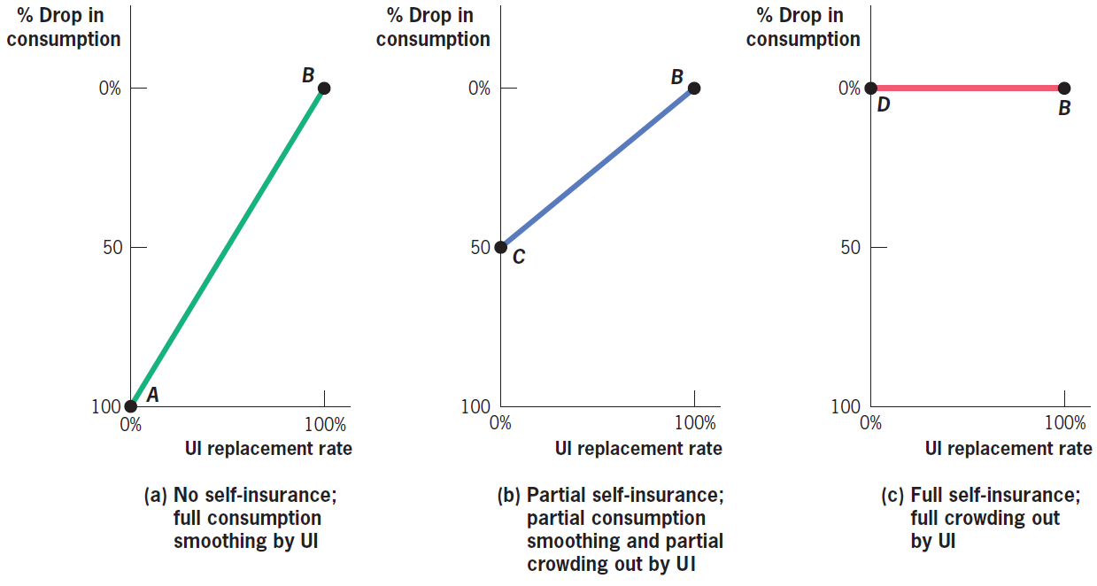
social insurance
Example: Unemployment Insurance

Slide 47
social insurance
Lessons for Consumption-Smoothing Role of Social Insurance
The importance of social insurance for consumption smoothing will depend on two factors:
Predictability of the event: Easier to self-insure against predict able events.
Cost of the event: Easier to self-insure against low-cost events.

Slide 48
social insurance
The Problem with Insurance: Moral Hazard
The cost of insurance is moral hazard.
Moral hazard: Adverse actions taken by individuals or producers in response to insurance against adverse outcomes.
The existence of moral hazard means that it may not be optimal for the government to provide the full insurance that is demanded by risk-averse consumers.

Slide 49
social insurance
The Problem with Insurance: Moral Hazard
conflict between goals of principal and agent;
agent’s actions may not be observable/verifiable
examples:
insurance firm/insured agent
owner/manager
service provider/client

Slide 50
social insurance
The Problem with Insurance: Moral Hazard
What determines moral hazard?
How easy it is to observe whether the adverse event has happened.
How easy it is to change behavior in order to establish the adverse event.
Notes:
50

Slide 51
social insurance
The Problem with Insurance: Moral Hazard
In examining the effects of social insurance, four types of moral hazard play a particularly important role:
Reduced precaution against entering the adverse state.
Increased odds of entering the adverse state.
Increased expenditures when in the adverse state.
Supplier responses to insurance against the adverse state.
Notes:
51

Slide 52
social insurance
The Consequences of Moral Hazard
Moral hazard is costly for two reasons:
The adverse behavior encouraged by insurance lowers social efficiency because it reduces the provisions of socially efficient labor supply.
When social insurance encourages adverse events, which raise the cost of the social insurance program, it increases taxes and lowers social efficiency further.

Slide 53
social insurance
Putting It All Together: Optimal Social Insurance
Optimal social insurance systems should partially, but not completely, insure individuals against adverse events.
The main benefit of social insurance is the amount of consumption smoothing provided by social insurance programs.
The cost of social insurance is the moral hazard caused by insuring against adverse events.

Slide 54
social insurance
Conclusion
Asymmetric information in insurance markets has two important implications:
It can cause adverse selection.
It can cause moral hazard.
The ironic feature of asymmetric information is therefore that it simultaneously motivates and undercuts the rationale for government intervention through social insurance.

