Slide 1
public goods
definition and examples
optimal provision
indivisibility and efficiency
non-excludability and efficiency
private provision vs. public provision

Slide 2
public goods
  examples: national defense, radio broadcast
  1st Welfare Theorem assumptions do not hold
definition of a public good
determining the socially optimal level of public good
achieving and financing the socially optimal level of public good

Slide 3
public goods definition
non-rivalry/indivisibility
consumption by one agent does not reduce quantity available for consumption by another
non-excludability
if supplied, no consumer can be excluded
impossibility of rejection
if supplied, it must be consumed

Slide 4
public goods definition
 |  | Is the good rival in consumption?
Is the good excludable? |  | Yes | No
 | Yes | Private good (ice cream) | Impure public good (Cable TV)
 | No | Impure public good (crowded sidewalk) | Public good (defense)

Slide 5
public goods definition
 | rival | non-rival
excludable | private | club
non-excludable | common property resource | public

Slide 6
public goods optimal provision
Optimal Provision of Public Goods
How much of the public good should society provide?
Markets will not provide the correct amount.
To answer this question, start by reconsidering the market for a private good, ice cream cones.
Ben and Jerry have different tastes for ice cream (ic), relative to the other good (c). How does the market aggregate their preferences?

Slide 7
public goods: optimal provision
Horizontal Summation in the Private Goods Market
Ben’s Marginal
Benefit
Jerry’s Marginal
Benefit
Market
Price
of ice cream cone
Price
of ice cream cone
Price
of ice cream cone
S = SMC
$2
D_{B}
$2
D_{J}
$2
E
D_{B&J} = SMB
0
2
Quantity of cones
0
1
Quantity of cones
0
3
Quantity of cones
To find social demand curve, add quantity at each price—sum horizontally.

Slide 8
public goods: optimal provision
Vertical Summation in the Public Goods Market
Price of missiles
Ben’s marginal benefit
$2
1
D_{B}
Price of
missiles
0
1
5
Quantity of missiles
Jerry’s marginal benefit
$4
2
D_{J}
0
1
5
Quantity of missiles
Price of missiles
Social marginal benefit and cost
$6
S = SMC
3
D_{B&J} = SMB
0
1
5
Quantity of missiles

Slide 9
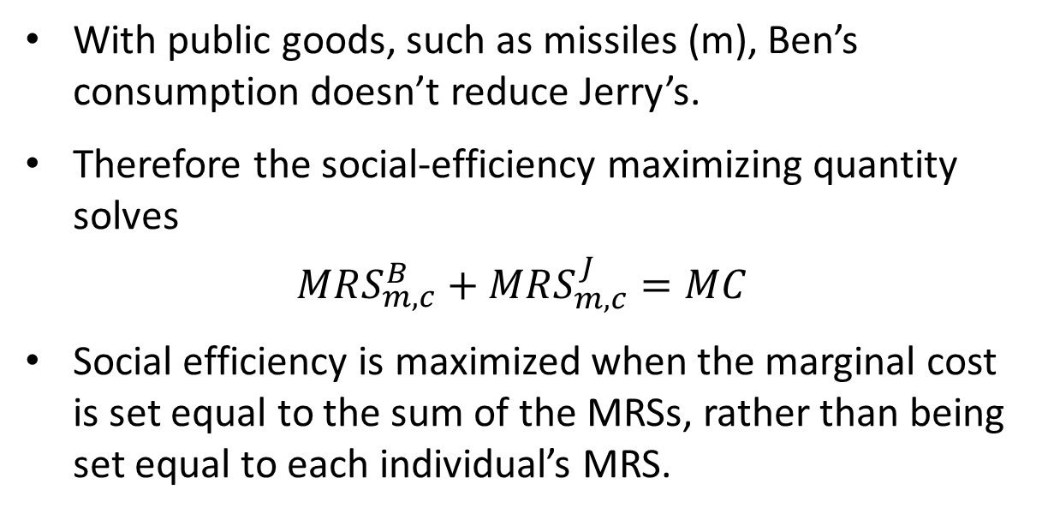
public goods: optimal provision
Optimal Provision of Public Goods

Slide 10
public goods: indivisibility
Samuelson condition
Samuelson condition: efficient level
Max U^{A}(g,y^{A})
s.t. U^{B}(g,y^{B})≥ U^{B}
F(g,y)=0
y^{A}+y^{B}=y
→ Σ_{i} MRS_{i} = MRT

Slide 11
public goods: indivisibility efficiency
p
Mg Cost
D_{A+B}
D_{B}
D_{A}
g*
g

Slide 12
public goods indivisibility and efficiency
marginal cost
of congestion
N₀
N
optimal number of consumers?
if indivisible, N*=N_{max} (no consumer should be excluded)
optimal level of indivisible good?
Samuelson condition

Slide 13
public goods: indivisibility and efficiency discussion
optimal number of agents implies no exclusion prices
optimal level of public good requires information
  problem in perfect competition (uniform price) and in monopolies with a large number of agents (no perfect price discrimination, information)
  in a monopoly with a small number of consumers, information cost is smaller – more feasible
information also a problem for public provision

Slide 14
public goods: non-excludability and efficiency discussion
2 1 | Contribute | Don’t contribute
Contribute | 1/2,1/2 | 0,1
Don’t contribute | 1,0 | 0,0

Slide 15
public goods: non-excludability and efficiency discussion
Free-riding problem
no alternative to public provision (with large numbers)
private provision possible if small number of agents and coordination is possible
  Clarke-Groves mechanisms

Slide 16
public goods: non-excludability and efficiency discussion
APPLICATION: The Free Rider Problem in Practice
The free rider problem is one of the most powerful concepts in all of economics.
Radio and television programming:
  WNYC has an estimated listening audience of about 1 million people, but only 7.5% of their listeners support the station.
  The United Kingdom uses a non-market solution: The BBC charges an annual licensing fee to anyone who owns and operates a TV!

Slide 17
public goods: non-excludability and efficiency discussion
APPLICATION: The Free Rider Problem in Practice
File sharing:
  85% of users of a file sharing program download files only from others.
  The file-sharing software Kazaa gives download priority to users according to their ratings, thus discouraging free riders.
Bicycle shares:
  Users were expected to return each bike riding.
  Within four days, not a single bicycle was left.
  Literal example of a “free ride.”

Slide 18
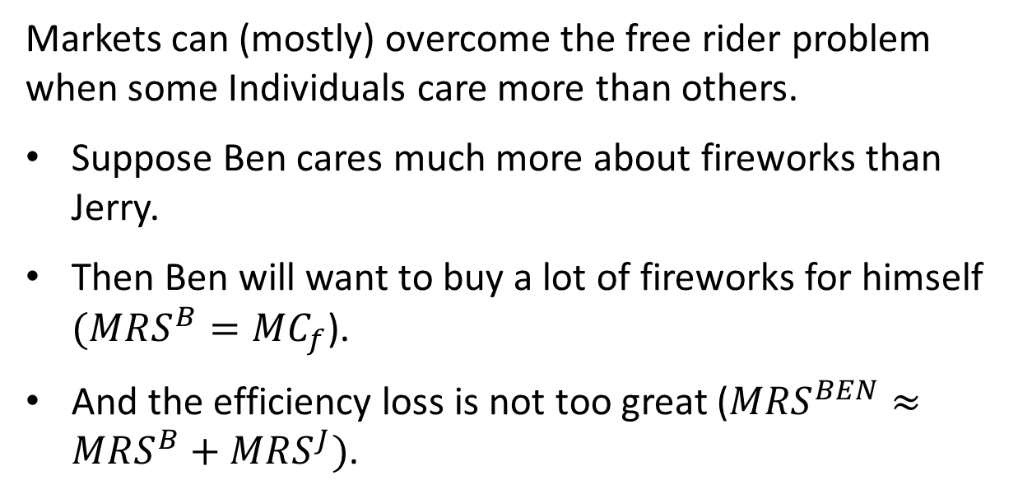
public goods: non-excludability and efficiency discussion
Can Private Provision Overcome the Free Rider Problem?

Slide 19
public goods: non-excludability and efficiency discussion
Altruism and social capital.
Private markets provide public goods when people are altruistic.
Altruistic: When individuals value the benefits and costs to others in making their consumption choices.
Many laboratory experiments provide evidence for altruism and show that people contribute to public goods.
How altruistic people are is measured by social capital.
Social capital: The value of altruistic and communal behavior in society.

Slide 20
public goods: non-excludability and efficiency discussion
Warm Glow
People might simply feel good about contributing to public goods or charity.
Warm glow model: A model of the public goods provision in which individuals care about both the total amount of the public good and their particular contributions as well.
Different from altruism because people don’t care about just the amount of the public good.

Slide 21
public goods: non-excludability and efficiency discussion
Public Provision of Public Goods
Despite private provision, there is a role for government provision of public goods:
Under private provision, not everyone contributes to the good, even though everyone benefits.
Government provision potentially solves the problem of non-contributors.
Nonetheless, there are several challenges to government provision.

Slide 22
public goods: non-excludability and efficiency discussion
Public Provision: Measuring the Costs and Benefits of Public Goods
Optimal public good provision requires knowing the MRS for each person. How to measure this?
Consider the case of a highway. Cost include wages and materials.
  What if, without this highway project, half of the workers on the project would be unemployed?
  How can the government take into account that it is not only paying wages but also providing a new job opportunity for these workers?

Slide 23
public goods: non-excludability and efficiency discussion
Public Provision: Measuring the Costs and Benefits of Public Goods
The benefits of highway construction are also difficult to measure.
  What is the value of the time saved for commuters due to reduced traffic jams?
  And what is the value to society of the reduced number of deaths if the highway is improved?

Slide 24
public goods: non-excludability and efficiency discussion
Public Provision: How Can We Measure Preferences for the Public Good?
Three challenges in measuring preferences for public goods.
Preference revelation: People may not want to reveal their true valuation because the government might charge them more for the good if they say that they value it highly.
Preference knowledge: People may not know what their valuation is.
Preference aggregation: How can the government combine the preferences of millions of citizens?

Slide 25
public goods: non-excludability and efficiency discussion
Conclusion
A major function of governments at all levels is the provision of public goods.
Sometimes, the private sector can provide public goods, but usually not the optimal amount.
Government intervention can potentially increase efficiency.
Success of intervention depends on:
  Ability of government to measure costs and benefits
  Ability to implement optimal plan

