Slide 1
redistribution and fairness
preference-based fairness criteria
axiomatic approach:
start from desirable properties
normative vs. positive
general application
scientific = consensual?
what’s fair?
Pareto efficiency (P):
it is not possible to make someone better off without making anyone else worse off

Slide 2
redistribution and fairness
preference-based fairness criteria
no-domination (D):
no agent should receive more of all goods than another.
no-envy (F):
no agent should prefer another agent’s allocation to her own i.e. the allocation is envy-free.
equal treatment of equals:
identical agents (in terms of preferences) should be indifferent with respect to the allocation that each of them receives.

Slide 3
redistribution and fairness
preference-based fairness criteria
equal-division lower bound (B_{ed}):
all agents should prefer their allocation to equal division of resources.
egalitarian-equivalence (E):
there should be a common reference bundle such that all agents are indifferent between their allocation and that bundle (that need not be feasible).

Slide 4
redistribution and fairness
preference-based fairness criteria

Slide 5



redistribution and fairness
preference-based fairness criteria
P= {(x₁, x₂): x₁ $+$ x₂ =1$\}$
D = E = F = ete = {(x₁, x₂): x₁ $=$ x₂ and x₁ $≤1/2\}$
DP = EP = FP = eteP = {(1/2, 1/2)$\}$

Slide 6
redistribution and fairness
preference-based fairness criteria
2-good, 2-agent case:
Edgeworth box
y
10
5
O_{B}
20
15
5
10
allocation t
10
allocation z
O_{A}
x
5
10
y

Slide 7
redistribution and fairness
preference-based fairness criteria
y
O_{B}
20
15
adding agent A’s preferences
10
R_{A}
O_{A}
x
5
10
y

Slide 8
redistribution and fairness
preference-based fairness criteria
y
10
5
O_{B}
5
R_{B}
adding agent B’s preferences
10
R_{A}
O_{A}
x
y

Slide 9
redistribution and fairness
preference-based fairness criteria
y
10
5
O_{B}
5
R_{B}
10
Efficient
allocation
efficiency?
R_{A}
O_{A}
x
y

Slide 10
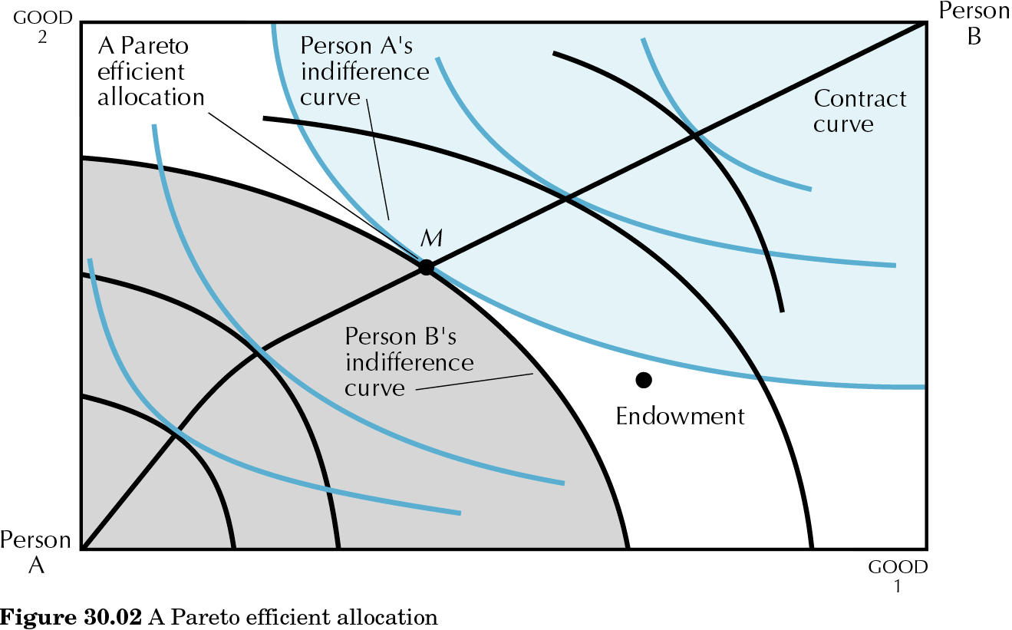
30.02
redistribution and fairness
preference-based fairness criteria
2-good, 2-agent case: Pareto efficiency (P)

Slide 11
example: u_{A} = x_{A}y_{A} u_{B} = x_{B}+y_{B} x_{A}+x_{B} = 10 y_{A}+y_{B} = 20
redistribution and fairness
preference-based fairness criteria
y
20
OB
R₂
15
5
10
10
ed
R₁
OA
x
5
10
y

Slide 12
Pareto solution
(P)
redistribution and fairness
preference-based fairness criteria
y
20
OB
R₂
15
5
10
P
10
ed
R₁
OA
x
5
10
y

Slide 13
no-domination
(D)
redistribution and fairness
preference-based fairness criteria
y
20
OB
15
5
10
P
10
ed
D
OA
x
5
10
y

Slide 14
no-domination
+
Pareto
(DP)
redistribution and fairness
preference-based fairness criteria
y
20
OB
15
5
10
P
10
ed
DP
OA
x
5
10
y

Slide 15
envy-free and Pareto?
(FP)
redistribution and fairness
preference-based fairness criteria
y
20
OB
R₂
15
5
10
P
10
ed
Take allocation A1. Is it envy-free?
R₁
A1
OA
x
5
10
y

Slide 16
redistribution and fairness
preference-based fairness criteria
y
20
P
For each efficient point (like point A1) in the Edgeworth box, find the symmetric with respect to equal division (ed): point B1 is what agent B receives at that allocation seen from agent A’s origin.
Since the two allocations are now seen from the same origin, we can compare the two: A strictly prefers B1 and therefore
A envies B.
15
B1
10
ed
A1
0
5
10
x

Slide 17
redistribution and fairness
preference-based fairness criteria
y
20
P
For point A2, the symmetric with respect to equal division (ed) is B2.
Agent A is exactly indifferent between the two and therefore
A no longer envies agent B.
15
B2
10
ed
A2
0
5
10
x

Slide 18
no-envy
+
Pareto
(FP)
redistribution and fairness
preference-based fairness criteria
y
20
OB
15
5
10
ed
10
P
A2
A envies B
R₁
OA
x
5
10
y

Slide 19
envy-free and Pareto?
(FP)
redistribution and fairness
preference-based fairness criteria
y
20
OB
R₂
15
5
A3
10
P
10
ed
Take allocation A3. Is it envy-free?
R₁
OA
x
5
10
y

Slide 20
redistribution and fairness
preference-based fairness criteria
y
20
P
For A3, find the symmetric with respect to equal division (ed): point B3 is what agent B receives and point A3 is what agent A receives, seen from the same origin.
Since the two allocations are now seen from the same origin, we can compare the two: B strictly prefers A3 and therefore
B envies A.
15
A3
10
ed
B3
0
5
10
x

Slide 21
redistribution and fairness
preference-based fairness criteria
y
20
For point A4, the symmetric with respect to equal division (ed) is B4.
Agent B is exactly indifferent between the two and therefore
B no longer envies A.
15
B4
10
ed
P
A4
OA
x
5
10
y

Slide 22
no-envy
+
Pareto
(FP)
redistribution and fairness
preference-based fairness criteria
y
20
OB
R₂
15
5
B envies A
10
ed
10
P
A4
OA
x
5
10
y

Slide 23
no-envy
+
Pareto
(FP)
redistribution and fairness
preference-based fairness criteria
y
20
OB
R₂
15
5
10
P
10
A4
FP
A2
R₁
OA
x
5
10
y

Slide 24
equal division lower bound
+
Pareto
(B_{ed}P)
redistribution and fairness
preference-based fairness criteria
y
20
OB
R₂
15
5
10
P
10
ed
B_{ed}P
R₁
OA
x
5
10
y

Slide 25
WALRASIAN SOLUTION FROM EQUAL DIVISION:
- walrasian equilibrium allocation:
- market prices adjust so that suppy equals demand in the markets for both goods;
- all agents are maximizing utility subject to the budget constraint;
- agents start with equal division of all the goods; therefore, both start with the same income: the market value (at market prices) of that initial endowment
redistribution and fairness
preference-based fairness criteria

Slide 26
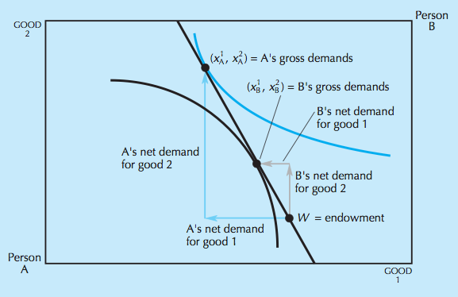
redistribution and fairness
preference-based fairness criteria
an example of disequilibrium:
the budget constraint for each agent goes through their endowment point and has a slope equal to the market price ratio
agents maximize utility subject to the budget constraint but there is excess demand of good 2 and excess supply of good 1

Slide 27
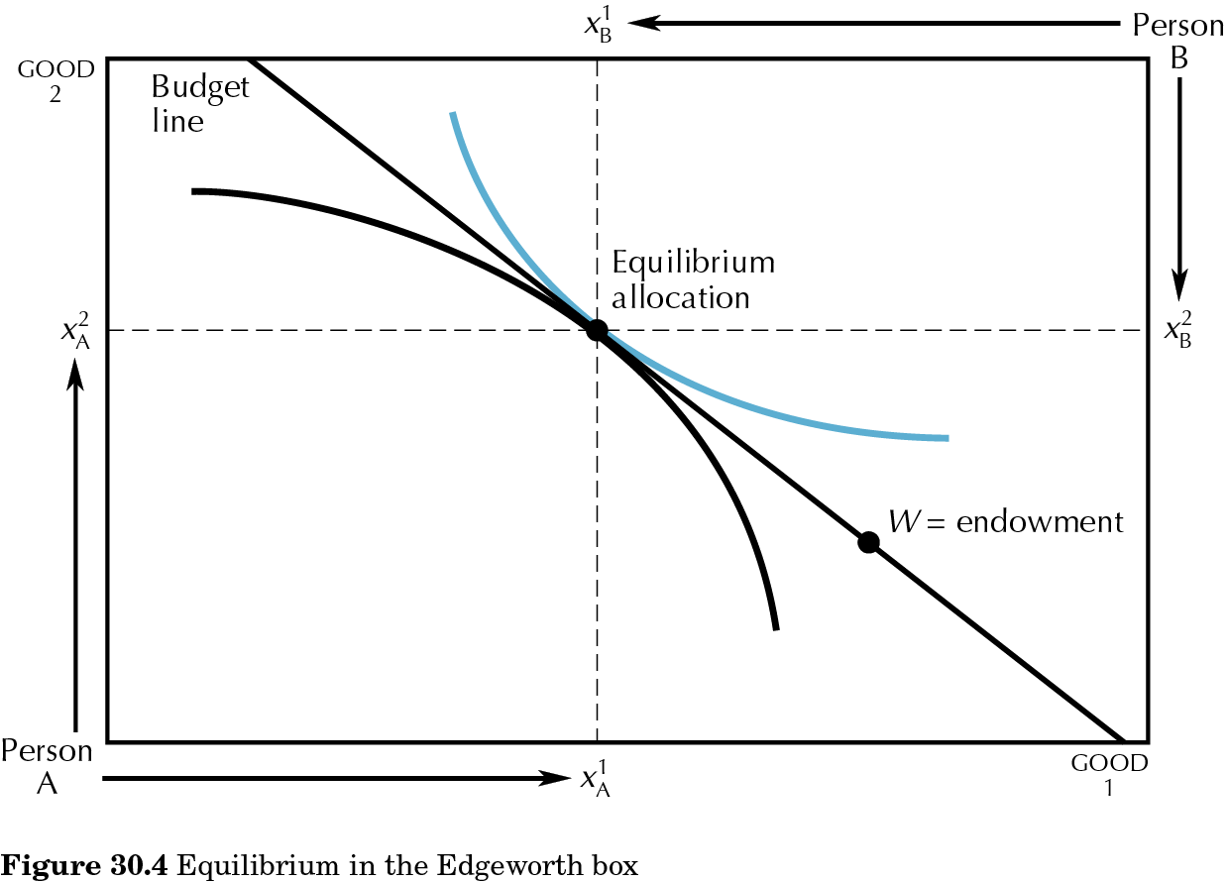
30.04
redistribution and fairness
preference-based fairness criteria
walrasian equilibrium: prices are such that both agents choose the same point in the Edgeworth box

Slide 28
walrasian solution from equal division
(W_{ed})
redistribution and fairness
preference-based fairness criteria
y
20
OB
R₂
15
5
10
P
10
ed
W_{ed}
R₁
OA
x
5
10
y

Slide 29
WALRASIAN SOLUTION FROM EQUAL DIVISION:
- is efficient: indifference curves are tangent to the budget constraint and therefore tangent to each other.
- is envy-free: all agents start from same endowment point and have the same budget set. Each agent ends up with her choice that must be at least as good for that agent as the other agent’s choice
- satisfies the equal division lower bound: for all agents, equal division is the starting point and is available in the budget set; they must be at least as well off at the final choice.
redistribution and fairness
preference-based fairness criteria

Slide 30
egalitarian equivalence and Pareto?
(EP)
redistribution and fairness
preference-based fairness criteria
y
20
OB
R₂
15
5
10
P
10
ed
A1
Take allocation A1. Is it egalitarian-equivalent?
R₁
OA
x
5
10
y

Slide 31
egalitarian-equivalence
redistribution and fairness
preference-based fairness criteria
y
20
P
reference bundle
B’s indifference curve through B1
15
B1
10
A is indifferent between A1 and the reference bundle;
B is indifferent between B1 and the same reference bundle:
the allocation is egalitarian-equivalent.
ed
A’s indifference curve through A1
A1
0
5
10
x

Slide 32
egalitarian-equivalence
redistribution and fairness
preference-based fairness criteria
y
B’s indifference curve through B2
20
P
15
B2
10
ed
A is indifferent between A2 and the reference bundle (that coincides with A2);
B is indifferent between B2 and the same reference bundle:
the allocation is egalitarian-equivalent.
reference bundle
A’s indifference curve through A2
A2
0
5
10
x

Slide 33
egalitarian-equivalence
redistribution and fairness
preference-based fairness criteria
y
20
P
15
B3
10
A’s indifference curve through A3
ed
A3
No intersection of indifference curves: no reference bundle!
The allocation is not egalitarian-equivalent.
B’s indifference curve through B3
0
5
10
x

Slide 34
egalitarian-equivalence
+
Pareto
(EP)
redistribution and fairness
preference-based fairness criteria
y
20
OB
R₂
15
5
10
P
10
ed
R₁
EP
OA
5
10
x
y

