Slide 1
government intervention in a market economy main objectives
When Should the Government Intervene in the Economy?
Economics generally presumes that markets deliver efficient outcomes, so why should government do anything?
Primary motive for government intervention when efficiency is the concern is therefore market failure.
Market failure: Problem that causes the market economy to deliver an outcome that does not maximize efficiency.

Slide 2
government intervention in a market economy main objectives
When Should the Government Intervene in the Economy?
Even if the market is well-functioning, an efficient outcome is not necessarily socially desirable.
Redistribution is a second reason for government intervention.
Redistribution: The shifting of resources from some groups in society to others.

Slide 3
government intervention in a market economy main tools
How Might Governments Intervene?
Tax or Subsidize Private Sale or Purchase
Use the price mechanism, changing the price of a good to encourage or discourage use.
Taxes raise the price for private sales or purchases of goods that are overproduced.
Subsidies lower the price for private sales or purchases of goods that are under-produced.

Slide 4
government intervention in a market economy main tools
How Might Governments Intervene?
Restrict or Mandate Private Sale or Purchase
Quotas restrict private sale of goods that are overproduced.
Mandates require private purchase of goods that are under-produced.
Public Provision
The government can provide the good directly.
Public Financing of Private Provision
Governments pays, private companies produce.

Slide 5
government intervention in a market economy effects
What Are the Effects of Alternative Interventions?
Interventions have direct and indirect effects.
Direct effects: The effects that would be predicted if individuals did not change their behavior in response to the interventions.
With 49 million uninsured, providing universal health insurance covers 49 million people.
Indirect effects: The effects that arise only because individuals change their behavior in response to the interventions.
If people drop private coverage, many more people may end up covered by the public plan.

Slide 6
government intervention in a market economy challenges
Why Do Governments Do What They Do?
Governments do not always choose efficient or socially desirable outcomes.
Political economy: The theory of how the political process produces decisions that affect individuals and the economy.

Slide 7
efficiency
Pareto efficiency: it is not possible to improve the welfare of one agent without reducing the welfare of another agent.
Pareto improvement: change that makes one agent better off without making any other agent worse off.
promotion of efficiency requires:
identification and study of market failure
identification of motives for public corrective action (issues of information, avaliable instruments and motivation)

Slide 8
efficiency
examples
Representatives from three neighboring regions (X, Y, and Z) are faced with three possibilities of improving the quality of life of their co-citizens: building a bridge from X to Y (option B), building a new cultural center in X (option C), and building new sport facilities (option S). Their preferences are given by:
Find the Pareto optimal choices and indicate a change that constitutes a Pareto improvement
 | X | Y | Z
1 | C | B | B
2 | B | S | C
3 | S | C | S

Slide 9
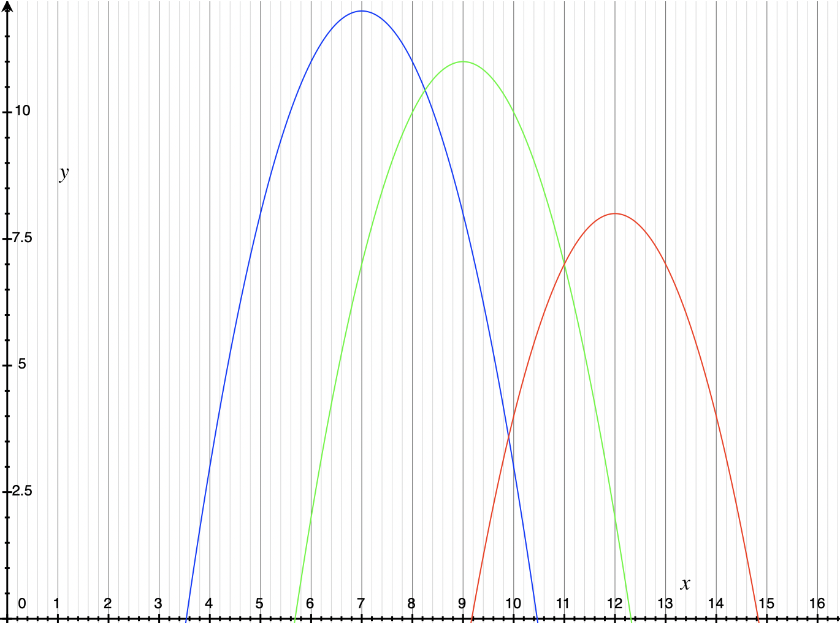
efficiency
examples
Three students share the same room and therefore need to wake up at the same time. Their utility levels as a function of wake-up time are represented in the graph.
Identify a change in wake-up time that is a Pareto improvement. Are there Pareto-optimal wake-up times?

Slide 10
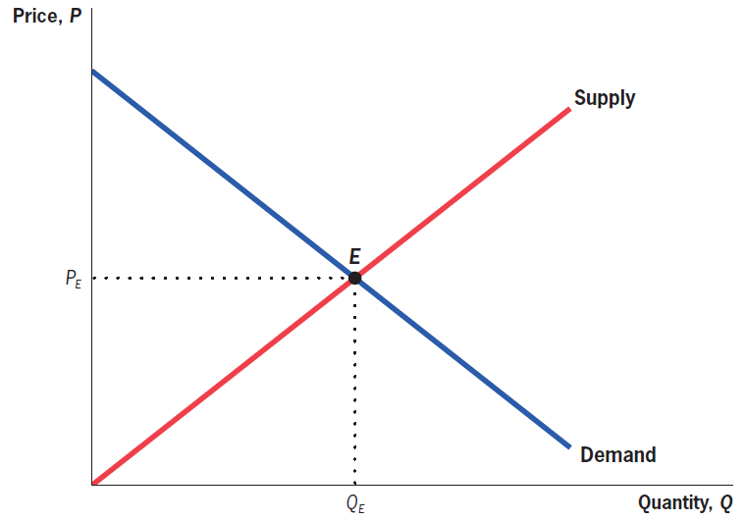
efficiency
Equilibrium: Graphical Representation

Slide 11
efficiency
Social Efficiency
Social efficiency represents the net gains to society from all trades that are made in a market, and it consists of the sum of two components: consumer and producer surplus. Also called total social surplus.
Consumer surplus: The benefit that consumers derive from consuming a good, above and beyond the price they paid for the good.
Producer surplus: The benefit that producers derive from selling a good, above and beyond the cost of producing that good.

Slide 12
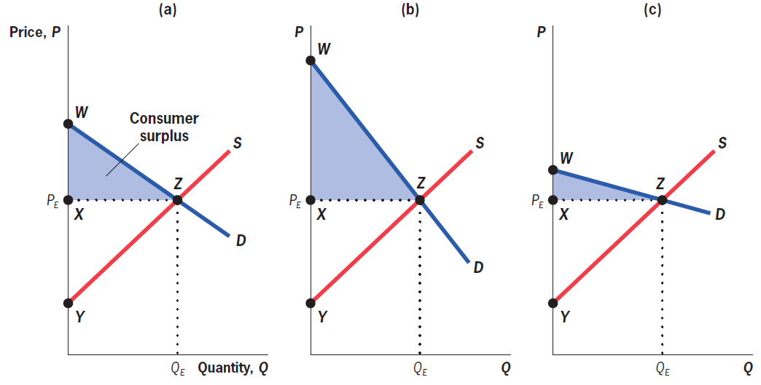
efficiency
Consumer Surplus: Graphical Representation
Consumer surplus is the area under the demand curve since demand = willingness to pay.

Slide 13
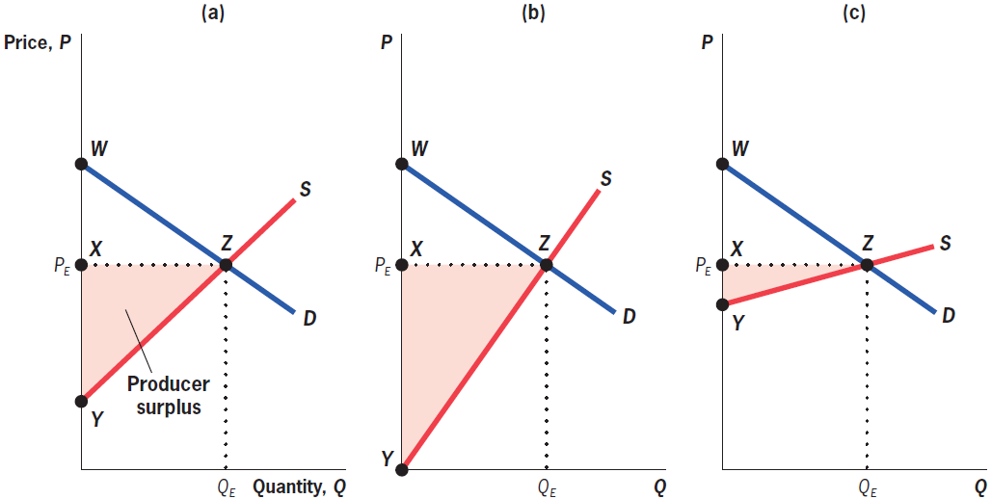
efficiency
Producer Surplus: Graphical Representation
Producer surplus is the area above the supply curve since supply = marginal cost.

Slide 14
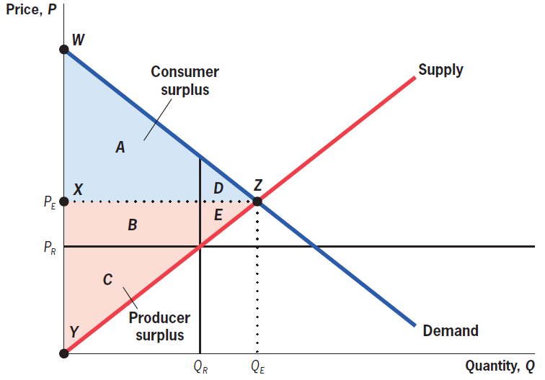
efficiency
Social Surplus: Graphical Representation

Slide 15
efficiency equilibrium and social welfare
Competitive Equilibrium Maximizes Social Efficiency
First fundamental theorem of welfare economics: The competitive equilibrium, where supply equals demand, maximizes social efficiency.
Deadweight loss: The reduction in social efficiency from preventing trades for which benefits exceed costs.
Quick hint: Deadweight loss is a triangle that points toward the equilibrium price and grows away from it.

Slide 16
efficiency equilibrium and social welfare
Efficiency and the Utility Possibility Frontier
u_{B}
Q
V
T
S
R
u_{A}
u_{A}

Slide 17
efficiency equilibrium and social welfare
Example: finding a Utility Possibility Frontier
u_{A}(x_{A}, y_{A}) = x_{A}^{1/2}. y_{A}^{1/2}
u_{B}(x_{B}, y_{B}) = x_{B}^{1/2}. y_{B}^{1/2}
and there is 1 unit of x and 1 unit of y in the economy
What’s efficient?
max x_{A}^{1/2}. y_{A}^{1/2}
s.t. x_{B}^{1/2}. y_{B}^{1/2} = u_{B}
x_{A}+x_{B}=1
y_{A}+y_{B}=1
We have y_{B}=1- y_{A} and x_{B}=1- x_{A}
and (1- x_{A})^{1/2}. (1- y_{A})^{1/2} = u_{B} $⟺$ y_{A} = 1- u_{B}² /(1- x_{A})

Slide 18
efficiency equilibrium and social welfare
Example: finding a Utility Possibility Frontier
Replacing in the objective function:
max ${xA}^{1/2} {\left(1−\frac{{\overline{u_{B}}}^{2}}{1− xA}\right)}^{1/2}$
FOC: ${\frac{1}{2}xA}^{−1/2} {\left(1−\frac{{\overline{u_{B}}}^{2}}{1− xA}\right)}^{1/2}+{\frac{1}{2}xA}^{1/2} {\left(1−\frac{{\overline{u_{B}}}^{2}}{1− xA}\right)}^{−1/2}.\left(−\frac{{\overline{u_{B}}}^{2}}{{\left(1− xA\right)}^{2}}\right)$ = 0
$⟺$ ${\left(1−\frac{{\overline{u_{B}}}^{2}}{1− xA}\right)}^{}+xA.\left(−\frac{{\overline{u_{B}}}^{2}}{{\left(1− xA\right)}^{2}}\right)$ = 0 $⟺$ ${\left(1− xA\right)}^{2} −{{\overline{u_{B}}}^{2}\left(1−xA\right)}^{}={\overline{u_{B}}}^{2}.xA$
yielding the efficient allocations:$xA$=1- $\overline{u_{B}}$ and $yA$=1- $\overline{u_{B}}$ and $xB$= $\overline{u_{B}}$ and$yB$= $\overline{u_{B}}$.
Replacing in A’s utility function, we get u_{A} = x_{A}^{1/2}. y_{A}^{1/2} = 1- $\overline{u_{B}}$
The utility possibility frontier is therefore: u_{A} = 1- u_{B}

Slide 19
efficiency equilibrium and social welfare
Example: finding a Utility Possibility Frontier
u_{B}
1
u_{B}
1
u_{A}

Slide 20
efficiency equilibrium and social welfare
Example: finding a Utility Possibility Frontier
What if u_{A}(x_{A}, y_{A}) = x_{A}^{1/4}. y_{A}^{1/4}
u_{B}(x_{B}, y_{B}) = x_{B}^{1/2}. y_{B}^{1/2}
and there is 1 unit of x and 1 unit of y in the economy
What’s efficient?
max x_{A}^{1/4}. y_{A}^{1/4}
s.t. x_{B}^{1/2}. y_{B}^{1/2} = u_{B}
x_{A}+x_{B}=1
y_{A}+y_{B}=1
We have y_{B}=1- y_{A} and x_{B}=1- x_{A}
and (1- x_{A})^{1/2}. (1- y_{A})^{1/2} = u_{B} $⟺$ y_{A} = 1- u_{B}² /(1- x_{A})

Slide 21
efficiency equilibrium and social welfare
Example: finding a Utility Possibility Frontier
Replacing in the objective function:
max ${xA}^{1/4} {\left(1−\frac{{\overline{u_{B}}}^{2}}{1− xA}\right)}^{1/4}$
yielding the same efficient allocations:
$xA$=1- $\overline{u_{B}}$ and $yA$=1- $\overline{u_{B}}$ and $xB$= $\overline{u_{B}}$ and$yB$= $\overline{u_{B}}$.
Replacing in A’s utility function, we get u_{A} = x_{A}^{1/4}. y_{A}^{1/4} = (1- $\overline{u_{B}})\text{1/}\text{2}$
The utility possibility frontier is therefore: u_{B} = 1- u_{A} $\text{2}$

Slide 22
efficiency equilibrium and social welfare
Example: finding a Utility Possibility Frontier
u_{B}
1
u_{B}
1
u_{A}

Slide 23
redistribution and fairness equilibrium and social welfare
From Social Efficiency to Social Welfare: The Role of Equity
Social welfare: The level of well-being in society.
Determined by both how much gets produced, and how it is distributed.
Second fundamental theorem of welfare economics: Society can attain any efficient outcome by suitably redistributing resources among individuals and then allowing them to freely trade.
Difficult in practice to redistribute like this.
Equity–efficiency trade-off: The choice society must make between the total size of the economic pie and its distribution among individuals.

Slide 24
redistribution and fairness equilibrium and social welfare
u_{B}
T
S
R
u_{A}

Slide 25
redistribution and fairness utility-based fairness criteria
Bergson-Samuelson Social Welfare Functions
functions that combine utility functions of all individuals into na overall social utility function (interpersonal comparison of utilities)
utilitarianism (Bentham):
Max W=Σu_{i}(y_{i})
Harsanyi: Max W=Σp_{i}u_{i}(y_{i}) - total ignorance: p_{i}=1/N
Rawls: original position, veil of ignorance
Maximin rule: Max min {u₁(y₁), u₂(y₂), ..., u_{I}(y_{I})}
maximize utility of agent with lowest welfare; extreme degree of risk aversion (only information on worst possible outcome is considered)

Slide 26
redistribution and fairness utility-based fairness criteria
Example: Utilitarian
u_{B}
Max u_{A} + u_{B}
s.t. u_{A} = 1- u_{B}
1
u_{A} = 1- u_{B}
Isowelfare Curves
All points on the UPF
are optimal
UPF
1
u_{A}

Slide 27
redistribution and fairness utility-based fairness criteria
Example: Utilitarian
u_{B}
Max u_{A} + u_{B}
s.t. u_{B} = 1- u_{A}²
1
Isowelfare Curves
u_{A} = ½
and u_{B} = ¾
UPF
1
u_{A}

Slide 28
redistribution and fairness utility-based fairness criteria
Example: Rawls
u_{B}
Max min{u_{A} , u_{B} }
s.t. u_{A} = 1- u_{B}
1
u_{A} = u_{B}
u_{A} = u_{B} = 1/2
1
u_{A}

Slide 29
redistribution and fairness utility-based fairness criteria
Example: Rawls
u_{B}
Max min{u_{A} , u_{B} }
s.t. u_{B} = 1- u_{A}²
1
u_{A} = u_{B}
u_{A} = u_{B} = ($√$5-1)/2
UPF
1
u_{A}

Slide 30
redistribution and fairness utility-based fairness criteria
Social welfare functions may reflect different possible equity criteria, including:
Commodity egalitarianism: The principle that society should ensure that individuals meet a set of basic needs, but that beyond that point income distribution is irrelevant.
Equality of opportunity: The principle that society should ensure that all individuals have equal opportunities for success but not focus on the outcomes of choices made.
Issues:
interpersonal utility comparisons: cardinal vs. ordinal information and comparability
equity vs. efficiency – if there are no lump-sum transfers, distortionary intervention creates deadweight loss

