Slide 1
Spring 2024 | Practical Sessions
Industrial Organization
Midterm revision
Week 10

Slide 2
Spring 2024| Practical Sessions
Information about the midterm
Midterm topics:
The Extremes: Perfect Competition and Monopoly
Market Structure:
- Measures of Concentration
- Measures of Volatility
Game Theory
Oligopoly models:
- Dominant Firm and Monopolistic Competition
- Cournot
- Stackelberg
- Bertrand
Midterm structure:
2 True or False questions (8 points)
2 Exercises (12 points)
Check Moodle for OH days!

Slide 5
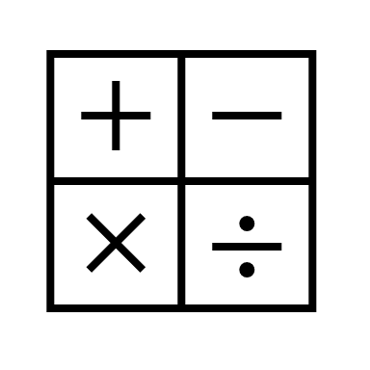
Spring 2024 | Practical Sessions
True or False
Exercise
“Entry of new firms is always good for consumers and bad for incumbents.”
“In a duopoly, price may be equal to both firm’s constant average and marginal cost, i.e., both firms may be making no profit whatsoever and yet the Herfindahl-Hirschman index may be approximately 1.”
Notes:
1 - (Fall 2003)
2 – (Spring 2018)

Slide 6
Spring 2024 | Practical Sessions
Competition in Quantities
Exercise
Two firms, 1 and 2, supply a market for an homogeneous product whose demand equals $q=10−p$. They do so at a constant marginal and average cost of 2 while competing in quantities.
How much will each produce? What price will prevail? How much will each profit?
Firm 2’s factory has partially burned down. As a result, firm 2 can produce at most 2 units of output.
(ii) How does this affect firm 2’s best-reply function? Draw a figure. And firm 1’s? Complete the figure.
(iii) What is firm 2’s output? And firm 1’s? What is firm 2’s profit? And firm 1’s?
Notes:
Fall 2015

Slide 7
Spring 2024 | Practical Sessions
Competition in Quantities
Exercise
Two firms, 1 and 2, supply a market for an homogeneous product whose demand equals $q=10−p$. They do so at a constant marginal and average cost of 2 while competing in quantities.
Suppose that firm 1’s manager is unaware of the fire.
(iv) What is firm 1’s output? And firm 2’s? What is firm 2’s profit? And firm 1’s?
(v) Is it preferable for consumers that firm 1’s manager remain unaware of the fire? Compute and explain.
(vi) And for society as a whole? Compute and explain.
Notes:
Fall 2015

Slide 8
Spring 2024 | Practical Sessions
Competition in Prices
Exercise
One firm, denoted 1, supplies a medicine whose demand is equal to $q=10−p$, producing it at a constant marginal and average cost of 2.
What price will firm 1 set? What will its profit be? Quantify.
Another firm, denoted 2, comes up with another medicine that is a perfect substitute for the medicine produced by firm 1. Firm 2 also produces at a marginal and average cost of 2. Both firms quote prices, which they choose simultaneously and independently.
(ii) What is the value of firm 2’s new medicine to its shareholders?
(iii) Who benefits from firm 2’s invention? Who is hurt by firm 2’s invention? What is the value of firm 2’s new medicine for society as a whole? Compute and explain.
Notes:
Spring 2018

Slide 9
Spring 2024 | Practical Sessions
Competition in Prices
Exercise
One firm, denoted 1, supplies a medicine whose demand is equal to $q=10−p$, producing it at a constant marginal and average cost of 2.
(iv) Suppose that a third firm, denoted 3, has invented yet another perfect substitute for the two medicines offered by firms 1 and 2, which it also produces at a constant marginal and average cost. Under what condition will this new medicine be privately and socially beneficial? Quantify and explain.
Notes:
Spring 2018

