Slide 1
general equilibrium
in a pure exchange economy
walrasian equilibrium definition aggregate excess demand example Walras’ law relative prices

Slide 2
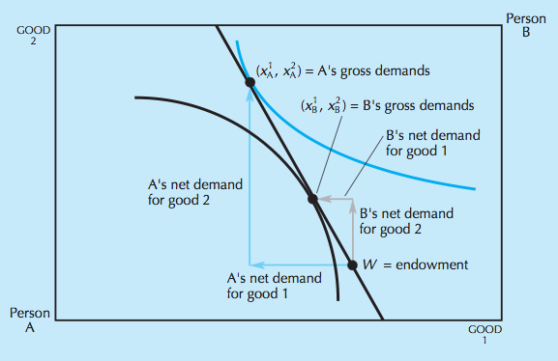
example: disequilibrium

Slide 3
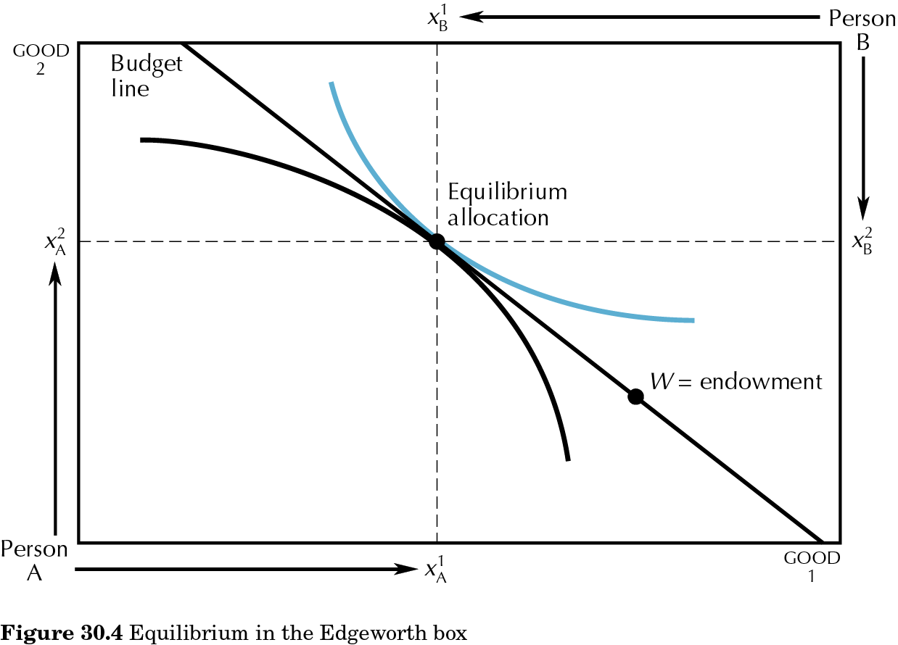
30.04
Edgeworth box
2-good, 2-agent case: walrasian equilibrium

Slide 4
walrasian equilibrium
(p₁*, p₂*, x₁^{A}*, x₂^{A}*, x₁^{B}*, x₂^{B}*)
is a walrasian equilibrium if:
all agents maximize utility subject to budget constraint
all markets clear

Slide 5
walrasian equilibrium
(p₁*, p₂*, x₁^{A}*, x₂^{A}*, x₁^{B}*, x₂^{B}*)
is a walrasian equilibrium if:
for all i, (x₁^{i}*, x₂^{i}*) solve
max u^{i}(x₁^{i}, x₂^{i}) s.t. p₁x₁^{i}+p₂x₂^{i} ≤ p₁ω₁^{i} +p₂ω₂^{i}
all markets clear i.e.
x₁^{A}+x₁^{B} = ω₁^{A} +ω₁^{B}
x₂^{A}+x₂^{B} = ω₂^{A} +ω₂^{B}

Slide 6
walrasian equilibrium
aggregate excess demands
z₁ (p₁, p₂)= x₁^{A}(p₁, p₂) + x₁^{B}(p₁, p₂) – ω₁^{A} - ω₁^{B}
z₂ (p₁, p₂)= x₂^{A}(p₁, p₂) + x₂^{B}(p₁, p₂) – ω₂^{A} - ω₂^{B}
(p₁*, p₂*, x₁^{A}*, x₂^{A}*, x₁^{B}*, x₂^{B}*)
is a walrasian equilibrium if:
z₁ (p₁*, p₂*) = 0
z₂ (p₁*, p₂*) = 0

Slide 7
walrasian equilibrium
Example:
u^{A}(x₁^{A}, x₂^{A}) = x₁^{A}. x₂^{A} and ω₁^{A} = 4, ω₂^{A} = 6
u^{B}(x₁^{B}, x₂^{B}) = x₁^{B}. x₂^{B} and ω₁^{B} = 6, ω₂^{B} = 14
Individual demands
- A solves max x₁^{A}. x₂^{A} s.t. p₁x₁^{A}+p₂x₂^{A} ≤ p₁ω₁^{A} +p₂ω₂^{A}
yielding x₁^{A}(p₁, p₂) = [p₁ω₁^{A} +p₂ω₂^{A}] / 2p₁ = [4p₁+6p₂] / 2p₁ = 2 + 3p₂/p₁
and x₂^{A}(p₁, p₂) = [p₁ω₁^{A} +p₂ω₂^{A}] / 2p₂ = [4p₁+6p₂] / 2p₂ = 2p₁/p₂ + 3
- B solves max x₁^{B}. x₂^{B} s.t. p₁x₁^{B}+p₂x₂^{B} ≤ p₁ω₁^{B} +p₂ω₂^{B}
yielding x₁^{B}(p₁, p₂) = [p₁ω₁^{B} +p₂ω₂^{B}] / 2p₁ = [6p₁+14p₂] / 2p₁ = 3 + 7p₂/p₁
and x₂^{B}(p₁, p₂) = [p₁ω₁^{B} +p₂ω₂^{B}] / 2p₂ = [6p₁+14p₂] / 2p₂ = 3p₁/p₂ + 7

Slide 8
walrasian equilibrium
Example:
2. Market clearing
Good 1:
x₁^{A} (p₁, p₂) +x₁^{B} (p₁, p₂) = ω₁^{A} +ω₁^{B}
2 + 3p₂/p₁ + 3 + 7p₂/p₁ = 4 + 6 $⟺$ 10p₂/p₁ = 5 $⟺\text{p}\text{2}\text{/}\text{p}\text{1}\text{ = }\text{1/2}$

Slide 9
walrasian equilibrium
Example:
2. Market clearing
Good 2:
x₂^{A} (p₁, p₂) +x₂^{B} (p₁, p₂) = ω₂^{A} +ω₂^{B}
2p₁/p₂ + 3 + 3p₁/p₂ + 7 = 6 + 14 $⟺$ 5p₁/p₂ = 10 $⟺\text{p}\text{1}\text{/}\text{p}\text{2}\text{ =}\text{2}$

Slide 10
Walras’ law
Since for all i and for all (p₁, p₂),
p₁x₁^{i}(p₁, p₂)+p₂x₂^{i} (p₁, p₂)= p₁ω₁^{i} +p₂ω₂^{i}
then p₁z₁(p₁, p₂)+p₂z₂ (p₁, p₂)= 0
i.e. the value of aggregate excess demand is 0 for all prices
Implication: only 1 out of 2 equilibrium equations is linearly independent (and only k-1 out of k, in the general case with k goods)

Slide 11
relative prices
Multiplying all prices (p₁, p₂) by t > 0, gross demands remain the same since the budget constraint does not change.
But then only relative prices matter and we can fix one of the goods to become the numeraire!
Implication: only 1 out of 2 equilibrium prices needs to be determined (and only k-1 out of k, in the general case with k goods).

Slide 12
walrasian equilibrium
Back to example:
$$p\text{1}\text{*}\text{/}\text{p}\text{2}\text{*}\text{=}\text{2}$$
yielding x₁^{A}(p₁*, p₂*) = 2 + 3p₂*/p₁*= 7/2
and x₂^{A}(p₁*, p₂*) = 2p₁*/p₂* + 3 = 7
and x₁^{B}(p₁*, p₂*) = 3 + 7p₂*/p₁* = 13/2
and x₂^{B}(p₁*, p₂*) = 3p₁*/p₂* + 7 = 13
The WE is (p₁*=2, p₂*=1, x₁^{A}*=7/2, x₂^{A}*=7, x₁^{B}*=13/2, x₂^{B}*=13)
... or (p₁*=1, p₂*=1/2, x₁^{A}*=7/2, x₂^{A}*=7, x₁^{B}*=13/2, x₂^{B}*=13)
... or (p₁*=4, p₂*=2, x₁^{A}*=7/2, x₂^{A}*=7, x₁^{B}*=13/2, x₂^{B}*=13)
…

