Slide 1
Time Value of Money
Interest rates and Cash-flows
Advanced Financial Management

Slide 2
Advanced Financial Management | Time Value of Money – Interest rates and CFs
Key takeaways
03
Apply the perpetuity and annuity formulas.
04
Convert quoted interest rates in the form provided into effective interest rates which are appropriate to use in the valuation of a stream of cash flows.
Notes:
The key takeaways you should take from this video lecture are: to

Slide 3
Advanced Financial Management | Time Value of Money – Interest rates and CFs
Perpetuity and Annuities: summary
With constant cash-flows
With cash-flows growing at a constant rate
Stream of perpetual cash-flows
PV of Perpetuity | = | CF₁
 |  | r
PV of growing Perpetuity | = | CF₁
 |  | r-g
When there is growth in cash-flows, the cash-flow that must be used in the formulas is the first one in the stream
Stream of cash-flows for a limited number of periods
These formulas provide the present value represented in the period right before the first payment, not necessarily today
PV of Annuity | = | CF₁ | x 1- | 1
 |  | r |  | (1+r)^{n}
PV of growing Annuity | = | CF₁ | x 1- | (1+g)^{n}
 |  | r-g |  | (1+r)^{n}

Slide 4
How to apply the formulas correctly
Advanced Financial Management | Time Value of Money – Interest rates and CFs
Computation
Formulas assume the first cash-flow accrues at the end of the first period!
  Remember to apply the formulas taking this into account
Use effective rates
Consistency is key!
  Frequency of payments, discount rates and growth rates should be the same (e.g. with monthly payments, use monthly discount and growth rates).
    Note: the frequency of payments dictates what rates you should use
  Discount nominal cash-flows with nominal interest rates and discount real cash-flows with real interest rates!
Notes:
Remember to apply the formulas taking this into account

Slide 5












Advanced Financial Management | Time Value of Money – Interest rates and CFs
Proof of perpetuity formula
$$C$$
$$C$$
$$C$$
$$C$$
$$C$$
$$PV_{1}=PV_{0}$$
$$PV_{0}=\frac{C}{1+r}+\frac{C}{{\left(1+r\right)}^{2}}+…$$
$$PV_{1}=\frac{C}{1+r}+\frac{C}{{\left(1+r\right)}^{2}}+…$$
$$PV_{0}=\frac{C+PV_{1}}{1+r}$$
$$⇒PV_{0}=\frac{C+PV_{0}}{1+r}$$
$$⇒PV_{0}=\frac{C}{r}$$

Slide 6
Annuities in real life with mortgages
Advanced Financial Management | Time Value of Money – Interest rates and CFs
A mortgage loan is an annuity with PV equal to the loan amount and C the monthly payment.
Mortgage loans are typically amortizing: each monthly payment C contains both interest payment on the outstanding balance as well as part of the balance itself.
You are buying a small apartment with a 30-year mortgage loan of €100,000. Payments are due monthly at an APR of 6% compounded monthly.
  What is the value of the monthly payment?
  What is the loan balance at the end of the first year? (the amount you would need to pay back to the bank in full at the end of the first year to pay off the mortgage)
  Split the total payment in the first year into interest payments and amortization
Example

Slide 7
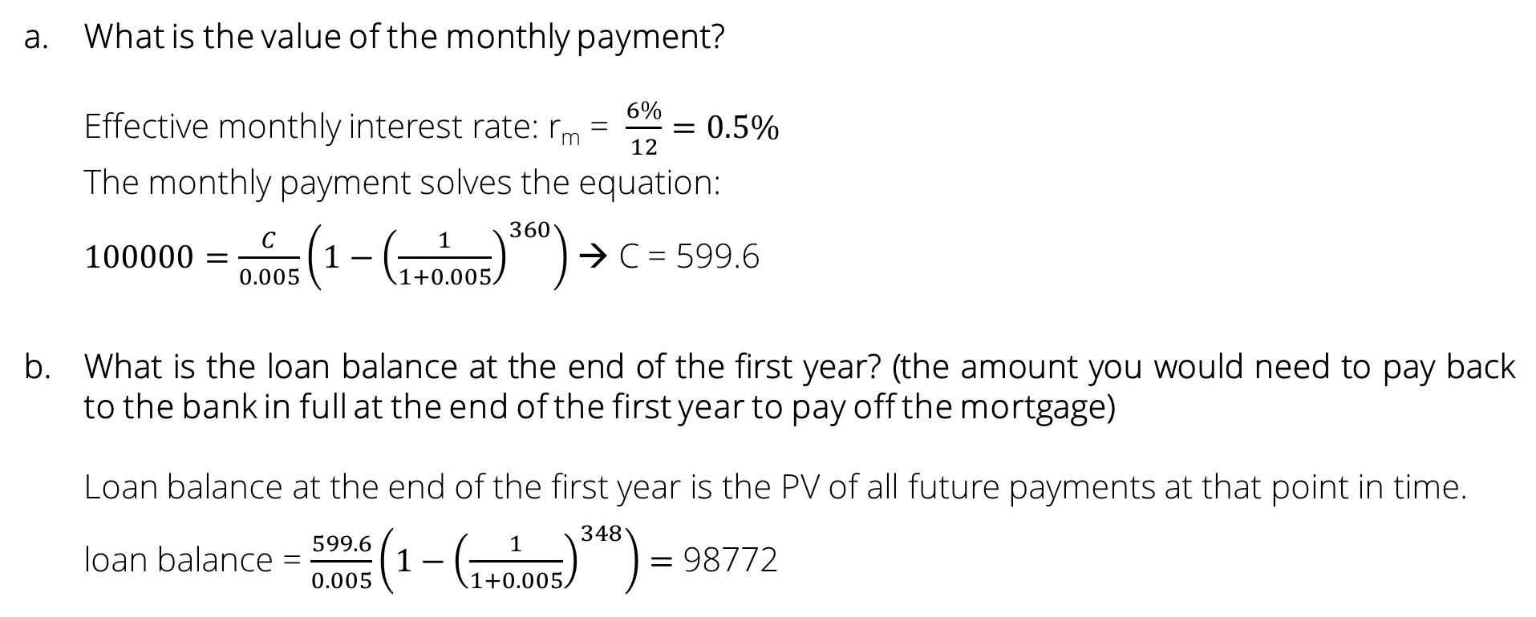
Example: amortizing loan
Advanced Financial Management | Time Value of Money – Interest rates and CFs
What is the value of the monthly payment?
Effective monthly interest rate: r_{m} = $\frac{6\%}{12}=0.5\%$
The monthly payment solves the equation:
$100000=\frac{C}{0.005}\left(1−{\left(\frac{1}{1+0.005}\right)}^{360}\right)$ → C = 599.6
What is the loan balance at the end of the first year? (the amount you would need to pay back to the bank in full at the end of the first year to pay off the mortgage)
Loan balance at the end of the first year is the PV of all future payments at that point in time.
loan balance = $\frac{599.6}{0.005}\left(1−{\left(\frac{1}{1+0.005}\right)}^{348}\right)=$ 98772
Notes:
360-12=348

Slide 8
Example: amortizing loan
Advanced Financial Management | Time Value of Money – Interest rates and CFs
Split the total payment in the first year into interest payments and amortization
Total payment in first year:
12 * 599.6 = 7,194.6
  Amortization: 100000-98772 = 1228
  Interest payment: 7194.6 – 1228 = 5966.6
Early in life of loan
Late in life of loan
Amortization
PAYMENT
Interest
Amortization
Interest
Payment is the same each year but composition changes

Slide 9
Exercise 1
Advanced Financial Management | Time Value of Money – Interest rates and CFs
Emma is 30 years old and her salary next year will be €40,000. Emma forecasts that her salary will increase at a constant rate of 5% per year until her retirement at age of 60.
  If the EAR is 8%, what is the PV of these future salary payments?
  If Emma saves 5% of her salary each year and invests these savings at an interest rate of 8%, how much will she have saved by age 60?
  If Emma plans to spend these savings in even amounts over her 20 years of retirement, how much can she spend each year?
5
4
3
2
1
Notes:
Take my notes with me and do it on the board

Slide 10
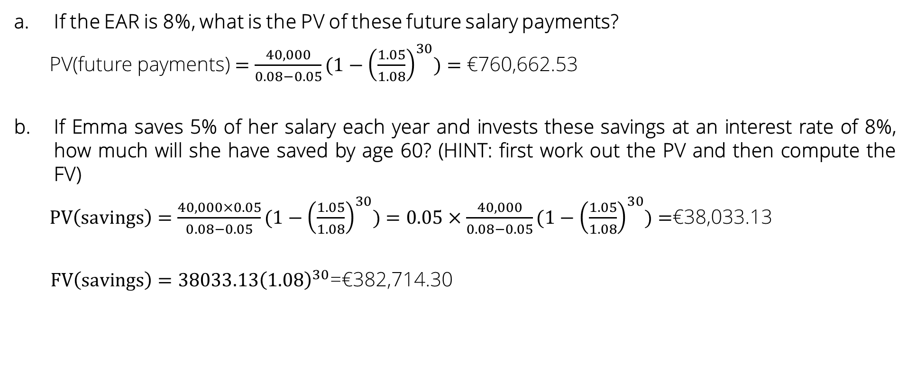
Exercise 1 - solutions
Advanced Financial Management | Time Value of Money – Interest rates and CFs
If the EAR is 8%, what is the PV of these future salary payments?
PV(future payments) $=\frac{40,000}{0.08−0.05}(1−{\left(\frac{1.05}{1.08}\right)}^{30})=$ €760,662.53
If Emma saves 5% of her salary each year and invests these savings at an interest rate of 8%, how much will she have saved by age 60? (HINT: first work out the PV and then compute the FV)
$PV\left(savings\right)=\frac{40,000×0.05}{0.08−0.05}(1−{\left(\frac{1.05}{1.08}\right)}^{30})=0.05×\frac{40,000}{0.08−0.05}(1−{\left(\frac{1.05}{1.08}\right)}^{30})=$€38,033.13
$FV\left(savings\right)=38033.13{\left(1.08\right)}^{30}$=€382,714.30
760,662.53

Slide 11

Exercise 1 - solutions
Advanced Financial Management | Time Value of Money – Interest rates and CFs
If Emma plans to spend these savings in even amounts over her 20 years of retirement, how much can she spend each year?
€382,714.30 = $\frac{C}{0.08}(1−\frac{1}{{1.08}^{20}})$
  She can spend €38,980.30

Slide 12



Slide 13
News discussion
Why should we care about Central Banks rate changes?
What happened to the time value of money on March 3rd 2020 in the USA?
Suppose you are living in the US and you currently have a mortgage. You pay $1000 every month and there are 48 payments remaining. The article mentions the following: “The Fed's move should lower the cost of borrowing, including for credit cards, auto loans and mortgages”. If the FED rate cut decreases the monthly interest rate, then surely the PV of your loan has increased.
Comment on the accuracy of the previous statement.
Why does the article mention that declines in indexes occurred despite the interest rate cut? That is, why should we have expected an increase in the indexes (holding everything else constant)?

Slide 14

Advanced Financial Management | Time Value of Money – Interest rates and CFs
Interest rates
Without compounding
With compounding
Calculating the annual rate from rate for the period n
Stated annual rate
Effective annual rate
APR = n x r_{n}
EAR = (1+r_{n})^{n}-1
EAR = (1+$\frac{APR}{n}$)^{n}-1
Calculating the rate for the period n from the annual rate
Proportional rate
Equivalent rate
r_{n} = | APR
 | n
r_{n}= (1+EAR)^{1/n}-1
Notes:
Make sure to note that we can use the rm from the apr in the EAR calculation
Also note the concept of equivalent rate. For example rm can be the equivalent monthly rate to the annual rate. If we were to invest 1 euro at rm for 1 year, that would be the same as investing 1 euro at the EAR for 1 euro.
APR=20%; r_S=20%/2 = 10% So if we invest 1 euro for 6 months we will have 1.1 at the end of the 6 months. How about at the end of 1 year? 1.1*1.1=1.21 = 1+EAR so the EAR is 21%

Slide 15
Exercise 2
Advanced Financial Management | Time Value of Money – Interest rates and CFs
A firm is considering buying a new telephone system which will last 4 years. The system has an upfront cost of €150,000. Alternatively the firm can lease the system from the manufacturer for €4,000 paid at the end of each month.
  If the firm can borrow or lend at a 5% stated annual interest rate with semi-annual compounding, should it purchase or lease the system?
  If instead the firm can borrow or lend at a 15% stated annual interest rate with monthly compounding, does the firm decision change?
5
4
3
2
1

Slide 16
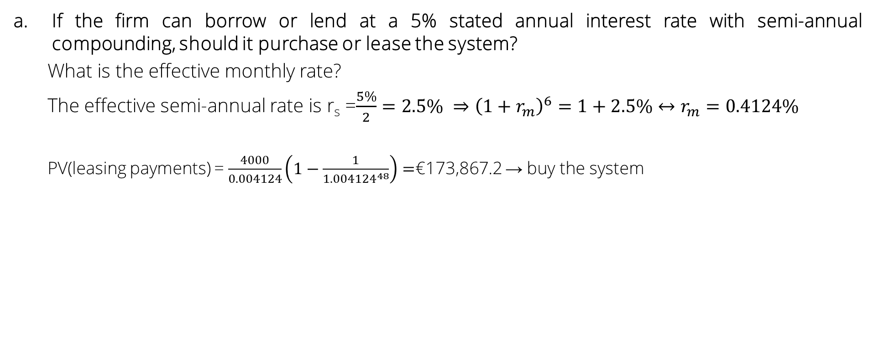
Exercise 2 - solutions
Advanced Financial Management | Time Value of Money – Interest rates and CFs
If the firm can borrow or lend at a 5% stated annual interest rate with semi-annual compounding, should it purchase or lease the system?
What is the effective monthly rate?
The effective semi-annual rate is r_{s} =$\frac{5\%}{2}=2.5\% ⇒{\left(1+r_{m}\right)}^{6}=1+2.5\%↔r_{m}=0.4124\%$
  PV(leasing payments) = $\frac{4000}{0.004124}\left(1−\frac{1}{{1.004124}^{48}}\right)=$€173,867.2 → buy the system

Slide 17

Exercise 2 - solutions
Advanced Financial Management | Time Value of Money – Interest rates and CFs
If instead the firm can borrow or lend at a 15% stated annual interest rate with monthly compounding, does the firm decision change?
The effective monthly rate is r_{m}=$\frac{15\%}{12}=1.25\%$
  PV(leasing payments) = $\frac{4000}{0.0125}\left(1−\frac{1}{{1.0125}^{48}}\right)=$€143,725.9 → lease the system

Slide 18
Through Moodle, complete the two quizzes:
- Summative quiz 01
- Summative quiz 02

Slide 19
Review
We use the effective rate
The rate and the horizon must be in the same units
We only compare cashflows at the same time period
We only undertake positive-NPV projects and if we need to choose, we always get the highest NPV

Slide 20
Exercise 3
You are planning to develop a product for which you will earn 4€ per unit sold. Next year you will sell 100 units and then sales will grow at the rate of 14% per year until the year you sell 250 units. After that point, sales will stay constant at 250. EAR is 20%.
What is the maximum amount you would pay today to develop the product?
Exercise 4
Today is December 31, 2024, and someone offers you a project that produces 100 in cashflow at the end of every month in 2026. Then, it grows at the 4% rate annually but always paying the same quantity per month within a year. EAR is 6%.
What is the present value of the project cashflows?
10
9
8
7
6
5
4
3
2
1

Slide 21




Exercise 3
You are planning to develop a product for which you will earn 4€ per unit sold. Next year you will sell 100 units and then sales will grow at the rate of 14% per year until the year you sell 250 units. After that point, sales will stay constant at 250. EAR is 20%.
What is the maximum amount you would pay today to develop the product?
$$8$$
$$9$$
Annuity (8 years, g=14%, EAR=20%) =$\frac{400}{0.20−0.14}\left(1−{\left(\frac{1.14}{1.20}\right)}^{8}\right)≈2244$
Perpetuity (g=0%, EAR=20%) = $\frac{1000}{0.20}=5000$
$$\frac{5000}{{1.20}^{8}}≈1163$$
$$PV=2244+1163=3407$$
1st we need to know at which year we reach 250 units:
$$250={100×1.14}^{T−1}⇒T=\frac{\ln\left(2.50\right)}{\ln\left(1.14\right)}+1≈8$$

Slide 22




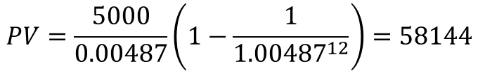
Exercise 4
100
100
104
104
108.2
108.2
112.5
112.5
Jan 2026
June 2026
Jan 2027
June 2027
Jan 2028
June 2028
Jan 2029
June 2029
Let’s consider January
It is a perpetuity!
Let’s consider June
It is the same perpetuity!
$$PV_{M}=\frac{100}{0.06−0.04}=5000$$
Remember: Perpetuity assumes, the first payoff is one period after; hence, the present value corresponds to
$$5000$$
$$5000$$
$$5000$$
Jan 2025
June 2025
Dec 2025
It is a “monthinty” (monthly annuity) !
$$r_{m}={\left(1+EAR\right)}^{1/n}−1={1.06}^{\frac{1}{12}}−1=0.487\%$$
$$PV=\frac{5000}{0.00487}\left(1−\frac{1}{{1.00487}^{12}}\right)=58144$$

