Slide 1
public goods
notion examples private provision and efficiency: free riding efficient level of public good provision Samuelson condition example: quasilinear preferences public good provision and efficiency public provision Groves-Clarke mechanism

Slide 2
public goods
definition:
  indivisibility / non-rivalry: consumption by one agent does not reduce quantity available for consumption by another
  impossibility of exclusion (and rejection): if supplied, no consumer can be excluded
examples: national defense, cable tv?
assumptions of First Welfare Theorem fail

Slide 3
private provision and efficiency:
free riding
Example:
2 agents share a flat and are planning on buying a television set
Initial wealth: w₁=w₂=500
Reservation price for television set: r₁ = r₂ = 300
Cost of television set: 400
If only one agent contributes, that agent needs to pay the full cost;
if both contribute, they share the cost equally.
The decision of whether to contribute is made simultaneously
by both agents.

Slide 4
private provision and efficiency:
free riding
2 1 | Contribute | Don’t contribute
Contribute | 600, 600 | 400, 800
Don’t contribute | 800, 400 | 500, 500

Slide 5
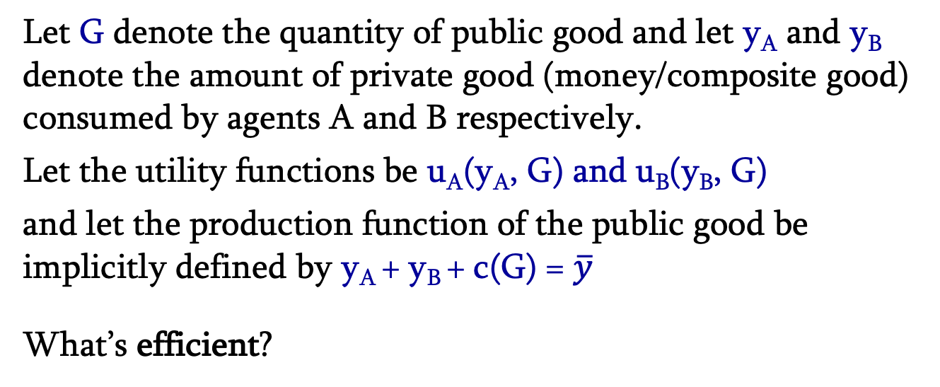

efficient level of public good provision
Let G denote the quantity of public good and let y_{A} and y_{B} denote the amount of private good (money/composite good) consumed by agents A and B respectively.
Let the utility functions be u_{A}(y_{A}, G) and u_{B}(y_{B}, G)
and let the production function of the public good be implicitly defined by y_{A} + y_{B} + c(G) = $\overline{y}$
What’s efficient?
max u_{A}(y_{A}, G)
s.t. u_{B}(y_{B}, G) $≥$ $\overline{\text{u}\text{B}}$
y_{A} + y_{B} + c(G) = $\overline{y}$
We have $ℒ=\text{u}\text{A}\text{(}\text{yA}\text{, }\text{G}\text{)}+λ\text{(}\text{u}\text{B}\text{(}\text{yB}\text{, }\text{G}\text{) -} \overline{\text{u}\text{B}}\text{) }+α\text{(}\overline{y} \text{- }\text{y}\text{A}\text{ - }\text{yB}\text{ - }\text{c}\text{(}\text{G}\text{))}$

Slide 6
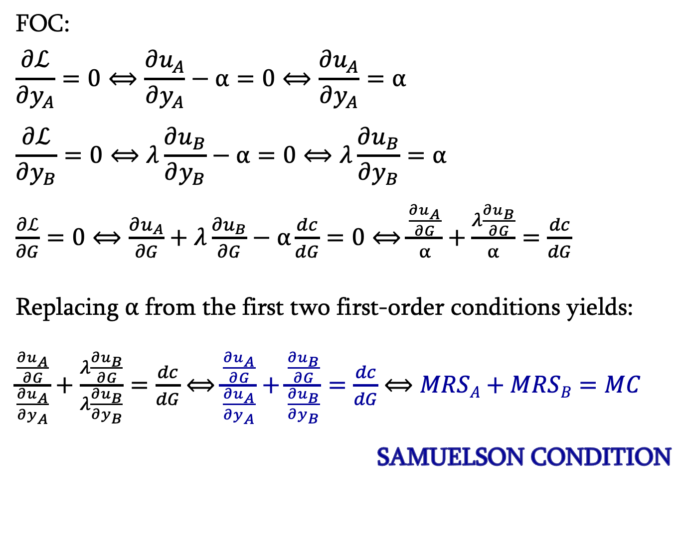
efficient level of public good provision
FOC:
$$\frac{∂ℒ}{∂y_{A}}=0⟺\frac{∂u_{A}}{∂y_{A}}−α=0⟺\frac{∂u_{A}}{∂y_{A}}=α$$
$$\frac{∂ℒ}{∂y_{B}}=0⟺λ\frac{∂u_{B}}{∂y_{B}}−α=0⟺λ\frac{∂u_{B}}{∂y_{B}}=α$$
$\frac{∂ℒ}{∂G}=0⟺\frac{∂u_{A}}{∂G}+λ\frac{∂u_{B}}{∂G}−α\frac{dc}{dG}=0$ $⟺$ $\frac{\frac{∂u_{A}}{∂G}}{α}+\frac{λ\frac{∂u_{B}}{∂G}}{α}=\frac{dc}{dG}$
Replacing $α$ from the first two first-order conditions yields:
$\frac{\frac{∂u_{A}}{∂G}}{\frac{∂u_{A}}{∂y_{A}}}+\frac{λ\frac{∂u_{B}}{∂G}}{λ\frac{∂u_{B}}{∂y_{B}}}=\frac{dc}{dG}$ $⟺$ $\frac{\frac{∂u_{A}}{∂G}}{\frac{∂u_{A}}{∂y_{A}}}+\frac{\frac{∂u_{B}}{∂G}}{\frac{∂u_{B}}{∂y_{B}}}=\frac{dc}{dG}$ $⟺$ $MRSA+MRSB=MC$
SAMUELSON CONDITION

Slide 7
efficient level of public good provision
example
Demands for agents 1 and 2 are given by
P₁= 5-G
P₂=10-2G
Marginal cost of production of G is c’(G) = 2G
Samuelson condition: (5-G)+(10-2G)=2G and G*=3

Slide 8
efficient level of public good provision
Samuelson condition: ΣMRS=MC
vertical aggregation

Slide 9
efficient level of public good provision
p
Lindahl
tax-prices
Mg Cost
D_{A+B}
t_{B}
D_{B}
t_{A}
D_{A}
g*
g

Slide 10
efficient level of public good provision
- The Lindahl tax for each agent is equal to the agent’s marginal benefit from the public good evaluated at the socially optimal level.
  allows for full financing of public good
  ensures both global and individual equilibria i.e. ensures unanimous choice of socially optimal level

Slide 11
efficient level of public good provision
example
Demands for agents 1 and 2 are given by
P₁= 5-G
P₂=10-2G
Marginal cost of production of G is c’(G) = 2G
Samuelson condition: (5-G)+(10-2G)=2G and G*=3
Lindahl tax-prices:
t₁ = 5-G* = 5-3 = 2
t₂ = 10-2G* = 10-6 = 4 (... and MC=6)

Slide 12
public good provision and efficiency
public provision
decentralized solution: Groves-Clarke
1. Ask each agent how much she is willing to pay to have x units of the public good provided: r_{i}(x).
2. Choose the level of the public good x∗ that would be efficient for the reported WTP.
3. Each agent receives a sidepayment which is the sum of the reported WTP of everyone else, evaluated at the level of x determined in step 2.
It is a dominant strategy for each agent to report his true utility function.

